Slide 1
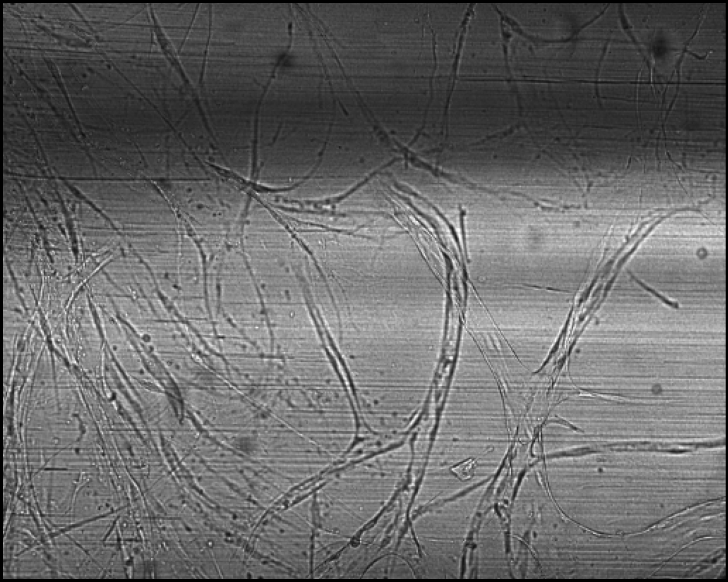
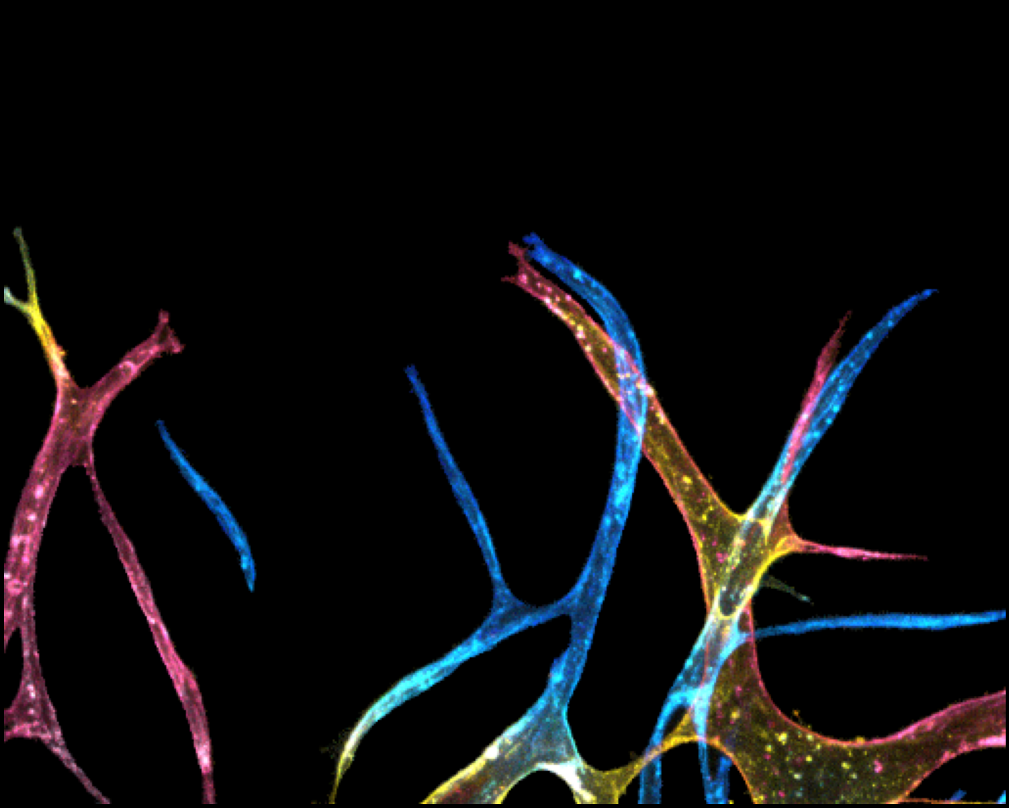
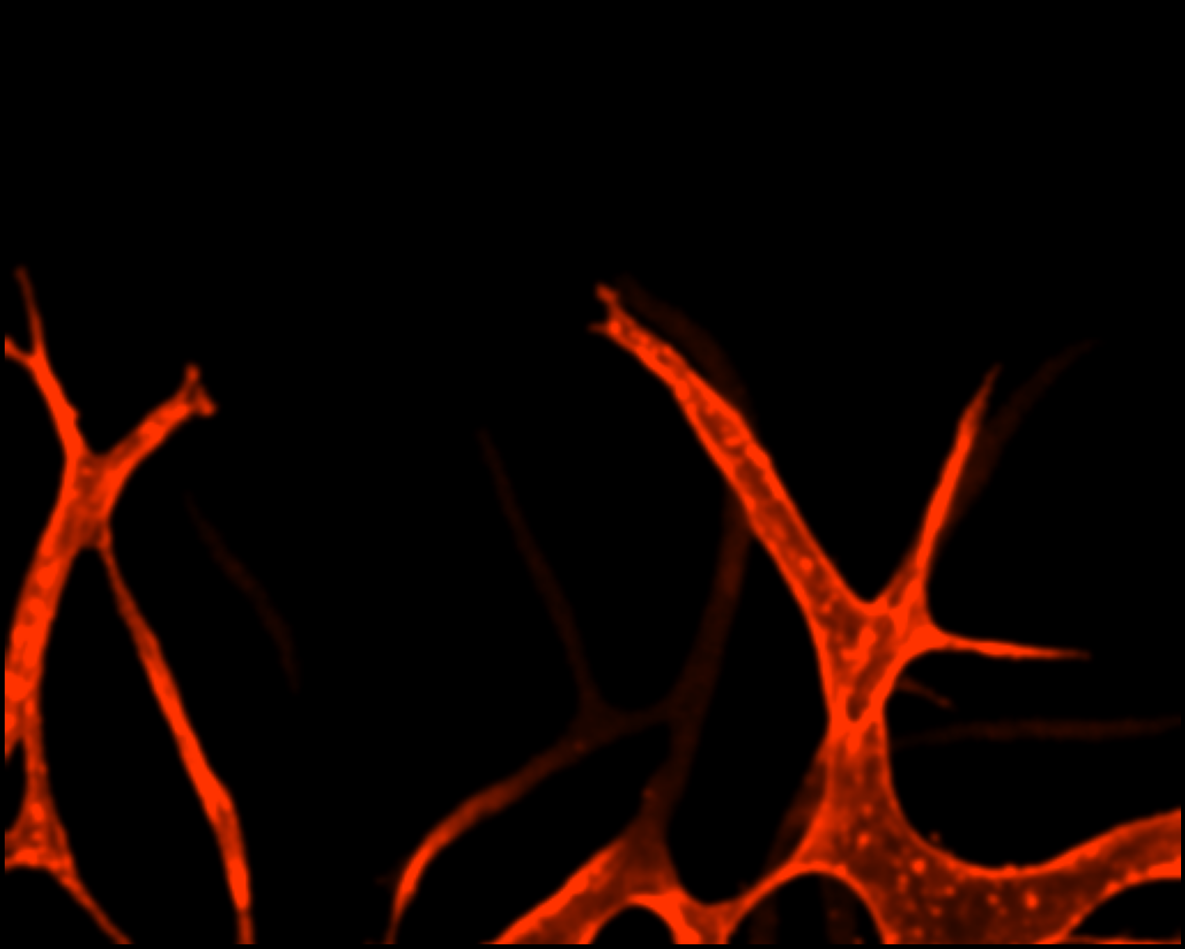
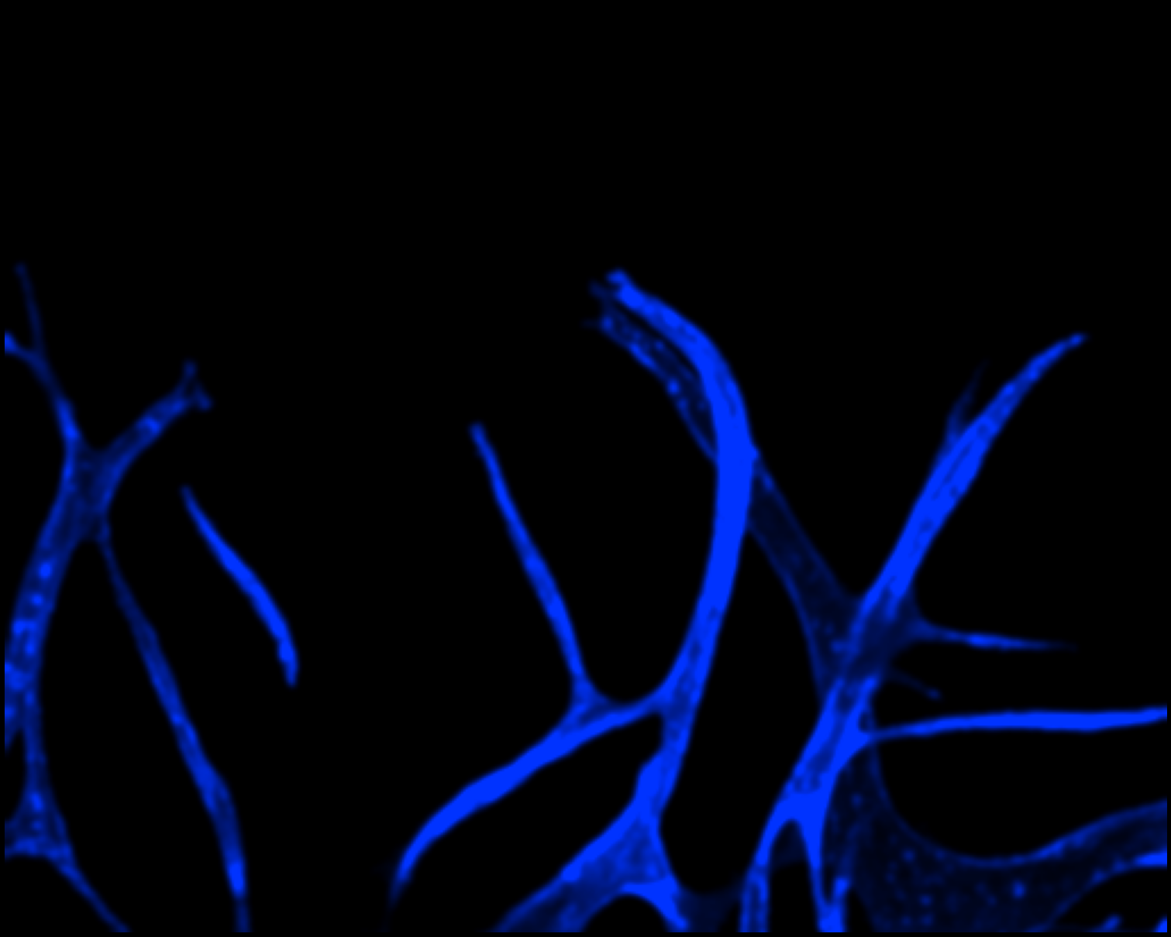
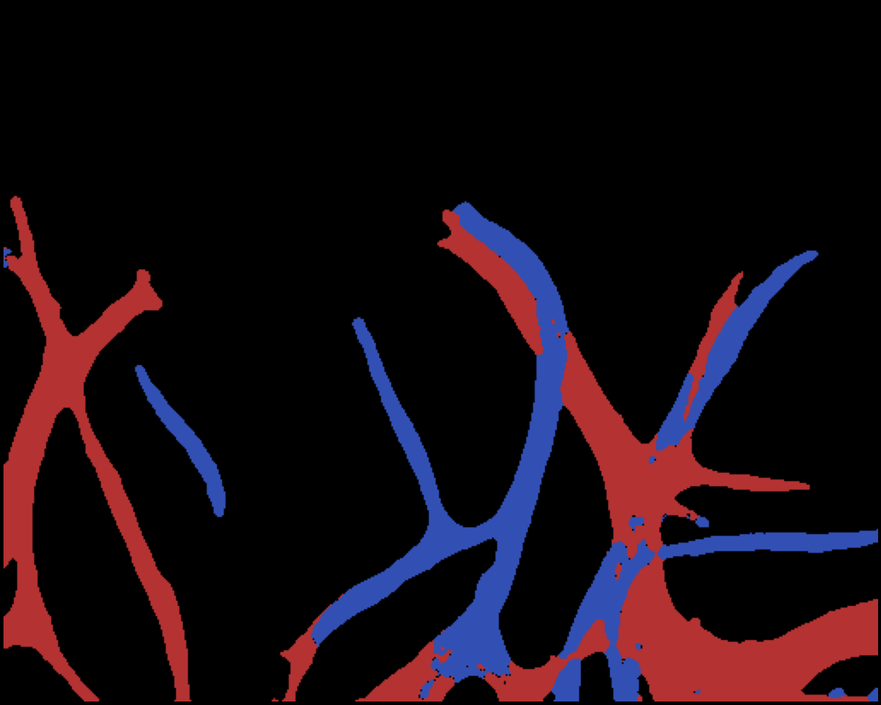
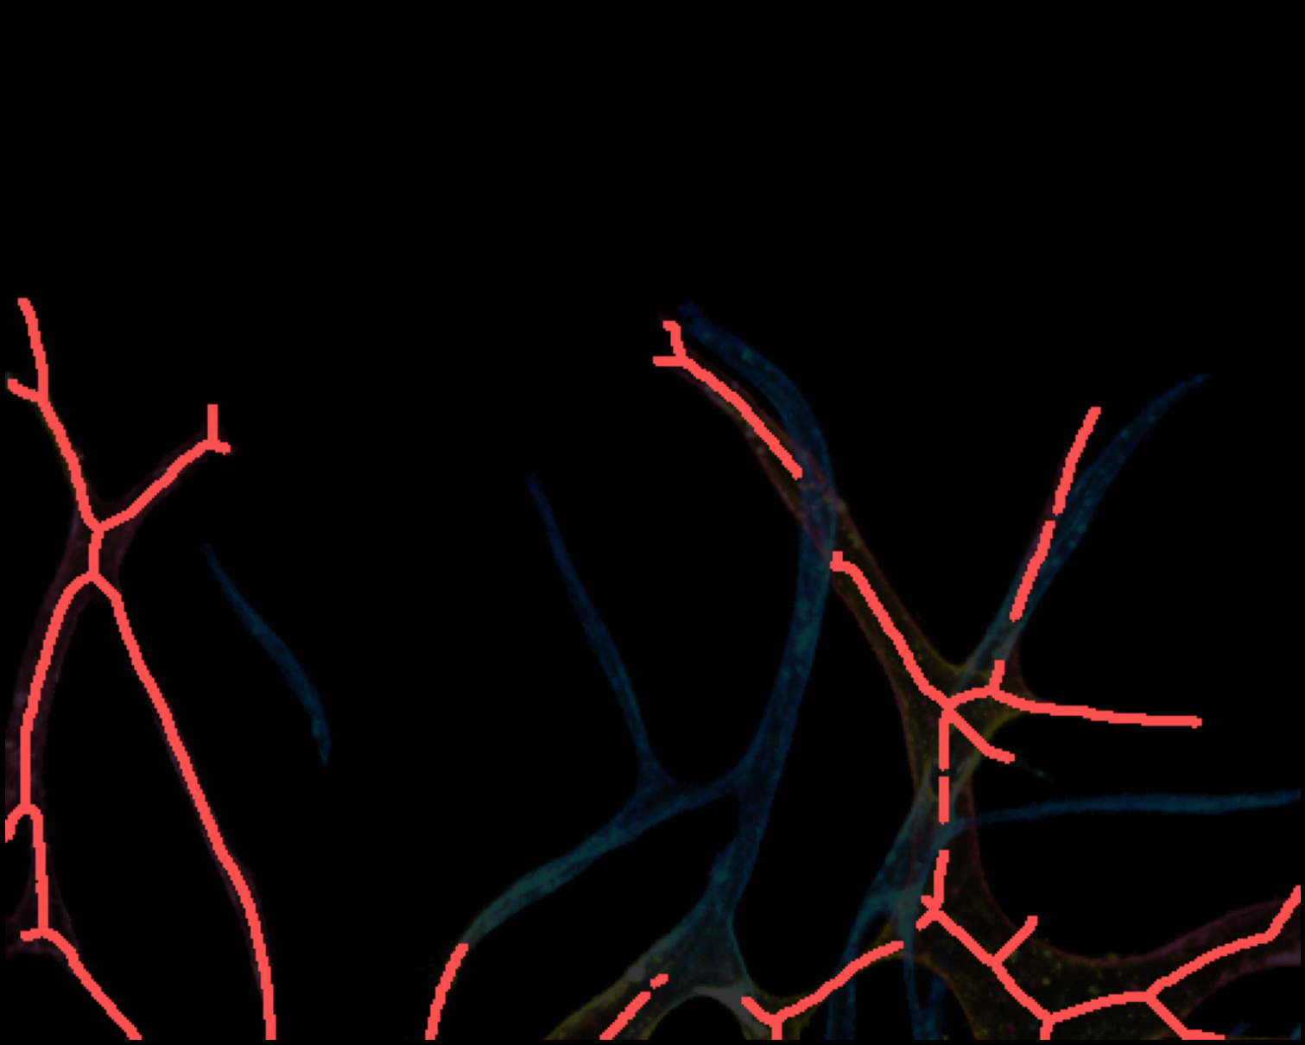
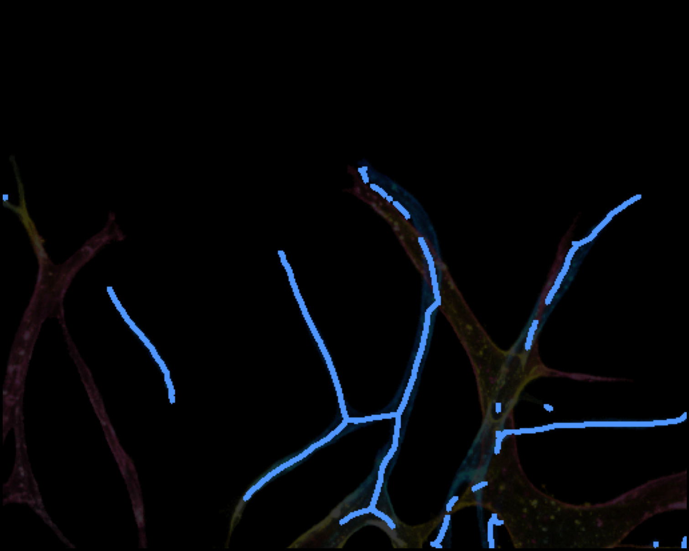
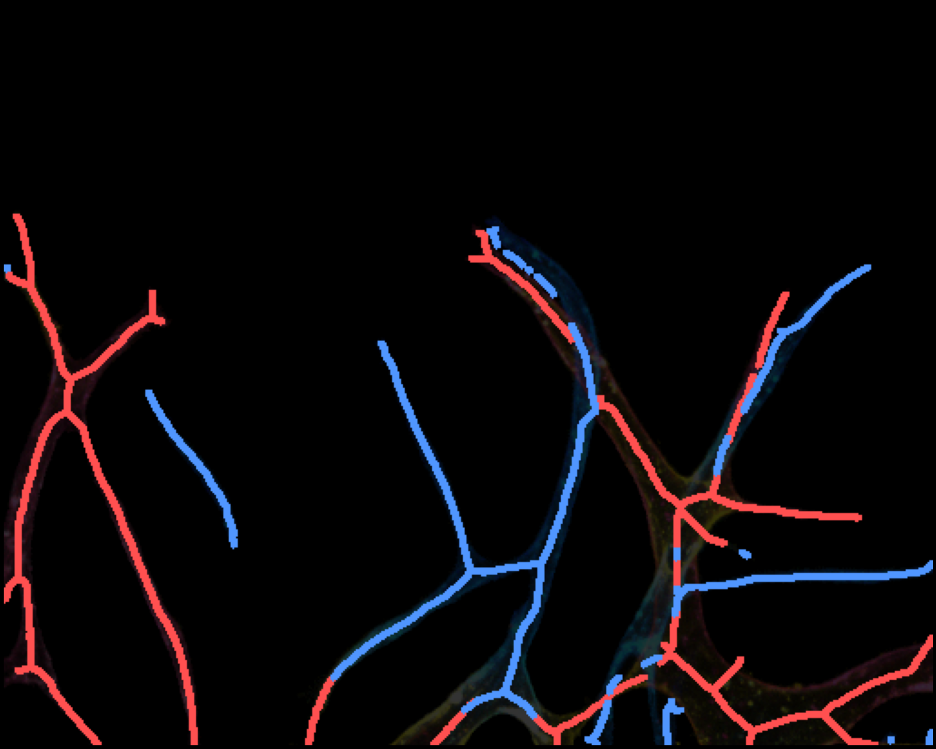
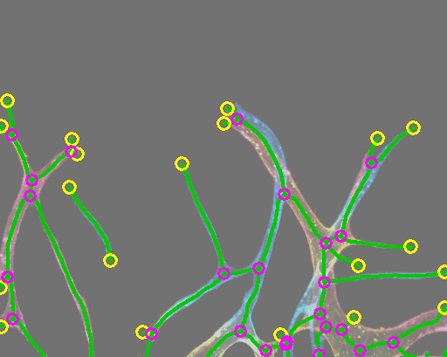
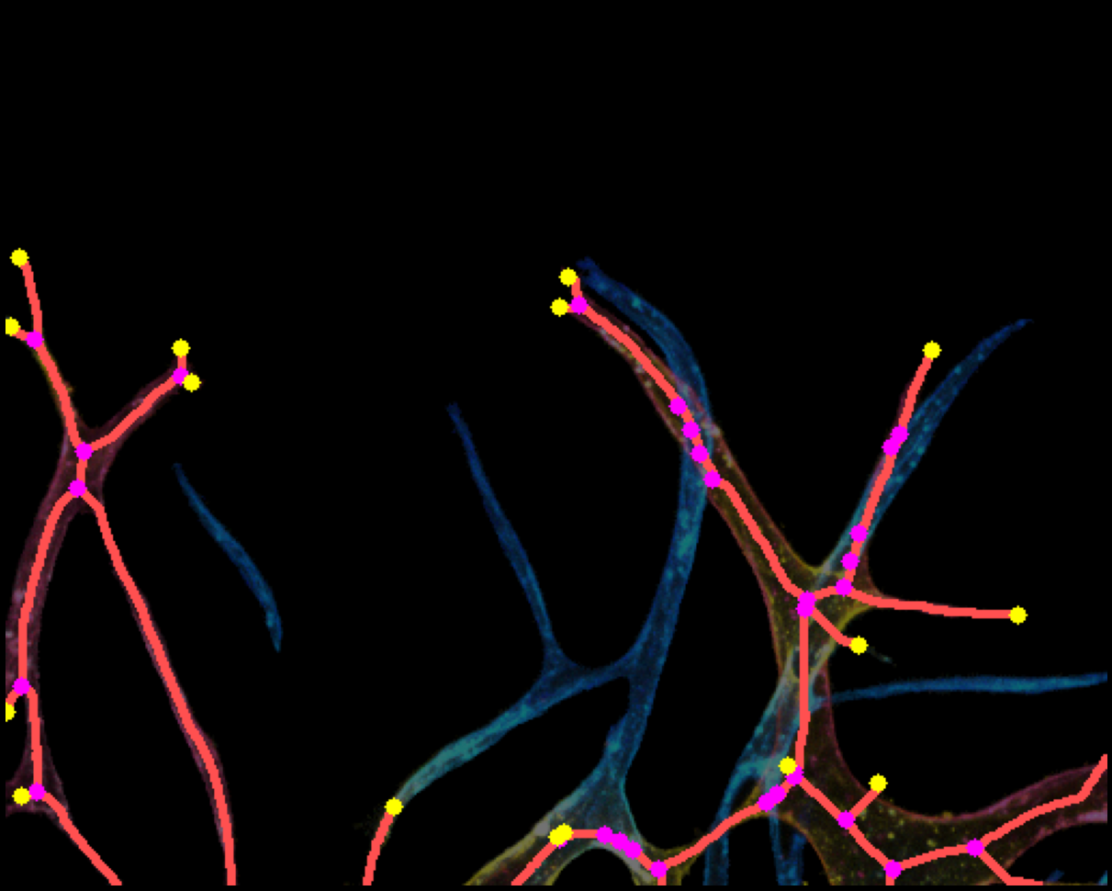
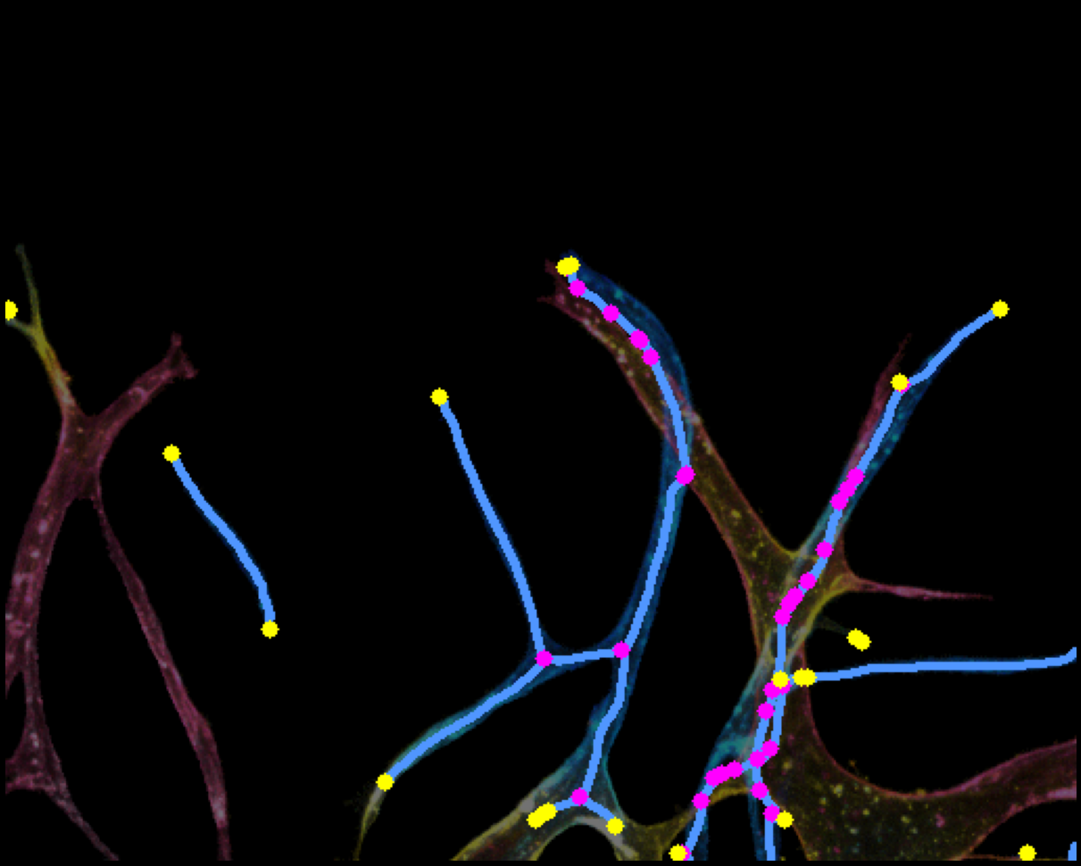
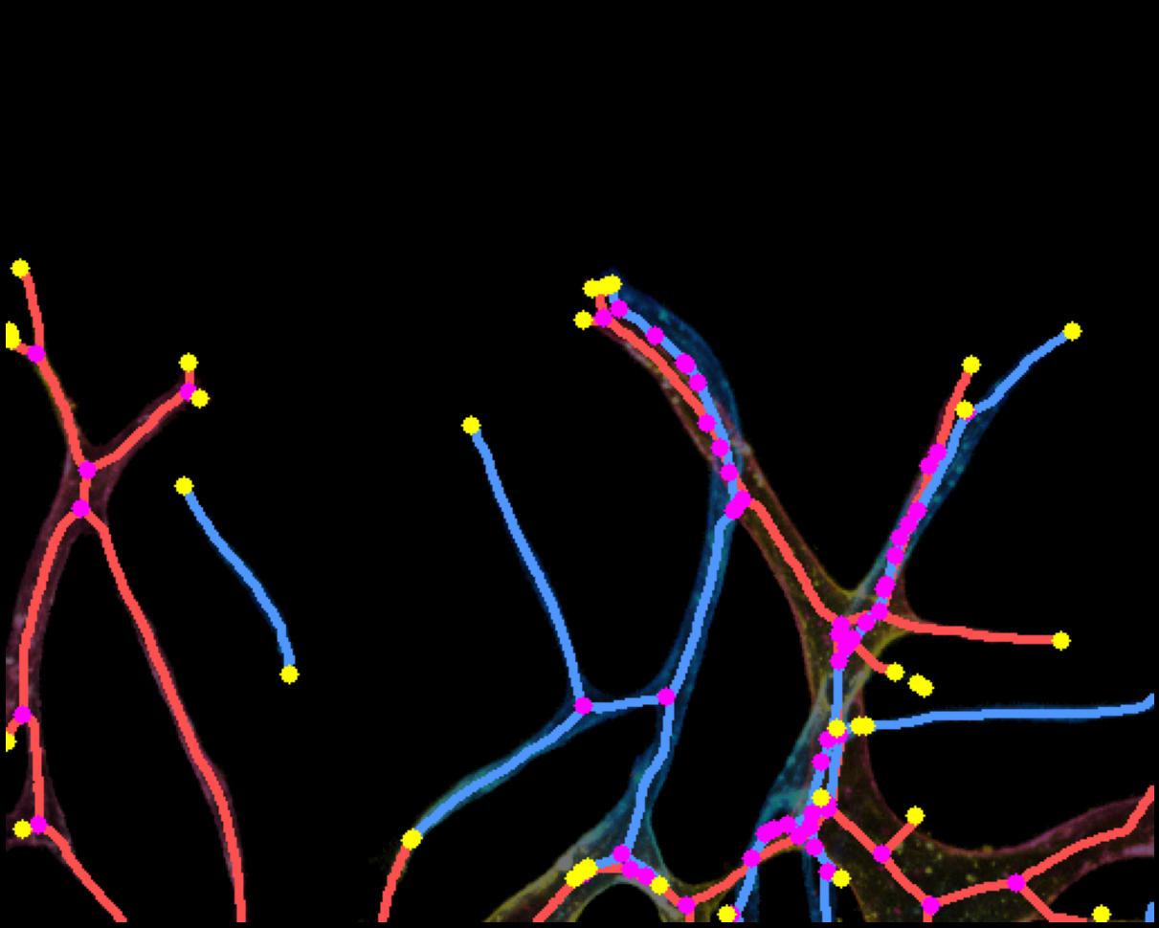
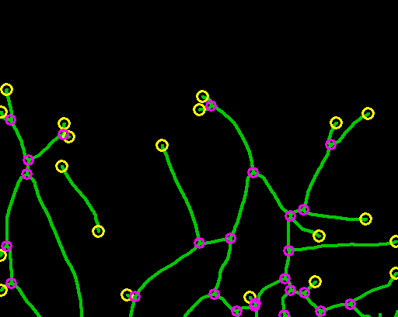
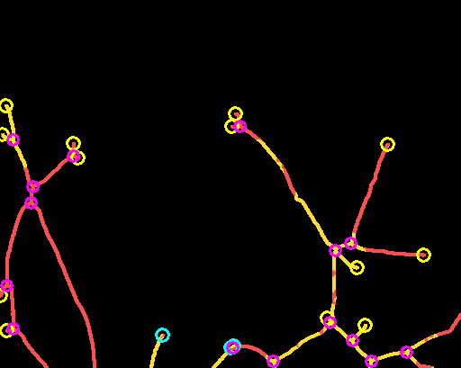
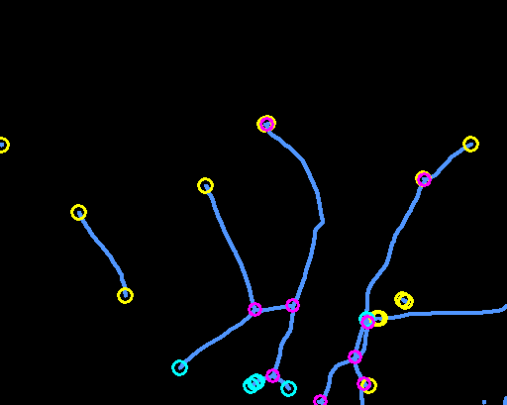
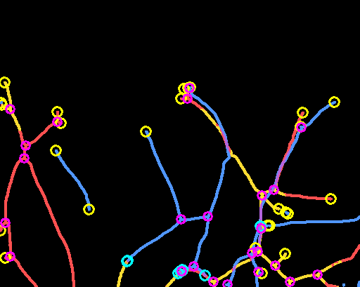
Depth-aware Vessel Network Analysis Pipeline
(a) Brightfield
(b) Multi-color GT
(c) R channel
(d) B channel
(e) R-B dominance
(f) R skeleton
(g) B skeleton
(h) R+B overlay
(i) Single GT skel
(j) R bridged
(k) B bridged
(l) R+B combined
(i') Single skel only
(j') R skel only
(k') B skel only
(l') R+B skel only
Red R skel Yellow Y skel Blue B skel Purple R+B overlap Magenta JN Yellow○ EP Cyan○ Conn.EP

Slide 2
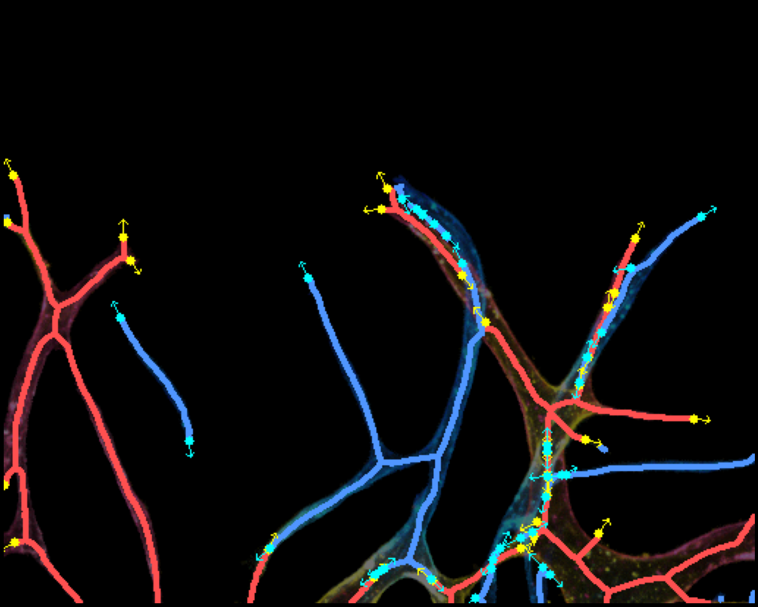
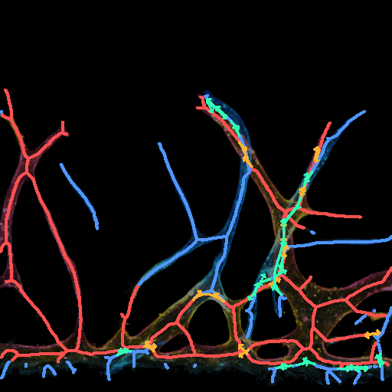
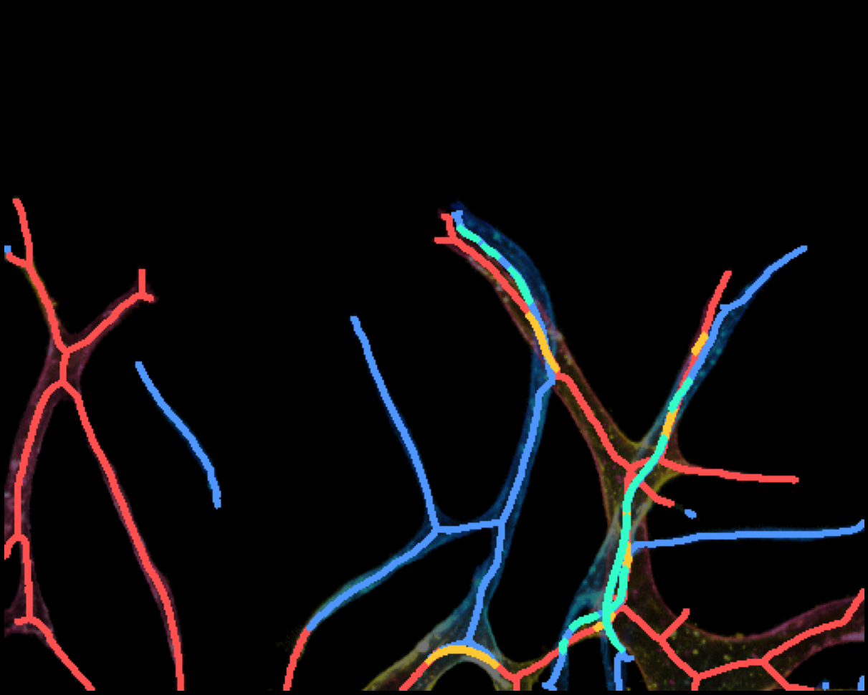
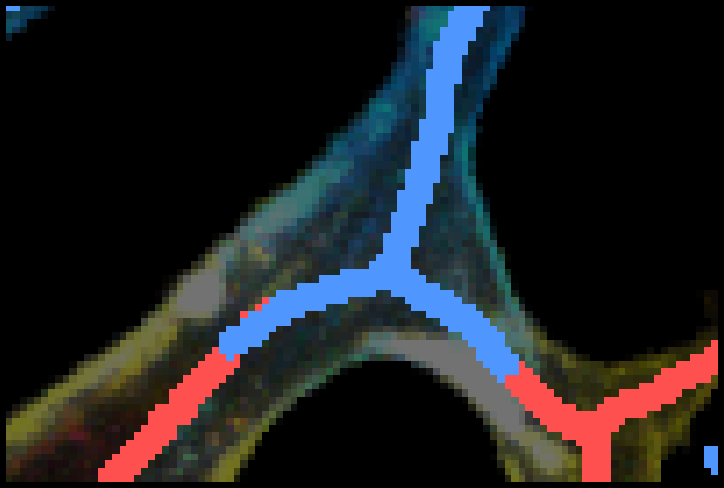
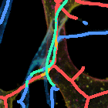
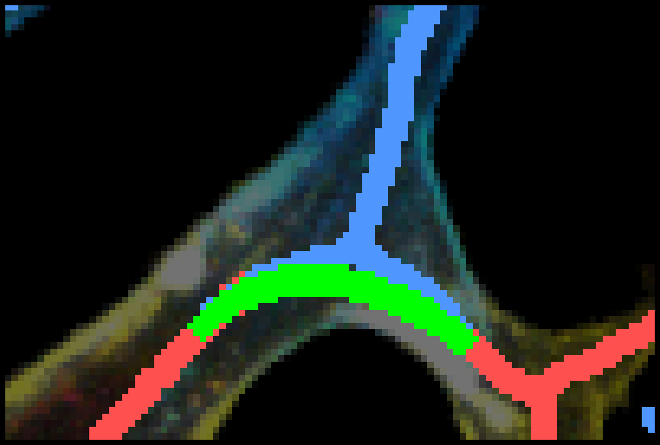
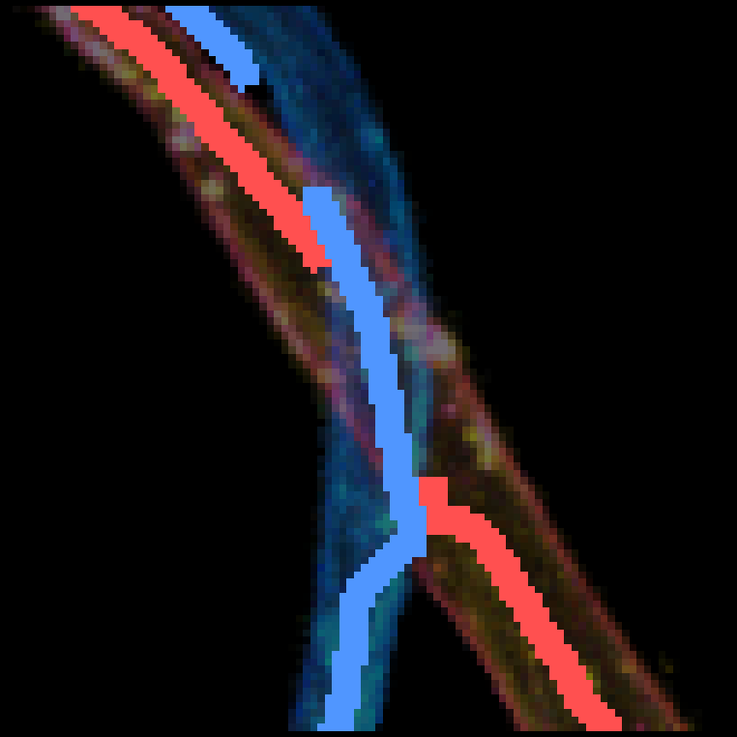
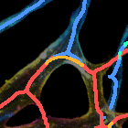
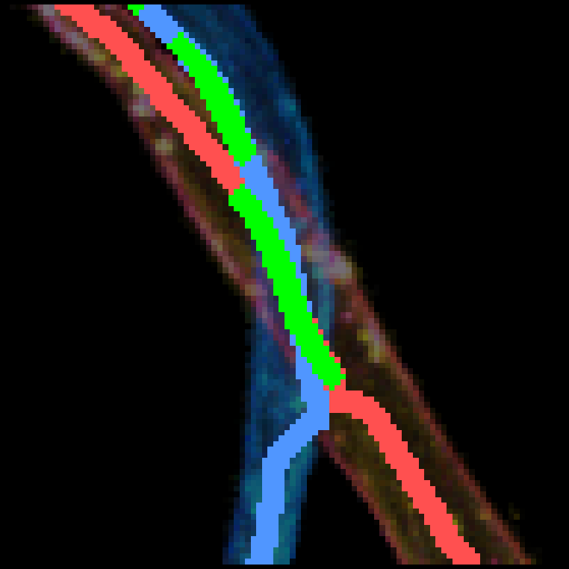
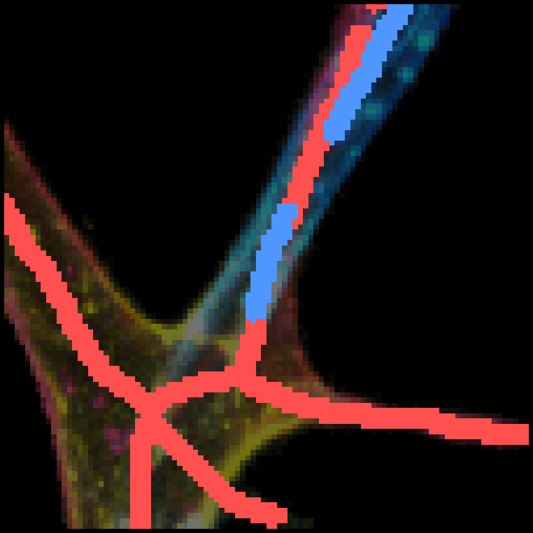
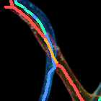
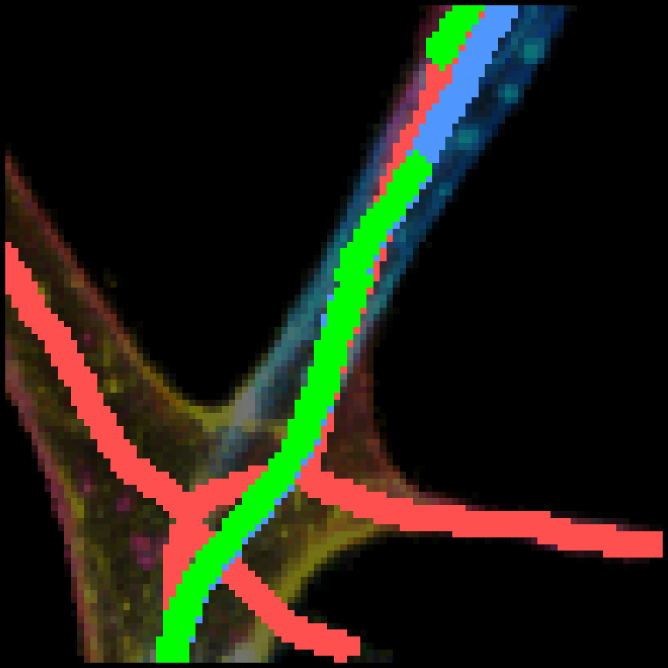
Tangent-guided Gap Bridging
(m) Gap Bridging Process
→
→
Before (filtered)
Bridging
After (connected)
(n) Bridge Zoom Detail (Before → Bridging → After)
before
bridging
after
B bridge #1
R bridge #2
R bridge #3
Orange R bridge Teal B bridge

Slide 3
Tangent-guided Gap Bridging Algorithm
Step 1
Step 2
Step 3
Endpoint Detection
Tangent Estimation
Candidate Matching
Find skeleton pixels with
neighbor count = 1
Trace back 10-20 px along
skeleton → compute direction
EP pair distance < 80 px
cos(θ) > cos(60°)
vessel mask overlap ≥ 70%
Step 4
Step 5
Bézier Interpolation
Score & Select
P(t) = (1-t)³P₁ + 3(1-t)²tC₁
+ 3(1-t)t²C₂ + t³P₂
C₁ = P₁ + 0.4d·t₁
score = (cos₁+cos₂)/2
- d/dmax · 0.2
+ vessel_ratio · 0.2
Greedy: best-first, no reuse
Bridging Scheme
Before Bridging
After Bridging
t₂
t₁
Bézier bridge
gap
Bridge Examples
B bridge
R bridge
R bridge

Slide 4
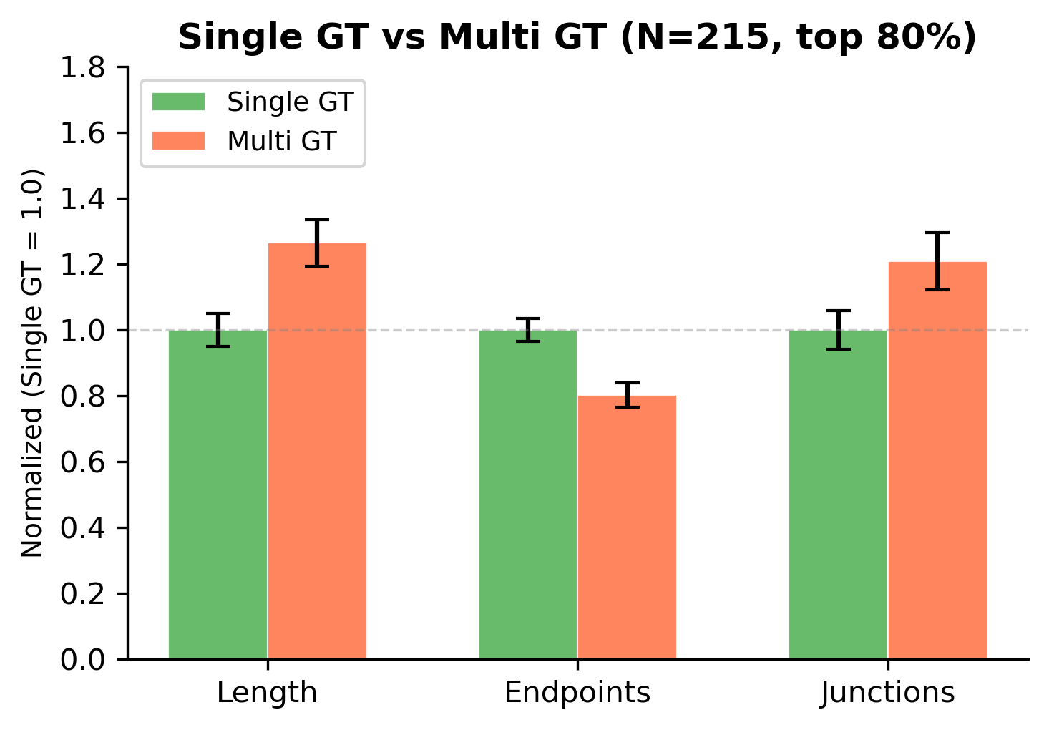
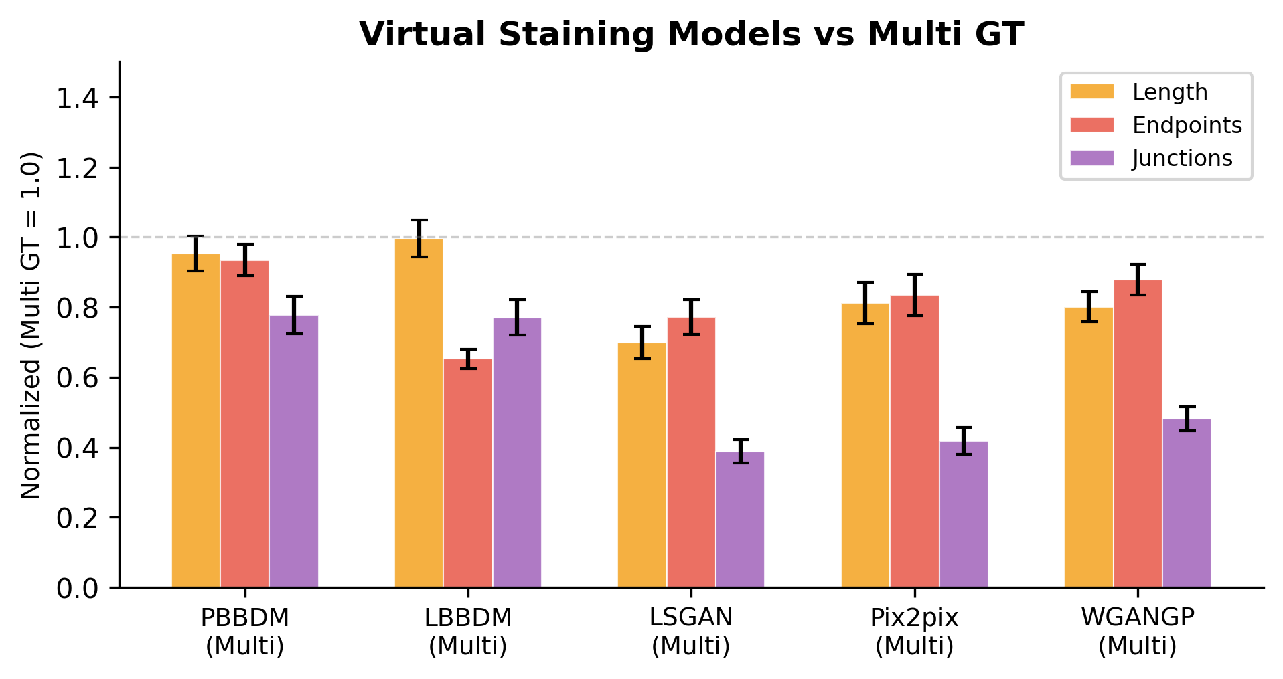
Vessel Network Quantification
(a) Single GT vs Multi GT (N=215, top 80%)
 | Length | EP | JN
Single GT | 1.00 | 1.00 | 1.00
Multi GT | 1.26 | 0.80 | 1.21
(b) Virtual Staining Models vs Multi GT
(c) Normalized Metrics (Multi GT = 1.0)
Model | Length | EP | JN
PBBDM | 0.95 | 0.93 | 0.78
LBBDM | 1.00 | 0.65 | 0.77
WGANGP | 0.80 | 0.88 | 0.48
Pix2pix | 0.81 | 0.83 | 0.42
LSGAN | 0.70 | 0.77 | 0.39
PBBDM achieves the closest match to GT across all multi-color depth metrics

Slide 5
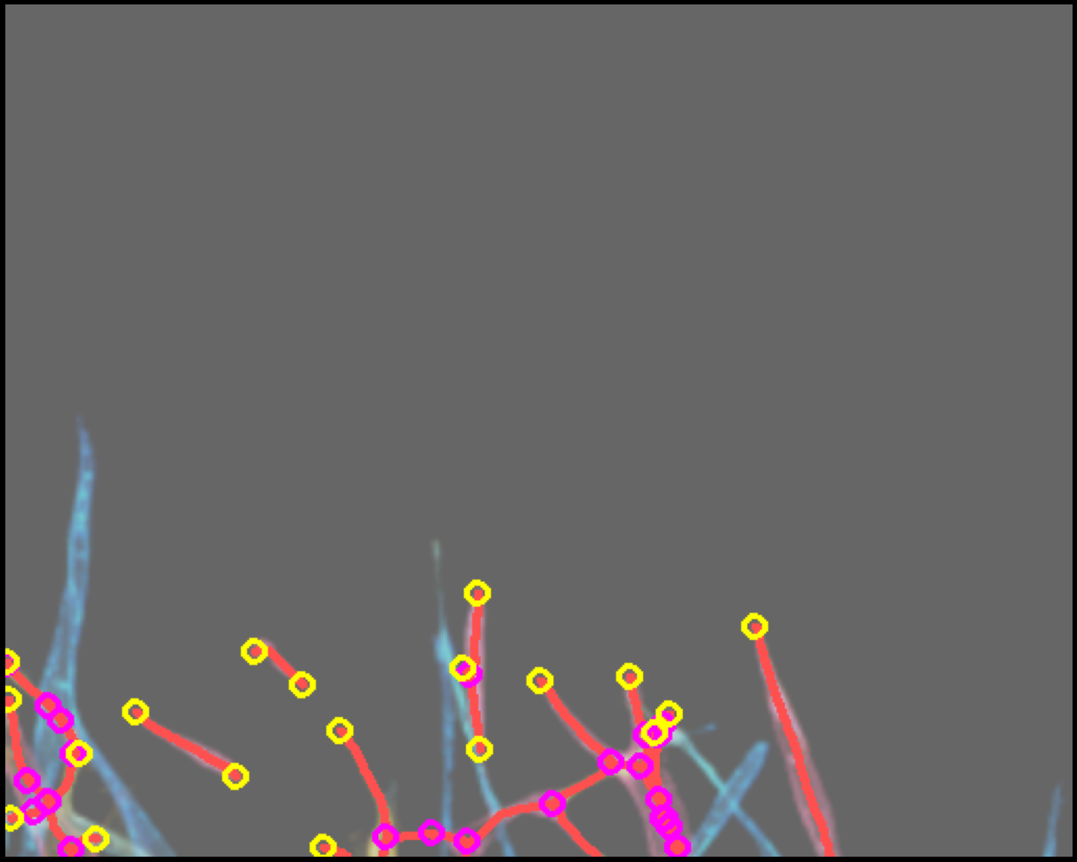
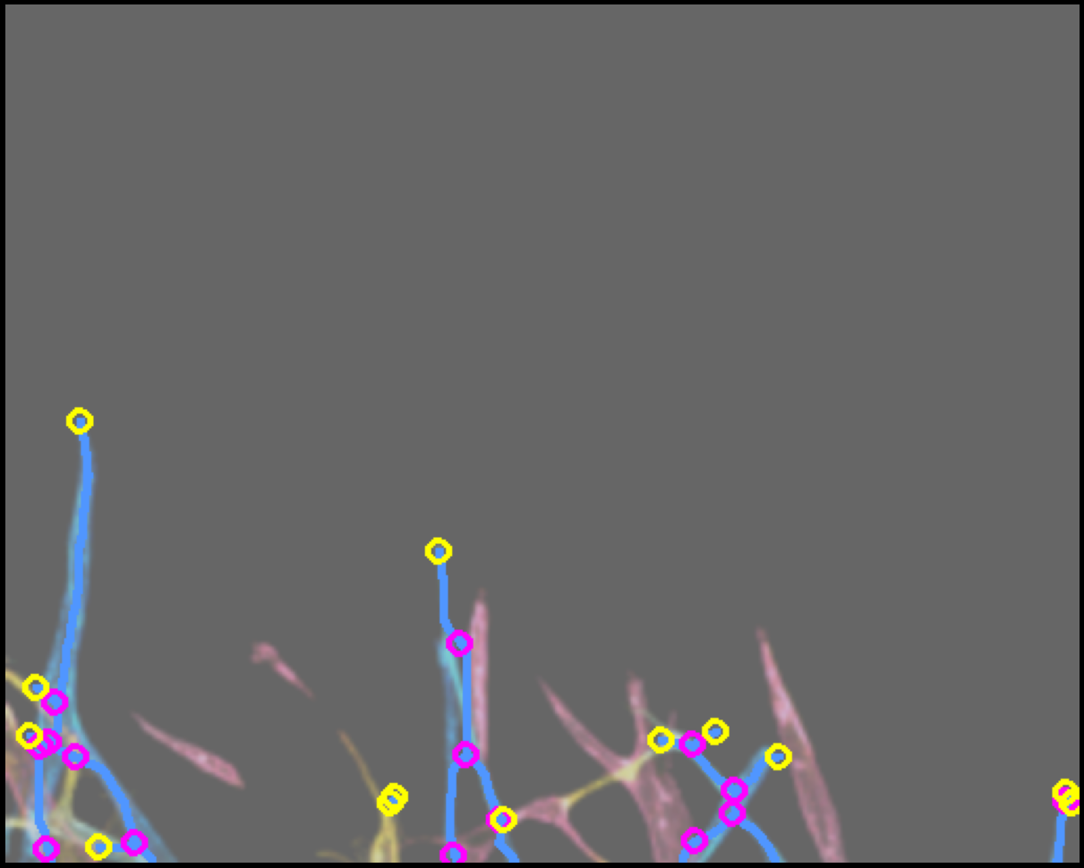
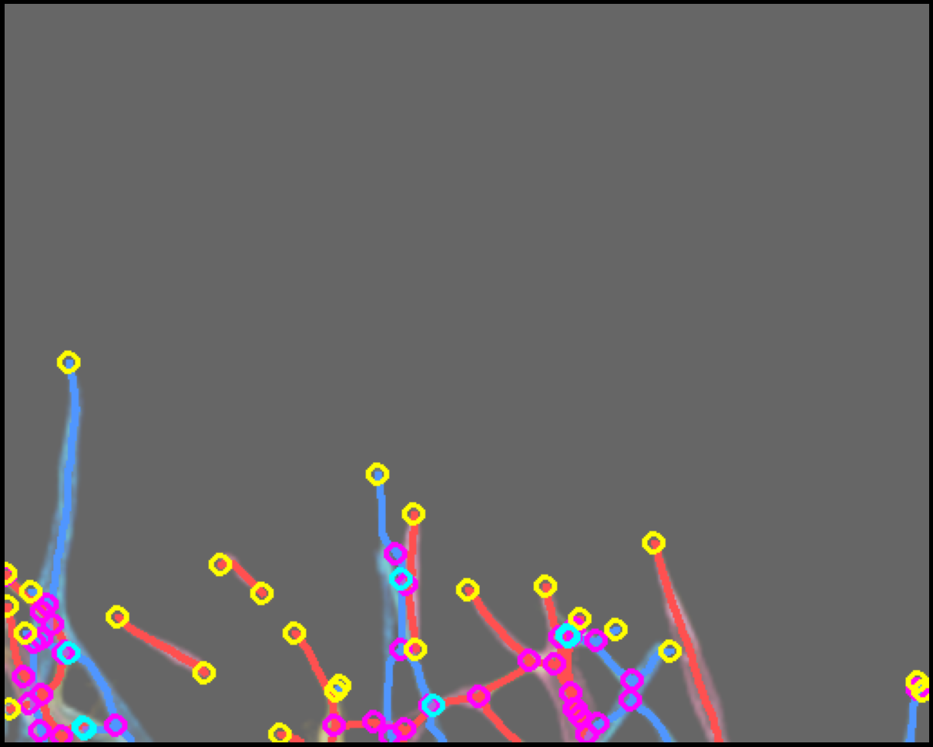
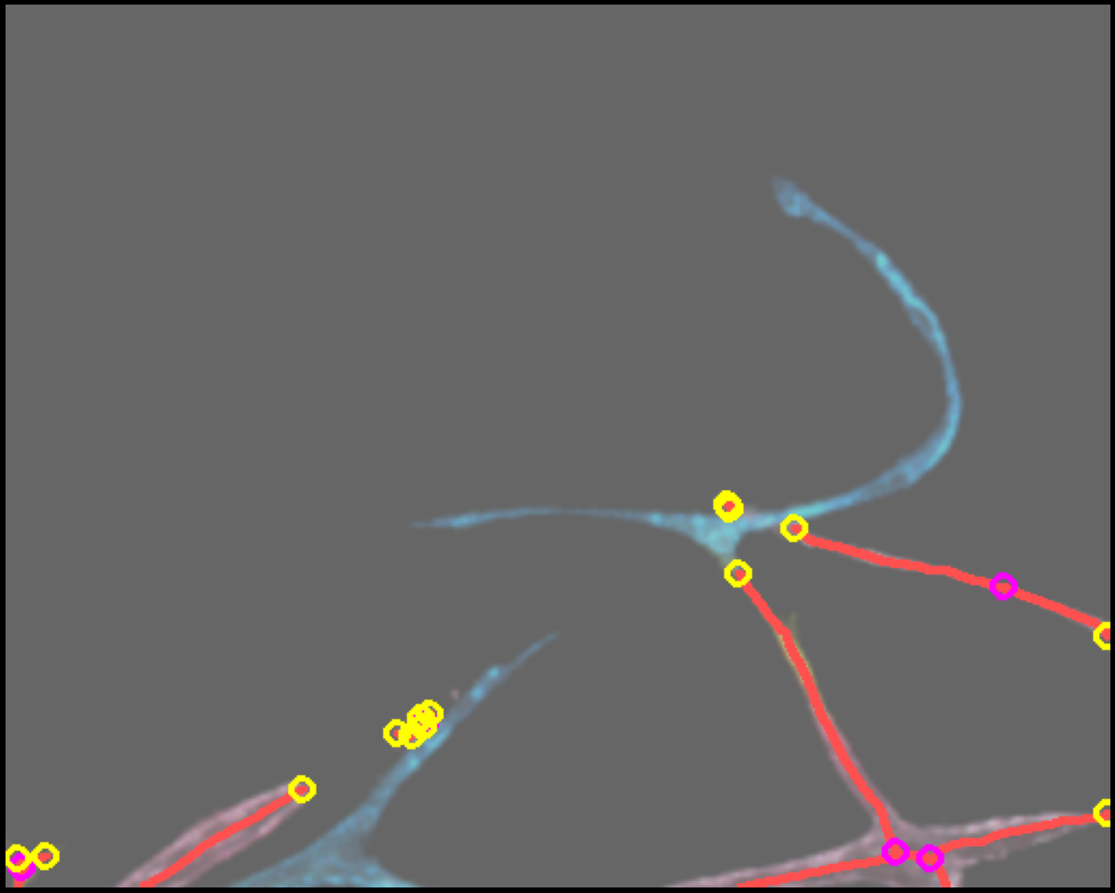
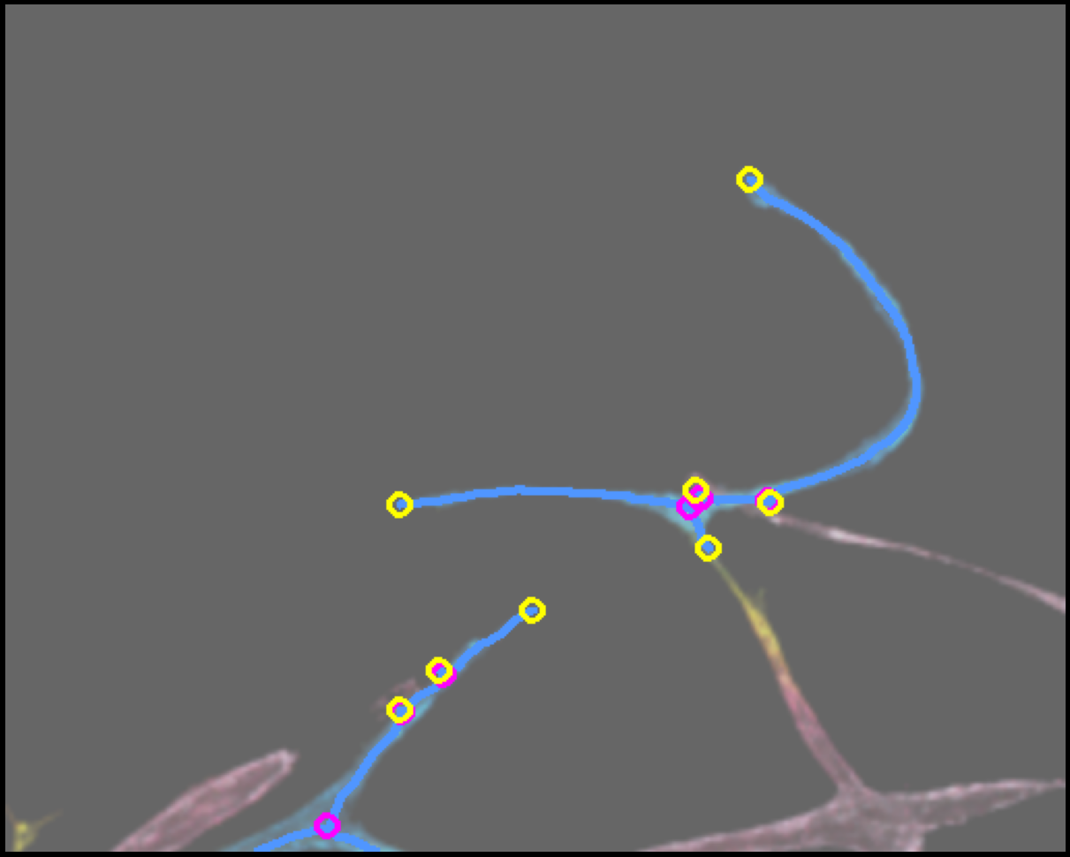
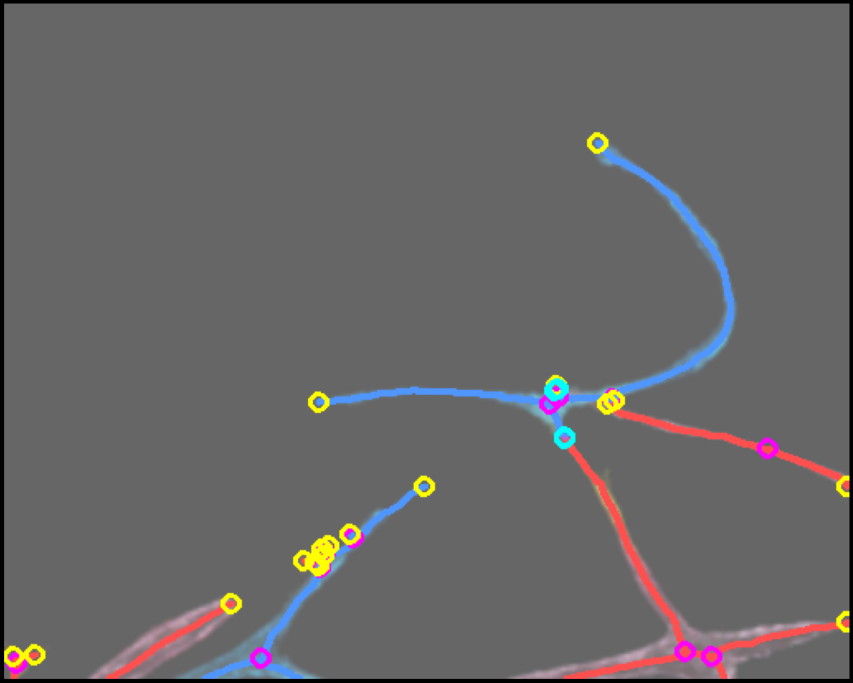
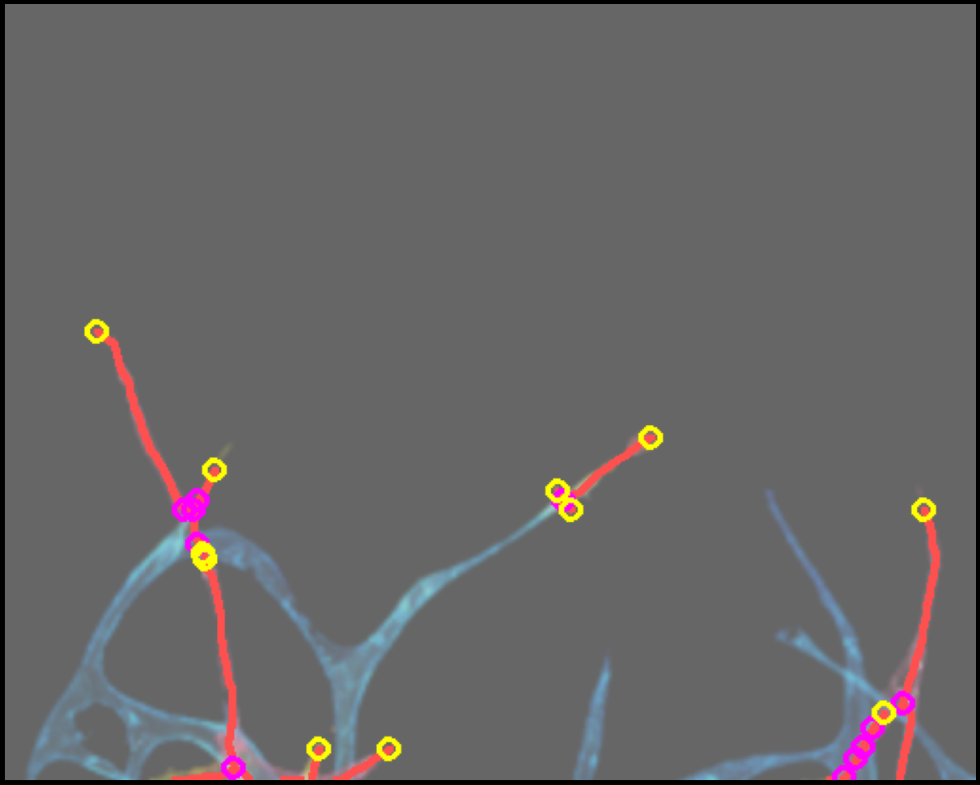
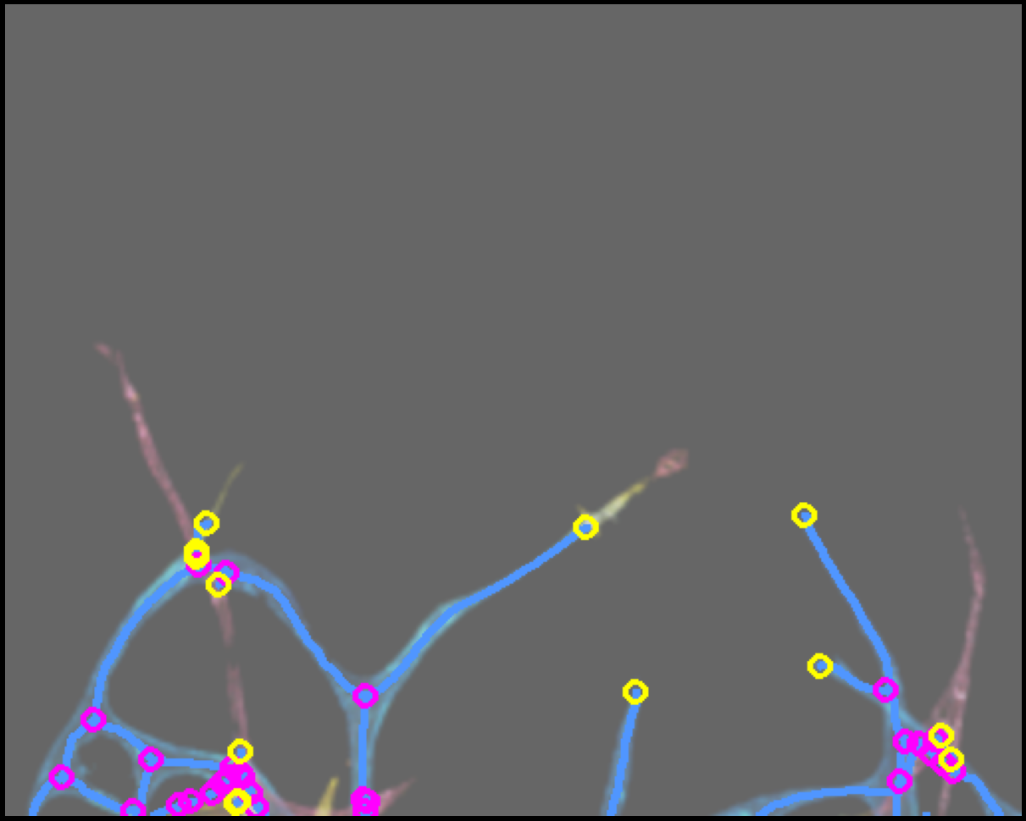
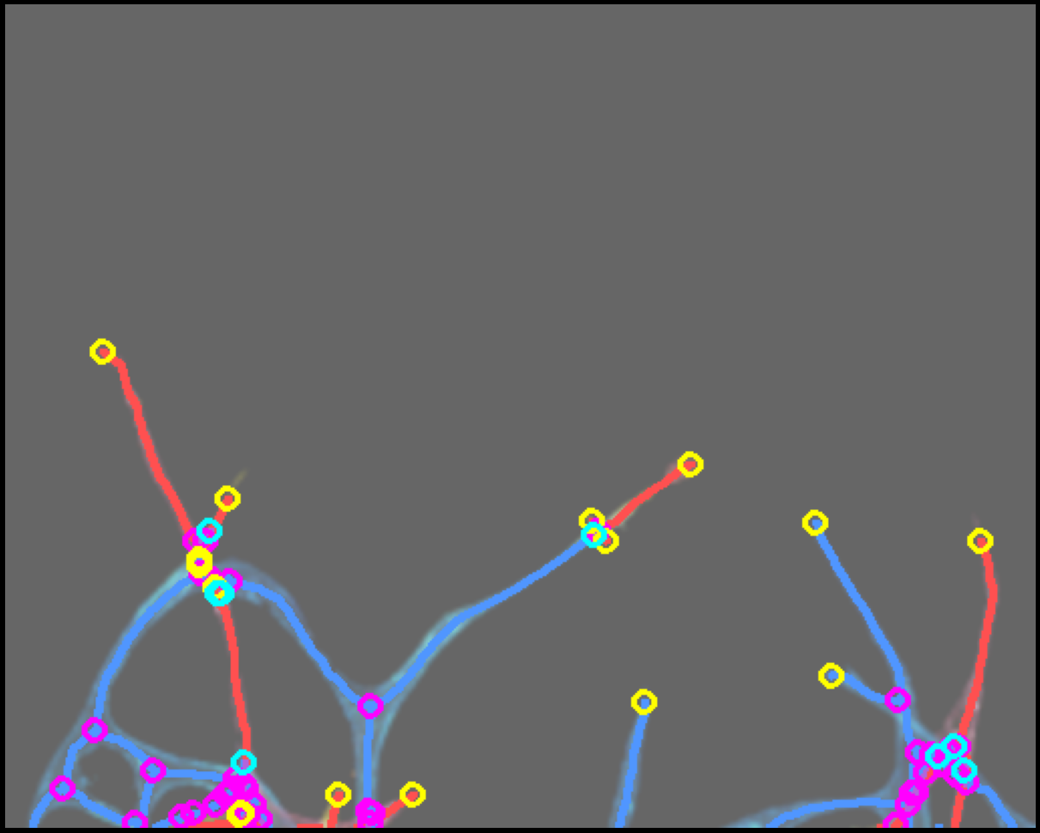
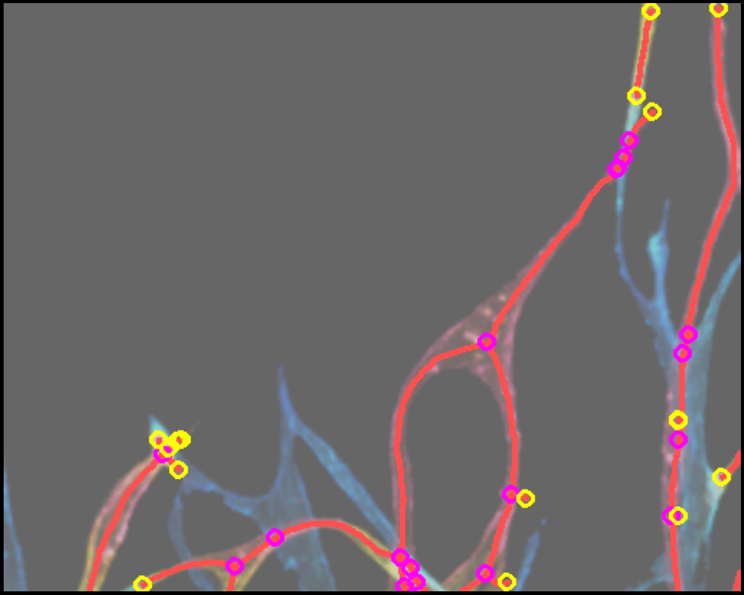
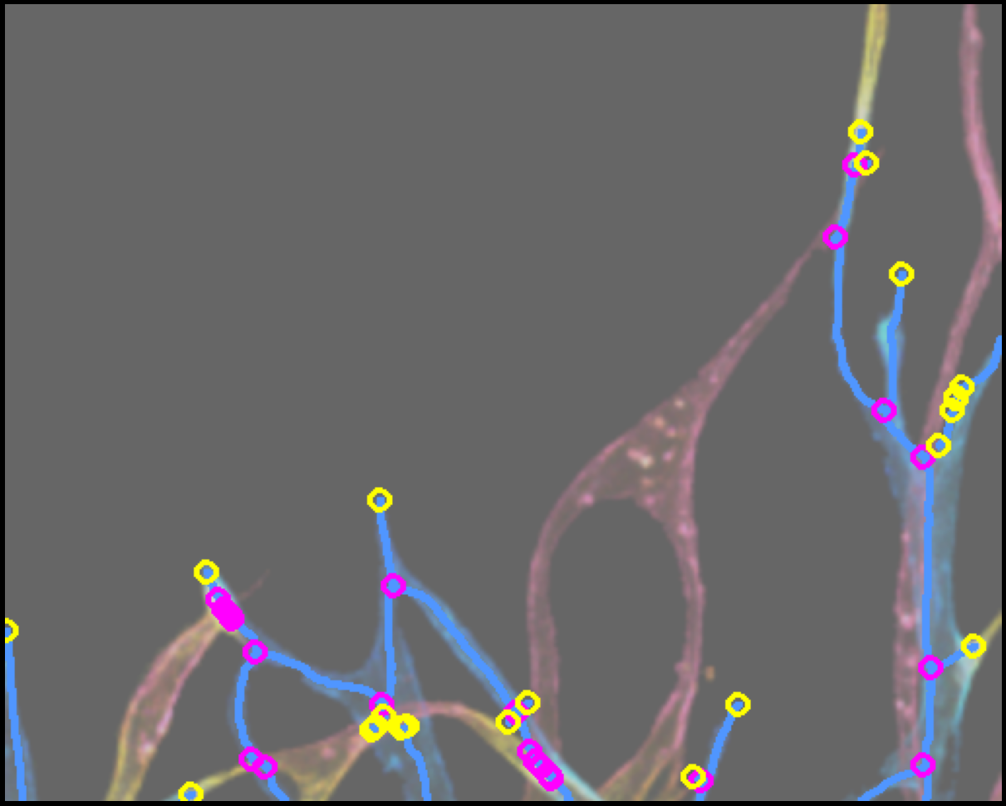
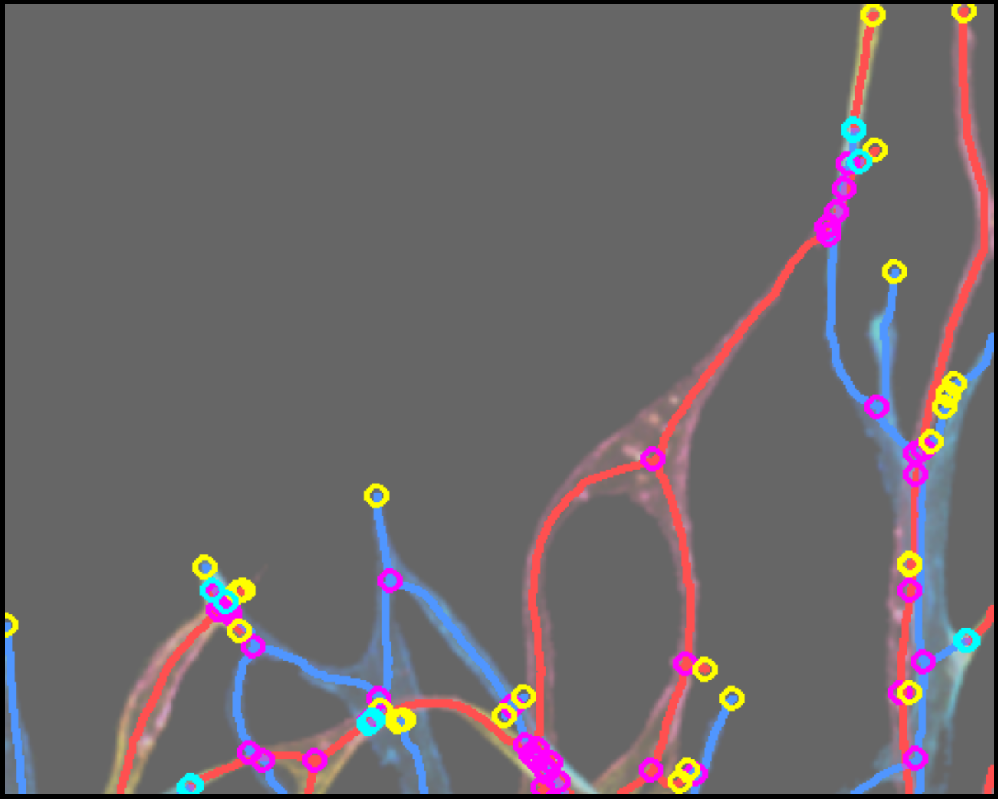
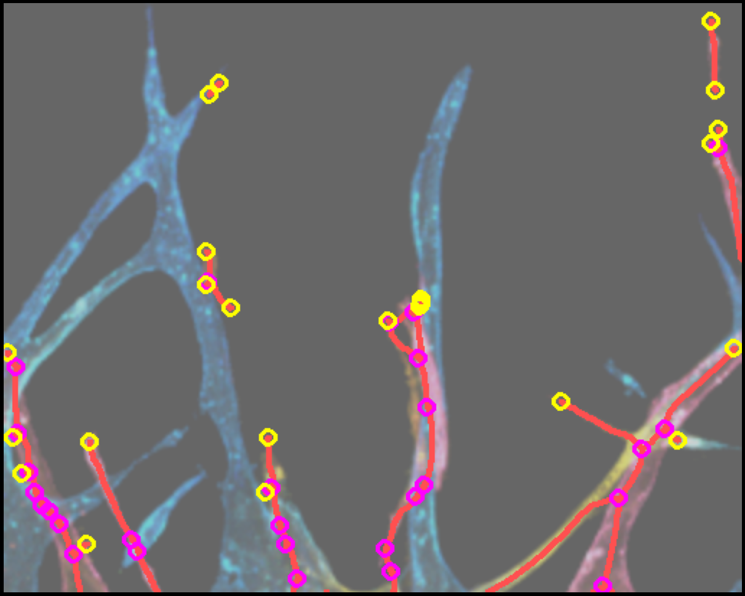
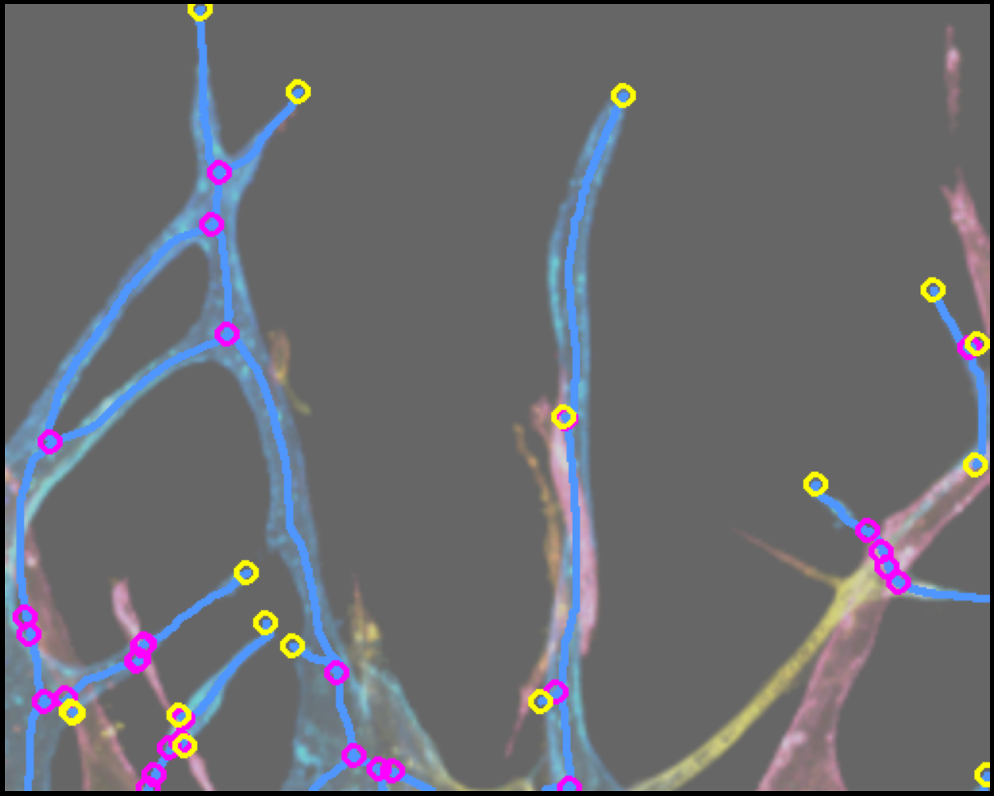
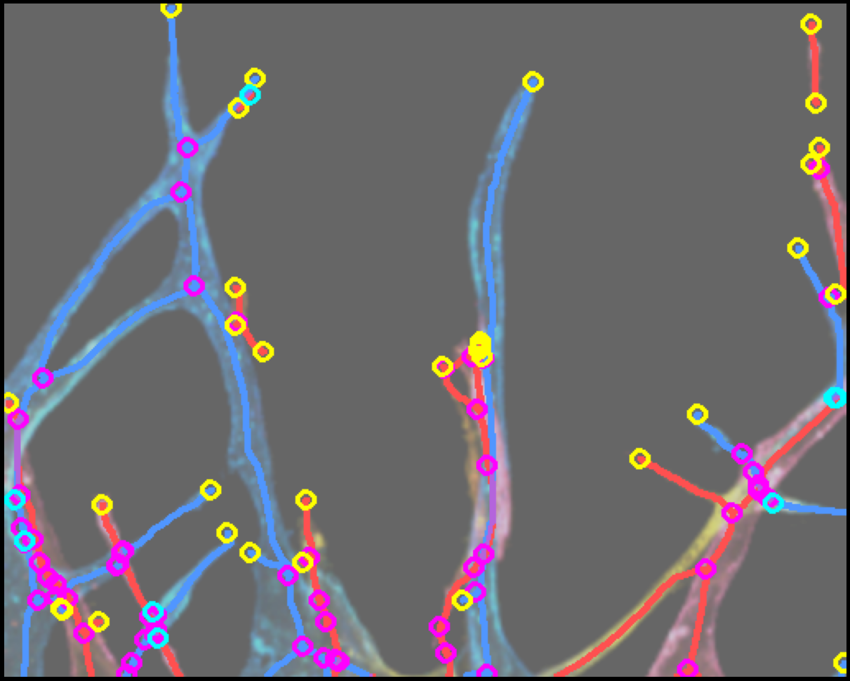
Multi-sample Depth-aware Skeleton Comparison
Skel R (bridged)
Skel B (bridged)
R+B Combined
1-19-716
9-15-512
16-18-716
18-19-512
1-16-512

