Slide 1
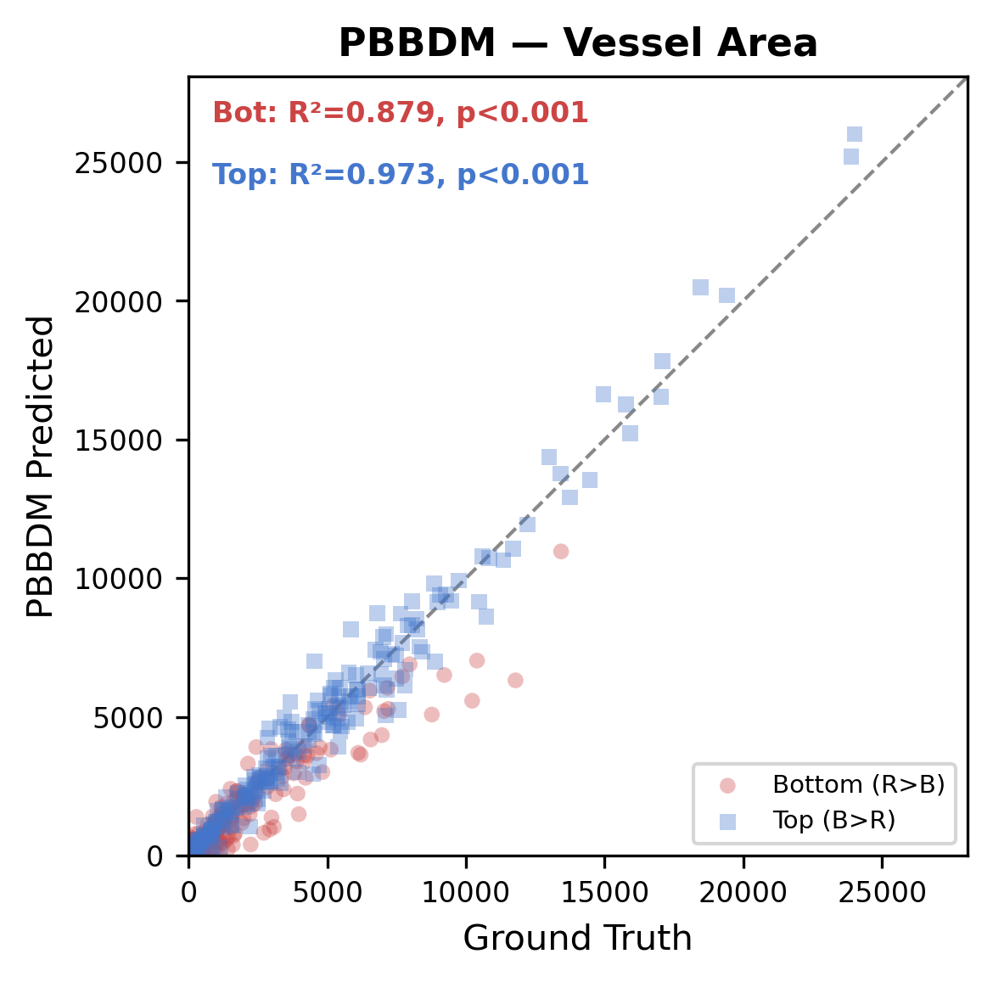
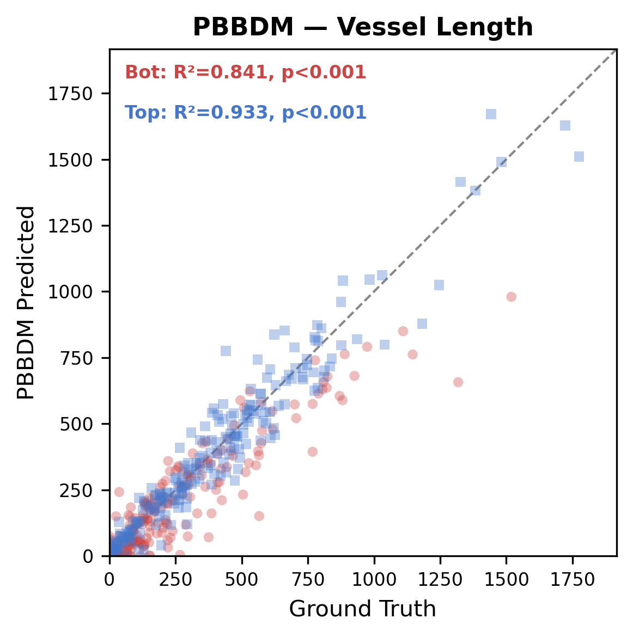
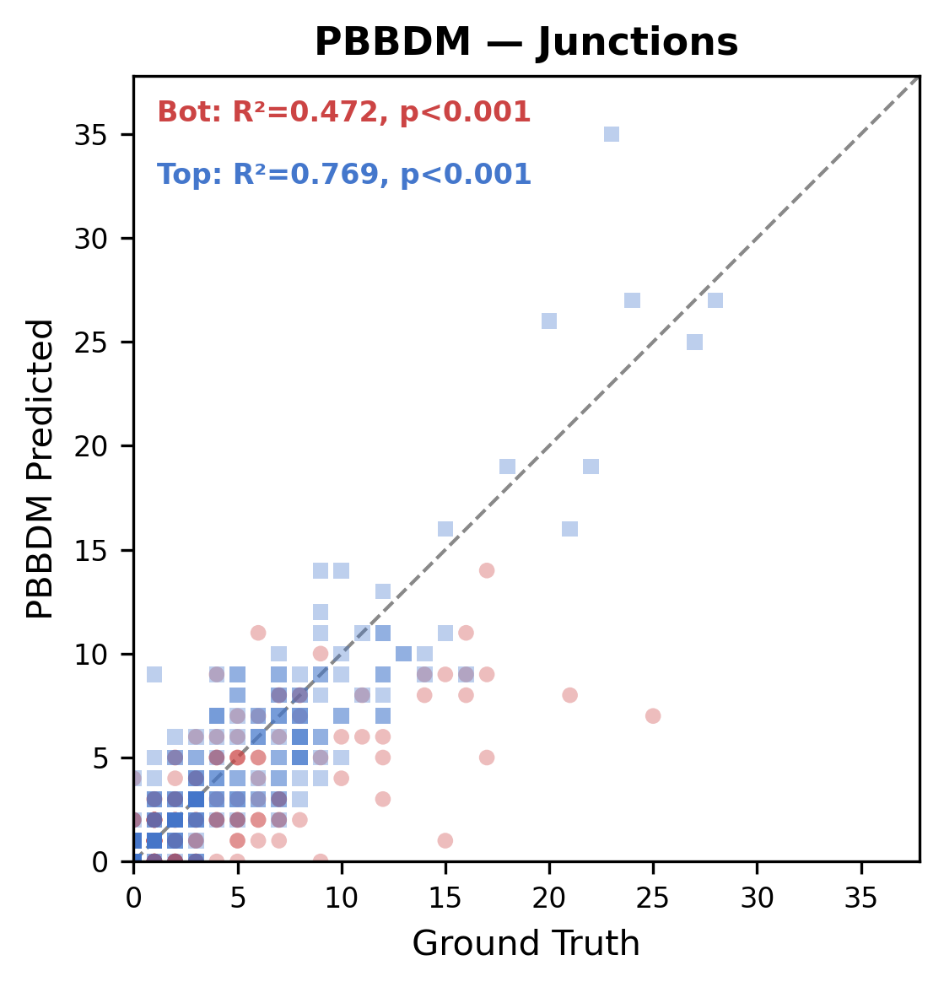
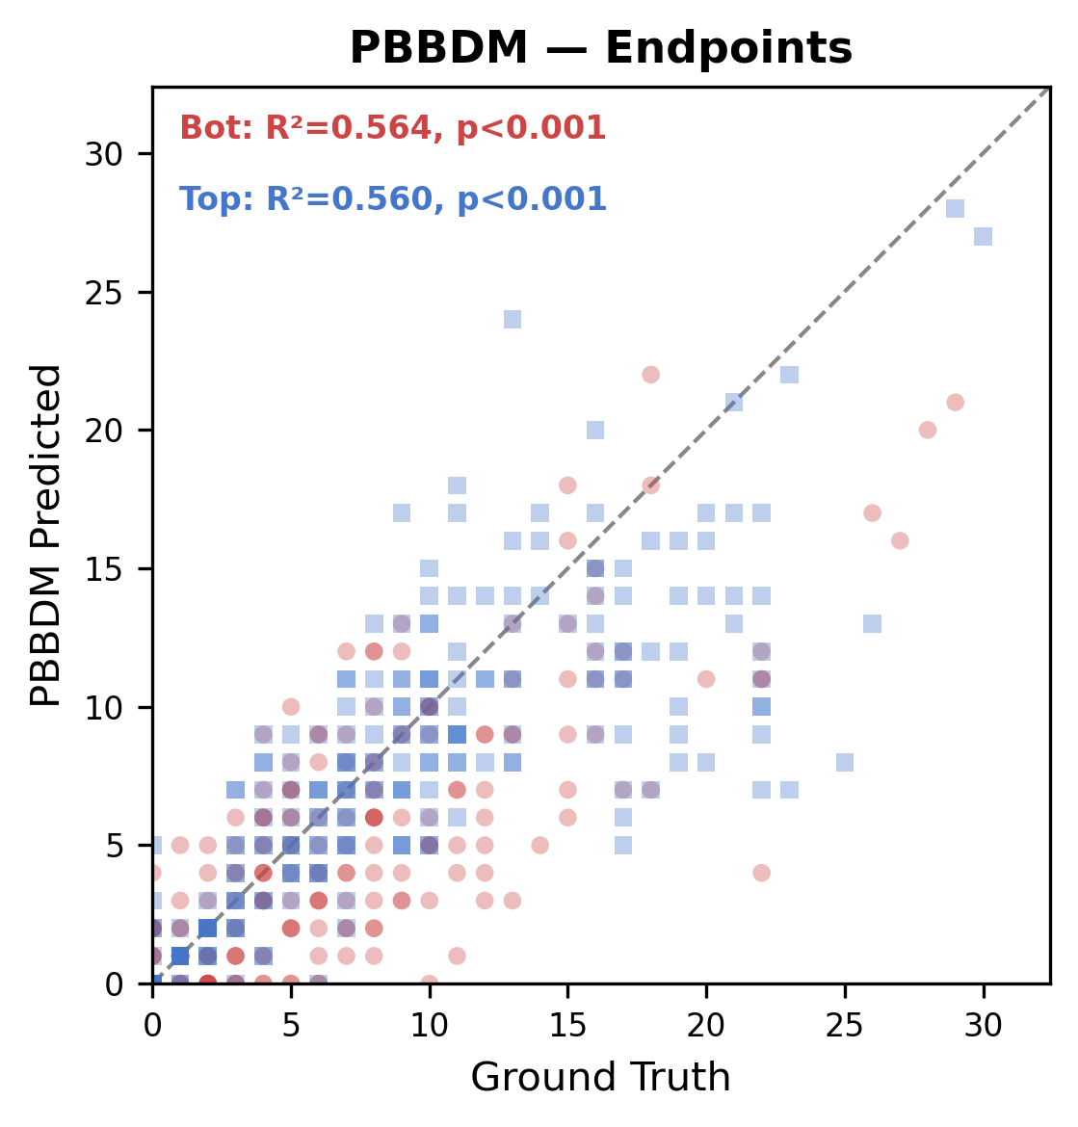
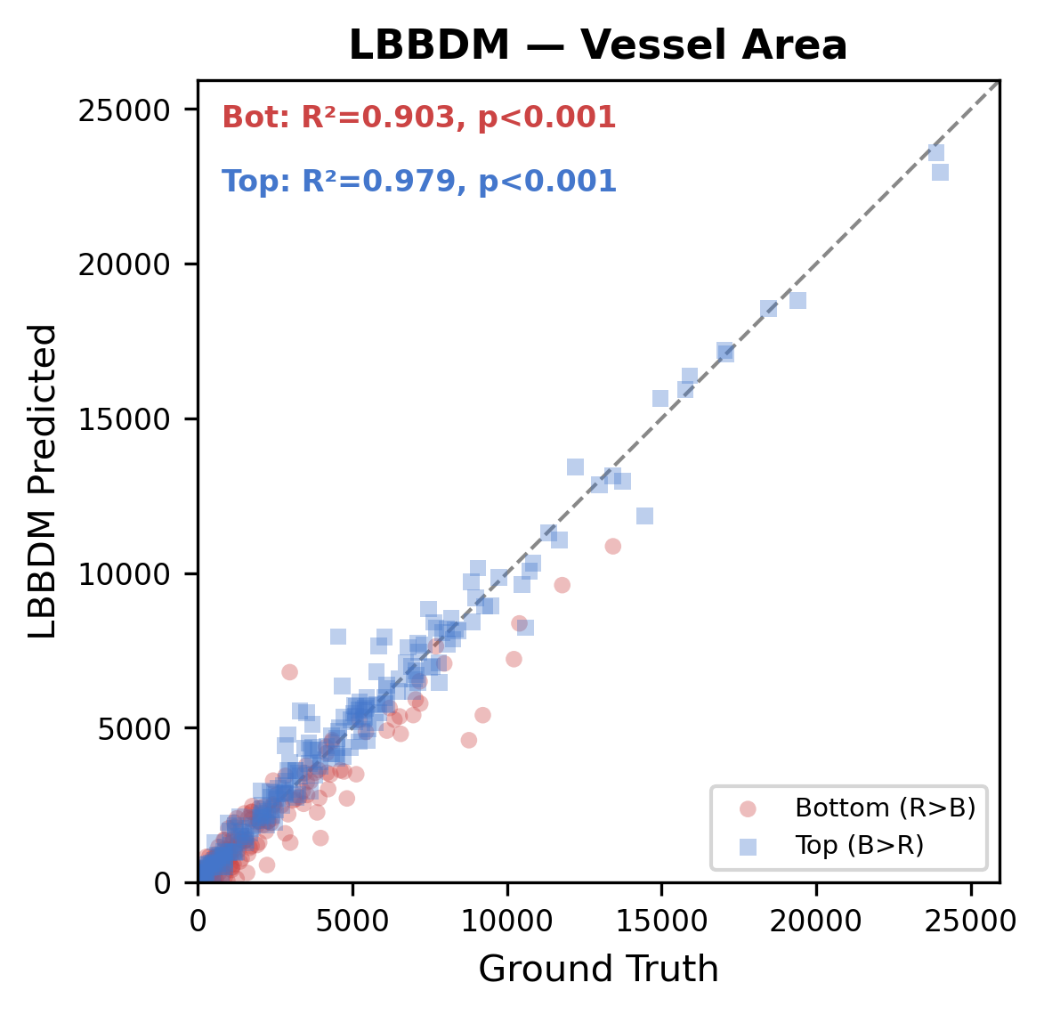
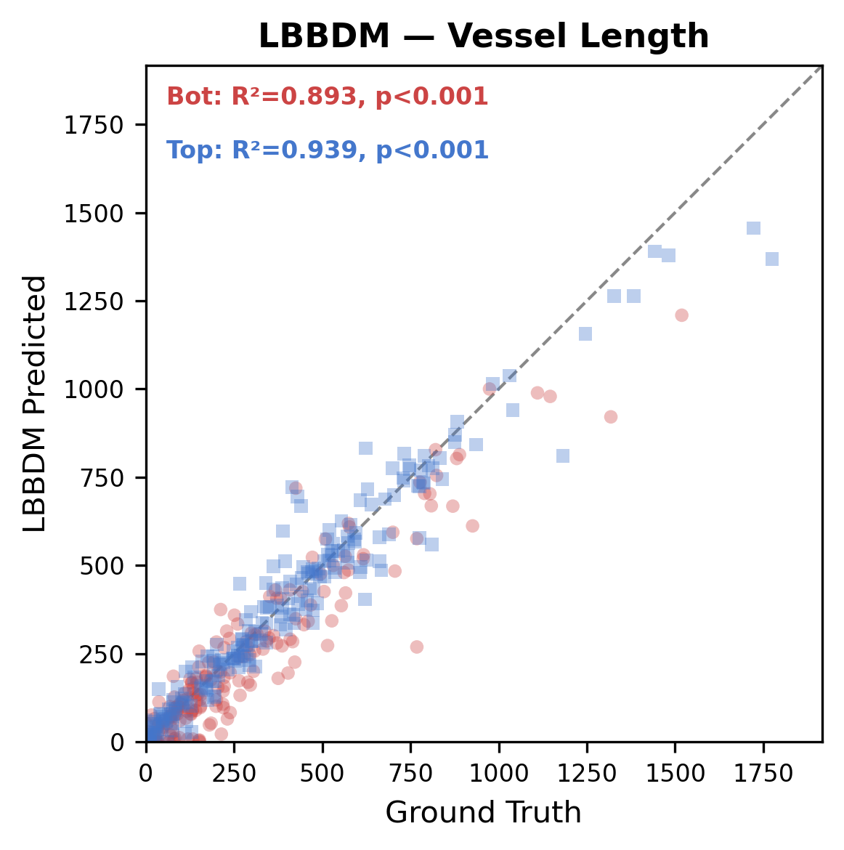
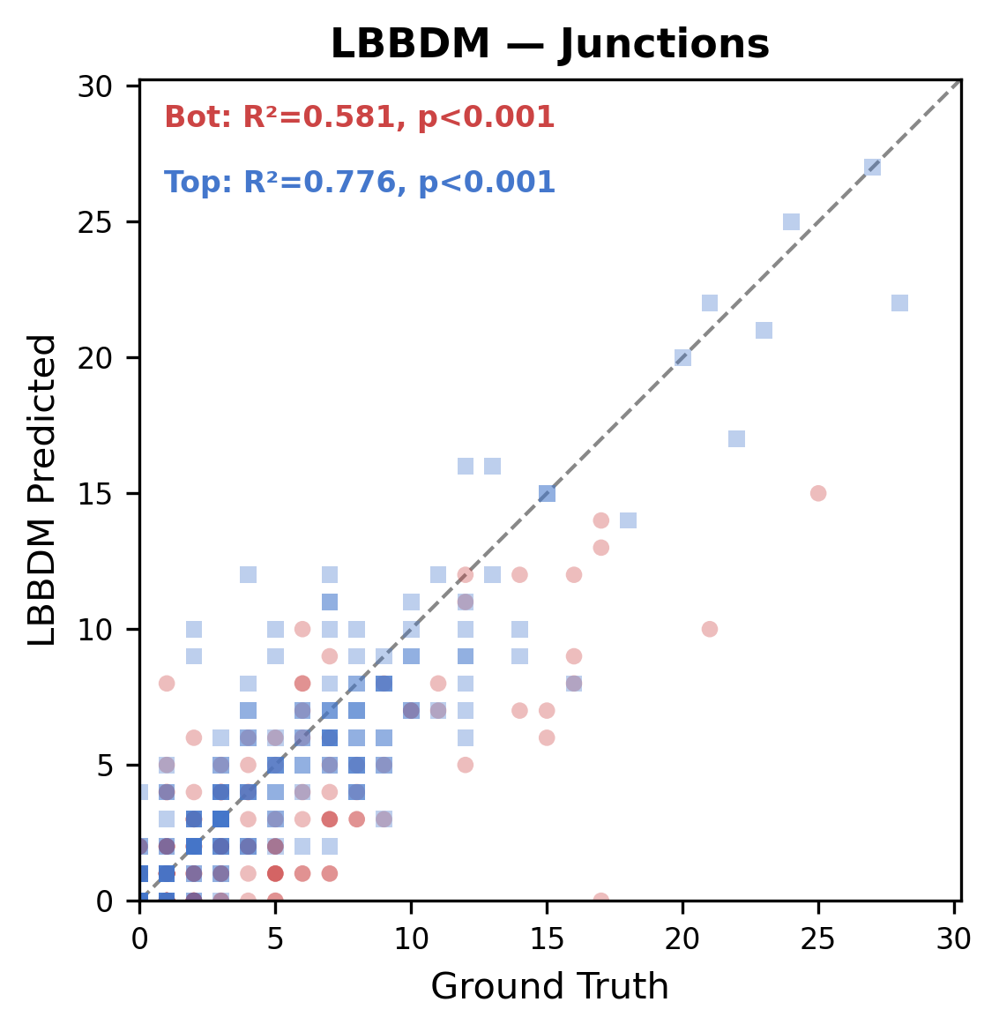
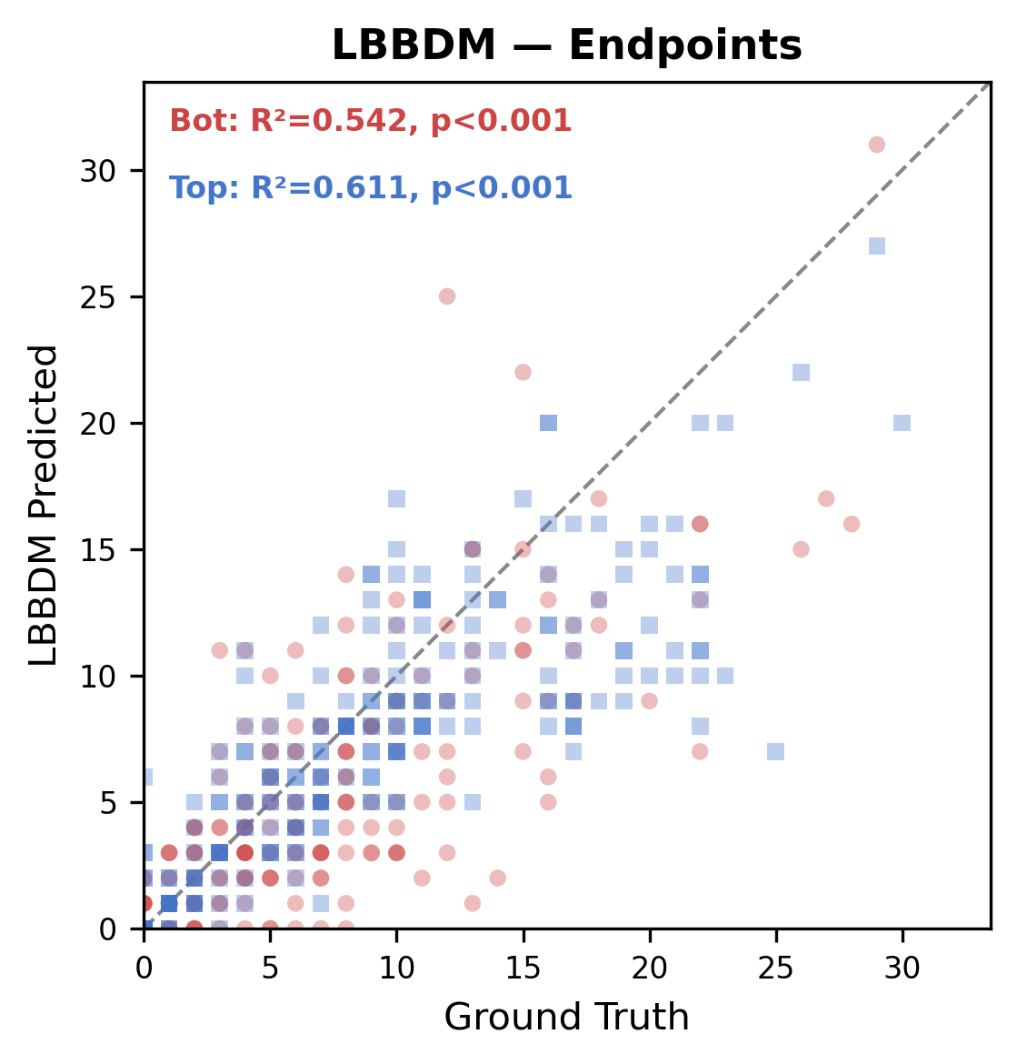
Per-layer Concordance: Diffusion Models
RGB Channel Separation (R>B = Bottom layer, B>R = Top layer) | N=228
Vessel Area
Vessel Length
Junctions
Endpoints
PBBDM
LBBDM
R² Summary (Diffusion Models)
 | Area R | Area B | Length R | Length B | JN R | JN B | EP R | EP B
PBBDM | 0.879 | 0.973 | 0.841 | 0.933 | 0.472 | 0.769 | 0.564 | 0.560
LBBDM | 0.903 | 0.979 | 0.893 | 0.939 | 0.581 | 0.776 | 0.542 | 0.611

Slide 2
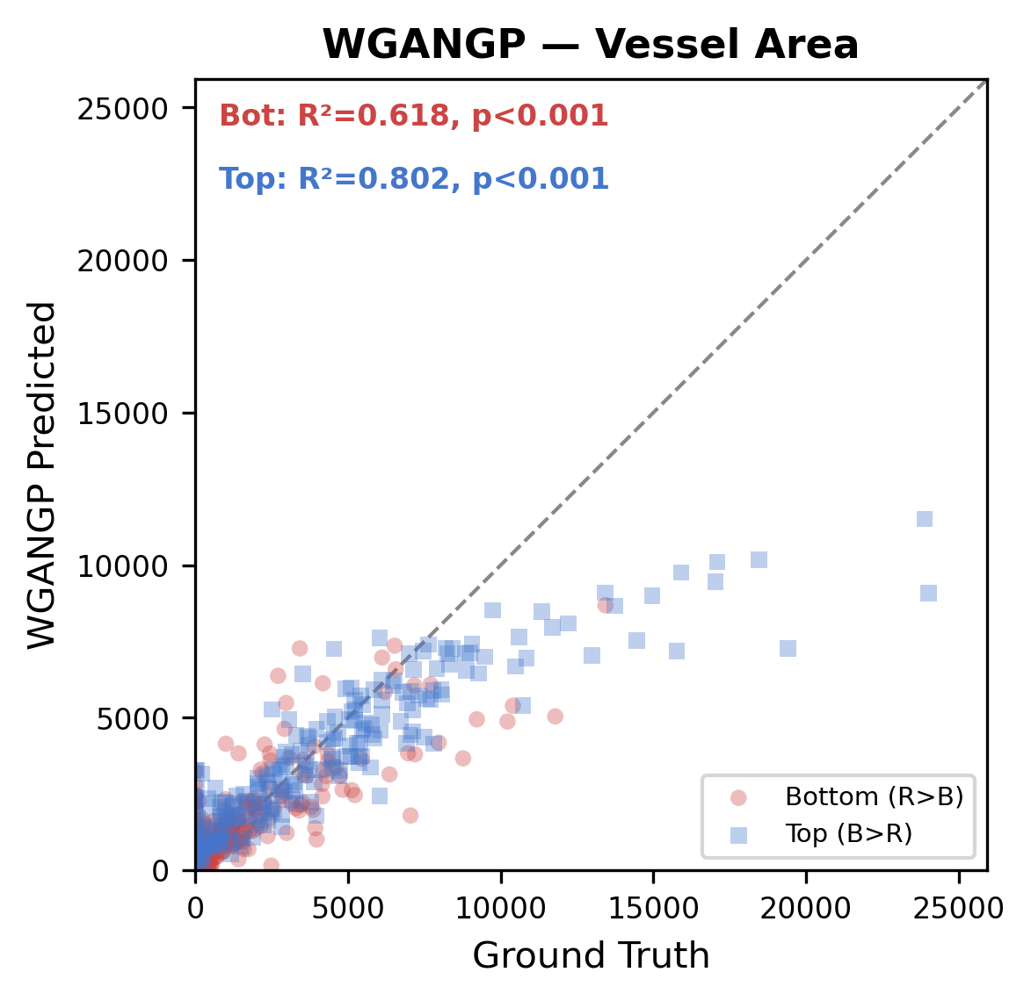
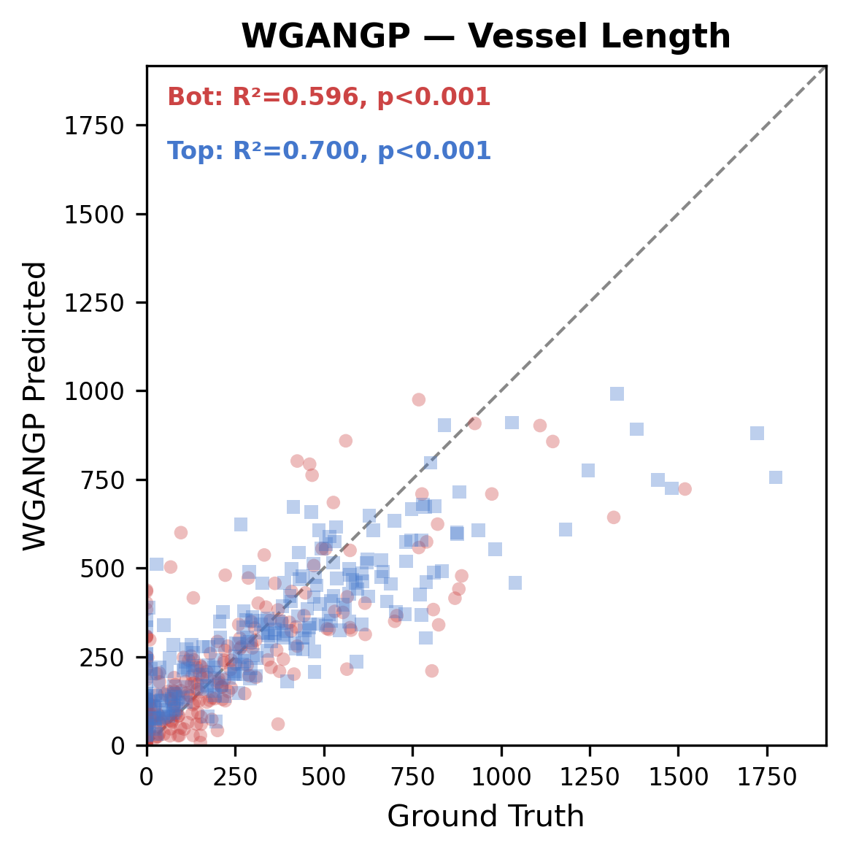
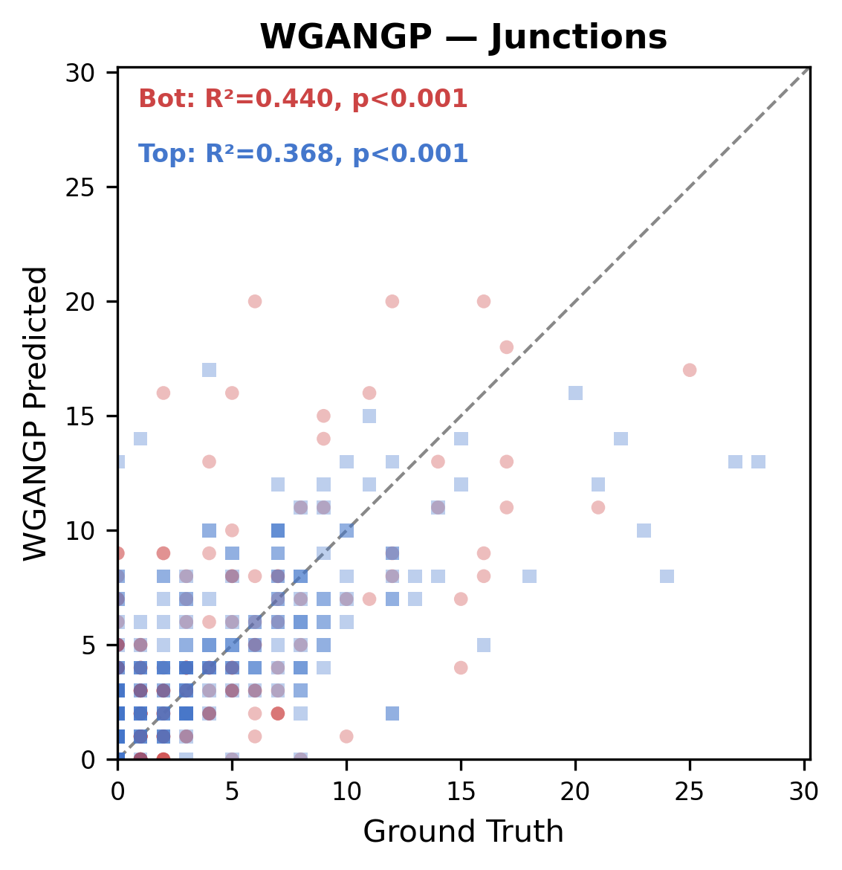
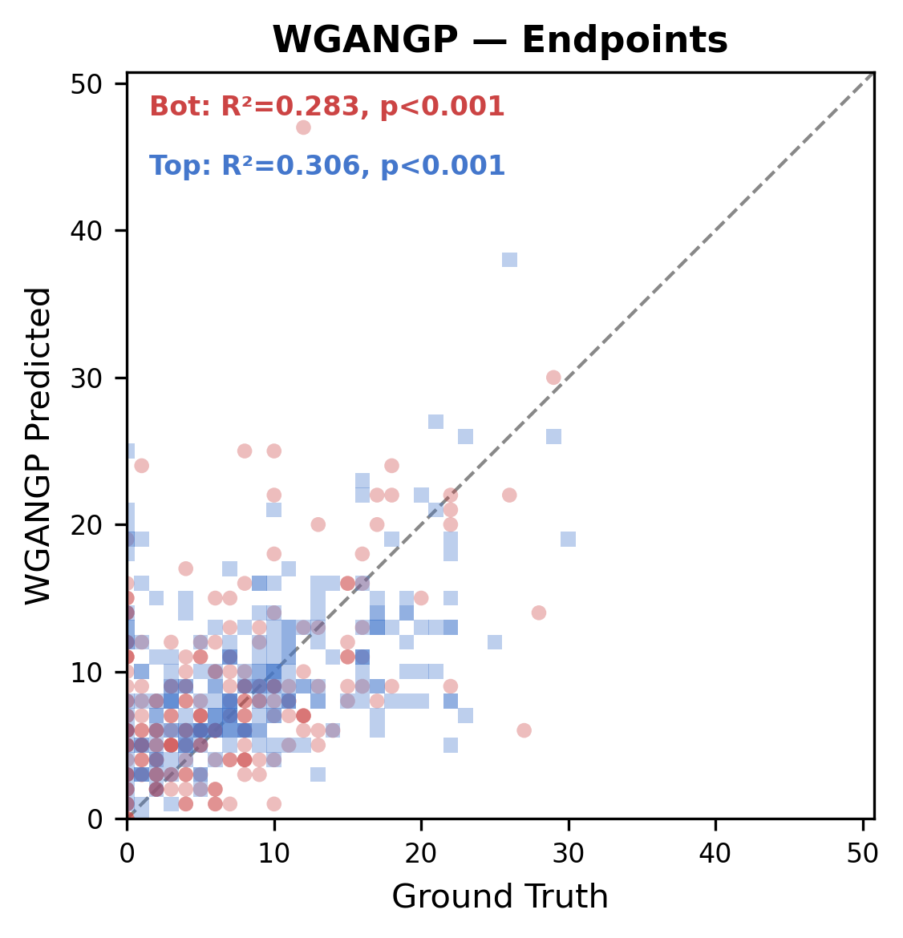
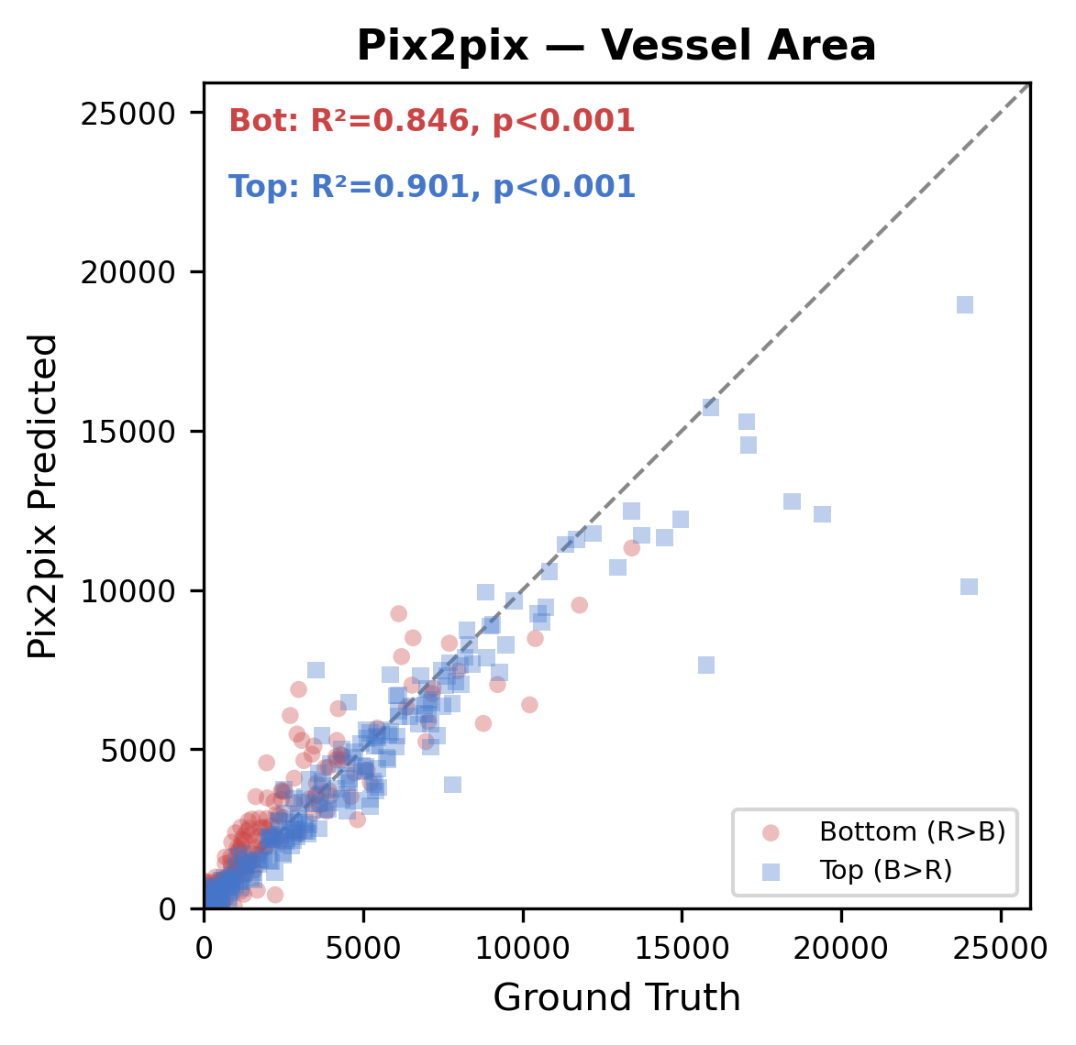
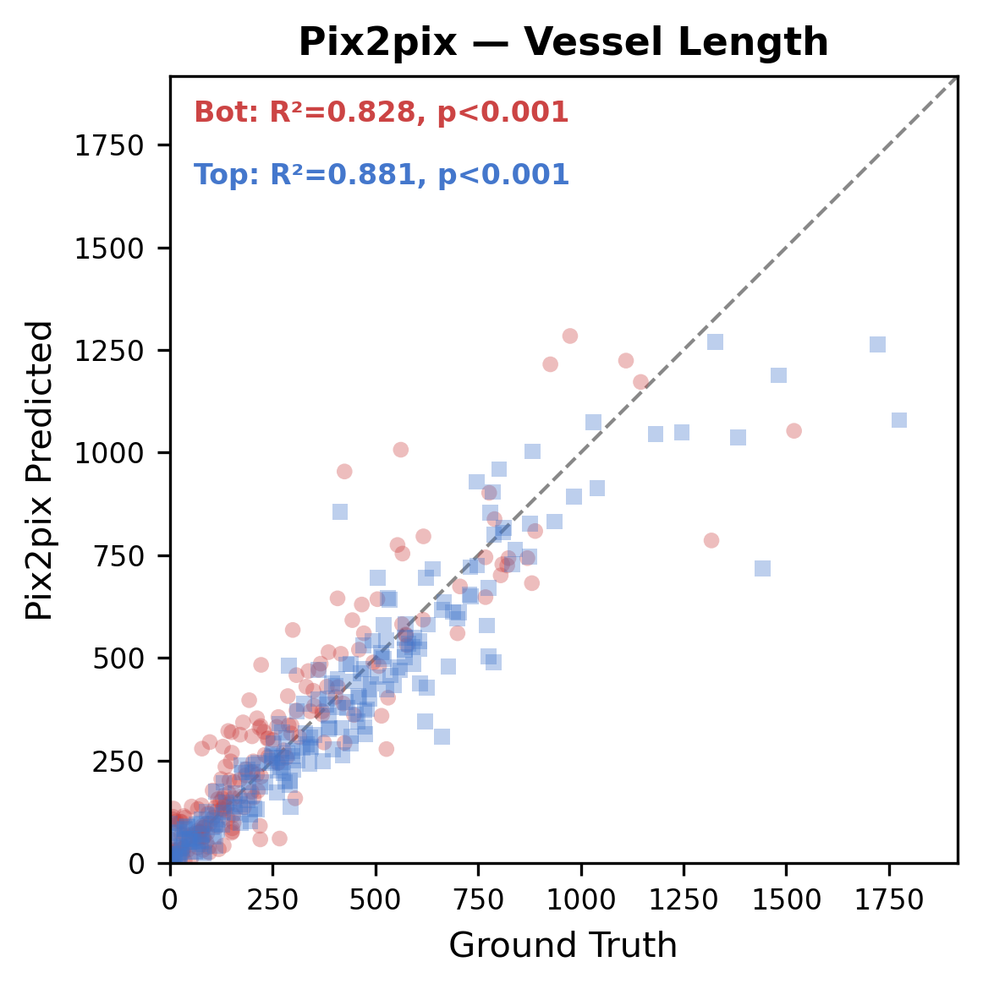
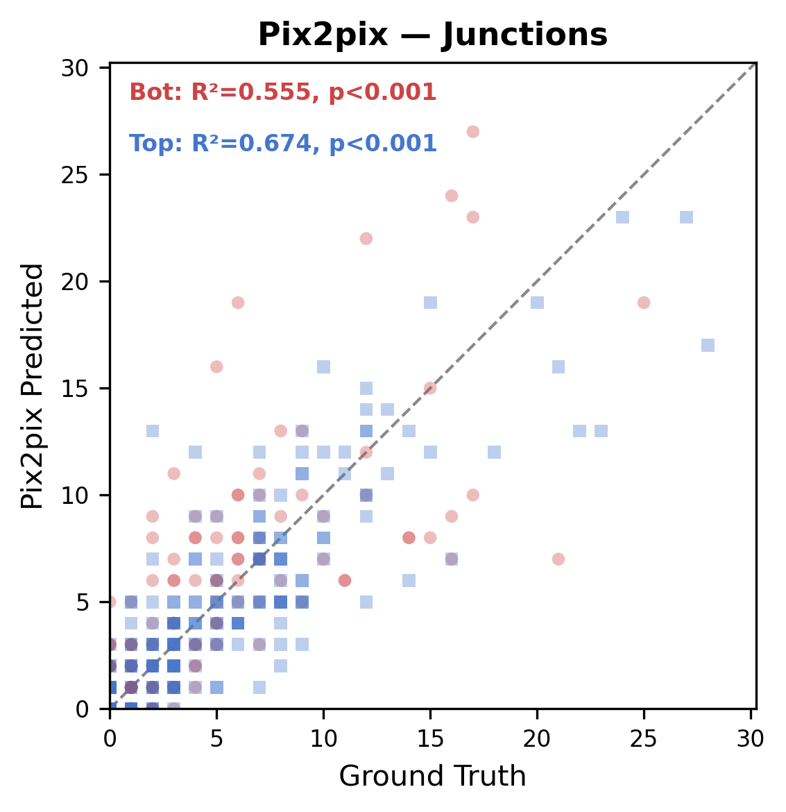
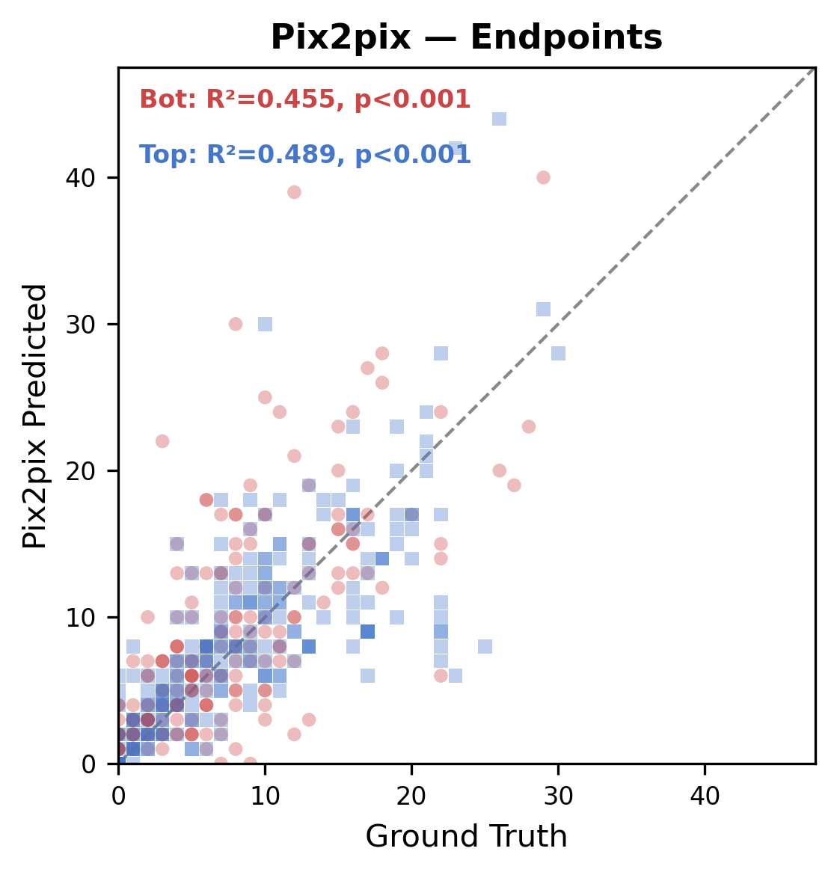
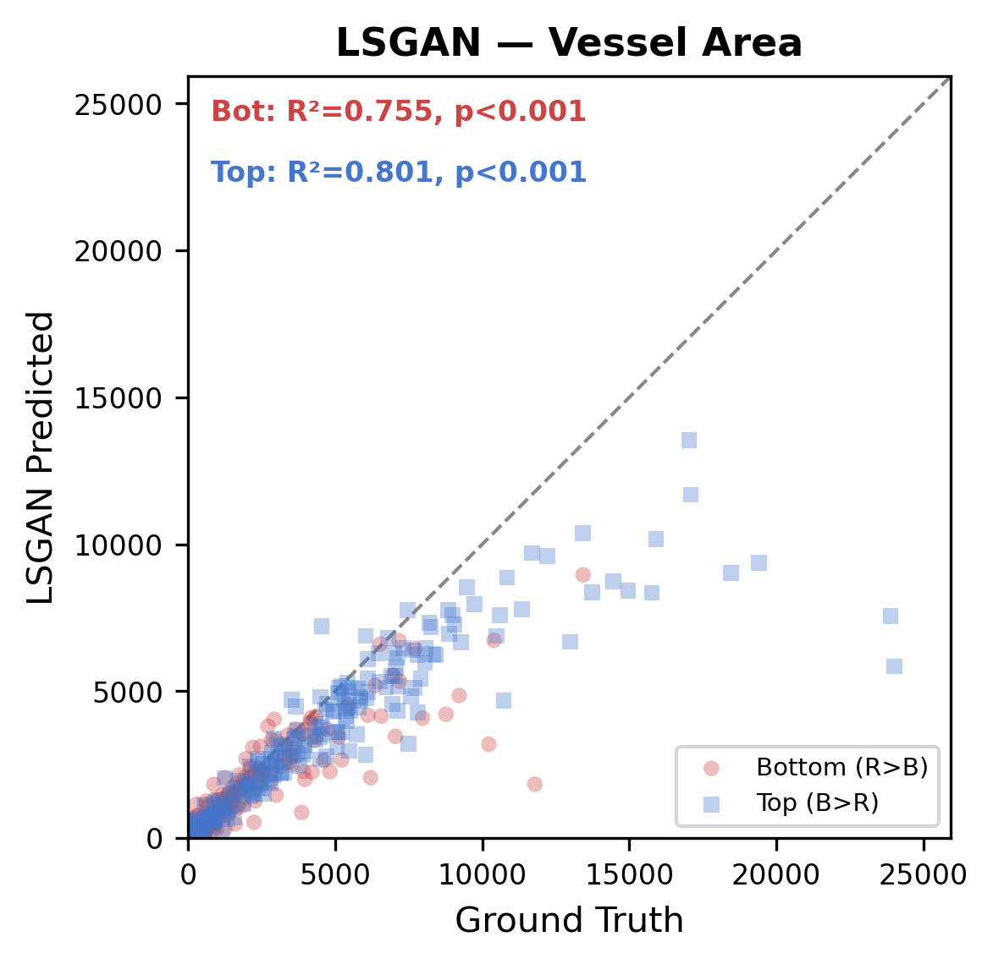
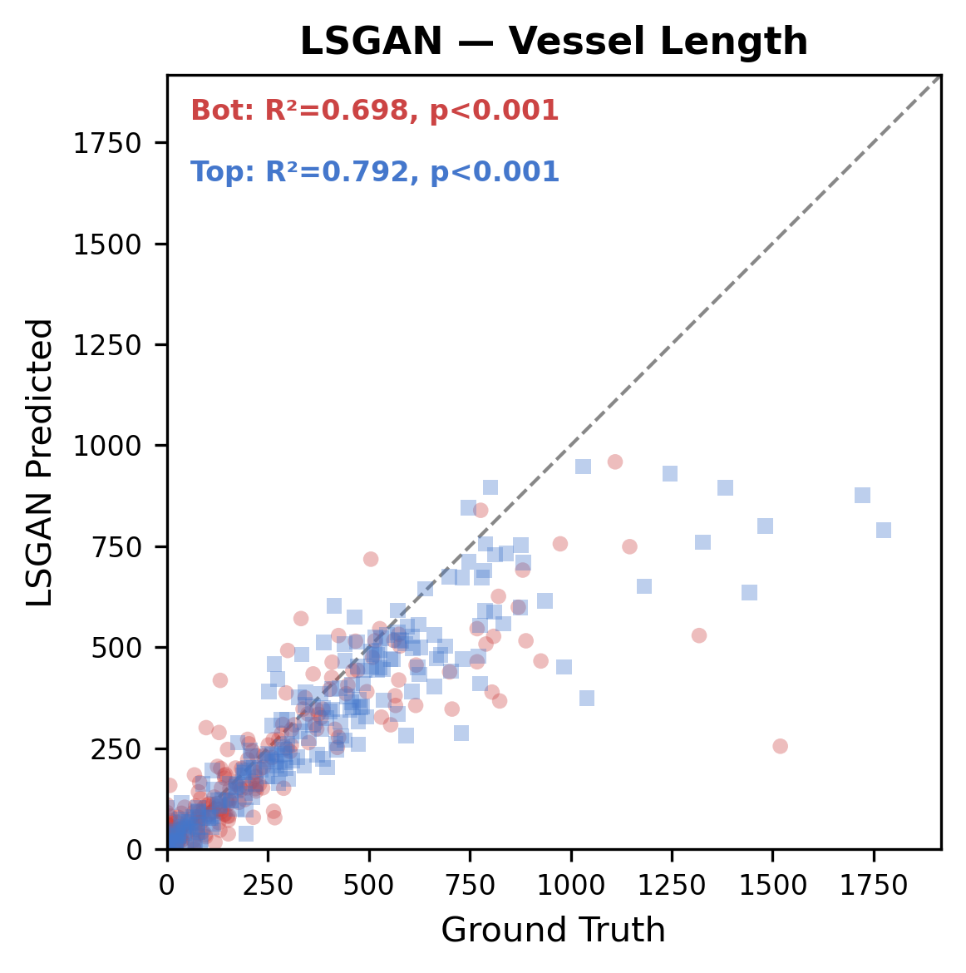
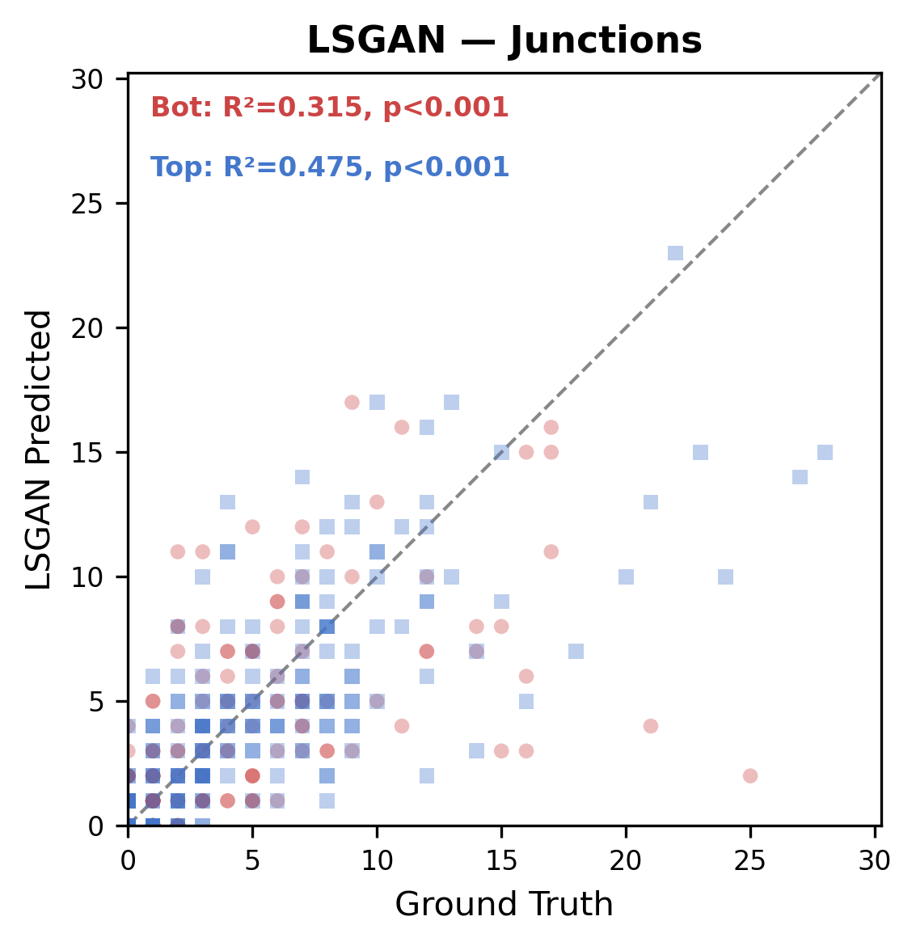
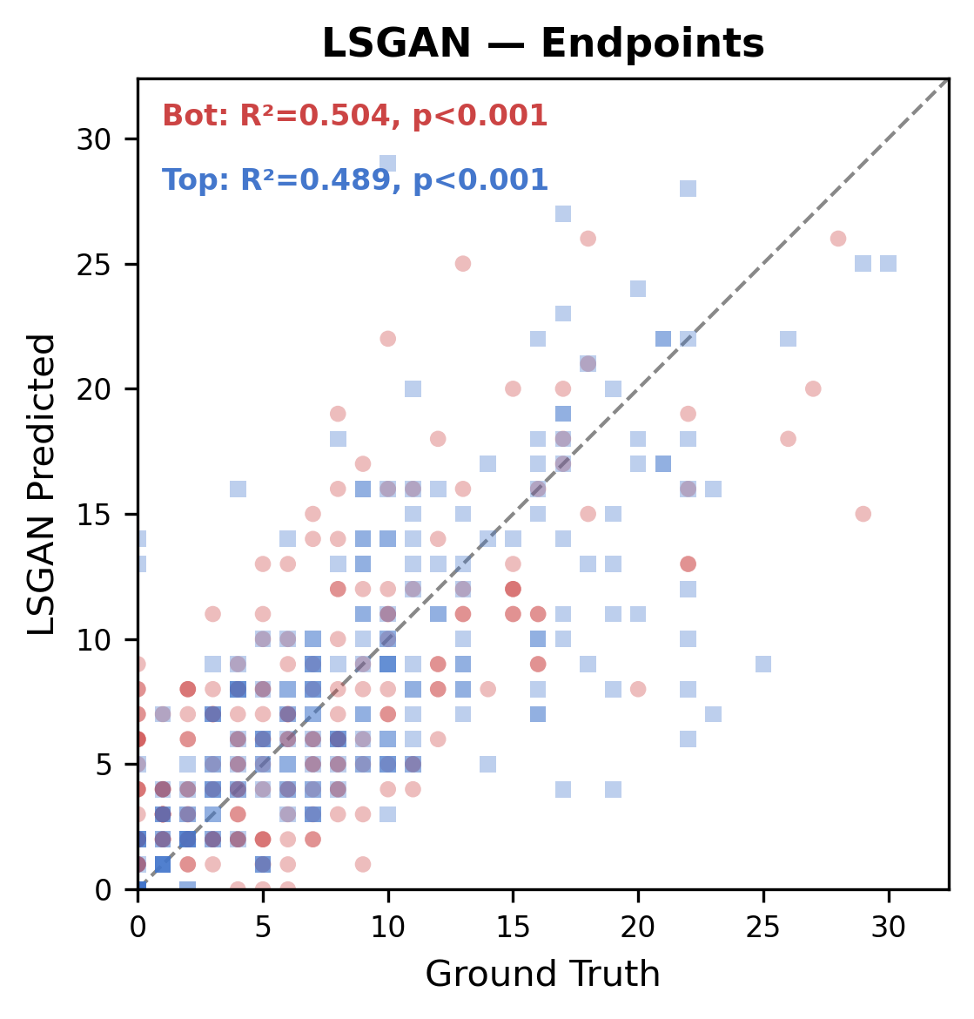
Per-layer Concordance: GAN Models
RGB Channel Separation (R>B = Bottom layer, B>R = Top layer) | N=228
Vessel Area
Vessel Length
Junctions
Endpoints
WGANGP
Pix2pix
LSGAN
R² Summary (GAN Models)
 | Area R | Area B | Length R | Length B | JN R | JN B | EP R | EP B
WGANGP | 0.618 | 0.802 | 0.596 | 0.700 | 0.440 | 0.368 | 0.283 | 0.306
Pix2pix | 0.846 | 0.901 | 0.828 | 0.881 | 0.555 | 0.674 | 0.455 | 0.489
LSGAN | 0.755 | 0.801 | 0.698 | 0.792 | 0.315 | 0.475 | 0.504 | 0.489
Diffusion models (PBBDM, LBBDM) achieve R² > 0.84 for Area/Length across both layers,
while GANs show substantially lower concordance especially for Top layer (B>R) Junctions.

Slide 3
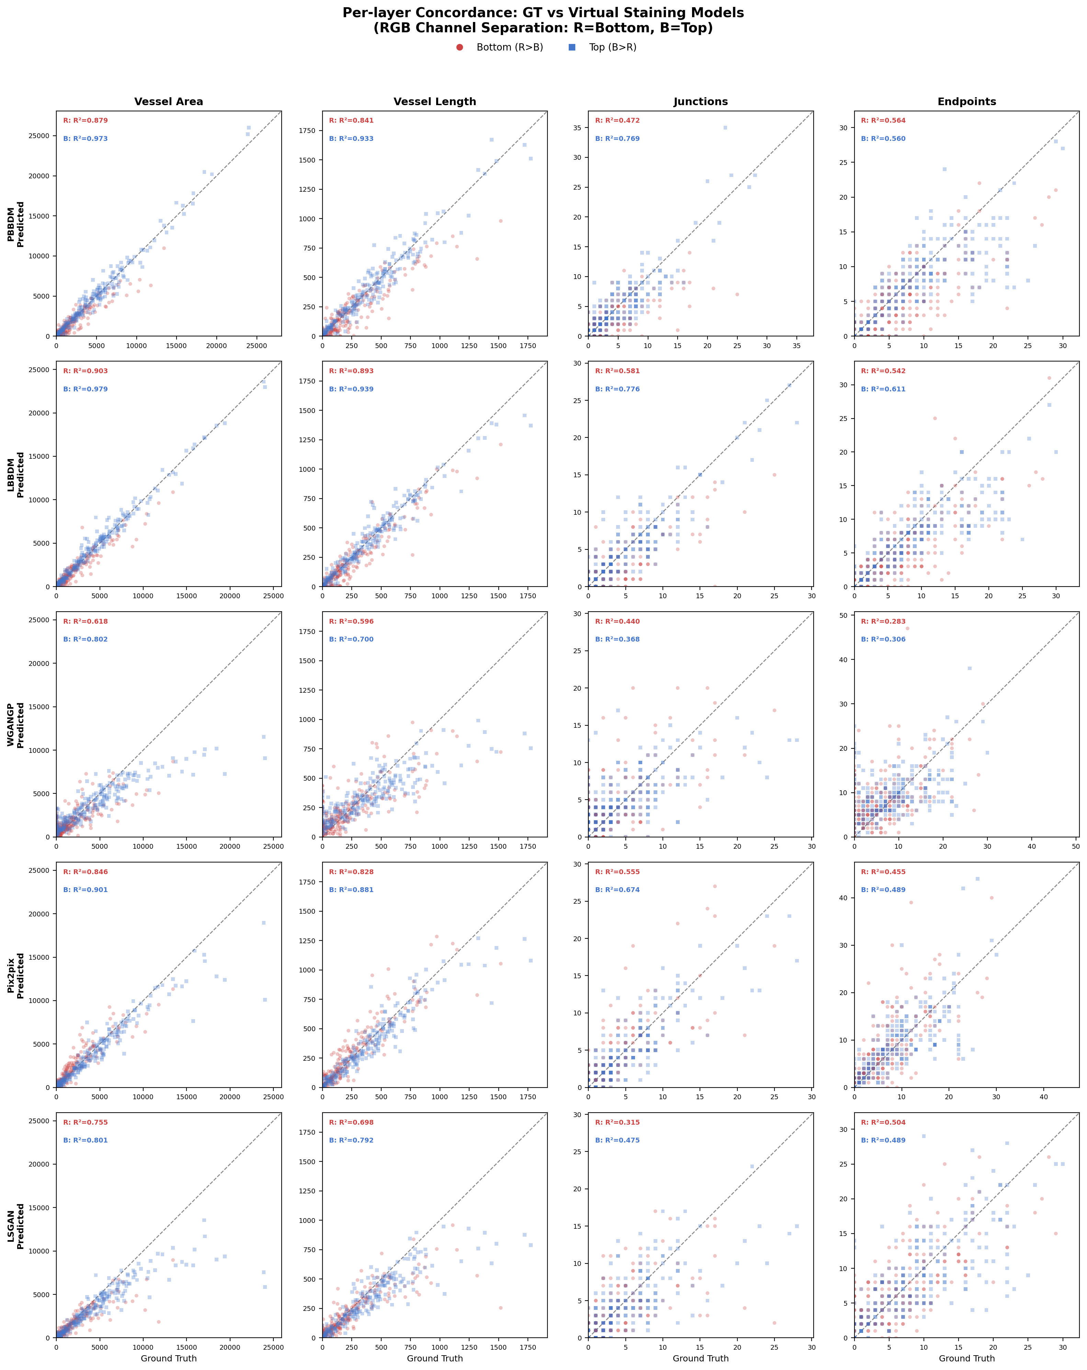
R² Comparison Across All Models

