Slide 1
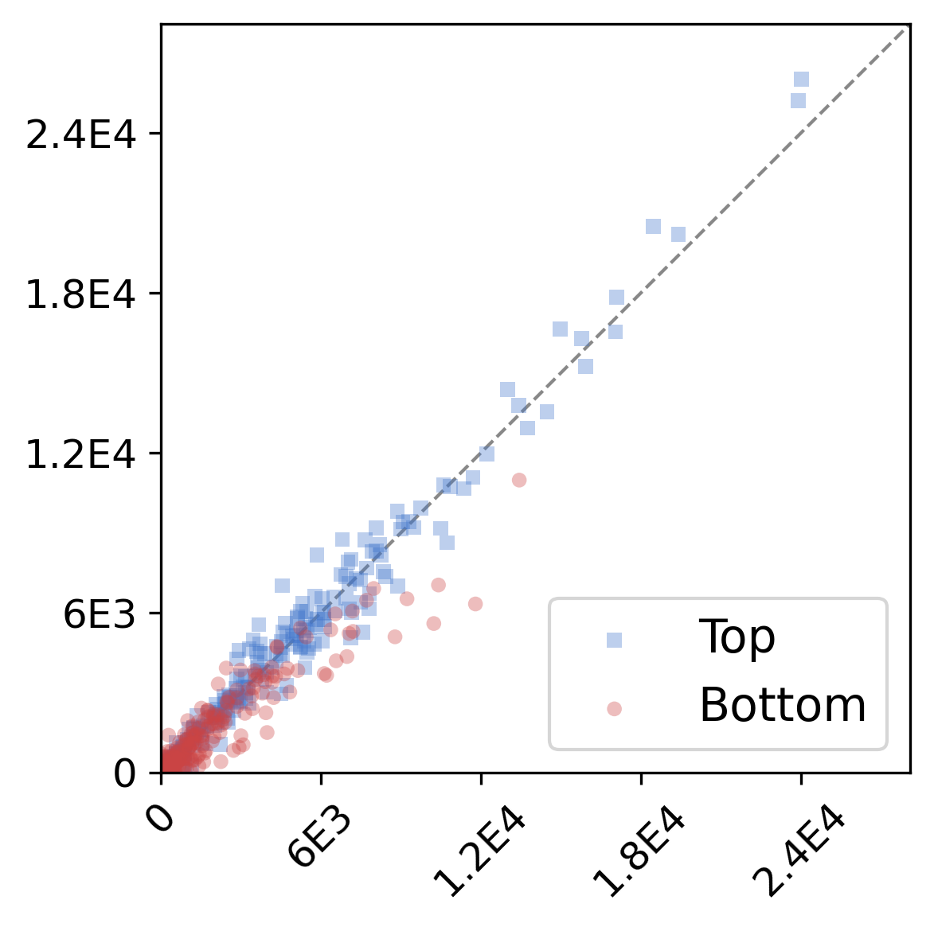
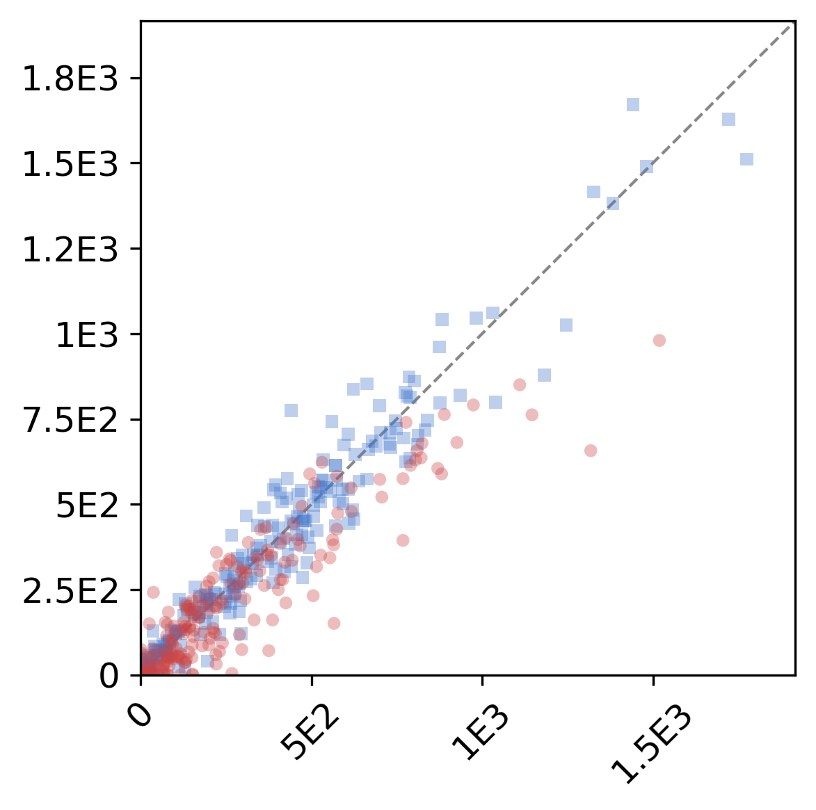
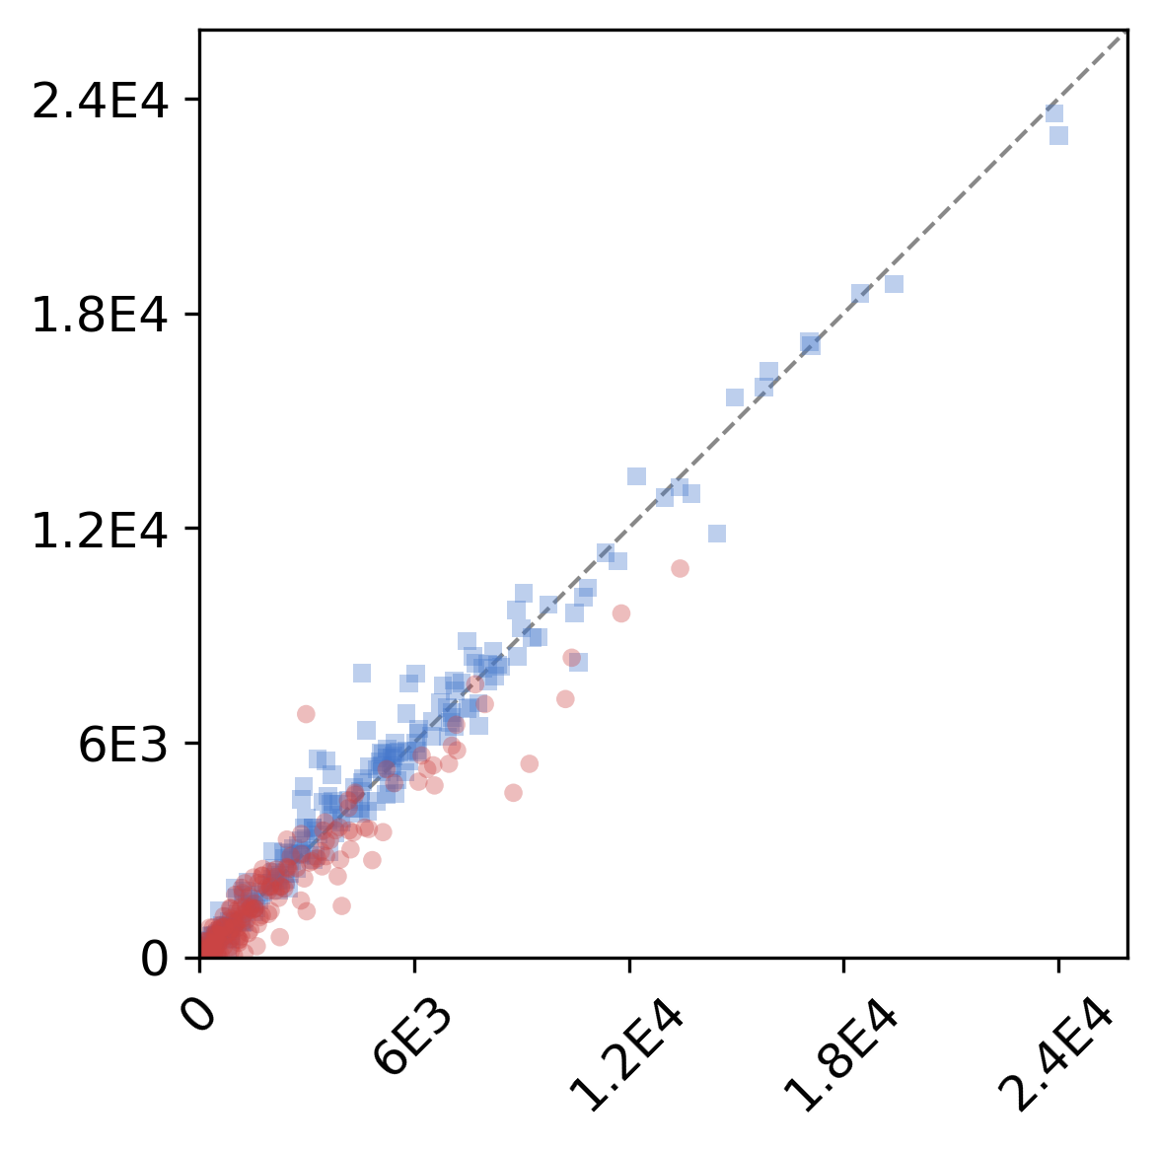

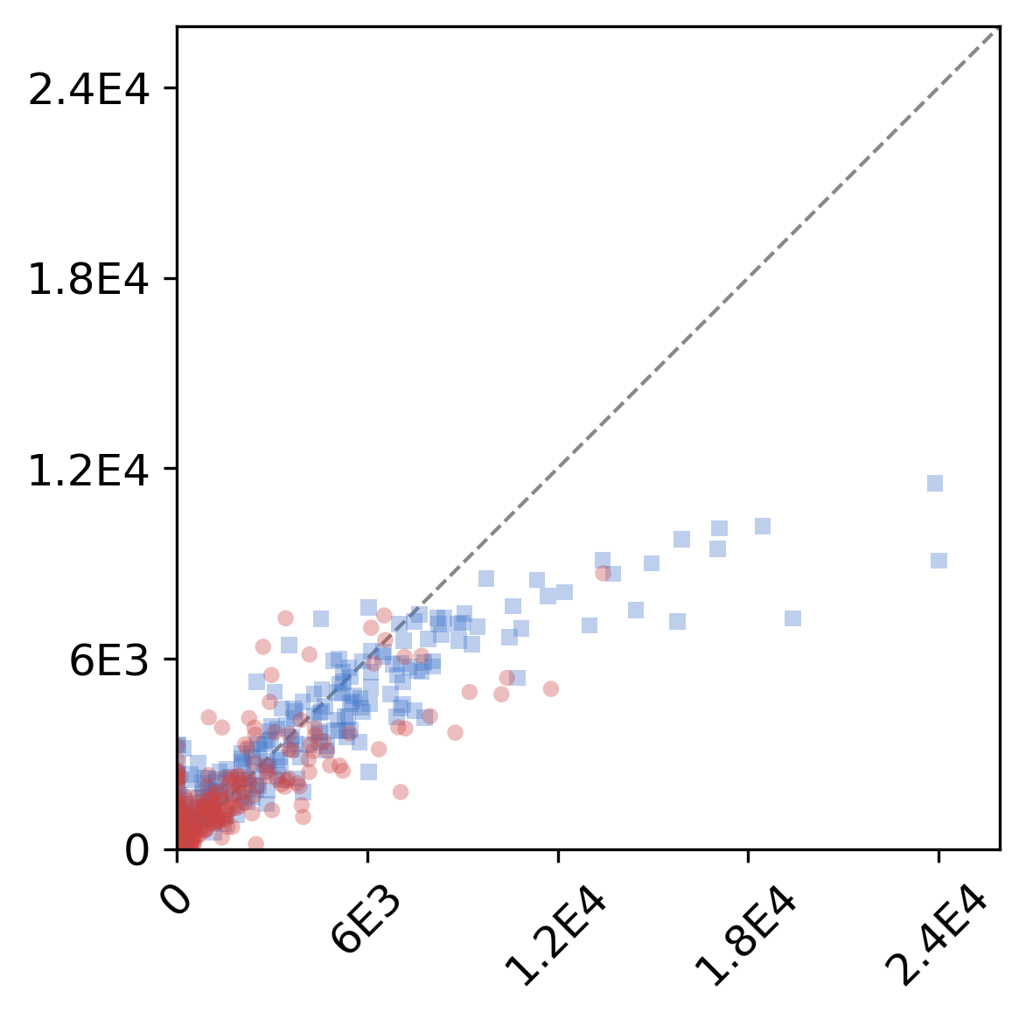
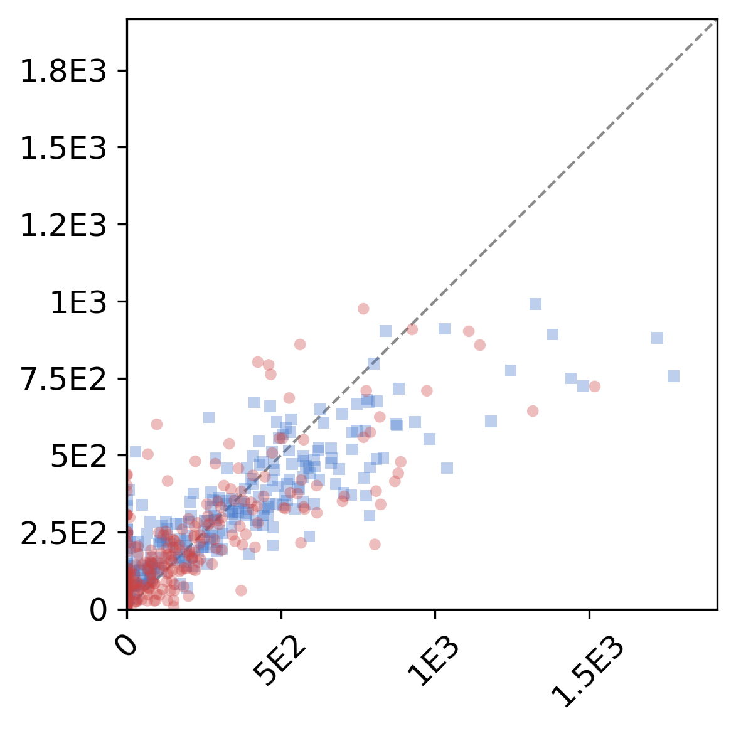
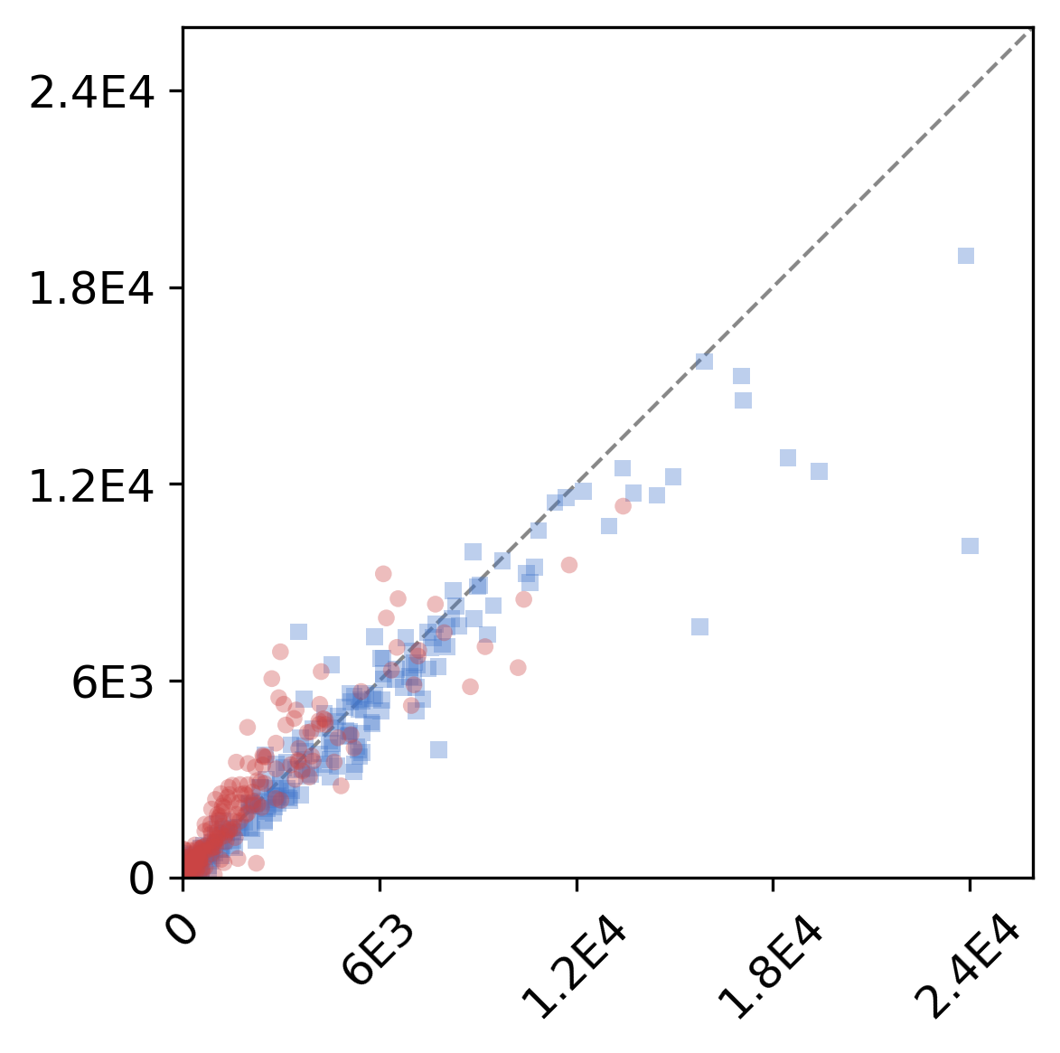
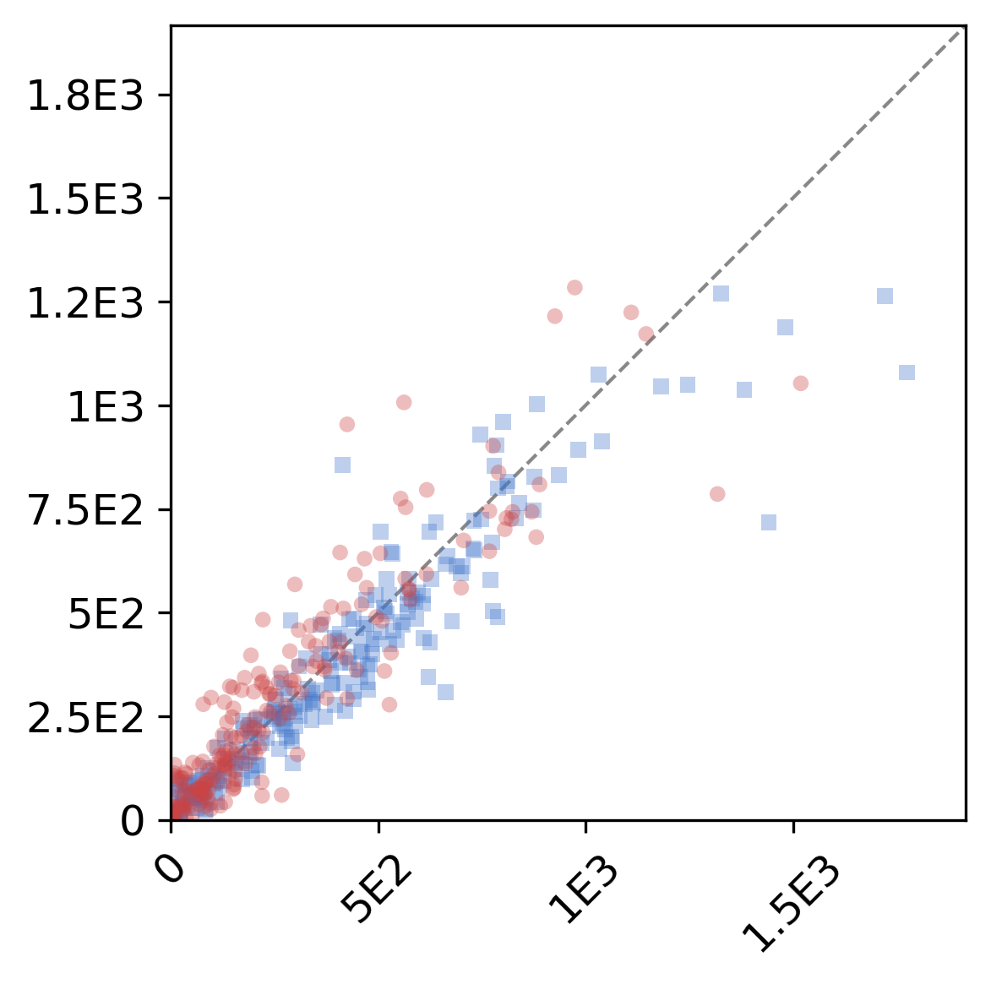
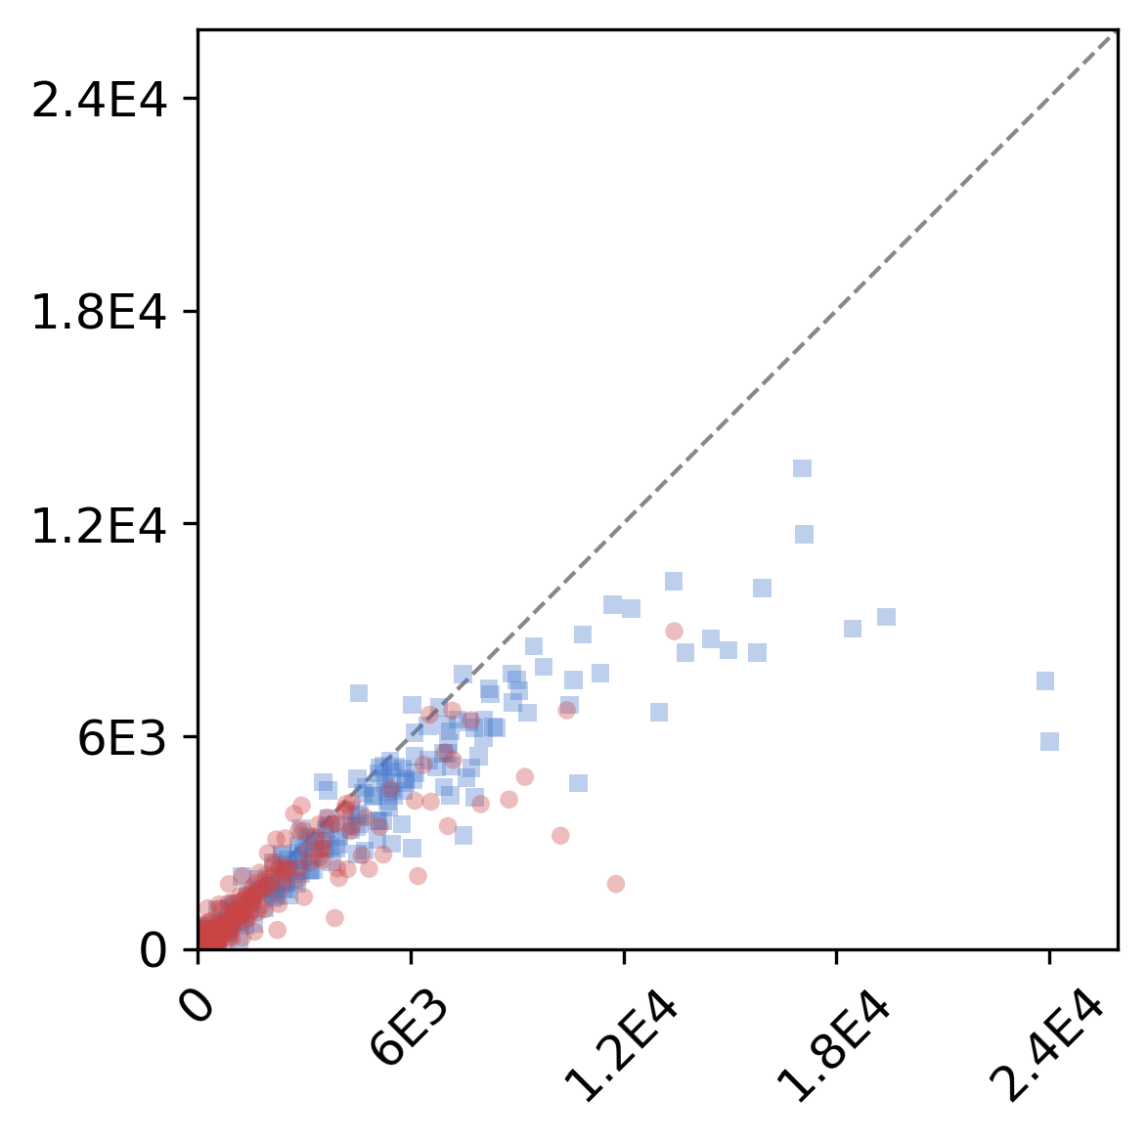
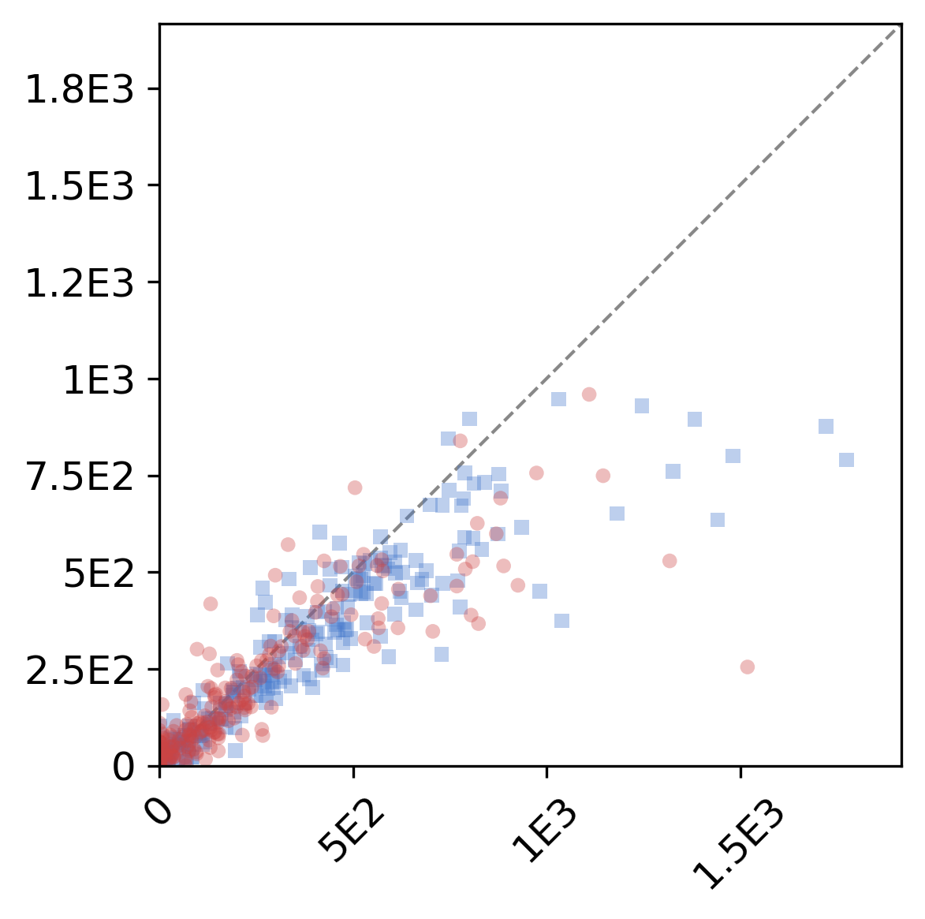
Per-layer Concordance: Area & Length (R² Scatter)
RGB Channel Separation: R>B = Bottom, B>R = Top | N=228 | Bottom 20% excluded
Vessel Area
Vessel Length
Unified Per-layer Metrics
Area R²
Length R²
JN MAE
JN ±3%
EP MAE
EP ±3%
Model | Bot | Top | Bot | Top | Bot | Top | Bot | Top | Bot | Top | Bot | Top
PBBDM | .879 | .973 | .841 | .933 | 1.6 | 1.5 | 84% | 88% | 2.8 | 2.9 | 70% | 70%
LBBDM | .903 | .979 | .893 | .939 | 1.6 | 1.4 | 85% | 87% | 2.7 | 3.0 | 71% | 71%
Pix2pix | .846 | .901 | .828 | .881 | 1.6 | 1.7 | 85% | 86% | 3.2 | 3.3 | 68% | 64%
LSGAN | .755 | .801 | .698 | .792 | 1.9 | 2.1 | 85% | 80% | 3.2 | 3.4 | 62% | 59%
WGANGP | .618 | .802 | .596 | .700 | 2.3 | 2.7 | 75% | 75% | 4.6 | 4.8 | 49% | 52%
PBBDM
LBBDM
WGANGP
Pix2pix
LSGAN

Slide 2
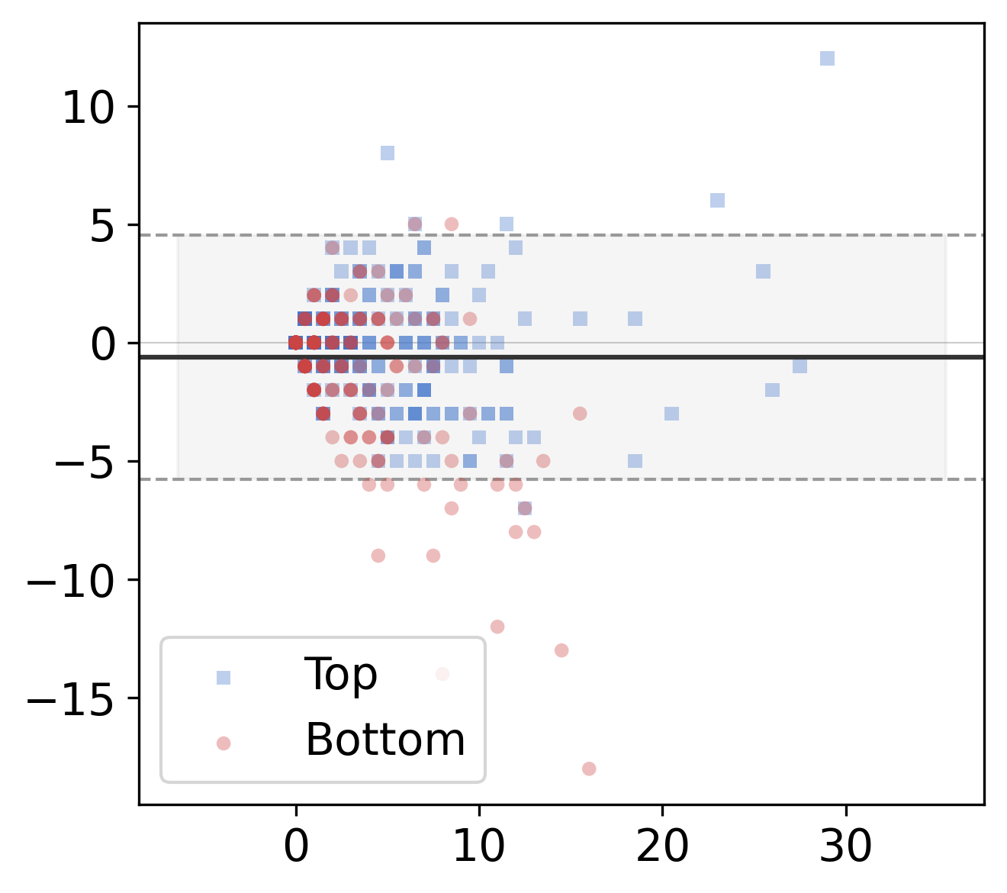
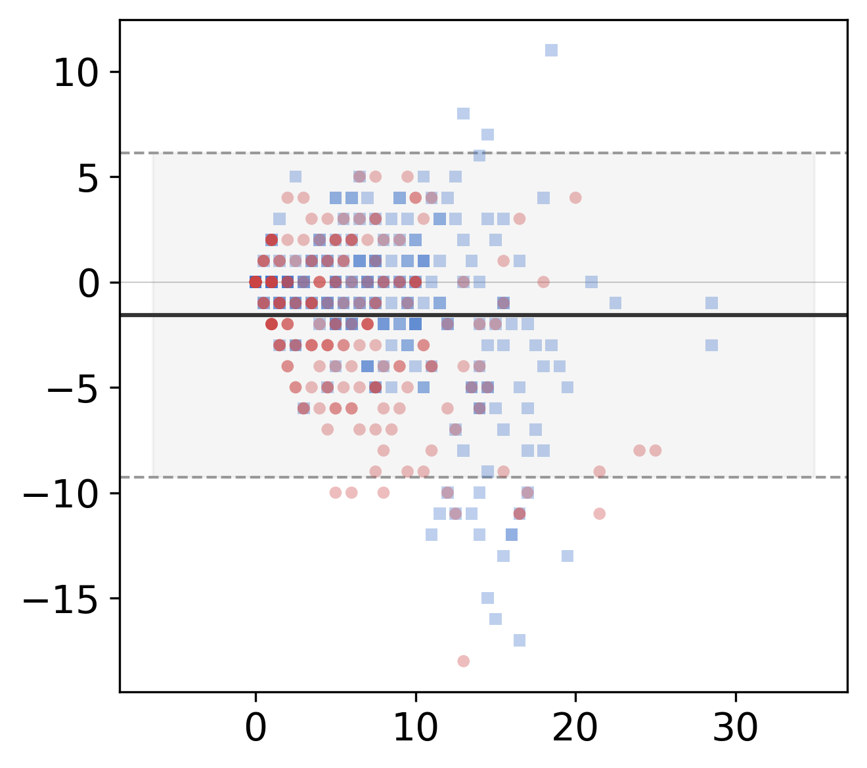
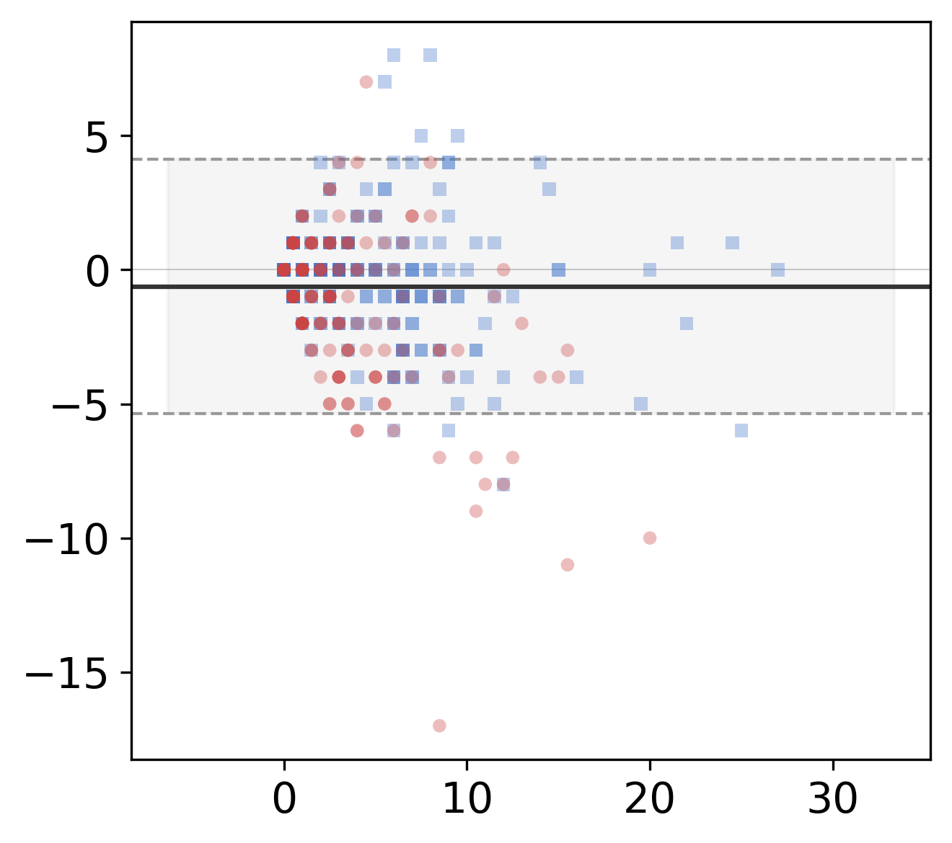
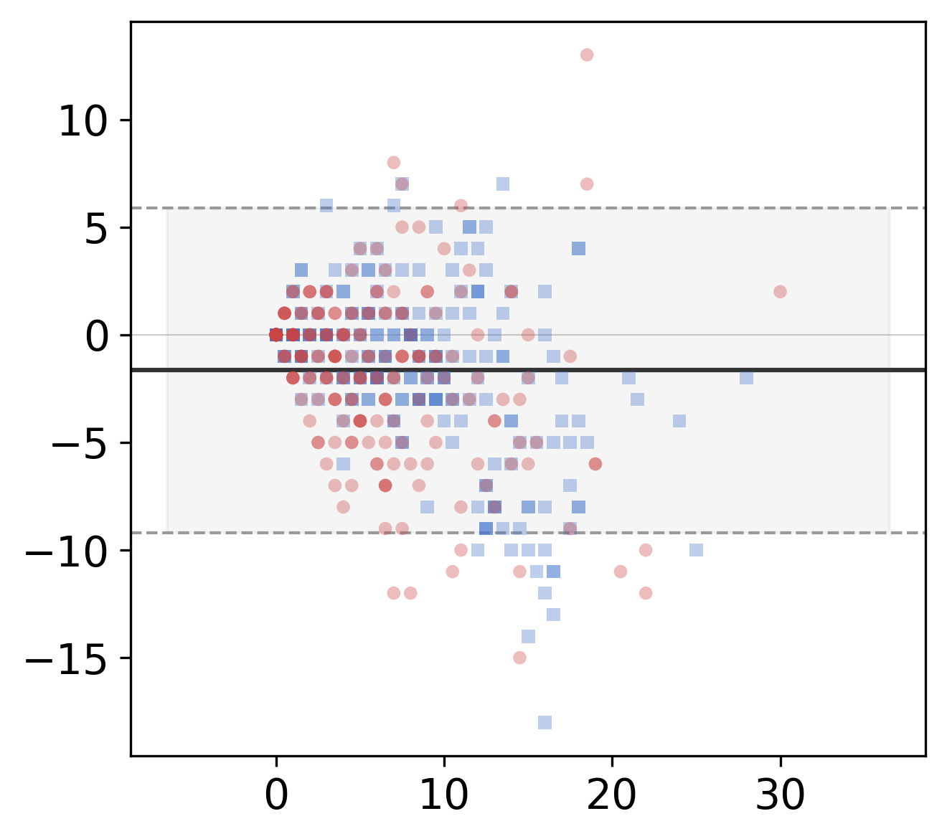
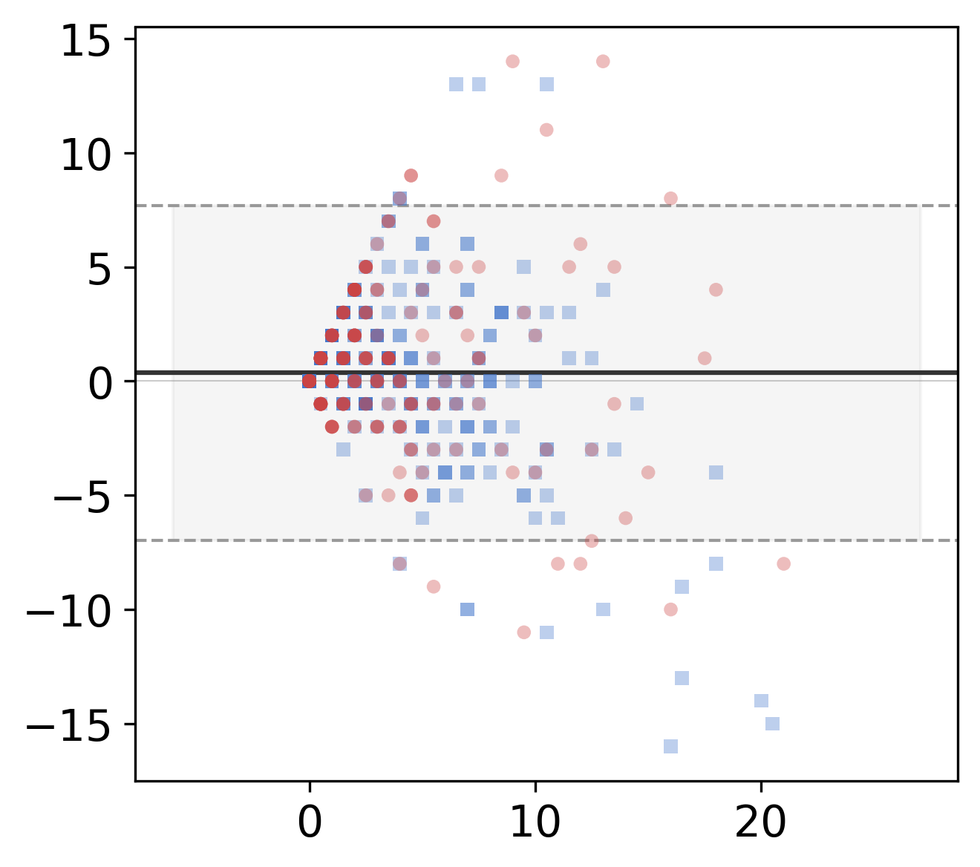
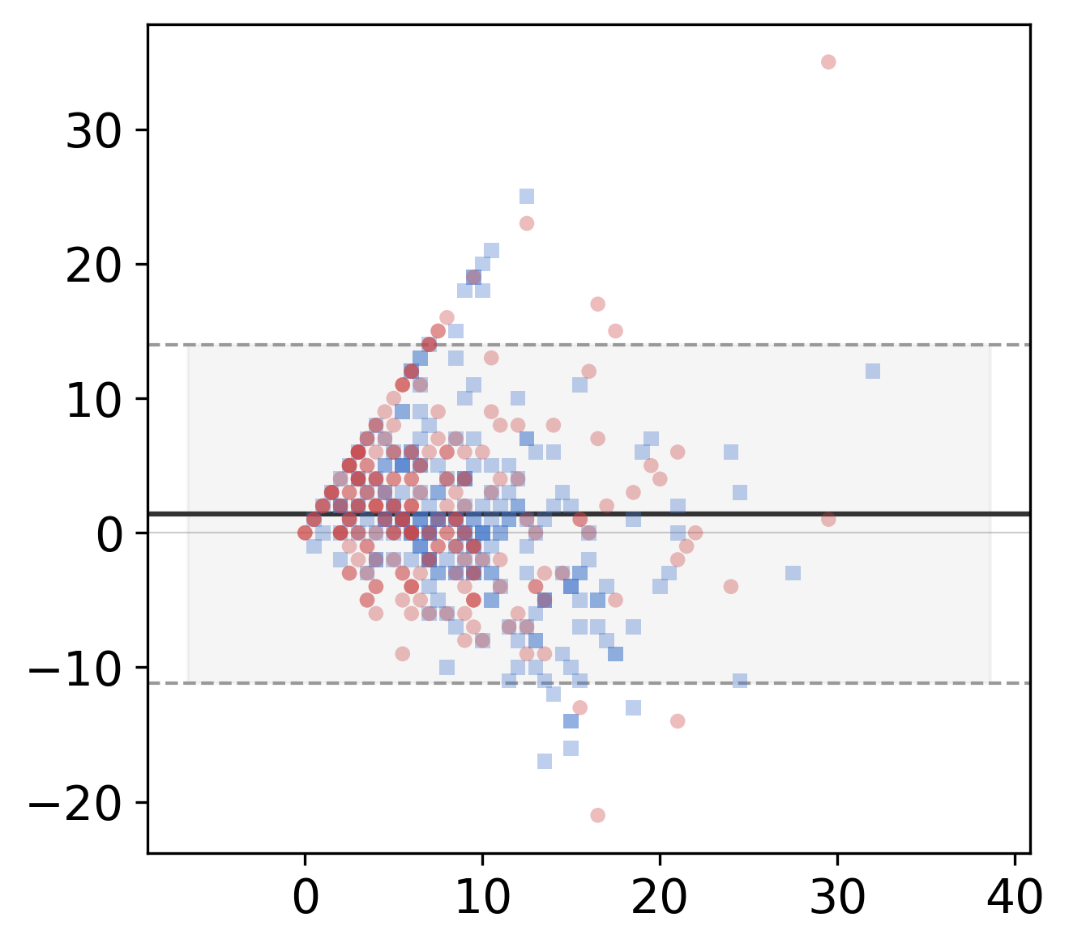
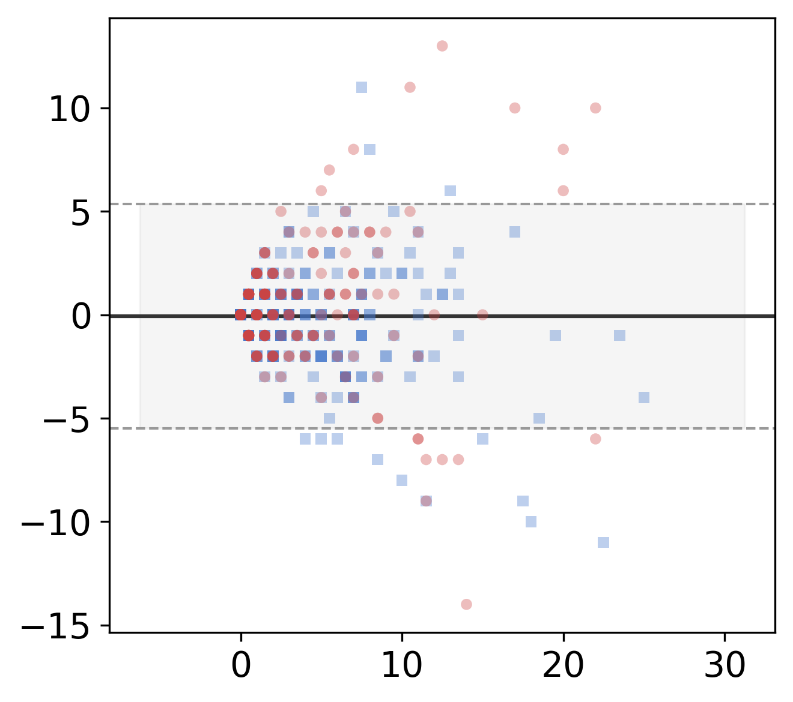
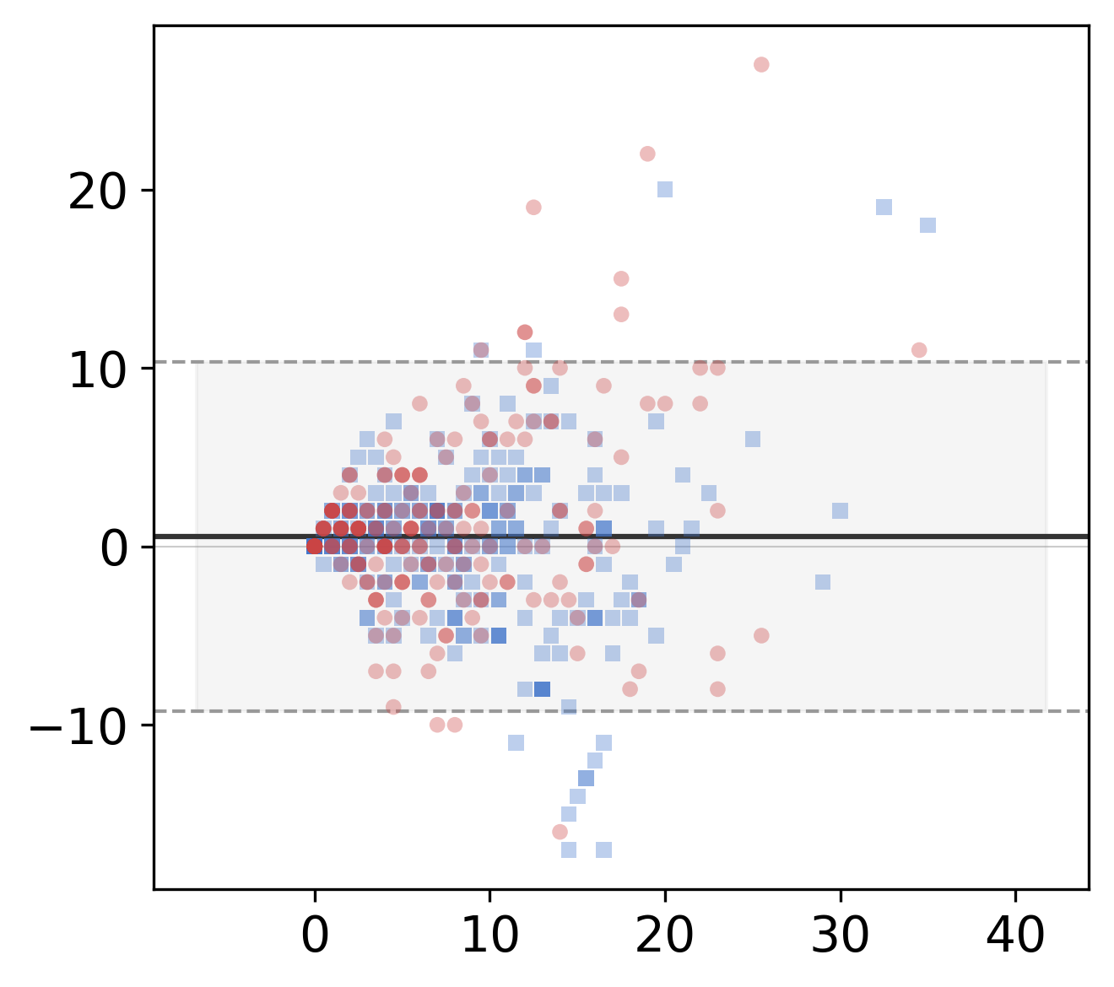
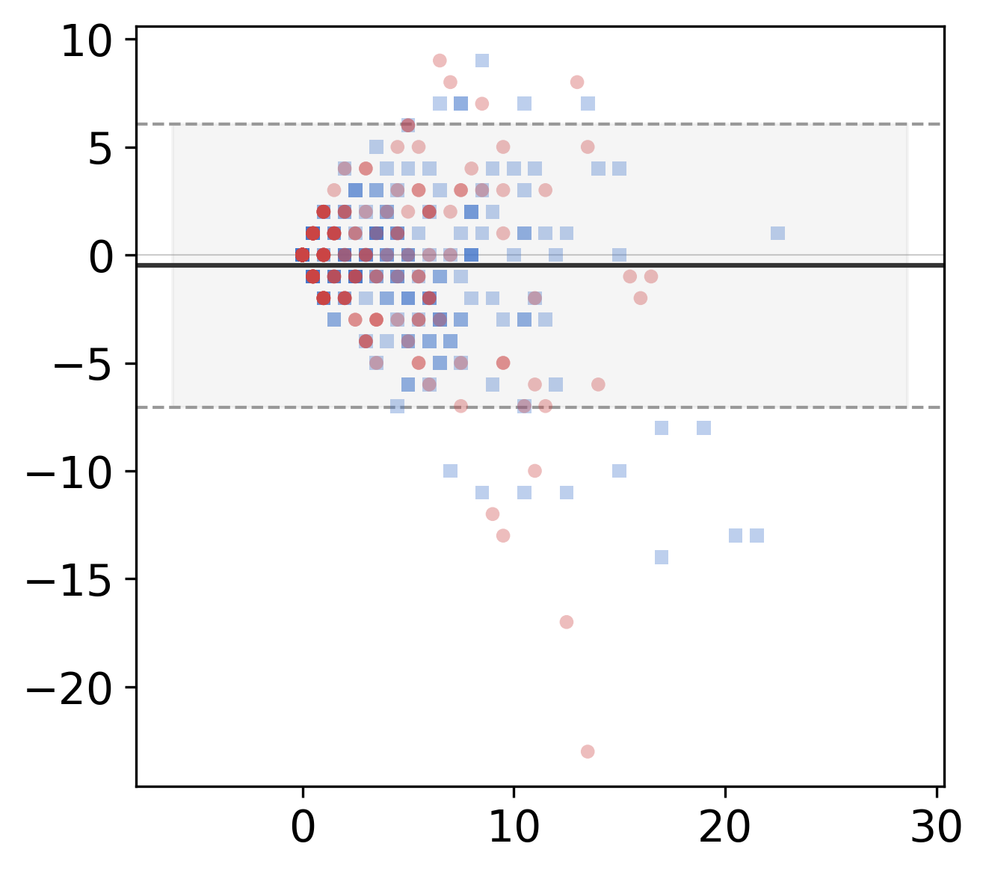
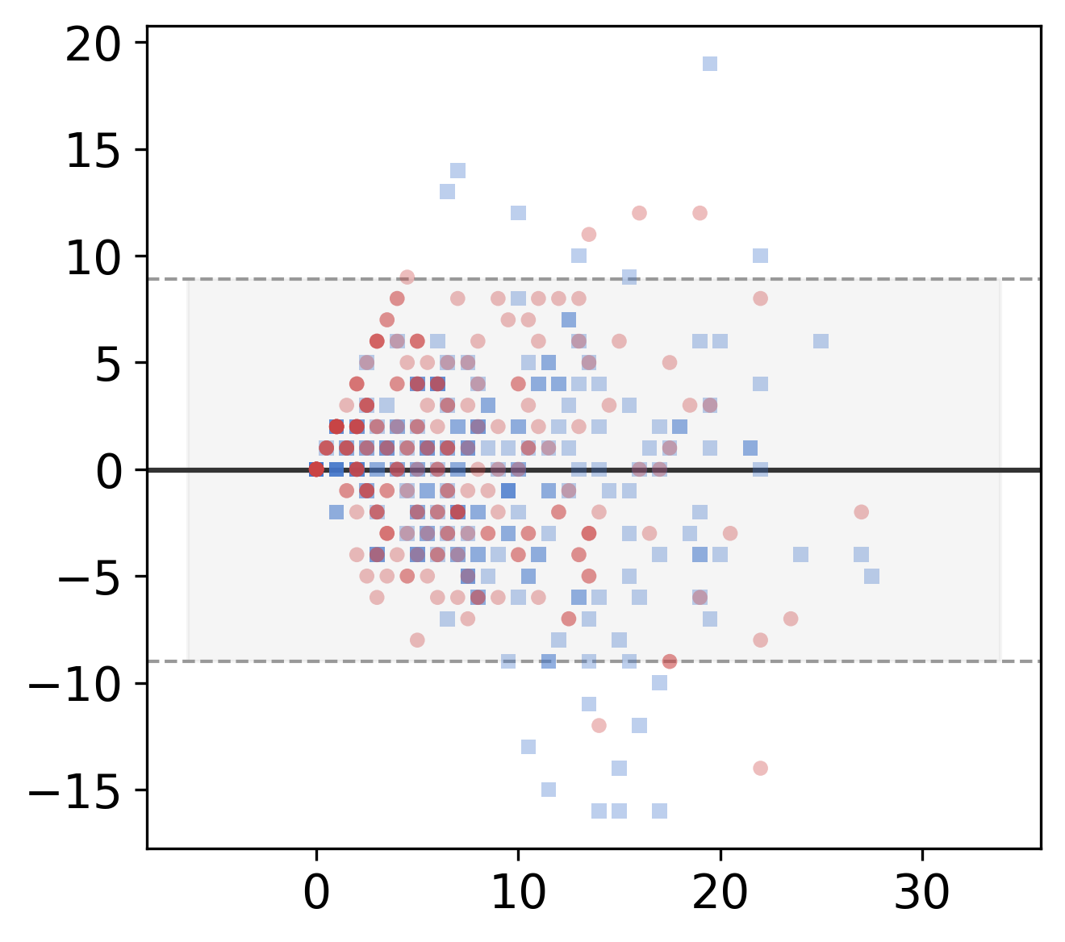
Per-layer Concordance: Junctions & Endpoints (Bland-Altman)
Count metrics (0-30 range): MAE + % within ±3 are more appropriate than R²
Junctions
Endpoints
See unified table on Slide 1 for all metrics
PBBDM
LBBDM
WGANGP
Pix2pix
LSGAN

Slide 3
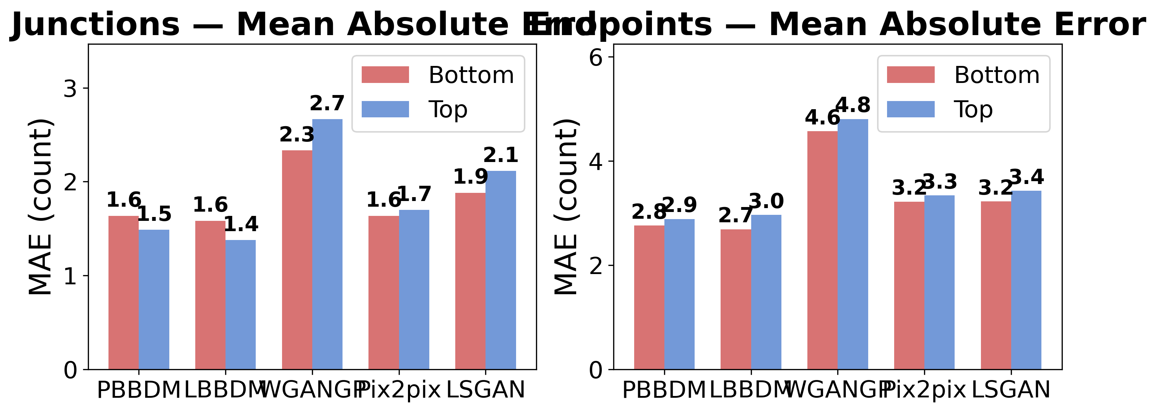
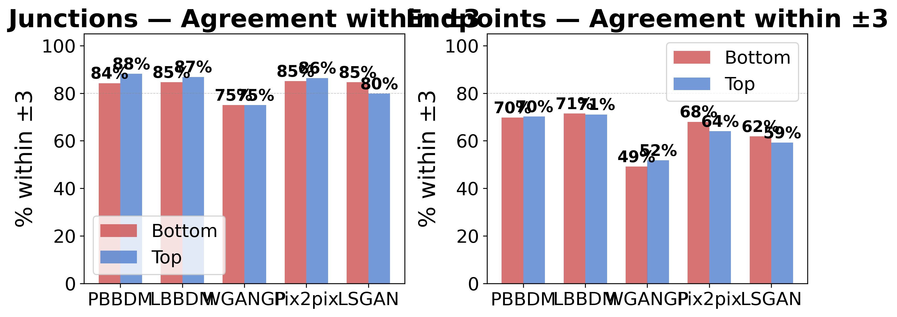
Summary: Per-layer Metric Comparison
Key Findings
1. Diffusion models (PBBDM, LBBDM) achieve JN MAE ≤ 1.6 with 84-88% agreement within ±3
2. GANs show 2-3× higher EP MAE (WGANGP: 4.6-4.8) indicating poor topological fidelity
3. Bottom (R>B) and Top (B>R) layers show consistent patterns across all models
4. Area/Length R² > 0.84 for diffusion models confirms strong morphometric concordance

