Slide 1
Supplementary Figure S2
Tangent-guided Gap Bridging Algorithm for Depth-separated Skeletons
A
Step 1
Step 2
Step 3
Step 4
Step 5
Endpoint
Detection
Tangent
Estimation
Candidate
Matching
Bézier
Interpolation
Score &
Select
neighbor
count = 1
→
trace 10–20 px
along skeleton
→
d < 80 px
cosθ > cos60°
overlap ≥ 70%
→
cubic Bézier
C₁ = P₁+0.4d·t₁
→
greedy
best-first
no reuse
B
Before
Bridging
After
t₂
→
→
t₁
gap
Bézier

Slide 2
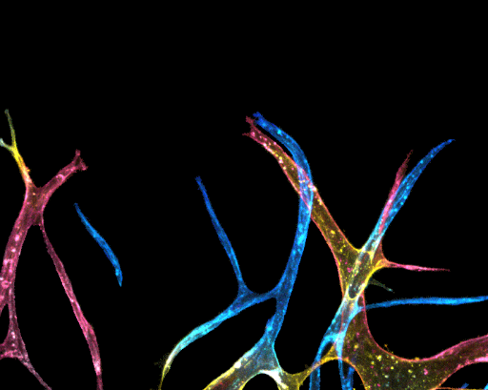
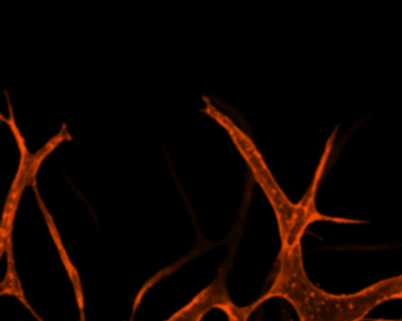
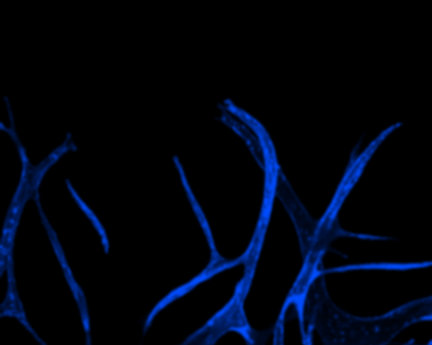
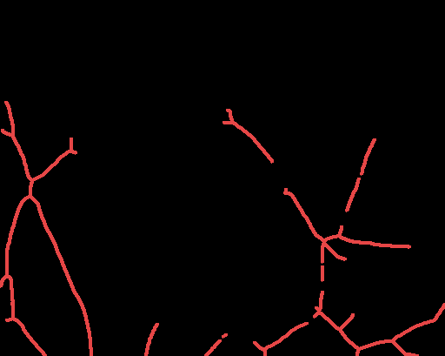
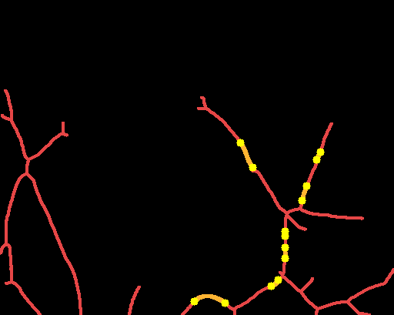
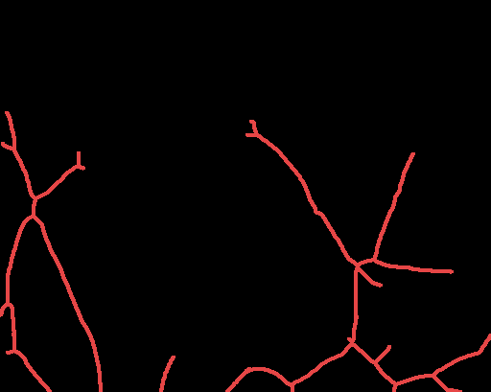
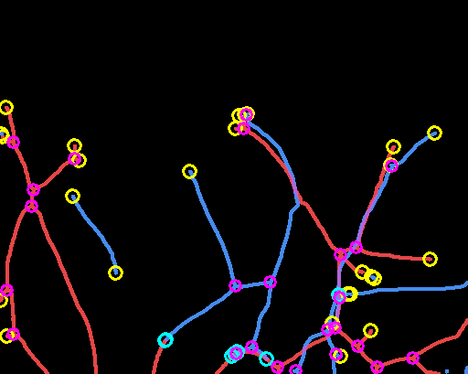
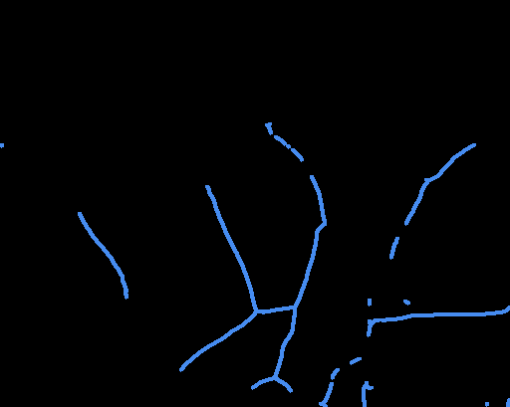
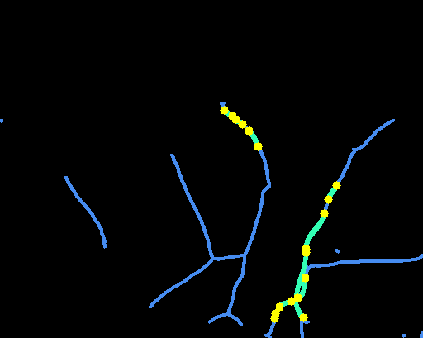
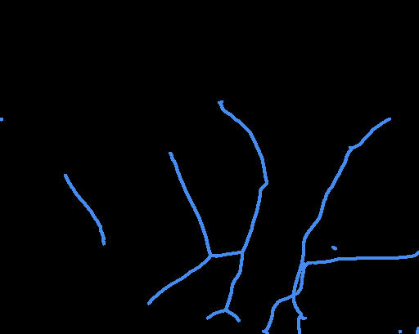
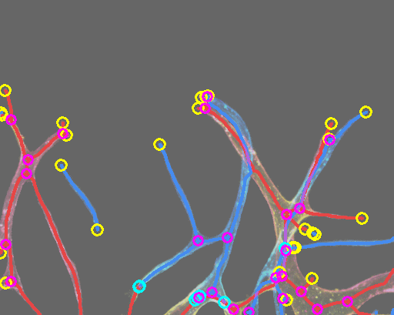
C Depth-separated Skeleton Bridging Results
Multi-color GT
R channel
B channel
Before
Bridging
After
Combined
R skel
(Bottom)
→
→
→
B skel
(Top)
→
→
Full image overlay

Slide 3
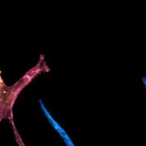
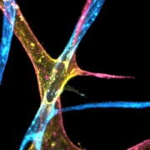
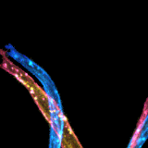
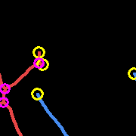
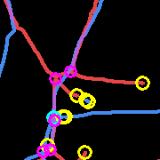
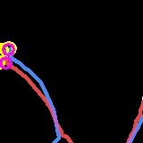
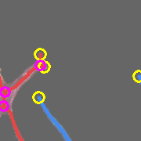
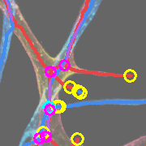
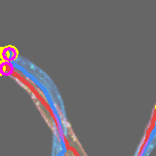
C (cont.) Zoomed Examples
Region 1 (left vessels)
Region 2 (crossing)
Region 3 (top area)
GT
Skeleton
GT + Skeleton
Red R skel Blue B skel Orange R bridge Teal B bridge Purple Overlap ○ EP ○ Conn. ○ JN

