Slide 1
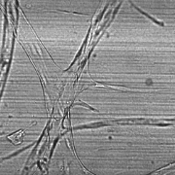
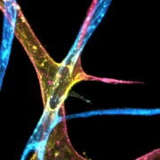
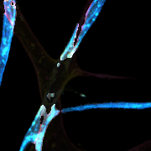
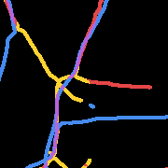
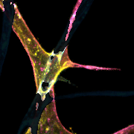
E
Single-plane
Brightfield
Generative
Model
Depth-encoded
Fluorescence
Depth-layer
Separation
Per-layer
Morphometrics
LBBDM
Top (B>R)
→
→
→
→
Latent
Brownian Bridge
Diffusion Model
Virtual
Staining
RGB Channel
Separation
Skeletonize
& Quantify
Bot (R>B)
Vessel Area
Vessel Length
Junctions
Endpoints
Red Bottom Yellow Middle Blue Top Purple Overlap

