Slide 1
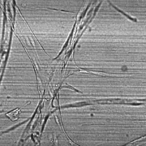
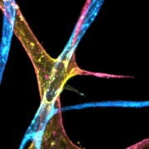
E
Single-plane Brightfield
Depth-encoded Fluorescence
Depth-separated Skeletonization & Quantification
Top layer (B>R)
Per-layer
Metrics
LBBDM
• Vessel Area
• Vessel Length
Virtual Staining
RGB
Separation
• Junctions
crossing
resolved
• Endpoints
Bottom layer (R>B)
● Junction ● Endpoint ── Top skel ── Bottom skel

