Slide 1
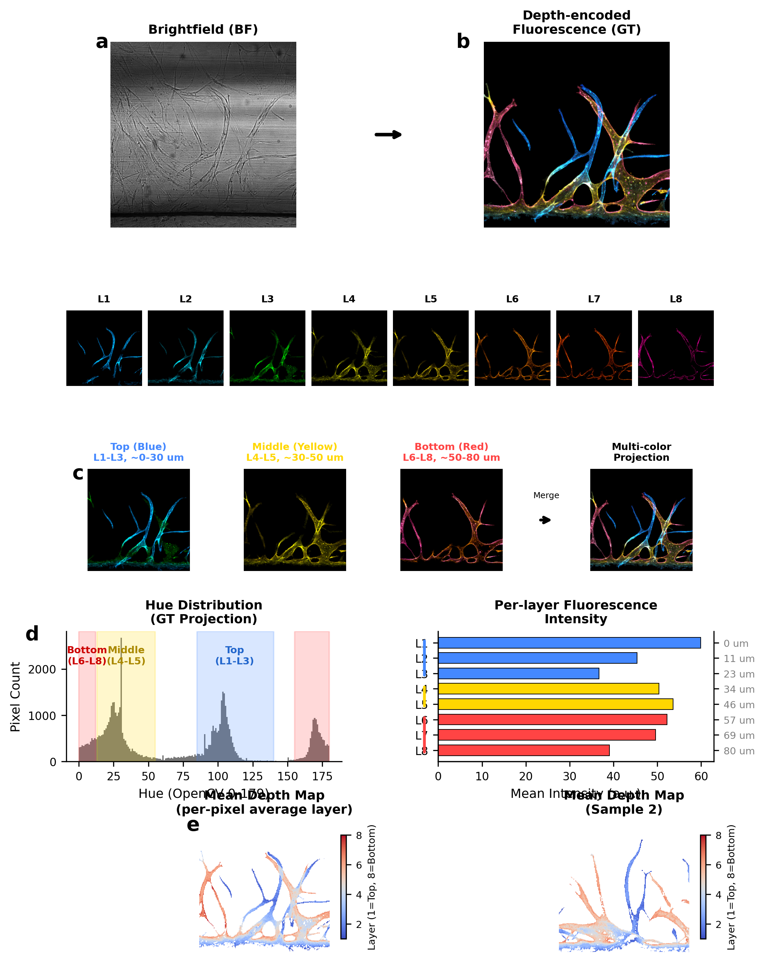
Multi-color depth-encoded fluorescence dataset. (a) BF to depth-encoded GT showing vessel network with color-coded depth information. (b) 8 individual z-layers with distinct color assignments spanning 0-80 µm MPS height. L1-L3: Top layer (Blue, 0-30 µm), L4-L5: Middle layer (Yellow, 30-50 µm), L6-L8: Bottom layer (Red, 50-80 µm). (c) Layer group merging to multi-color maximum intensity projection. (d) Hue distribution confirming separable depth-color encoding, and per-layer fluorescence intensity profile. (e) Mean depth maps showing spatial depth distribution across two representative samples.

