Slide 1
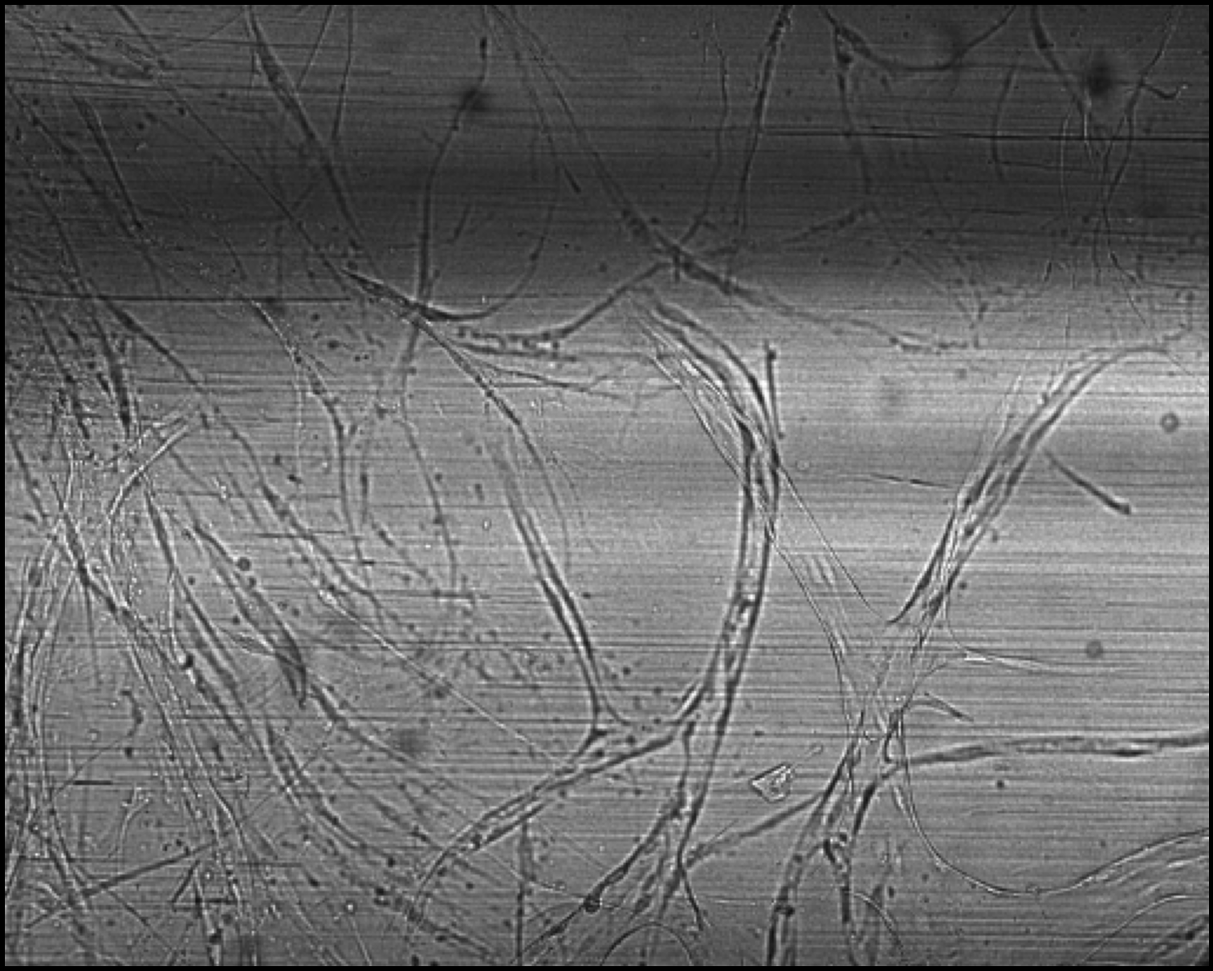
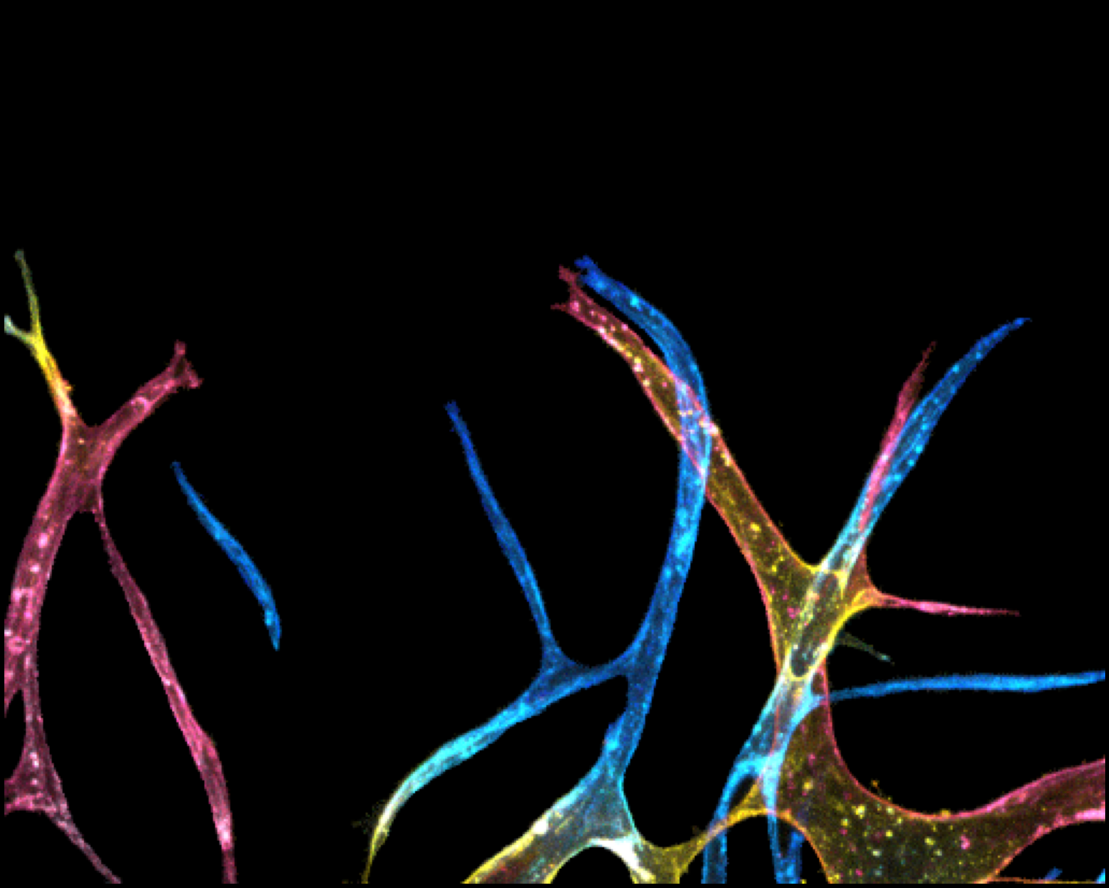

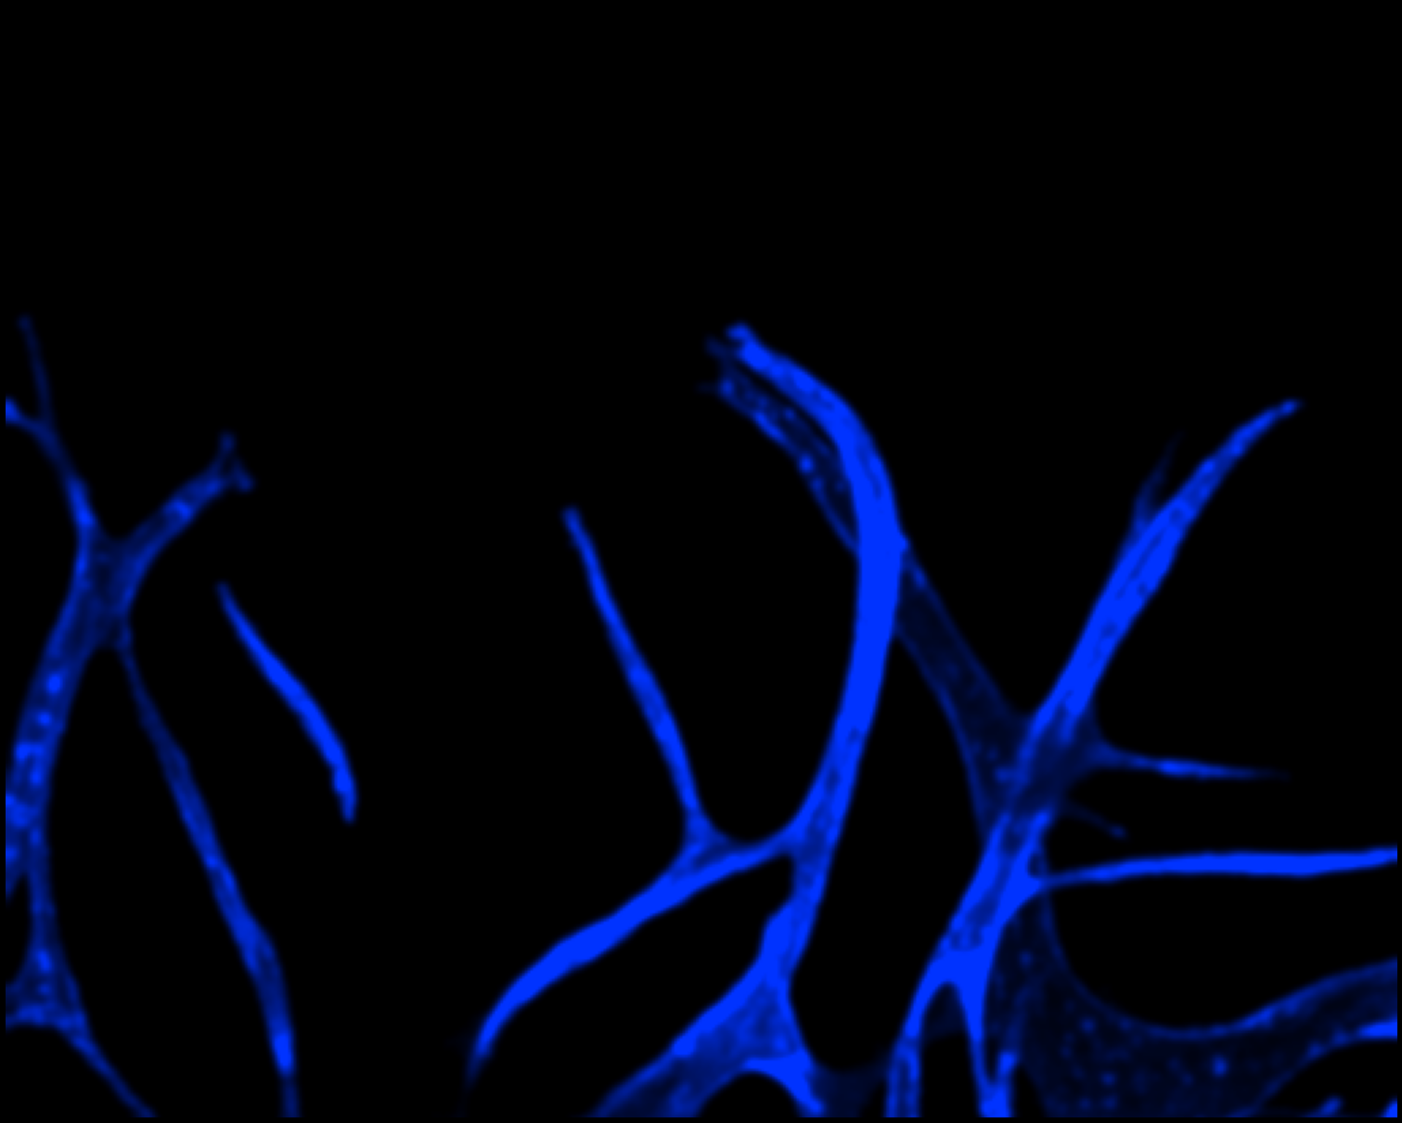

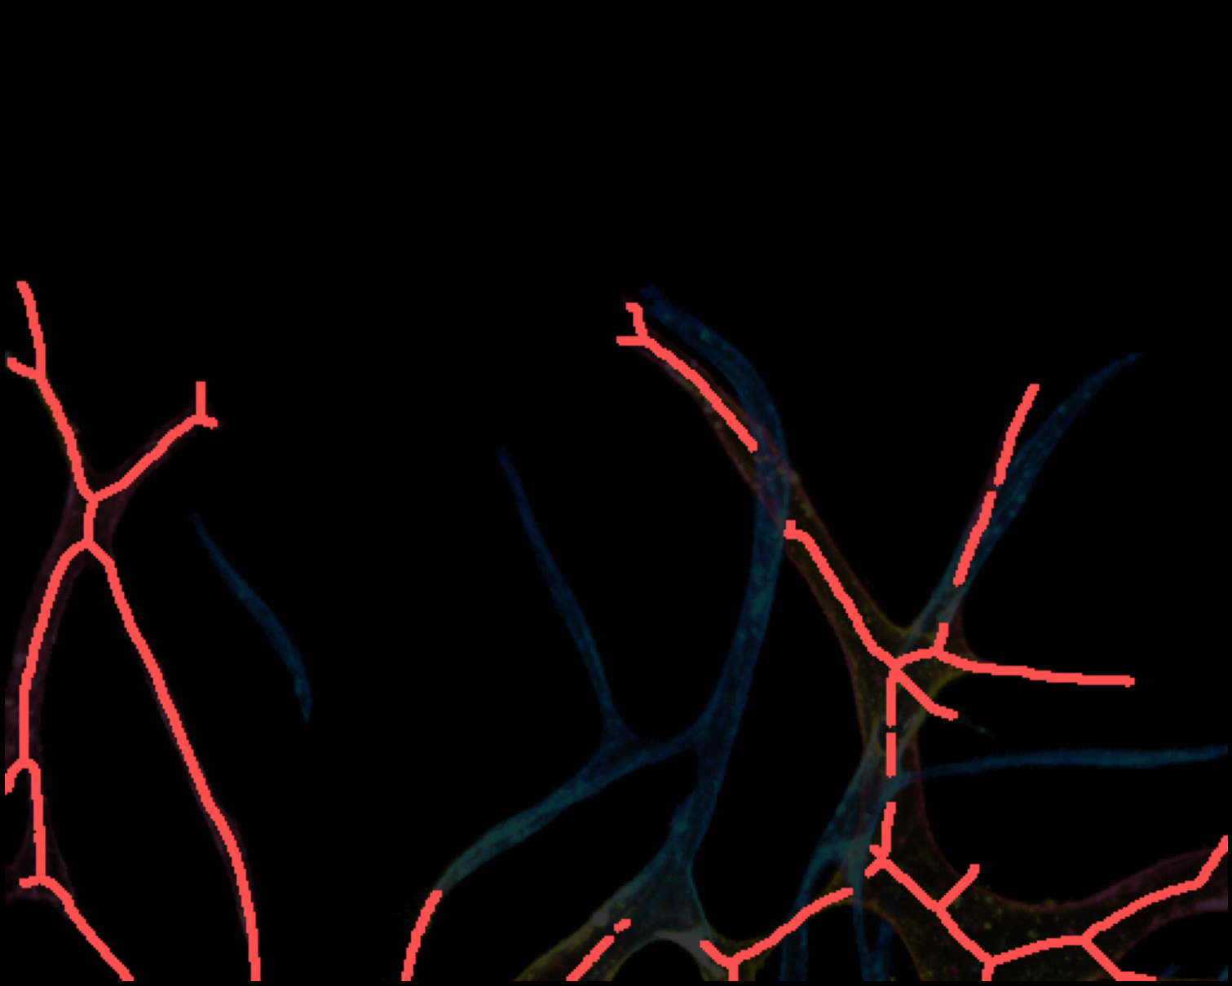
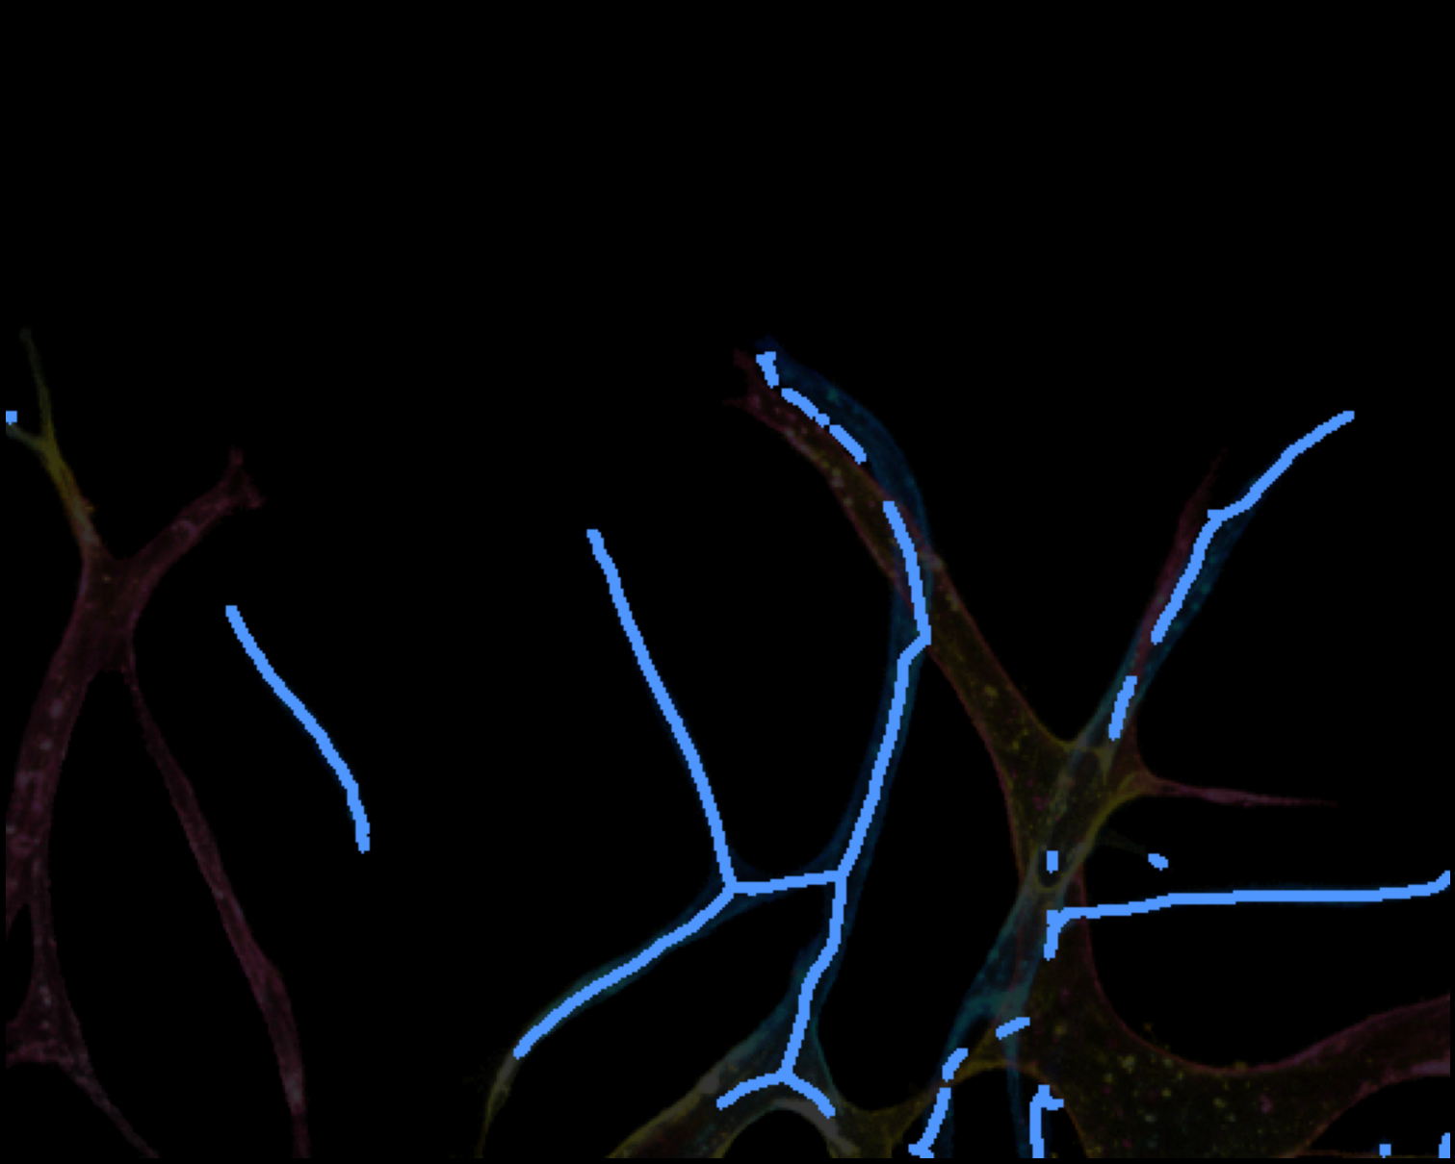
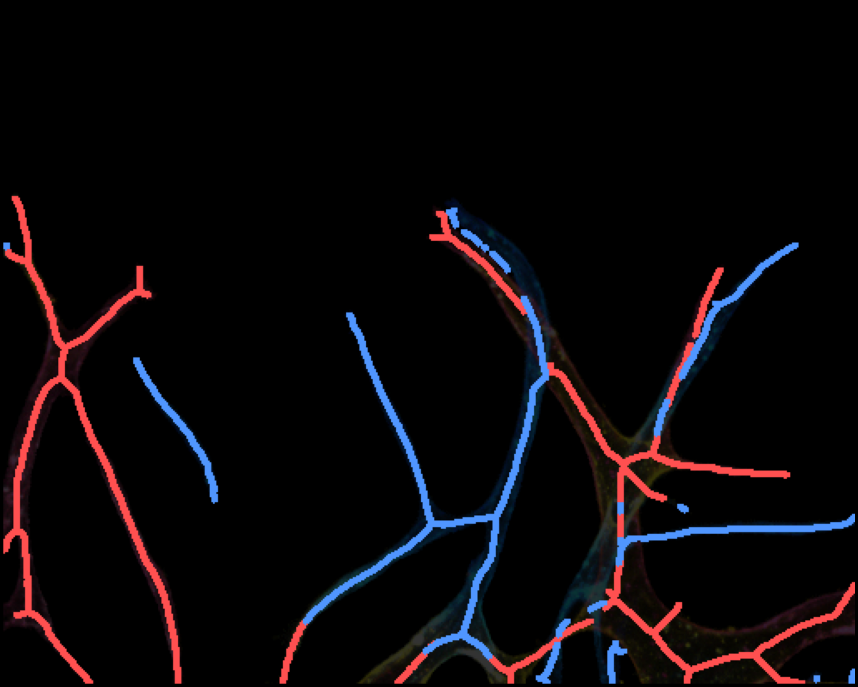
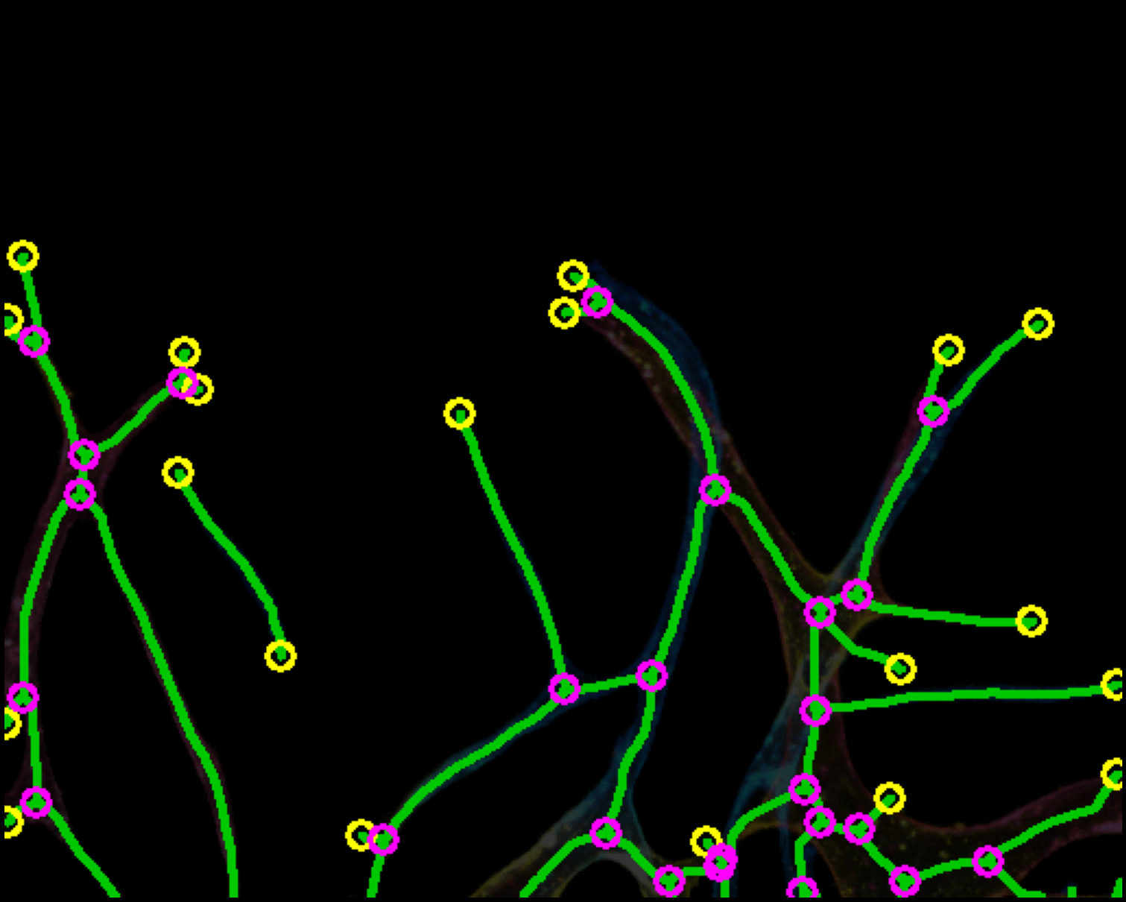
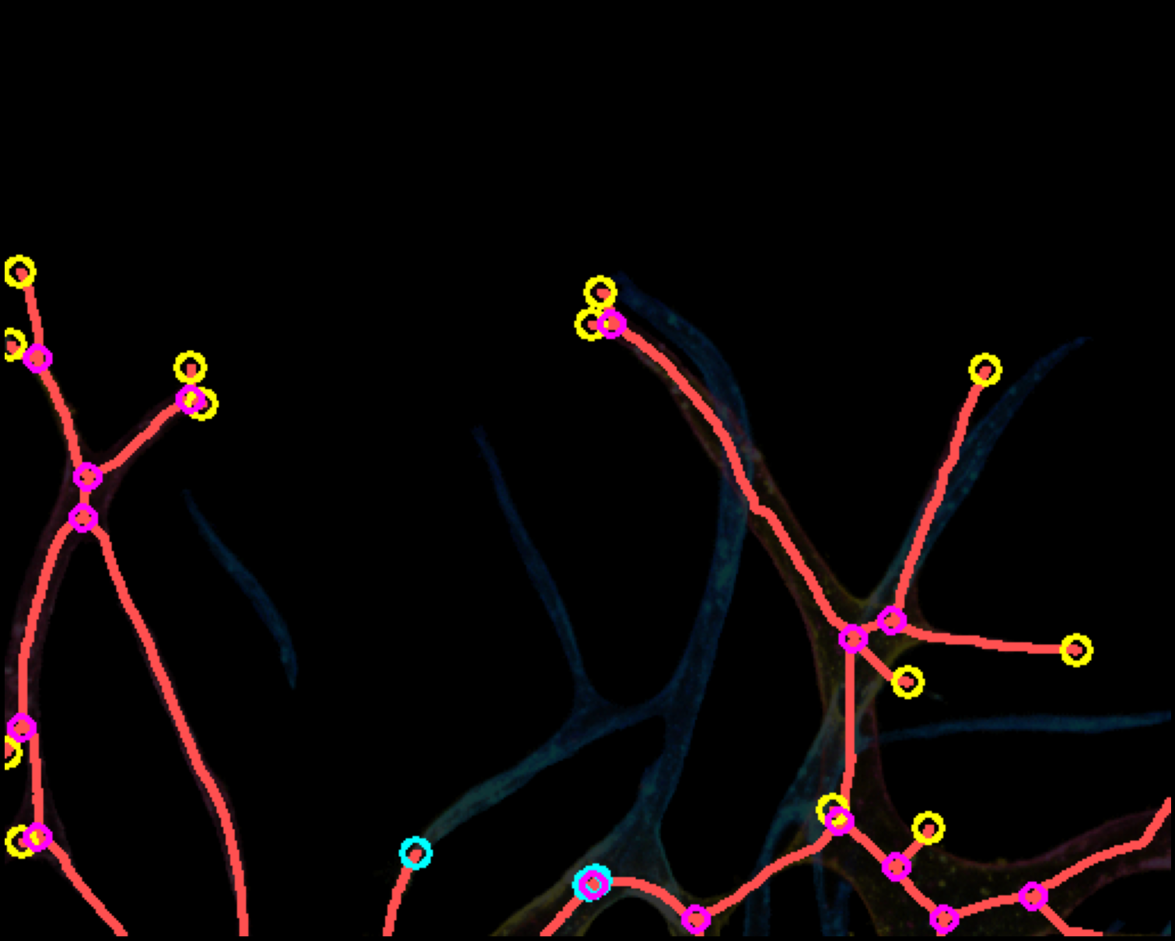
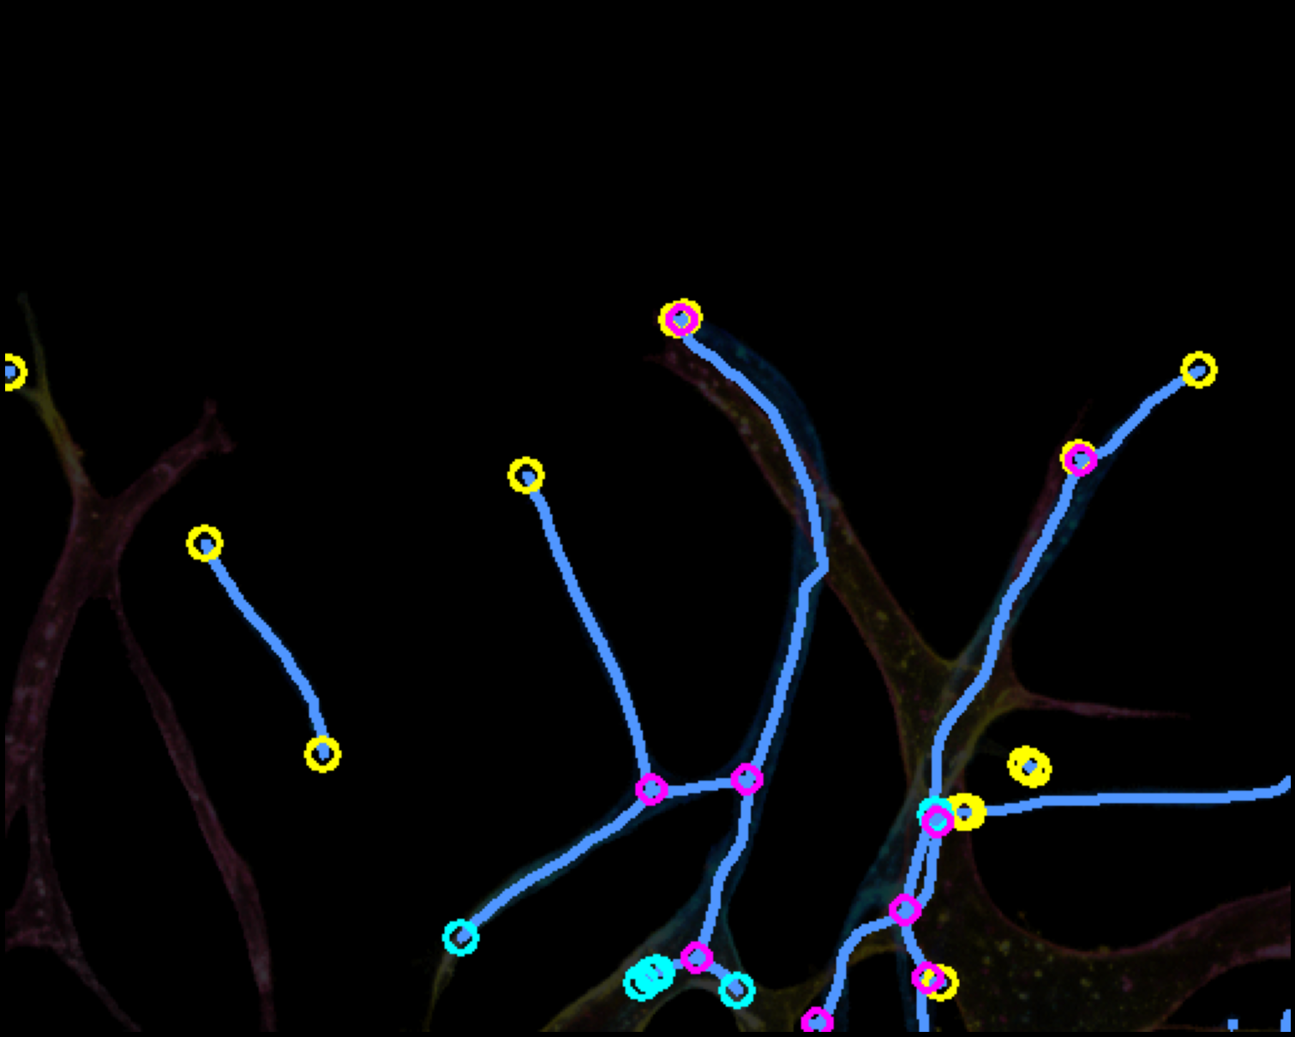
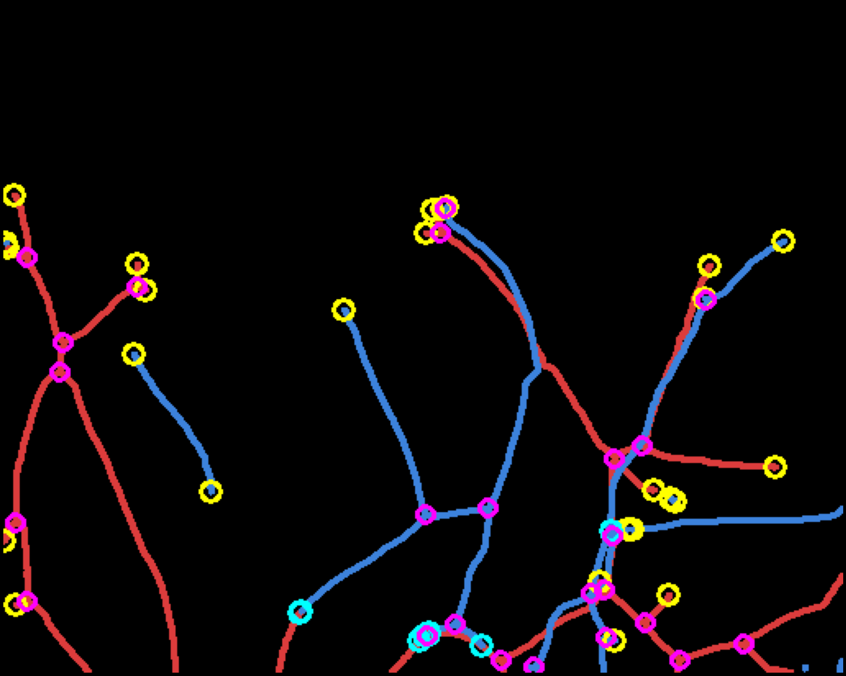
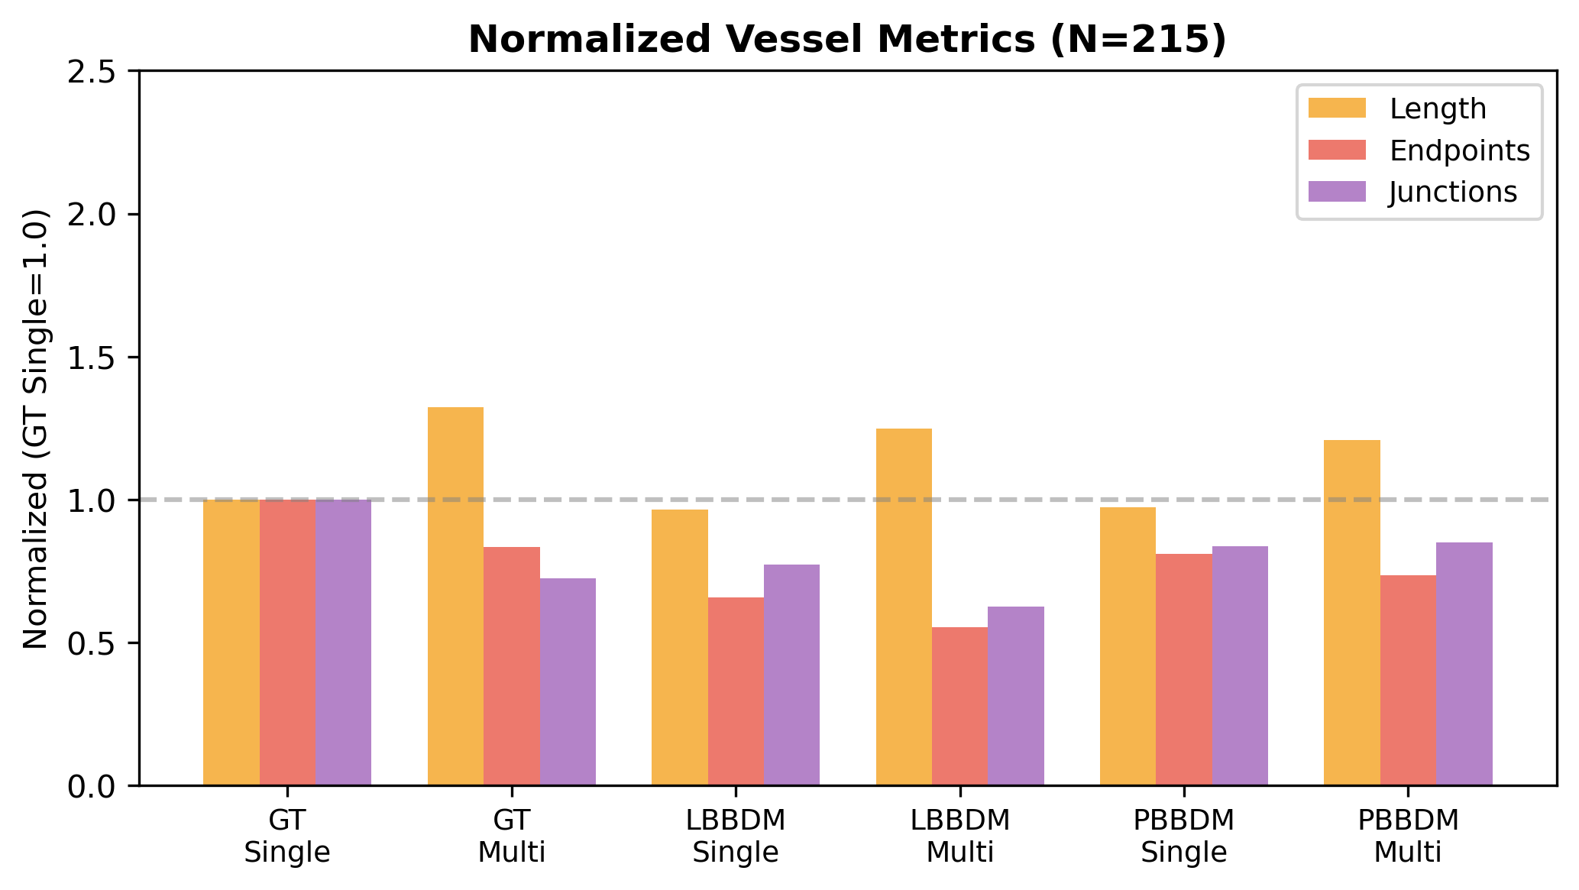
Depth-aware Vessel Network Analysis Pipeline
(a) Brightfield
(b) Multi-color GT
(c) R channel (bottom)
(d) B channel (top)
(e) Dominance map
(f) R skeleton (R>B)
(g) B skeleton (B>R)
(h) R+B overlay
(i) Single GT skel
(j) R bridged
(k) B bridged
(l) R+B final
(m) Normalized metrics (N=215)
(n) Sample 1 Quantification (top 80%)
 | Length | EP | JN
Single GT | 2268 | 20 | 25
R (R>B) | 1459 | 16 | 15
B (B>R) | 1166 | 19 | 9
R+B sum | 2625 | 35 | 24
R+B real EP |  | 26
Yellow = Real EP Cyan = Connected EP Magenta = Junction

