Slide 1
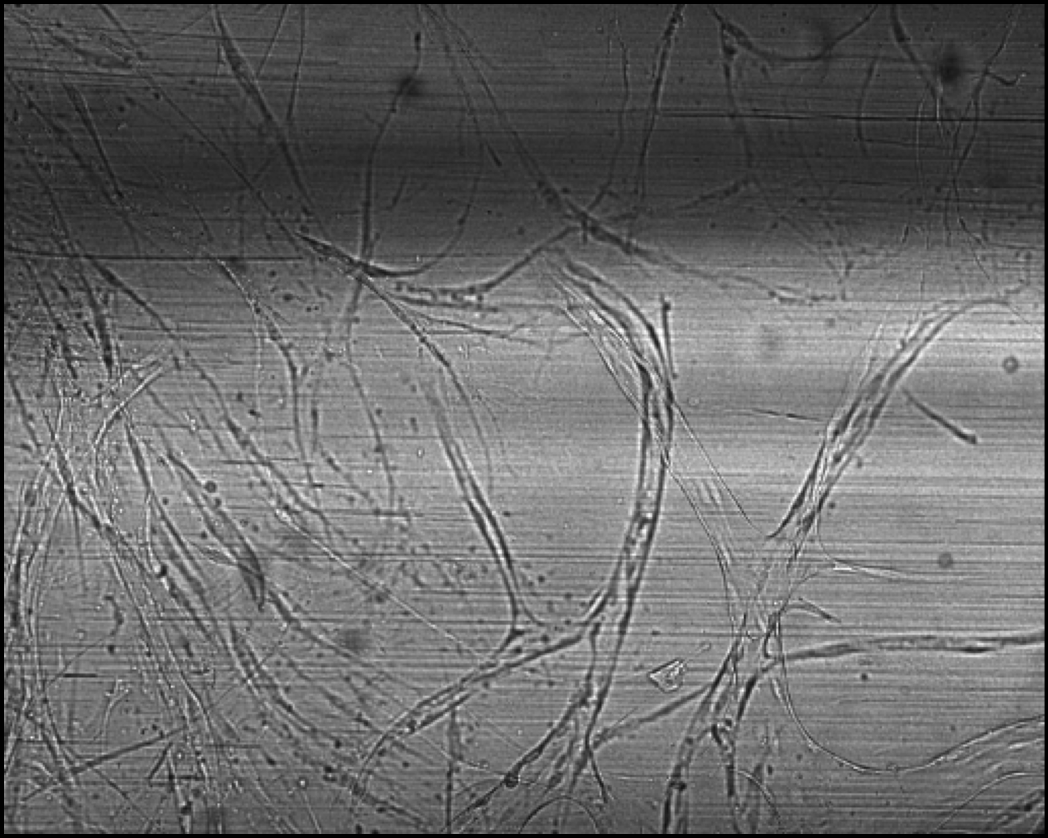
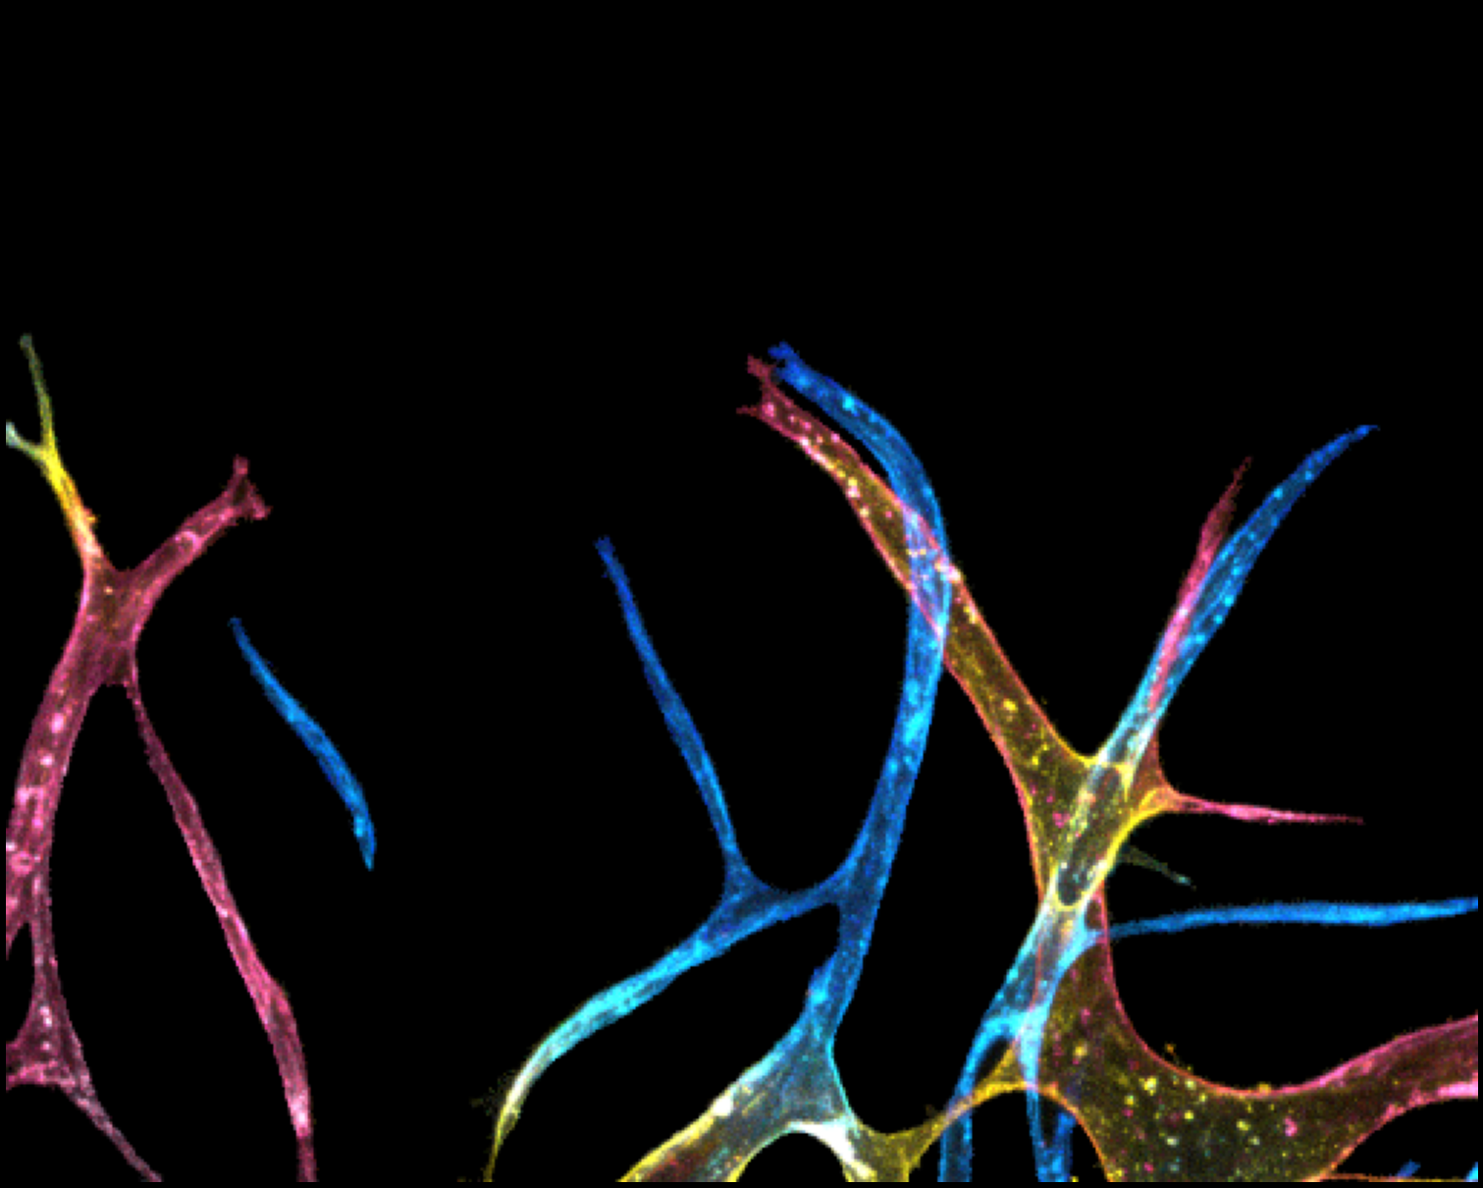
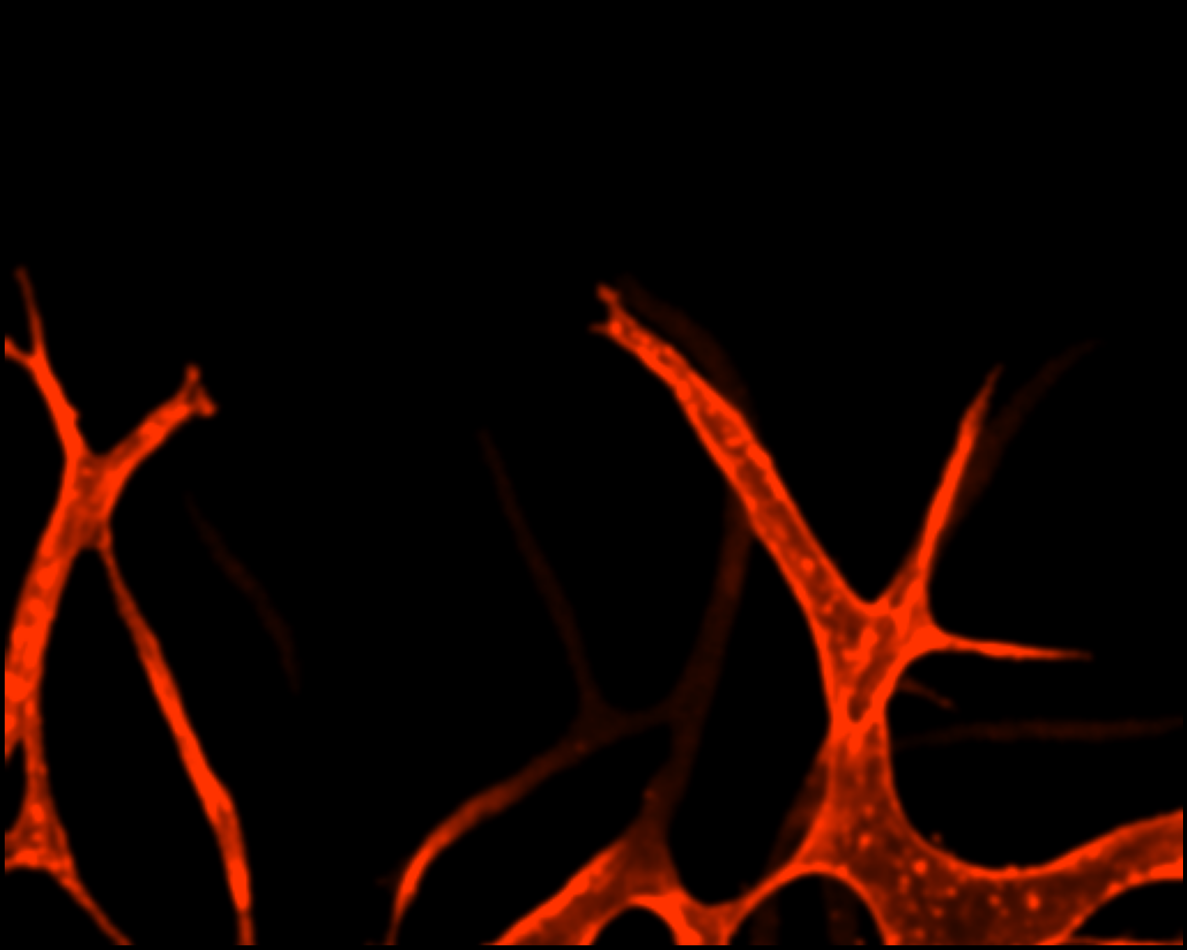
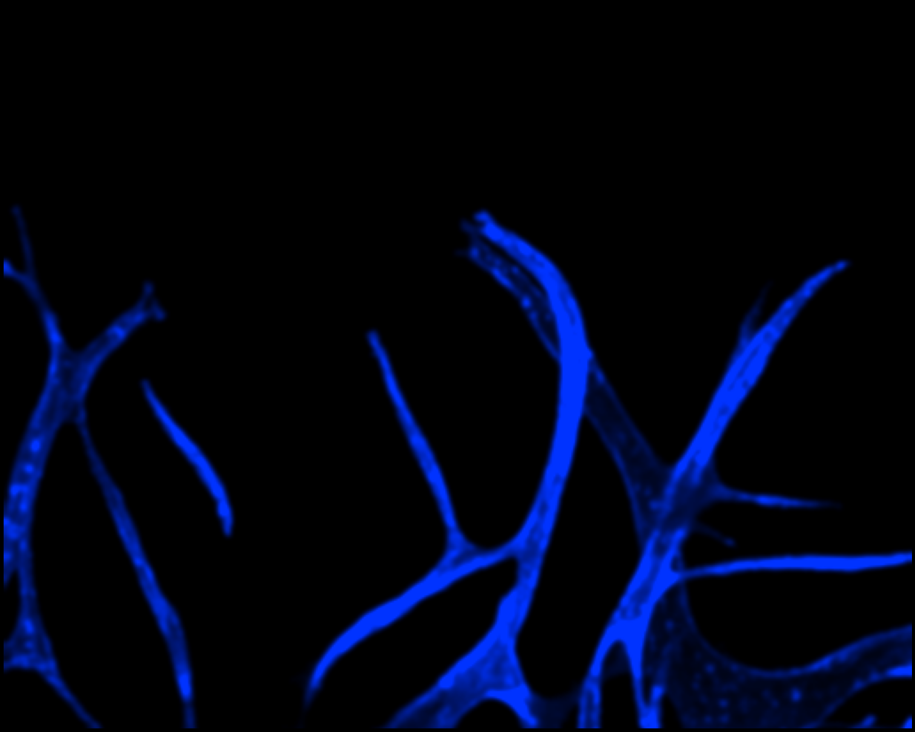

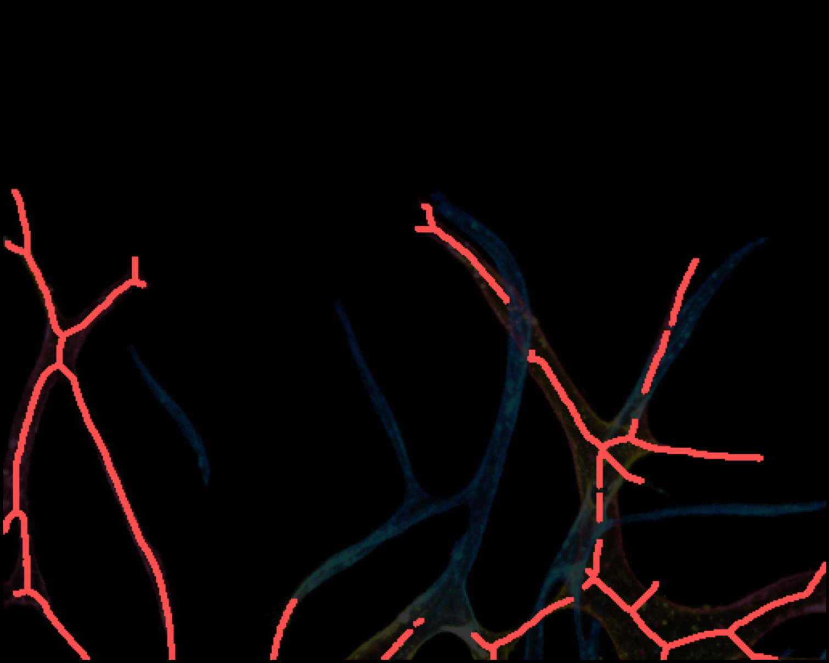
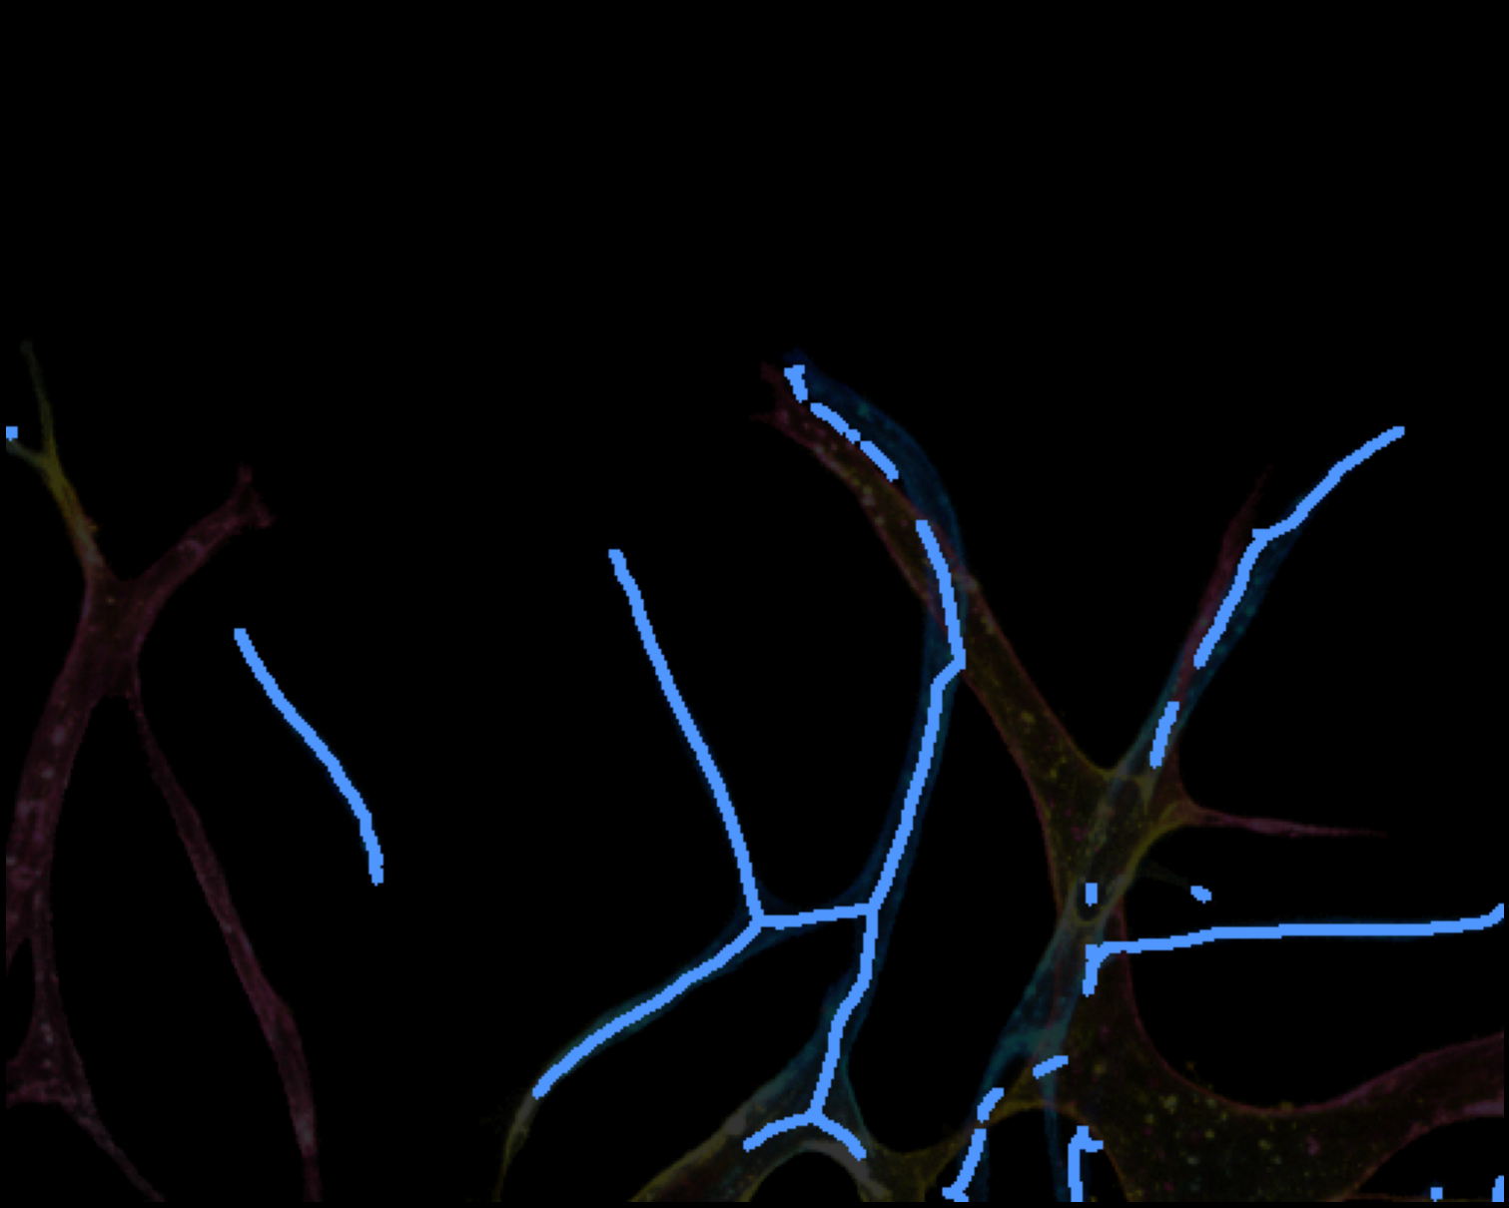
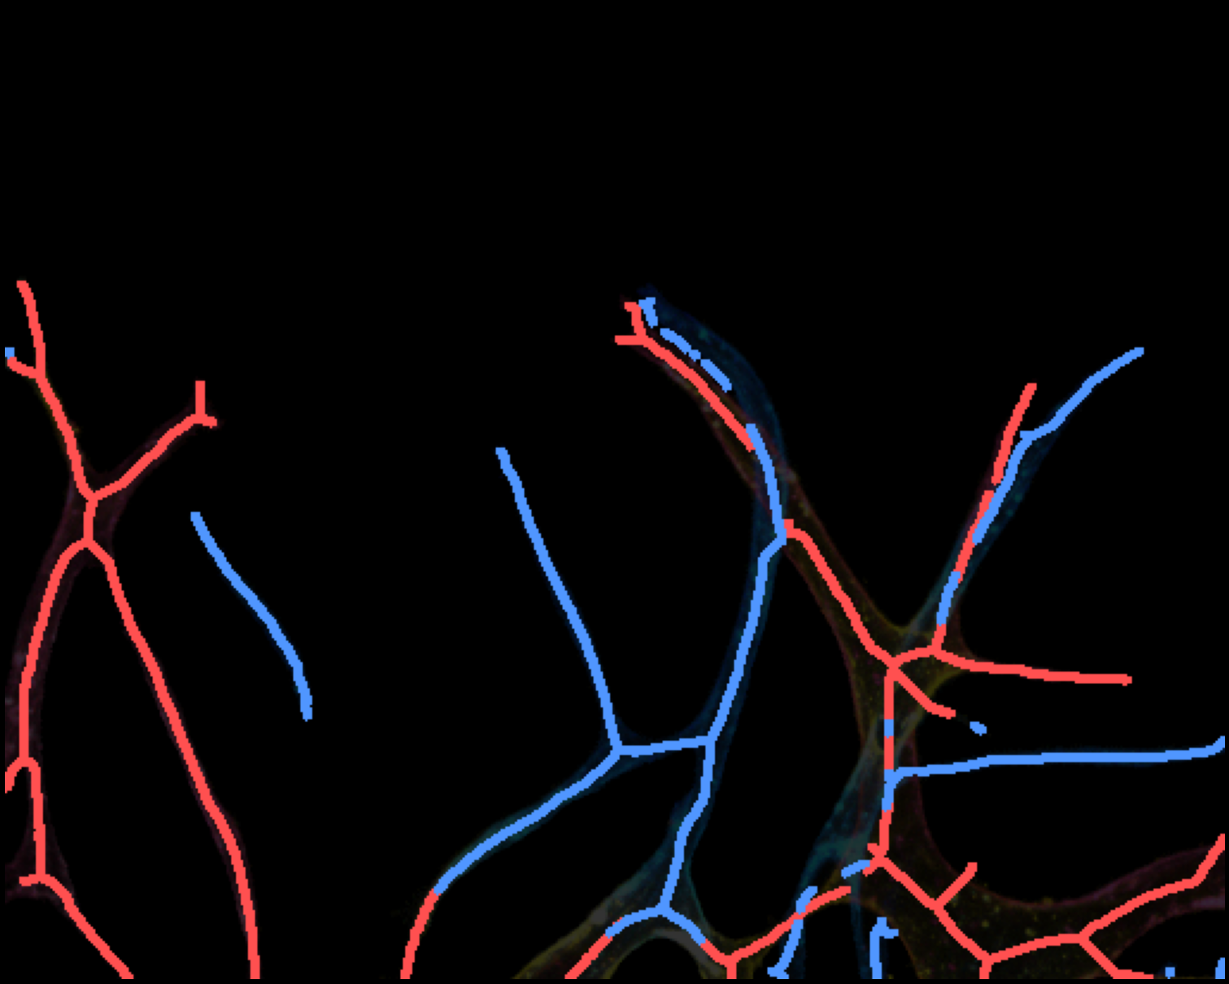
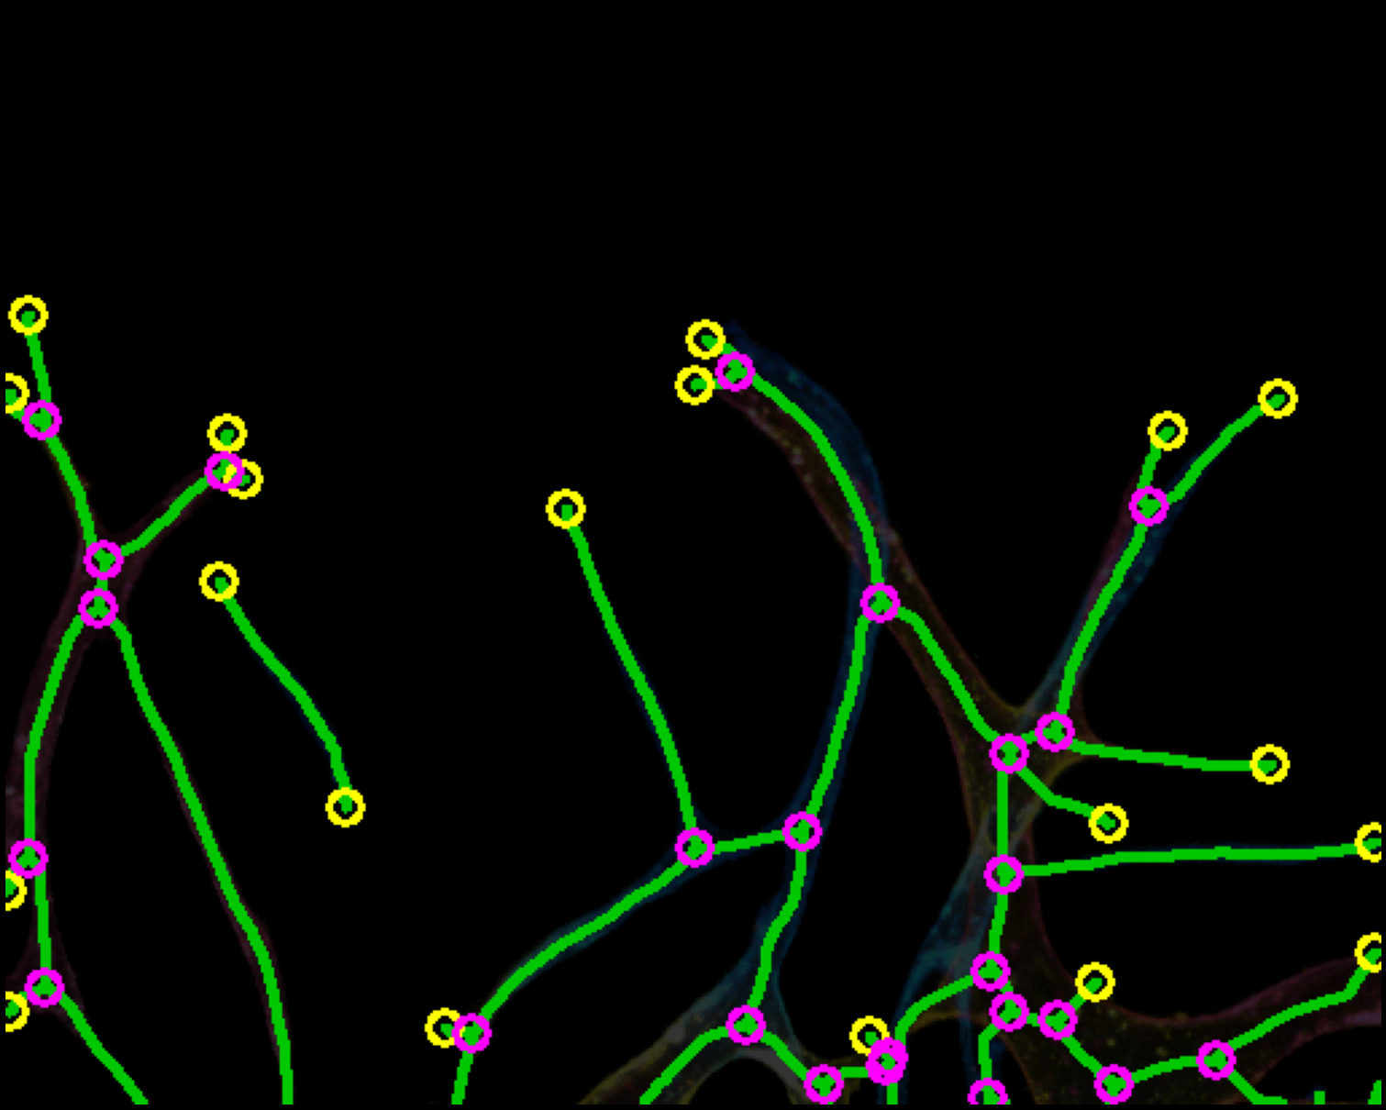
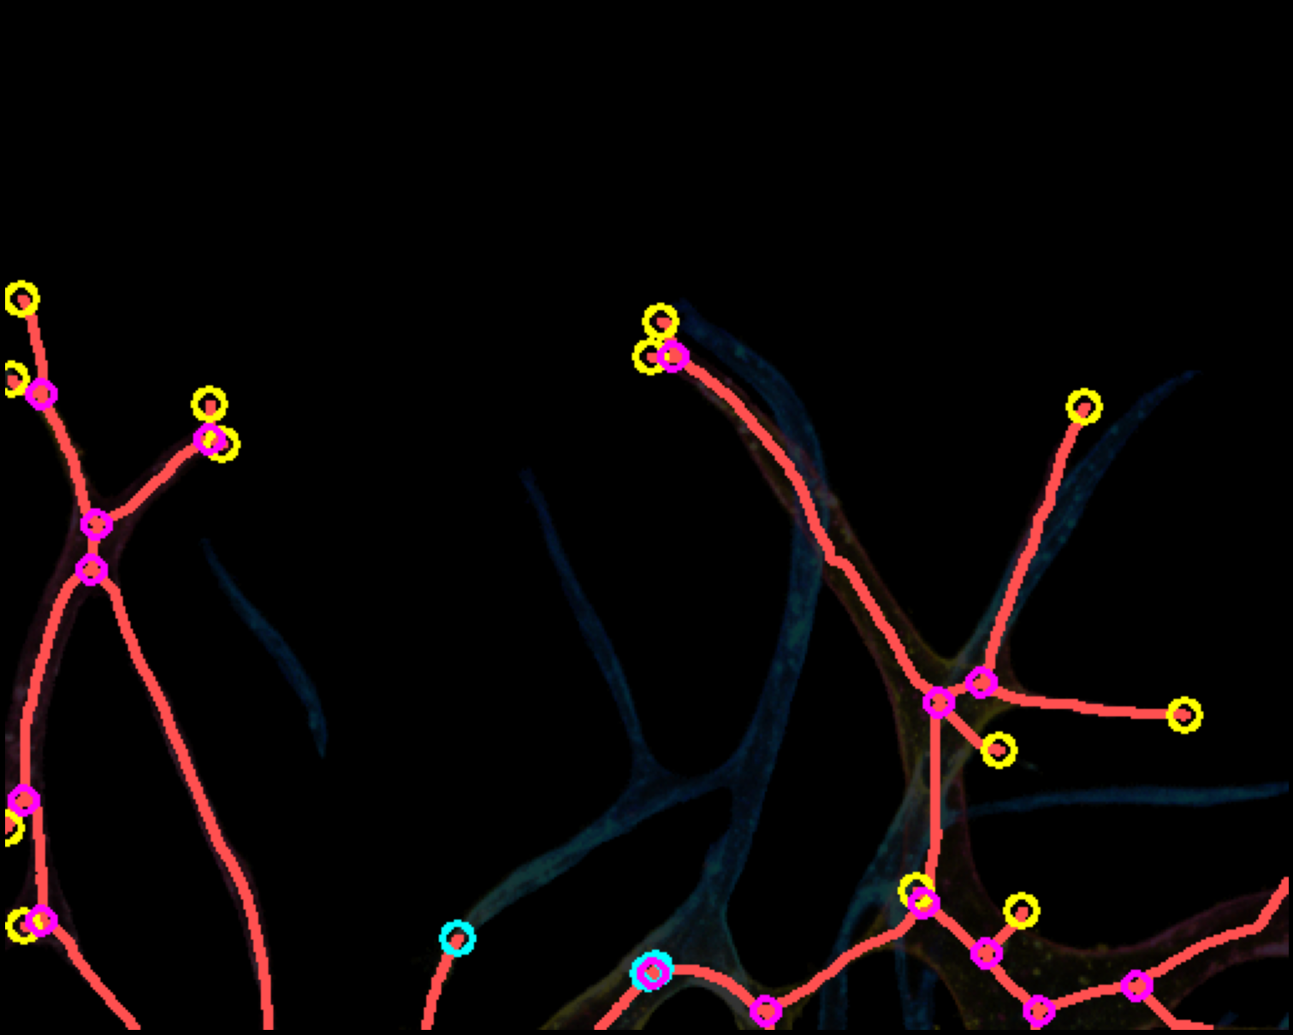
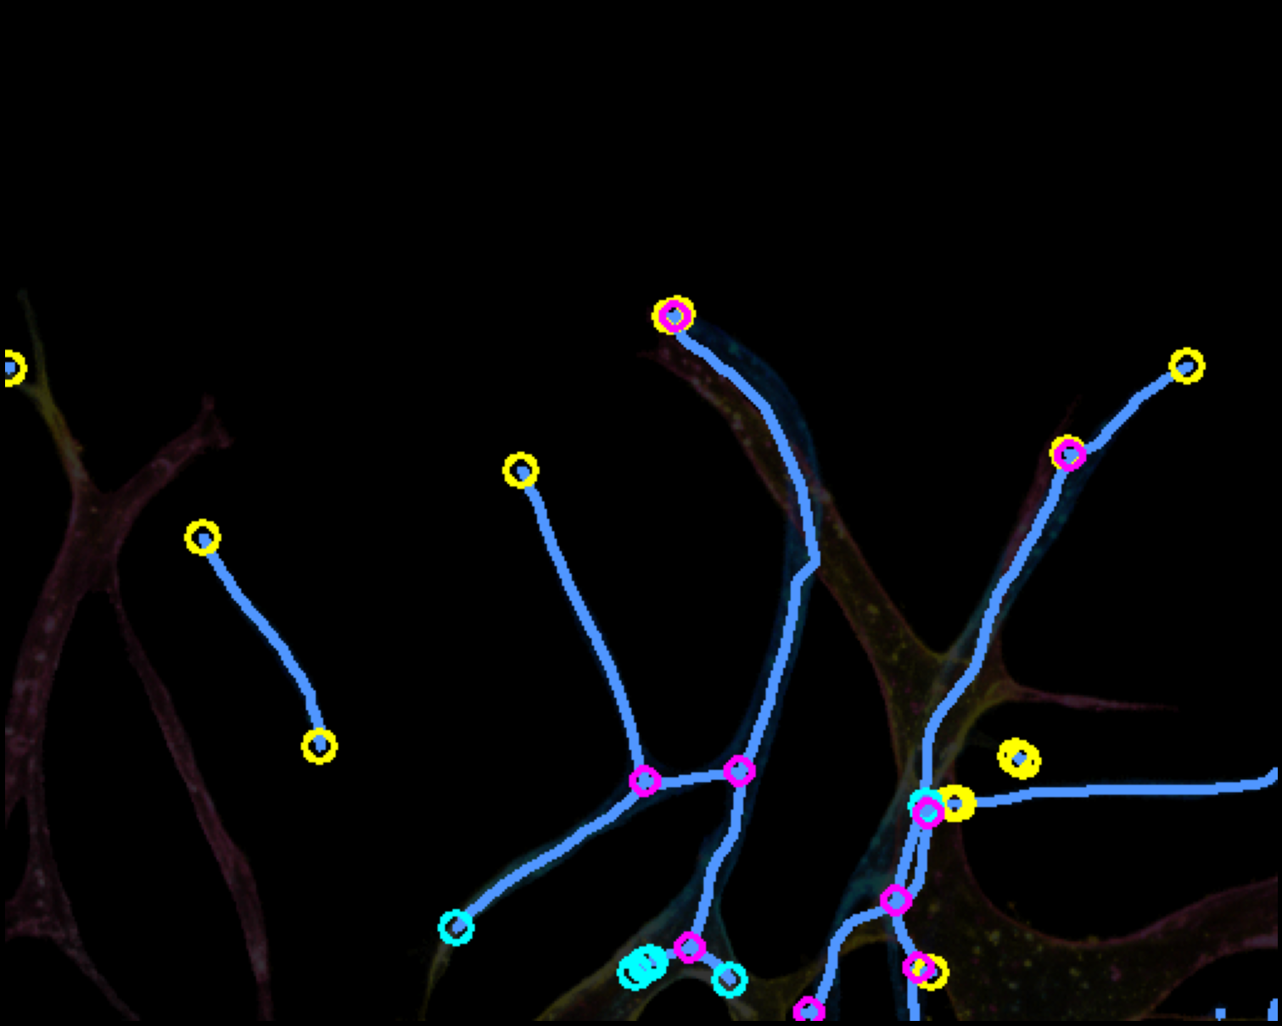
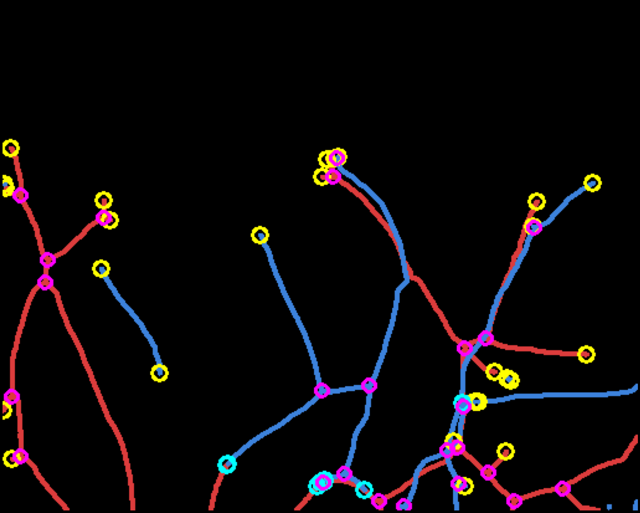
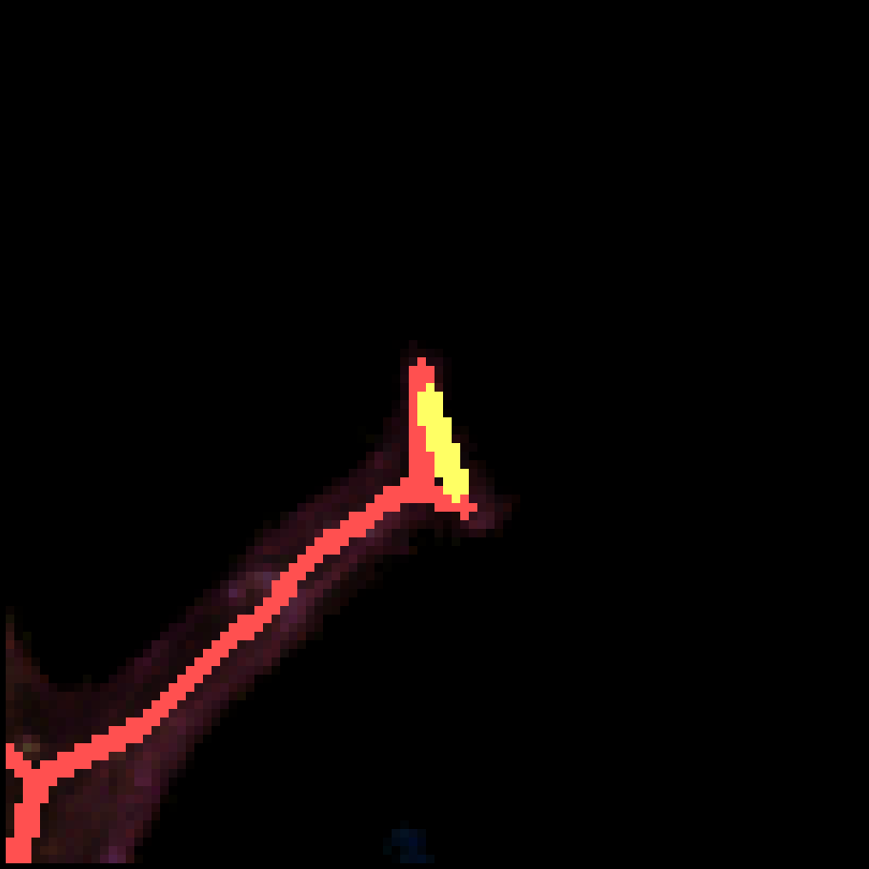
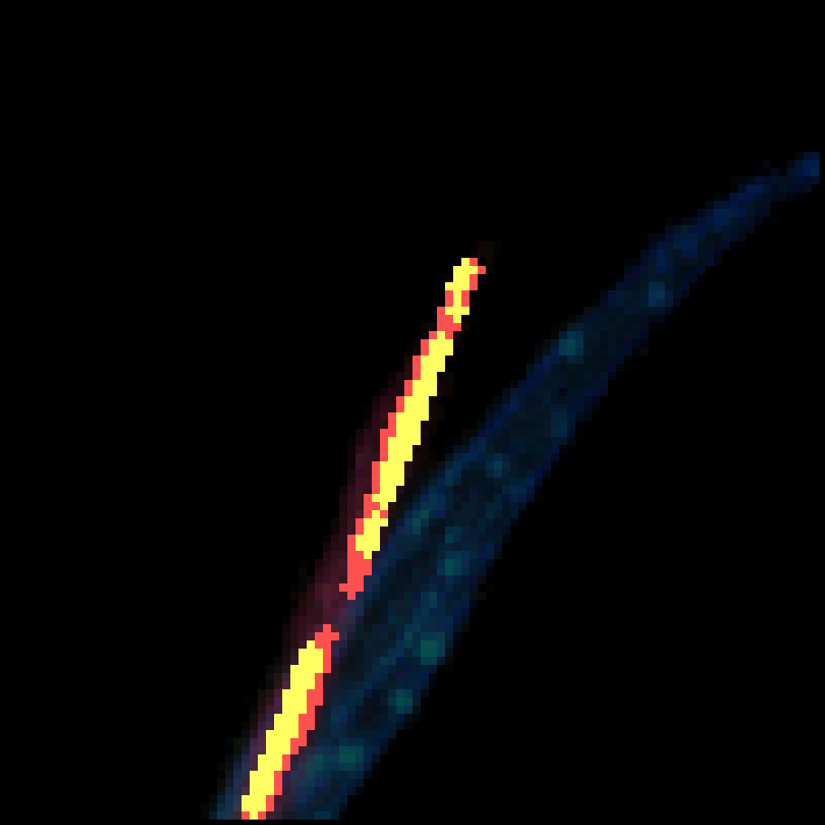
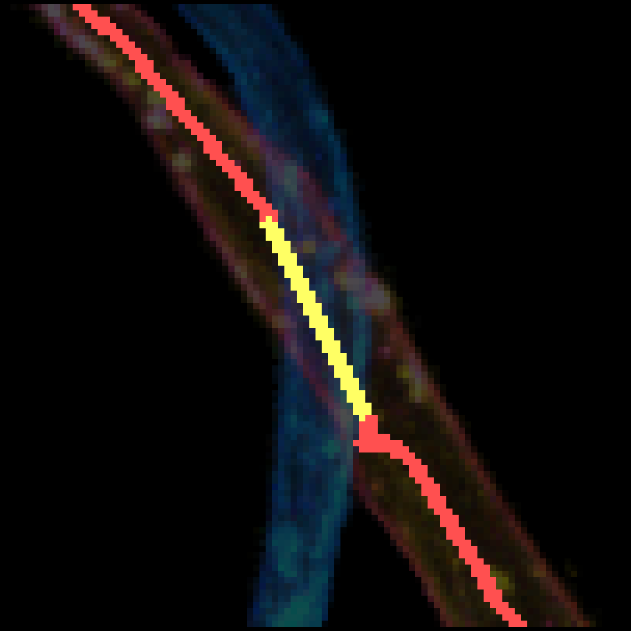

Depth-aware Vessel Network Analysis Pipeline
(a) Brightfield input
(b) Multi-color GT
(c) R channel
(d) B channel
Input
(e) R-B dominance
(f) R skel (R>B)
(g) B skel (B>R)
(h) R+B overlay
Separation
(i) Single GT skel
(j) R bridged
(k) B bridged
(l) R+B combined
Skeleton
(m) Bridging Detail (yellow = bridged gap)
Bridging
Red = R skel Blue = B skel Yellow = Bridged gap Magenta = Junction Yellow dot = Real EP Cyan dot = Connected EP

Slide 2
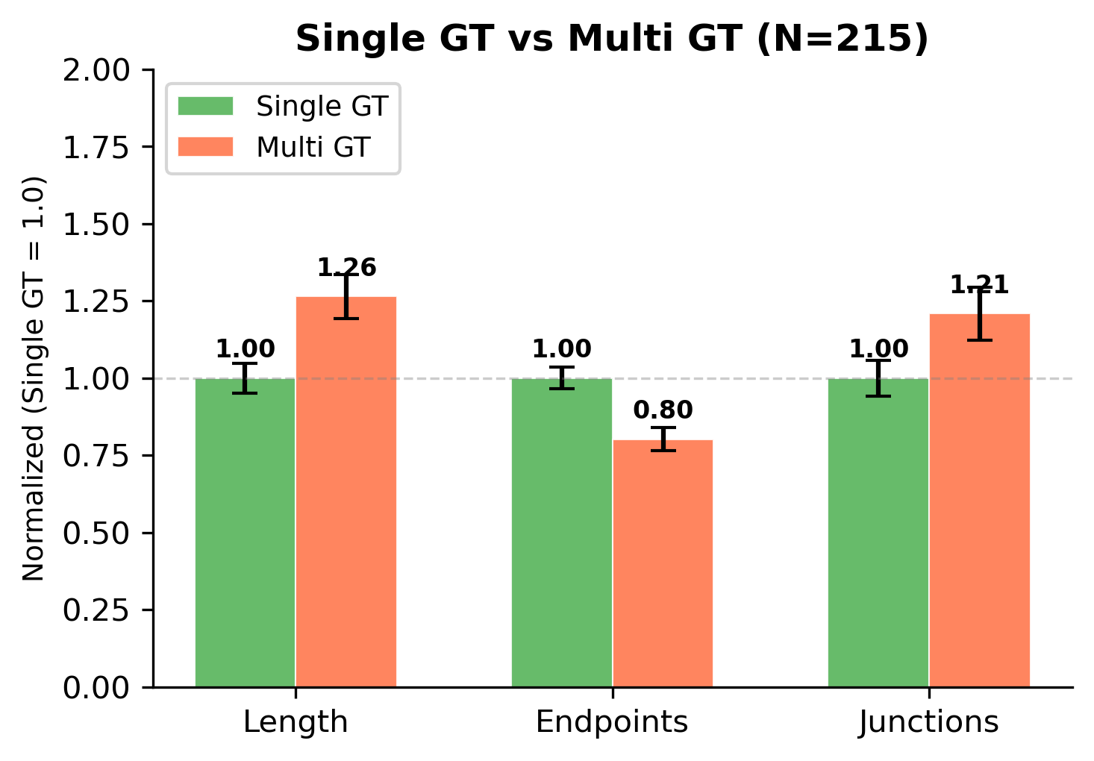
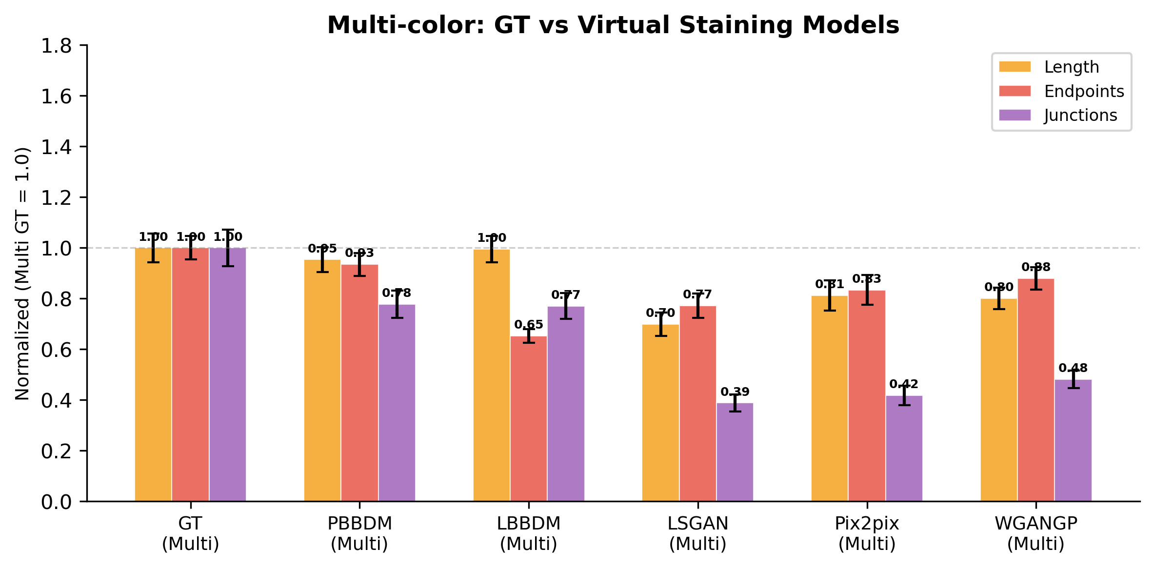
Vessel Network Quantification
(a) Single GT vs Multi GT (N=215)
(b) Multi-color GT vs Virtual Staining Models
(c) Normalized Metrics Summary (Multi GT = 1.0)
Model | Length | Endpoints | Junctions
GT (Multi) | 1.00 | 1.00 | 1.00
PBBDM | 0.95 | 0.93 | 0.78
LBBDM | 1.00 | 0.65 | 0.77
WGANGP | 0.80 | 0.88 | 0.48
Pix2pix | 0.81 | 0.83 | 0.42
LSGAN | 0.70 | 0.77 | 0.39
PBBDM achieves closest match to GT across all metrics

