Slide 1
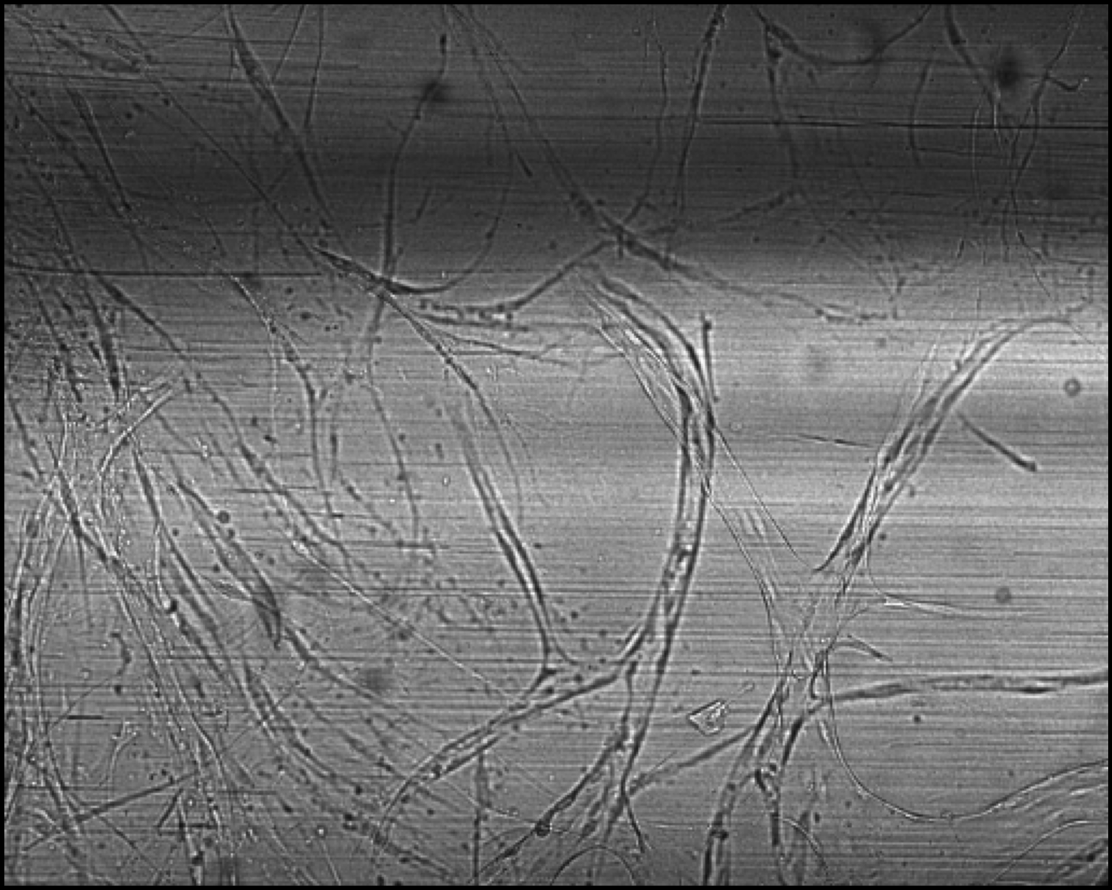
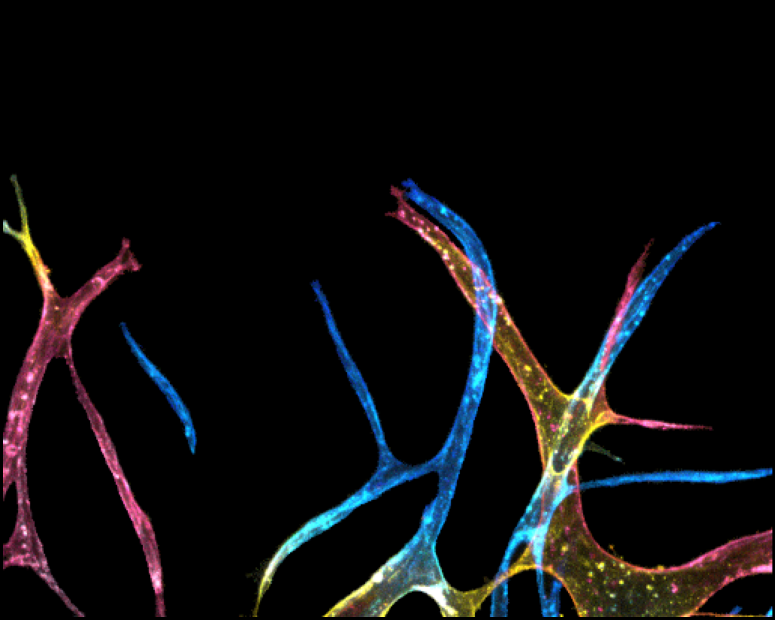
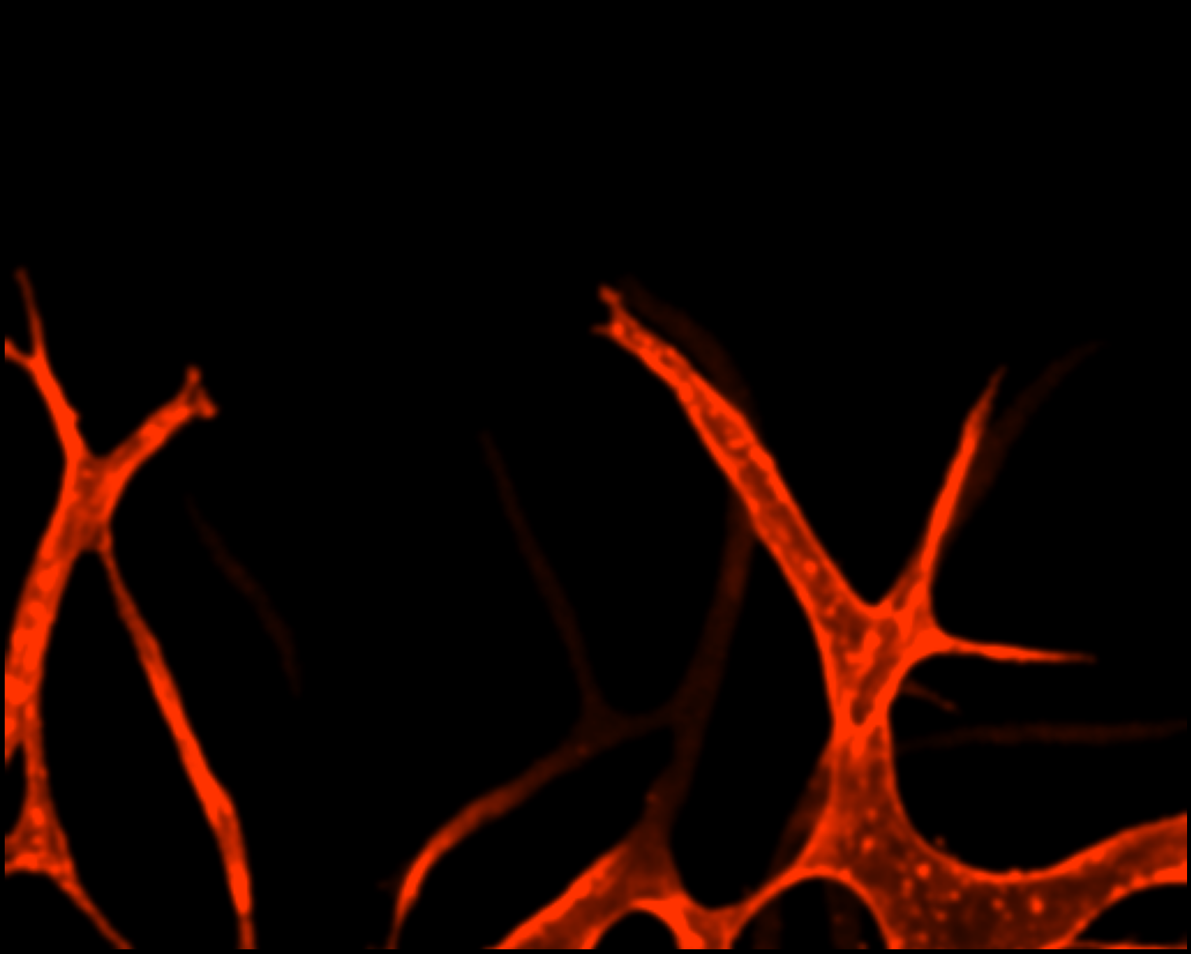
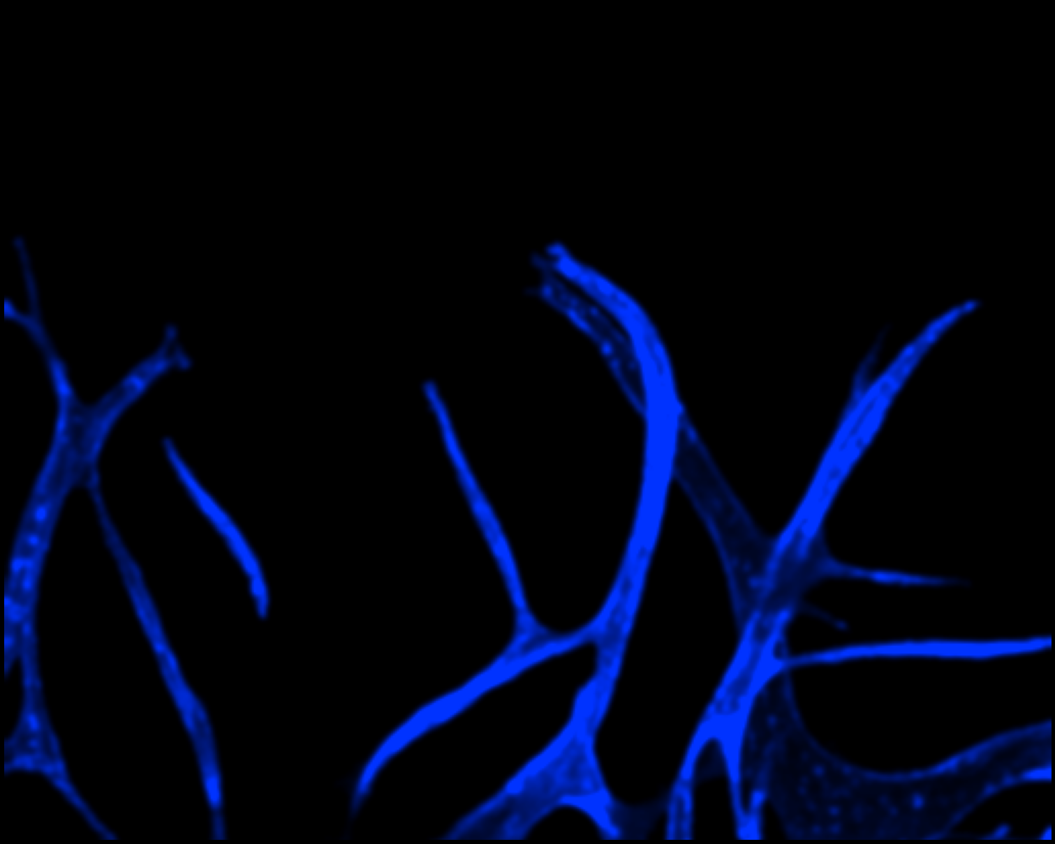
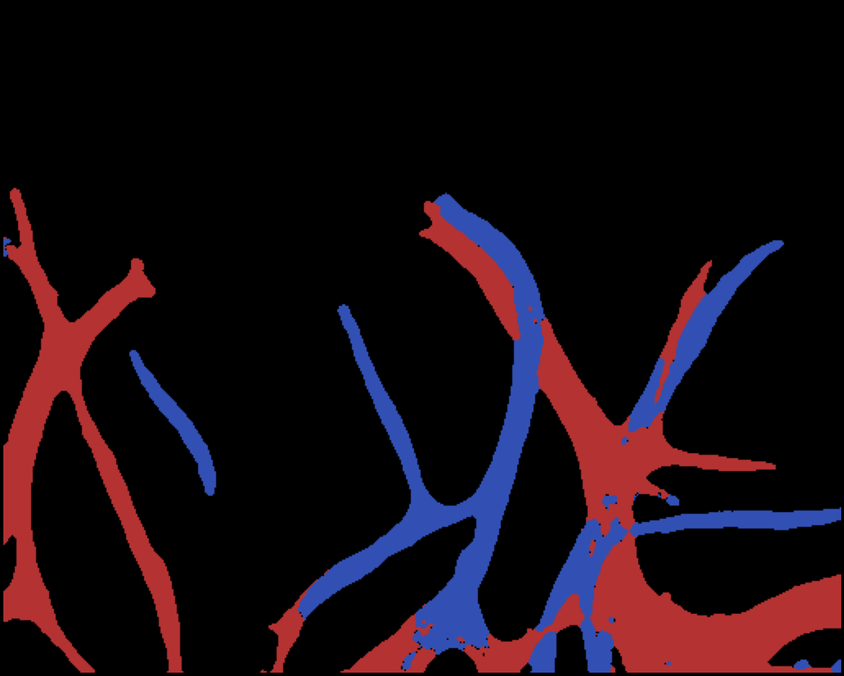
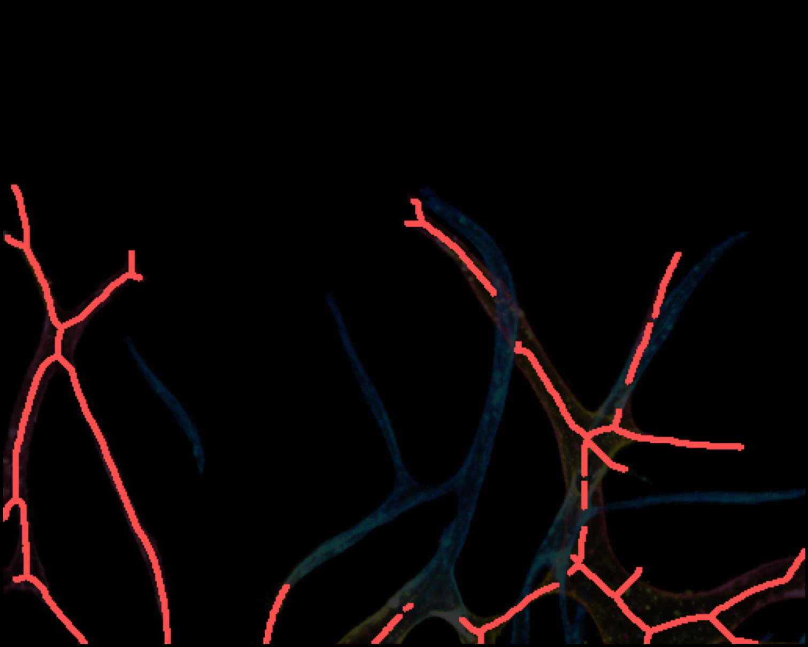
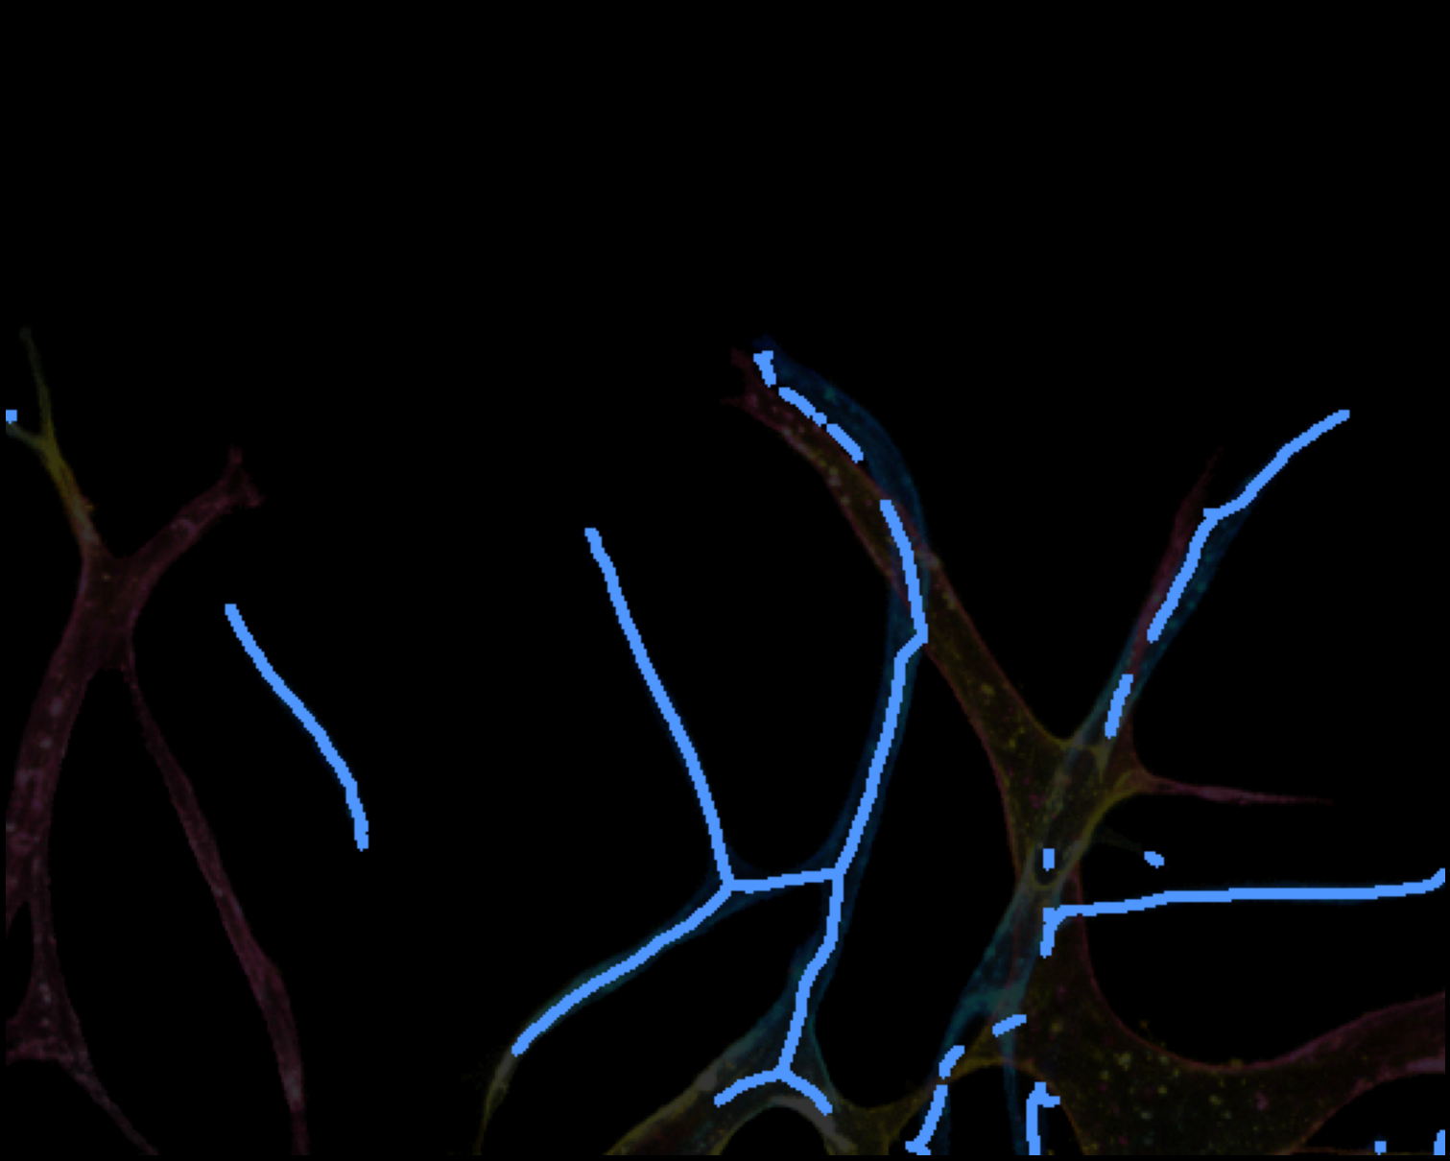
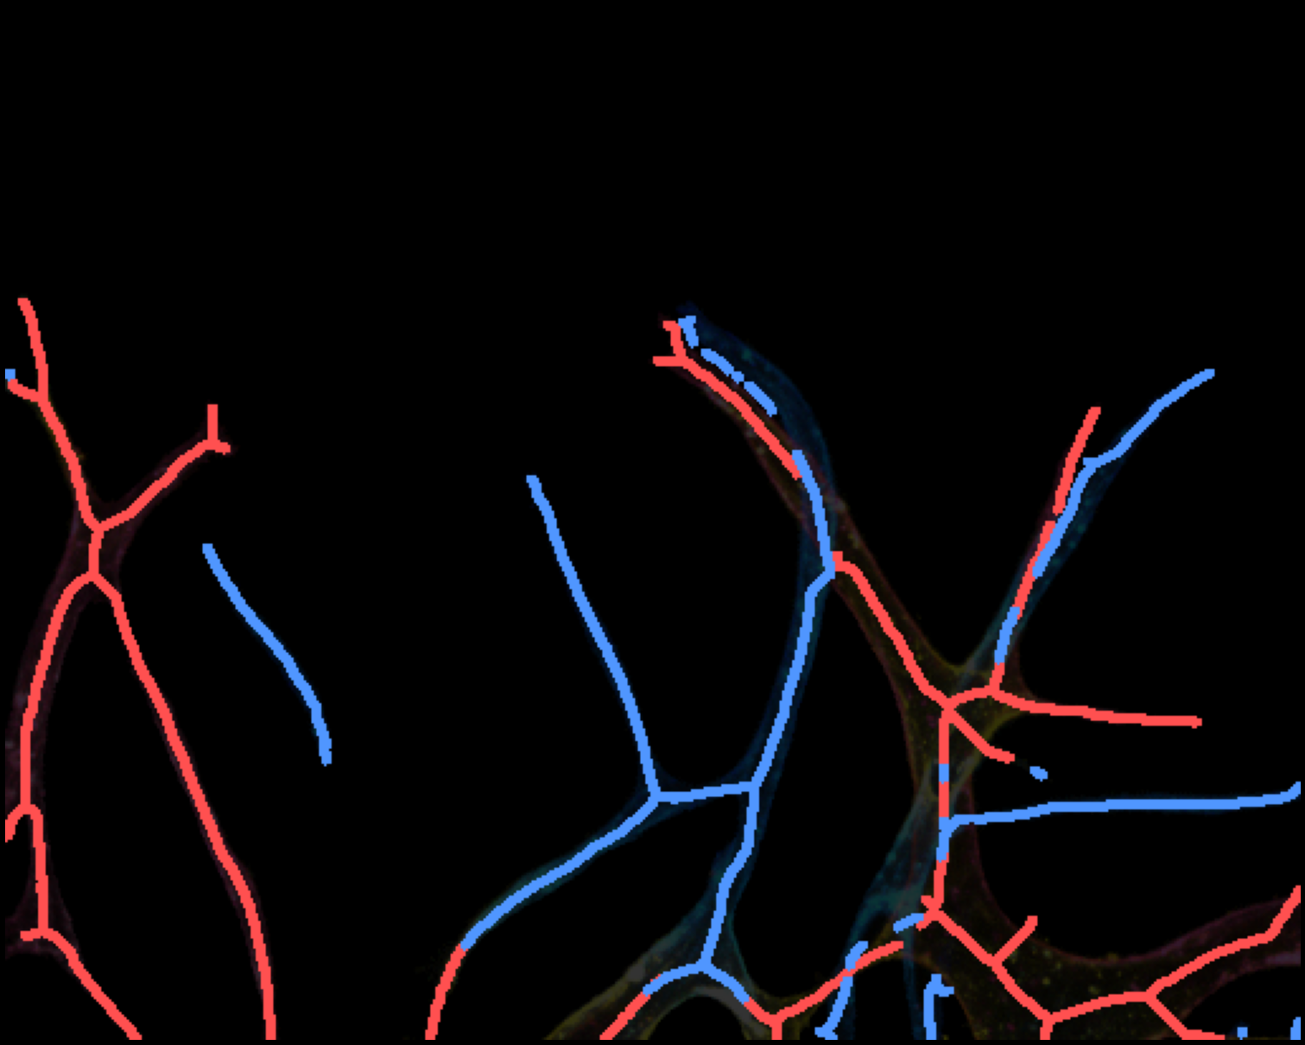
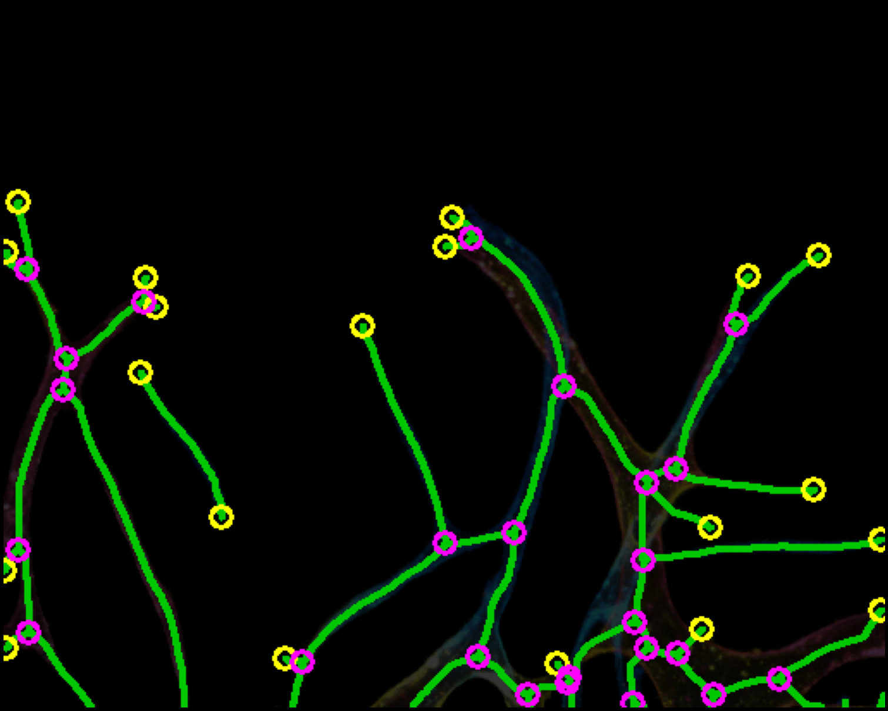
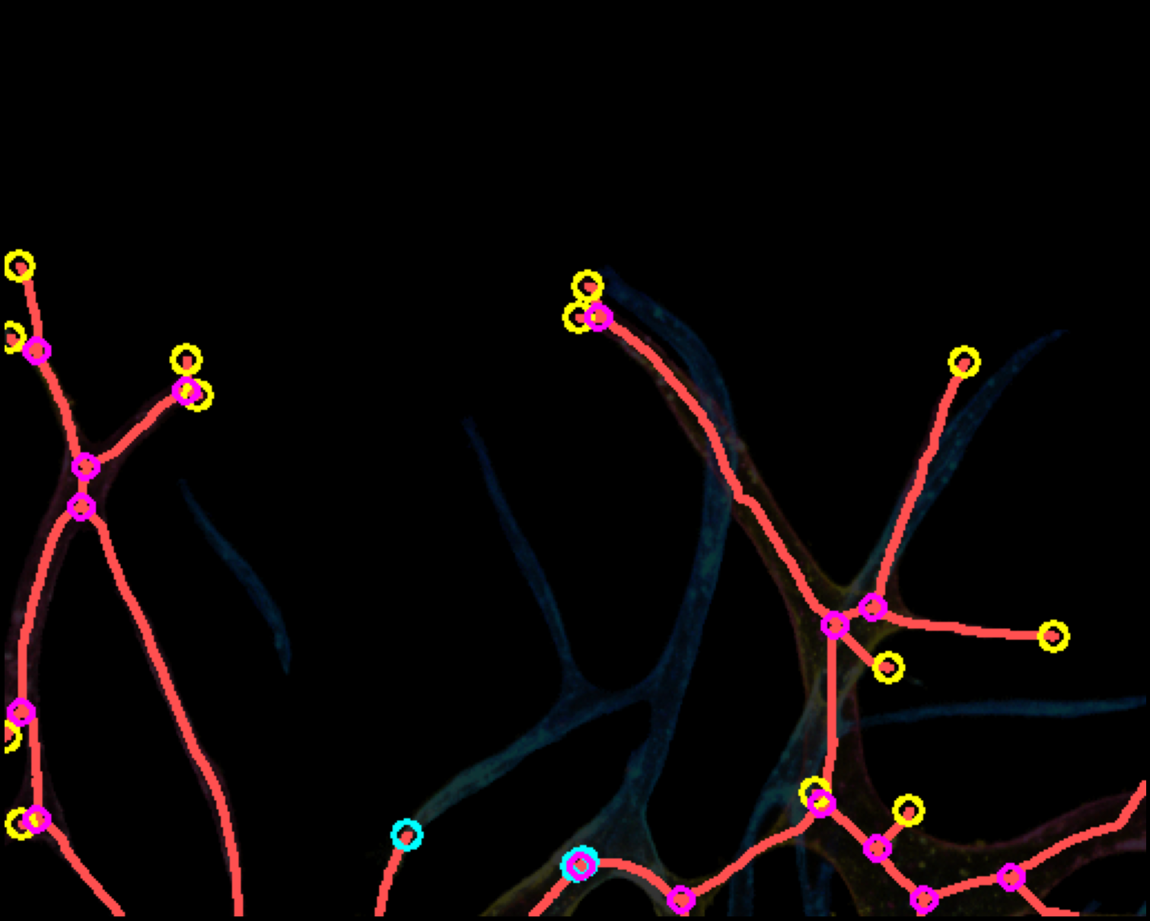
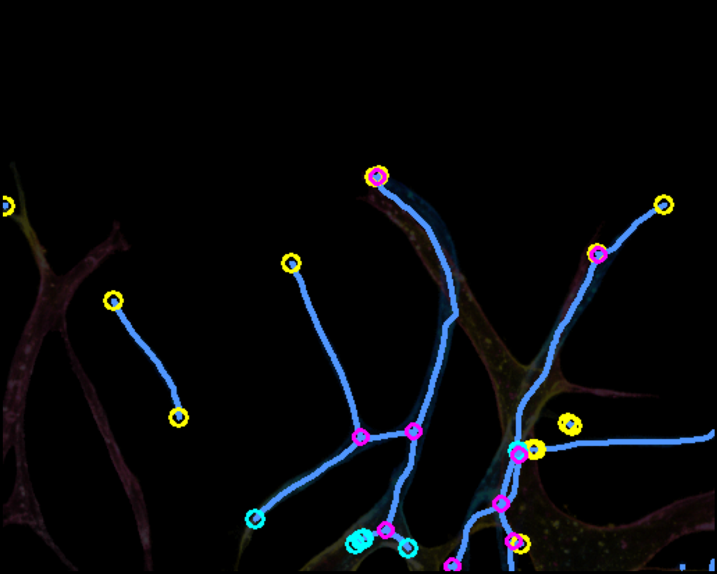
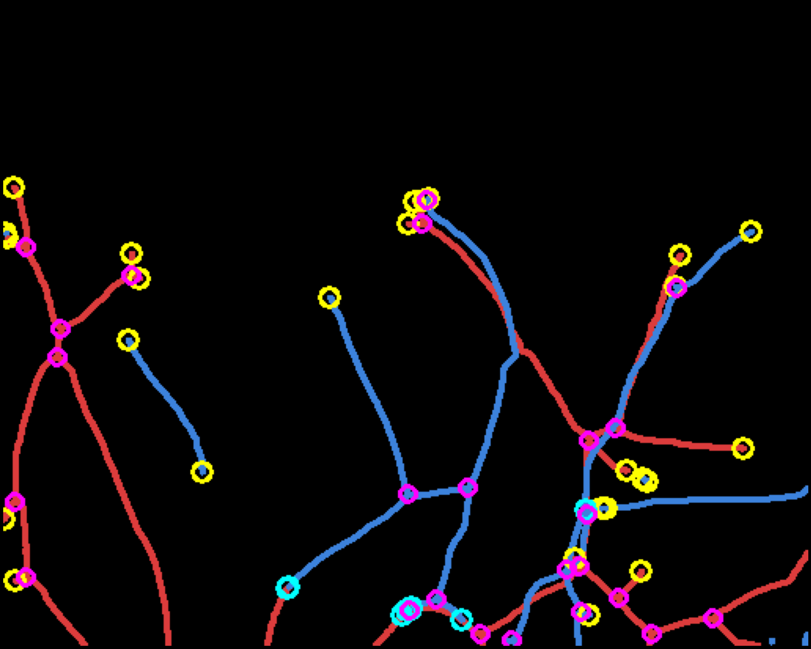
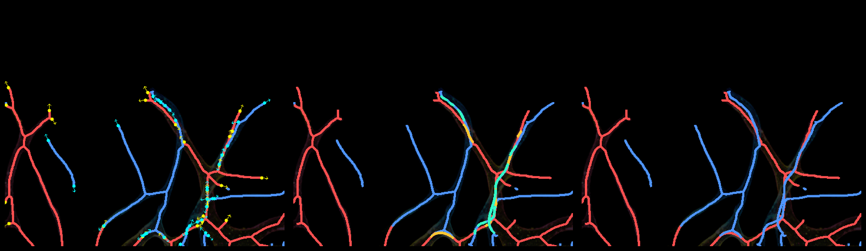
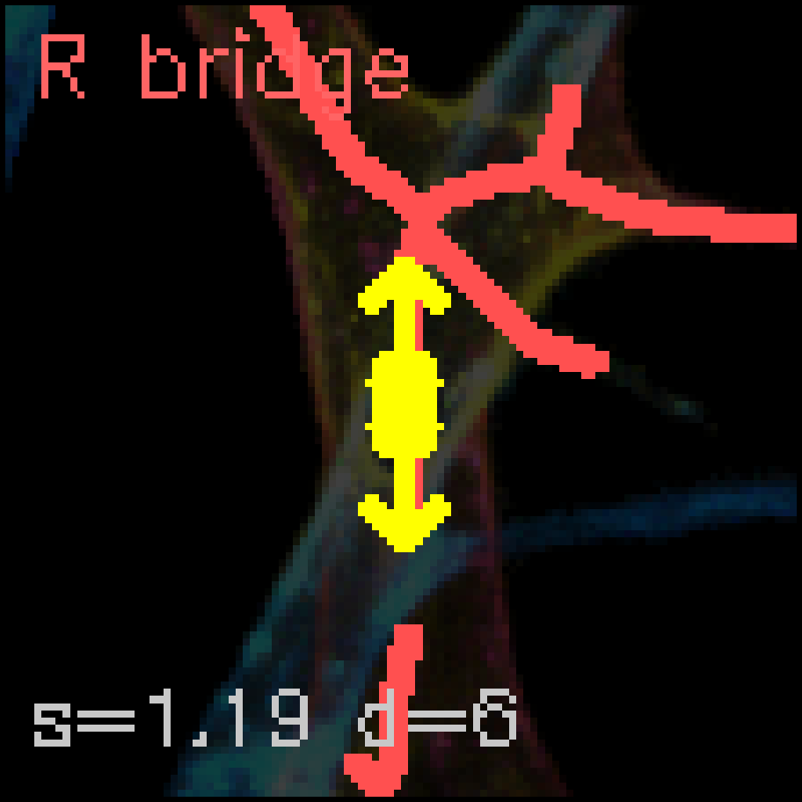
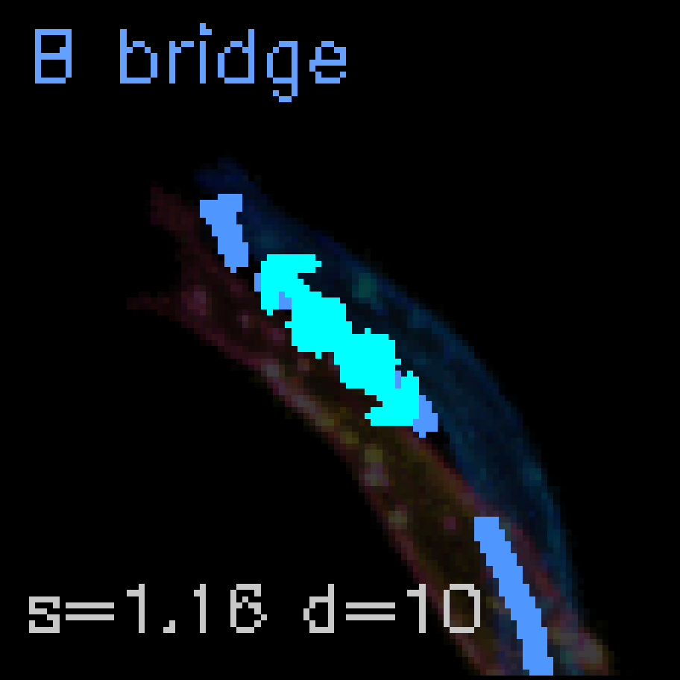
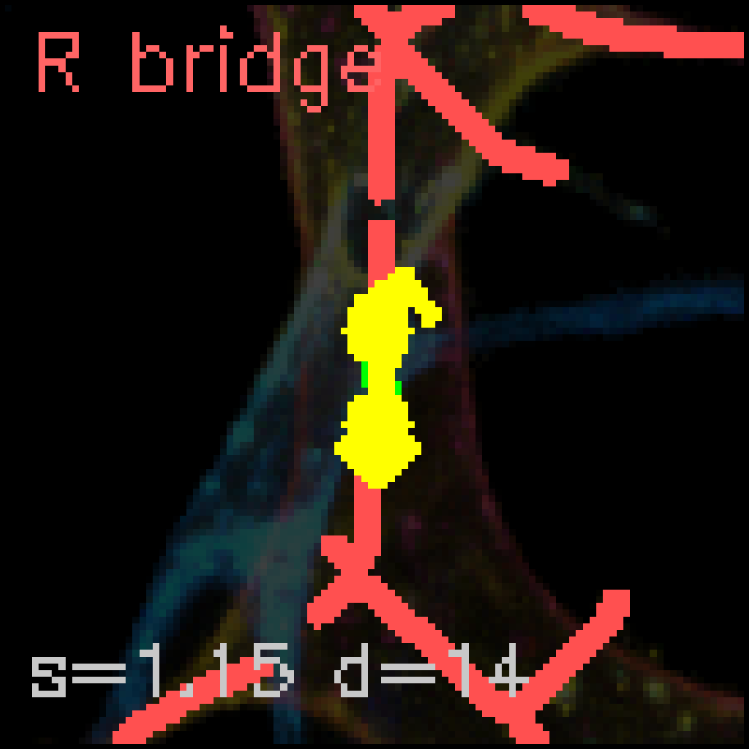
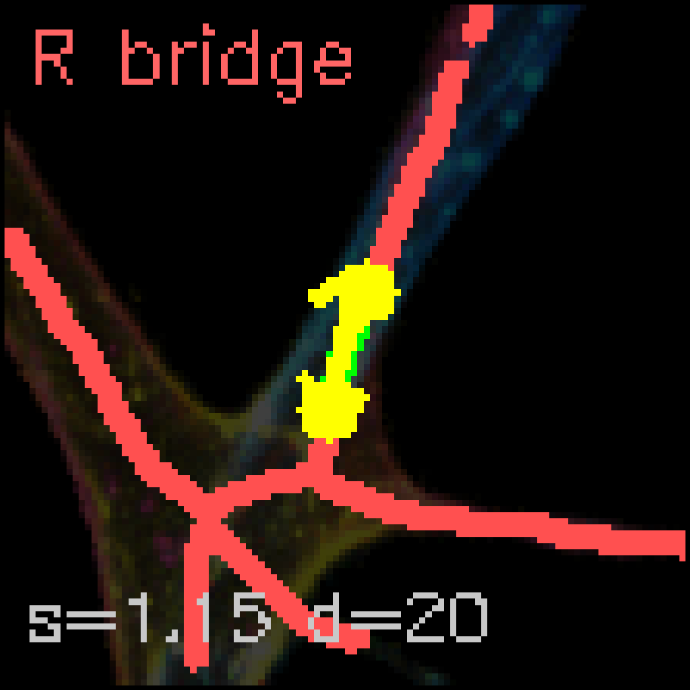
Depth-aware Vessel Network Analysis Pipeline
(a) Brightfield
(b) Multi-color GT
(c) R channel
(d) B channel
(e) R-B dominance
(f) R skeleton
(g) B skeleton
(h) R+B overlay
(i) Single GT skel
(j) R bridged
(k) B bridged
(l) R+B combined
(m) Bridging: Before → After → Final
Red = R skel Blue = B skel Yellow ● = EP + tangent Green = Bridge path
(n) Bridge Zoom Details (endpoint tangent → Bézier curve)

Slide 2
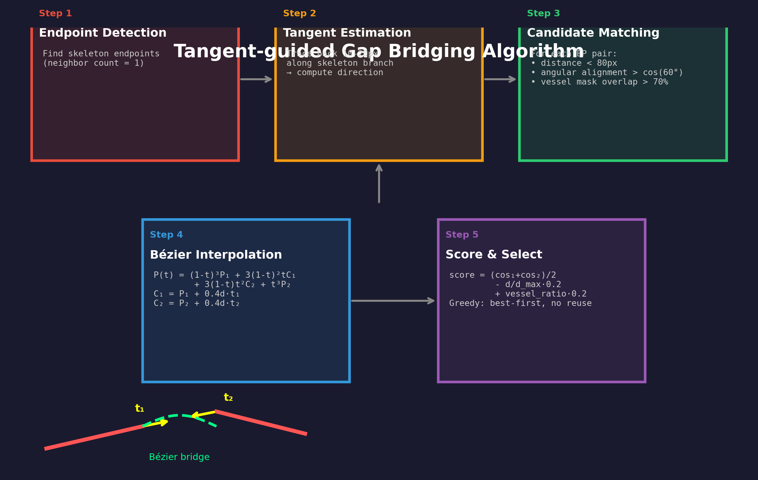
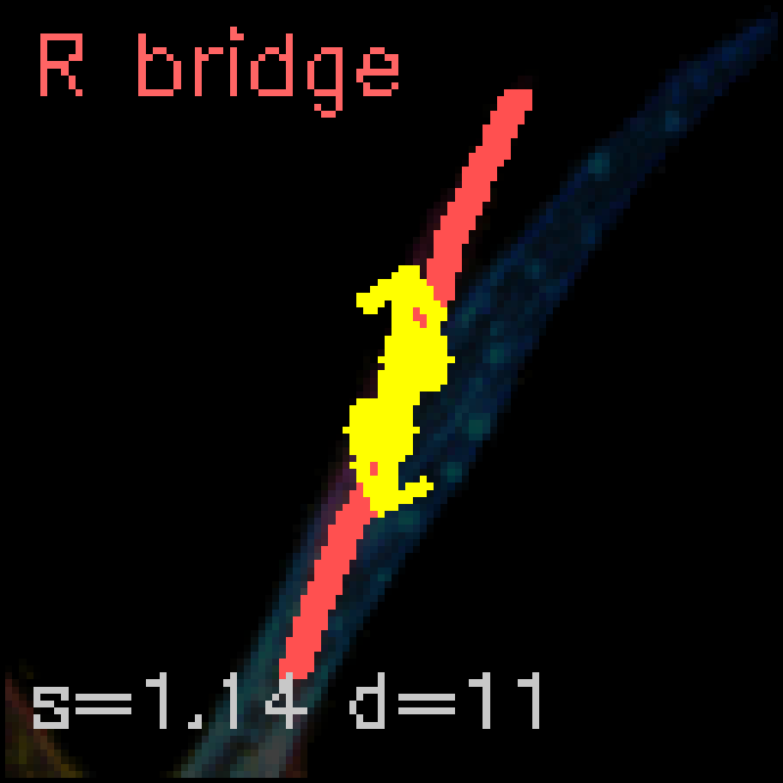
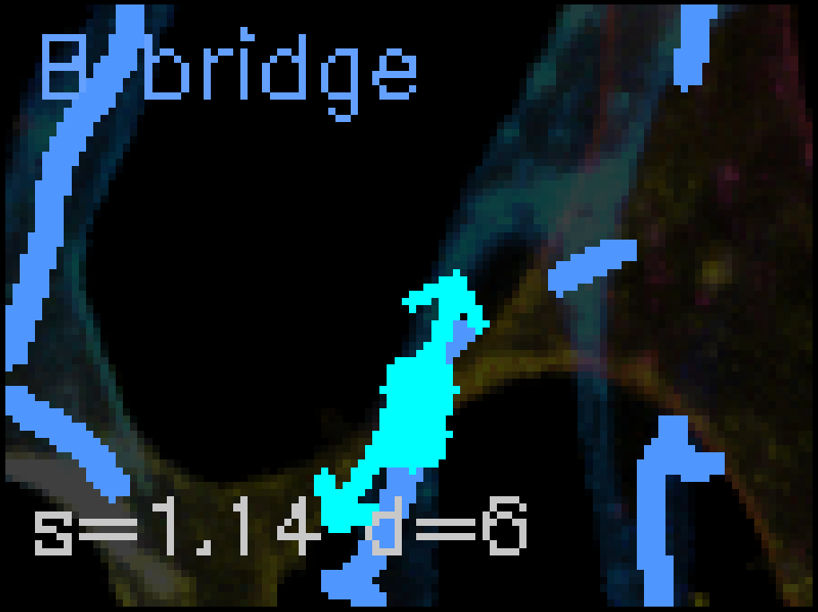
Tangent-guided Gap Bridging Algorithm
Bridge Examples (R and B channels)
Key Criteria for Bridge Matching:
1. Distance constraint: endpoint pair distance < 80 px
2. Angular alignment: tangent vectors align with connection direction (cos θ > cos 60°)
3. Vessel mask validation: ≥70% of bridge path lies within vessel mask
4. Bézier interpolation: cubic Bézier with control points from tangent vectors
5. Greedy selection: best-scoring pairs first, no endpoint reuse

Slide 3
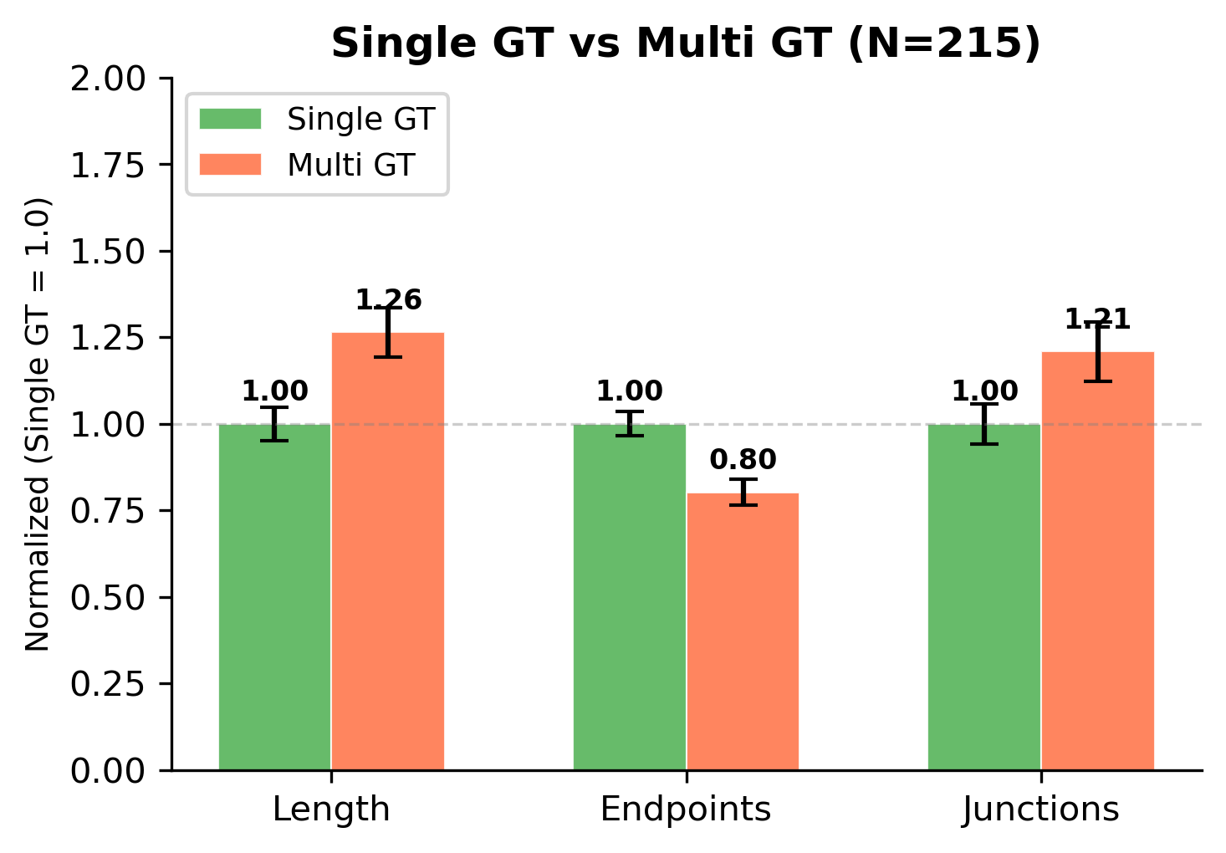
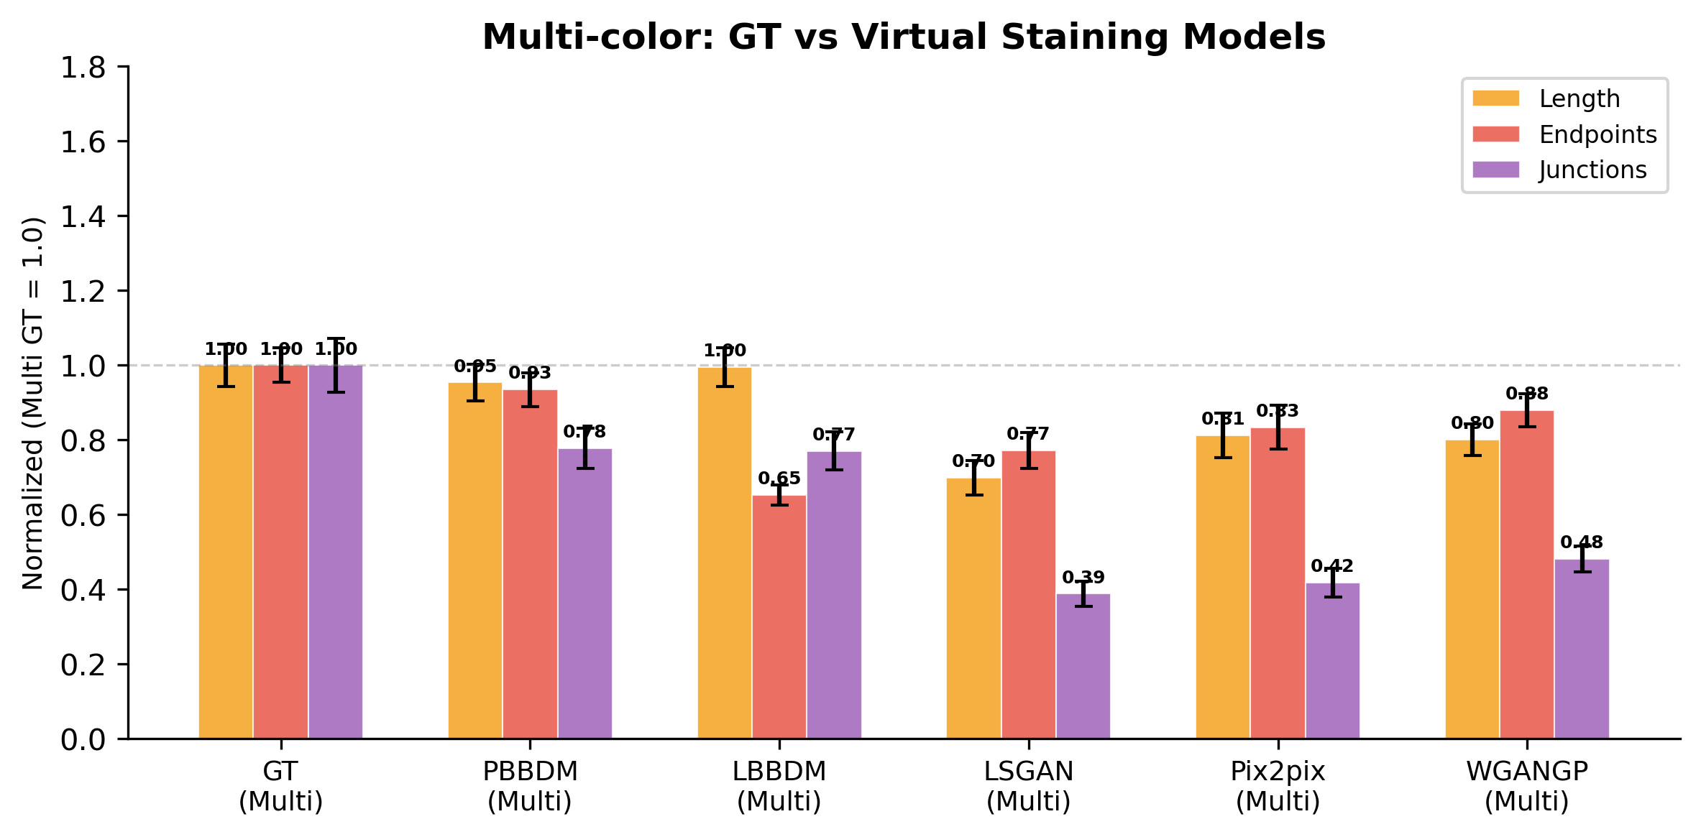
Vessel Network Quantification
(a) Single GT vs Multi GT — Normalized (Single GT = 1.0, N=215, top 80%)
(b) Multi-color GT vs Virtual Staining Models — Normalized (Multi GT = 1.0)
(c) Normalized Metrics Summary
Model | Length | EP | JN
GT (Multi) | 1.00 | 1.00 | 1.00
PBBDM | 0.95 | 0.93 | 0.78
LBBDM | 1.00 | 0.65 | 0.77
WGANGP | 0.80 | 0.88 | 0.48
Pix2pix | 0.81 | 0.83 | 0.42
LSGAN | 0.70 | 0.77 | 0.39
PBBDM achieves closest match to GT across all multi-color metrics

