Slide 1
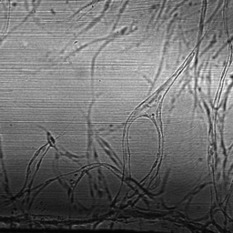
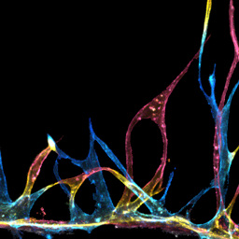
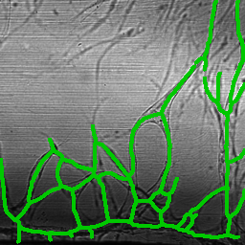
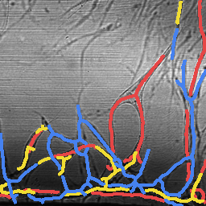
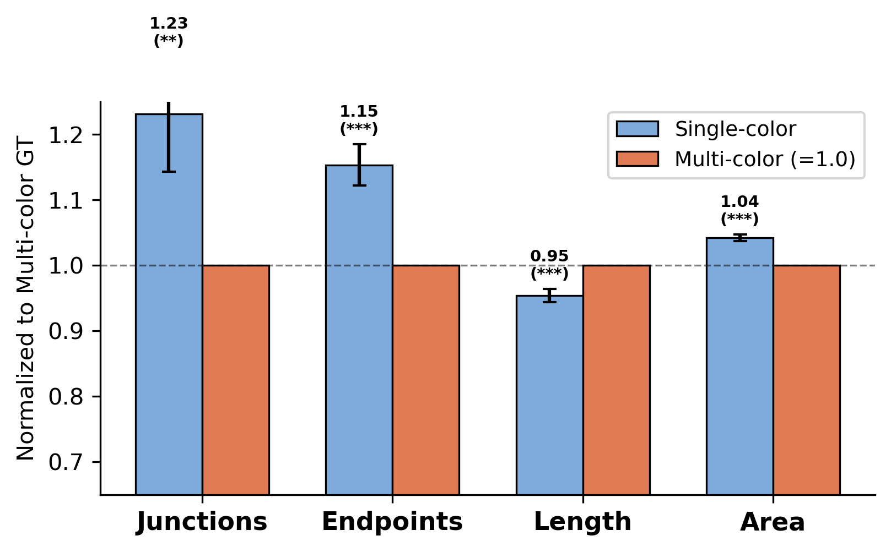
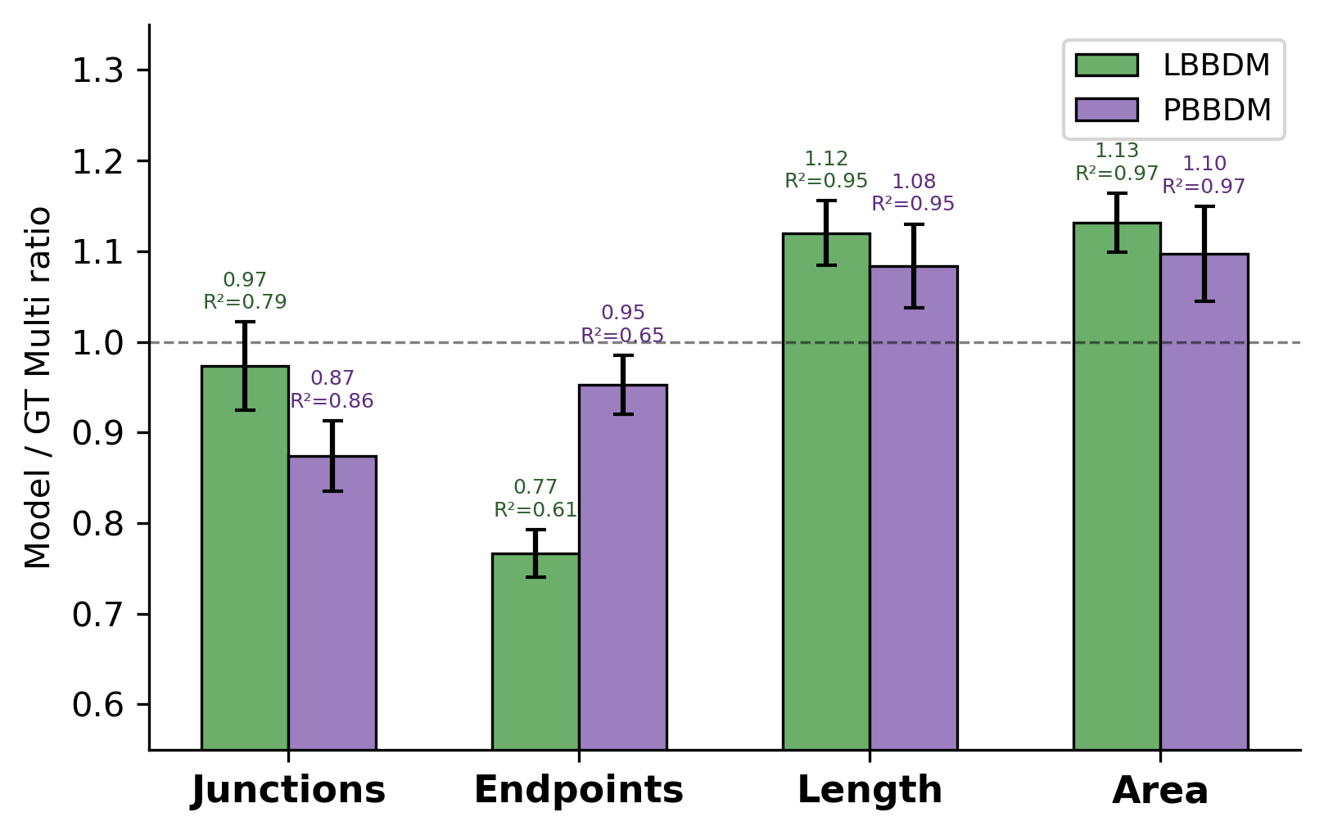
a
Insert Schematic: Single-color vs Multi-color Depth Separation
(Replace with refined illustration)
Bottom (Red)
Middle (Yellow)
Top (Blue)
b
Brightfield
Multi-color FL (GT)
Single Skeleton on BF
Depth-sep Skeleton on BF
c
Single-color GT vs Multi-color GT (normalized, N=215)
d
Model fidelity: Model Multi / GT Multi (dashed = 1.0)
Bottom 20% excluded (ECM baseline). Hole-filling for crossing vessel continuity. Per-layer independent metrics. N=215 paired samples.

