Slide 1
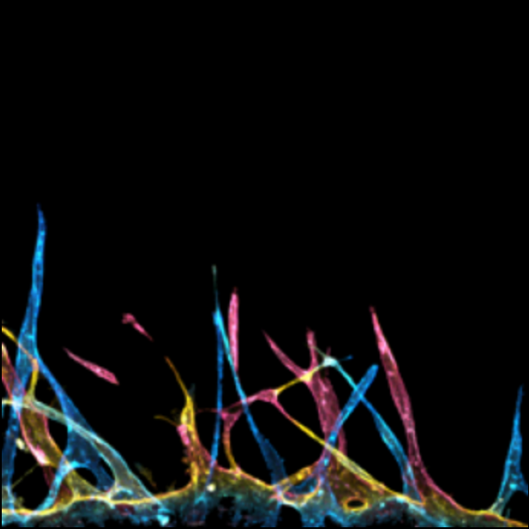
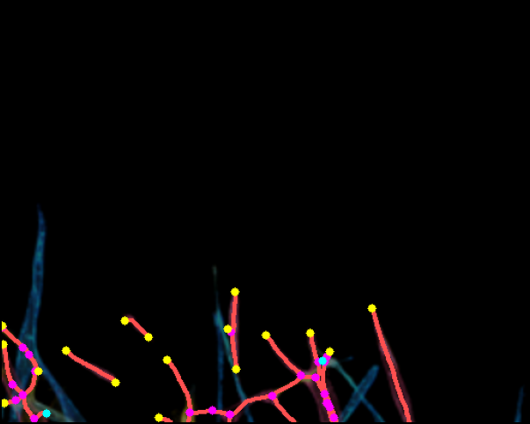
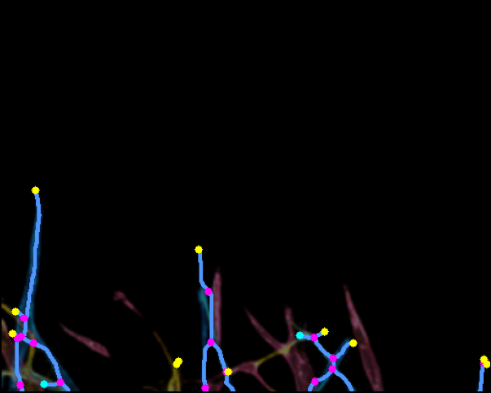
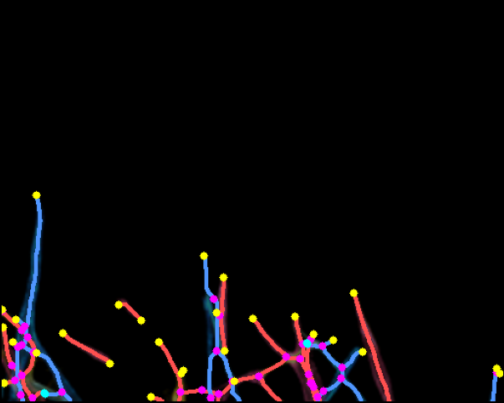
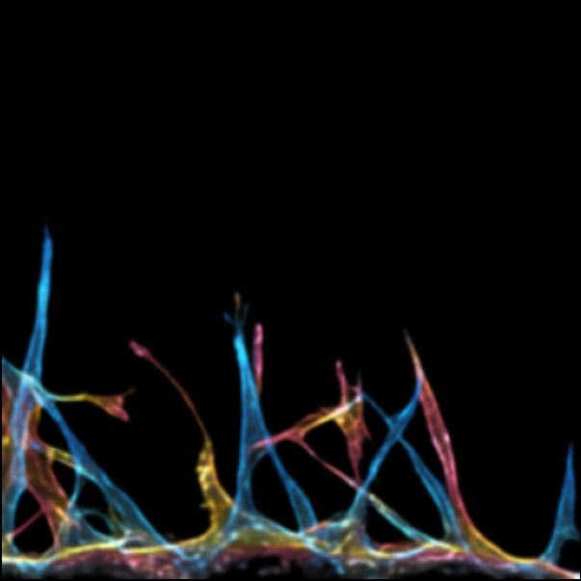
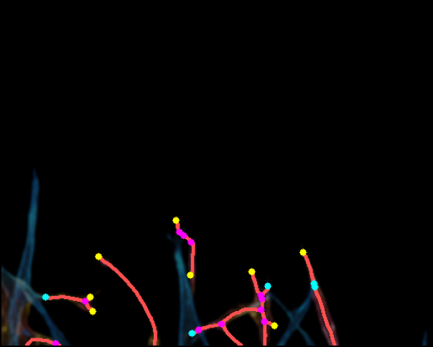
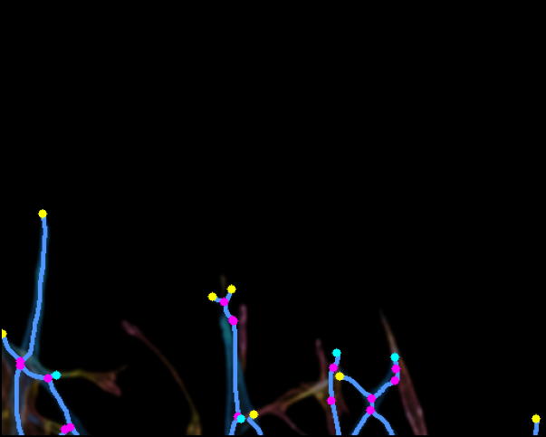
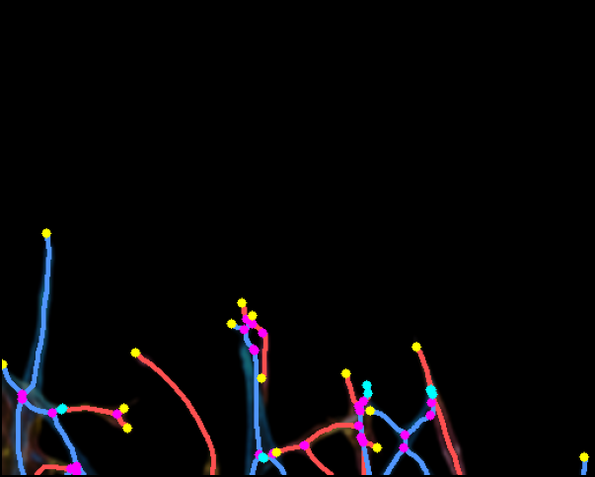
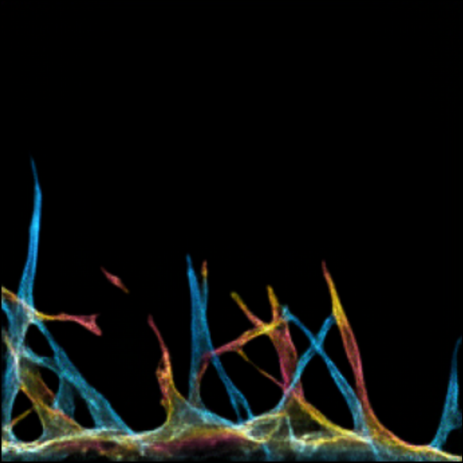
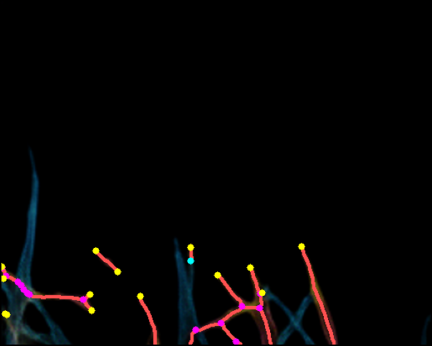
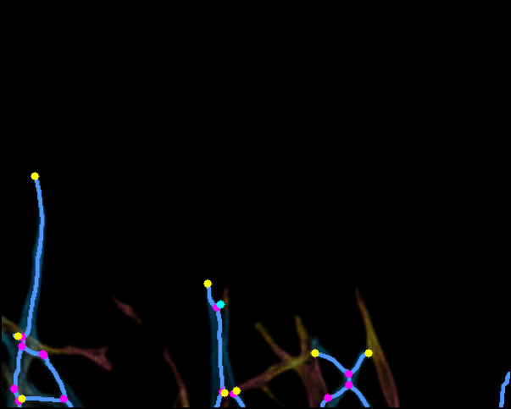
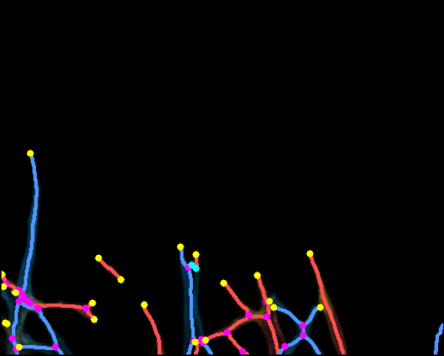
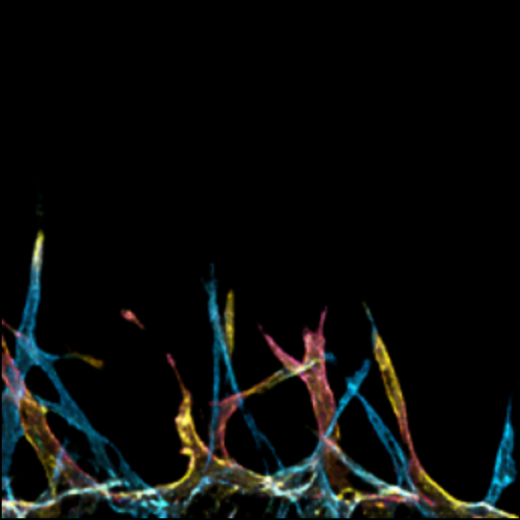
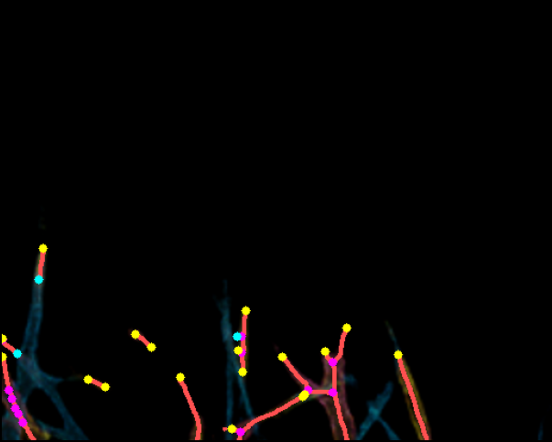
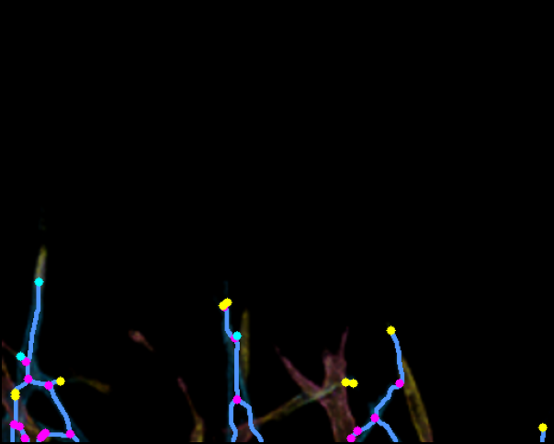
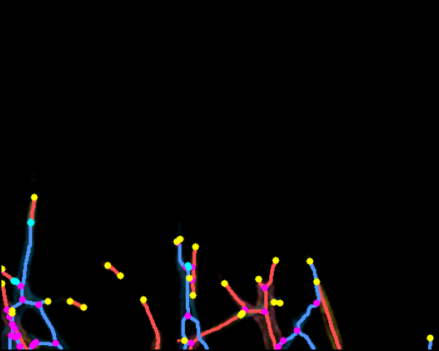
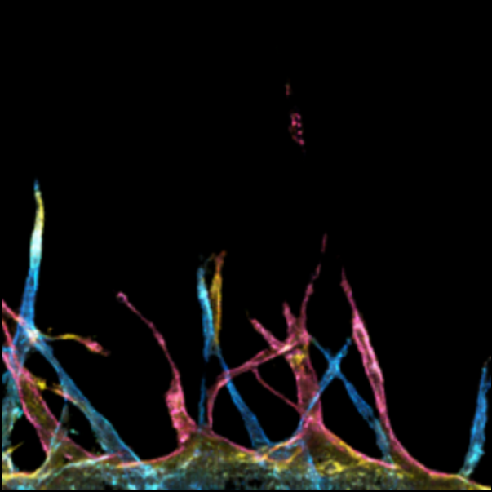
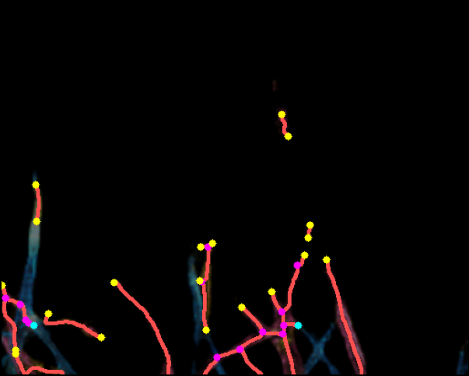
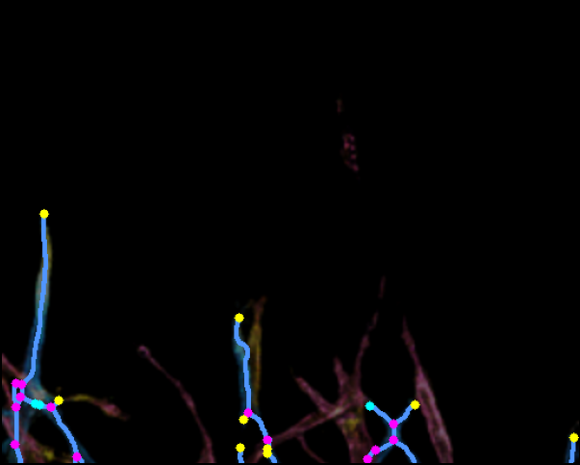
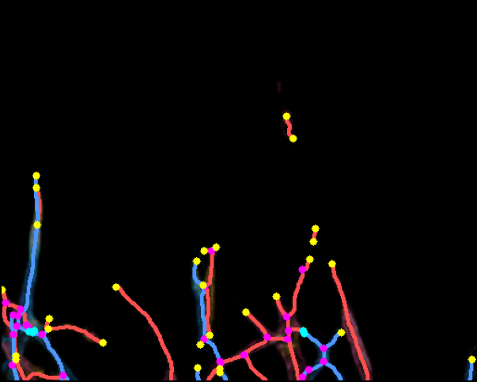
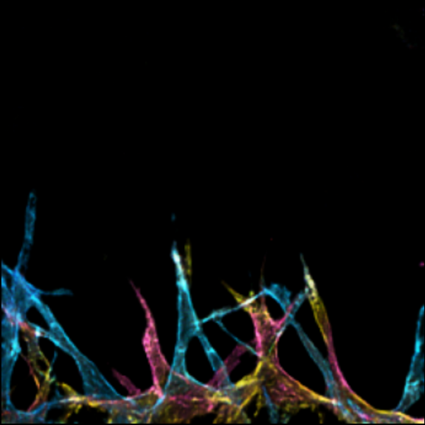
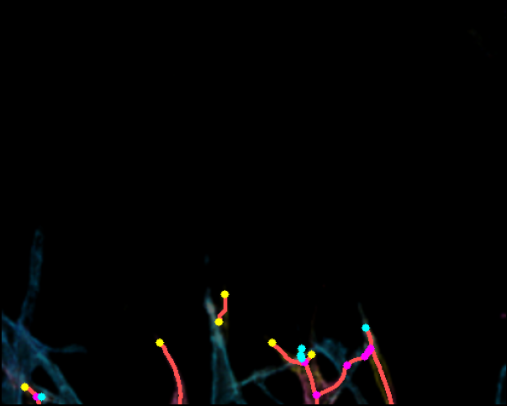
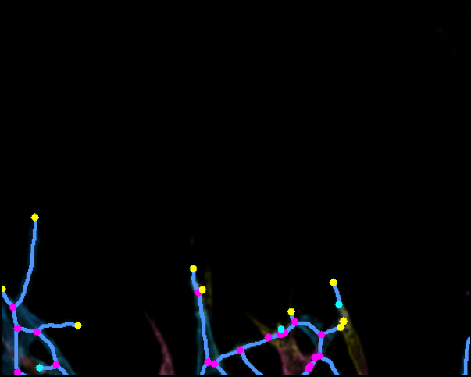
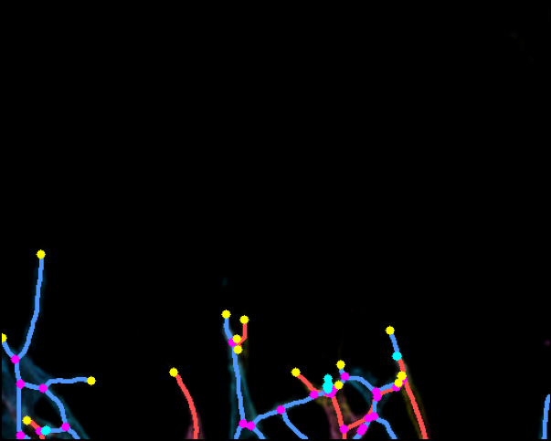
Sample: 1-19-716
Original
Skel R
Skel B
R+B Combined
R: JN=23 EP=17(+2c)
B: JN=15 EP=11(+2c)
GT
R: JN=11 EP=8(+5c)
B: JN=15 EP=7(+4c)
PBBDM
R: JN=15 EP=14(+1c)
B: JN=13 EP=8(+1c)
LBBDM
R: JN=12 EP=18(+3c)
B: JN=17 EP=9(+3c)
LSGAN
R: JN=13 EP=20(+2c)
B: JN=13 EP=9(+3c)
Pix2pix
R: JN=7 EP=6(+5c)
B: JN=18 EP=10(+3c)
WGANGP
Magenta = JN Yellow = Real EP Cyan = Connected EP (excluded from count)

Slide 2
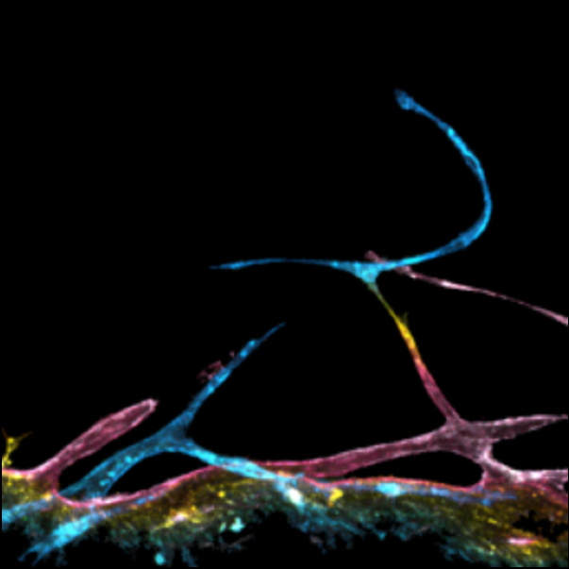
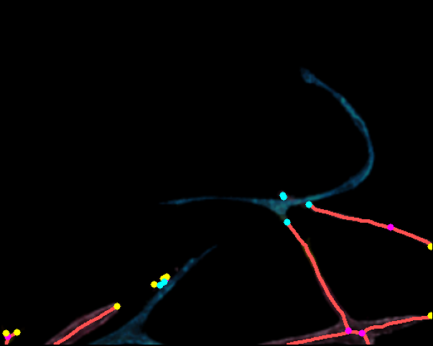
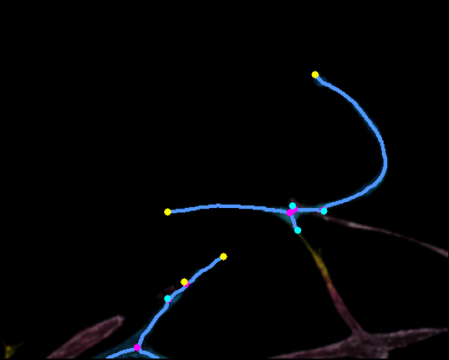
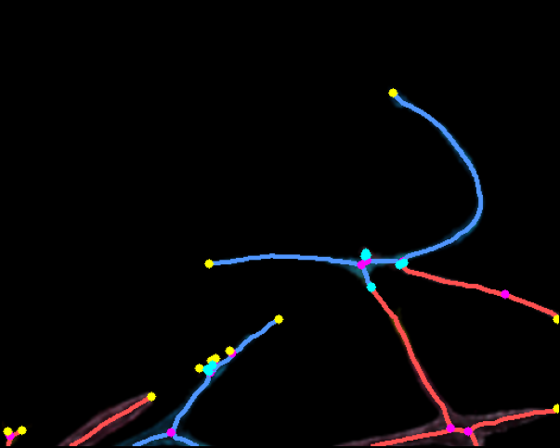
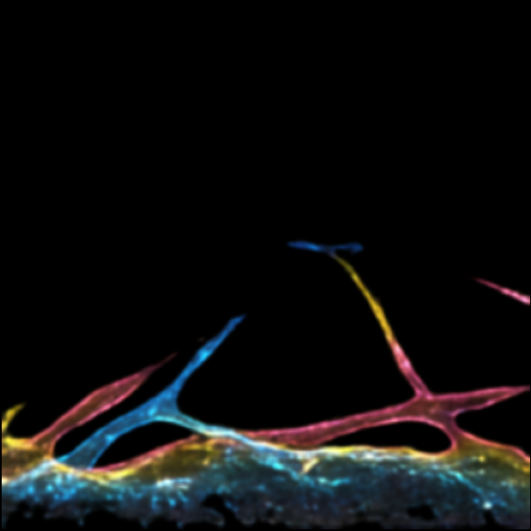
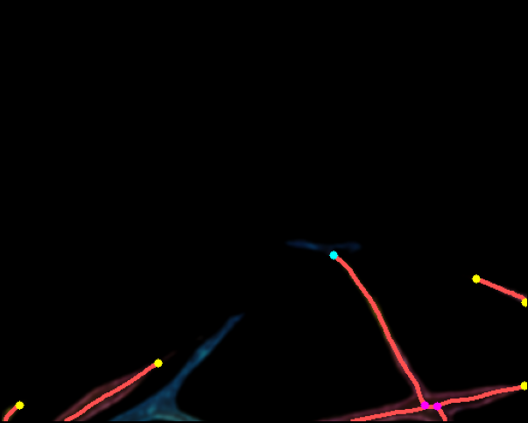
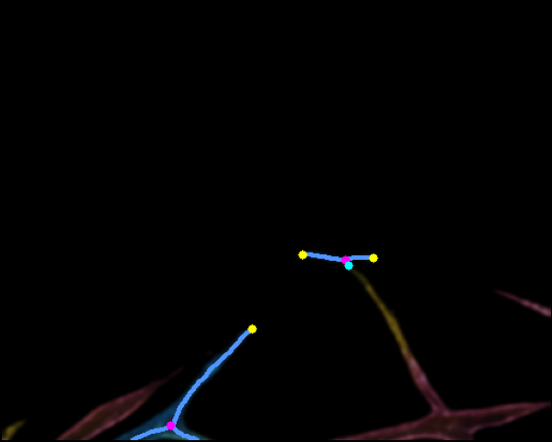
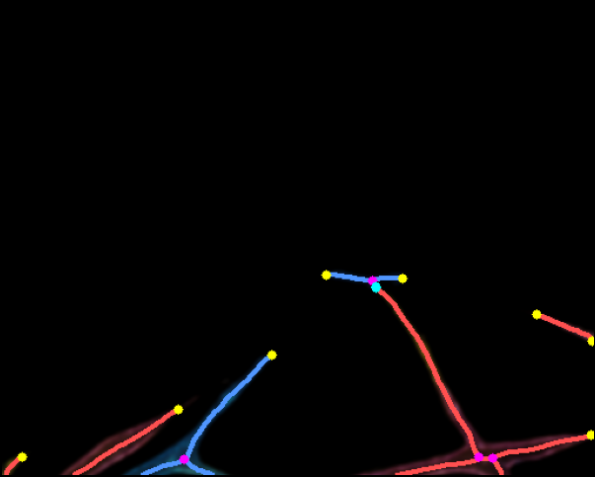
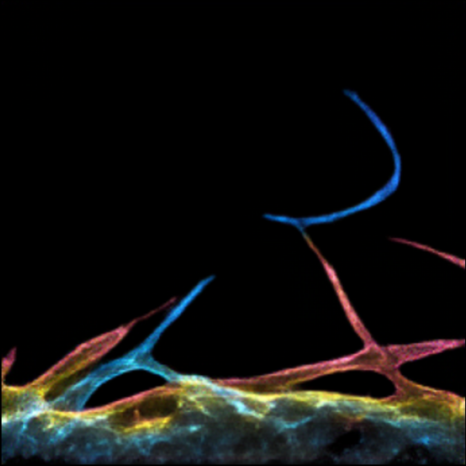
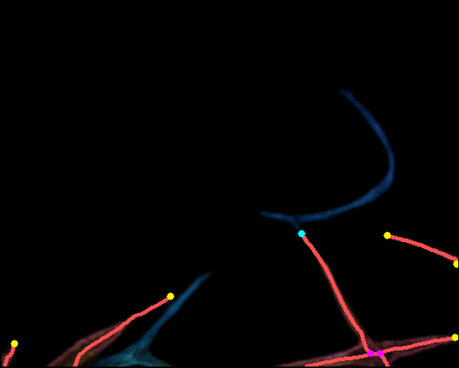
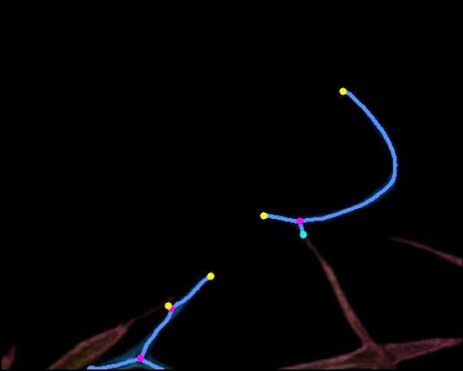
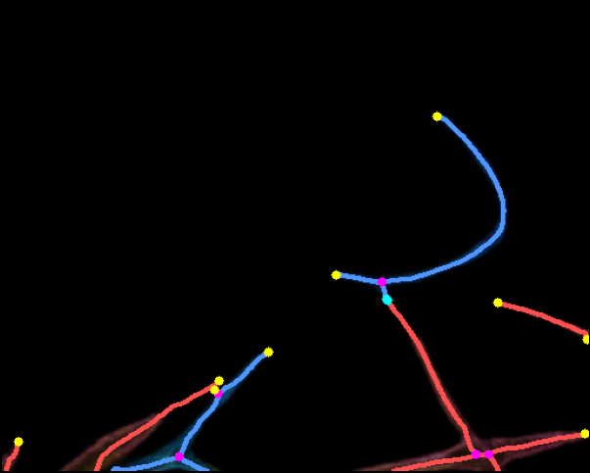
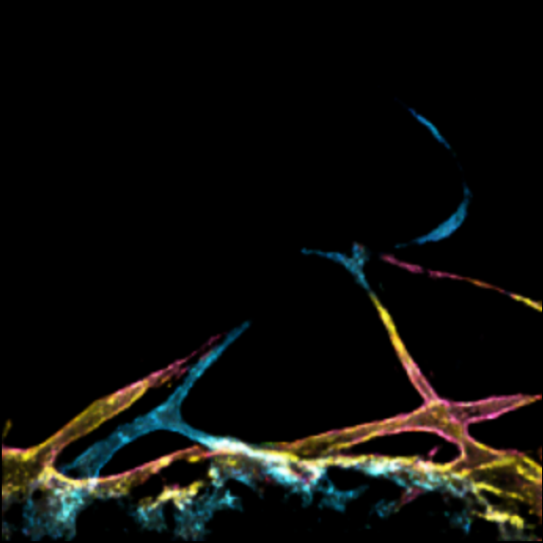
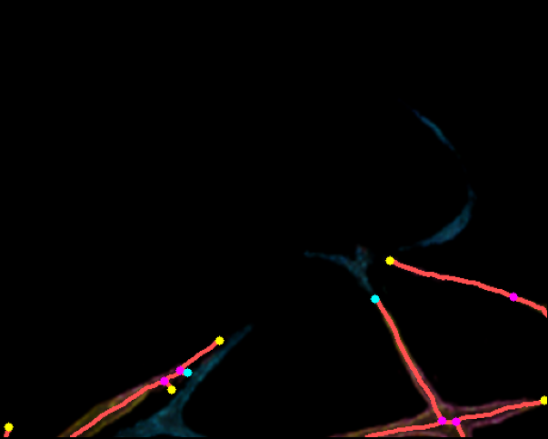
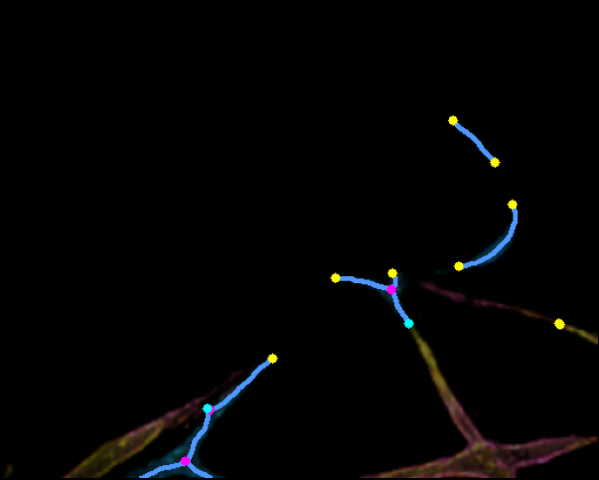
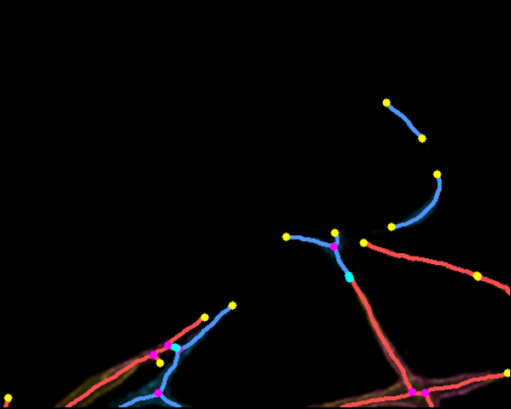
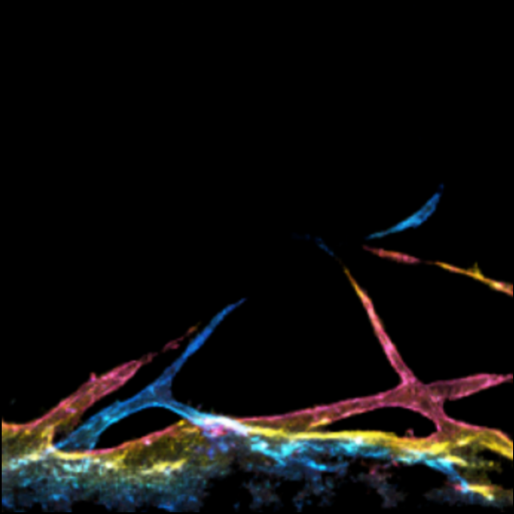
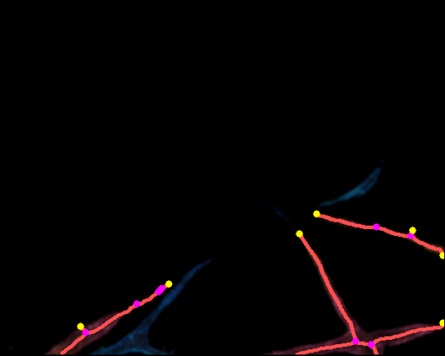
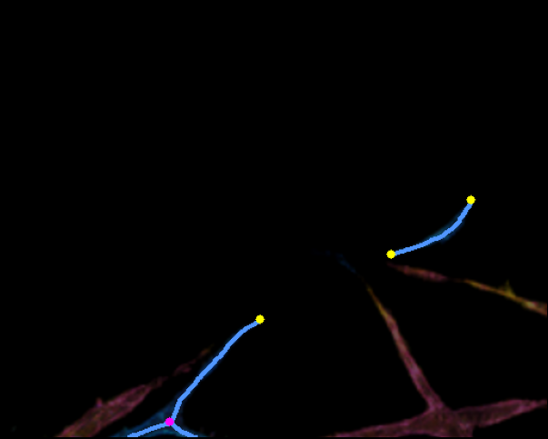
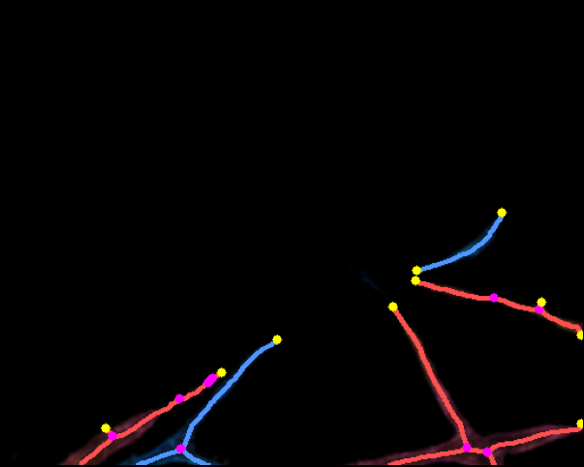
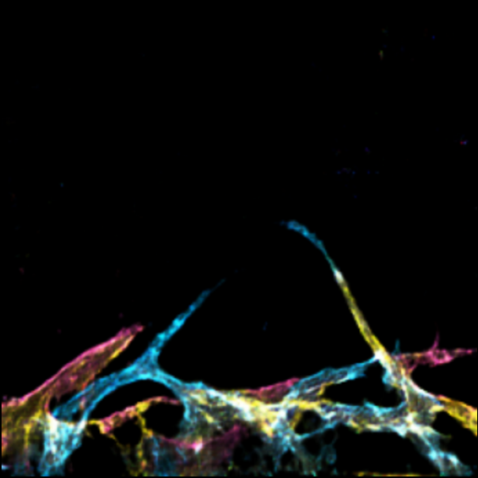
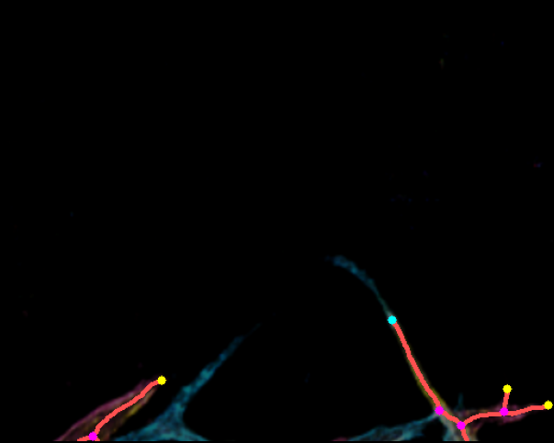
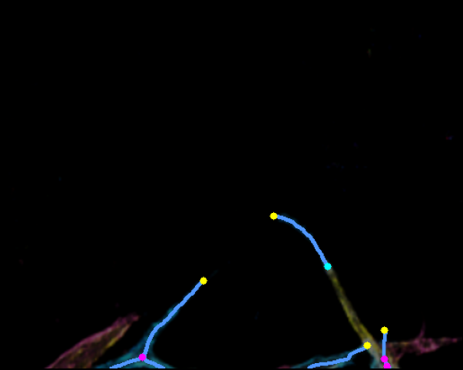
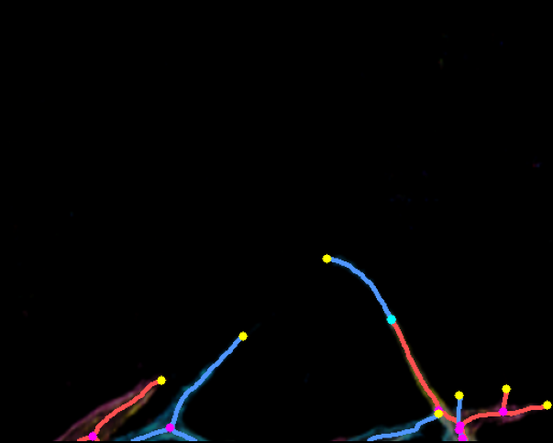
Sample: 9-15-512
Original
Skel R
Skel B
R+B Combined
R: JN=5 EP=8(+6c)
B: JN=6 EP=4(+4c)
GT
R: JN=2 EP=5(+1c)
B: JN=2 EP=3(+1c)
PBBDM
R: JN=2 EP=5(+1c)
B: JN=3 EP=4(+1c)
LBBDM
R: JN=5 EP=5(+2c)
B: JN=3 EP=9(+2c)
LSGAN
R: JN=10 EP=7(+0c)
B: JN=1 EP=3(+0c)
Pix2pix
R: JN=4 EP=3(+1c)
B: JN=3 EP=4(+1c)
WGANGP
Magenta = JN Yellow = Real EP Cyan = Connected EP (excluded from count)

Slide 3
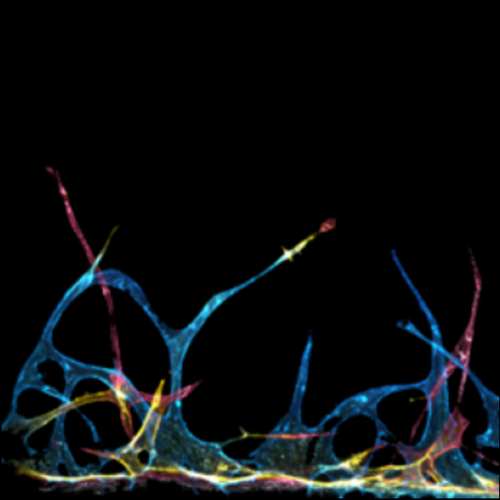
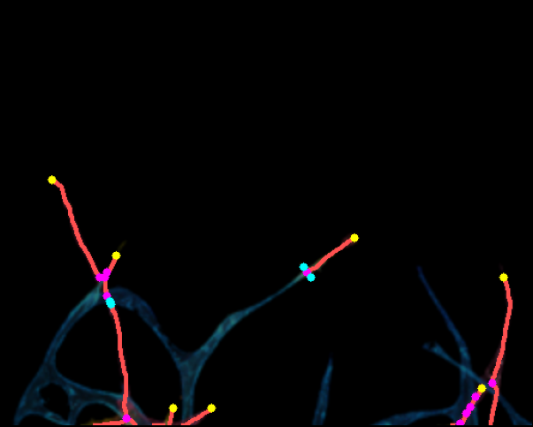






















Sample: 16-18-716
Original
Skel R
Skel B
R+B Combined
R: JN=11 EP=7(+4c)
B: JN=28 EP=11(+2c)
GT
R: JN=31 EP=9(+1c)
B: JN=24 EP=14(+1c)
PBBDM
R: JN=11 EP=6(+2c)
B: JN=18 EP=7(+2c)
LBBDM
R: JN=4 EP=5(+3c)
B: JN=24 EP=17(+3c)
LSGAN
R: JN=23 EP=5(+4c)
B: JN=17 EP=8(+4c)
Pix2pix
R: JN=12 EP=6(+0c)
B: JN=15 EP=14(+0c)
WGANGP
Magenta = JN Yellow = Real EP Cyan = Connected EP (excluded from count)

Slide 4
























Sample: 18-19-512
Original
Skel R
Skel B
R+B Combined
R: JN=18 EP=12(+4c)
B: JN=23 EP=18(+4c)
GT
R: JN=20 EP=11(+2c)
B: JN=19 EP=13(+2c)
PBBDM
R: JN=16 EP=4(+1c)
B: JN=26 EP=17(+1c)
LBBDM
R: JN=34 EP=19(+2c)
B: JN=41 EP=31(+1c)
LSGAN
R: JN=22 EP=8(+5c)
B: JN=38 EP=26(+8c)
Pix2pix
R: JN=17 EP=9(+2c)
B: JN=18 EP=21(+2c)
WGANGP
Magenta = JN Yellow = Real EP Cyan = Connected EP (excluded from count)

Slide 5
























Sample: 1-16-512
Original
Skel R
Skel B
R+B Combined
R: JN=28 EP=20(+3c)
B: JN=29 EP=15(+2c)
GT
R: JN=15 EP=16(+4c)
B: JN=27 EP=12(+4c)
PBBDM
R: JN=19 EP=13(+4c)
B: JN=31 EP=14(+4c)
LBBDM
R: JN=27 EP=12(+4c)
B: JN=22 EP=18(+4c)
LSGAN
R: JN=29 EP=23(+9c)
B: JN=20 EP=15(+9c)
Pix2pix
R: JN=20 EP=18(+6c)
B: JN=33 EP=15(+5c)
WGANGP
Magenta = JN Yellow = Real EP Cyan = Connected EP (excluded from count)

