Slide 1
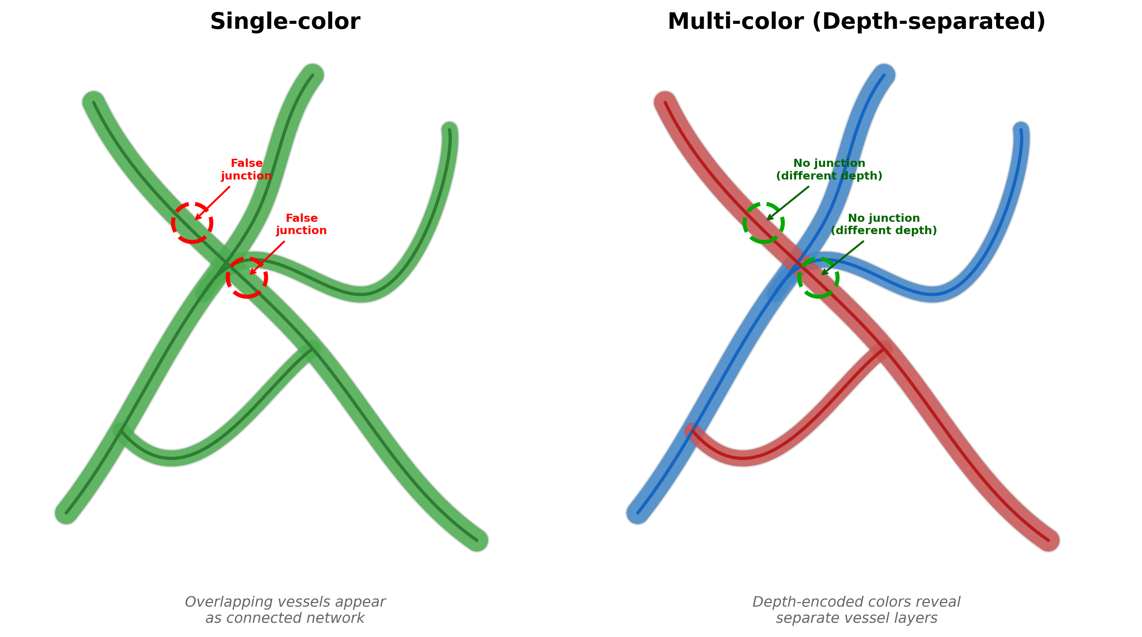
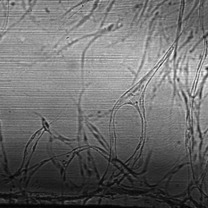
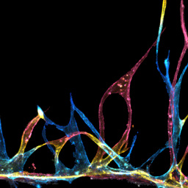
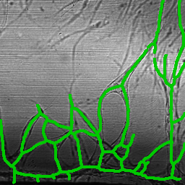
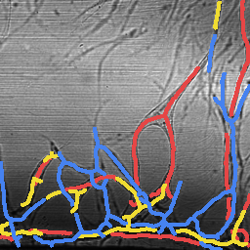
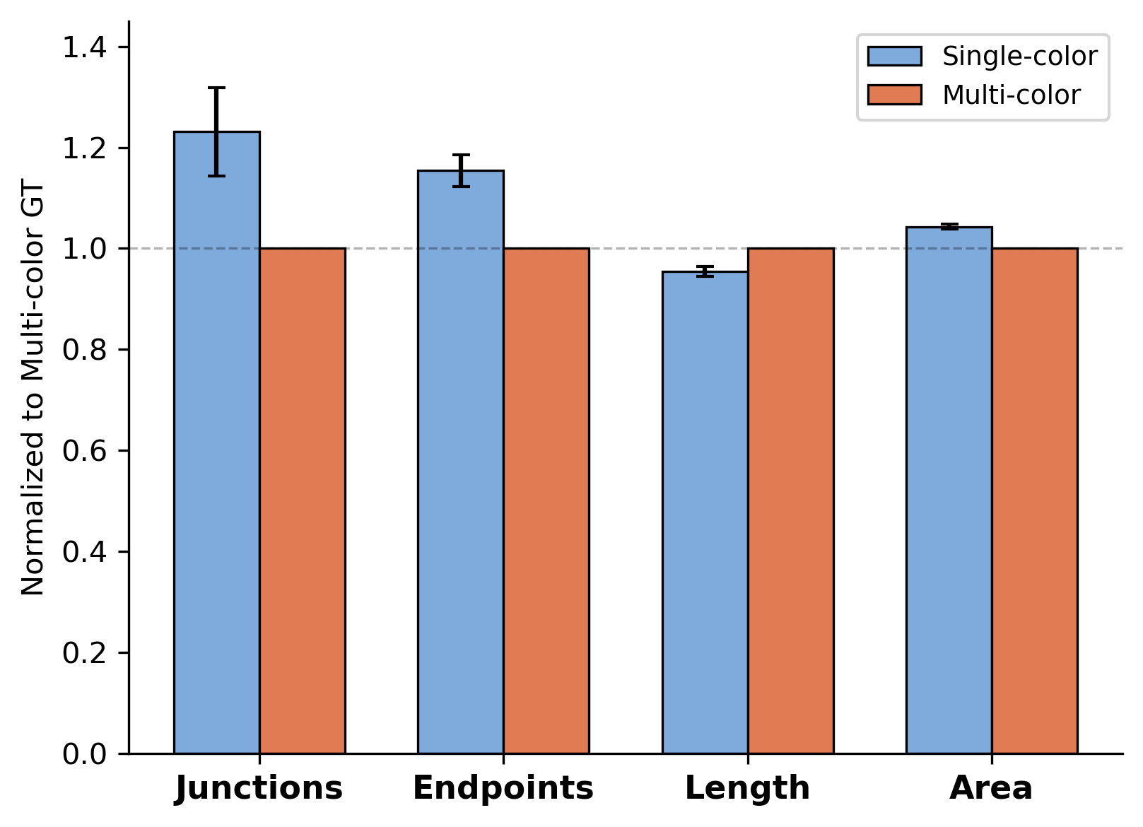
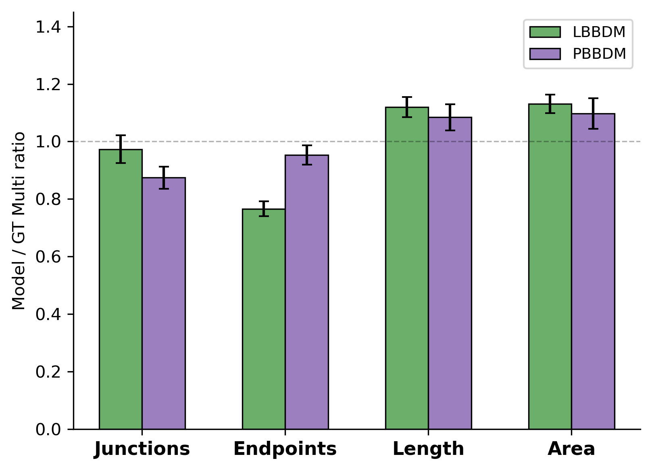
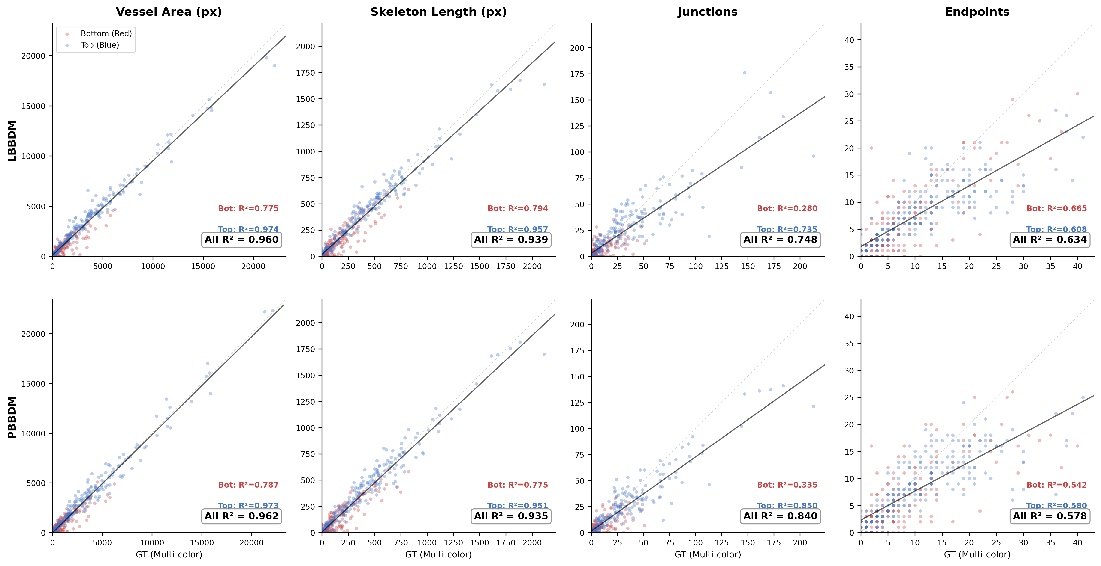
a
b
Brightfield
Multi-color FL (GT)
Single Skeleton
Depth-sep Skeleton
c
Single vs Multi-color GT (normalized to Multi GT = 1.0)
Metric | Ratio | SEM | p
Junction | 1.231 | ±0.088 | **
Endpoint | 1.154 | ±0.031 | ***
Length | 0.954 | ±0.010 | ***
Area | 1.043 | ±0.005 | ***
d
Model fidelity: Model / GT Multi (dashed = 1.0)
 | LBBDM Ratio | R² | PBBDM Ratio | R²
Junction | 0.973 | 0.787 | 0.874 | 0.857
Endpoint | 0.766 | 0.611 | 0.953 | 0.653
Length | 1.120 | 0.953 | 1.084 | 0.952
Area | 1.131 | 0.974 | 1.097 | 0.974
Bottom 20% excluded (ECM baseline). Hole-filling applied for crossing vessel continuity. N=215 paired samples.
e
Per-layer depth concordance: GT vs Model (Bottom/Top layer, N=215×2)

Slide 2
Panel (a) - Editable Schematic
Single-color
Multi-color (Depth-separated)
False junction
No junction
(different depth)
Bottom (Red)
Top (Blue)
Single-color

