Slide 1
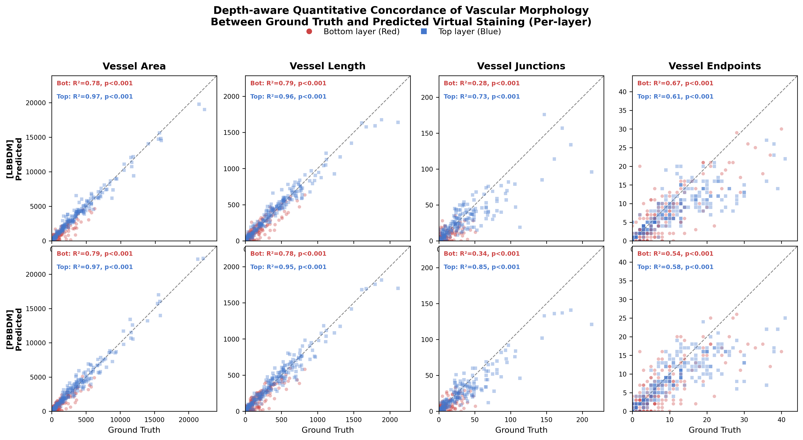
Per-layer depth-aware concordance between GT and model-predicted multi-color virtual staining. Bottom layer (Red, ●) and Top layer (Blue, ■) are independently compared. Bottom 20% excluded (ECM baseline). Hole-filling applied. N=215 per layer.

