Slide 1
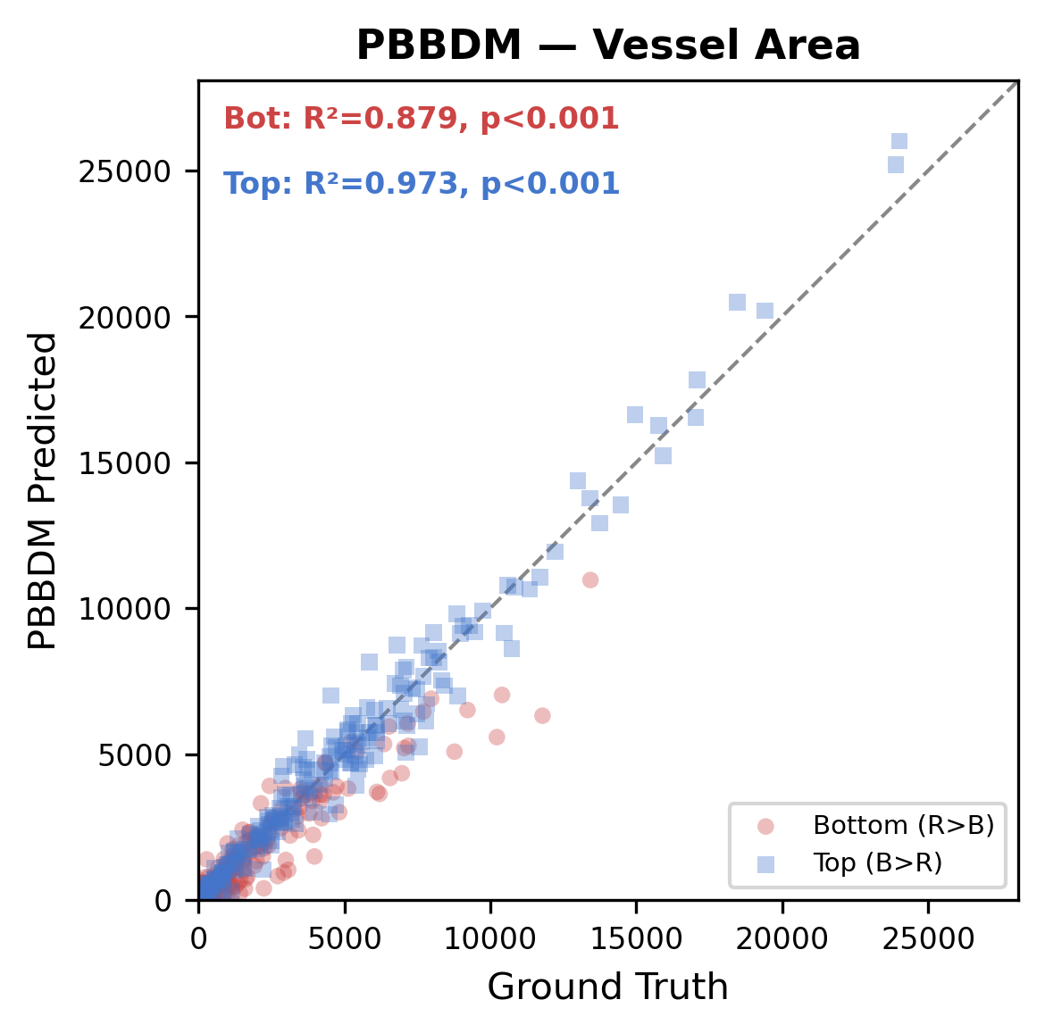
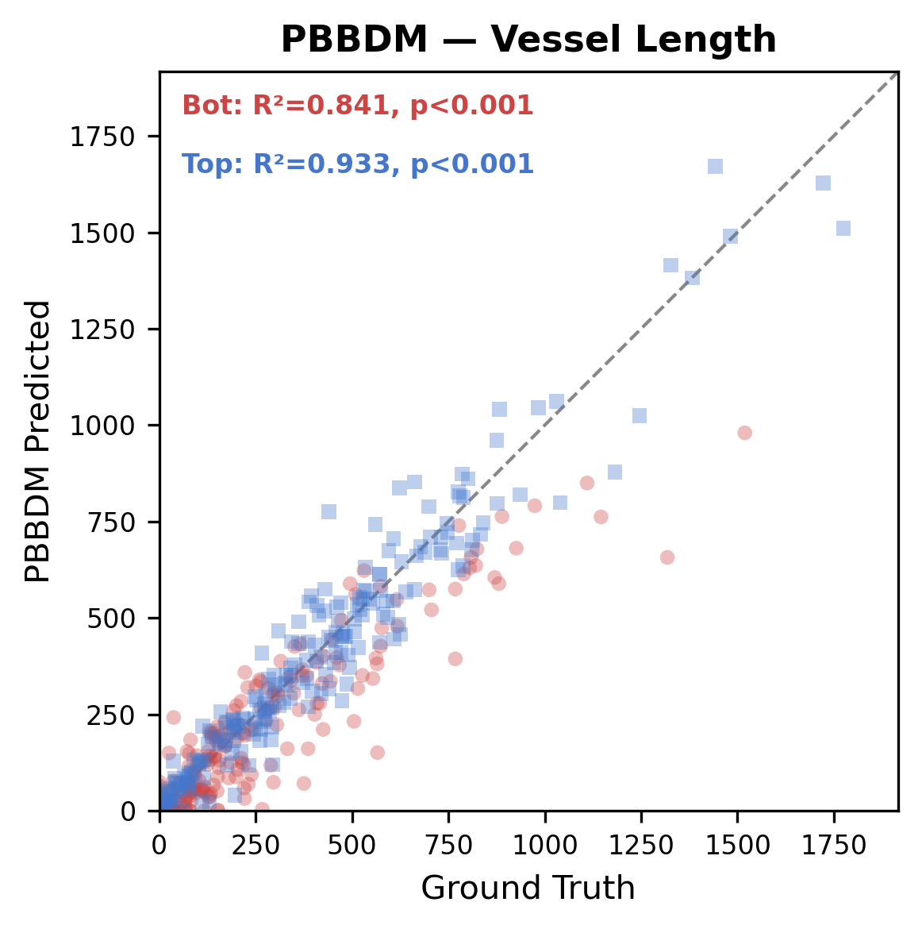
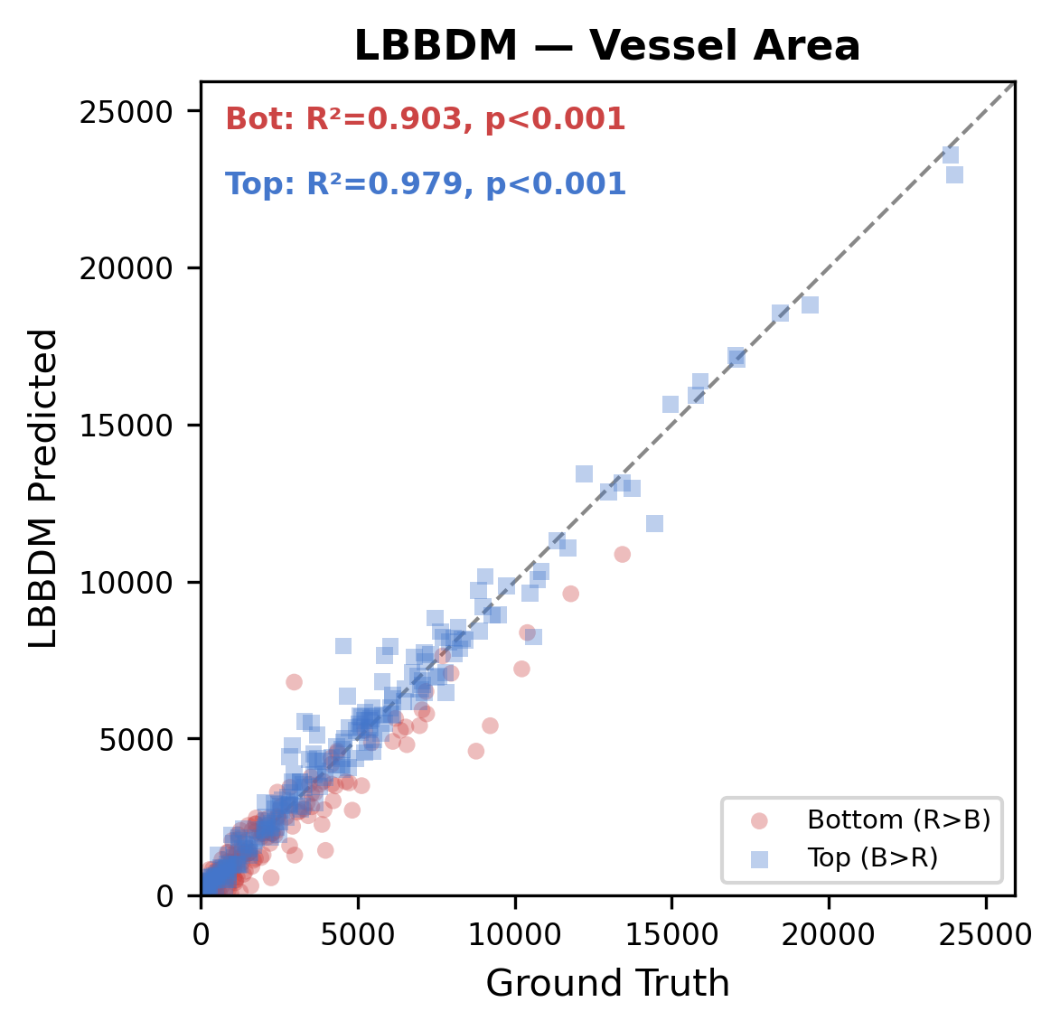
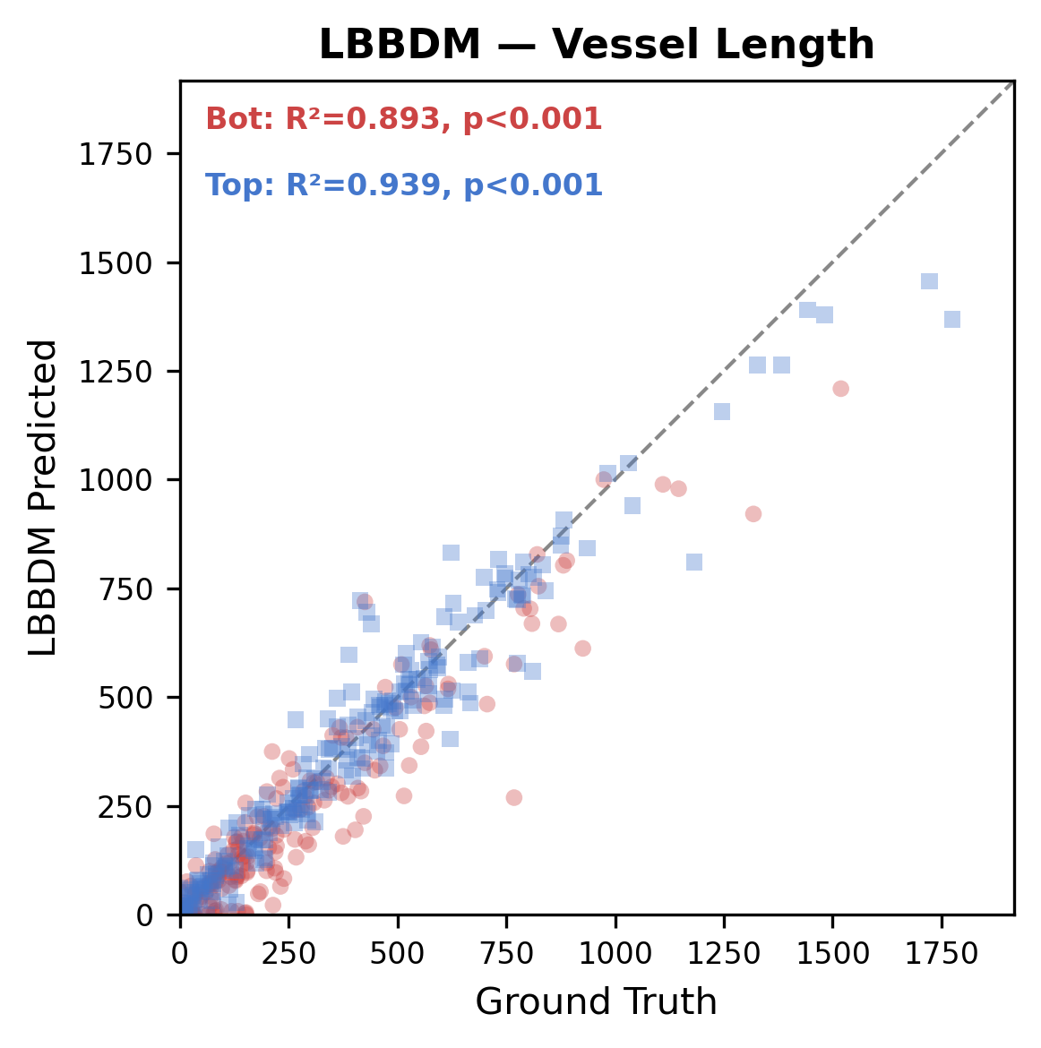
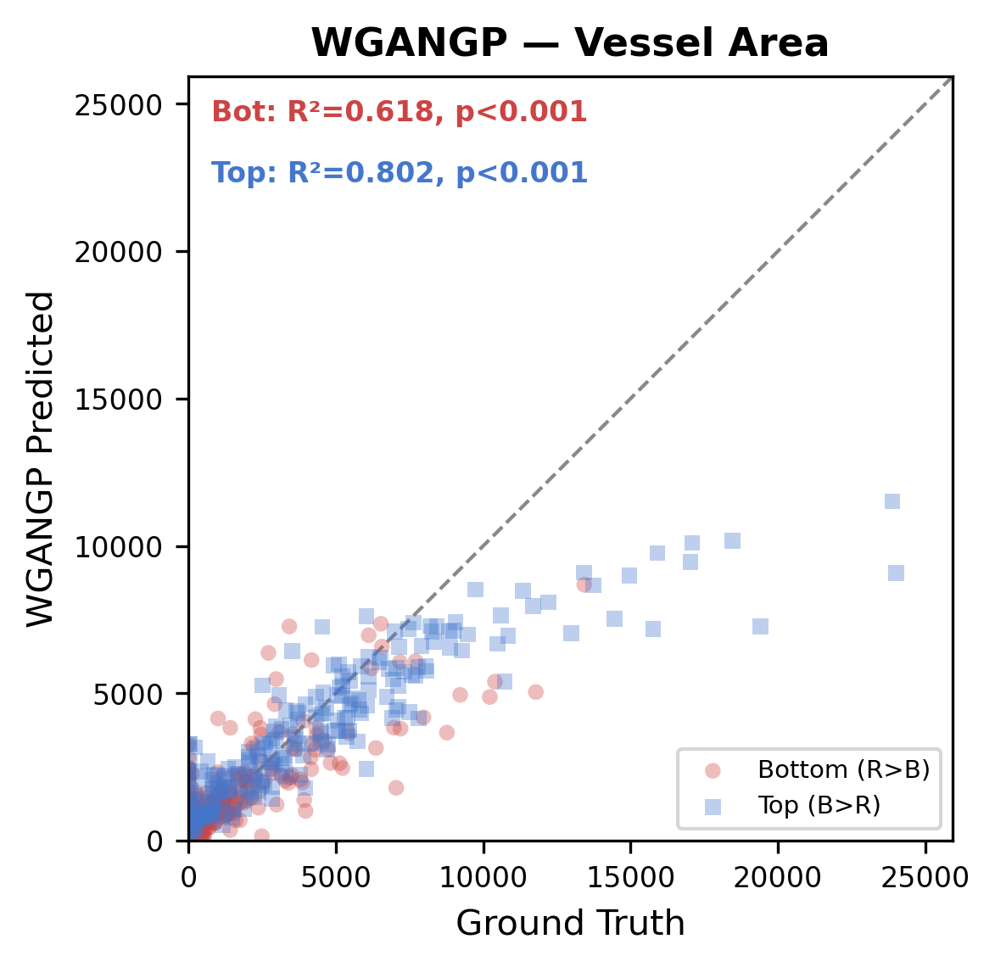
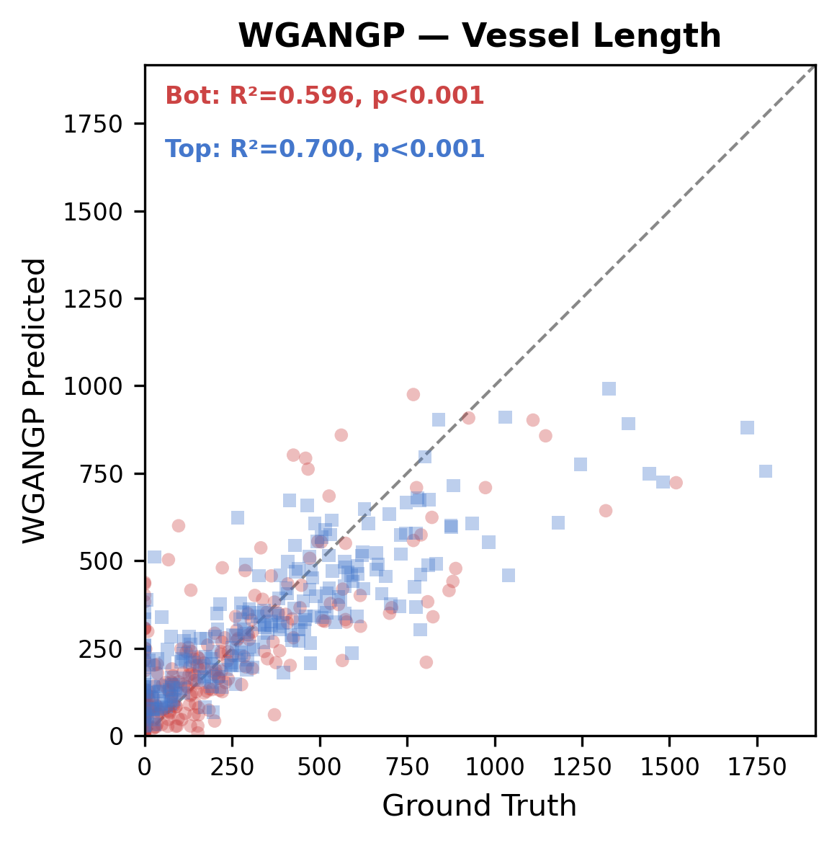
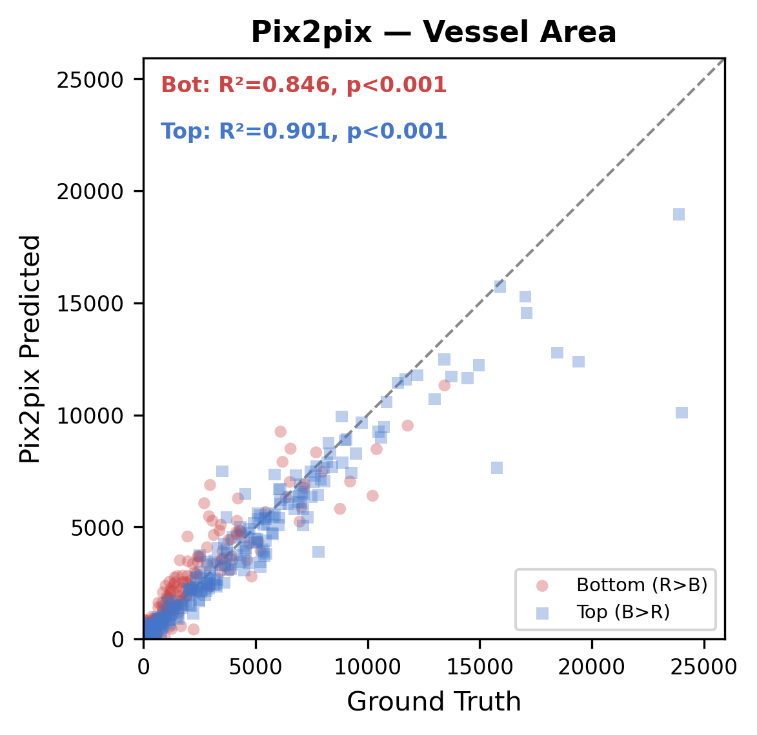
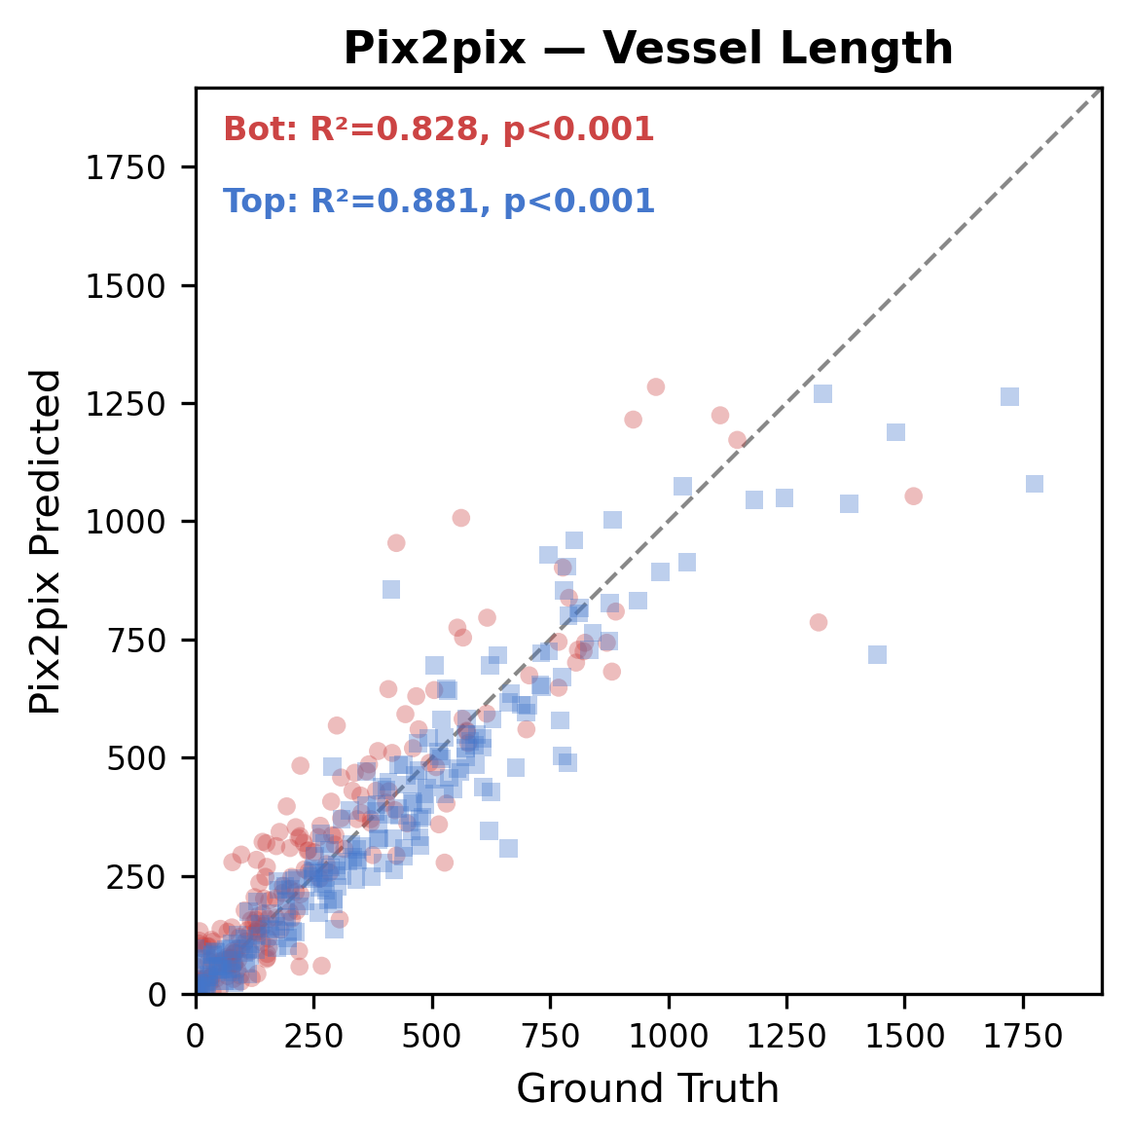
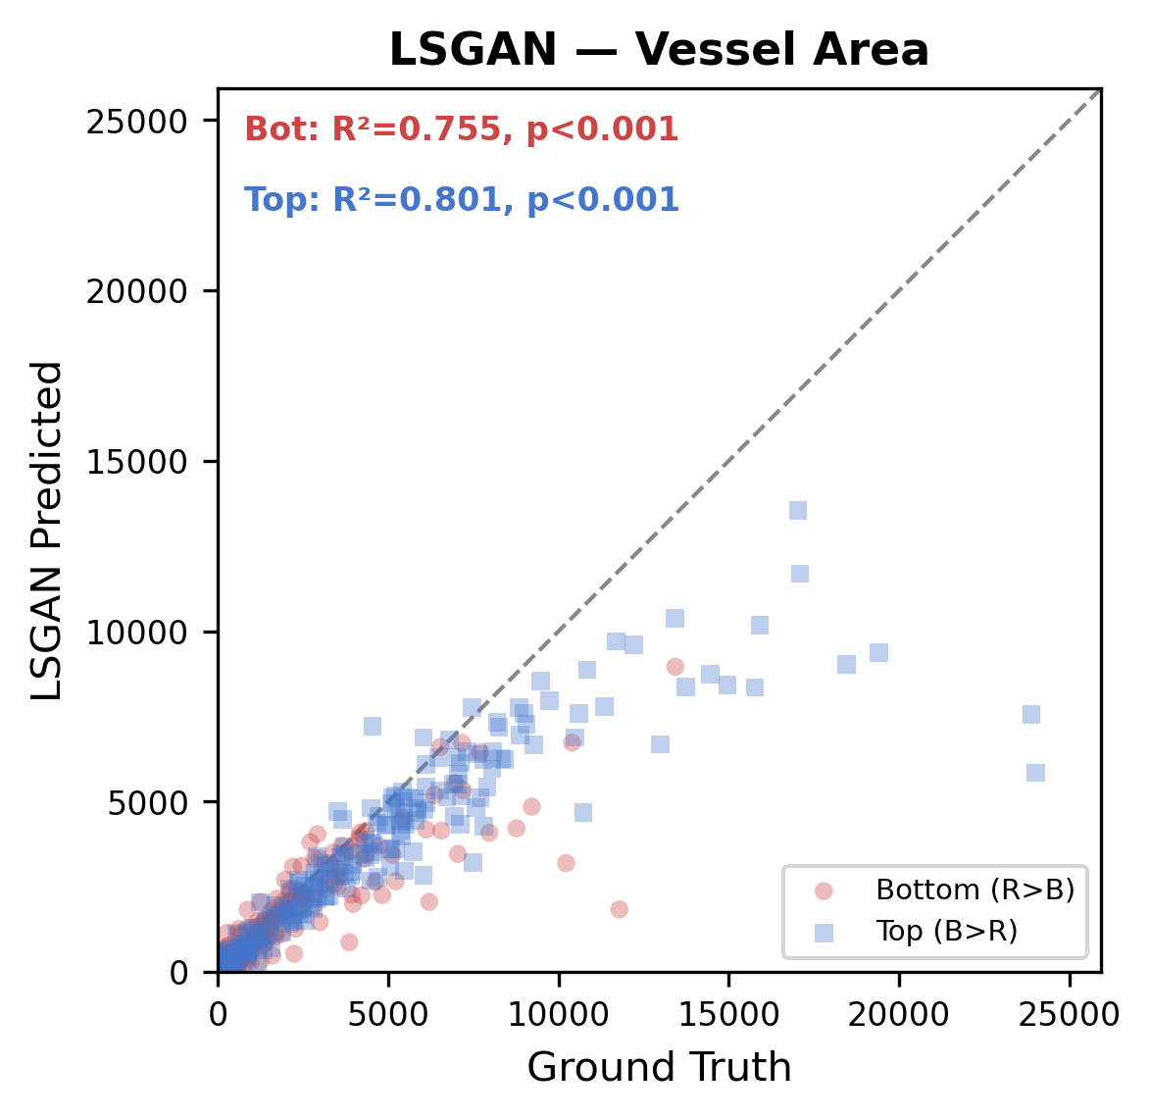
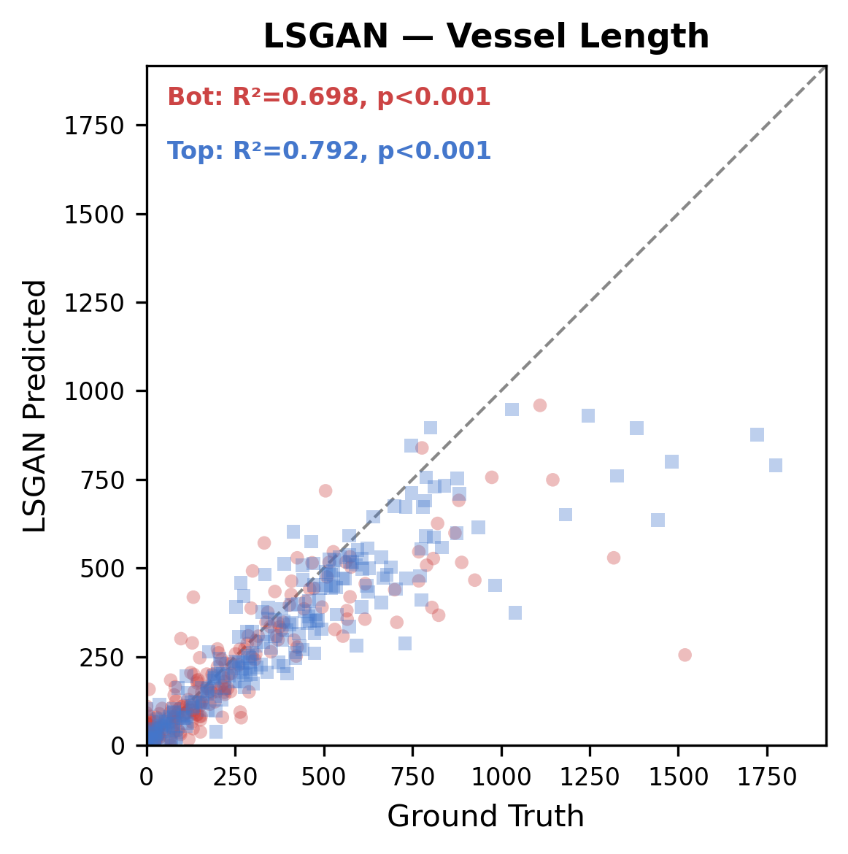
Per-layer Concordance: Area & Length (R² Scatter)
RGB Channel Separation: R>B = Bottom, B>R = Top | N=228 | Bottom 20% excluded
Vessel Area
Vessel Length
R² Summary
 | Area R | Area B | Len R | Len B
PBBDM | 0.879 | 0.973 | 0.841 | 0.933
LBBDM | 0.903 | 0.979 | 0.893 | 0.939
Pix2pix | 0.846 | 0.901 | 0.828 | 0.881
LSGAN | 0.755 | 0.801 | 0.698 | 0.792
WGANGP | 0.618 | 0.802 | 0.596 | 0.700
PBBDM
LBBDM
WGANGP
Pix2pix
LSGAN

Slide 2
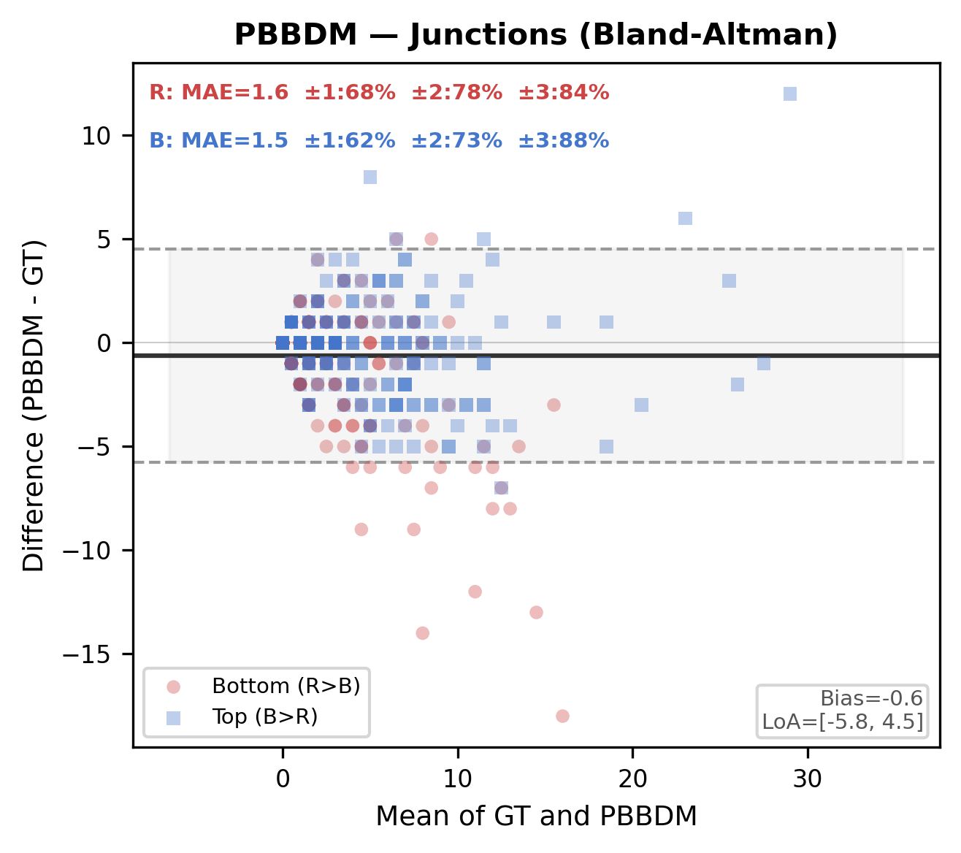
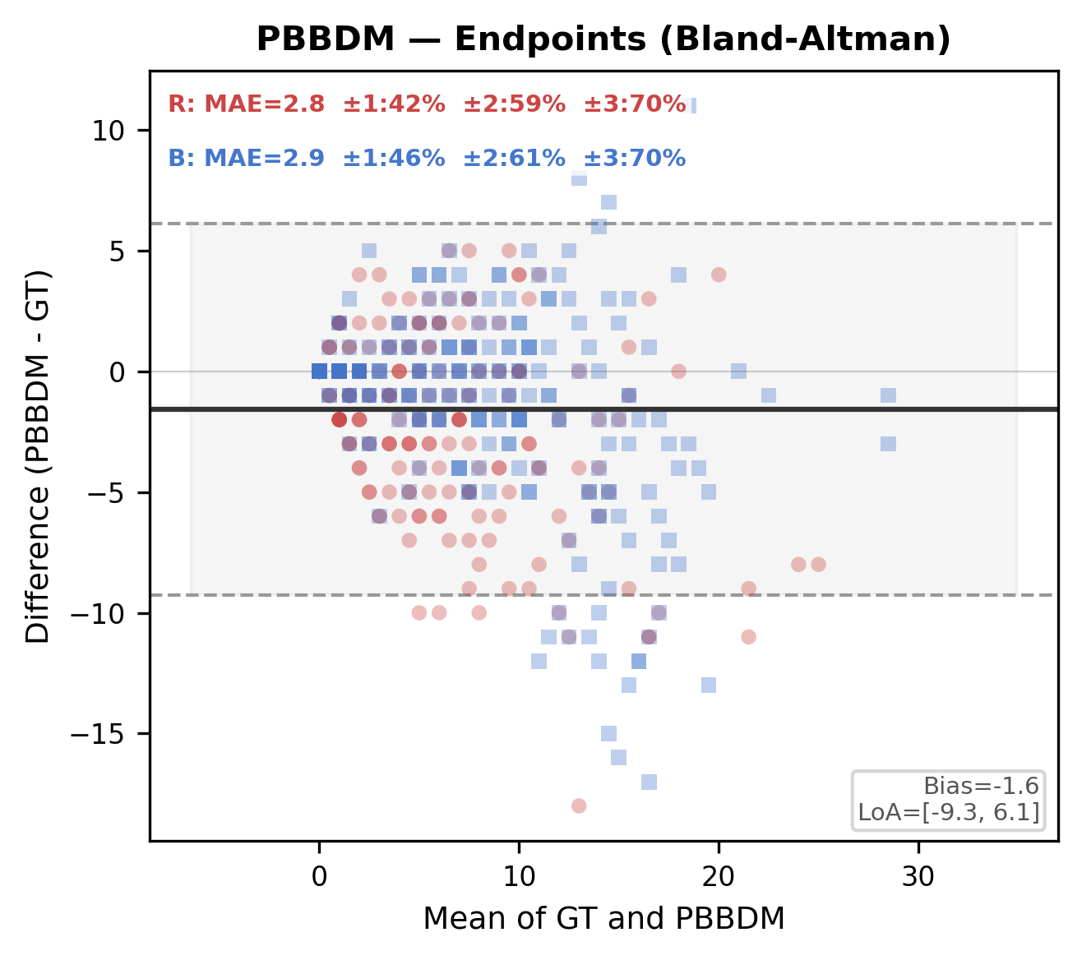
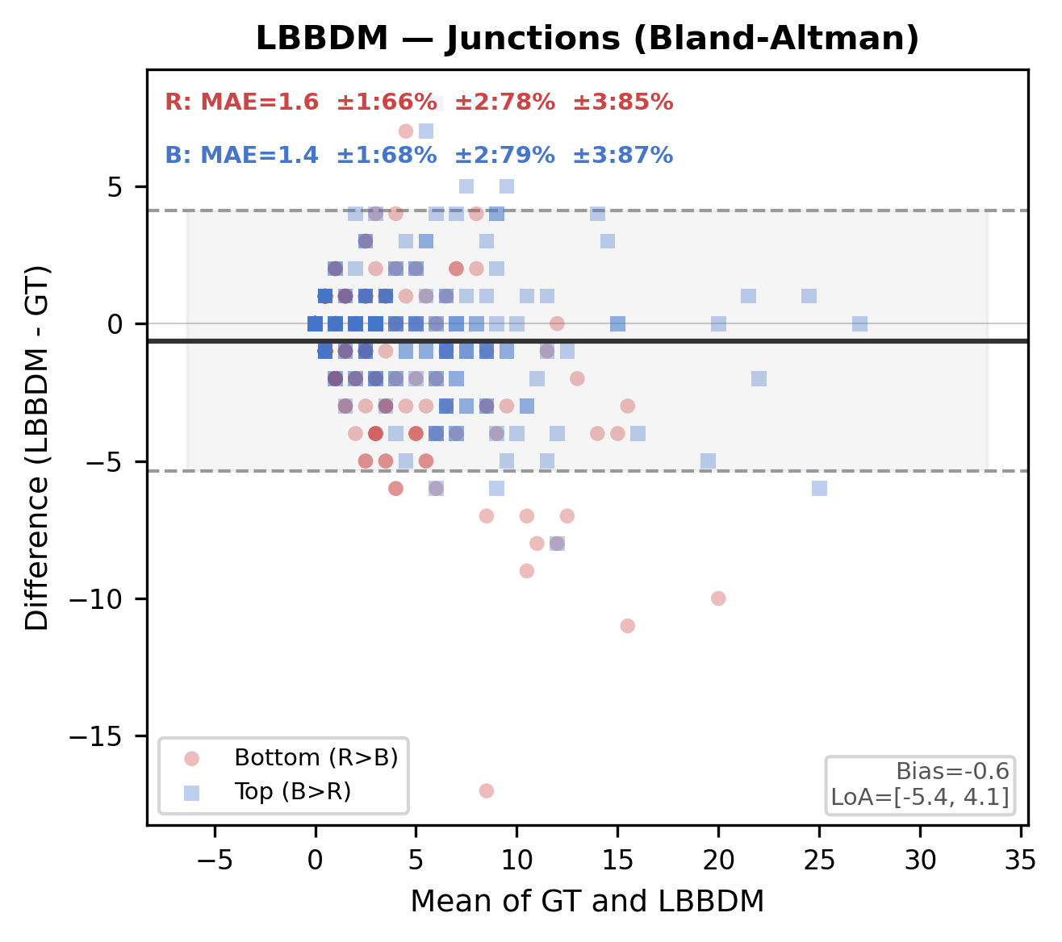
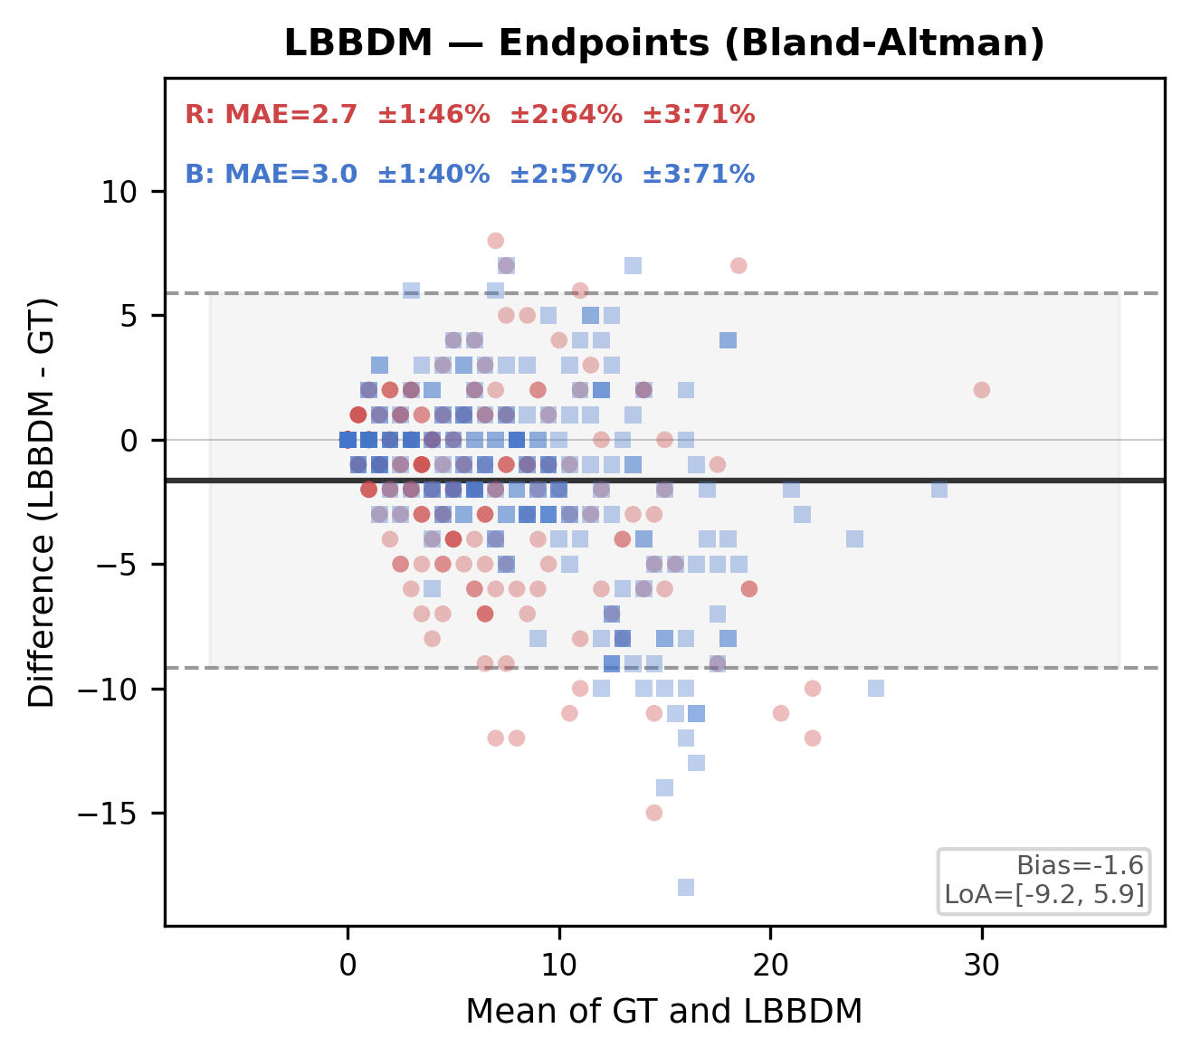
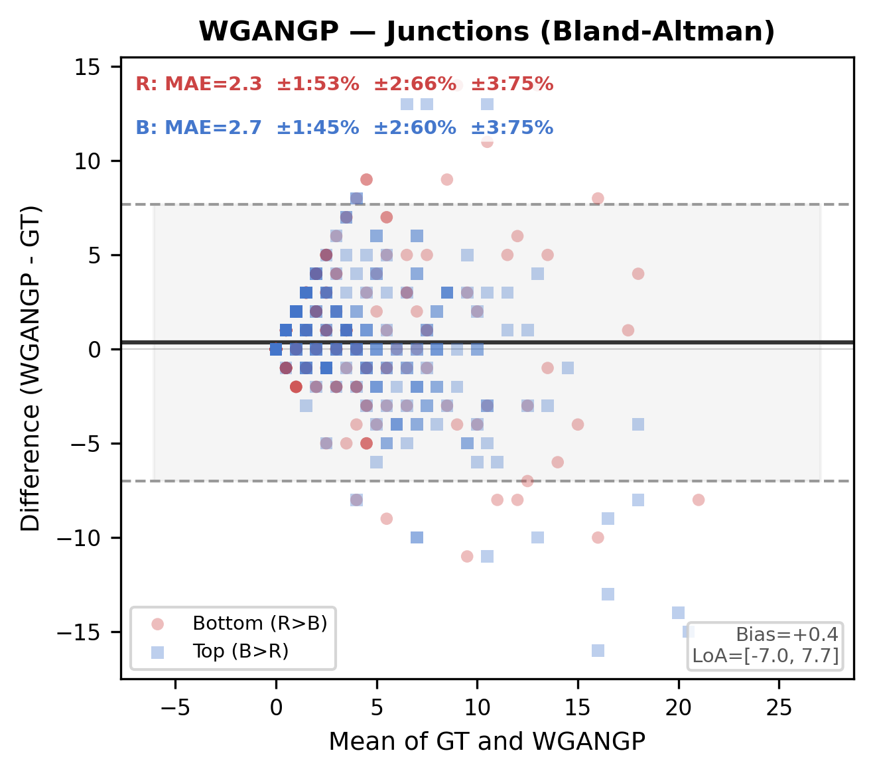
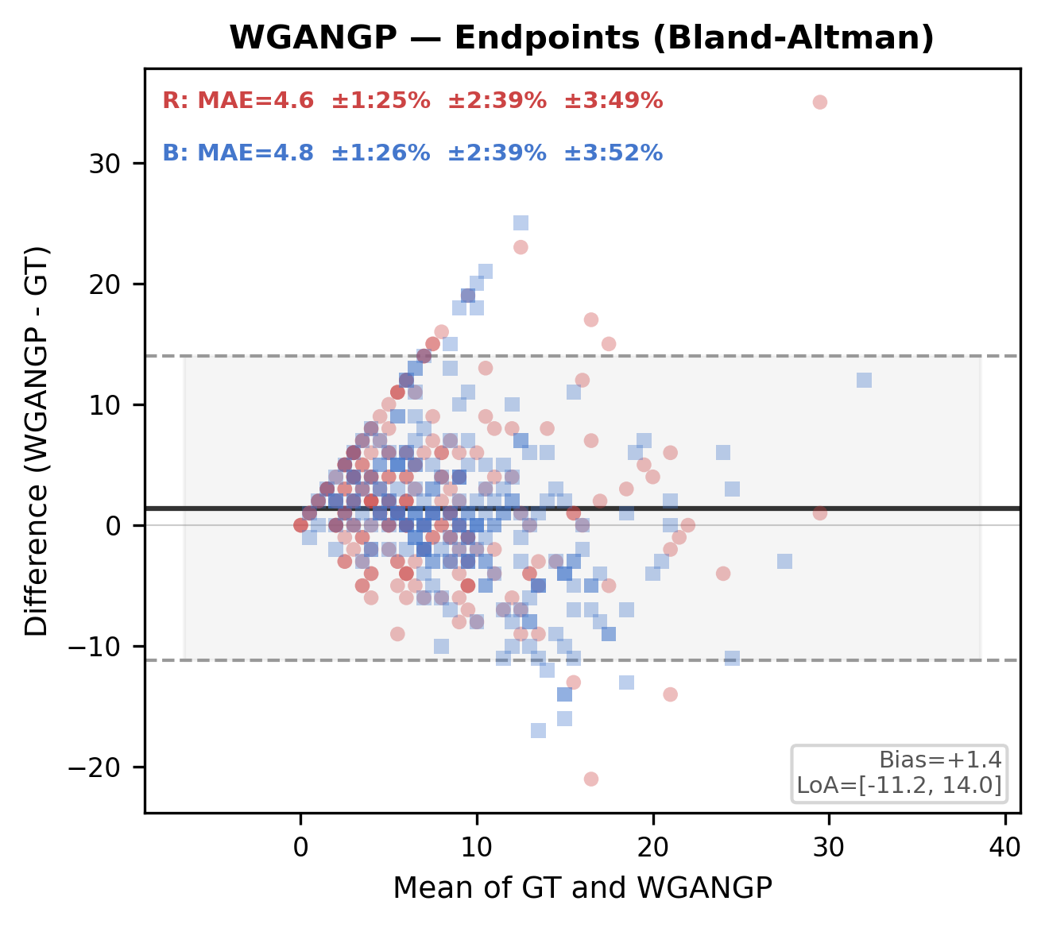
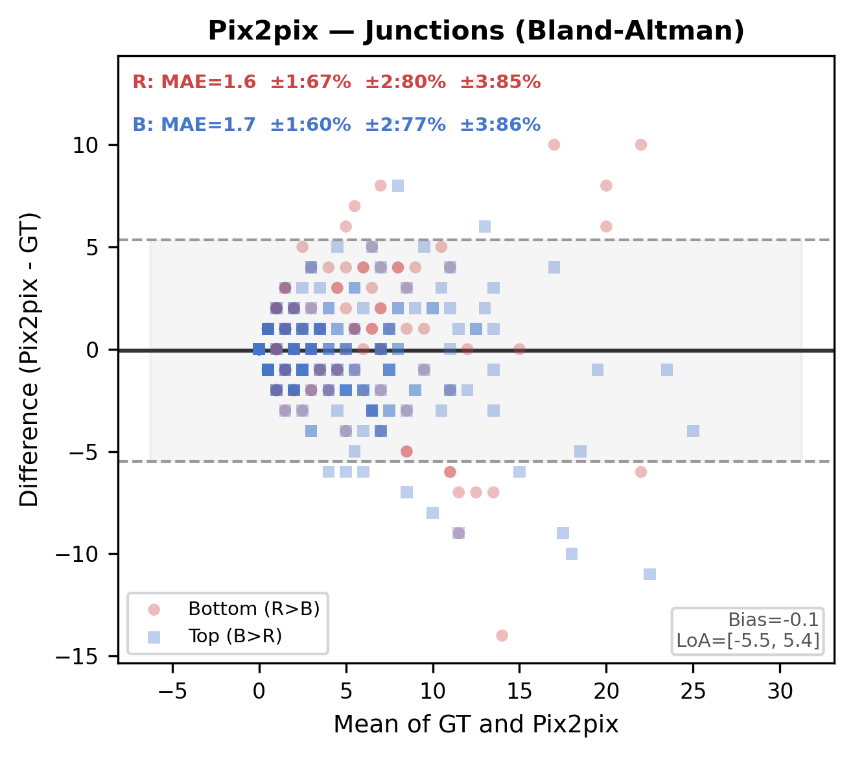
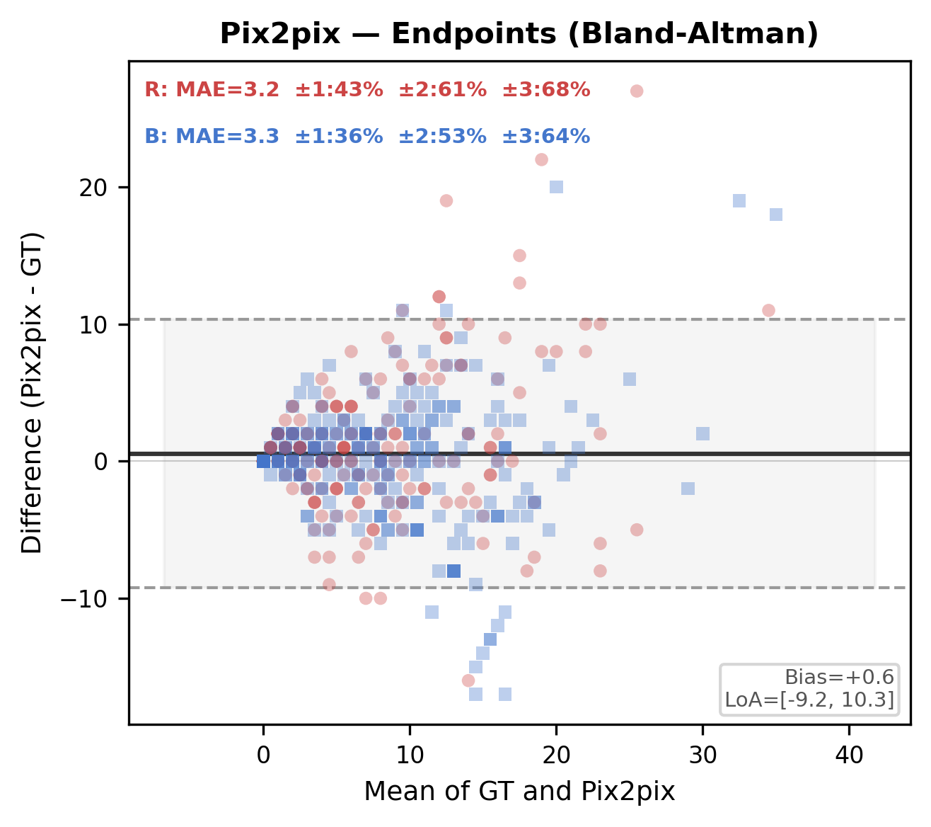
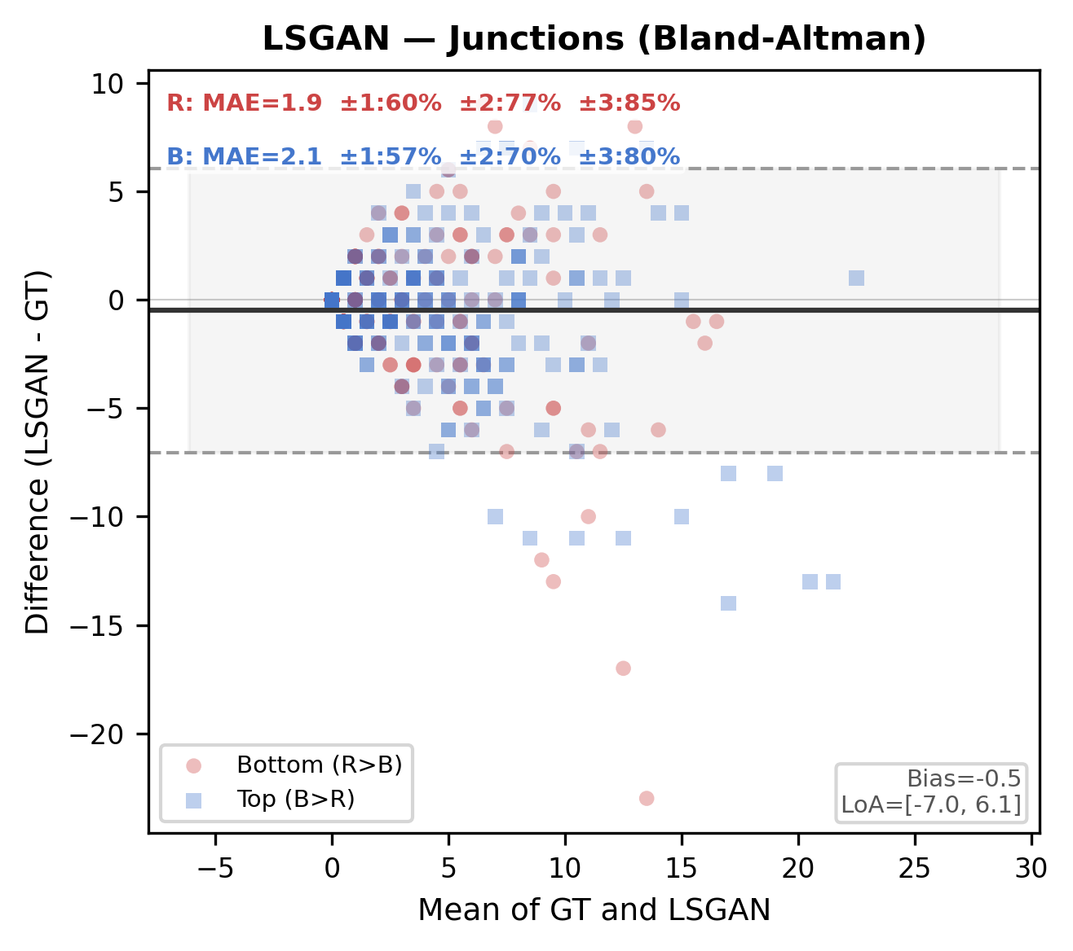
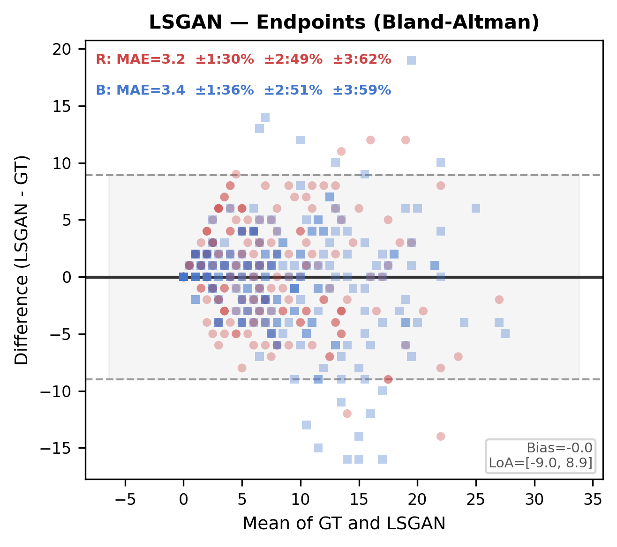
Per-layer Concordance: Junctions & Endpoints (Bland-Altman)
Count metrics (0-30 range): MAE + % within ±3 are more appropriate than R²
Junctions
Endpoints
MAE & Agreement
 | JN MAE | JN ±3% | EP MAE | EP ±3%
PBBDM | 1.6 | 86% | 2.9 | 70%
LBBDM | 1.5 | 86% | 2.9 | 71%
Pix2pix | 1.7 | 86% | 3.3 | 66%
LSGAN | 2.0 | 83% | 3.3 | 61%
WGANGP | 2.5 | 75% | 4.7 | 51%
PBBDM
LBBDM
WGANGP
Pix2pix
LSGAN

Slide 3
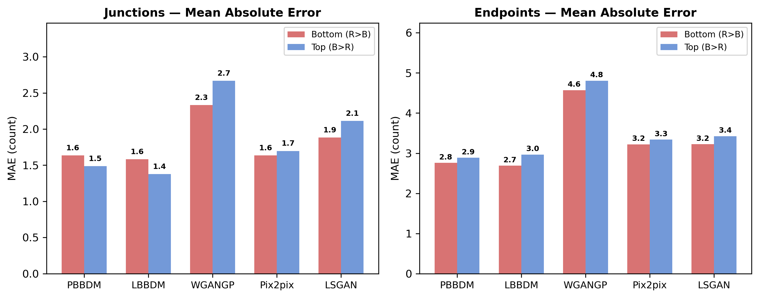
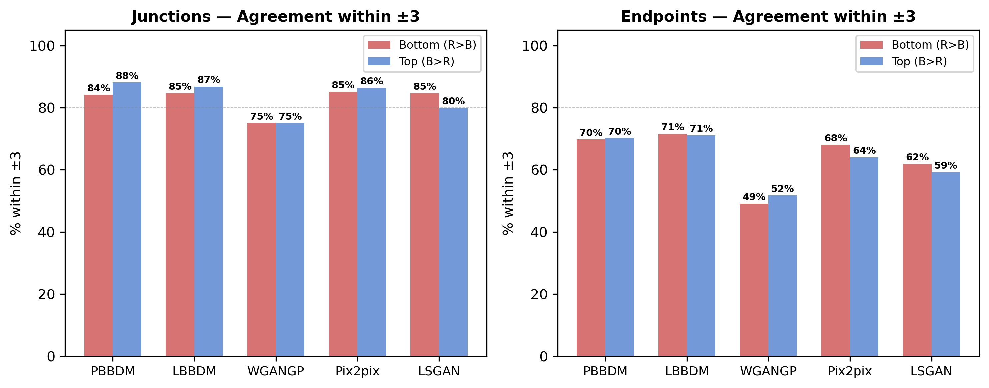
Summary: Per-layer Metric Comparison
Key Findings
1. Diffusion models (PBBDM, LBBDM) achieve JN MAE ≤ 1.6 with 84-88% agreement within ±3
2. GANs show 2-3× higher EP MAE (WGANGP: 4.6-4.8) indicating poor topological fidelity
3. Bottom (R>B) and Top (B>R) layers show consistent patterns across all models
4. Area/Length R² > 0.84 for diffusion models confirms strong morphometric concordance

