Slide 1
Supplementary Figure S2: Tangent-guided Gap Bridging Algorithm
A Algorithm Overview
Step 1
Step 2
Step 3
Endpoint Detection
Tangent Estimation
Candidate Matching
Identify skeleton pixels
with neighbor count = 1
Trace 10–20 px along skeleton
from each endpoint;
compute direction vector
Pair endpoints where:
• distance < 80 px
• cos(θ) > cos(60°)
• vessel mask overlap ≥ 70%
→
→
↓
Step 4
Step 5
Bézier Interpolation
Greedy Selection
Connect via cubic Bézier:
P(t) = (1−t)³P₁ + 3(1−t)²tC₁
+ 3(1−t)t²C₂ + t³P₂
C₁ = P₁ + 0.4d · t₁
Score = (cos₁+cos₂)/2
− d/dₘₐₓ · 0.2
+ overlap · 0.2
Best-first, no endpoint reuse
→
B Bridging Scheme
Before
After
t₂
→
gap
t₁
Bézier

Slide 2
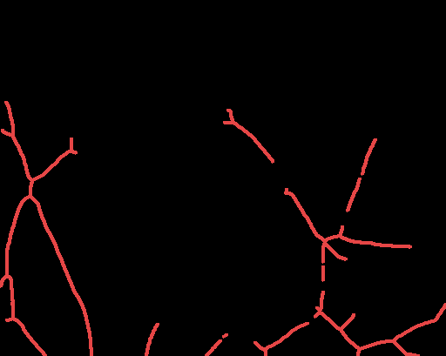
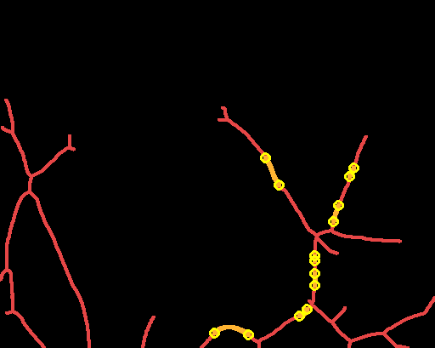
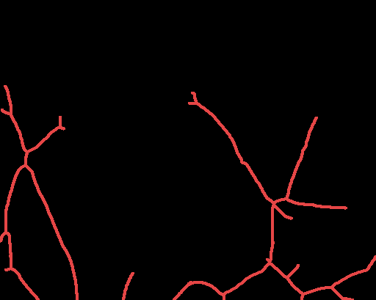
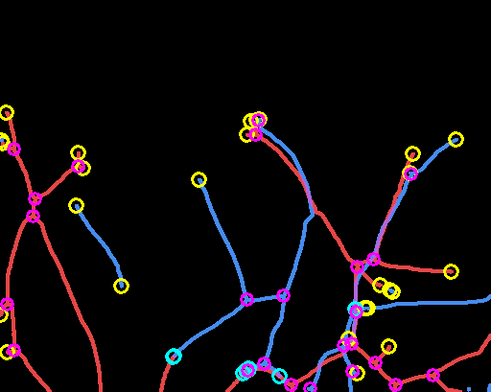
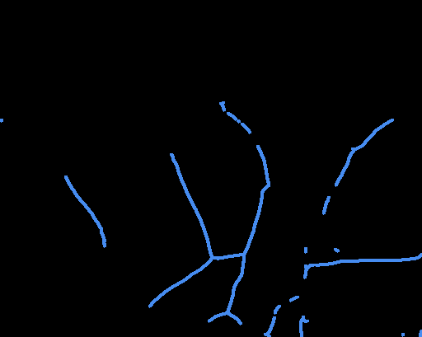
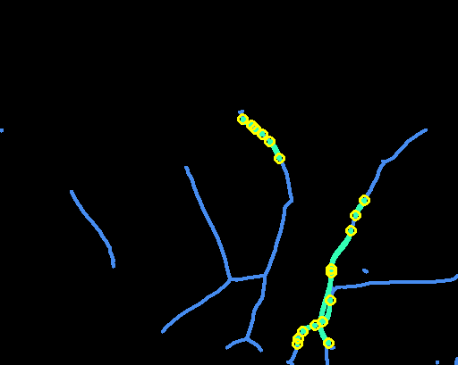
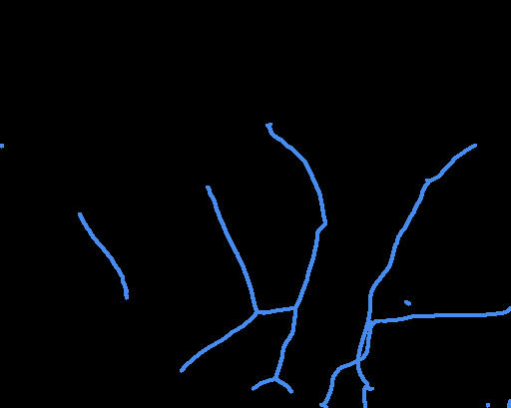
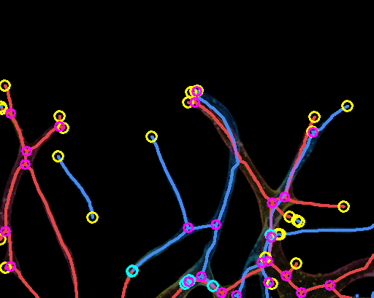
C Bridging Results: Per-layer Before → Bridging → After → Combined
Before
Bridging
After
Combined
R skeleton
(Bottom)
→
→
→
B skeleton
(Top)
→
→
Full image: Combined skeleton on GT overlay
Red R skel Blue B skel Orange R bridge Teal B bridge Purple Overlap ○ EP ○ Conn. ○ JN
R: EP=13(real)+3(conn), JN=15 | B: EP=13(real)+6(conn), JN=9 | Combined: EP(real)=26, JN=24

