Slide 1

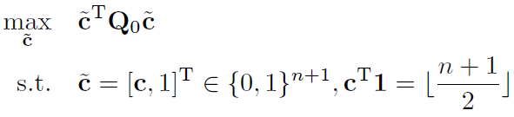

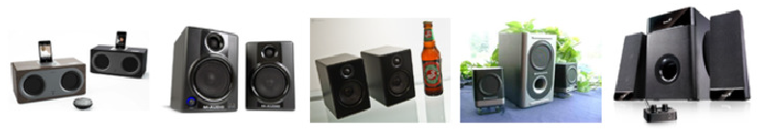

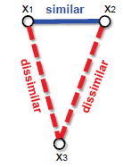
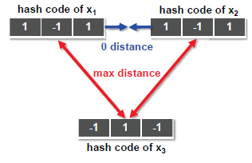
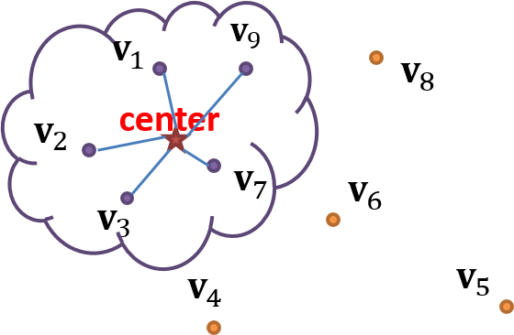

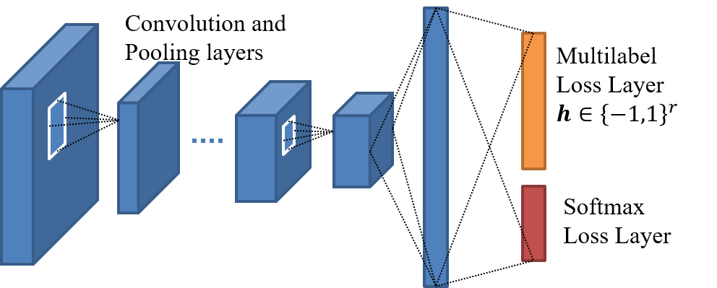
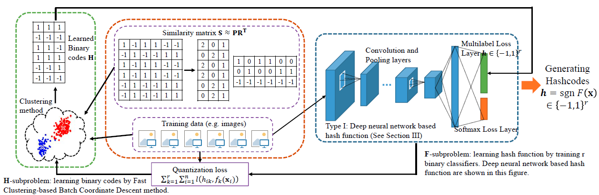
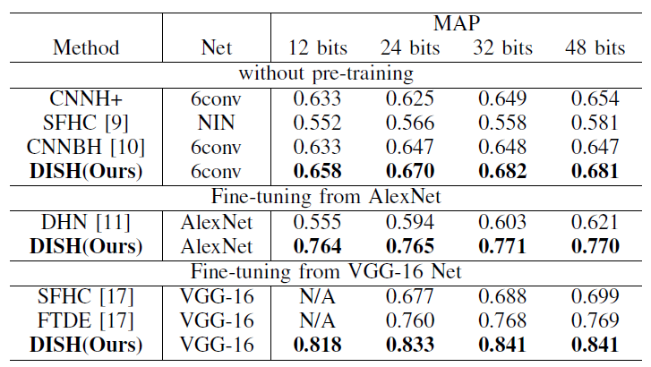
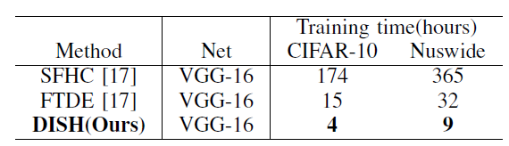
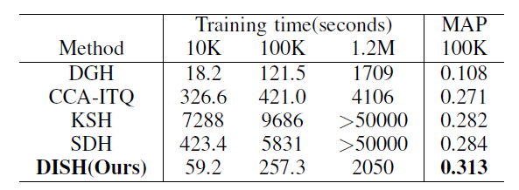
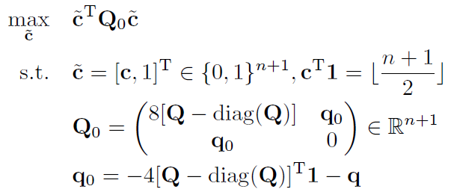


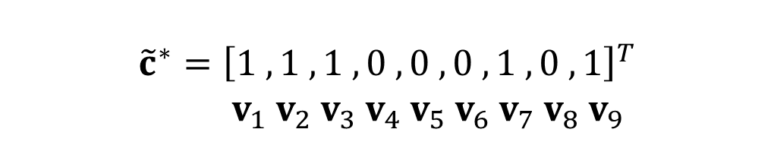



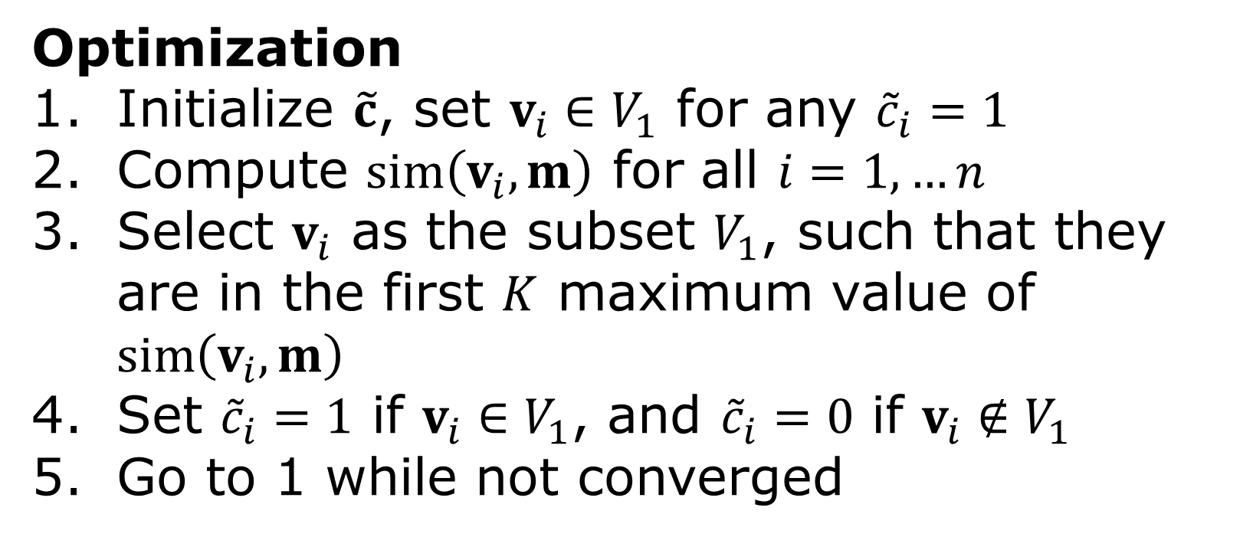
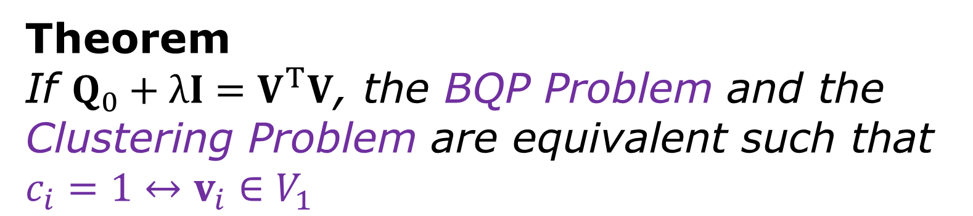
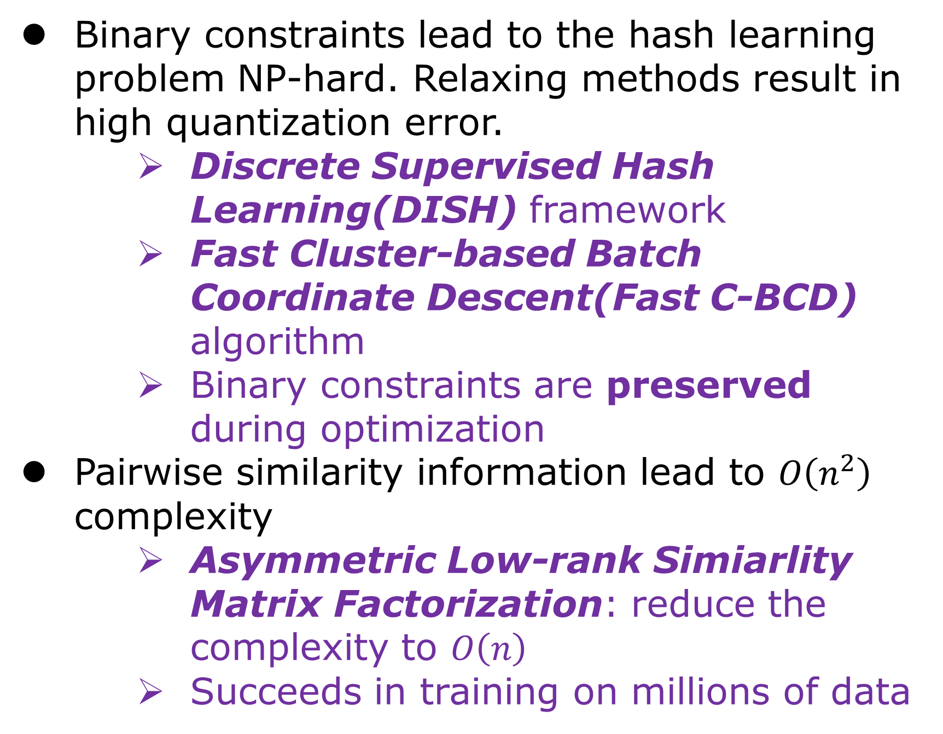
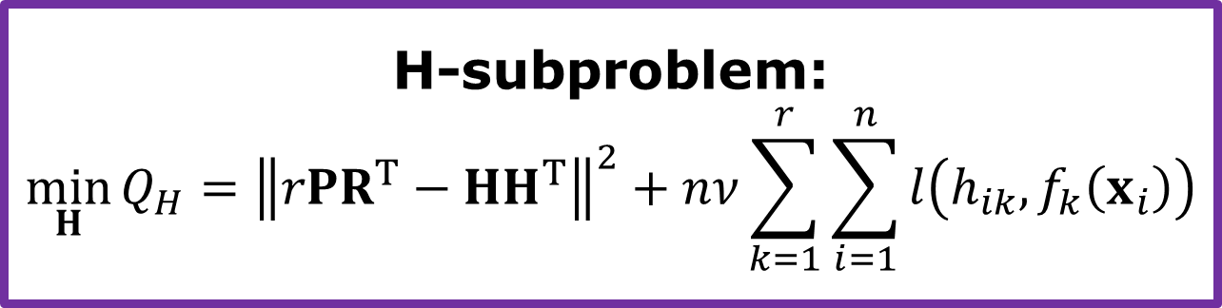
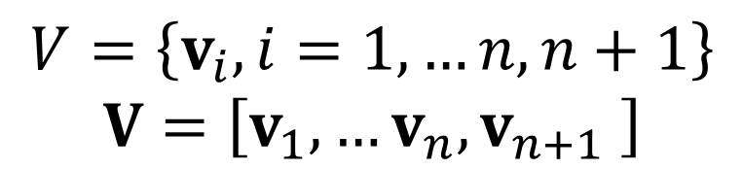


Scalable Discrete Supervised Hash Learning with
Asymmetric Matrix Factorization
Shifeng Zhang, Jianmin Li, Jinma Guo and Bo Zhang
from Department of Computer Science and Technology, Tsinghua University.
Introduction
Fast C-BCD Algorithm
Retrieval for high dimensional data has attracted extensive attentions from academia and industry.
BQP Problem
Hashing methods encode high-dimensional data into compact short binary codes to compress data into small storage space, as well as conduct efficient nearest neighbor search.
$$V=\left\{v_{i},i=1,…n,n+1\right\}$$
$$V=\left[v_{1},…v_{n},v_{n+1} \right]$$
Clustering Problem
Theorem
If $Q_{0}+λI=V^{T}V$, the BQP Problem and the Clustering Problem are equivalent such that $c_{i}=1↔v_{i}∈V_{1}$
$${\tilde{c}}^{∗}={\left[1 ,1 ,1 ,0 ,0 ,0 ,1 ,0 ,1\right]}^{T}$$
$v_{1}{ v}_{2} v_{3} v_{4} v_{5} v_{6} v_{7} v_{8} v_{9}$
Optimization
Initialize $\tilde{c}$, set $v_{i}∈V_{1}$ for any ${\tilde{c}}_{i}=1$
Compute $sim\left(v_{i},m\right)$ for all $i=1,…n$
Select $v_{i}$ as the subset $V_{1}$, such that they are in the first $K$ maximum value of $sim\left(v_{i},m\right)$
Set ${\tilde{c}}_{i}=1$ if $v_{i}∈V_{1}$, and ${\tilde{c}}_{i}=0$ if $v_{i}∉V_{1}$
Go to 1 while not converged
Challenges
Binary constraints lead to the hash learning problem NP-hard. Relaxing methods result in high quantization error.
Discrete Supervised Hash Learning(DISH) framework
Fast Cluster-based Batch Coordinate Descent(Fast C-BCD) algorithm
Binary constraints are preserved during optimization
Pairwise similarity information lead to $O\left(n^{2}\right)$ complexity
Asymmetric Low-rank Simiarlity Matrix Factorization: reduce the complexity to $O\left(n\right)$
Succeeds in training on millions of data
Extension to Deep Hashing
Optimize during the F-subproblem
Input data$x_{i}$
DISH framework
Experimental Results
We demonstrate our models on three real datasets:
Ranking performance of different deep hashing methods
Scalability: training time on different dataset
Data Set | # Training set | # images in database | # query set | Similarity measure
CIFAR10 | 5,000 | 59,000 | 1,000 | Share at least one semantic label
Nuswide | 190K | 190K | 2,100
ImageNet | 10K-1200K | 1200K | 50K
The learning problem
$$\min_{F}{Q}=\sum_{i,j=1}^{n}{{\left({rs}_{ij}−h{\left(x_{i}\right)}^{T}h\left(x_{j}\right)\right)}^{2}}={\left\|rS−H\left(X\right)H{\left(X\right)}^{T}\right\|}^{2}$$
Deal with binary constraints
$$\min_{H,F}{Q}={\left\|rS−HH^{T}\right\|}^{2}+nν\sum_{i=1}^{n}{\sum_{k=1}^{r}{l\left(h_{ik},f_{k}\left(x_{i}\right)\right)}}$$
Asymmetric Matrix Factorization
$$\min_{H,F}{Q}={\left\|rPR^{T}−HH^{T}\right\|}^{2}+nν\sum_{k=1}^{r}{\sum_{n=1}^{n}{l\left(h_{ik},f_{k}\left(x_{i}\right)\right)}},S≈PR^{T}, P∈R^{n×l},R∈R^{n×l}, l≪n$$
Discrete Learning Scheme
H-subproblem:
$$\min_{H}{{Q_{H}=\left\|rPR^{T}−HH^{T}\right\|}^{2}+nν\sum_{k=1}^{r}{\sum_{i=1}^{n}{l\left(h_{ik},f_{k}\left(x_{i}\right)\right)}}}$$
F-subproblem:
$$\min_{F}{Q_{F}=\sum_{k=1}^{r}{\sum_{i=1}^{n}{l\left(h_{ik},f_{k}\left(x_{i}\right)\right)}}}$$
Deep hashing methods (left)
ImageNet+kernel-based hashing (right)
F-subproblem
Train $r$ binary classifiers
H-subproblem
Batch Coordinate Descent: learn one column of $H$ iteratively
$$\min_{b}{{Q_{H}(b)=\left\|rPR^{T}−bb^{T}−H{′H′}^{T}\right\|}^{2}+nν\sum_{i=1}^{n}{l\left(h_{ik},f_{k}\left(x_{i}\right)\right)}}$$
Constrained Binary Quadratic Programming(BQP)
$$c =(b+1)/2$$
Bit-balanced constraints
$$Q=rPR^{T}−H{′H′}^{T}$$
Contact Info
$q$ is related to $l\left(⋅,⋅\right)$
Shifeng Zhang (张世枫) PhD Student @ THU
zhangsf15@mails.tsinghua.edu.cn
Welcome for discussing!

