Slide 1

Bitcoin Trading Agent with Reinforcement Learning
CSE402_Reinforcement Learning
DGIST
Jung wonkyun
Choi donghyeon

Slide 2
Table of Contents
Introduction
Dataset
Design & Experiment Setting
Results
Conclusion
References

Slide 3
Introduction
About Bitcoin
around 8 million won in early 2017, has risen at least 10 times to a high of 80 million won in 2021.
price volatility of up to 50% or more.
Why Learn with Reinforcement Learning?
RNNs or CNNs is not enough to make mostly correct decisions in the crypto-trading world
reinforcement learning in combination with some clever deep neural network optimized policies.

Slide 4
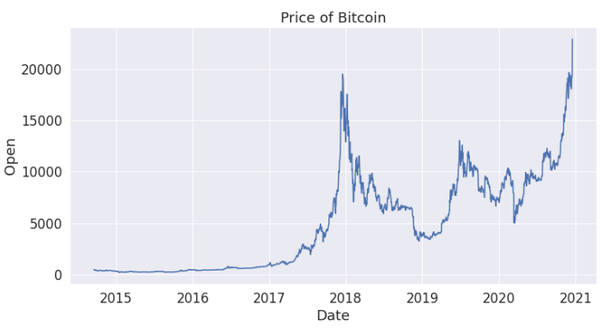
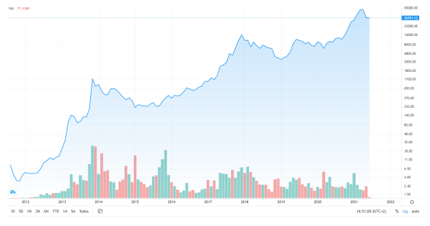
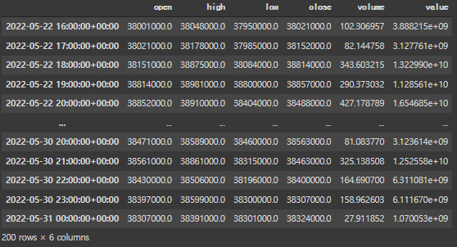
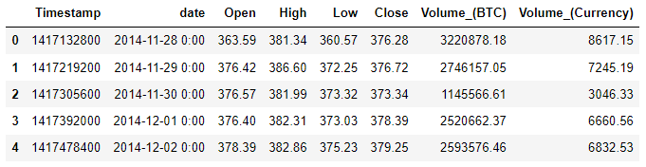
Dataset
Historical Bitcoin
Price of Bitcoin, from 2014/11/28 to 2022/03/01
Data Sample of BTC price from Crypto Data, from 2014/11/28 to 2022/03/01
Results the latest 200 hours of Bitcoin data with the pyupbit library

Slide 5
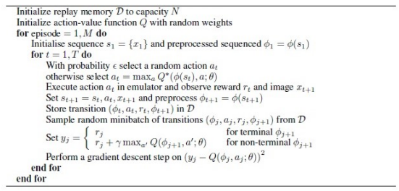
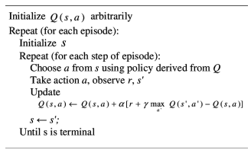
Design
Deep Q-learning algorithm

Slide 6
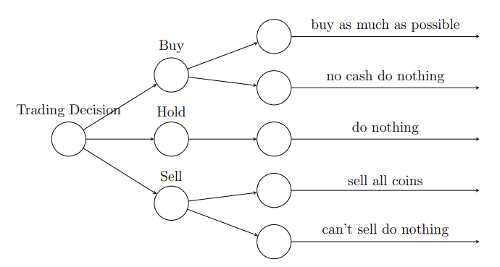


Design
Action
 m: remaining cash
 r: rate of commission fee
 pi: the price of each cryptocurrency
 ni: the number of shares of each cryptocurrency
Rewards
Agent
schematic diagram of the Illustration of Trading Decision

Slide 7
Experiment Setting
Experiment Environment
Jupyter Notbook environment, configured with a Nvidia Geforce GTX 1050 GPU, Intel(R) Core(TM) i7-7700HQ CPU, 8.00GB memory capacity.
Training and Testing Data
Data Type | Time Range
Training | 2014-11-28 to 2022-03-01
Testing | 2022-03-02 to 2022-05-30
Hyper-parameter Setting
Hyper-parameter | Value | Description
Money | 500000 | Initial capital
Epoch | 10 | Number of passing through the entire training dataset
Batch size | 32 | Number of samples propagating through the network
Discount rate γ | 0.95 | Importance of considering rewards in the distant future
Exploration rate | 1 | Probability of choosing actions in random
decay rate | 0.995 | Decrease the probability of choosing actions in random

Slide 8
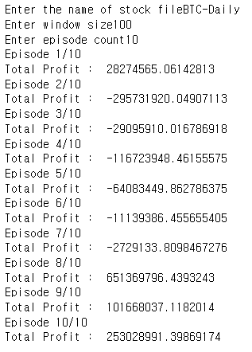
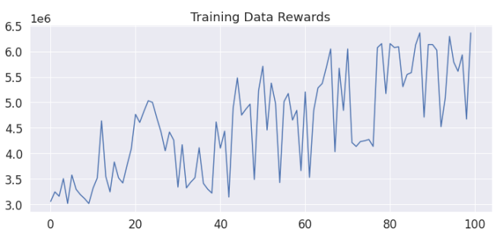
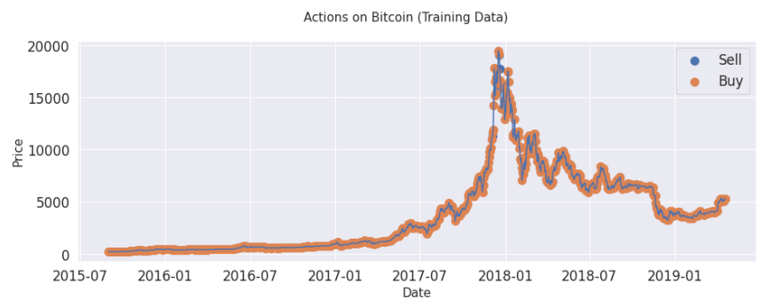

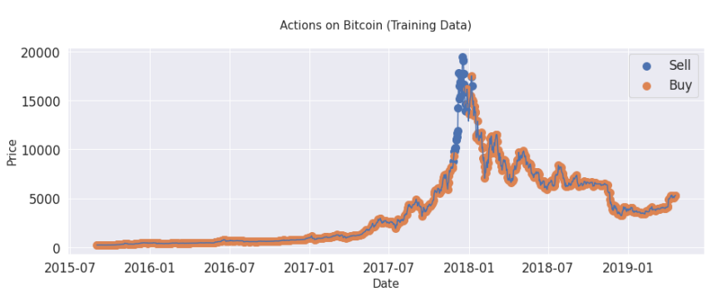
Results
Training Result (10 epochs)
Training Result (100 epochs) / Buy-Sell propensity in training model
Trend of Training Data Rewards within 100 epochs
Trend of Training Data Rewards within 10th epochs
Training Result for 10 Episode
Trend of Training Data Rewards within 55th epochs
Trend of Training Data Rewards within 100th epochs

Slide 9
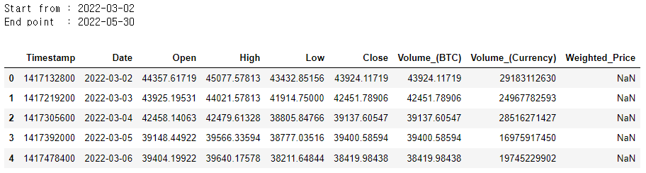
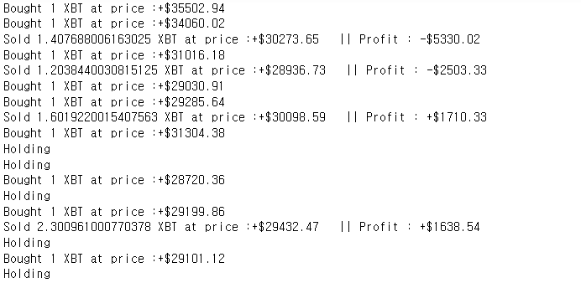
Results
Testing Result
Test Data Sample of BTC price from Crypto Data, from 2022/03/02 to 2022/05/30
['-$190104.89', '+$255050.92', '+$959016.59', '-$108321.19', '-$2026325.06', '+$0.00', '+$0.00', '+$0.00', '+$0.00', '+$0.00’… ]
Learning Process for Test dataset
profit of $959016 was obtained with a capital of $500000

Slide 10
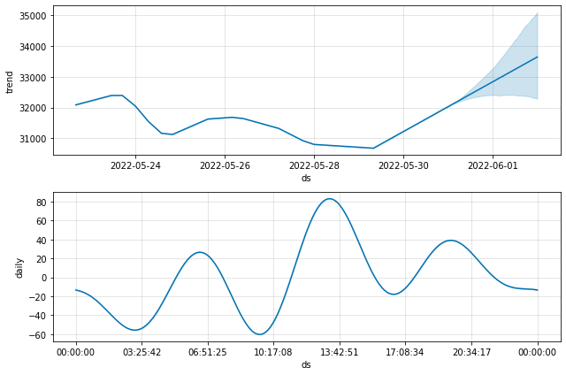
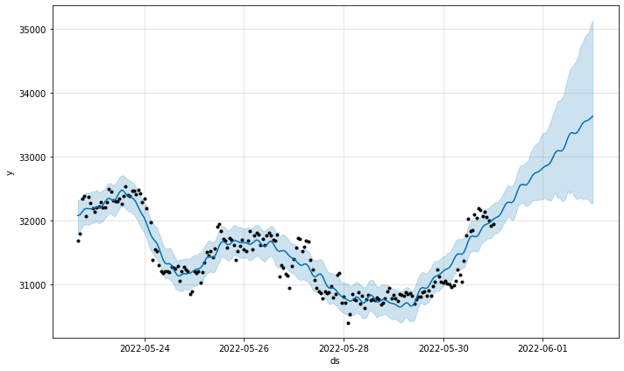
Results
API Testing Result
With May 30, Bitcoin Price Prediction for May 31st and June 1
Bitcoin Price Prediction and Bitcoin Price Plot Over Time

Slide 11
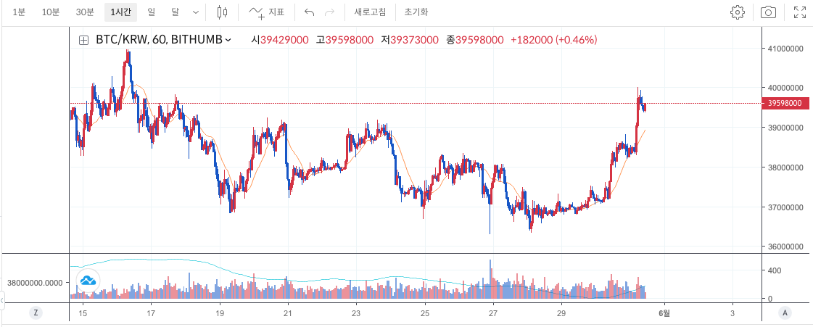
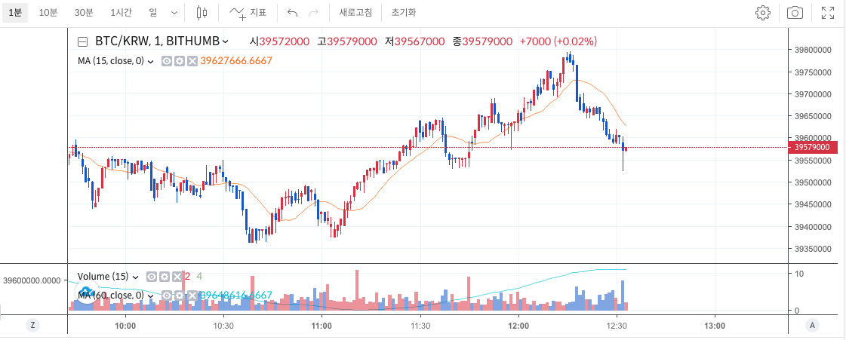
Results
API Testing Result
Real Bitcoin Price for each day
Real Bitcoin Price for each hour on May 31

Slide 12
Conclusion
Similar Research of Auto trading bot
when Q-learning and DQN are used, good returns can be obtained by testing the latest data.
According to Cano (2021) Double Deep-Q-Learning, Deep Actor-Critic, Proximal Policy Optimization, Deep Deterministic Policy Gradient, Twin Delayed DDPG, Soft Actor-Critic Algorithm to make Auto trading model.
Analysis of Global Results
• Agents.
• Environment.

Slide 13
References
Chakole, J. B., Kolhe, M. S., Mahapurush, G. D., Yadav, A., & Kurhekar, M. P. (2021). A Q-learning agent for automated trading in equity stock markets. Expert Systems with Applications, 163, 113761. https://doi.org/10.1016/j.eswa.2020.113761
Lee, J. W., Park, J., O, J., Lee, J., & Hong, E. (2007). A Multiagent approach to Q-Learning. for daily stock trading. IEEE Transactions on Systems, Man, and Cybernetics - Part A: Systems and Humans, 37(6), 864-877. https://doi.org/10.1109/tsmca.2007.904825
Park, H., Sim, M. K., & Choi, D. G. (2020). An intelligent financial portfolio trading strategy using deep Q-learning. Expert Systems with Applications, 158, 113573.
https://doi.org/10.1016/j.eswa.2020.113573
Schnaubelt, M. (2020). Deep reinforcement learning for the optimal placement of. cryptocurrency limit orders. European Journal of Operational Research, 296(3), 993-1006. https://doi.org/10.1016/j.ejor.2021.04.050
Cano, J. (2021). AutoTrading with Reinforcement Learning. Departament de Matemàtiques i. Informàtica (Attached to our zip file)

Slide 14
Thank you! Q & A

