Slide 1

Operation and Tensor

Slide 2
Reference
Youtube
Code

Slide 3
Operation and Tensor

Slide 4
Operation = Function

Slide 5
Input = Tensor
Operation = Function

Slide 6
Input = Tensor
Operation = Function
Output = Tensor

Slide 7
Operation = Placeholder
Constant

Slide 8
No Input
Operation = Placeholder
Constant

Slide 9
No Input
Operation = Placeholder
Constant
Output = Tensor

Slide 10
Experiment

Slide 11
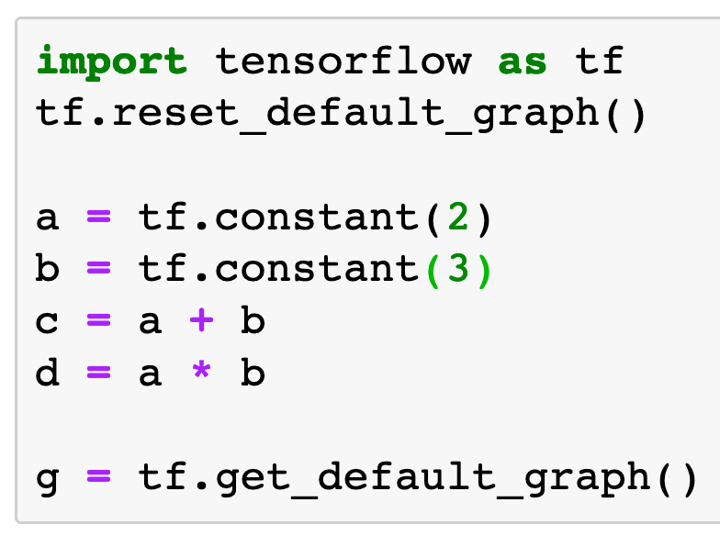

Slide 12
g.get_operations()

Slide 13
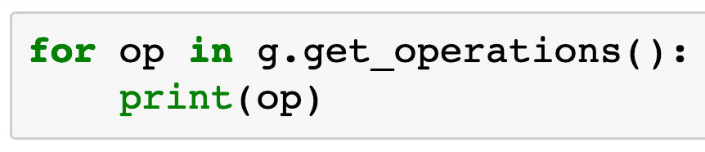

Slide 14
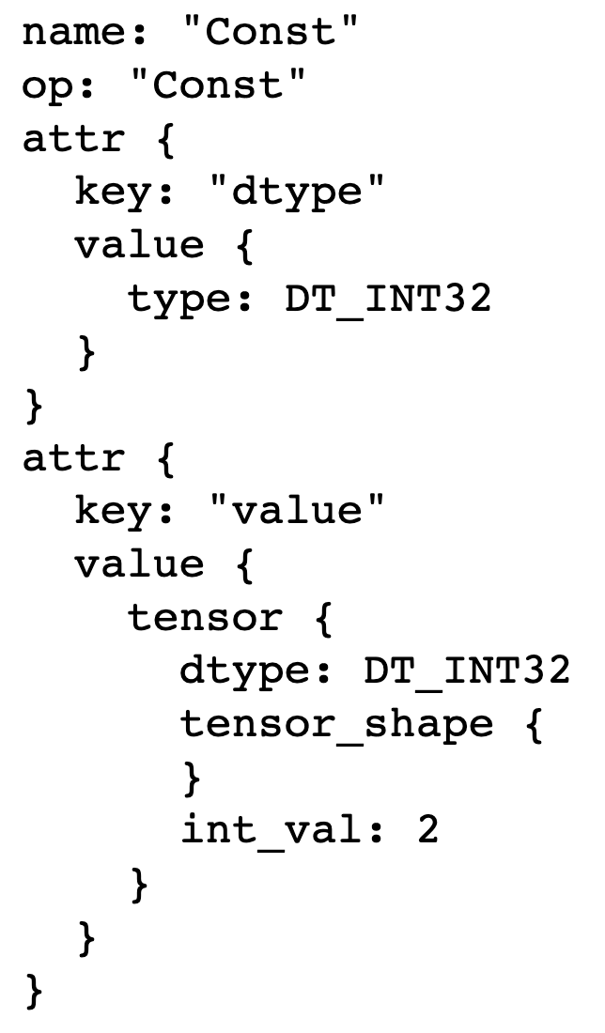
a = tf.constant(2)

Slide 15
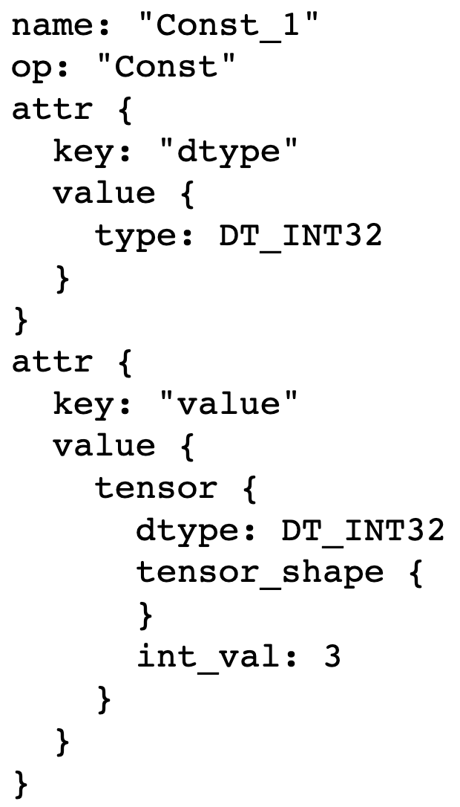
b = tf.constant(3)

Slide 16
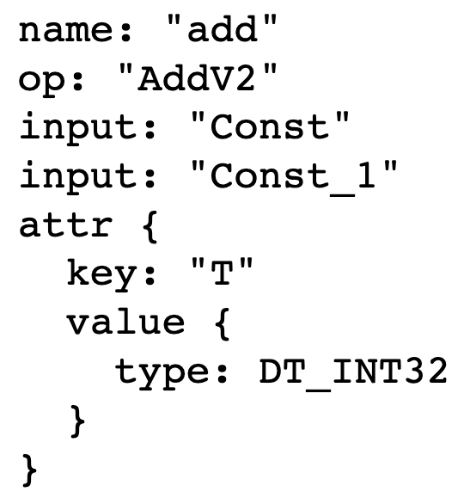
c = a + b

Slide 17
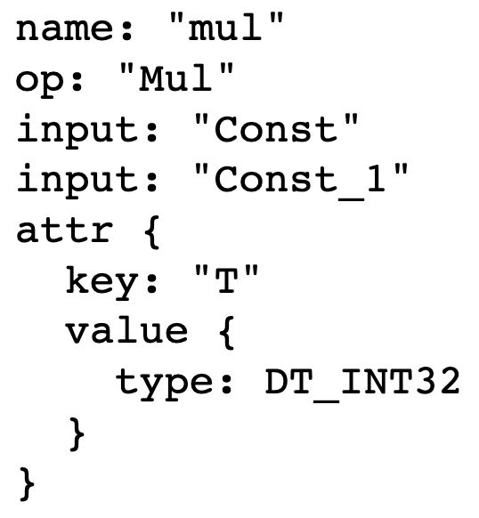
d = a * b

Slide 18
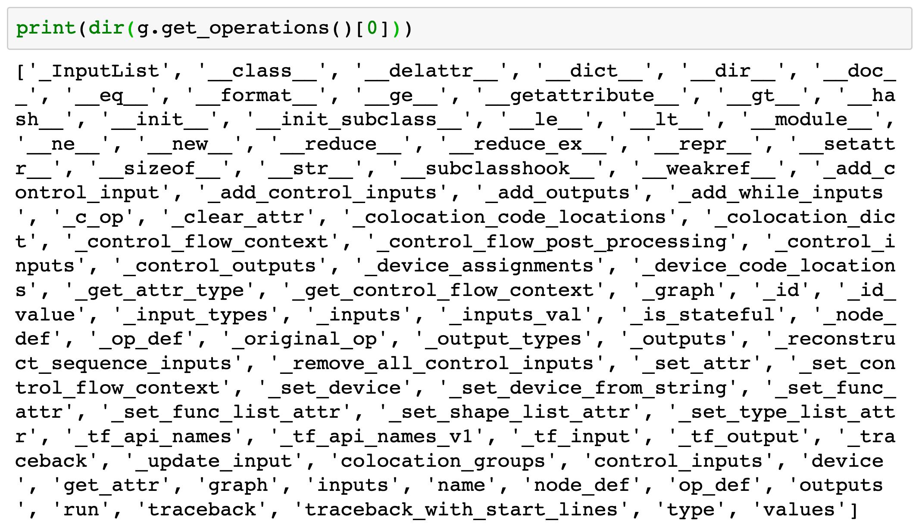

Slide 19
op.name

Slide 20
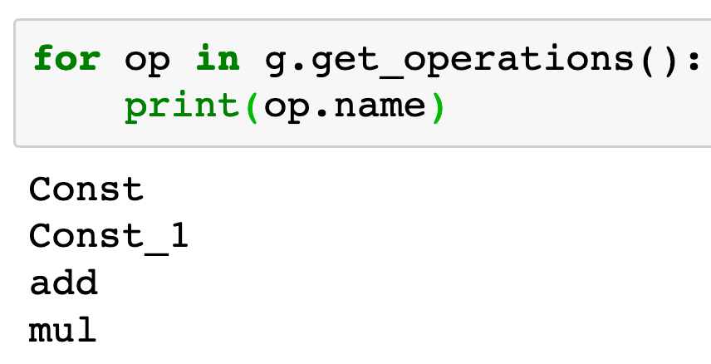

Slide 21
op.inputs

Slide 22
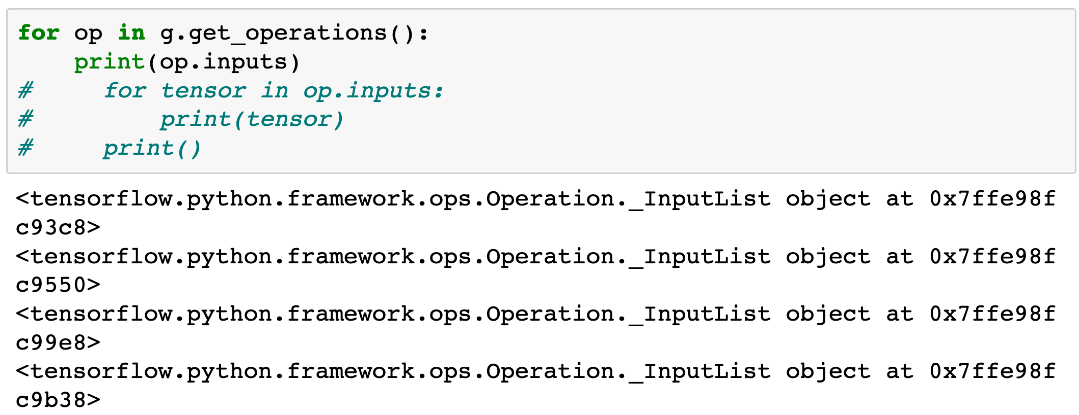

Slide 23
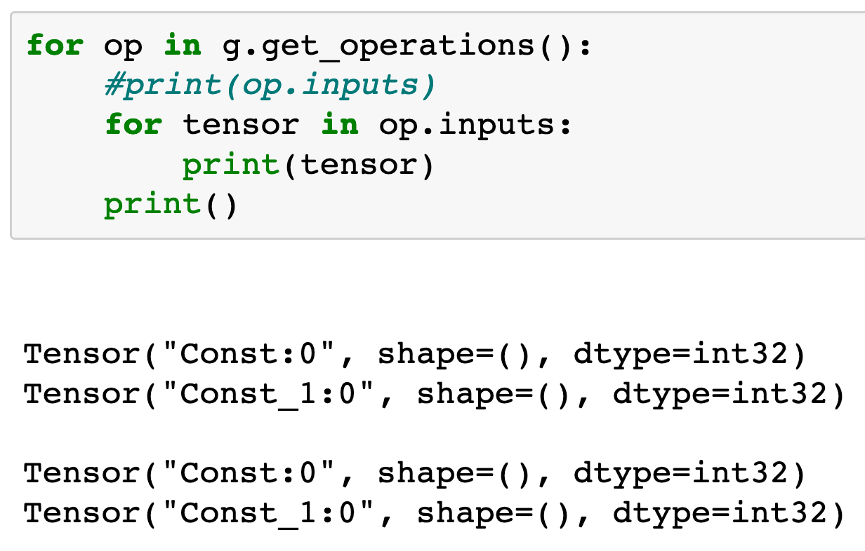

Slide 24
input of a = tf.constant(2)

Slide 25
input of a = tf.constant(2)
input of b = tf.constant(3)

Slide 26
input of a = tf.constant(2)
input of b = tf.constant(3)
input of c = a + b

Slide 27
input of a = tf.constant(2)
input of b = tf.constant(3)
input of c = a + b
input of d = a * b

Slide 28
op.outputs

Slide 29
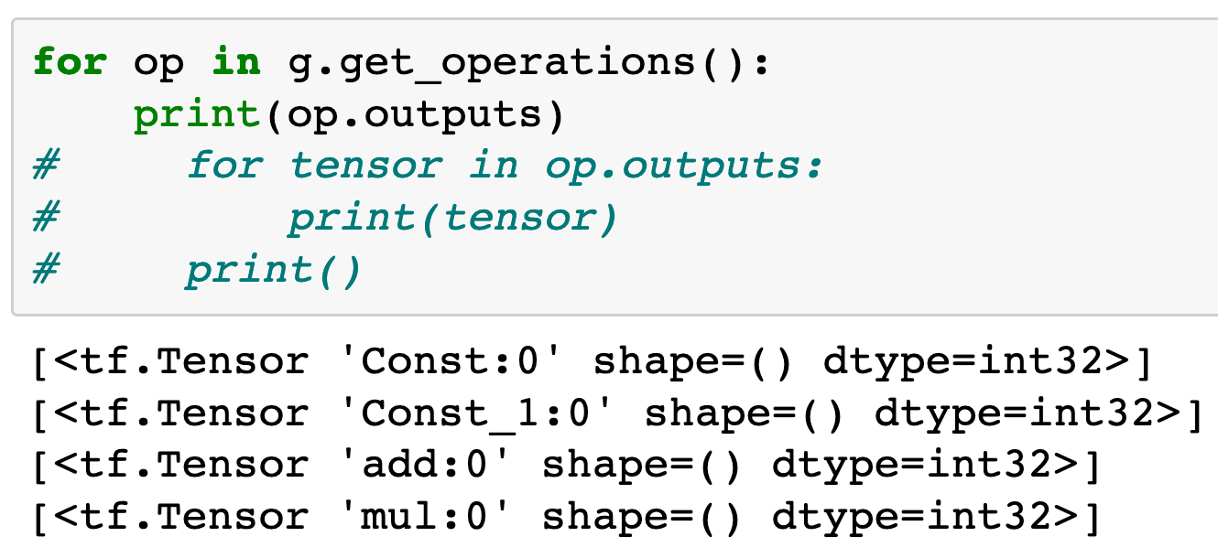

Slide 30
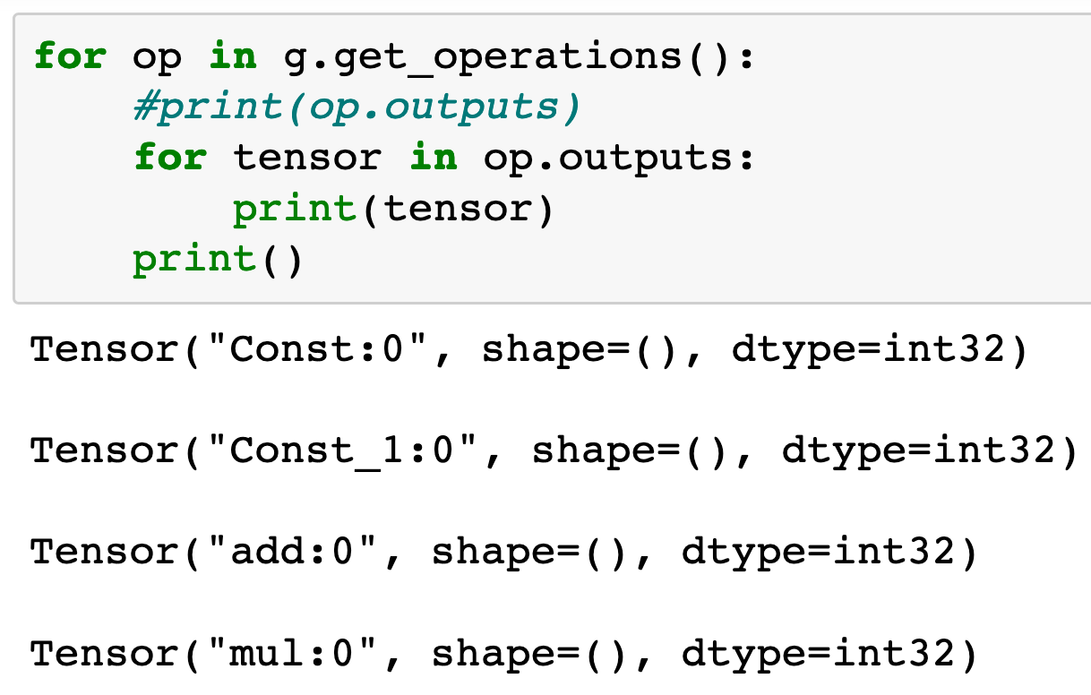

Slide 31
output of a = tf.constant(2)

Slide 32
output of a = tf.constant(2)
output of b = tf.constant(3)

Slide 33
output of a = tf.constant(2)
output of b = tf.constant(3)
output of c = a + b

Slide 34
output of a = tf.constant(2)
output of b = tf.constant(3)
output of c = a + b
output of d = a * b

Slide 35
op.values()

Slide 36
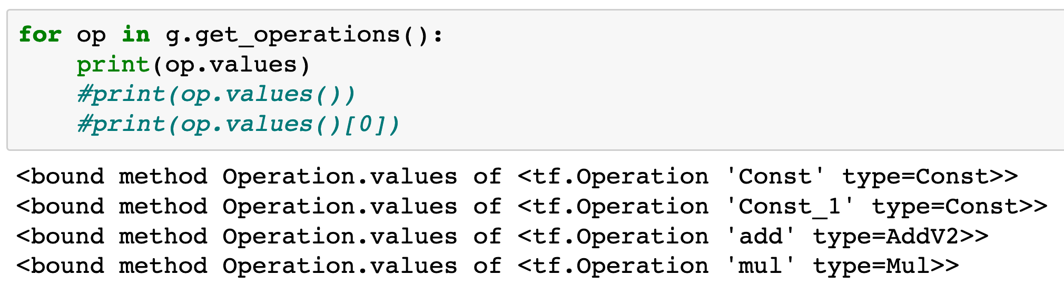

Slide 37
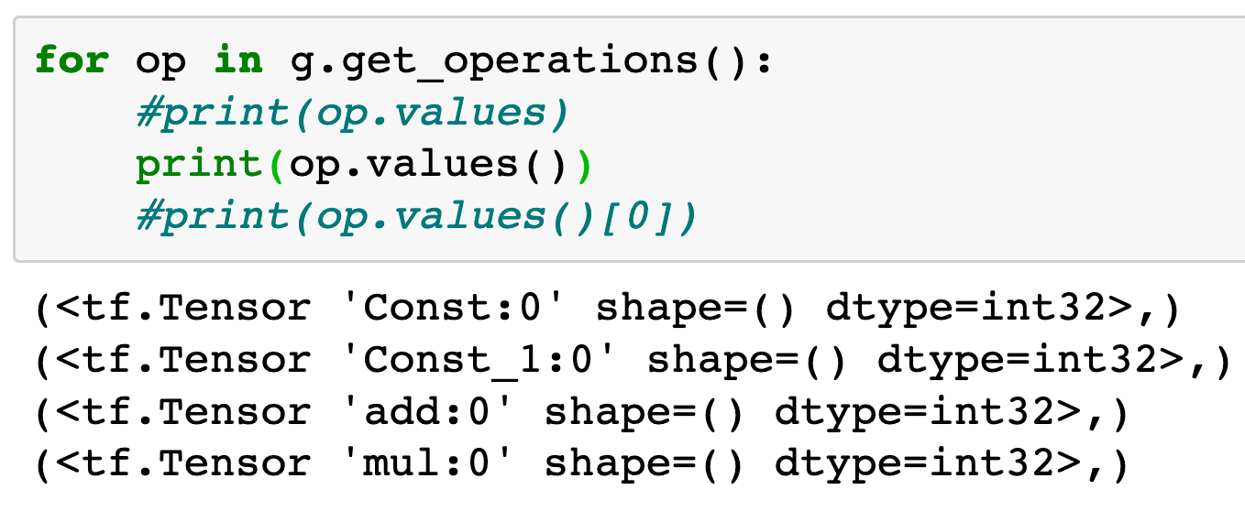

Slide 38
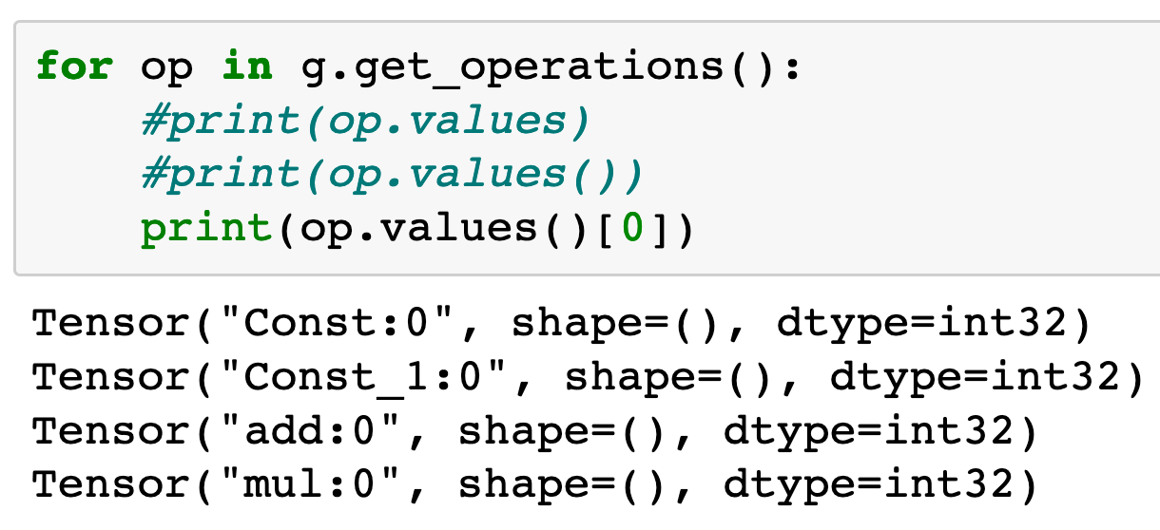

Slide 39
get_operation_by_name
and
get_tensor_by_name

Slide 40
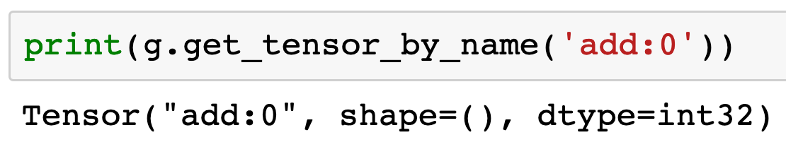

Slide 41
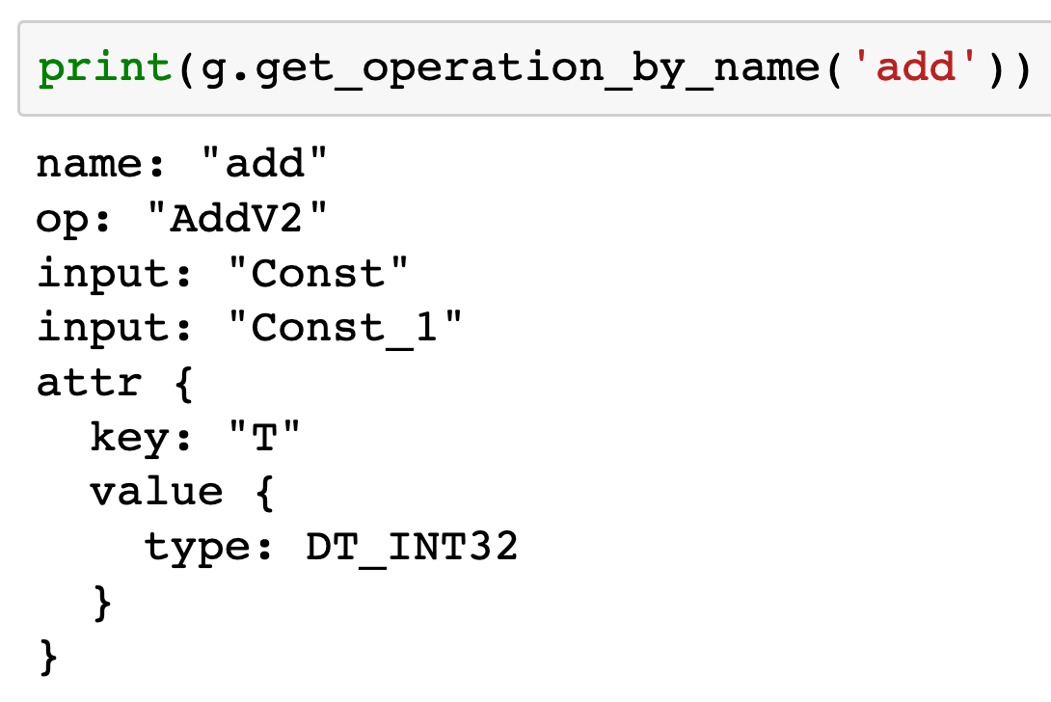

Slide 42
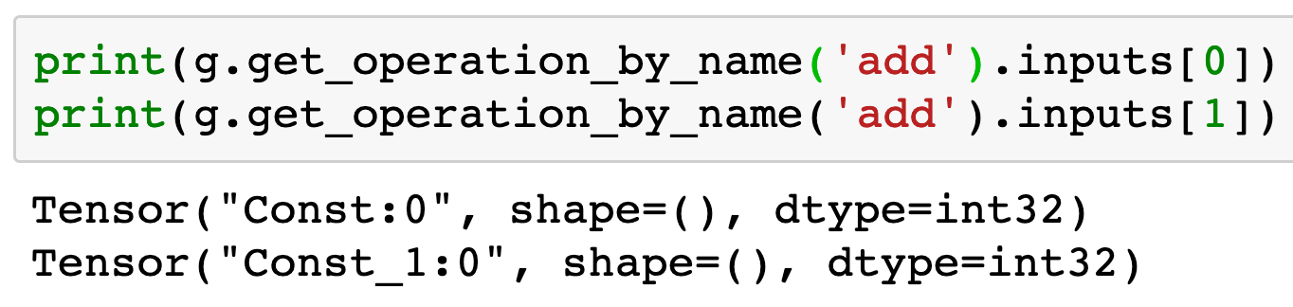

Slide 43
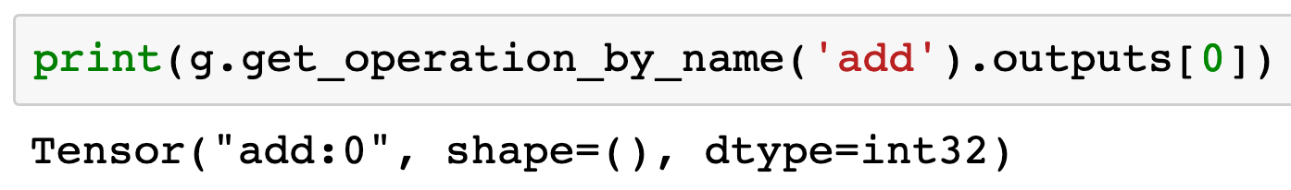

Slide 44
Operation Name
and
Tensor Name

Slide 45
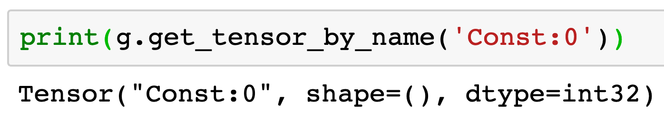
Output Index
Operation Name

Slide 46
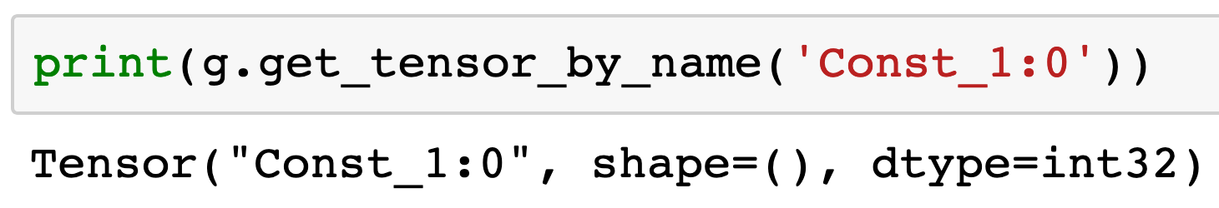
Output Index
Operation Name

Slide 47
Output Index
Operation Name

Slide 48
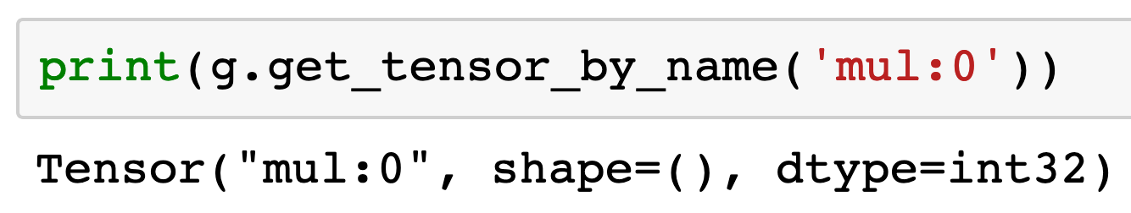
Output Index
Operation Name

Slide 49
What is TensorFlow

Slide 50
Operation
Tensor
Const
add
Const:0
add:0
Const:0
Const_1
Const_1:0
mul
Const_1:0
mul:0

Slide 51
Now
Let’s Play with Code

