Slide 1




KOR
외국인등록증
RESIDENCE CARD
외국인등록번호
Registration No.
성명
Name
국가 / 지역
Country / Region
체류자격
Status

Slide 2

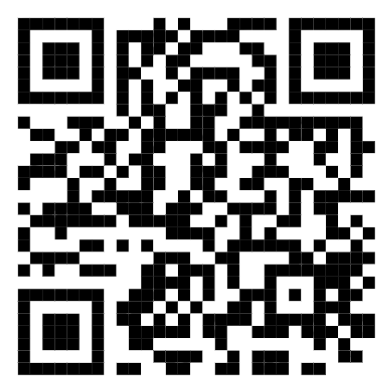
KOR
외국인등록증
RESIDENCE CARD
REPUBLIC OF KOREA SEOUL IMMIGRATION OFFICE REPUBLIC OF KOREA SEOUL IIMIGRATION OFFICE REPUBLIC OF KOREA SEOUL IMMIGRATION OFFIC
REPUBLIC OF KOREA SEOUL IMMIGRATION OFFICE REPUBLIC OF KOREA SEOUL IMMIGRATION OFFICE
외국인등록번호
Registration No.
921015-6249105
REPUBLIC OF KOREA SEOUL IMMIGRATION OFFICE REPUBLIC OF KOREA SEOUL IMMIGRATION OFFICE
성명
Name
Sophia Moore
(소피아 무어)
958571
REPUBLIC OF KOREA SEOUL IMMIGRATION OFFICE REPUBLIC OF KOREA SEOUL IMMIGRATION OFFICE
국가 / 지역
Country / Region
Dominion of Canada
REPUBLIC OF KOREA SEOUL IMMIGRATION OFFICE REPUBLIC OF KOREA SEOUL IMMIGRATION OFFICE
체류자격
Status
회화지도(E-2)
REPUBLIC OF KOREA SEOUL IMMIGRATION OFFICE REPUBLIC OF KOREA SEOUL IMMIGRATION OFFICE
발급일자 Issue Date 2022.12.23.
서울출입국·외국인청장
CHIEF, SEOUL IMMIGRATION OFFICE
REPUBLIC OF KOREA SEOUL IMMIGRATION OFFICE REPUBLIC OF KOREA SEOUL IMMIGRATION OFFICE

