Slide 1


CSE 180: Lab Section
Recap (Students, Courses, Enrolments)
Views
Indexes
Monday, November 6th
Utkarsh Gupta

Slide 2
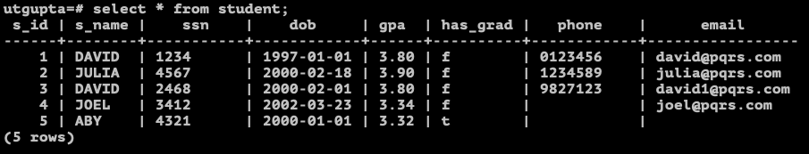
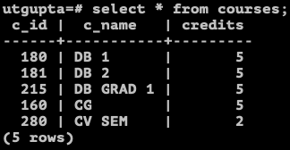
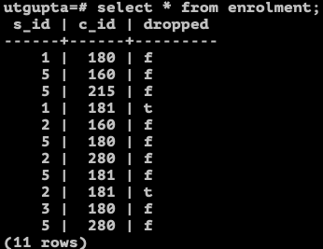
Student, Courses, & Enrolment

Slide 3
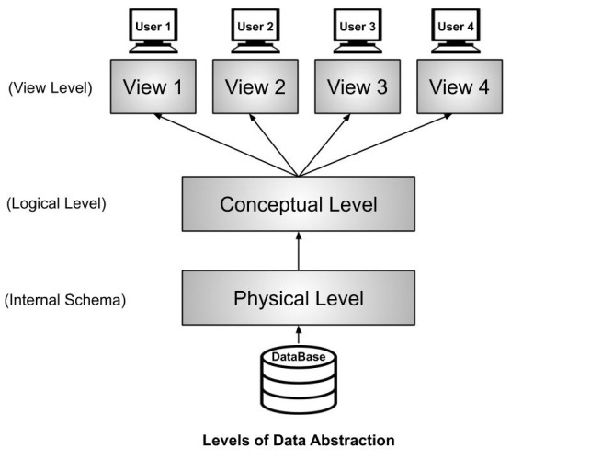
Views
Reference: https://afteracademy.com/blog/what-is-data-abstraction-in-dbms-and-what-are-its-three-levels/

Slide 4
Views (cont.)
View is a virtual table based on the result-set of an SQL statement.
Syntax:
CREATE VIEW view_name AS
SELECT column1, column2
FROM table_name
WHERE condition_1
[GROUP BY column1, column2, … ]
[HAVING condition_h1, …];

Slide 5
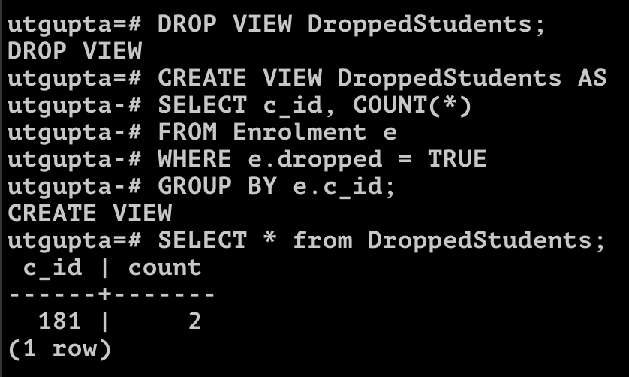
Views (cont.)
View is a virtual table based on the result-set of an SQL statement.
Example: Create a view DroppedStudents which displays the total number of students dropped from a course.
CREATE VIEW DroppedStudents AS
SELECT c_id, COUNT(*)
FROM Enrolment e
WHERE e.dropped = TRUE
GROUP BY e.c_id;
SELECT * FROM DroppedStudents;

Slide 6
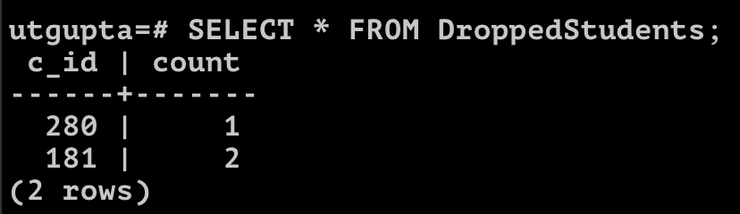
Views (cont.)
View is a virtual table based on the result-set of an SQL statement.
Example: Create a view DroppedStudents which displays the total number of students dropped from a course.
UPDATE Enrolment SET dropped=TRUE WHERE s_id = 2 and c_id = 280;
SELECT * FROM DroppedStudents;

Slide 7
Indexes (cont.)
Indexes are used to retrieve data from the database more quickly than otherwise.
The users cannot see the indexes, they are just used to speed up the searches/queries.
Syntax:
CREATE INDEX index_name
ON table_name (column1, column2, … );
Example: Create an index StudentsSearch on the Student table over the columns s_name, gpa, and phone.
CREATE INDEX StudentsSearch ON Student (s_name, gpa, phone);

Slide 8
Create commands (Students)
CREATE TABLE STUDENT (
S_ID INT,
S_NAME VARCHAR(30),
SSN CHAR(9),
DOB DATE DEFAULT '2000-01-01' NOT NULL,
GPA NUMERIC(3,2),
HAS_GRAD BOOL,
PHONE CHAR(10),
EMAIL VARCHAR(50),
PRIMARY KEY (S_ID),
UNIQUE (EMAIL),
UNIQUE (PHONE, S_NAME),
UNIQUE (SSN)
);
CREATE TABLE COURSES (
C_ID INT PRIMARY KEY,
C_NAME CHAR(9) UNIQUE,
CREDITS INT DEFAULT 5 NOT NULL
);
CREATE TABLE ENROLMENT (
S_ID INT REFERENCES STUDENT,
C_ID INT REFERENCES COURSES,
DROPPED BOOL NOT NULL,
PRIMARY KEY(S_ID, C_ID)
);

Slide 9
Insert Commands (Students)
Student
INSERT INTO STUDENT VALUES (1, 'DAVID', '1234', '1997-01-01', 3.8, false, '0123456', 'david@pqrs.com');
INSERT INTO STUDENT VALUES (2, 'JULIA', '4567', '2000-02-18', 3.9, false, '1234589', 'julia@pqrs.com');
INSERT INTO STUDENT VALUES (3, 'DAVID', '2468', '2000-02-01', 3.8, false, '9827123', 'david1@pqrs.com');
INSERT INTO STUDENT VALUES (4, 'JOEL', '3412', '2002-03-23', 3.34, false, NULL, 'joel@pqrs.com');
INSERT INTO STUDENT (S_ID, S_NAME, SSN, GPA, HAS_GRAD, PHONE, EMAIL) VALUES (5, 'ABY', '4321', 3.32, true, NULL, NULL);
Courses
INSERT INTO COURSES VALUES (180, 'DB 1');
INSERT INTO COURSES VALUES (181, 'DB 2');
INSERT INTO COURSES VALUES (215, 'DB GRAD 1');
INSERT INTO COURSES VALUES (160, 'CG');
INSERT INTO COURSES VALUES (280, 'CV SEM', 2);
Enrolment
INSERT INTO ENROLMENT VALUES (1, 180, false);
INSERT INTO ENROLMENT VALUES (5, 160, false);
INSERT INTO ENROLMENT VALUES (5, 215, false);
INSERT INTO ENROLMENT VALUES (1, 181, true);
INSERT INTO ENROLMENT VALUES (2, 160, false);
INSERT INTO ENROLMENT VALUES (5, 180, false);
INSERT INTO ENROLMENT VALUES (2, 280, false);
INSERT INTO ENROLMENT VALUES (5, 181, false);
INSERT INTO ENROLMENT VALUES (2, 181, true);
INSERT INTO ENROLMENT VALUES (3, 180, false);
INSERT INTO ENROLMENT VALUES (5, 280, false);

