Slide 1
COP3530 Final Project
Junhao Li, Xinye Li, Yuan Yao

Slide 2
Introduction: Finding the Most Efficient Route
Real-world relevance:
Navigation apps like Google Maps and Waze are essential in daily life
Help users reduce travel time, fuel consumption, and costs
Core technology:
These apps rely on shortest path algorithms in graph theory
Real-time routing = solving shortest path problems efficiently
Why shortest path matters:
Critical in transportation, network routing, logistics, and supply chain management
Enables optimal decision-making in connected systems

Slide 3
Algorithms
Dijkstra’s Algorithm: Efficient for graphs with non-negative weights, widely used in practice
Bellman-Ford Algorithm: Can handle negative weights and detect negative cycles

Slide 4
Functions:
generateDirectedGraph(num_nodes, avg_degree, min_weight, max_weight)
generateDAGraph(num_nodes, avg_degree, min_weight, max_weight)
Dijkstra(num_nodes, source, target, adjacencyList)
BellmanFord(num_nodes, source, target, adjacencyList);

Slide 5
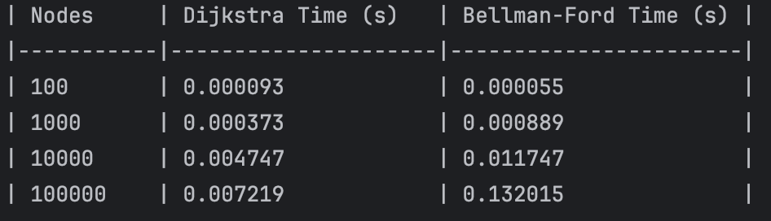
Computational Time for a Directed Graph (w/o negative weight)

Slide 6
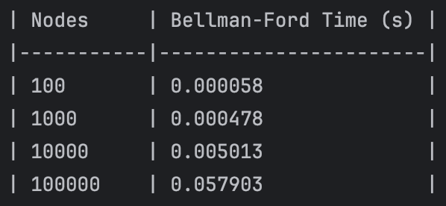
Computational Time for a Directed Acyclic Graph (w/ negative weight)
Faster than computing on the graph with only positive weighted edges!

Slide 7
Dijkstra’s Algorithm
Worst Case Time Complexity: O((V+E)*logV)
✅ Pros:
Fast and efficient for graphs with non-negative edge weights
Works well with priority queues to reduce runtime
Ideal for real-time systems due to low computational cost
❌ Cons:
Cannot handle negative edge weights, which may arise in some cases (e.g., toll rebates, time savings)
May be less flexible in dynamic or less constrained routing environments

Slide 8
Bellman-Ford Algorithm
Worst Case Time Complexity: O(V*E)
✅ Pros:
Supports negative edge weights
More flexible in handling complex or abstract graphs
❌ Cons:
Slower performance
Less suitable for large-scale real-time applications like city-wide navigation
More computationally expensive as graph size grows

Slide 9
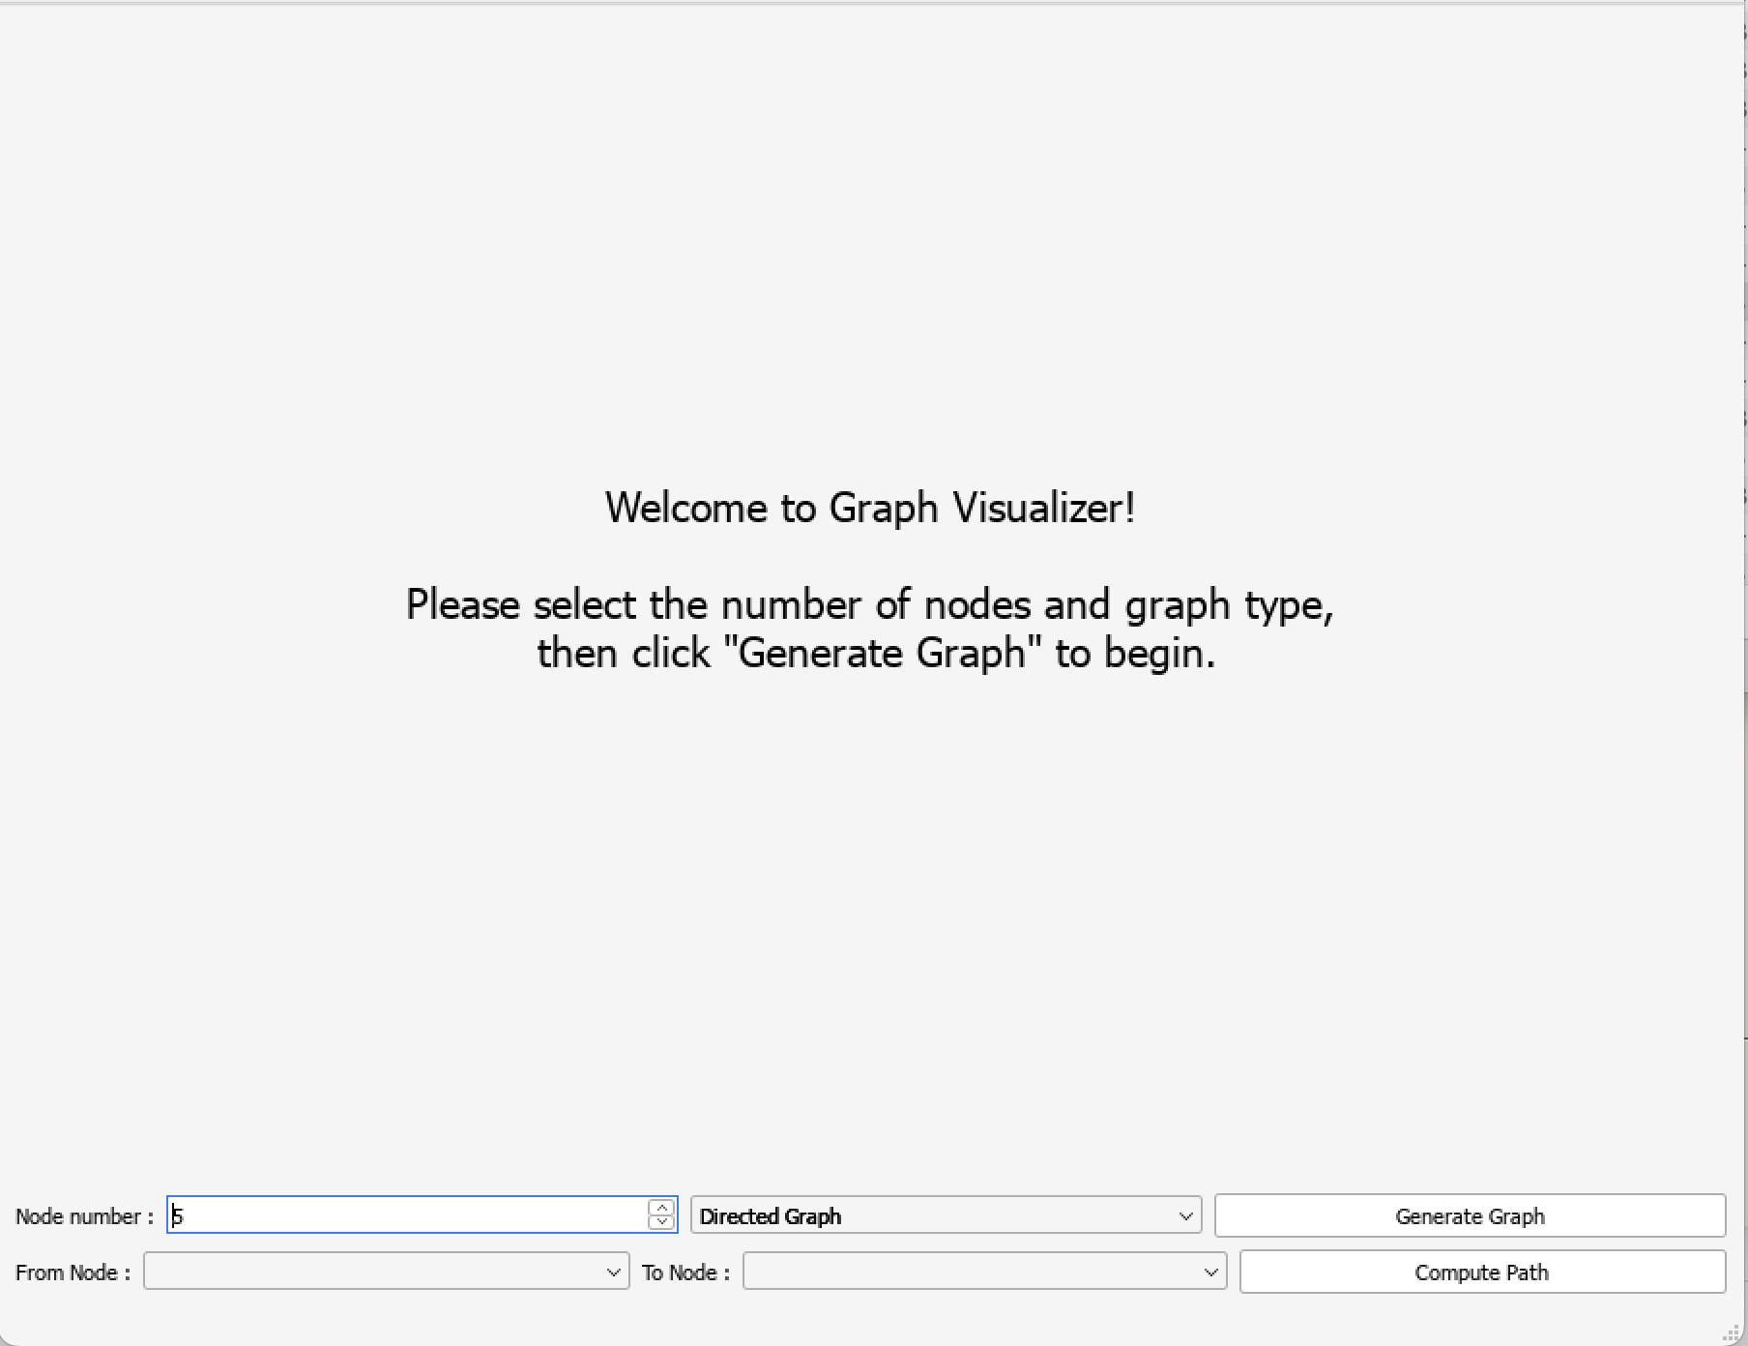
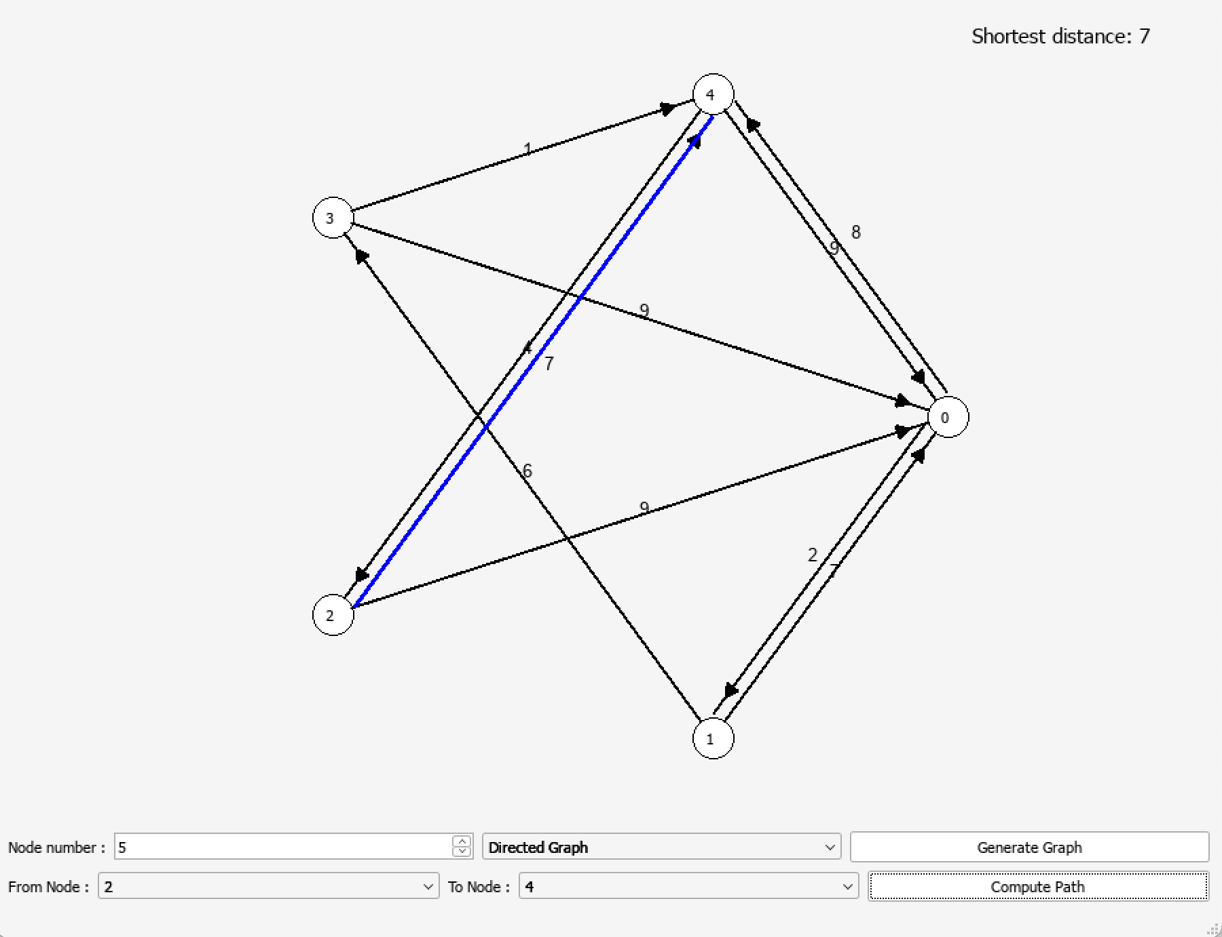
UI Design

Slide 10
Takeaways
Deepened understanding of graph theory
Connected classroom knowledge to real-world applications
Developed the ability to evaluate and choose between multiple problem-solving approaches

