Slide 1
Olist E-Commerce
Delivery Process Bottleneck Analysis & Improvement Strategy
Executive Report | Target: 물류 운영 책임자 및 경영진
95,082 Orders
Analyzed
8.2%
Delay Rate
4 Scenarios
Recommended

Slide 2
Executive Summary
Problem
Cause
Top Priority
Effect Size
8.2%
배송 지연율
Carrier Delivery
핵심 병목 구간
S1
RJ Delivery Time Optimization
20.19%
1순위 원인 설명력

Slide 3
Business Problem
7,797건
전체 95,082건 주문 중
배송 지연 발생 (지연율 8.2%)
Stage | Delayed (h) | Normal (h) | Ratio
Payment Approval | 12.05 | 9.44 | 1.28x
Seller Processing | 128.38 | 63.09 | 2.03x
Carrier Delivery | 616.34 | 189.78 | 3.25x
Business Risk: 고객 경험 저하 · 브랜드 신뢰도 하락 · 운영 비용 증가

Slide 4
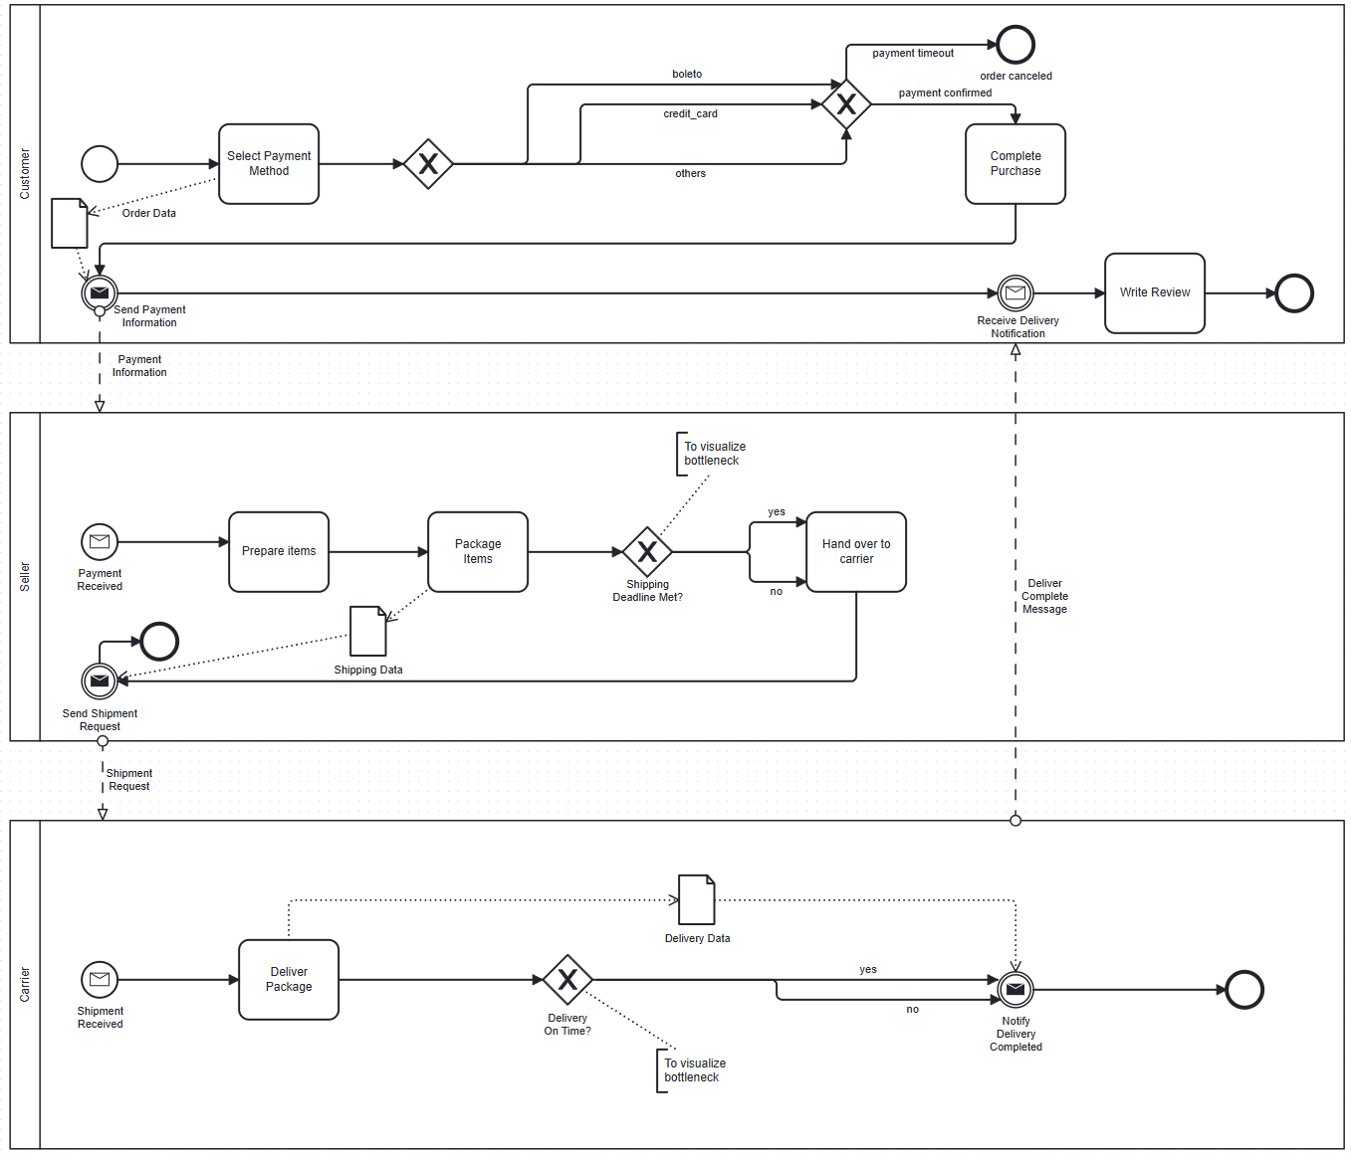
Process Modeling (BPMN)
각 구간별 병목 발생 가능성을 가설로 설정 → Bottleneck Detection으로 검증

Slide 5
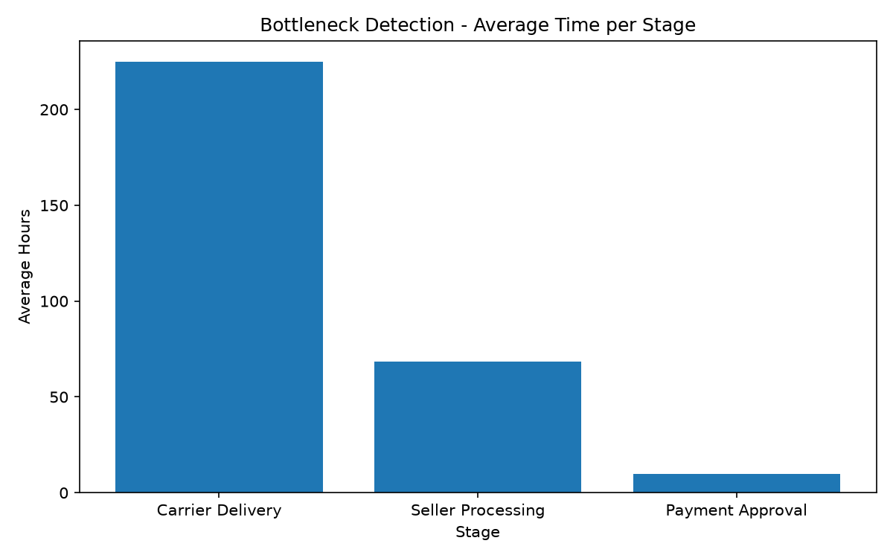
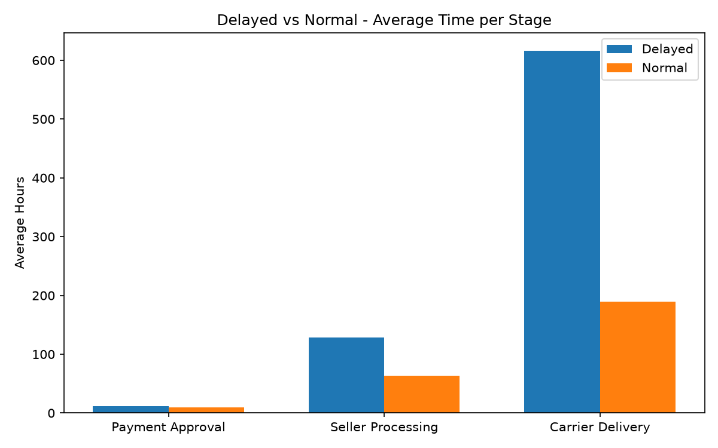
Bottleneck Detection
Carrier Delivery 74.21% of Total Lead Time | 지연 주문에서 3.25배 증가
74.21%
Carrier Delivery · avg 224.74h
22.6%
Seller Processing · avg 68.44h
3.19%
Payment Approval · avg 9.65h

Slide 6
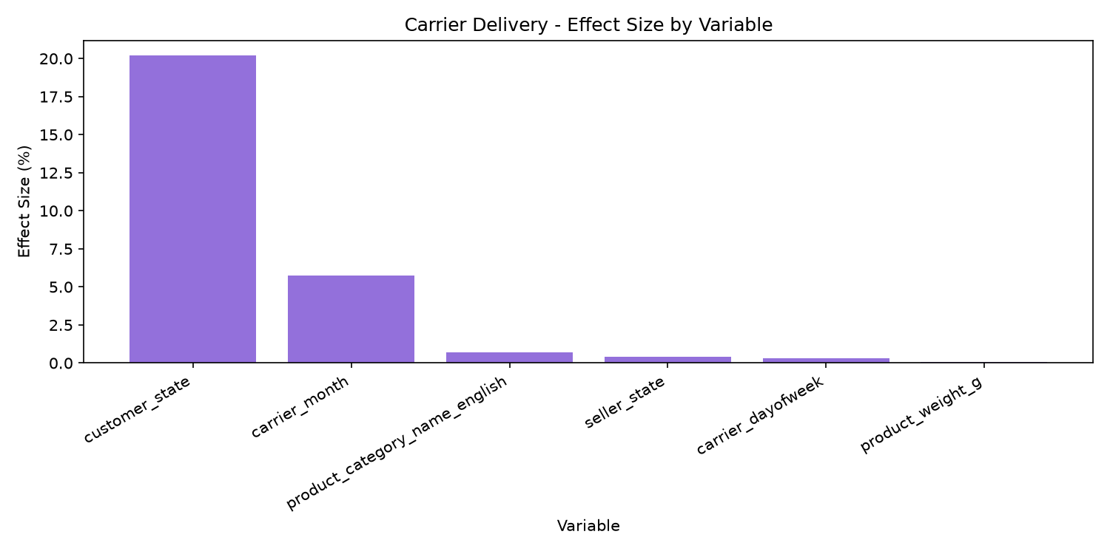
Root Cause Analysis — Carrier Delivery
1st Bottleneck | Lead Time 74.21%
Geography
η²=20.19%
Customer state strongly affects carrier delivery time due to differences in distance, regional infrastructure, and last-mile logistics complexity across states.
Seasonality
η²=5.77%
The month of carrier handling introduces variability from seasonal demand spikes, holiday congestion, and weather-related disruptions.
Carrier delivery delays are primarily driven by geographic factors, as customer state accounts for the largest share of variance, reflecting disparities in regional infrastructure and distance from distribution hubs. Seasonal timing of carrier operations also contributes meaningfully, likely due to demand fluctuations and periodic operational strain.

Slide 7
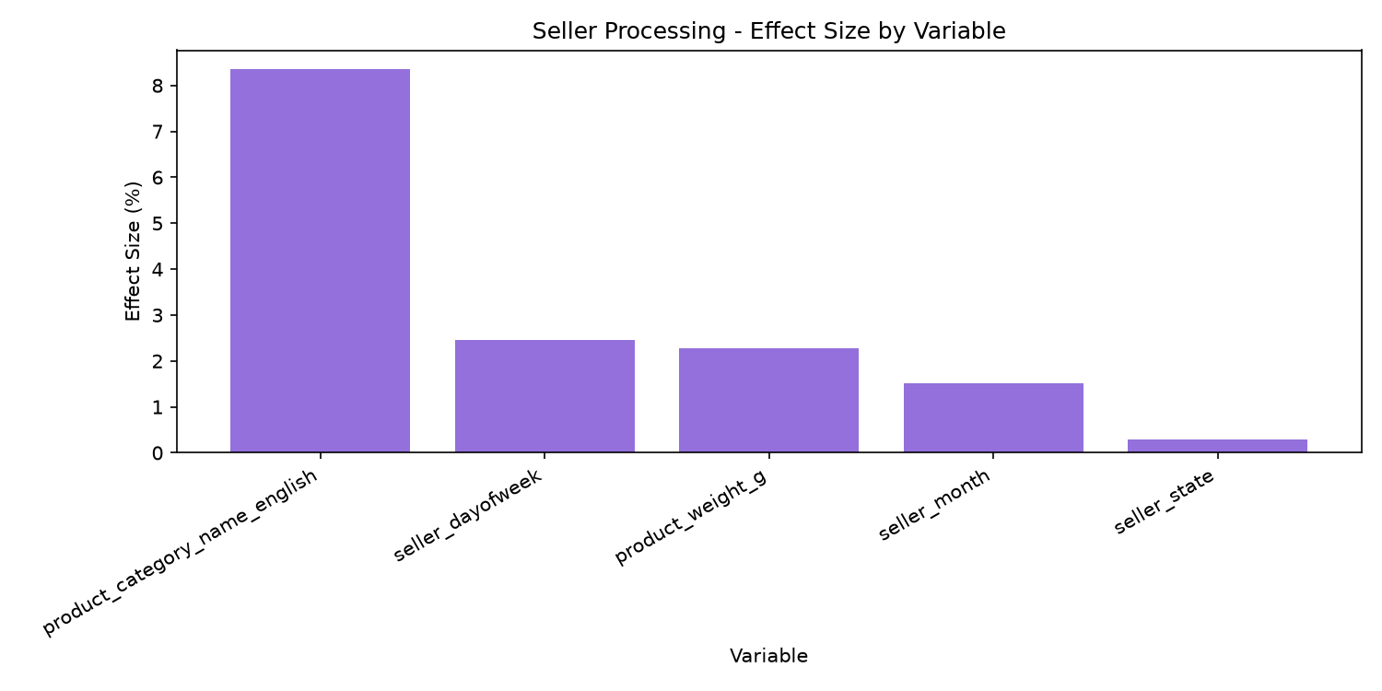
Root Cause Analysis — Seller Processing
2nd Bottleneck | Lead Time 22.6%
Product Category
η²=8.35%
Different product categories require varying handling, sourcing, and preparation processes, causing significant variation in seller processing time.
Seasonality/Timing
η²=2.45%
The day of the week an order is placed affects seller processing speed due to staffing levels and warehouse operation schedules.
Physical Characteristics
η²=2.27%
Heavier products often require more complex packing and handling procedures, which can slow down seller processing time.
The seller processing delay is primarily driven by product category differences, which account for the largest share of variance, reflecting diverse handling and sourcing complexity across product types. Timing factors such as day of week and physical product characteristics like weight also contribute, though to a lesser extent, indicating operational scheduling and packaging logistics play secondary roles.

Slide 8
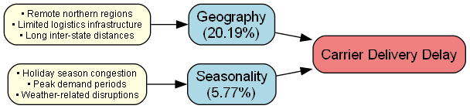
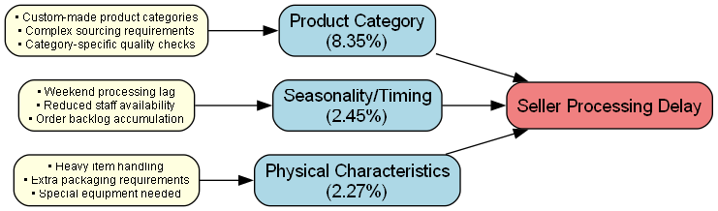
Cause-Effect Diagrams
Carrier Delivery
Seller Processing

Slide 9
Business Impact Simulation
전체 후보 — Effect Size + Impact Score
Scenario | Effect Size | Impact Score
customer_state=RJ | 20.19 | 788,027
carrier_month=3.0 | 5.77 | 740,331
carrier_month=2.0 | 5.77 | 571,326
customer_state=BA | 20.19 | 515,586
carrier_month=12.0 | 5.77 | 380,005
customer_state=RS | 20.19 | 349,653
Root Cause의 설명력(Effect Size)과 Business Impact(Impact Score)는 다를 수 있다

Slide 10
Recommended Scenarios
ID | Title | Effect Size | Impact Score
S1 | RJ Delivery Time Optimization | 20.19% | 788,027
S2 | Office Furniture Processing Time Improvement | 8.35% | 295,903
S3 | Carnival Season Delivery Delay Mitigation | 5.77% | 1,311,657
S4 | Pre-Weekend Seller Processing Delay Reduction | 2.45% | 519,915

Slide 11
A/B Test Design
S1: RJ Delivery Time Optimization
Primary Metric
Delivery Delay Rate (%)
Treatment
배송 최적화 조치 적용 거점 (RJ 담당)
Baseline
13.6% (RJ 기준)
Control
기존 운영 유지 거점
MDE
1.0%p → Target 12.6%
Success Criteria
Alpha / Power
α=0.05 / Power=0.8
✓ Primary Metric (Delivery Delay Rate) decreases by at least 1.0 percentage point
✓ p_value < 0.05
✓ Carrier Delivery Time (Secondary Metric) decreases
✓ No deterioration in Guardrail Metrics
Sample Size
28,749건 (그룹당 14,375건)
Experiment Unit
Fulfillment Center

Slide 12
Implementation Roadmap
1
2
3
4
Analysis Complete
A/B Test
Validation
Full Deployment
Done
Next
Pending
Pending
1~8단계 분석 완료
1순위 시나리오 실험 설계
통계적 유의성 검증
전사 확대 적용

Slide 13
Final Recommendation
customer_state이 배송 지연의 가장 중요한 통계적 원인(effect size 20.19%)으로 확인되었습니다.
따라서 S1(RJ Delivery Time Optimization)을 우선적으로 A/B Test를 통해 검증한 후, 효과가 확인되면 전사 확대 적용을 권고합니다.
74.21%
Carrier Delivery 핵심 병목 비중
20.19%
customer_state Effect Size
28,749건
A/B Test 필요 샘플 수

