Slide 1
My Finance with Roommates
Junho An

Slide 2
Idea
Hard to keep track of your expenses.
Targeted User: Anyone with roommate(s).
Analyze your expenses in higher level.

Slide 3
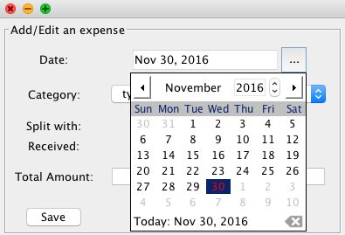
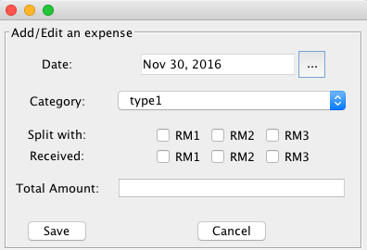
Implementation
JDatePicker
JCheckBox
JComboBox
Jbuttons
JTextField
Save
Load

Slide 4
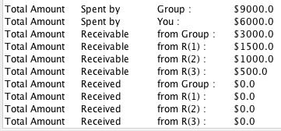
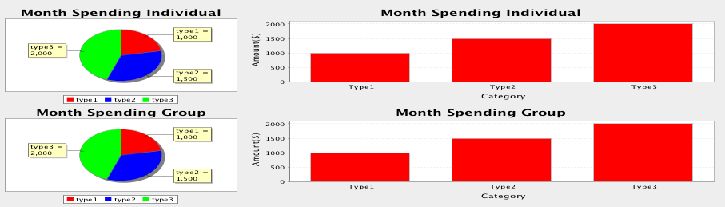
Tabulated Data / Visuals

