Slide 1
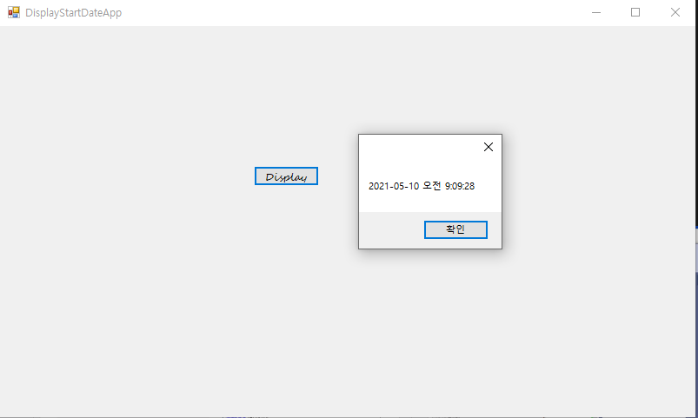
using System;
using System.Collections.Generic;
using System.ComponentModel;
using System.Data;
using System.Drawing;
using System.Linq;
using System.Text;
using System.Threading.Tasks;
using System.Windows.Forms;
namespace WindowsFormsApp1
{
public partial class Form1 : Form
{
public Form1()
{
InitializeComponent();
startDateTime = DateTime.Now;
}
DateTime startDateTime;
public DateTime GetStartDateTime()
{
return startDateTime;
}
private void button1_Click(object sender, EventArgs e)
{
MessageBox.Show(GetStartDateTime().ToString());
}
}
}

Slide 2
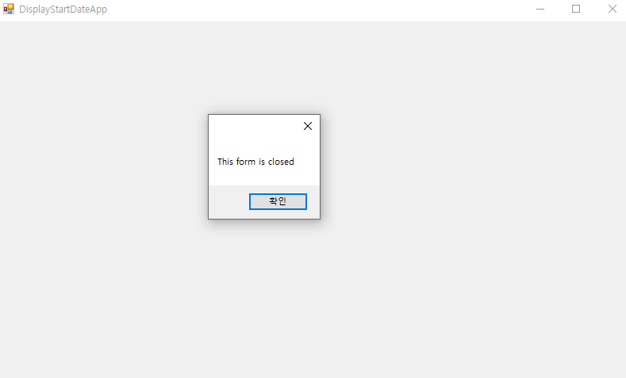
namespace WindowsFormsApp1
{
public partial class Form1 : Form
{
public Form1()
{
InitializeComponent();
}
private void Form1_Load(object sender, EventArgs e)
{
MessageBox.Show("This form is loaded");
}
private void Form1_FormClosed(object sender, FormClosedEventArgs e)
{
MessageBox.Show("This form is closed");
}
}
}

Slide 3
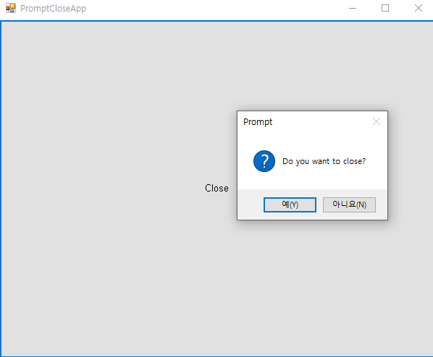
namespace WindowsFormsApp1
{
public partial class Form1 : Form
{public Form1()
{InitializeComponent();}
private void Form1_FormClosing(object sender, FormClosingEventArgs e)
{ if (MessageBox.Show("Do you want to close?",
"Prompt",
MessageBoxButtons.YesNo,
MessageBoxIcon.Question) == DialogResult.Yes)
{e.Cancel = false;}
else{e.Cancel = true;}}
private void Form1_FormClosing_1(object sender, FormClosingEventArgs e)
{ }
private void button2_Click(object sender, EventArgs e)
{ Close();}
}
}

Slide 4
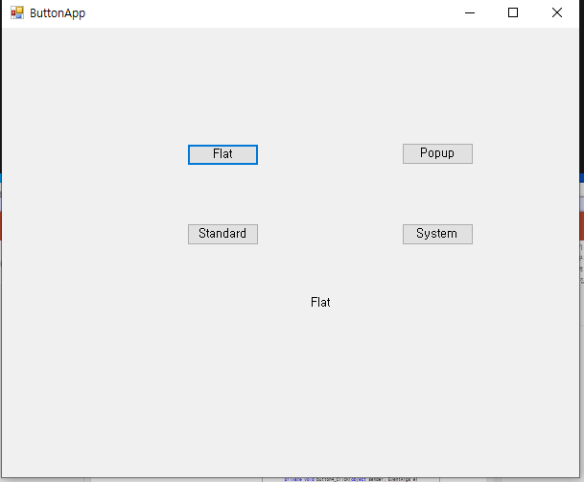
namespace WindowsFormsApp1
{public partial class Form1 : Form
{public Form1()
{InitializeComponent();}
private void button3_Click(object sender, EventArgs e)
{ label1.Text = FlatStyle.Flat.ToString();}
private void button4_Click(object sender, EventArgs e)
{label1.Text = FlatStyle.Flat.ToString(); }
private void button5_Click(object sender, EventArgs e)
{label1.Text = FlatStyle.Flat.ToString();}
private void button6_Click(object sender, EventArgs e)
{ label1.Text = FlatStyle.Flat.ToString();}
}
}

