Slide 1

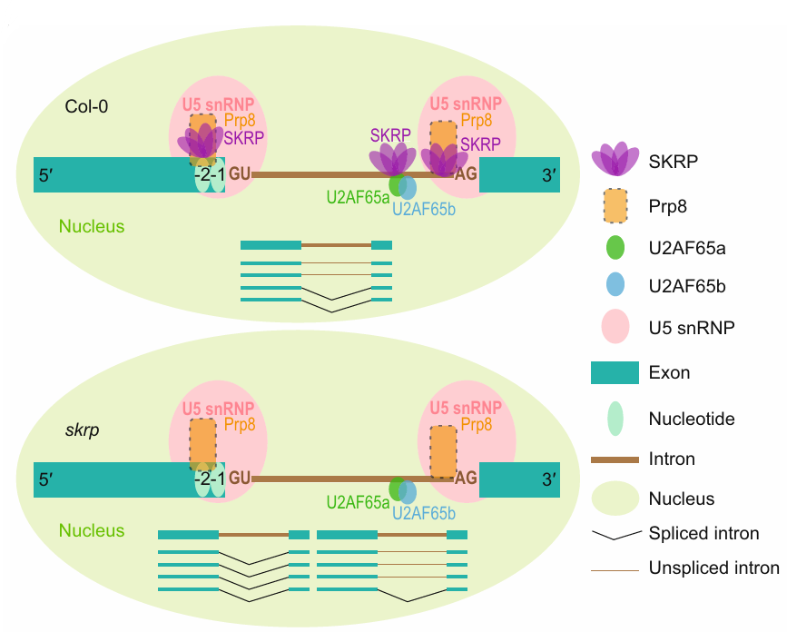
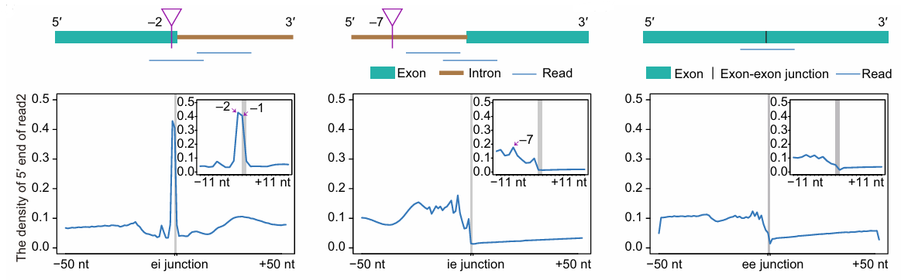
동기 및 배경, 연구 목표
발표자: 공준형
협동과정 농생명유전체학전공
Chen et al., New Phytol. (2023)

Slide 2
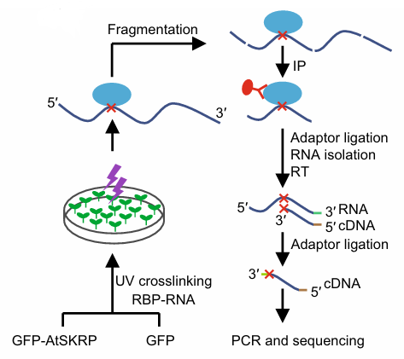
시퀀싱 데이터 소개 및 분석
발표자: 공준형
협동과정 농생명유전체학전공
GFP-AtSKRP eCLIP-seq
Download eCLIP-seq raw sequencing data
Arabidopsis GFP-AtSKRP transgenic line
https://ngdc.cncb.ac.cn/gsa under accession number CRA006308
Reads pre-processing
Remove adaptors, short reads, or N (fastp)
reads passed filter: 57,176,502/58,153,328 (0.983%)
Reads alignment & 5’-end peak calling
Alignment read to Arabidopsis genome (TAIR 9) using Hisat2 (42% alignment rate)
Calculate number of 5’-end reads per position
Chen et al., New Phytol. (2023)
Notes:
fastp -i GFP-eCLIP_f1.fastq -I GFP-eCLIP_r2.fastq -o GFP-eCLIP_f1.parse.fastq -O GFP-eCLIP_r2.parse.fastq -w 16 -w 16 --detect_adapter_for_pe --umi --umi_loc=read2 --umi_len=10 --umi_prefix="UMI" -5 -3

Slide 3
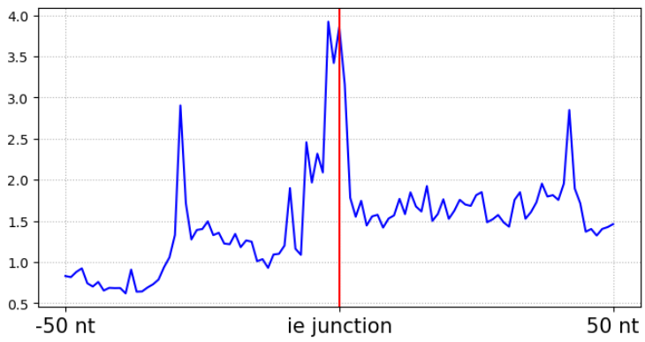
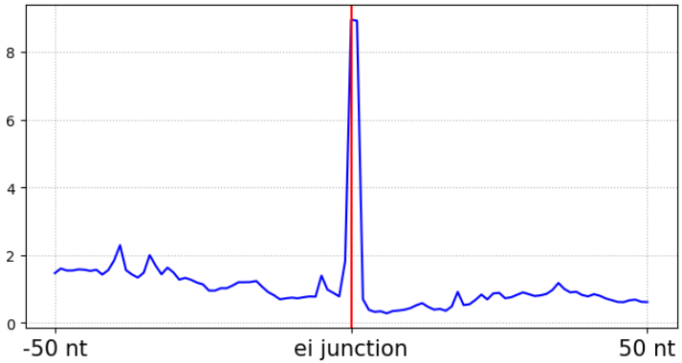
데이터 분석 및 결과 해석
발표자: 공준형
협동과정 농생명유전체학전공
Identify peaks near plus-exon
Remove minus-exon
Remove alternative spliced forms
Add padding in exon region (bedtools slop)
Merge plus-exon bed and 5’-end depth bed
The number of 5’end of reads (x10,000 counts)
5’
EXON
3’
Padding
Padding
5’
EXON
3’
ie junction
ei junction

Slide 4
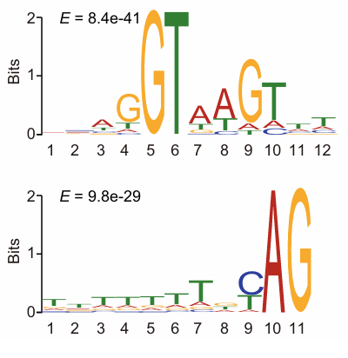
한계점 및 추가 분석
발표자: 공준형
협동과정 농생명유전체학전공
Limitation
Discrepancy in 5’-end peak positions
PCR duplicates were not removed
Only exons on the plus strand were considered
Biological triplicates were not applied
First exon and last exon were considered
Additional analysis
Binding motif analysis for the regions where AtSKRP binds

