Slide 1
Interactive computer graphics
20145337 우준혁

Slide 2
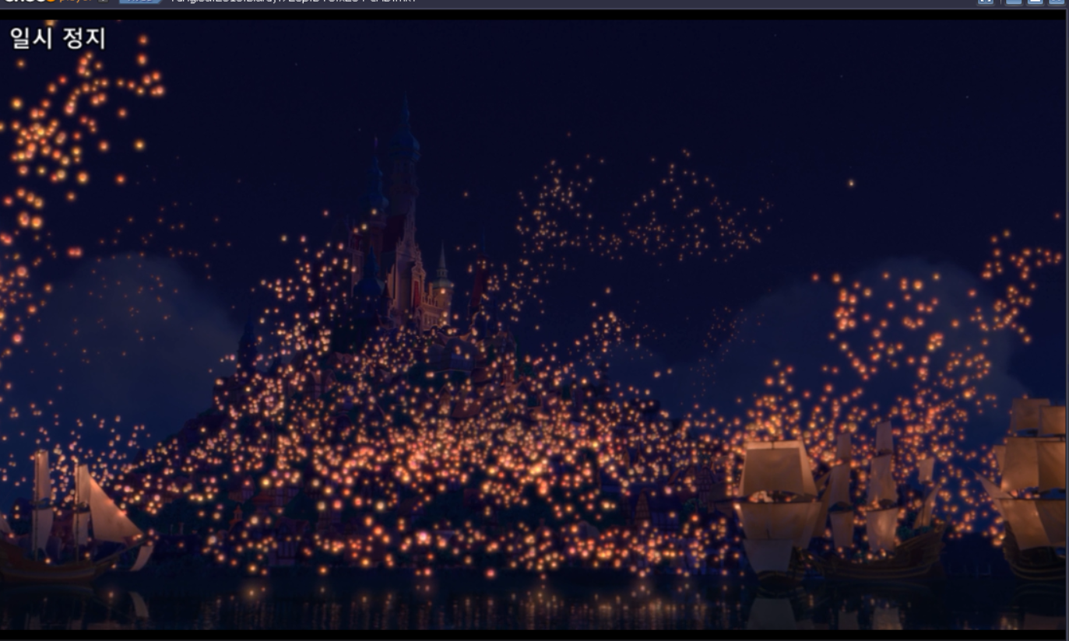
concept

Slide 3
implement
Animation - Lantern - Camera
Object file use - Palace - Mountain - Field
Camera Moving - Mouse - Keyboard
Shading - Phong - Toon
Texturing - Single - Multi

Slide 4
Day (Press ‘D’ key)
Palace – Toon shading – Light
Mountain – Multi Texture
Field – Multi Texture
Liver – Single Texture

Slide 5
Night (Press ‘n’ key)
Palace – Toon Shading – Spot Light
Mountain – Multi Texture
Field – Single Texture
Lantern – Single Texture

Slide 6
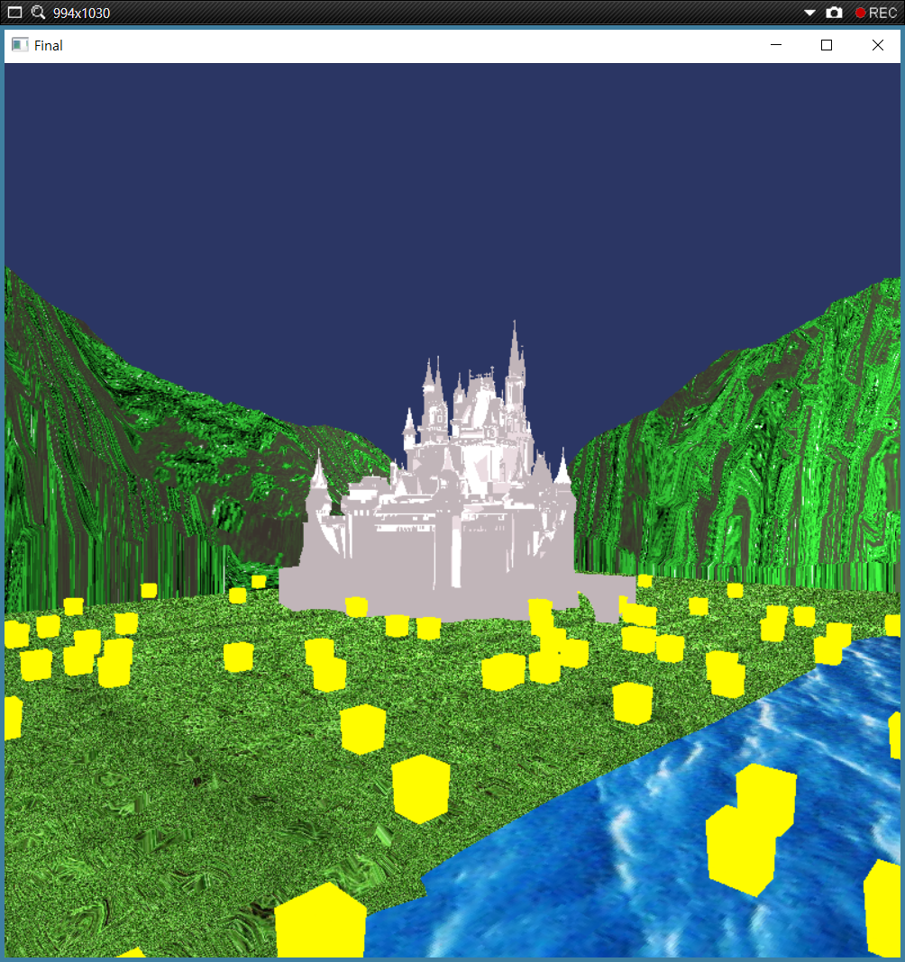
Demo

Slide 7
END

