Slide 1
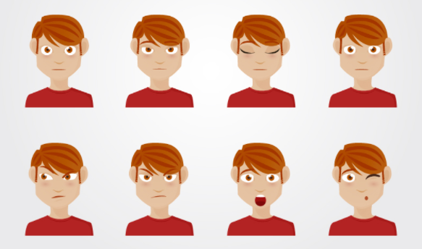
Face Match
Global AI Hackathon Vancouver, BC
Explore your emotional self

Slide 2
Face Match
Global AI Hackathon Vancouver, BC
Explore your emotional self

Slide 3
Face Match
Global AI Hackathon Vancouver, BC
Explore your emotional self

Slide 4

ROAD MAP
1
PROBLEM
2
SOLUTION
3
DATA
4
MODEL

Slide 5


PROBLEM
Physical
vs.
Emotional Interaction?
Emotional Social Interaction?
Feeling LOST ?
Too SHY to ask?
4
1
2
3
4

Slide 6

SOLUTION
Feeling LOST ?
Too SHY to ask?
Control technology using facial expressions
A fun, interactive game using an “emotional joystick”
Tap-tap-dance for emojis
4
1
2
3
4
Notes:
Control technology using facial expressions
A fun, interactive game using an “emotional joystick”
Tap-tap-dance for emojis

Slide 7

CHALLENGES
Feeling LOST ?
Too SHY to ask?
Real-time emotion detection
Multi-player gameplay
Accuracy of emotion classification model
4
1
2
3
4
Notes:
Control technology using facial expressions
A fun, interactive game using an “emotional joystick”
Tap-tap-dance for emojis

Slide 8



DATA ( ALWAYS THE BEST)
COMBINATION OF DATASETS
500 images
Open available dataset
28,000 images
Unsupervised dataset + enrich with MS Emotion API
600 images
Unlabelled dataset + enrich with MS Emotion API
1
2
3
4
Notes:
Used a combination of data sets including an open available data set which have about 500 images.
Other data set was created using an unsupervised data-set while enriching it using Microsoft Emotion API for approx. 20,000 images.
Another unlabelled data set containing about 600 images and enriching with MS Emotion API.

Slide 9





CONVOLUTIONAL NEURAL NETWORK
Trained model using facial datasets on six emotional states
SAD HAPPY ANGRY FEAR NEUTRAL SURPRISE
4
1
2
3
4
Notes:
Trained model using facial datasets on six emotional states
sad, happy, angry, fear, neutral, surprise

Slide 10
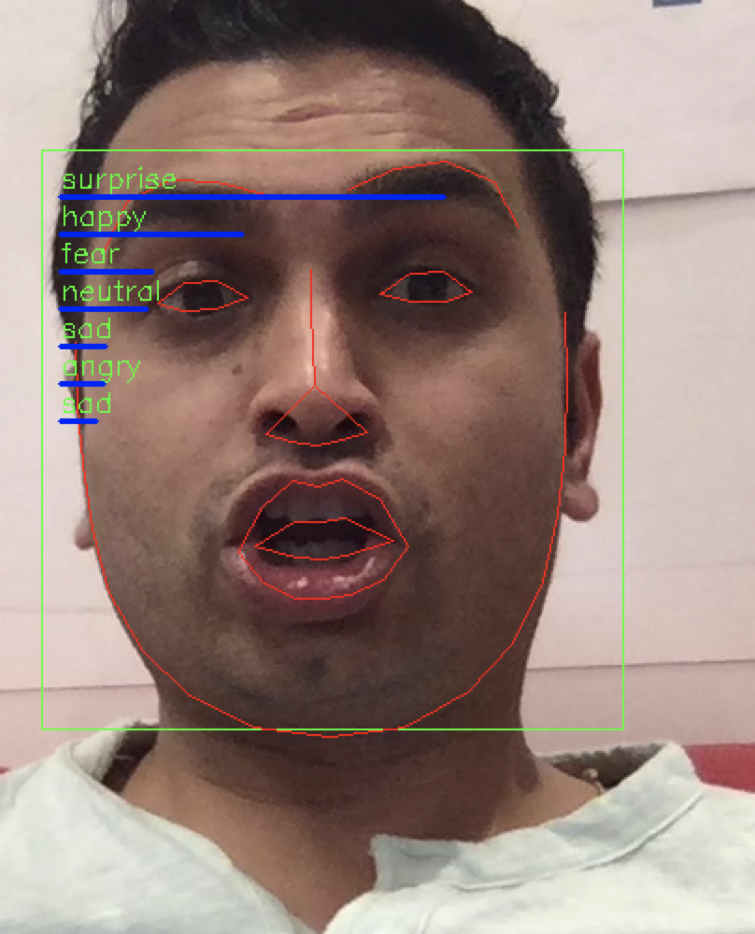
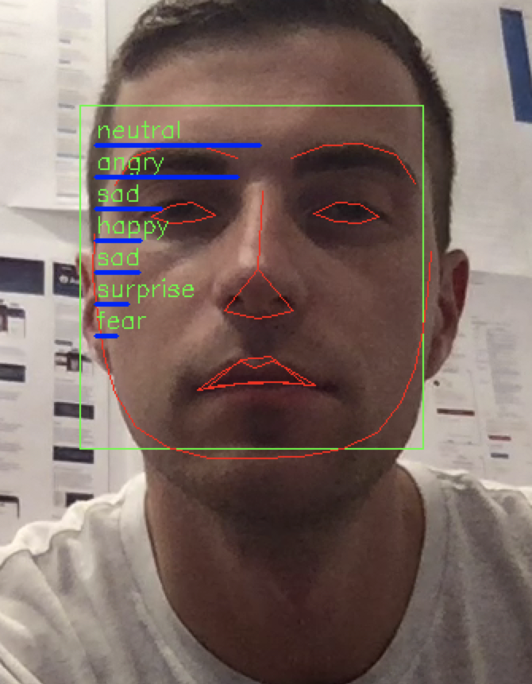
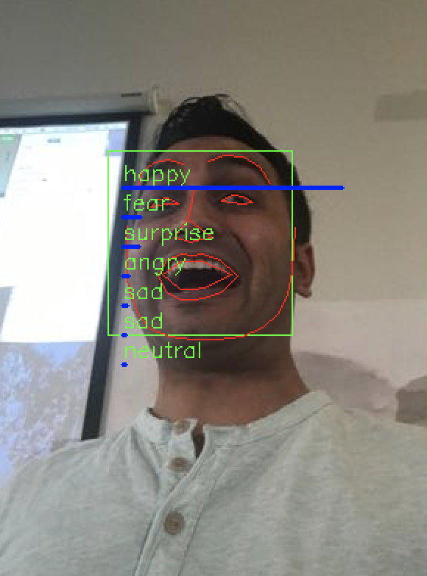
SUPPORT VECTOR MACHINES
USE FACIAL LANDMARKS AS INPUT. MUCH BETTER ACCURACY AND ~1 MIN TRAINING. FLEXIBILITY FOR MORE EMOTION LEVELS
4
1
2
3
4
Notes:
Trained model using facial datasets on six emotional states
sad, happy, angry, fear, neutral, surprise

Slide 11
FUTURE DIRECTION
1
FACE DETECTION IN VR
2
HCI
3
USER EXPERIENCES
4
AND MORE ……

Slide 12


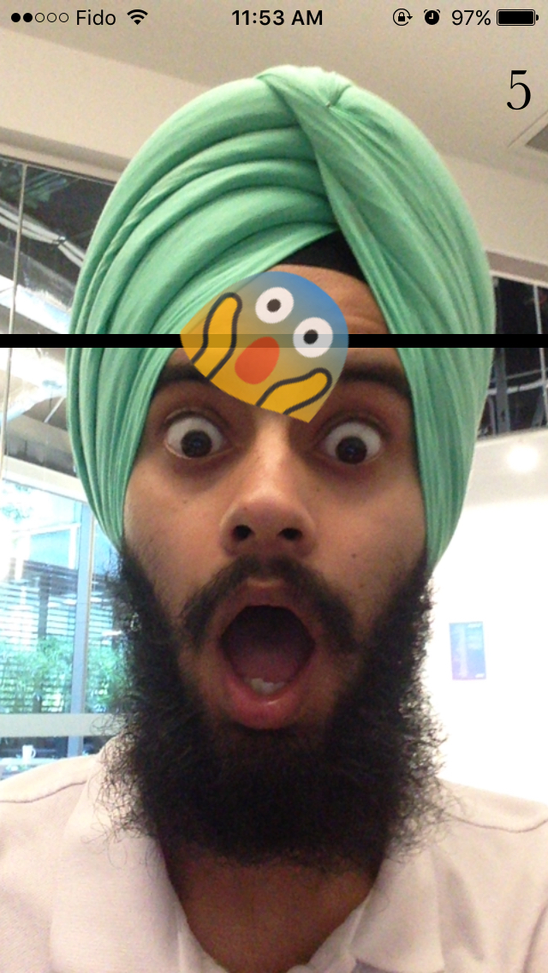
DEMO
Face Match time !!!

Slide 13
Thank you
Q & A
Face Match

