Slide 1
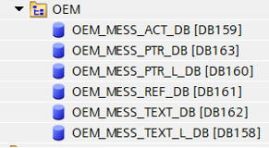
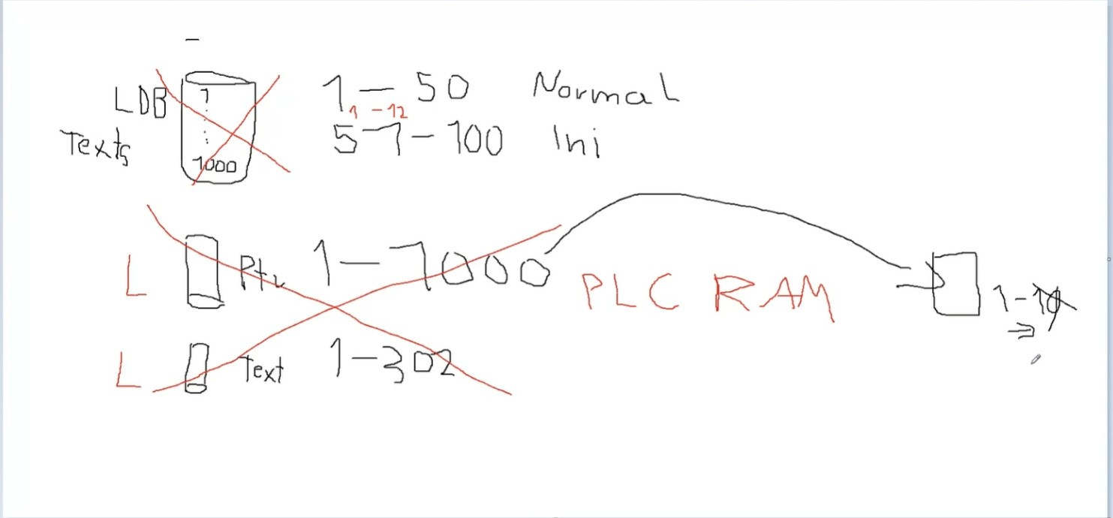
Question 1: In last week's report, I presented about creating more mess but I was not clear about DBs like PTR and REF, can you explain to me?
Question 2: In D3-1, They explained to me about L_DB but I have difficulty hearing so this is the information I compiled
non L_DB: only the last temporary active alarm will be stored in RAM and other alarms will not exist in PLC RAM memory
If we delete a text at position 10, the following texts will be pushed up one by one ??
Am I explaining that correctly?

Slide 2
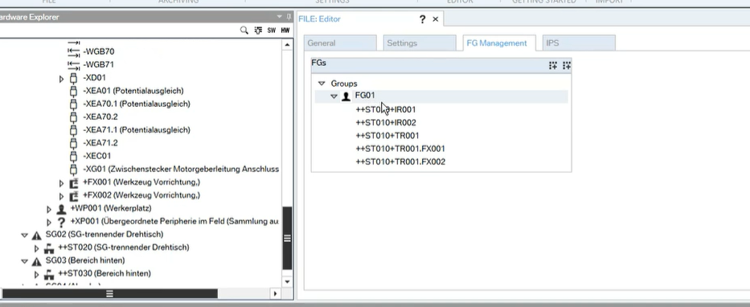
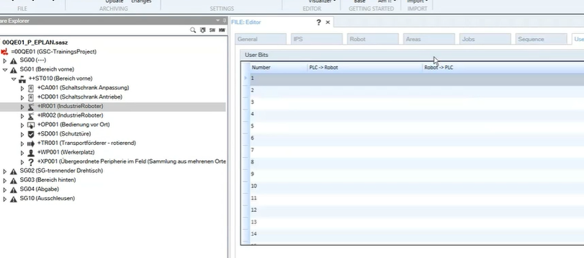
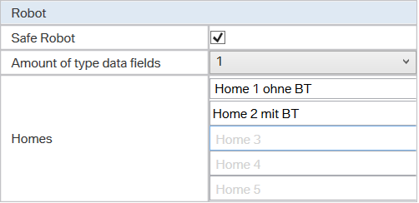
Q4: I see that a robot with a gripper has 2 home positions in the GSC standard, can we set it up further because it is the same as in the TKB standard?
And we can choose or not choose safe interface, so what device does not need safety?
Q3: In SAS, besides preparing hardware and eplan, we can modify some functions only when we drop components with MODE level (IR, FX, TR,...) into FG, what about other devices (CG, CE,...) should we add it?

