Slide 1
APSS Research Website
CUSTOMER CHECK-IN 1 · LOW-FIDELITY CONCEPTS
A dedicated home for research from AIDS Programs South Saskatchewan
October 7, 2026 · Group A
Samuel Willis · Muhammad Mouzzan · Chop Peter Kur · Oluwateniola Fayokun · Marie Basler
Notes:
Introduce the team and thank Erin for her time. Today we are sharing our first, low-fidelity ideas, and we want honest feedback on what is good, what is bad and what we can improve.

Slide 2
Today’s agenda
CUSTOMER CHECK-IN 1
01
What we heard
02
Empathy map and problem insights
03
Site map ideas
04
Low-fidelity prototypes
05
User story map
06
Questions and next steps
Each topic ends with your feedback: what’s good, what’s bad and what we can improve.
APSS Research Website · Customer check-in 1
2
Notes:
Walk through the topics quickly. Every section ends with a question for APSS. One teammate who is not presenting takes notes under three headings: good, bad, improve. Those notes become the summarized customer notes file for GitHub.

Slide 3
A dedicated home for APSS research
WHAT WE HEARD
The main APSS website already serves people who use its programs and services. Research from two U of R projects connected to reportneedles.ca needs its own complementary website.
Show the research
Share updates
Connect the sites
Current and completed projects, journal articles and research posters
A research blog that visitors can follow over time
Easy movement between the research site, the main APSS site and reportneedles.ca
Platform: WordPress · Final delivery: December 2
APSS Research Website · Customer check-in 1
3
Notes:
What we heard from the brief: the main APSS site works well for people using programs and services, so we are not redesigning it. The research from the two U of R projects connected to reportneedles.ca needs its own home. The site has to show projects, publications and posters, include a blog, and connect cleanly to the main site and reportneedles.ca. It will be built in WordPress.

Slide 4

Who is looking for APSS research?
EMPATHY MAP · DRAFT TO CONFIRM
Says
Thinks
ASSUMED VISITOR
“Where is APSS research?”
“Is this project current?”
Can I trust and cite this?
How do the sites connect?
A researcher, partner or community member looking for APSS research
Does
Feels
Searches for articles and posters
Moves between APSS sites
Lost when research is scattered
Confident when it looks professional
Who visits most: researchers, funders, community members or media?
APSS Research Website · Customer check-in 1
4
Notes:
This empathy map is a draft built from the project brief, so present it as assumptions to confirm with Erin. Ask who actually visits most. If your team's own empathy map differs, replace this content with it.

Slide 5

What visitors need, and why
PROBLEM INSIGHTS · FROM OUR AFFINITY DIAGRAM
Theme | What visitors need | Why it matters
Research projects | Browse current and completed projects | Shows finished and ongoing work
Research materials | Reach articles and posters quickly | Materials exist but have no home
Research updates | Follow ongoing work through a blog | Keeps partners informed over time
Connected websites | Move easily between all three sites | The sites serve one mission
Website experience | A clear, professional, easy site | Builds trust; must run on WordPress
Did we miss a need your visitors have?
APSS Research Website · Customer check-in 1
5
Notes:
These five themes come from our affinity diagram. Read the need and the reason for one or two rows, then ask whether anything is missing. "All three sites" means the research site, the main APSS site and reportneedles.ca.

Slide 6
Option A: a lean structure
SITE MAP · OPTION A
Home
Research Projects
Publications
Updates
Related Sites
Current Projects
Journal Articles
Blog
APSS Main Website ↗
Completed Projects
Research Posters
reportneedles.ca ↗
Project Details page (one per project)
Footer on every page: Contact information · Privacy / Terms · Acknowledgements
Do these labels make sense to your visitors?
APSS Research Website · Customer check-in 1
6
Notes:
Option A keeps the main menu short: four sections plus a footer on every page. Both current and completed projects lead to a Project Details page. External links have an arrow and a dashed outline so visitors know they are leaving for the main APSS site or reportneedles.ca. That is how this structure supports digital wayfinding.

Slide 7
Option B: an expanded structure
SITE MAP · OPTION B
Home
About
Research Projects
Publications
News & Updates
Get Involved
Related Sites
Overview
Current Projects
Journal Articles
Blog
Research Opportunities
APSS Main Website ↗
Our Team
Completed Projects
Reports
Announcements
Collaborate with Us
reportneedles.ca ↗
Our Partners
Project Categories
Posters
Events
Community Partnerships
Other Links (optional)
Contact
Project Details
Other Resources
Newsletter (optional)
Contact / Inquiries
Lean (A) or expanded (B)? Which sections matter most to you?
APSS Research Website · Customer check-in 1
7
Notes:
Option B adds About and Get Involved, splits publications into more types, and turns updates into a blog, announcements, events and an optional newsletter. Its footer on every page holds contact information, social media links, privacy and terms, and acknowledgements. Ask whether A or B fits APSS better, or which parts of each to combine. If your team has more site map proposals (one per member is required), add a slide for each.

Slide 8
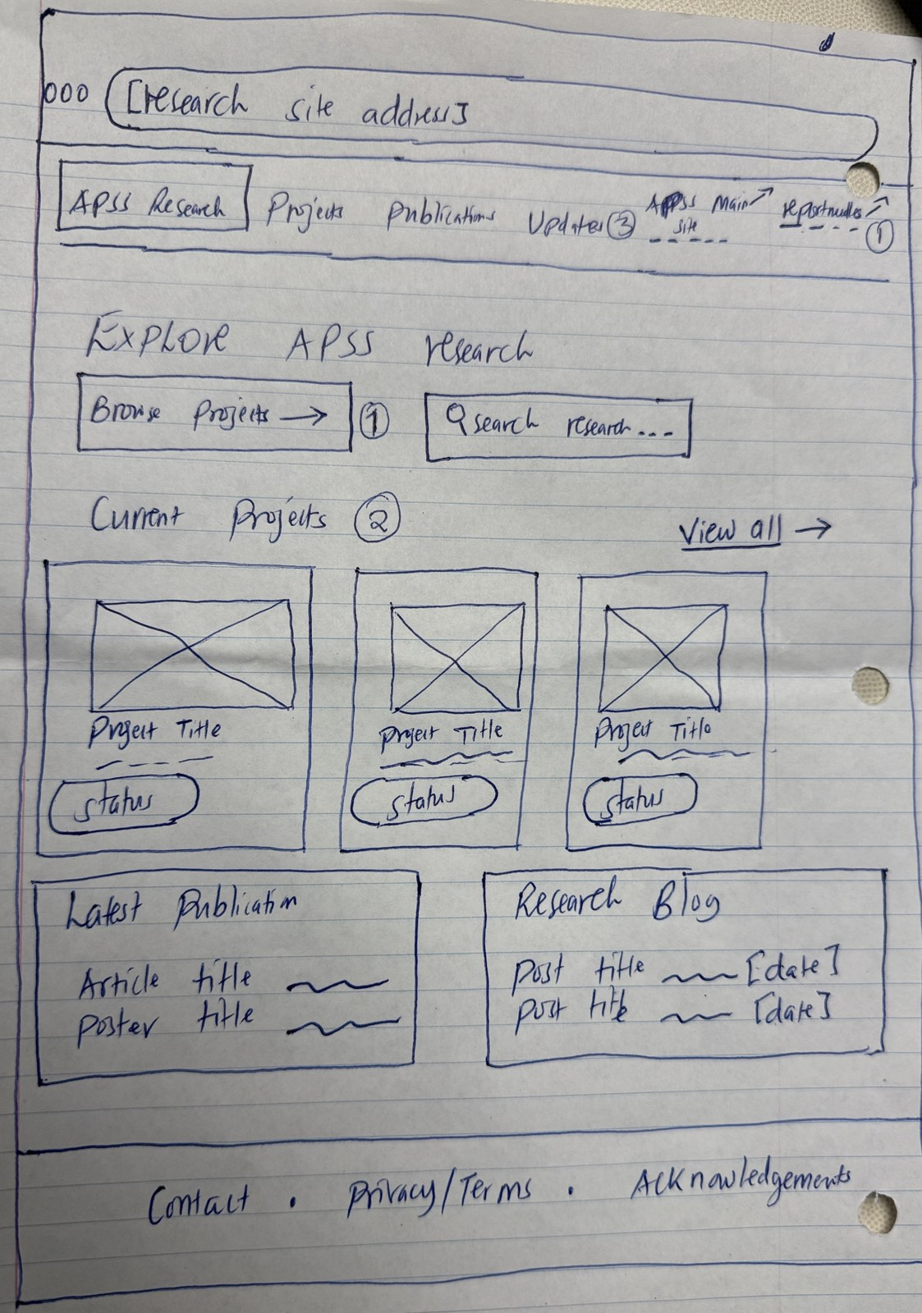
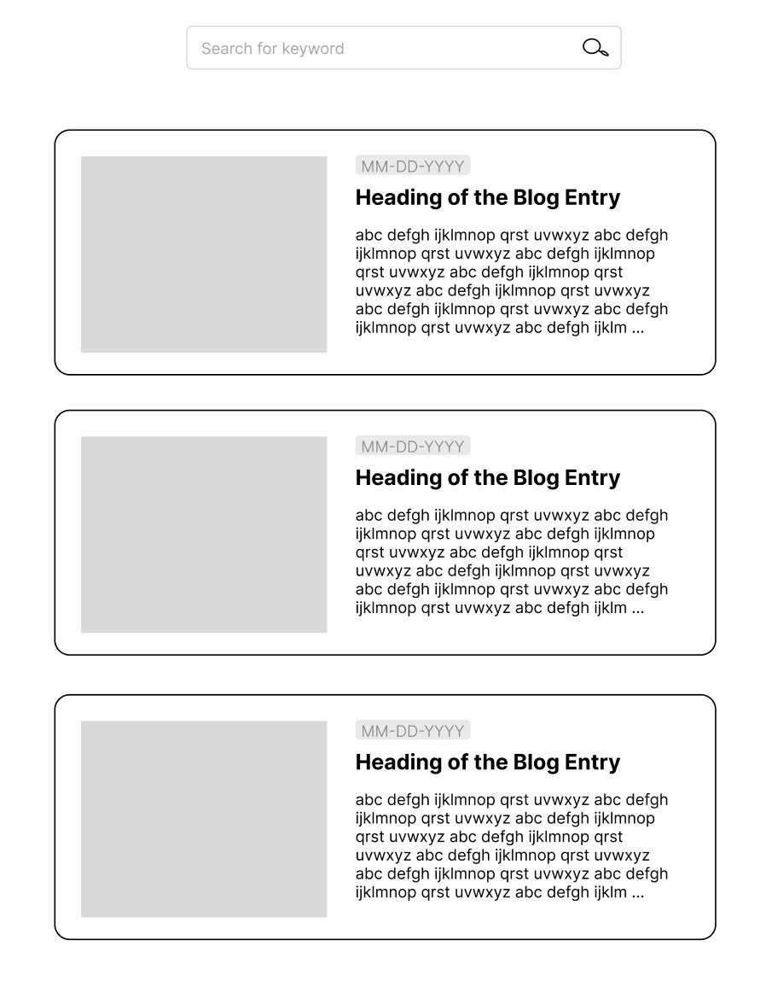
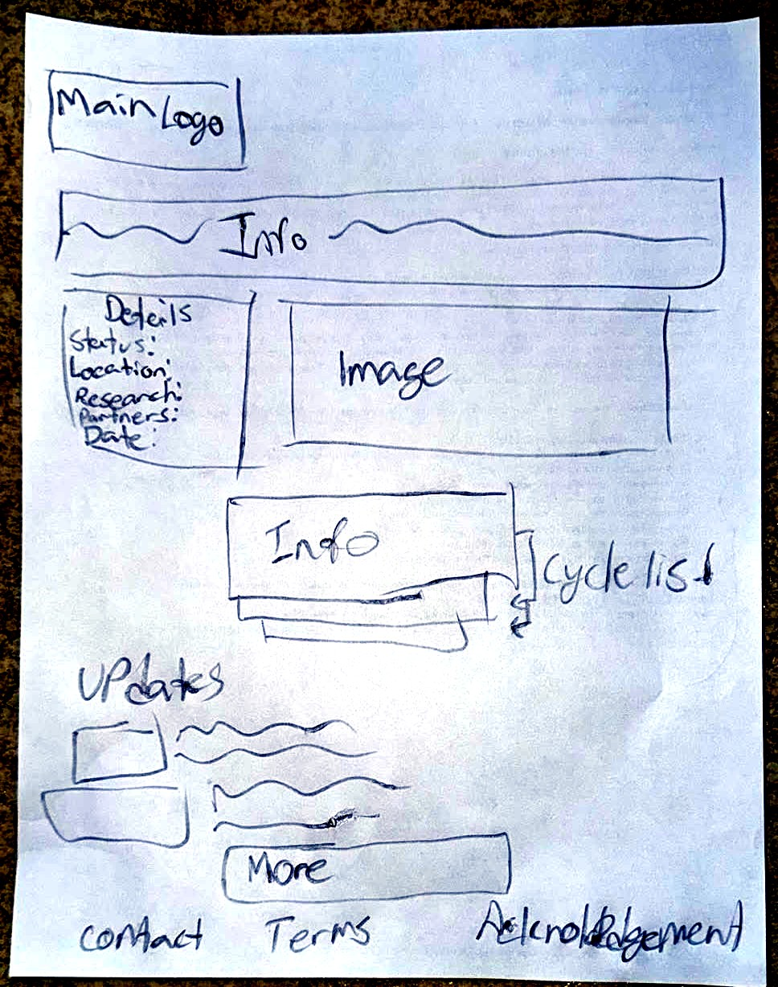
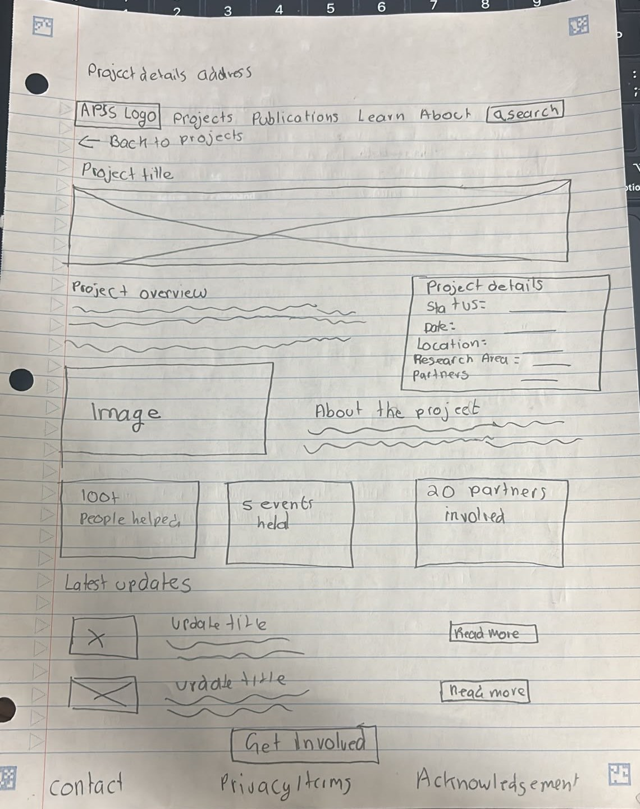
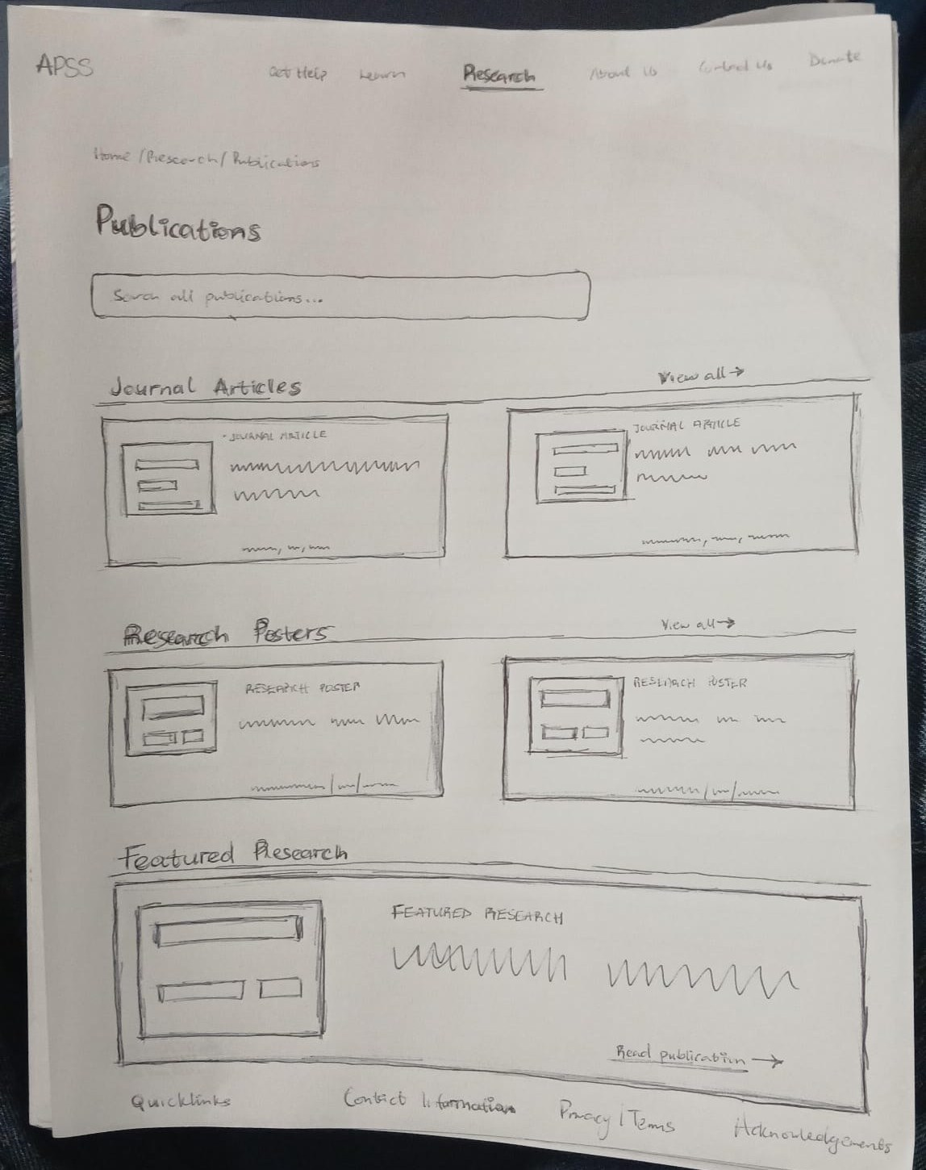
One sketch from each team member
LOW-FIDELITY PROTOTYPES · PAPER SKETCHES
Home page
Chop Peter Kur
Project page
Samuel Willis
Project Details page
Muhammad Mouzzan
Publications page
Oluwateniola Fayokun
Research Blog page
Marie Basler
What works, what doesn’t, and what would you change?
APSS Research Website · Customer check-in 1
8
Notes:
Each member: show your paper sketch, say which page it is, and name one design choice behind it. Chop presents the Home page; the circled numbers mark affordances (1), gestalt (2) and constraints (3).

Slide 9
People-centred design in our prototypes
DESIGN IDEAS BEHIND THE SKETCHES
01
02
03
Affordances & signifiers
Gestalt
Constraints
Buttons look clickable, and a ↗ marks links that leave for the main APSS site or reportneedles.ca.
Project cards share one structure (image, title, status), and related content sits in boxed areas, so groups read together.
A short main menu keeps the paths clear, and project filters only offer categories that exist.
Also in play: consistency (the same header on every page) and feedback (the current page is highlighted in the menu).
APSS Research Website · Customer check-in 1
9
Notes:
Connect the sketches to concepts from class. Before presenting, update these examples so they match what is actually on your team's sketches. The same content can become the required 1-page PDF.

Slide 10
From visitor goals to MVP releases
USER STORY MAP
Activities
Discover Research
Browse Projects
Understand Project
Access Materials
Follow Updates
Connect Sites
Tasks
What is this site?
Current Projects
Overview
Articles
Blog
APSS
Find research
Completed Projects
Status
Posters
Updates
reportneedles
MVP 1
Home
Current
Project Details
Articles
Blog
APSS link
Completed
Posters
reportneedles
MVP 2
Filters
Related Projects
Related Resources
Is MVP 1 the right first release? What must be live by December 2?
APSS Research Website · Customer check-in 1
10
Notes:
Orange cards are what visitors want to do, blue cards are the steps, and yellow cards are what we build. MVP 1 is the first usable release; MVP 2 adds filters and related content. Ask whether MVP 1 is the right priority and what must be live by December 2. Remember: the graded version of this map is the PDF export from StoriesOnBoard.

Slide 11
Questions for APSS
BEFORE WE CLOSE
Who visits the research site most: researchers, funders, community members or media?
Who will update the WordPress site after December 2?
Are the articles and posters ready in digital form?
Are there branding or accessibility guidelines we should follow?
Notes:
Ask whichever questions are still open; skip any that Erin already answered. The note-taker writes down her answers for the customer notes file.

Slide 12
Where your feedback goes next
NEXT STEPS
Oct 9
Oct 21
Nov 4
Dec 2
Activity 1 files on GitHub
High-fidelity designs
WordPress work in progress
Final delivery to APSS
Thank you. We’ll fold today’s feedback into our high-fidelity designs.
APSS Research Website · Customer check-in 1
12
Notes:
Close with the timeline from the brief: high-fidelity designs on October 21, WordPress work in progress on November 4 and final delivery on December 2. Thank Erin for her time.

