Slide 1
Réunion avancement du projet SDSA
BARET Kéa (DCPM/FIPU)
Frédérique BEC (CONSULTANTE BDF, CY CERGY PARIS University)
6/02/2025

Slide 2
OrganizaTion
The European Commission SDSA approach
The EU's new Economic Governance Framework
Implementation
Projects for BdF SDSA

Slide 3
The European Commission SDSA approach
The current EC methodology, based on the variance-covariance matrix approach, is based on Berti (2013)
The debt drivers considered in the SDSA
The key principles of the EC approach

Slide 4
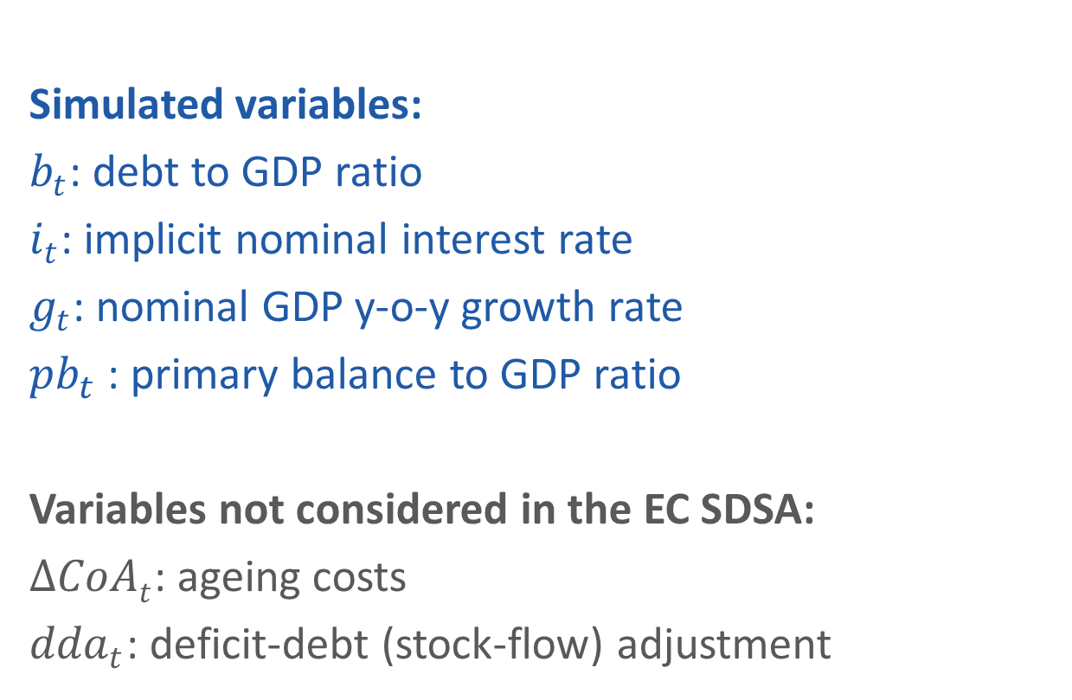

1) The debt drivers considered in the SDSA
$$b_{t}=\frac{{1+i}_{t}}{1+g_{t}}b_{t−1}−{pb}_{t}+{ΔCoAt+dda}_{t}$$
Simulated variables:
$b_{t}$: debt to GDP ratio
$i_{t}$: implicit nominal interest rate
$g_{t}$: nominal GDP y-o-y growth rate
${pb}_{t}$ : primary balance to GDP ratio
Variables not considered in the EC SDSA:
$ΔCoAt$: ageing costs
${dda}_{t}$: deficit-debt (stock-flow) adjustment

Slide 5
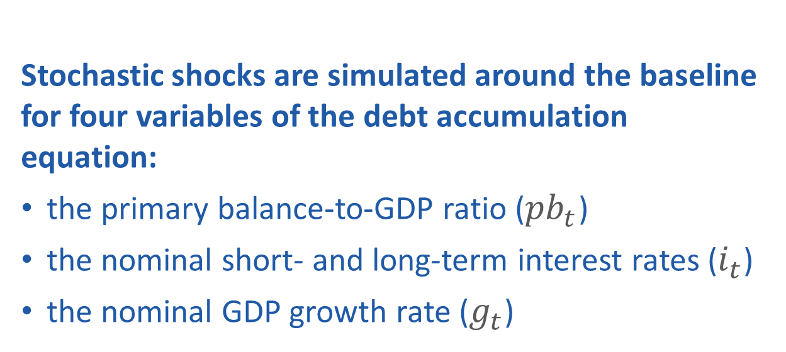

1) The debt drivers considered in the SDSA
$$b_{t}=\frac{{1+i}_{t}}{1+g_{t}}b_{t−1}−{pb}_{t}+{ΔCoAt+dda}_{t}$$
Stochastic shocks are simulated around the baseline for four variables of the debt accumulation equation:
the primary balance-to-GDP ratio (${pb}_{t}$)
the nominal short- and long-term interest rates ($i_{t}$)
the nominal GDP growth rate ($g_{t}$)

Slide 6
2) The key principles of the EC approach
The data:
Quarterly data mostly from Eurostat (some short-term interest rates come from OECD, some long-term interest rates come from ECB)
Sample from 2000Q1
The (quarterly) primary balance = headline balance (B9) + interest payments (D41PAY). It is seasonally adjusted using the Census X-12-ARIMA approach
Outliers are identified and treated using a winsorising approach:
For each variable and country within the sample period, observations outside their 5th and 95th percentiles are considered outliers and replaced by the closest percentile value

Slide 7
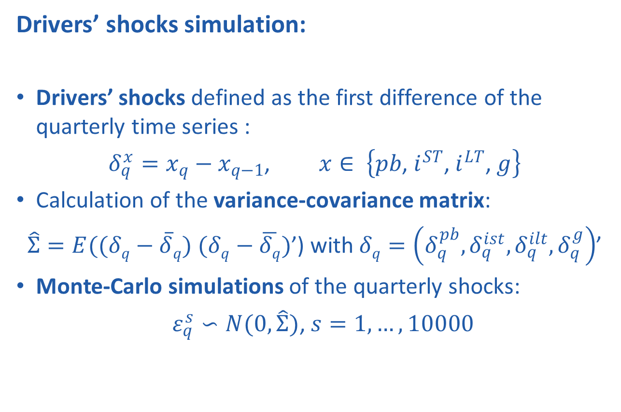
2) The key principles of the EC approach
Drivers’ shocks simulation:
Drivers’ shocks defined as the first difference of the quarterly time series :
$δ_{q}^{x}=x_{q}−x_{q−1}$, $x∈ \left\{pb\text{, }i^{ST}\text{, }i^{LT}\text{, }g\right\}$
Calculation of the variance-covariance matrix:
$\hat{Σ}=E((δq−\overline{δ}q)$ $(δq−\overline{δq})$’) with $δq=\left(δ_{q}^{pb},δ_{q}^{ist},δ_{q}^{ilt},δ_{q}^{g}\right)$’
Monte-Carlo simulations of the quarterly shocks:
$ε_{q}^{s}∽N(0,\hat{Σ})$, $s=1,…,10000$

Slide 8
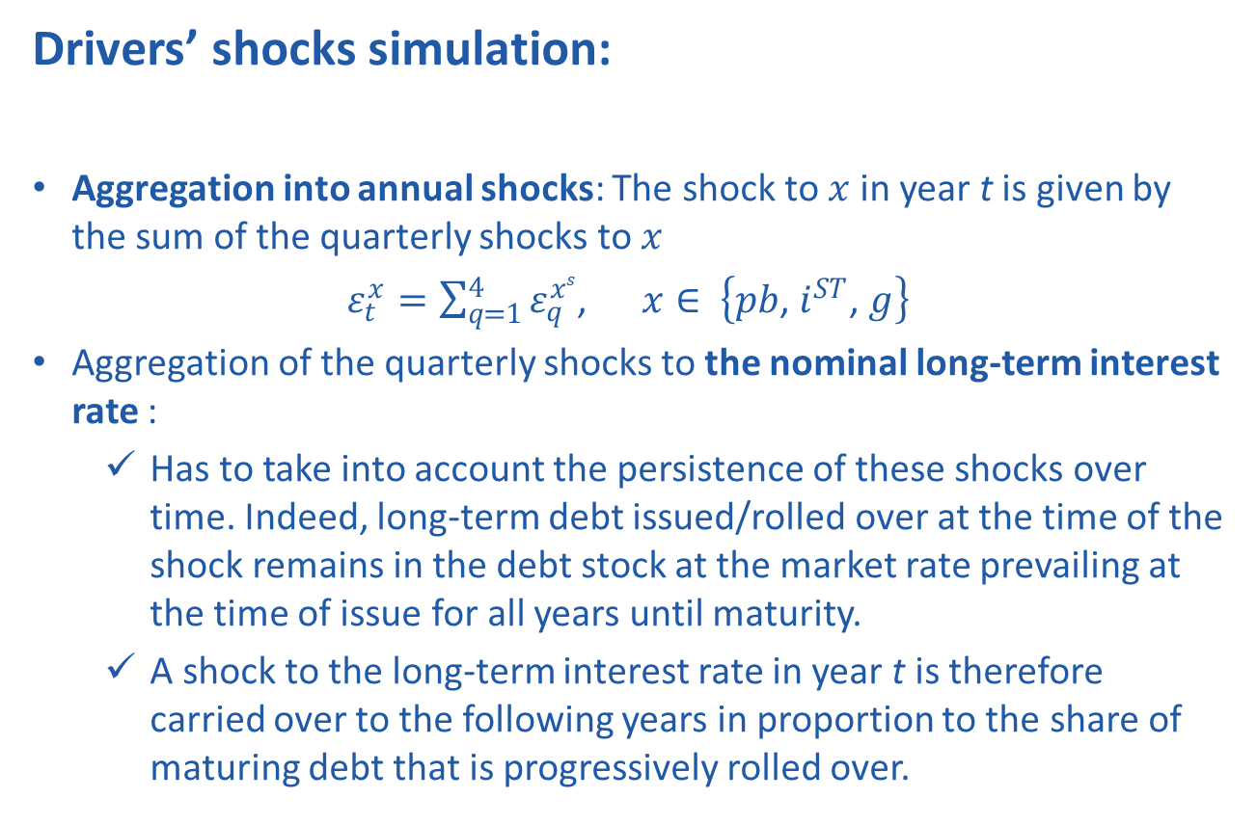
2) The key principles of the EC approach
Drivers’ shocks simulation:
Aggregation into annual shocks: The shock to $x$in year t is given by the sum of the quarterly shocks to $x$
$ε_{t}^{x}=\sum_{q=1}^{4}{ε_{q}^{xs}}$, $x∈ \left\{pb\text{, }i^{ST}\text{, }g\right\}$
Aggregation of the quarterly shocks to the nominal long-term interest rate :
Has to take into account the persistence of these shocks over time. Indeed, long-term debt issued/rolled over at the time of the shock remains in the debt stock at the market rate prevailing at the time of issue for all years until maturity.
A shock to the long-term interest rate in year t is therefore carried over to the following years in proportion to the share of maturing debt that is progressively rolled over.

Slide 9
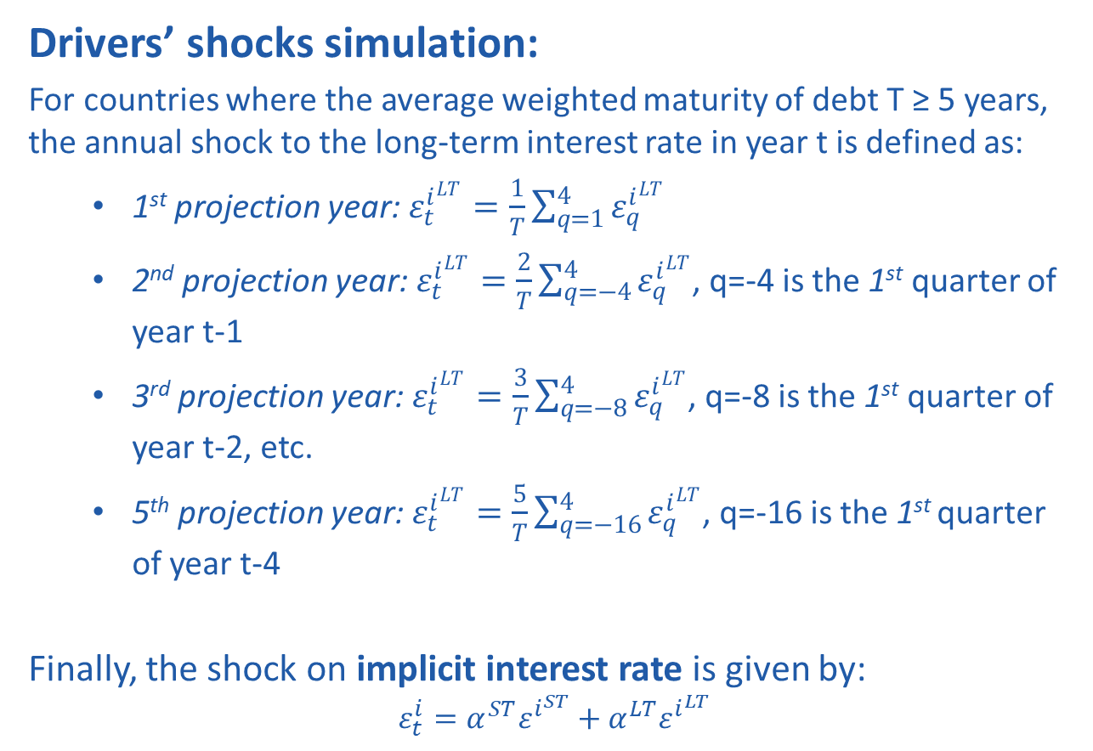
2) The key principles of the EC approach
Drivers’ shocks simulation:
For countries where the average weighted maturity of debt T ≥ 5 years, the annual shock to the long-term interest rate in year t is defined as:
1st projection year: $ε_{t}^{i^{LT}}=\frac{1}{T}\sum_{q=1}^{4}{ε_{q}^{i^{LT}}}$
2nd projection year: $ε_{t}^{i^{LT}}=\frac{2}{T}\sum_{q=−4}^{4}{ε_{q}^{i^{LT}}}$, q=-4 is the 1st quarter of year t-1
3rd projection year: $ε_{t}^{i^{LT}}=\frac{3}{T}\sum_{q=−8}^{4}{ε_{q}^{i^{LT}}}$, q=-8 is the 1st quarter of year t-2, etc.
5th projection year: $ε_{t}^{i^{LT}}=\frac{5}{T}\sum_{q=−16}^{4}{ε_{q}^{i^{LT}}}$, q=-16 is the 1st quarter of year t-4
Finally, the shock on implicit interest rate is given by:
$$ε_{t}^{i}=α^{ST}ε^{i^{ST}}+α^{LT}ε^{i^{LT}}$$

Slide 10
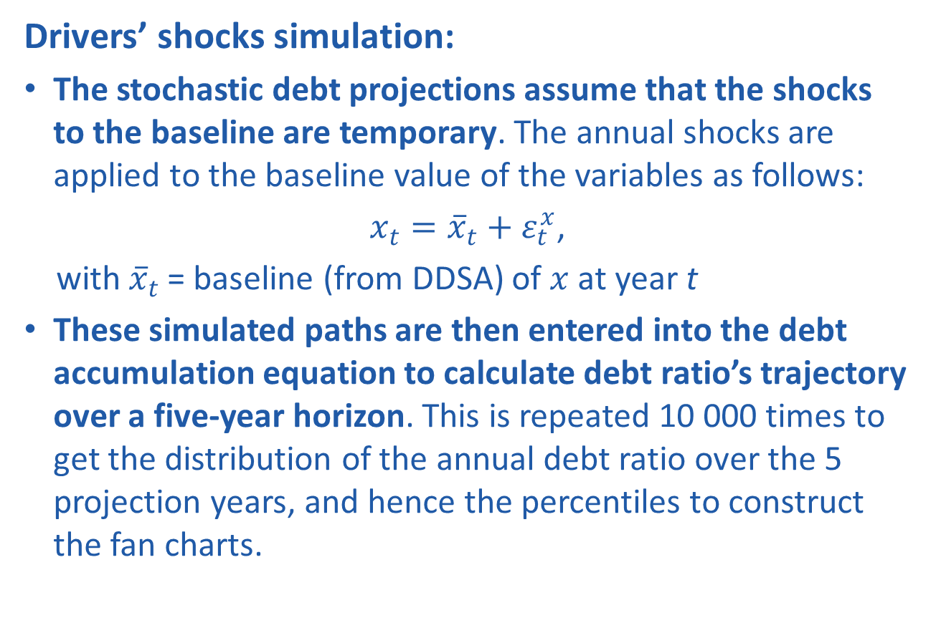
2) The key principles of the EC approach
Drivers’ shocks simulation:
The stochastic debt projections assume that the shocks to the baseline are temporary. The annual shocks are applied to the baseline value of the variables as follows:
$x_{t}={\overline{x}}_{t}+ε_{t}^{x}$,
with ${\overline{x}}_{t}$ = baseline (from DDSA) of $x$at year t
These simulated paths are then entered into the debt accumulation equation to calculate debt ratio’s trajectory over a five-year horizon. This is repeated 10 000 times to get the distribution of the annual debt ratio over the 5 projection years, and hence the percentiles to construct the fan charts.

Slide 11
2. The EU's new Economic Governance Framework
Adopted in April 2024
By the end of the adjustment period (4 or 7 years) and without further budgetary measures:
Debt ratio is put or remains on a plausibly downward path, or stays below 60%, over the 10 years following the adjustment period (DDSA)
The deficit ratio is brought or kept below 3% and maintained below it over the 10 years following the adjustment period (DDSA)
Debt ratio declines with probability of at least 70% (in line with the threshold used in the Commission’s standard DSA) in the 5 years following the adjustment period (SDSA)
Notes:
"

Slide 12
3. Implementation
Current criteria retained by the EC’s SDSA for risk classification:
(q₉₀-q₁₀) cone width at the 5th projected year
probability that the 5th projected year debt ratio is greater than its last observed value
NEW: probability that the debt ratio declines in the 5 years following the adjustment period

Slide 13
3. Implementation
French data 2000q1-2023q4 (winsorized) and using the latest deterministic DSA benchmark scenario which accounts for a 7-year adjustment period (2025-2031):
(q90-q10) = 18,8 pps
P(debt ratio 2028 > debt ratio 2023) = 89,4%

Slide 14
3. Implementation
Impact of each shock on the cone width and probability
Shocks on g and pb are the most influential for debt distribution
Shocks on the interest rates have a negligible impact
 | All shocks | No iir | No i_LT | No i_ST | No pb | No g
q90-q10 | 18,8 | 19,0 | 18,9 | 18,8 | 14,2 | 8,2
% change w.r.t. all |  | +1,1% | +0,5% | 0 | -24,5% | -56,4%
Prob | 89,9 | 89,7 | 89,7 | 89,9 | 96,1 | 99,7
% change w.r.t. all |  | -0,2% | -0,2% | 0,0% | +6,9% | +10,9%

Slide 15
3. Implementation
2 options regarding the implementation of the new criterium:
P[debt ratio in 2036 < debt ratio in 2031] ≥ 70%
Draw randomly 10 000 sequences of 52 quarters (13 years x 4 quarters) for all the drivers’ shocks, so as to get the distribution of the debt ratio over the next 13 years: uncertainty over a 13-year horizon…
Transpose the fanchart above to the deterministic trajectory for years 2032-2036 (EC? and Cepremap)
the sole information available within the EC approach to evaluate uncertainty over a 5-year horizon is derived from the sample of observations employed
as such, the measure of uncertainty over a 5-year horizon ought to be grounded in this information set.

Slide 16
3. Implementation
Draw randomly 10 000 sequences of 52 quarters (13 years x 4 quarters) :
P[debt ratio in 2036 < debt ratio in 2031] = 82,5% > 70%

Slide 17
3. Implementation
2) Transpose the 5-year distribution to the deterministic trajectory for years 2032-2036:
P[debt ratio in 2036 < debt ratio in 2031] = 92% > 70%

Slide 18
4. PROJEcTS for BdF SDSA
Implémentation de la SDSA version COM
collection et traitement des données (en lien avec dans la DDSA)
Simulation de Monte-Carlo et traitement spécifique des chocs de taux longs
Extension de la SDSA à l’Allemagne, l’Espagne, l’Italie et aux Pays-Bas
Collection et traitement de données (in progress)
(B-)VAR et EC Monte-Carlo (Benchmark COM)

