Slide 1


This document is covered by copyright and cannot be copied, distributed or reproduced in whole or in part, without specific authorization.

Slide 2
LTVL
LONGARINADIANTEIRA- LTVL
GREIFER_1340
OS-569

Slide 3
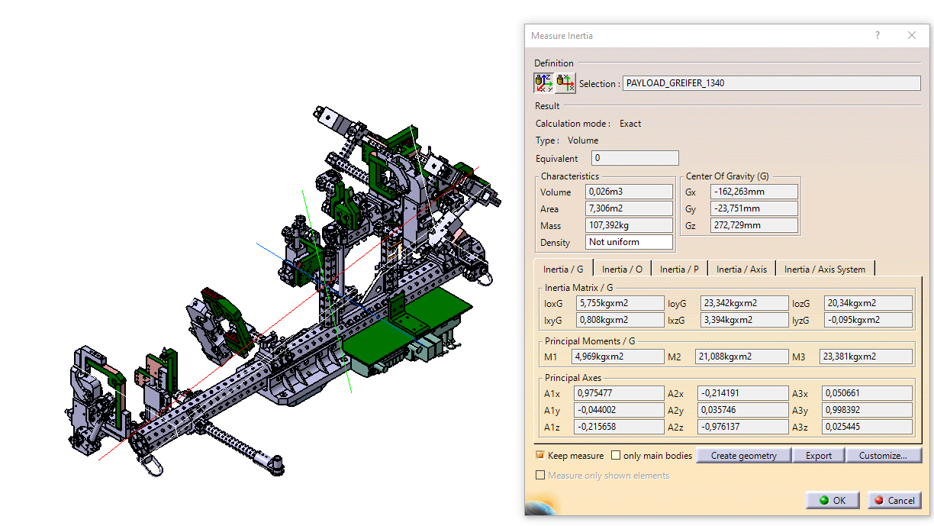
CENTRO DE GRAVIDADE

Slide 4
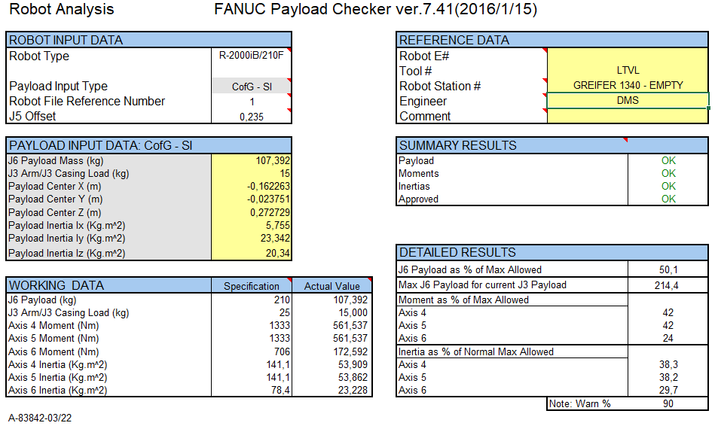

Slide 5
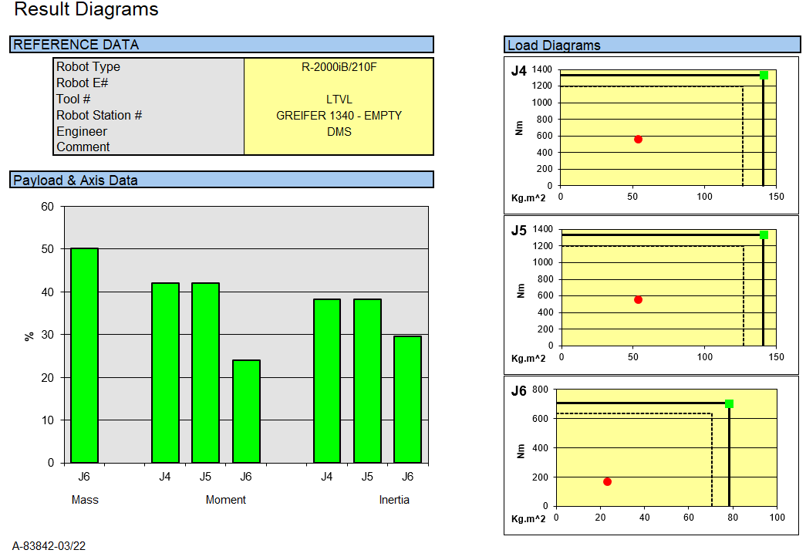

Slide 6
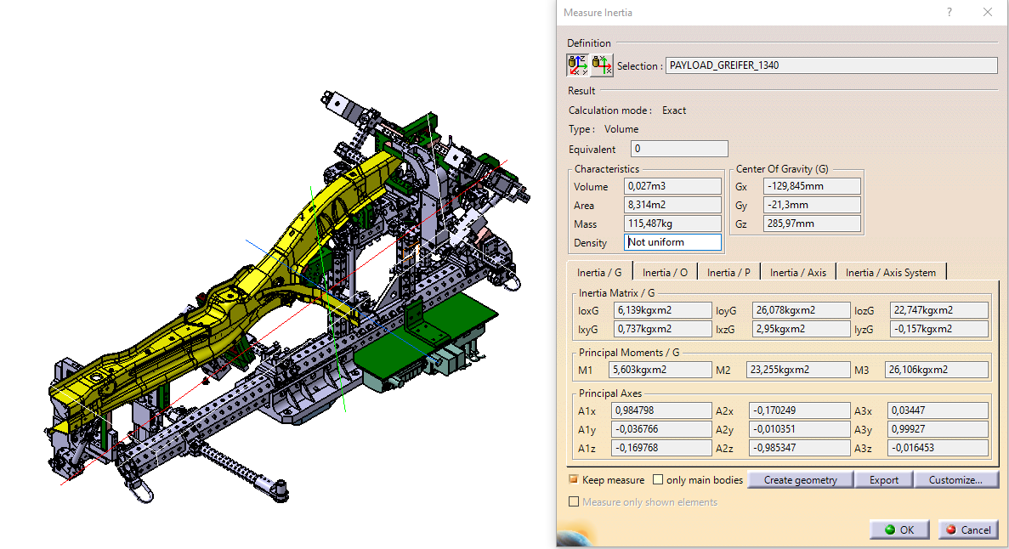

Slide 7
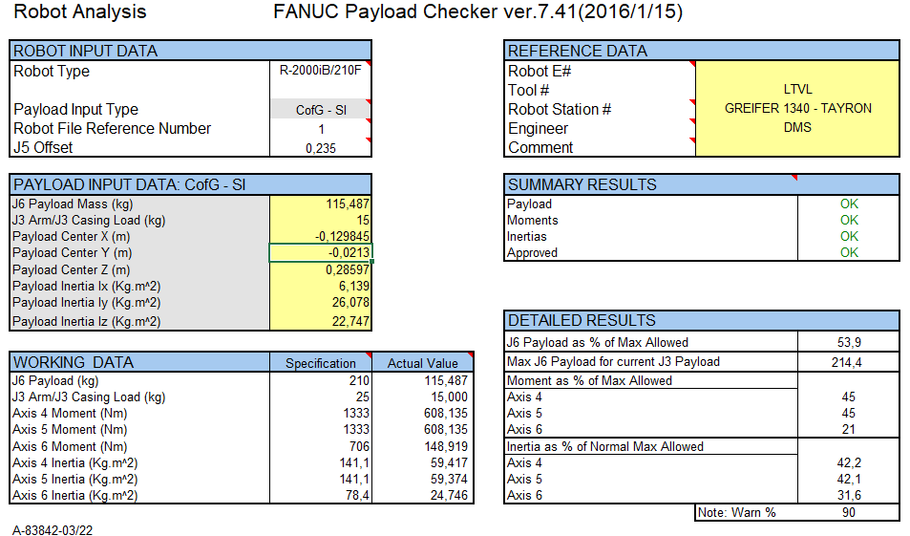

Slide 8
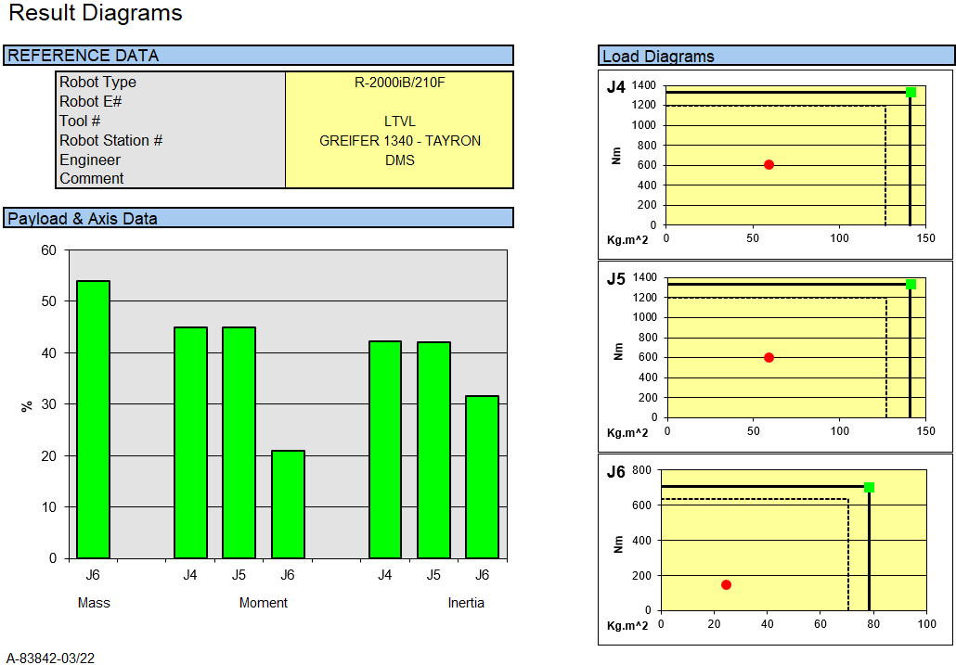

Slide 9
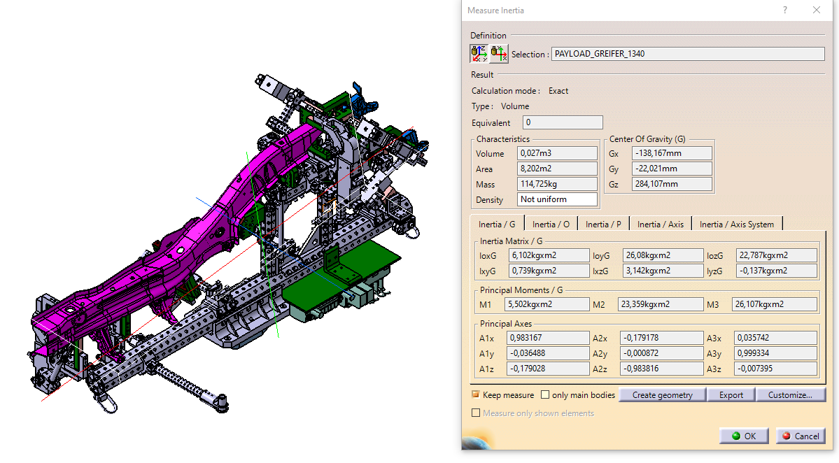

Slide 10
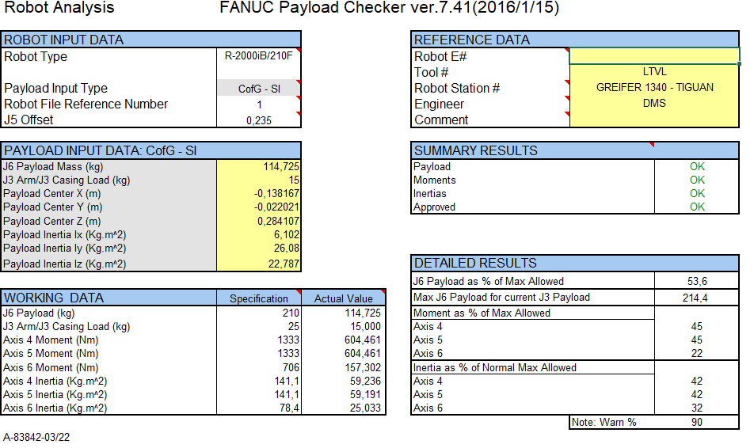

Slide 11
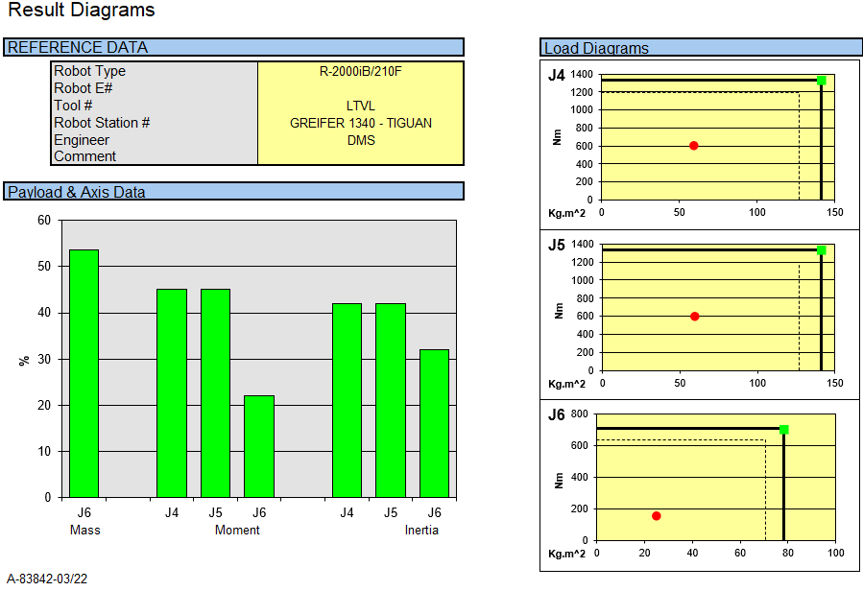

Slide 12









Thank you for your kind attention
georgeton.silva@gmebrasil.com.br
+55 41 3299-2029
O.L.C.I. ENGINEERING S.r.l.
Via I° maggio 8
10040 Rivalta di Torino (TO)
ITALY
Via Padania Superiore 111/A
Castegnato (BS)
ITALY
www.olcieng.eu
GME Aerospace Indústria de Material Composto S.A.
Alameda Bom Pastor, 1683 – Ouro Fino
CEP 83.015-140 - São José dos Pinhais
Paraná BRAZIL
www.gmebrasil.com.br
Efort France S.a.s.
13 Rue Camille Desmoulins
92130 Issy-Les-Moulineaux
FRANCE
Autorobot - Strefa Sp. z o.o.
Ul. Leona Wyczółkowskiego 29, 44-100 Gliwice
POLAND
www.autorobotstrefa.pl
CMA Robotics S.p.A.
Viale del lavoro 41
33050 Pavia di Udine loc. Z.I.U.
ITALY
www.cmarobotics.it
O.L.C.I. ENGINEERING India Pvt. Ltd.
Plot No. A-22-A/1/1, MIDC Chakan Industrial Area Ph-II Village Khalumbre, Tal.Khed, - Pune 410501,Maharashtra INDIA
CMA Roboter GmbH
Eisenstraße 1
57489 Drolshagen
GERMANY
www.cmaroboter.de

