Slide 1
How do Casual riders and Annual Members use cyclistic bikes differently ?
Presented by : Junior Alphonse
Last Updated : 2024-02-19

Slide 2
Table of contents
Difference between Casuals and Members
Purpose Statement (what are we talking about ?)
Tell Your Story (with Data)
Conclusion
Appendix

Slide 3
Objective
Analyse and identify ways in which Casual riders and Annual Members use cyclistic bikes
differently from each other using data from 2023 to drive Marketing strategy aimed at
converting Casual riders to Members.
This research will help us drive key marketing strategies and techniques to convert
casual riders to members , which will in turn generate more revenue to our company .

Slide 4
Next steps
We will start by analysing the ride lengths in minutes and the ride volumes, ride volumes represent
the total ride_Id’s created in the current year 2023.
This analysis will be broken down visually between the casual riders and member
Riders for comparison purposes as reflected in our objective.

Slide 5
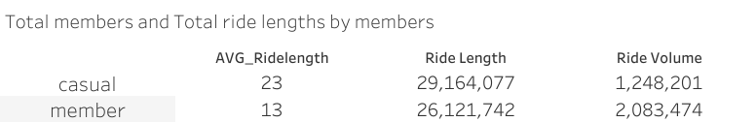
Total members and Total ride lengths by members
Key take aways
The average ride length for casuals surpasses that of members by 10 mins
The overall ride volume for members surpasses that of casuals but casuals have a larger
overall ride length ride length in minutes than members.

Slide 6
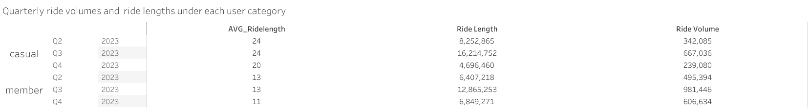
Quarterly ride volume and ride length under each user category
Key take aways
From the second quarter, the casual
riders, have an average ride length of 24 minutes
while the members have an average ride
Length of 13 minutes.
Overall Ride length and ride volume follow a
similar trend through out the quarters for both user
categories.
The only period where member’s overall
ride length is greater than casual’s is at the 4th quarter.
Through out each quarter the casual riders’ ride
Volume Is lower than members respectively.
(mins)

Slide 7
Next steps
We will describe how ride lengths varies over time specifically start of week,
under each user category through the medium of line graphs.
We have to note that the ride company has three sorts of bikes : Electric bikes,
Classic bikes and docked bikes.
Note : for the graphs consider the blue lines and the blue arrows to represent
casual riders and the grey lines and/or grey arrows represent the members

Slide 8
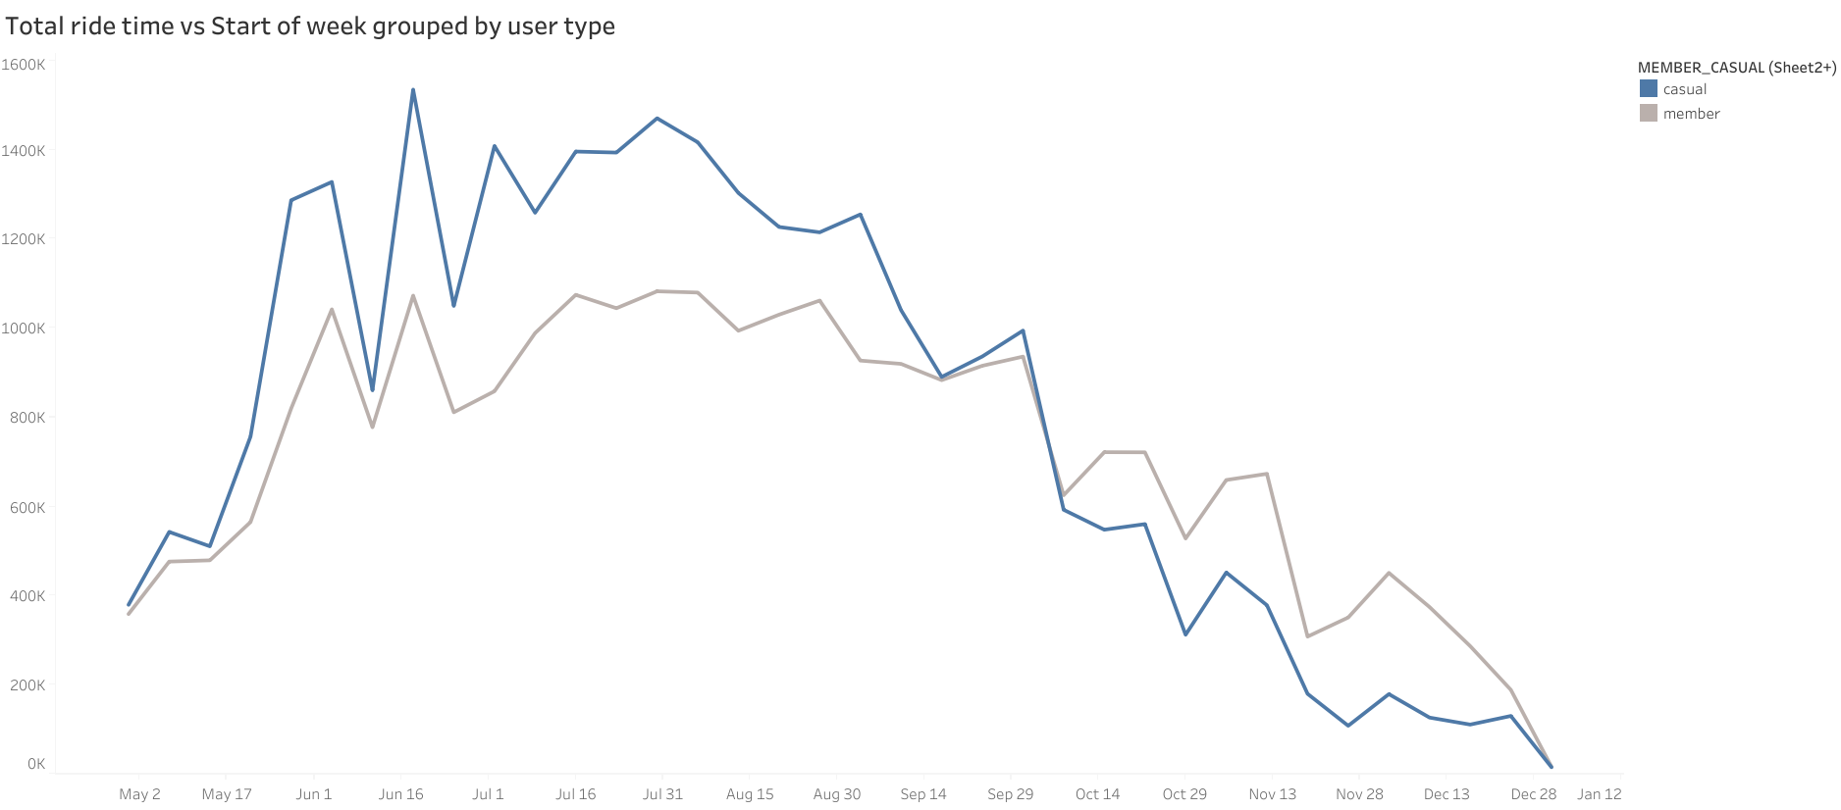
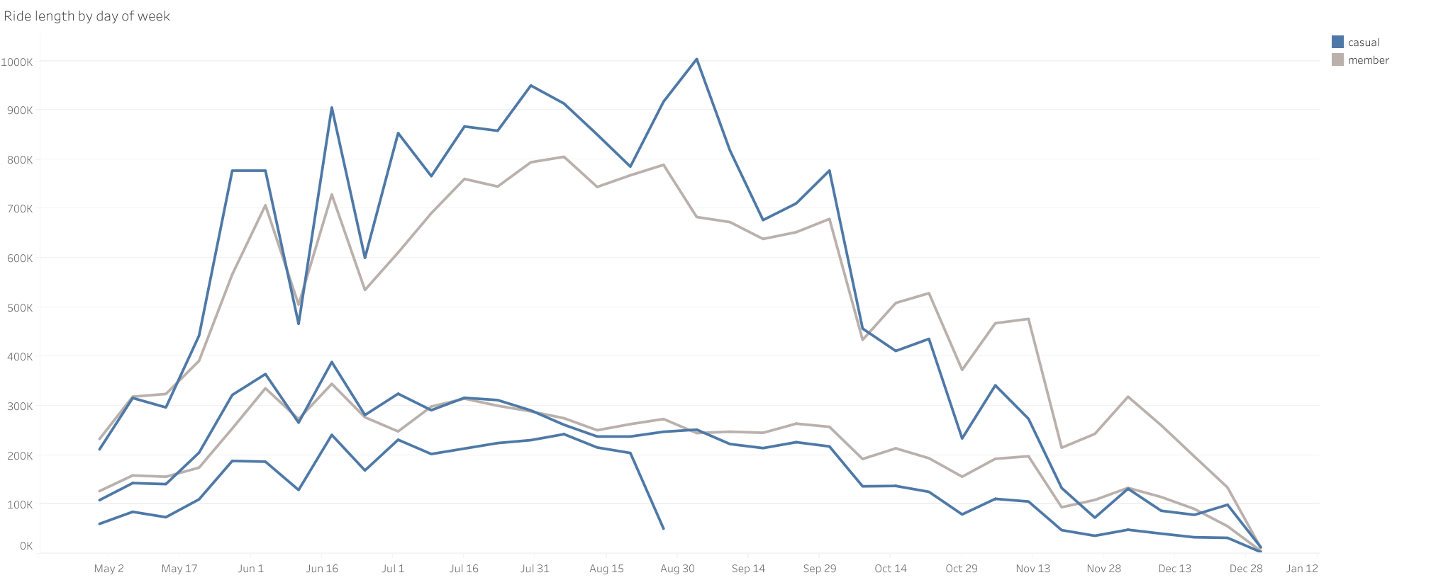
Ride length vs Start of week grouped by user type
Ride Length by start of week under each user category grouped by rideable type
Classic bike
Casual
Casual
Member
Classic bike
Ride length (mins)
Member
Electric bike
Docked bike
Electric bike
Day [Start of week]
Day [Start of week]

Slide 9
Key take aways
The ride lengths for casual and members follow a similar seasonality and a similar trend overall.
Total ride lengths by start of week for casuals is greater than that of members’ up to October 8th 2023 for every week start. Then it falls below that of members till the end of the year.

Slide 10
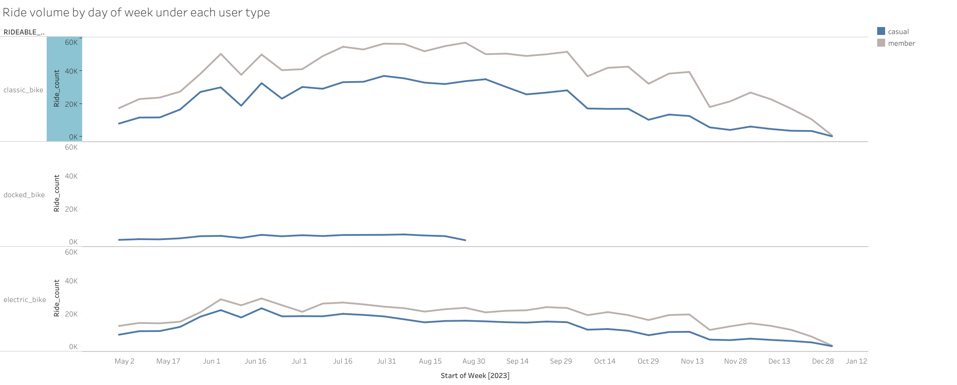
Ride volume by Start of week under each user type and grouped by rideable type
Key take aways
Members have a higher bike usage frequency than casuals
for both classic and electric bikes through out the parameter
week start.
From the graph we clearly see that only casuals make use
Of docked bikes
Casuals and members follow a similar seasonality and a similar
Trend through out the year 2023
Ride volume
Start of week [2023]

Slide 11
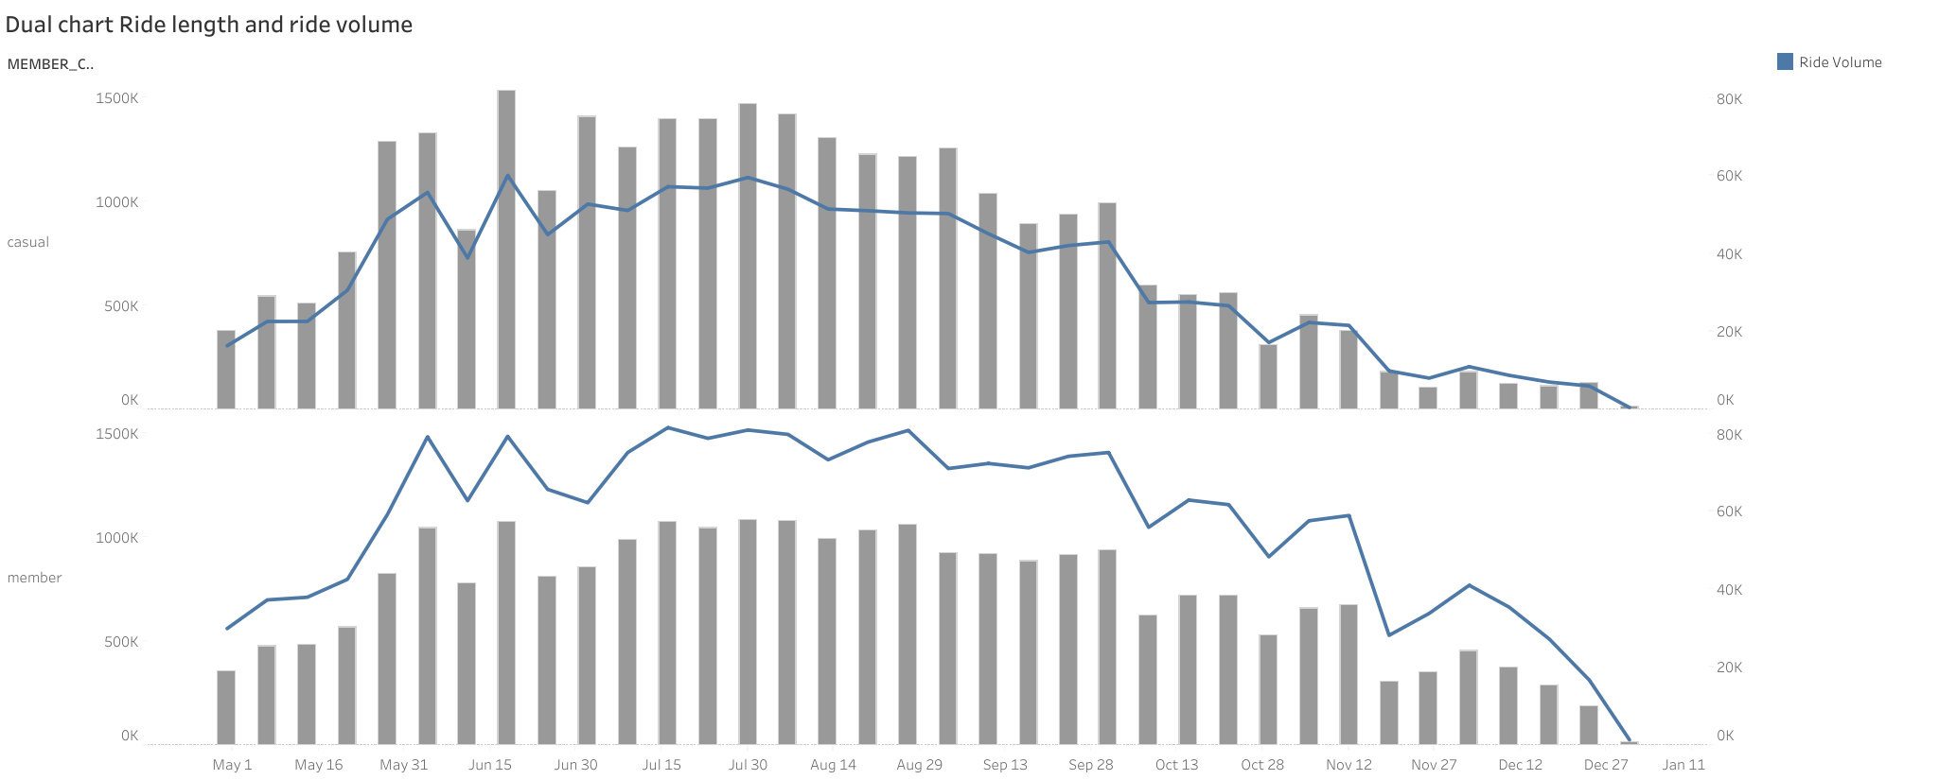
Dual chart of ride length and ride volume by start of week
Ride volume
Ride Length
Key take aways
Casuals and Members experience similar seasonality and
trends in terms of the graphs parameters even though their
magnitudes vary.
From ending October we observe that Members take longer rides
than casuals up to the end of year.
Towards the end of year annual members have a steep rise in Ride volume from Nov 19 to Dec 3 from 28339 to 41201 rides.
Casuals experience a rise in ride volume from Nov 26 to Dec 3 but not as steep as that of Members. From 8185 to 11119.
Ride length (mins)
Ride volume
Start of week [2023]

Slide 12
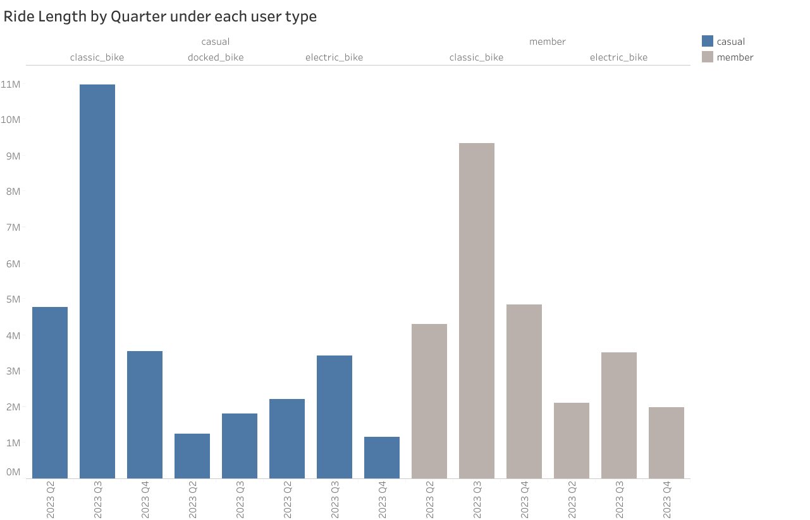
Quarterly Ride length for each user category under each rideable type
Key take aways
Casuals take longer rides than members on classic bikes
On the third quarter of the year
Casuals and members have similar ride lengths on
electric bikes for the second and third quartiles ,but by the
4th quarter members take longer rides in total than casuals.
Towards the third quarter of the year, the Casuals take longer rides on classic
bikes than Members . And in the final quarters we observe that the
total ride length for members on classic bikes exceeds that of casuals.
From the third quarter of 2023 to the last quarter the ride length on classic
Bikes for casual users drop drastically by about 67% ,but that of members fall
by about 48%
There is a drastic fall by 66% in Ride lengths for casual users on electric bikes
occurring from the third quarter to the last quarter of 2023. Mean while there ,
Is a similar trend for members, it drops by just 43%.
Overall the ride lengths for each user type under each rideable type
Follows a similar trend and seasonality .
Ride length
Start of week

Slide 13
Next steps
In the next graph we will be talking about binned ride lengths in intervals of 10,
Versus Ride volume/frequency, for each user type grouped by rideable type.

Slide 14
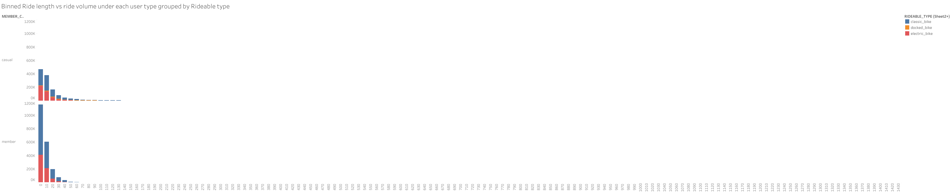
Binned Ride length vs ride volume under each user type grouped by Rideable type
Key Takeaways
A lot of users under either Members or casuals are more prone to using bikes for
0 – 10 mins ride than any other amount of ride time.
The graphs both follow a falling trend
Members use classic bikes at a higher frequency than casuals for rides that last between
0 – 10 mins. Members have a ride volume of about 750,635 while casuals have 243,095.
Above the 70 mins mark casuals make up a bigger proportion of riders with mainly classic
bikes.
classic_bike
docked_bike
electric_bike
Casual
Ride volume
Member
Ride length

Slide 15
Next steps
Next , we will analyse the Top 10 start dation IDs For each user category under the specific rideable types.
Getting to know the distribution/patterns of ride frequencies, and primarily who between Annual members and
Casual riders have the highest and lowest , as well as under which Rideable type category does this apply.

Slide 16
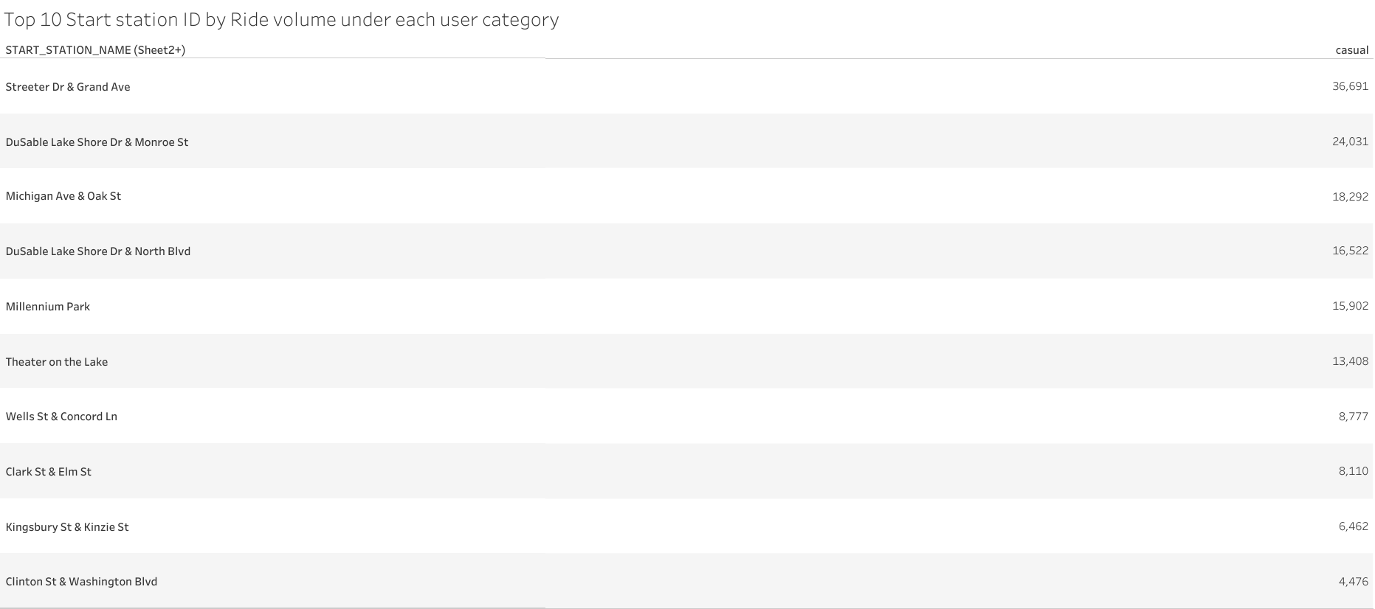
Top 10 Start station ID by Ride volume by casuals
Start station Name

Slide 17
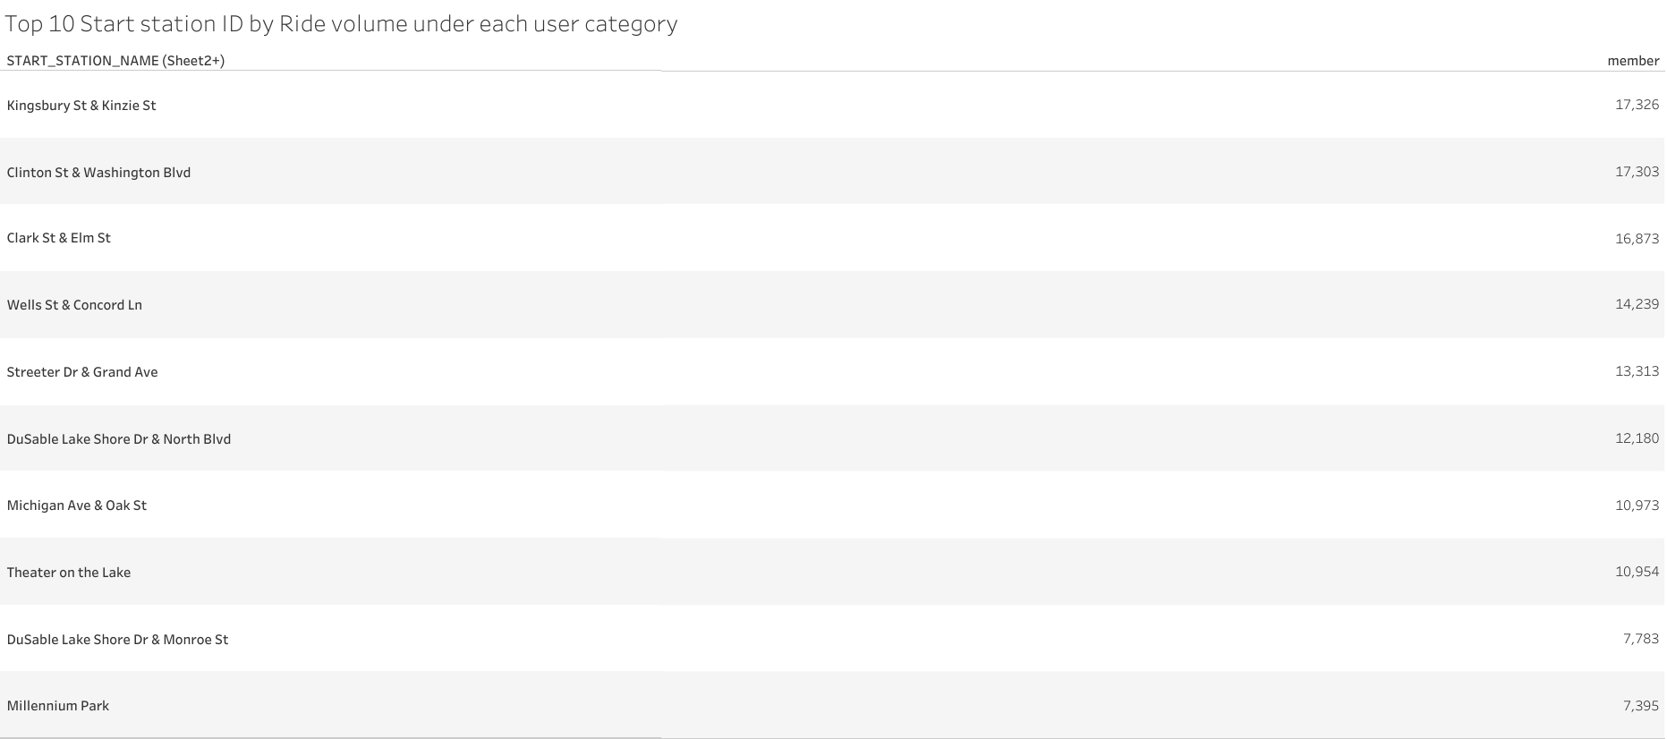
Top 10 Start station ID by Ride volume for members
Start station Name
Start station Name

Slide 18
Key Takeaways
The start station with the largest volume of casual riders is Streeter Dr & Grand Avenue with
About 36691 , this station is in the 5th position under member riders with about 13313 distinct rides.
On the other hand, the start station with the largest volume of member rides is Kingsbury St &
Kinzie St with about 17326 rides , this station is in the 9th position under casual riders with about
6462 distinct rides.
Following this reasoning, we can clearly identify similar stations which appear at different ranks under
The different user categories , generating a pattern.

Slide 19
Next steps
We will add more granularity to the tables used above by subdividing the results
Under each specific rideable type to get more understanding as to how the rides
are distributed under each rideable type.
Leading us to answer questions like what is the most or least used bike per start station ID
Under each specific member type and more.

Slide 20
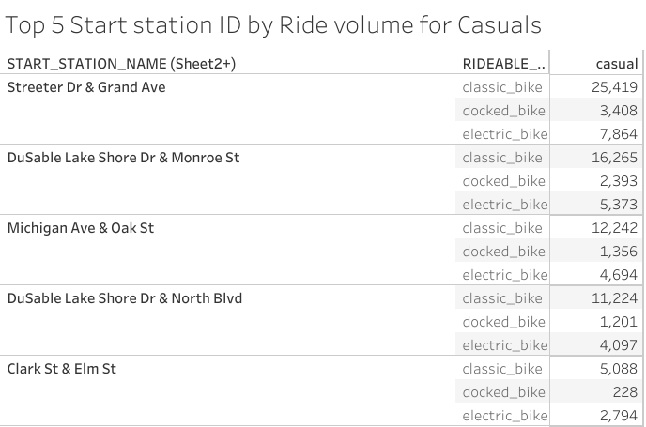
Top 5 Start stations for casual users by ride volume under each rideable type

Slide 21
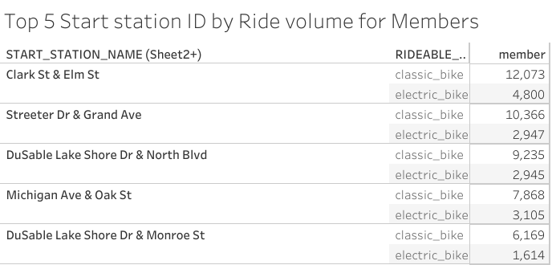
Top 5 Start stations for annual members by ride volume under each rideable type

Slide 22
Key take aways
For Casuals the Start station with the largest ride count/volume/frequency is Streeter Dr & Grand Avenue, its Ride count under classic bikes is 25419 surpassing that of annual members of 12073 in their Top Region of Clark St & Elm St.
For both members and casuals category , classic bikes make up the biggest portion of the total ride count/ bike usage
The same start stations occur in the top 5 listings of both Casuals and annual members, but they have different rankings. This shows that these start stations are really popular amongst our bike users . An example is Clark St & Elm. It also
shows that a big portion of our users originate from or live in that area.
Streeter Dr & Grand Ave is the Top start station under casuals with an impressive 25419 ride count for Classic bikes, meanwhile the same start station ID is found under members at the second position with a lower ride count of 10366 .
Next for Casuals we have Dusable Lake Shore Dr & Monroe St, with about 16265 classic bikes, occupying the second position . For members Dusable Lake Shore Dr & Monroe St has a lower classic bike usage count of about 6169.
Overall the same reasoning can be applied to any other station that appears in Top 5 of both tables, under Casuals and Members respectively.

Slide 23
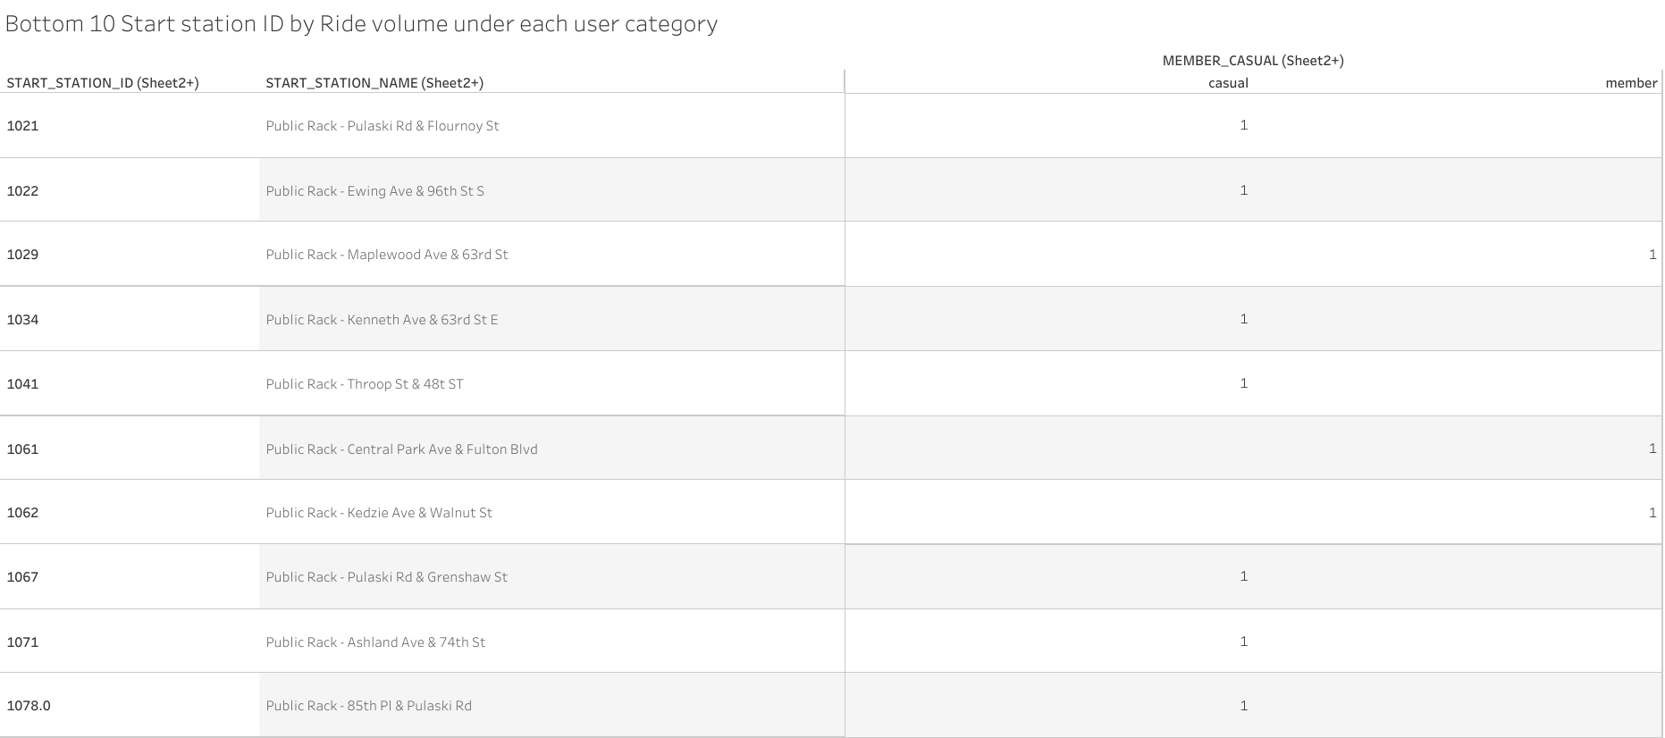
Bottom 10 Start station ID by Ride volume under each user category

Slide 24
Key take aways
We see that there are stations where the number of rides are very minimal getting
Just about 1 casual riders and no annual members like Public Rack-Pulaski.
Start station names that start with Public Rack generally have low ride counts for both
Casuals and Annual members.

Slide 25
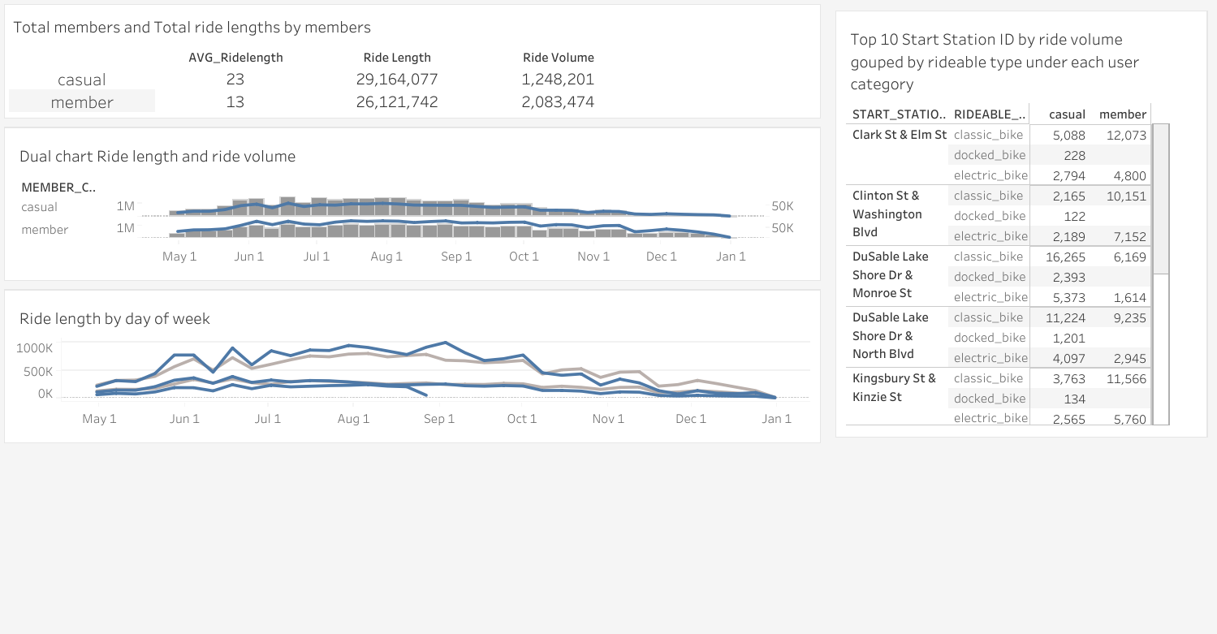
DASHBOARD

Slide 26
Solutions
Focus our marketing strategy in those regions with Start stations having large density of casual riders, for example the Top 10 start stations.
Make docked bikes more attractive to casuals under the annual membership plan in our marketing strategy in order to attract those casuals who love to use docked bikes For riding.
Rides above the 1 hour mark can only be done through an annual membership
As Casuals make up the biggest portion of these rides. As seen in the binned graph
Small rides between the zero and the 10 minutes mark , can only be carried out by Annual members.
From the graph in slide 10 , it would be a good idea to include docked bikes only
Under an annual membership to attract those casuals who enjoy using docked
bikes in becoming annual members

Slide 27
Conclusion
The average ride length for casuals surpasses that of members by 10 mins
The overall ride volume for members surpasses that of casuals but casuals have a larger
overall ride length ride length in minutes than members
The only period where member’s overall ride length is greater than casual’s is at the 4th quarter.
Through out each quarter the casual riders’ ride volume Is lower than members’ respectively.
Total ride lengths by start of week for casuals is greater than that of members’ up to October 8th 2023 for every week start.
Then it falls below that of members till the end of the year.
Members have a higher bike usage frequency than casuals for both classic and electric bikes through out the parameter
week start.
Only casuals make use of docked bikes
From the third quarter of 2023 to the last quarter the ride length on classic Bikes for casual users drop drastically by about 67% ,
but that of members fall by about 48%
There is a drastic fall by 66% in Ride lengths for casual users on electric bikes occurring from the third quarter to the last
quarter of 2023. Mean while there , Is a similar trend for members, it drops by just 43%.
Members use classic bikes at a higher frequency than casuals for rides that last between
0 – 10 mins. Members have a ride volume of about 750,635 while casuals have 243,095.
Above the 70 mins mark casuals make up a bigger proportion of riders with mainly classic
bikes.

Slide 28
Next steps
In the next slide we will dive into some solutions in detail and describe how the could be
implemented

Slide 29
Solution
Small ride lengths between the zero and the 10 minutes mark , can only be carried out by Annual members.
This solution is adequate for the problem at hand as it provides a strong incentive for casuals to become
Annual members. Keeping in mind that we have a volume of about 500,000 rides from riding
between 0-10 mins , we have the possibility to convert this 500,000 casuals to Annual members (assuming
All the riders are distinct). Thereby boosting our revenue and the performance of the business.
This could be implemented by making End station located within a 10 minutes ride from the every other
start station only available to annual members, meaning Casuals will have no other choice to ride to a
Farther station to drop the bike. If this works as planned casuals will really want to become members to run
Away from the hassle of riding farther distances.
The person to enforce it is the manager.
This could be implemented as of the start of next year.

Slide 30
Solution [ii]
The company could make docked bikes available only to Annual members, because the only and primary users of docked bikes are Casuals.
On the other hand the company could wait periods of peaks in the volume of rides, to restrict casual members access to docked bikes , making it available only to Members.
From June 11th – June 18th 2023 Casuals experienced a hike in the ride volume. So , I suggest The company should seize this opportunity, identify periods where there are
Hikes like this, and make Docked bikes only available to annual members , this with
The aim of converting docked bike lovers to Annual members.
The manager should enforce it during periods of sudden surges in ride volumes during the year by Casual riders.

