Slide 1
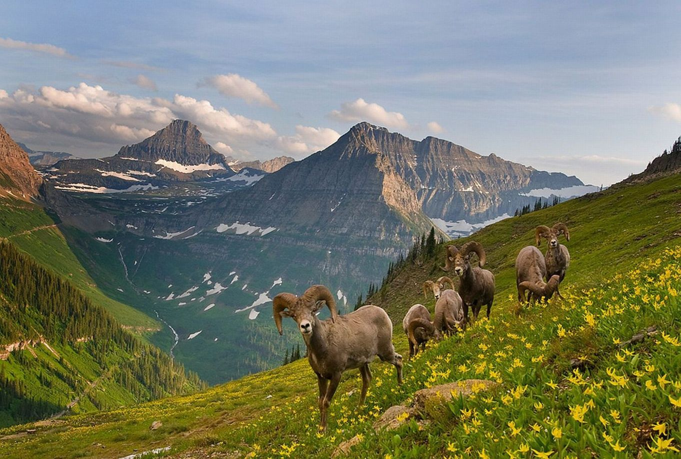
Temperature, Body Size, and Altitudinal Biodiversity Gradients:
A Neutral-Metabolic Model
Calum Pennington
Supervised by Dr Samraat Pawar and Dr James Rosindell
Notes:
The living world changes with elevation and I studied a couple of reasons why the number of species declines.

Slide 2
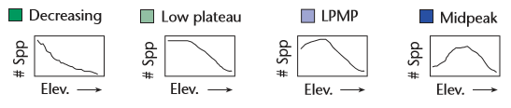
A Debated Pattern
Species richness declines going up mountains.
The exact form of the decline is debated.
(McCain & Grytnes 2010)
Notes:
Although species richness generally declines going up mountains
it is debated whether the decline is purely decreasing or whether there’s a peak in biodiversity at mid-elevations

Slide 3
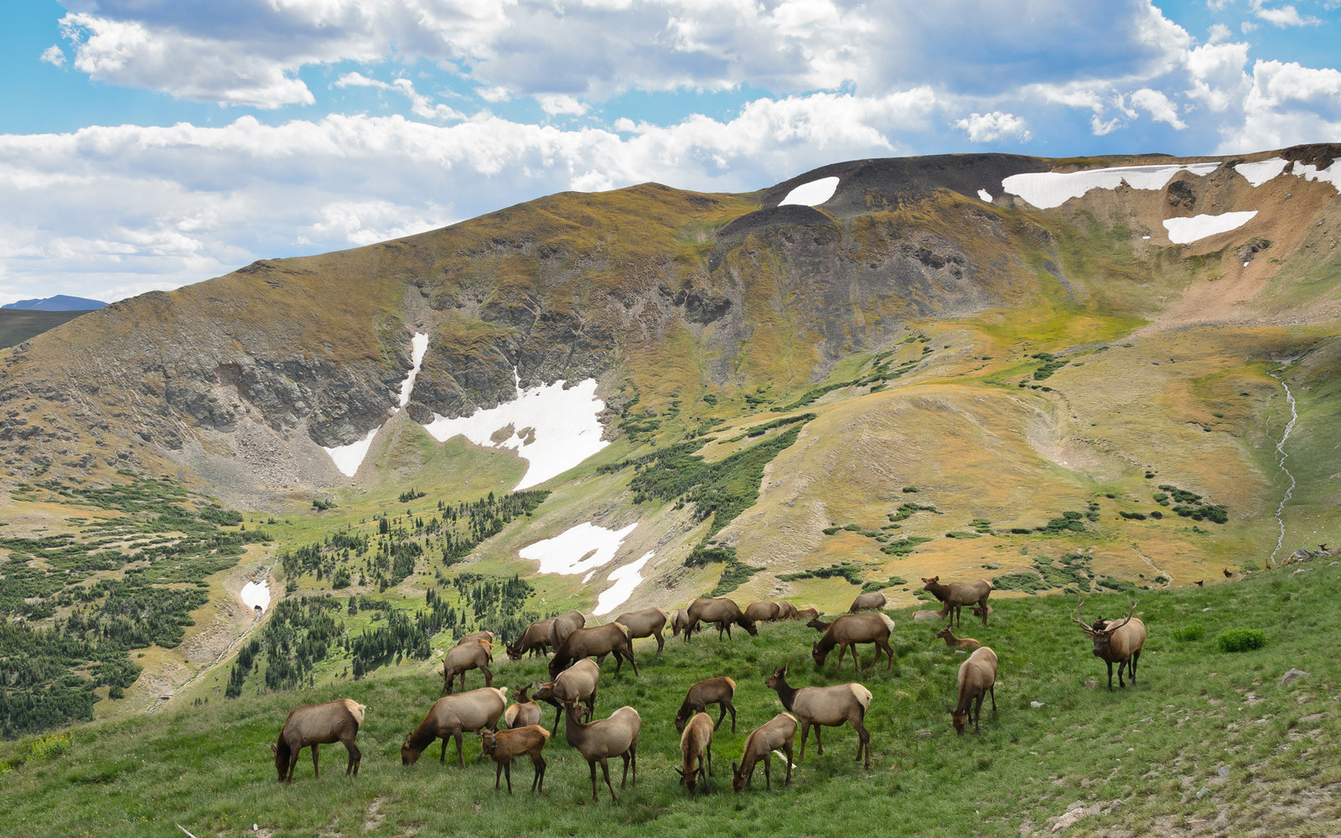
Numerous, Speculative Causes
Focus on specific taxa and mountains – hard to generalise
Methodological issues of sampling and scale
Overreliance on studies of correlation
Notes:
A resolution to this debate is compounded by issues.
There is a focus on specific taxa in specific mountains, with no reference to taxonomic or geographic features.
Variation in biodiversity trends may be due to the scale of study – whether you study local or regional biodiversity.

Slide 4
Numerous, Speculative Causes
climate
productivity
rainfall
temperature
source-sink dynamics
Species-Area Relationship
Mid-Domain Effect
space/area
evolutionary history
E.g. Rahbek 1997; Heaney 2001; McCain 2009; Lomolino 2001; Grytnes and Vetaas 2002
Notes:
A multitude of causes have been proposed but the field is dominated by studies of correlation - a mechanistic model may be better placed to unpick the causes.

Slide 5
Numerous, Speculative Causes
climate
productivity
rainfall
temperature
source-sink dynamics
Species-Area Relationship
Mid-Domain Effect
space/area
evolutionary history
Notes:
Taking a simple approach, I focus on just two - both temperature and area decline going up mountains
no substantial explanations are tied to temperature
area, despite being part of what distinguishes mountains, is understudied – often ignored
So, my aim was to build a simple, mechanistic model based on a temperature and area gradient.
temperature is my main focus

Slide 6
Aim
Make a simple mechanistic model to:
reproduce altitudinal diversity gradients
and test causes (= temperature and area?)
Notes:
my aim was to build a simple, mechanistic model based on a temperature and area gradient.
temperature is my main focus

Slide 7
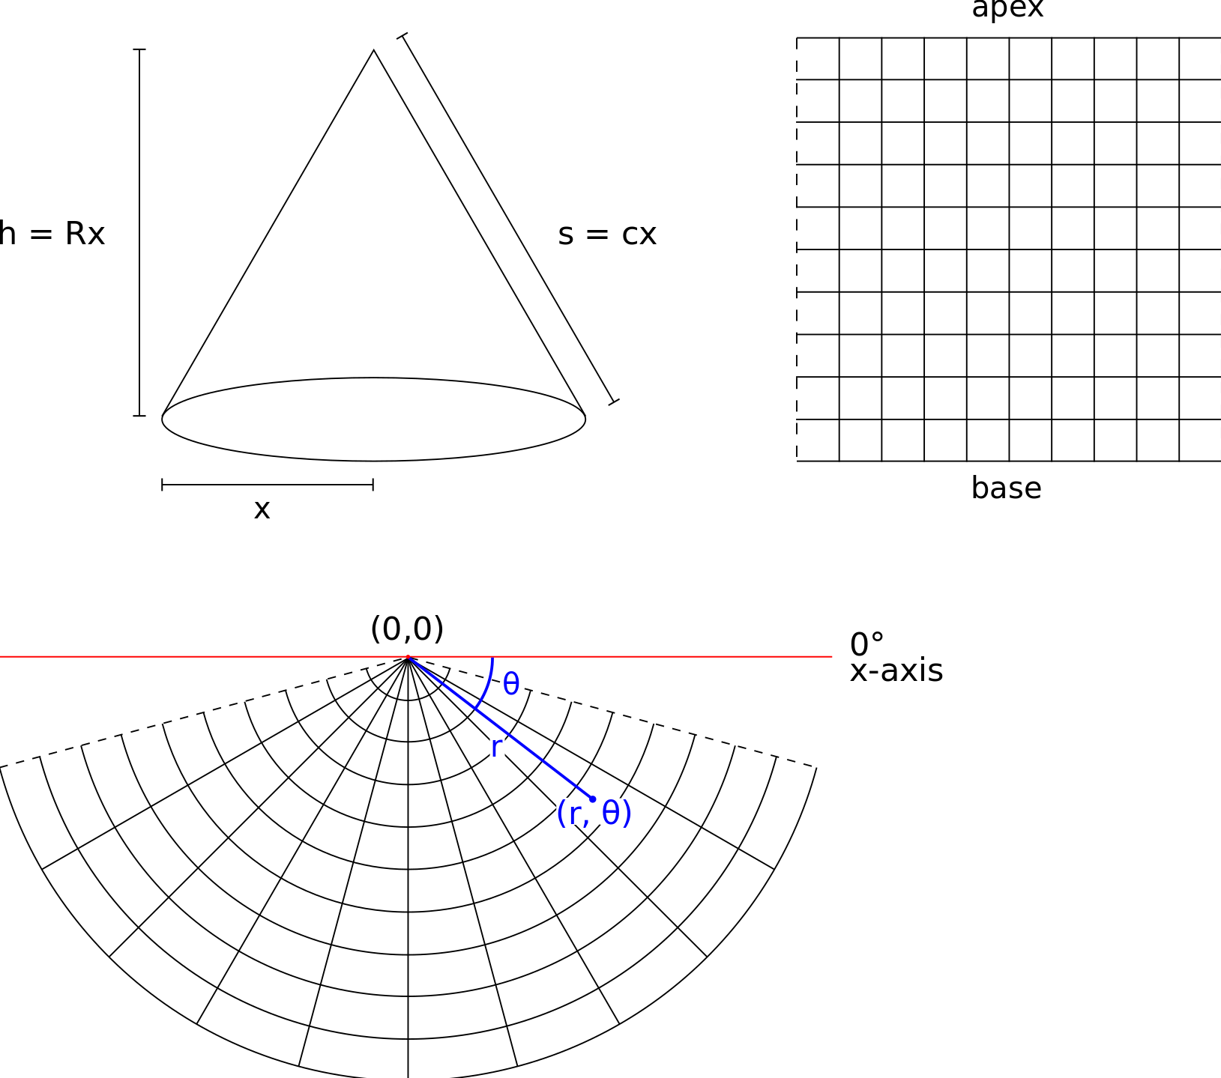
The Theoretical Mountain – A Cone
temperature
Notes:
SA cone but computationally a grid
I can vary the mountain’s environmental parameters.
Its height, area, and steepness – the temperature gradient – make it hotter or colder overall, or change the temperature increment.
This is a way to investigate how patterns may vary across different mountains.
**I don’t need to pick a scale for my mountain – an absolute size – area and distance are expressed as proportions in terms of these parameters, so the model’s flexible and tractable.

Slide 8
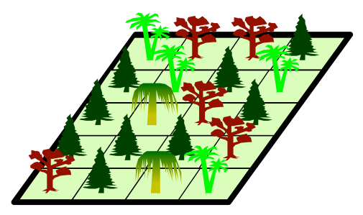
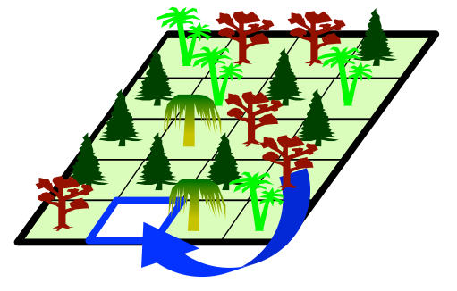
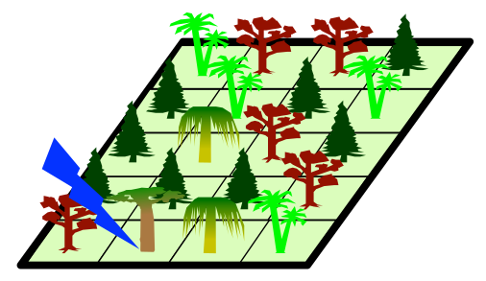
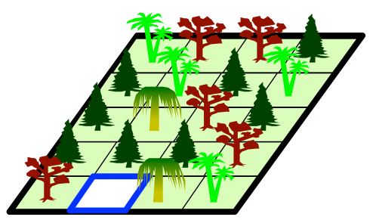
Neutral Theory: A Simple Start Point
Suite of modelling approaches that simplify reality
Assume trait variation is independent of species identity
3 parameters: random birth/death, speciation, dispersal
I add an altitudinal temperature gradient that drives variation
(Hubbell 2001;
image c/o Rosindell 2016)
Notes:
I need a way to link temperature to biodiversity – what are my hypothesised mechanisms?
I base my model on Neutral Theory because of NT’s simplicity.
Neutral models consist of a community and proceed in time steps.
In each step, a randomly-chosen individual dies.
They are replaced either by
- via dispersal, by the offspring of another randomly-chosen individual.
- a new species.
So neutral models have 3 parameters – birth or death, speciation, and dispersal
In a basic model these rates do not vary but in my version a temperature gradient drives variation in…

Slide 9
Neutral Theory: A Simple Start Point
Suite of modelling approaches that simplify reality
Assume trait variation is independent of species identity
3 parameters: random birth/death, speciation, dispersal
I add an altitudinal temperature gradient that drives variation
(Rosindell 2016)

Slide 10
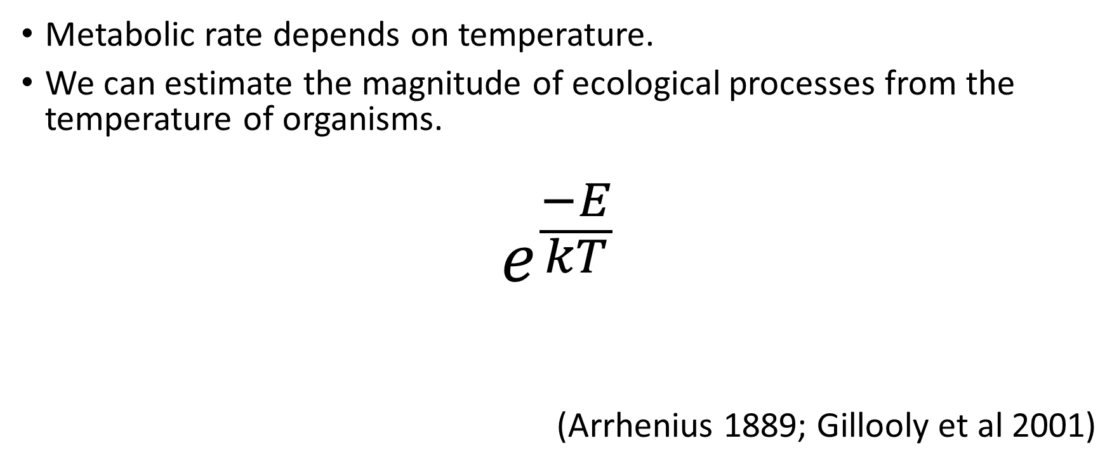
Metabolic Theory: A Layer of Complexity
Metabolic rate depends on temperature.
We can estimate the magnitude of ecological processes from the temperature of organisms.
$$e^{\frac{−E}{kT}}$$
(Arrhenius 1889; Gillooly et al 2001)
Notes:
I now need a link to these processes temperature – Metabolic Theory.
MR, the rate at which organisms process energy and matter, depends predictably on temperature. We can estimate the magnitude of ecological processes from the temperature of organisms.

Slide 11
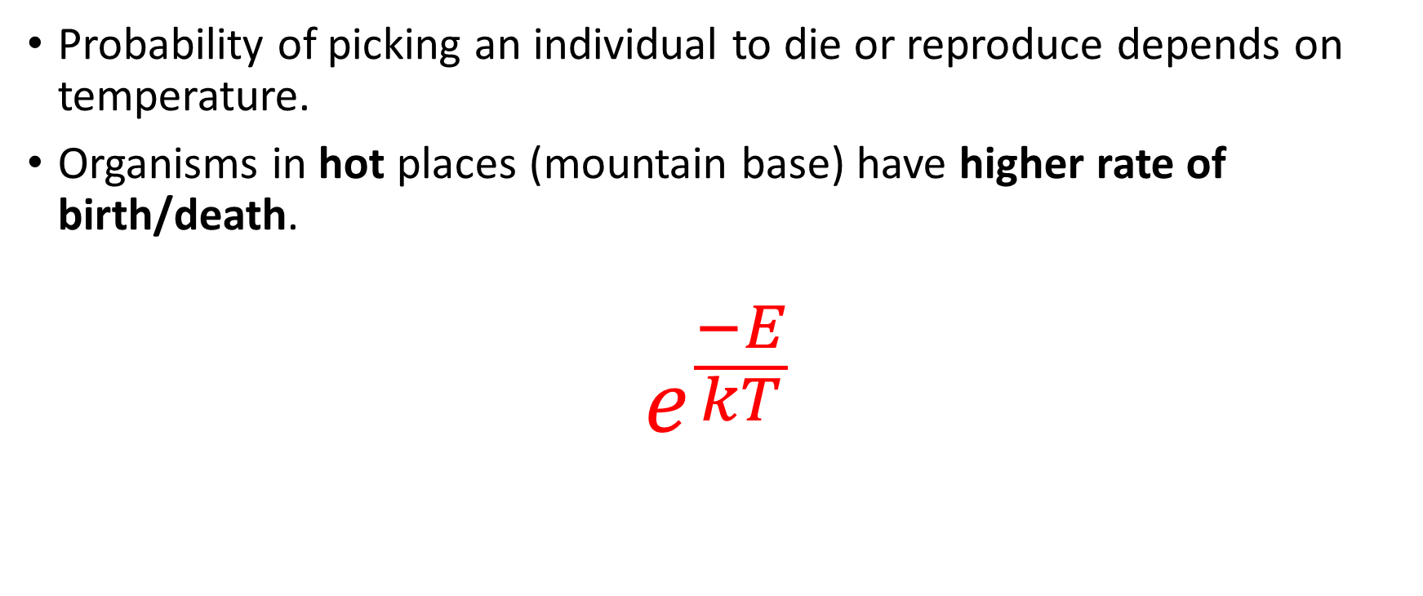
Metabolic Theory: A Layer of Complexity
Probability of picking an individual to die or reproduce depends on temperature.
Organisms in hot places (mountain base) have higher rate of birth/death.
$$e^{\frac{−E}{kT}}$$
Notes:
depends -- exponentially

Slide 12
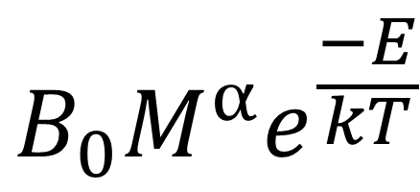
Dispersal
$$B_{0}M^{α}e^{\frac{−E}{kT}}$$
Notes:
As well as temperature, MR depends on body size.
MT is a powerful set of generalisations -
I use this power-law dependence on body size as a simple start point to investigate whether biodiversity patterns vary across broad classes of organisms.

Slide 13
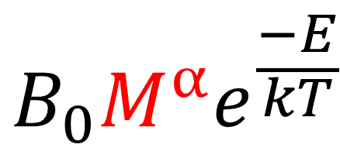
Dispersal
$$B_{0}M^{α}e^{\frac{−E}{kT}}$$

Slide 14
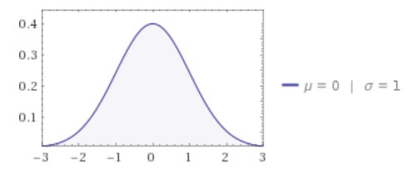
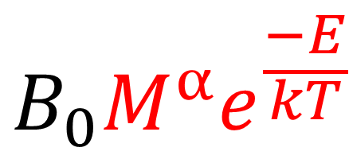
Dispersal
Bigger organisms and those in hot places (mountain base) disperse further.
Survival based on temperature at the dispersal destination.
$$B_{0}M^{α}e^{\frac{−E}{kT}}$$
Notes:
As well as temperature, MR depends on body size.
MT is a powerful set of generalisations -
I use this power-law dependence on body size as a simple start point to investigate whether biodiversity patterns vary across broad classes of organisms.
So dispersal depends on BS as well as temp
I also add a survival component, based on conditions at the dispersal destination.
Instead of moving from one temperature extreme to the other, species have a thermal optimum. Range of temperatures they can survive in, which I refer to as their thermal niche width – a new parameter.
Within a simulation, individuals have the same body size. But I re-run the simulations for different body sizes.

Slide 15
Area Effect
The number of individuals declines going up the mountain.
Abundance of individuals depends on body size – small organisms have bigger populations.
Notes:
area effect is simply manifested as a decline in the number of individuals, as well as dispersal distance, going up the mountain

Slide 16
Using the model to answer questions
How important are birth, death, and dispersal rates in controlling biodiversity gradients?
How might spatial variation in temperature affect them?
What is the comparative importance of area and temperature?
Can you produce a variety of biodiversity trends by varying:
body size
thermal niche width
the mountain’s environmental parameters?
Notes:
With this model, can specify more clearly my research questions
didn’t explore as thoroughly as I’d hoped – still some interesting parameter space

Slide 17
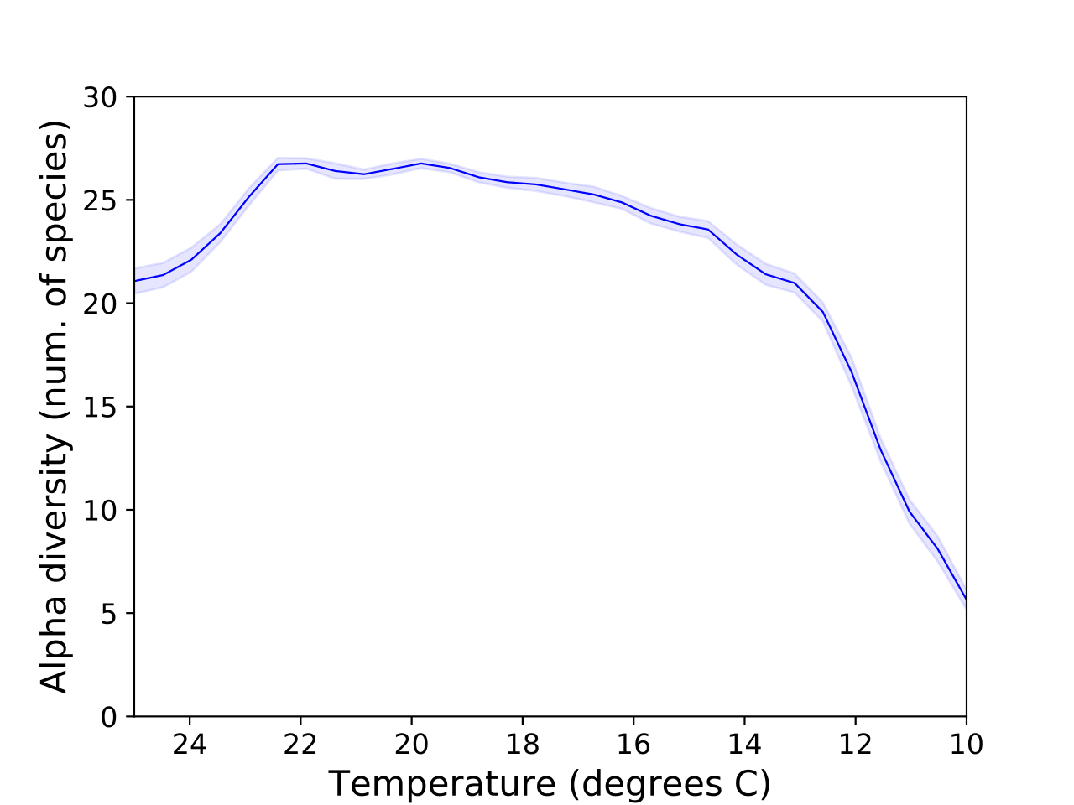
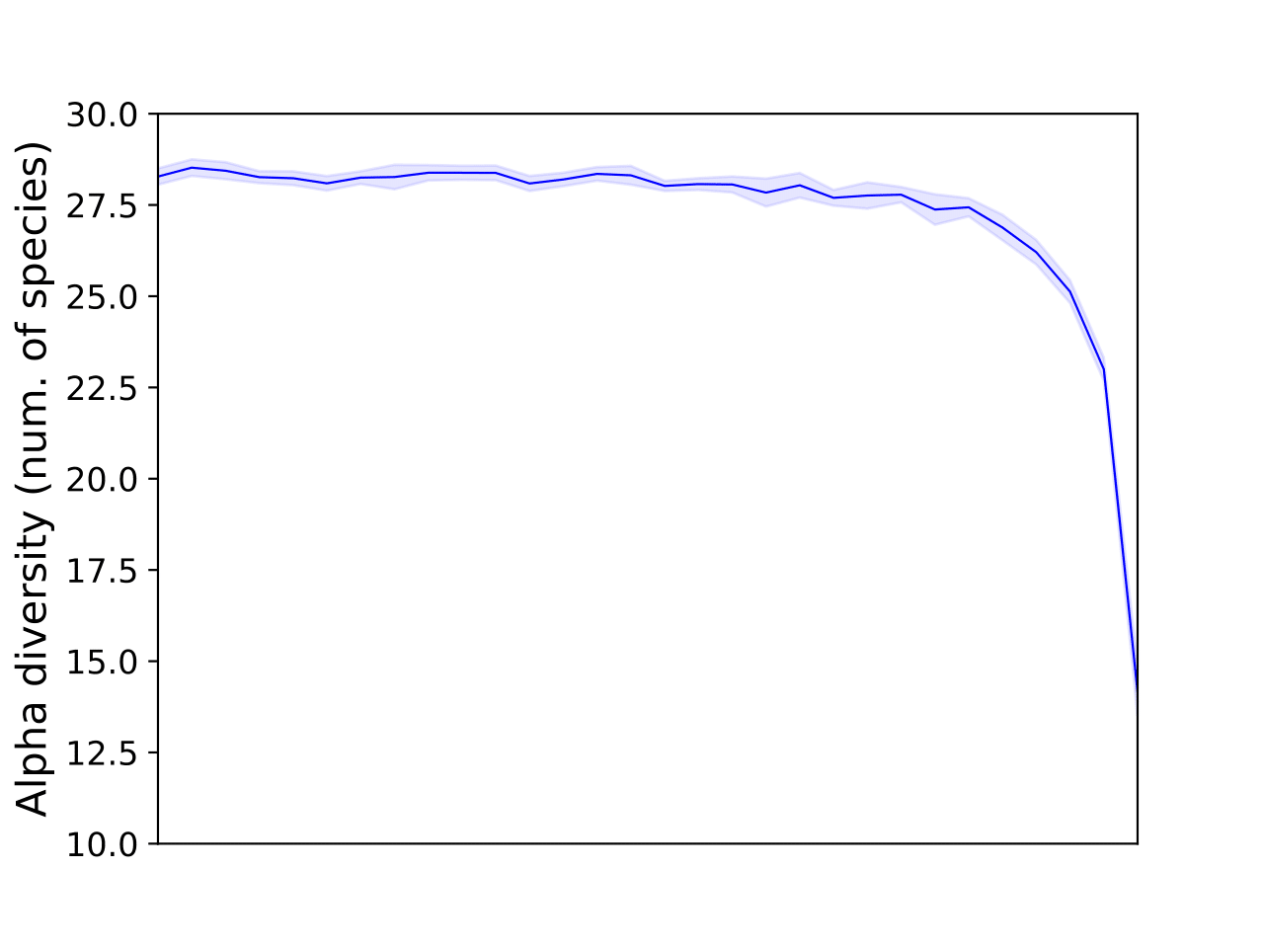
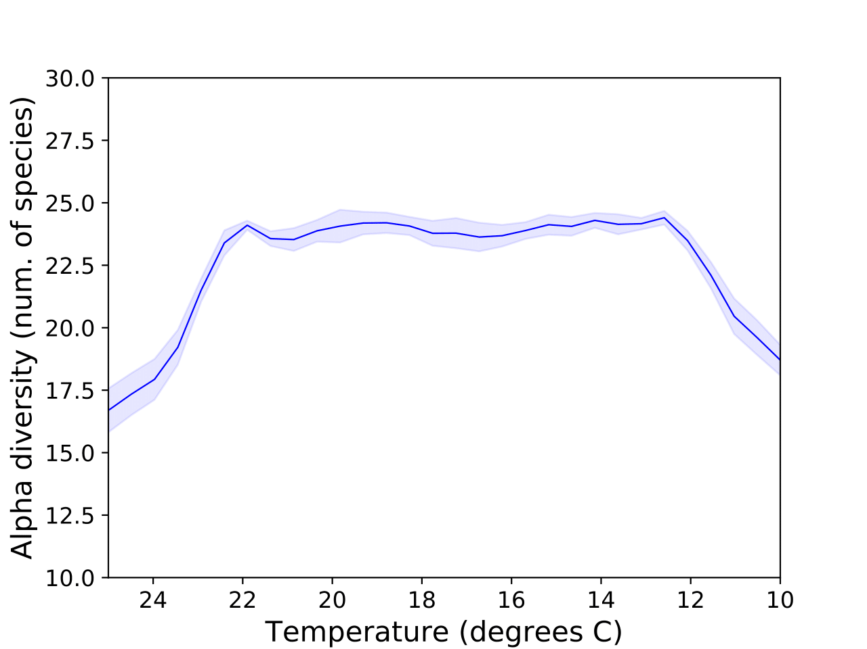
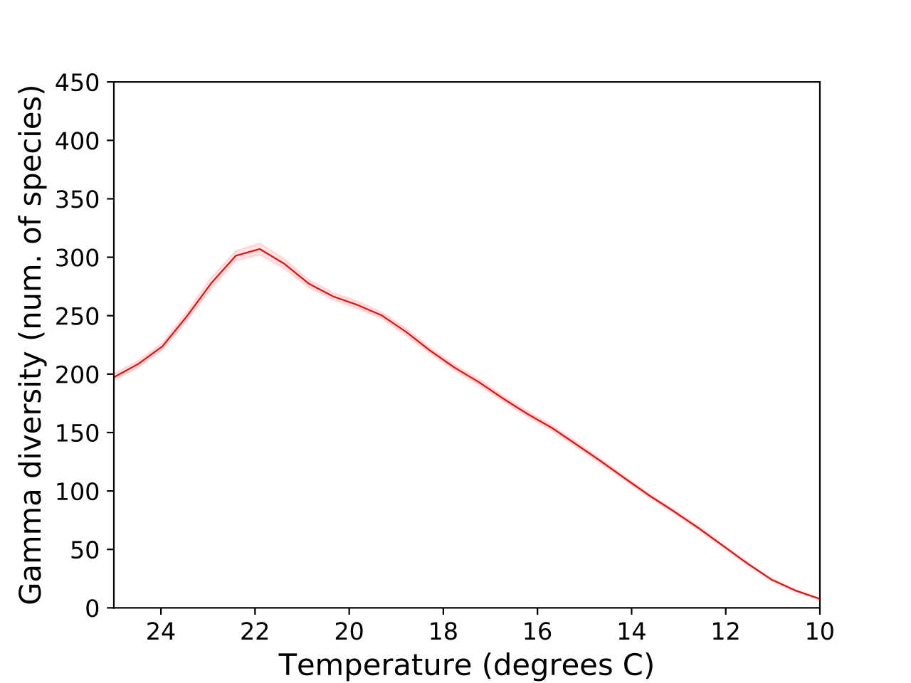
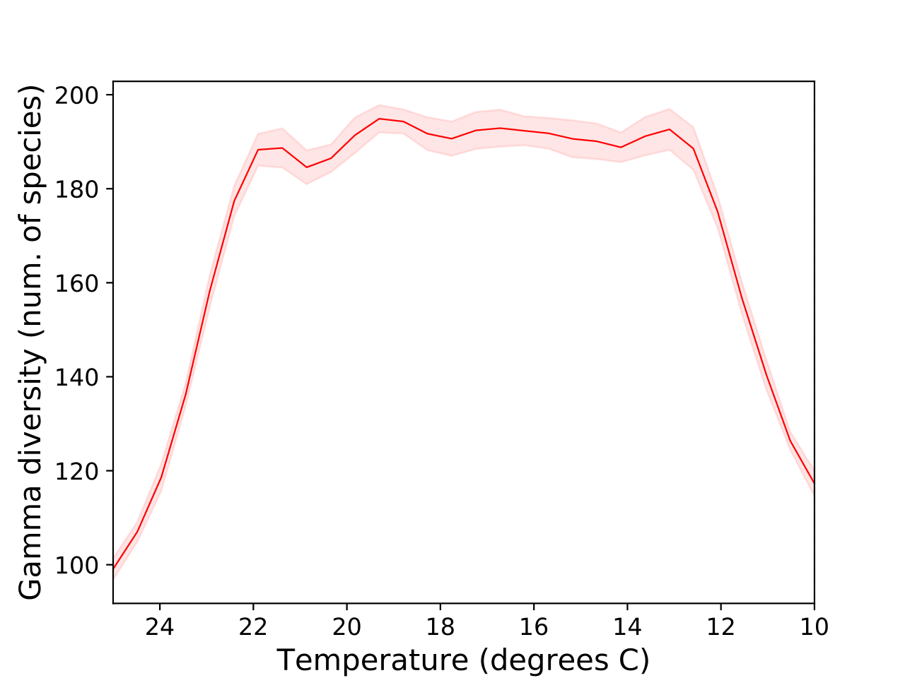
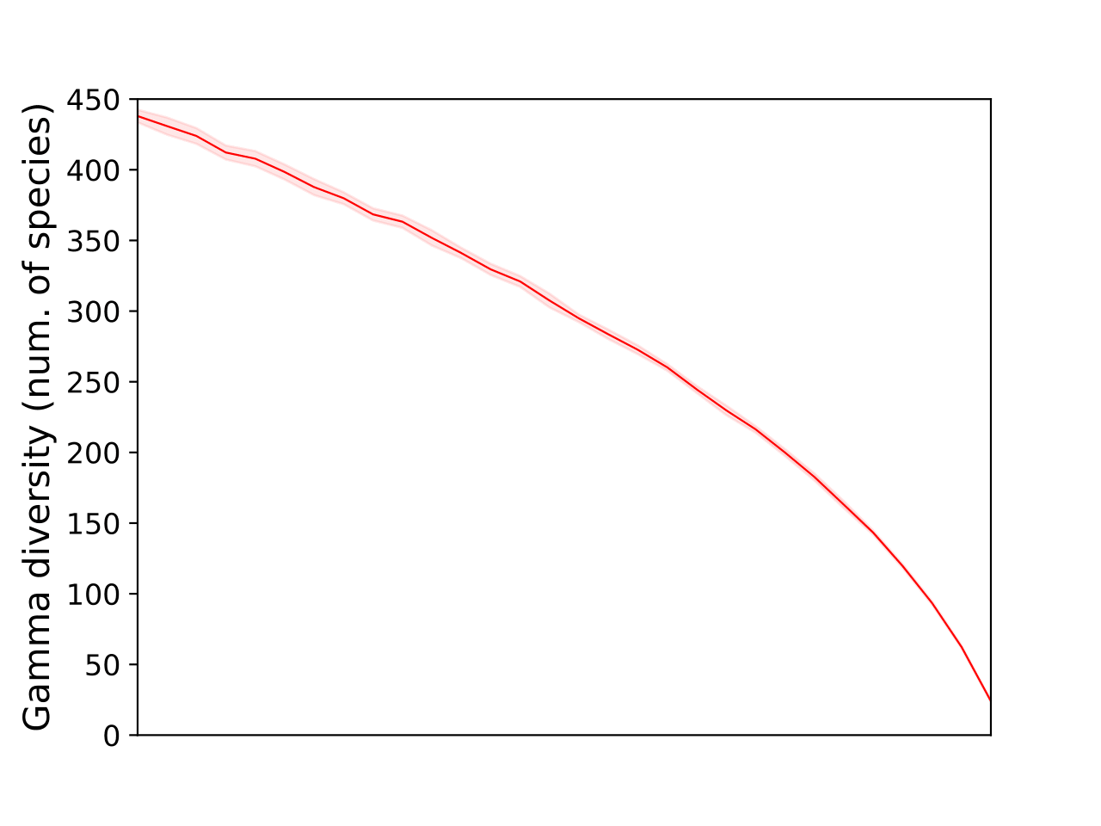
Gradients of Alpha and Gamma Diversity
(e.g. Nogués-Bravo et al 2008)
(e.g. Lomolino 2001)
Area may be important but the pattern depends on scale
A temperature effect is mediated by thermal niche width, in concert with dispersal barriers.
(e.g. McCain 2007)
(e.g. Rahbek 1997)
Notes:
Applied the area and temperature effects separately and in concert
ran the simulations until dynamic equilibrium – when speciation and extinction balance – number of species fluctuates but is quite stable
took about 48 hours on the university’s high performance computing system
resulting pattern of diversity – how the number of species changed going up the mountain
TO had no effect
Consistent across parameters, including body size, with some notable exceptions

Slide 18
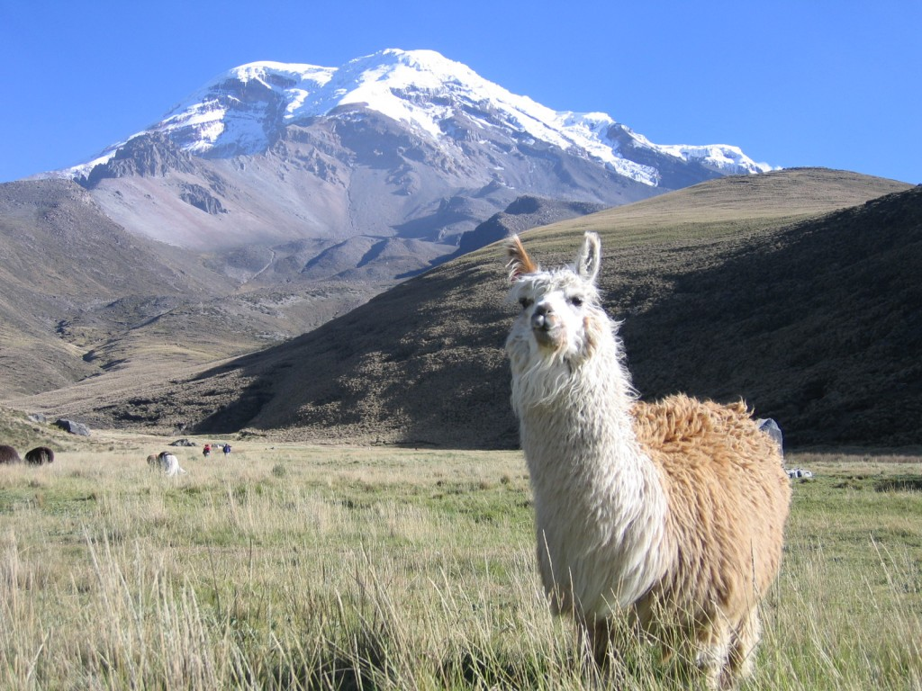
Conclusions & Future Research
Rates of dispersal, birth, and death may not be important
- at least at dynamic equilibrium!
But the processes themselves are
Variation in the decline may depend on:
temperature gradient (balance between area and temperature)
thermal tolerance of species.
Notes:
Robust decline in species richness
Beta diversity
Temperature, mediated by thermal niche width and dispersal barriers,
Mountain’s
variation in the exact form of the decline may depend on the shape of the mountain and its temperature gradient (balance between area and temperature)
and thermal niche width of species

Slide 19
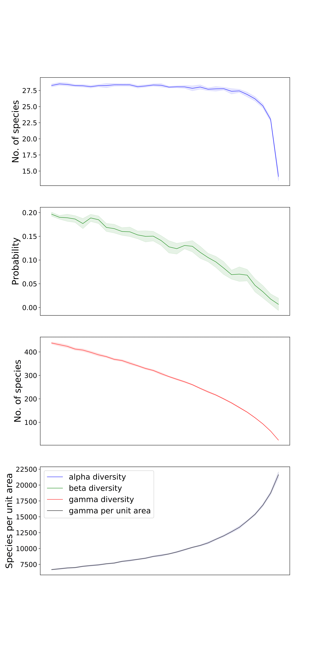
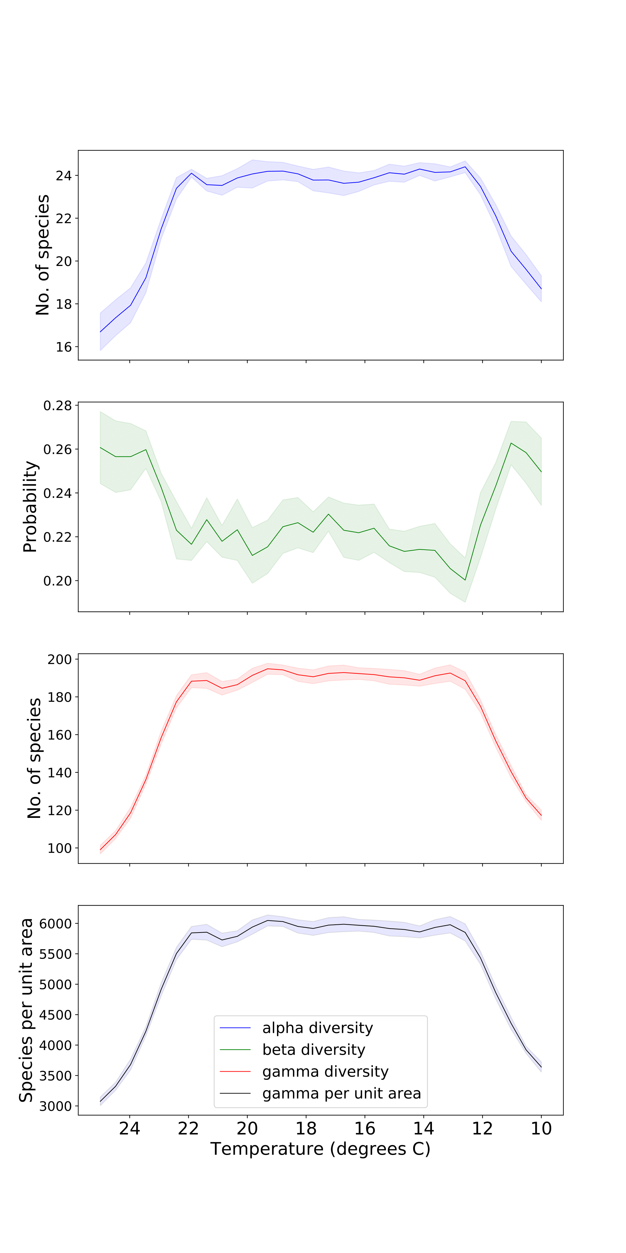
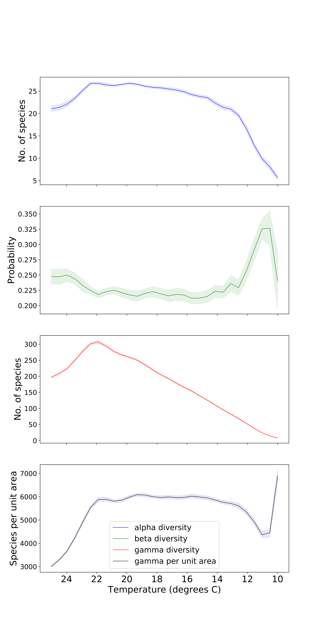
Gradients of Alpha and Gamma Diversity
Notes:
Applied the area and temperature effects separately and in concert
TO had no effect
Consistent across parameters, including body size, with some notable exceptions
dynamic equilibrium – rates at which species are lost and formed – speciation and extinction balance – number of species in the system fluctuates but is quite stable
took about 48 hours on the university’s high performance computing system
resulting pattern of diversity – how the number of species changed going up the mountain

Slide 20
Potential Causes – Numerous and Speculative
climate
temperature
rainfall
productivity
space/area
species-area relationship
mid-domain effect
source-sink dynamics
evolutionary history
Overreliance on correlation
Focused on specific taxa and mountains – hard to generalise
Methodological issues of sampling and scale
Notes:
There are numerous potential explanations but none are well-evidenced.
progress is compounded by methodological issues
- Variation in altitudinal diversity trends may be due to the scale of study – you can study biodiversity at two scales, local and regional
- sampling may not account for area (area declines going up mountains) or may be concentrated at particular elevations, biasing observations
Overreliance on studies of correlation
between species richness and altitude – or factors, such as precipitation, that change with altitude
*Also focus on specific taxa in specific mountains, with no reference to taxonomic or geographic factors
In contrast, a mechanistic model may be better-placed to unpick the causes.
may by informative

Slide 21
Potential Causes – Numerous and Speculative
climate
temperature
rainfall
productivity
space/area
species-area relationship
mid-domain effect
source-sink dynamics
evolutionary history
Overreliance on correlation
Focused on specific taxa and mountains – hard to generalise
Methodological issues of sampling and scale
Notes:
I focus mainly on temperature, but also area
but area, despite being part of what distinguishes mountains, is understudied – often ignored
hypotheses are touted but there are no substantial explanations why temperature or area may be responsible
So, my aim was to build a simple, mechanistic model based on a temperature and area gradient.

Slide 22
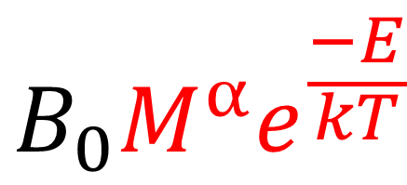
Dispersal
When individuals reproduce, offspring disperse according to a dispersal kernel – a probability distribution of dispersal distances.
To apply a metabolic effect, I multiply distance by a body-size and temperature dependent parameter.
Bigger organisms and those in hot places (mountain base) disperse further.
$$B_{0}M^{α}e^{\frac{−E}{kT}}$$
Notes:
As well as temperature, MR depends on body size. So MT is also a powerful set of generalisations -
I use this power-law dependence on body size as a simple start point to investigate whether biodiversity patterns vary across broad classes of organisms.
Within a simulation, individuals have the same body size. But I re-run the simulations for different body sizes.
I add a survival component, based on conditions at the dispersal destination.
**species have a thermal optimum, so the model moves away from neutrality
As individuals disperse up or down the mountain, they traverse the temperature gradient – move through different temperature environments
hard to add a dynamic temperature effect to dispersal as individuals move along a temperature gradient
Also may not be right to say individuals can move freely from one temperature extreme to another, without an impact on their fitness
survival dimension is intended to add a layer of realism to the dispersal model, but also introduces a new parameter and dynamic
I model temperature preference as a normal distribution – the scale or variance of that distribution defines species’ thermal niche width

Slide 23
In the absence of a temperature gradient
Dispersal rate everywhere is the same
Apex, base mountain – picture?
Notes:
In the absence of a temperature gradient, dispersal rate is the same everywhere.
But, the area gradient – mountain’s conical shape – affects distance round the mountain, and thus the probability of dispersing to a given position.
The black dot is the example destination
shows the probability of dispersing to a destination from every position on the mountain
- a broad overview of dispersal patterns on the mountain – how species spread and mix, where they come from, how far they can go
hot, orange colours mean a relatively high probability of immigrating to the destination
cold, blue colours mean a low probability
grey is 0 chance of immigrating to the destination
For a destination at the top (black dot), species from any side round the mountain are equally likely to immigrate in.
This is because distance round the mountain is short.
In contrast, the mountain base is wide – distances among positions may be further.
Species can only immigrate in from the same side of the mountain.
vertical distance – but area not main thing
How does this change when I add a temperature gradient?

