Slide 1
ME 367: Machine Design
Dr. Rungun Nathan
Feburary 04, 2020

Slide 2
Announcements
PADEP Team members that are continuing
Team Yellow (The Patty Flipper)
Team Orange (The Magnahold)
Team Violet (Rise-Up, Height Adjustable Transfer Base)
Feb 5th meeting common hour G121

Slide 3
What did we do last class?
Apply to ICE01 – shaft design
Matlab Code for ICE 01

Slide 4
What’s on the menu today?
Matlab Code for ICE 01
ICE 2
Hand calculations not very different
Matlab Code
Discussion
Project - first discussion
ICE 3 – Angular deflection
ICE 4 - Deflection

Slide 5
Matlab file
Discuss code
Publish pdf
Must submit this with project
Documentation
Think about what information you will need if you had to do this one year from now
Hand computation (show example)
Cannot write computer program without this starting point

Slide 6
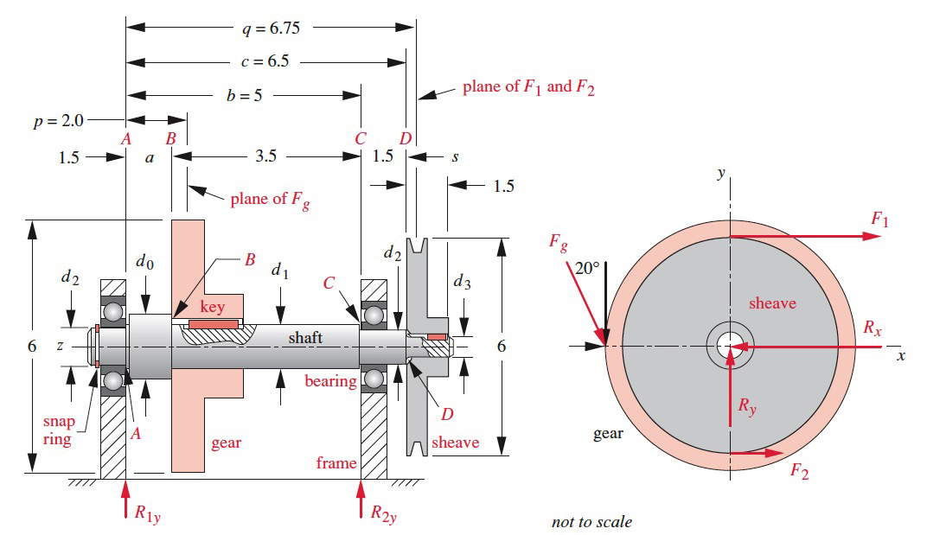
ICE 02 (Basics - same as ICE1)

Slide 7
ICE 02

Slide 8
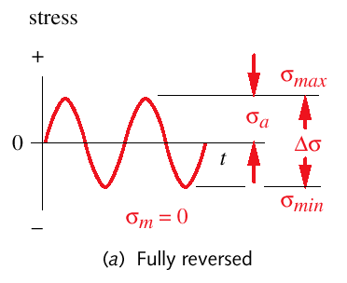
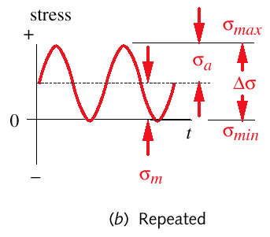
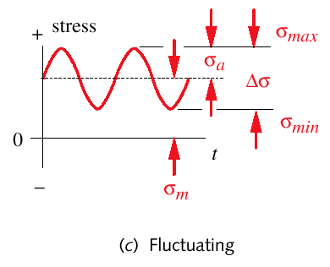
Typical Shaft Loadings
Note that constant applied moment = fully reversed stress
Stress range:
Alternating stress component:
Mean stress component:

Slide 9
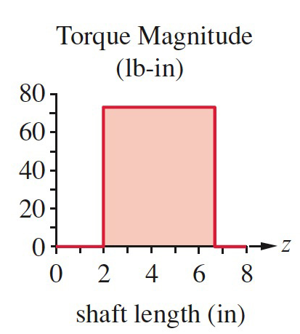
ICE 2 (Torque)
Design of shaft

Slide 10
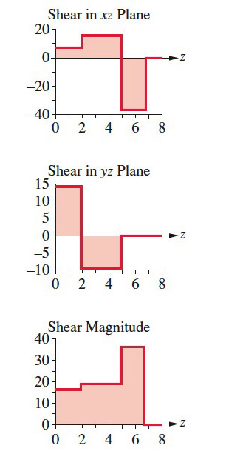
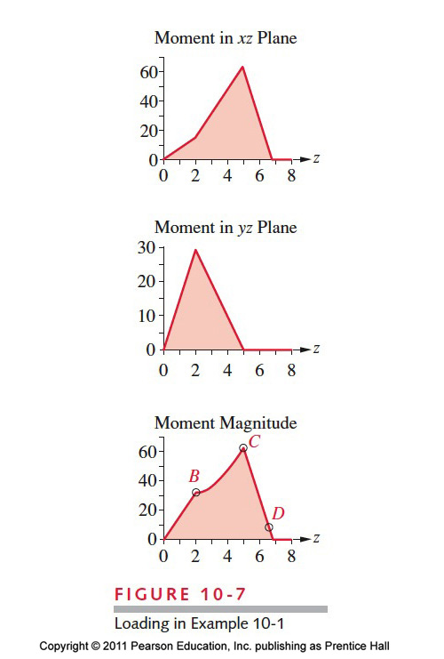
ICE 1 (SF and BM)

Slide 11
ICE 02
Same equations, but twice magnitude

Slide 12
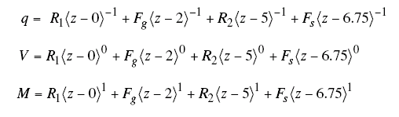
Bending and Torsion Loading
Torque magnitudes were given.
Use beam theory and singularity functions to find moment distributions over shaft length.
See Example 10-1 for complete derivation of force and moment.

Slide 13
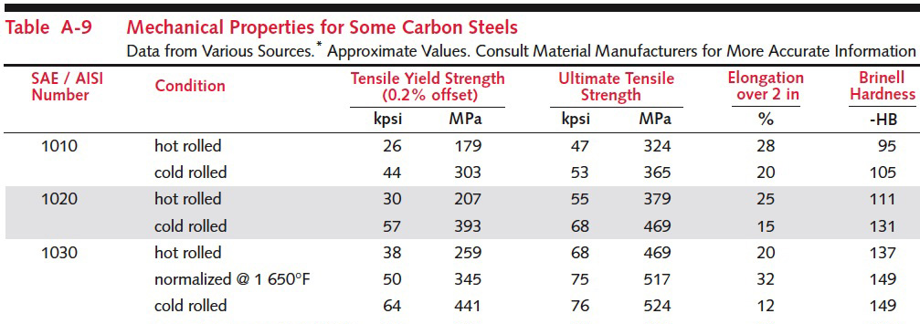
ICE 02
Select Material – SAE 1030 P 1024, table A-9

Slide 14

ICE 02
Uncorrected endurance limit
If published endurance limit is available use it
If not use material property and estimate using eq 6.5a, pp 360
Why these values? (next slide)

Slide 15
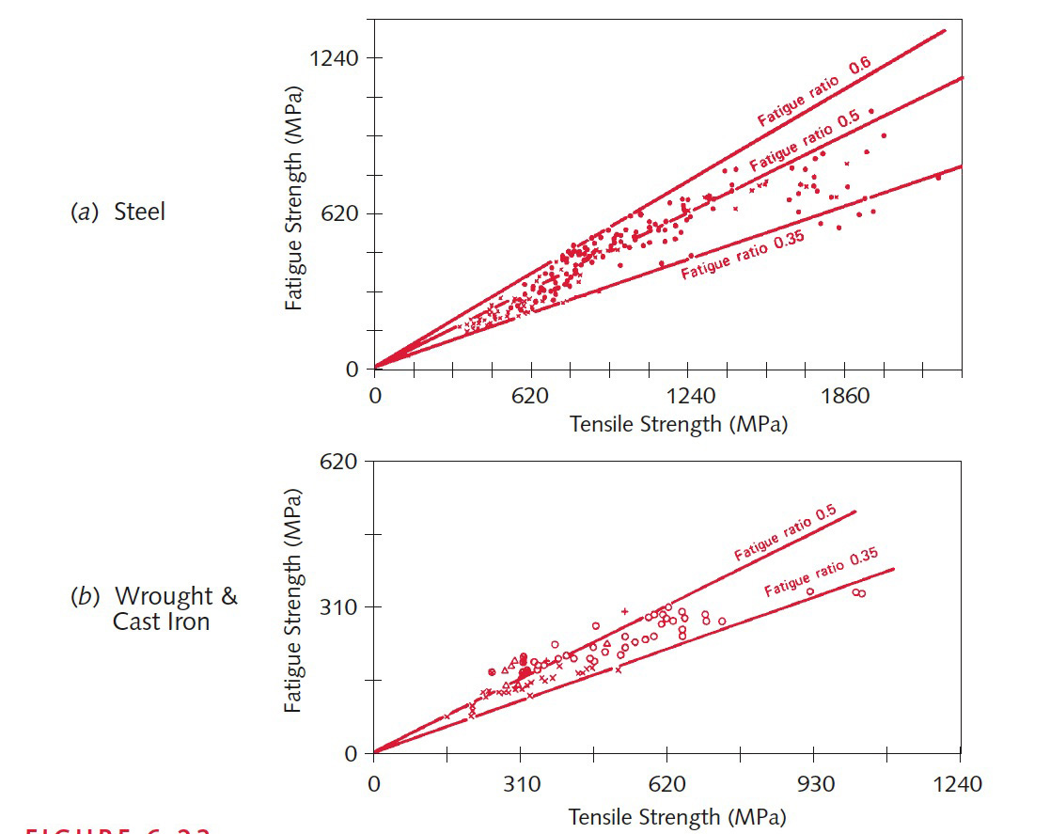
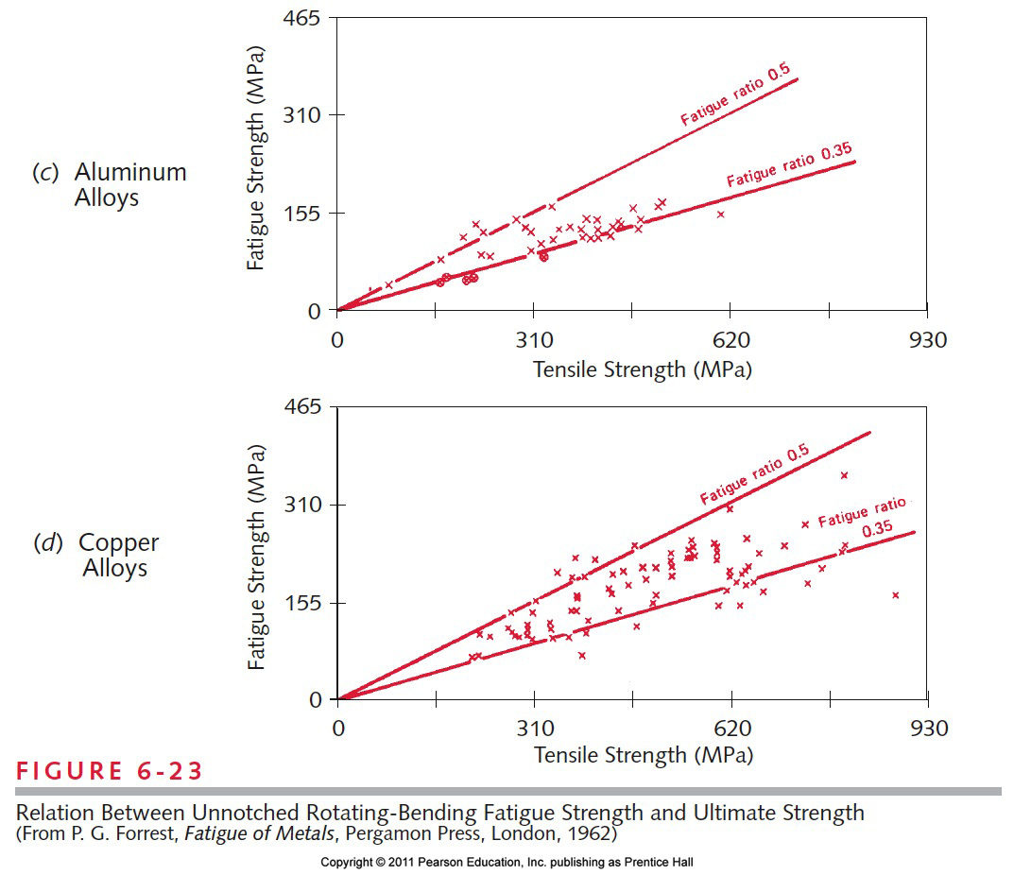
ICE 02
Relation between Unnotched rotating-bending fatigue strength and ultimate strength

Slide 16

ICE 02
Loading Factor (eq. 6.7a, pp. 362)
Why?
Published data is for rotating bending tests

Slide 17

ICE 02
Size factor (eq. 6.7 b pp. 363)
Why?
Published data is for rotating bending tests
Wait we do not know diameter. What to do?

Slide 18
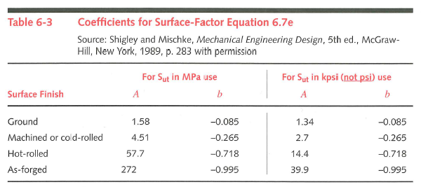
ICE 02
Surface factor (eq 6.7e p. 365 & table 6.3)
Why? I am sure you know this now

Slide 19

ICE 02
Temperature factor (eq. 6.7f pp 367)
Why?
Published data is room temperature

Slide 20
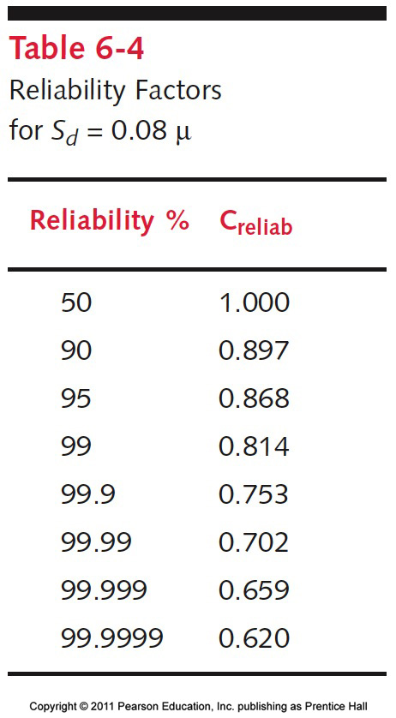
ICE 02
Reliability factor (table 6.4, pp. 367)
Why?
Published data based on experiments and we account for spread of data

Slide 21
ICE 02
plug in and compute

Slide 22

ICE 02
Notch sensitivity (fig 6.35 p 376)

Slide 23
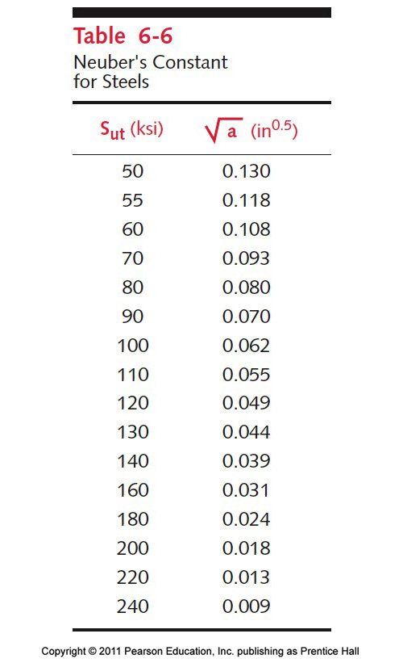
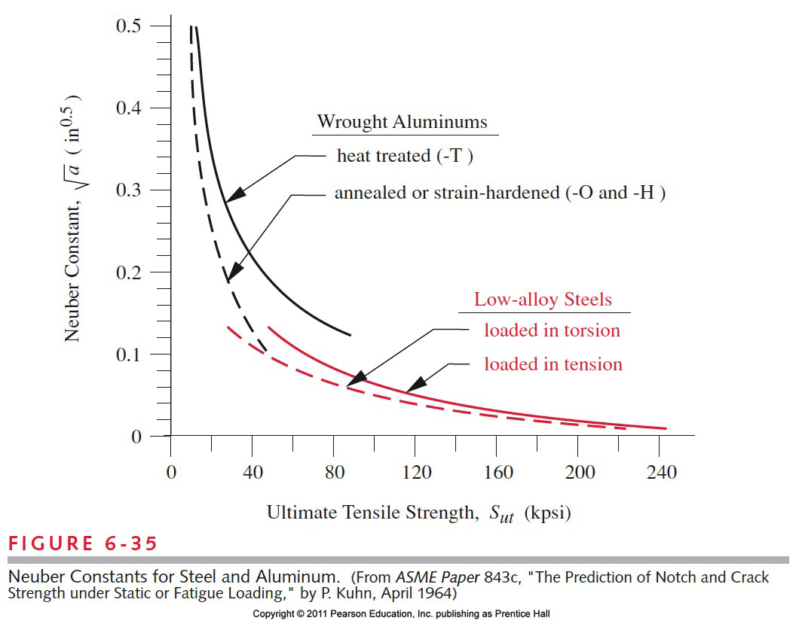
ICE 02
Value is (use a = 0.1²in)
Use r = 0.01 in

Slide 24
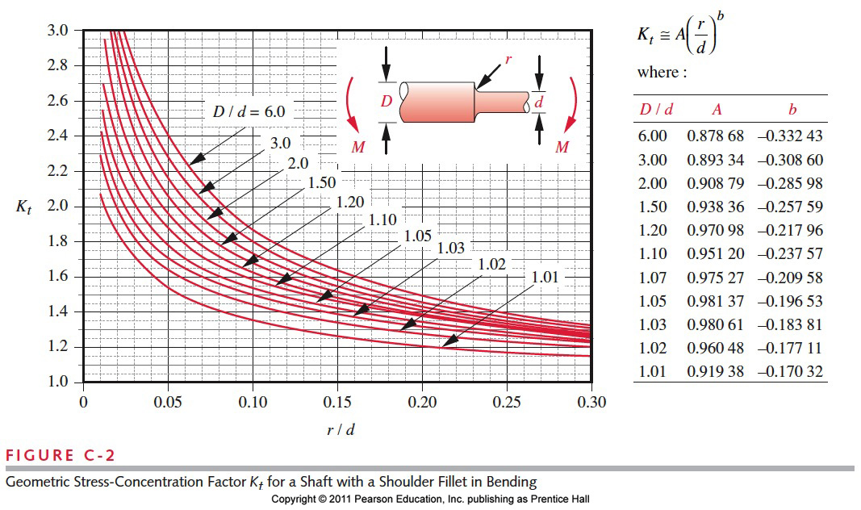
ICE 02
Hmm…What to do? I don’t know r,d,D

Slide 25
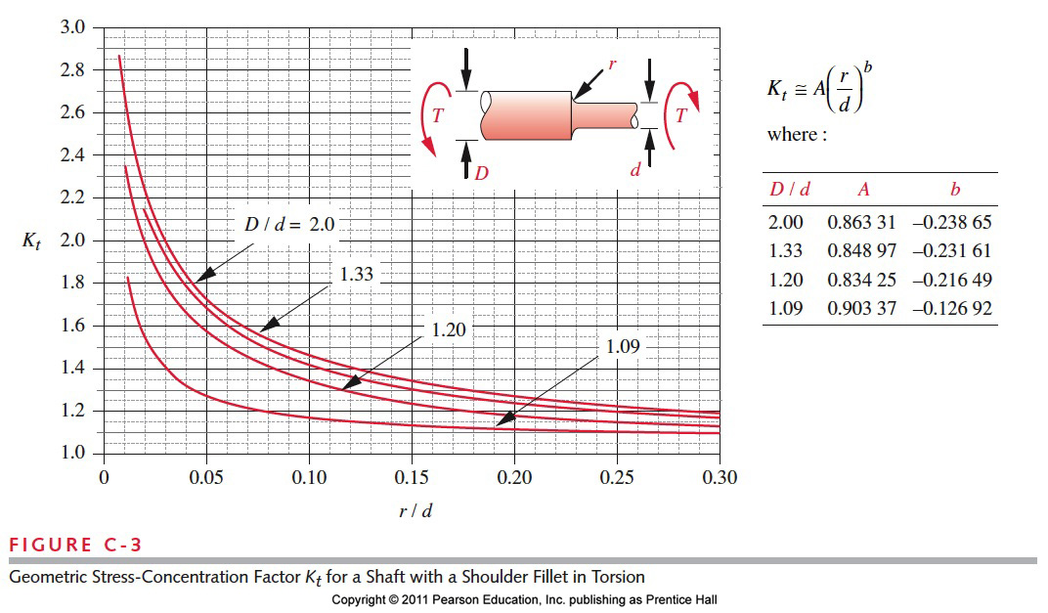
ICE 02
Hmm…What to do? I don’t know r,d,D

Slide 26
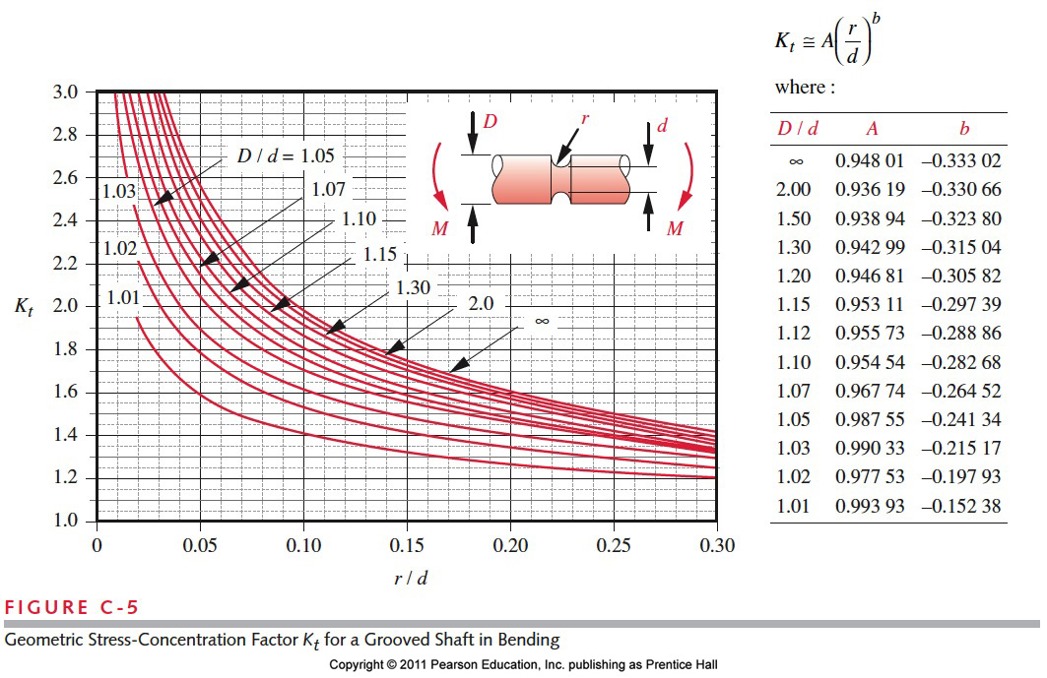
ICE 02
Hmm…What to do? I don’t know r,d,D

Slide 27
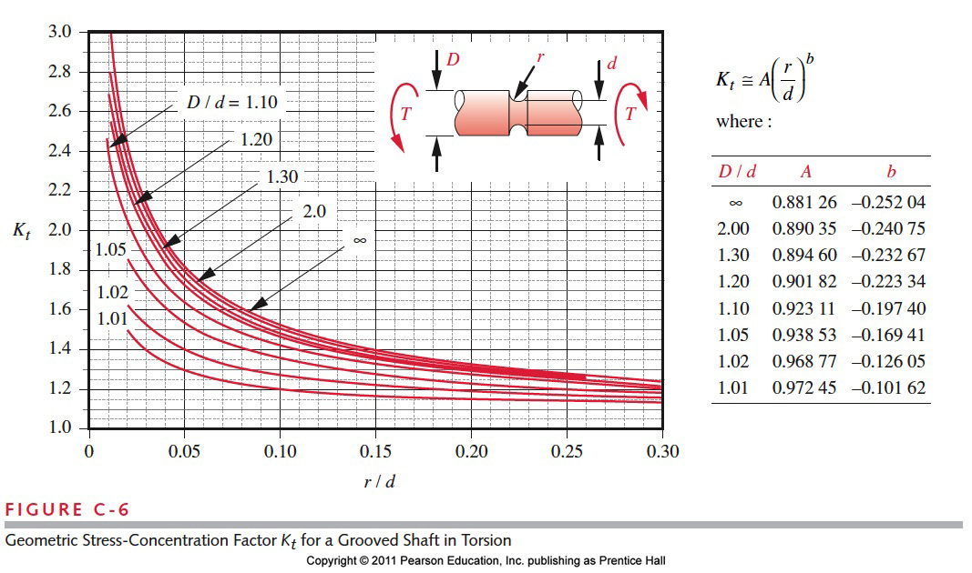
ICE 02
Hmm…What to do? I don’t know r,d,D

Slide 28
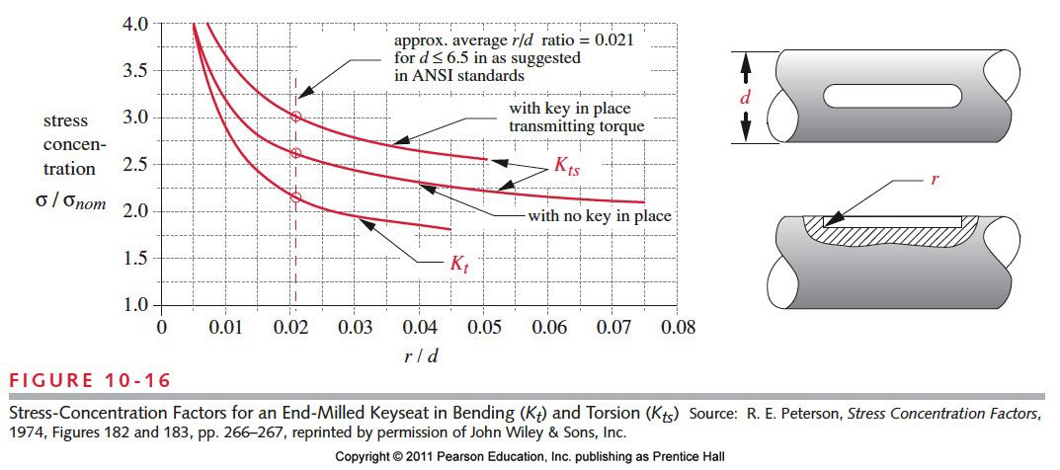
ICE 02
Keyway Fig 10.16, pp 607

Slide 29
ICE 02
Stress concentration factor

Slide 30
ICE 02
Now find diameter at various locations
Remember we have no axial load, we are assuming shear force is small and that bending moment and torque are dominant (eq 10.6a pp. 590, or 10.8 pp. 592)

Slide 31
ICE 02
Repeat at all critical locations
B, C, D
Remember we are trying to find d – diameter
Standard sizes https://www.mcmaster.com/steel-rods

Slide 32
Matlab file
Discuss code
Publish pdf
Documentation
Hand computation (show example)

Slide 33
ICE 01 & ICE 02
 |  | Cold Rolled Steel |  |  | Hot Rolled Steel
 |  | Loc C | Loc B | Loc D | Loc C | Loc B | Loc D | Units
ICE 01 | Diameter | 0.52811 | 0.51595 | 0.410616 | 0.563989 | 0.53044 | 0.413617 | inches
 | Stresses | 27742.4 | 27805.1 | 28427.9 | 21739.3 | 21869 | 22403.2 | psi
ICE 02 | Diameter | 0.61119 | 0.62913 | 0.507722 | 0.648837 | 0.667914 | 0.538838 | inches
 | Stresses | 27352 | 27275.3 | 27848.5 | 21445.8 | 21385.6 | 21835.8 | psi

Slide 34
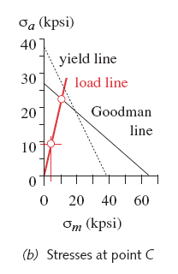
Find Safety Factors
 |  | Loc C | Loc B | Loc D
ICE 01 | Diameter | 0.52811 | 0.515945 | 0.410616 | inches
ICE 01 | Stresses | 27742.4 | 27805.1 | 28427.9 | psi
ICE 02 | Diameter | 0.611191 | 0.629132 | 0.507722 | inches
ICE 02 | Stresses | 27352 | 27275.3 | 27848.5 | psi
For Cold rolled OR Machined Steel

Slide 35
Shaft Deflection in Bending and Torsion

Slide 36
Many Shafts are Stepped

Slide 37
Shaft design
Deflection: bending
Stepped shafts: calculations become more involved
Stress is a local parameter
Deflection is a global parameter
But the value of I varies along length of a stepped shaft
It requires integration of these equations:
Numerical integration is usually necessary:

Slide 38
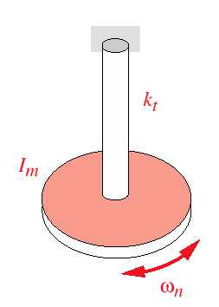
Shaft design
Deflection: torsion – stepped sections are in series so can be superposed as springs in series
Angular deflection (simple shaft):
Single disk
Torsional spring constant (simple shaft):
Angular deflection (stepped shaft):
Effective torsional spring constant (stepped shaft):

Slide 40
Torsional Deflection

Slide 41
Bending Deflection
The moment/EI function at right is for a constant shaft section I.
We have a varying I due to the steps, so this will not do.
In this integration, the value of I must be adjusted at each value of z where it changes

Slide 42
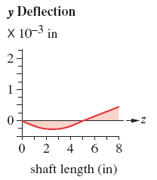
Bending Deflection

