Slide 1
ME 367: Machine Design
Dr. Rungun Nathan
January 28, 2020

Slide 2
Announcements
Homework 1 Due today
Tuesday 28, 2020
PADEP Team members that are continuing
Team Yellow (The Patty Flipper)
Team Orange (The Magnahold)
Team Violet (Rise-Up, Height Adjustable Transfer Base)
Meet with me

Slide 3
What did we do last class?
Homework 1
Questions
Continue ICE 01 Basics

Slide 4
What’s on the menu today?
Finish ICE 01 Basics
Shaft Design general approach
Apply to ICE01 – shaft design
Matlab Code for ICE 01

Slide 5
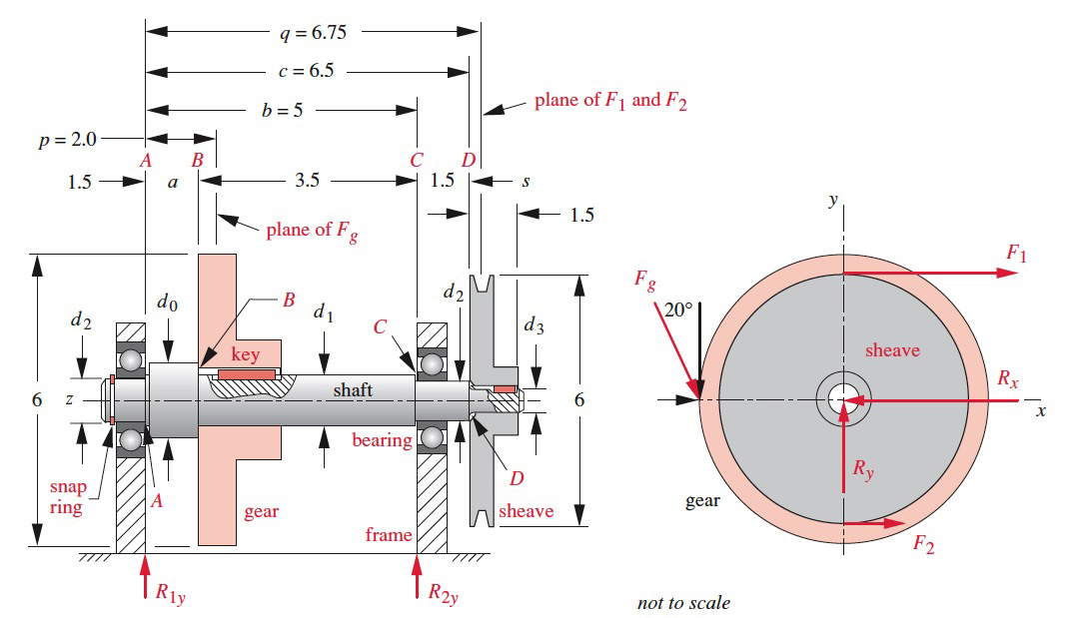
ICE 01 (Basics)

Slide 6
ICE 01 (Basics)

Slide 7
Shaft Design Handout
2020DesignOfShafthandout.docx

Slide 8
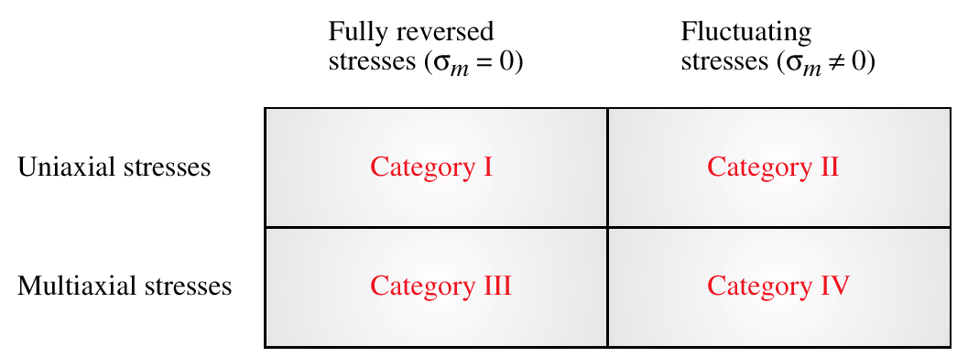
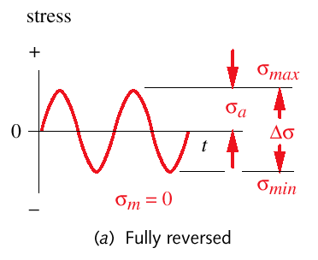
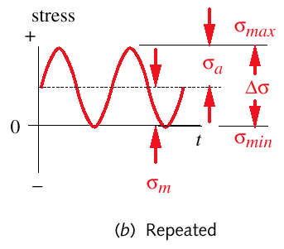
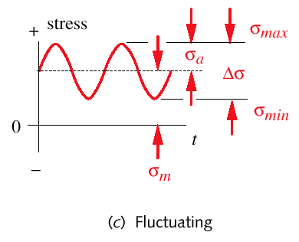
Designing for High-Cycle Fatigue
Four categories of fatigue design

Slide 9
Designing for Fully Reversed Uniaxial Stresses
Determine the number of cycles, N, of loading the expected service life
Determine the amplitude of the applied loads
Create a tentative part-geometry design
Determine any appropriate K_{t} or K_{ts}
Choose a tentative material → S_{ut}, S_{y}, S_{e’} or S_{f’}, and q
Covert K_{t} or K_{ts} to K_{f} or K_{fs}
Calculate the nominal alternating stress σ_{a} or τ_{a} at critical locations considering the K_{f} and K_{fs}
Calculate the principal stress amplitudes & von Mises effective stress for critical locations
Determine the corrected fatigue strength S_{e} or S_{f}
Create the S-N diagram
Calculate the safety factor for the design:
Refine the design or choose a more suitable material
Category I (σ_{m} = 0)
Examples: rotating bending of a shaft that supports static load, reversed torque on a shaft, etc.

Slide 10
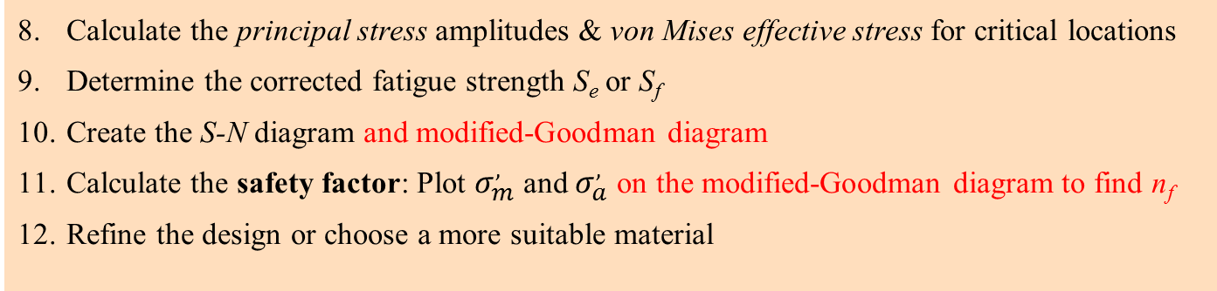
Designing for Fluctuating stresses
Determine the number of cycles, N, of loading the expected service life
Determine the amplitude of the applied loads
Create a tentative part-geometry design
Determine any appropriate K_{t}
Choose a tentative material → S_{ut}, S_{y}, S_{e’} or S_{f’}, and q
Covert K_{t} to K_{f}
Increase the nominal alternating stress σ_{a} at critical locations considering the K_{f} , also, increase the nominal mean stress at critical locations considering the K_{fm}
Category II (σ_{m} ≠ 0)
Calculate the principal stress amplitudes & von Mises effective stress for critical locations
Determine the corrected fatigue strength S_{e} or S_{f}
Create the S-N diagram and modified-Goodman diagram
Calculate the safety factor: Plot $σ_{m}^{,}$ and $σ_{a}^{,}$ on the modified-Goodman diagram to find n_{f}
Refine the design or choose a more suitable material

Slide 11
Multiaxial Stresses
Simple multiaxial stress: periodic synchronous in-phase loads that cause combined stresses whose principal directions do not change with time, e.g., load in a rotating shaft in combined bending and torsion if the torque is constant
Category III) Fully-reversed simple multiaxial stresses: σ_{m} = 0
after applying the stress concentration factor:
von Mises stress:
Safety Factor:
Category IV) Fluctuating simple multiaxial stresses: σ_{m} ≠ 0
after applying the stress concentration factor:
von Mises stress:
(2D)
Safety Factor: Eq. (6.18) for the four cases

Slide 12
Where do you see Shafts?
Input from class
Which category does it fall under?
Next slide

Slide 13
Shafts
Transfer torque and rotary motion from input to output
Transfer torque from driving device to driven device
Need gears, bearings, sheaves or pulleys, sprockets, belts, chains
Shafts can be simply supported, cantilevered or overhung, and other configurations
Generally rotating, but could also be stationary (called axle)

Slide 14
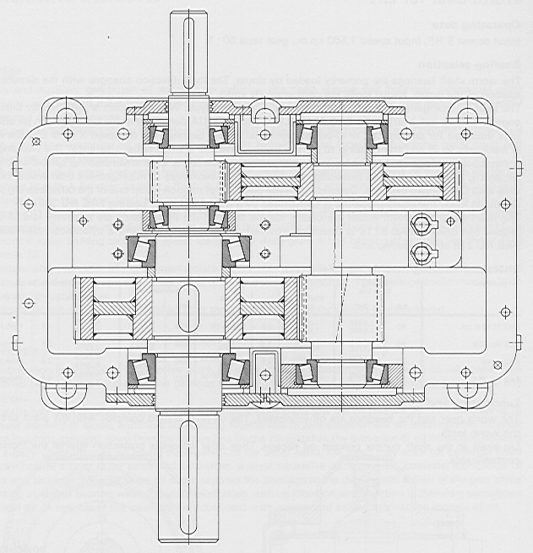
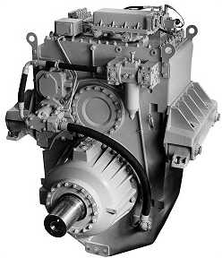
Shaft design
Example of rotating machinery: tapered roller bearings
Double reduction spur gear: maximum shaft diameter (largest bearing location) is 180 mm. Input power is 1500 HP at maximum speed of 1500 rpm. Gear ratio is 8:1

Slide 15
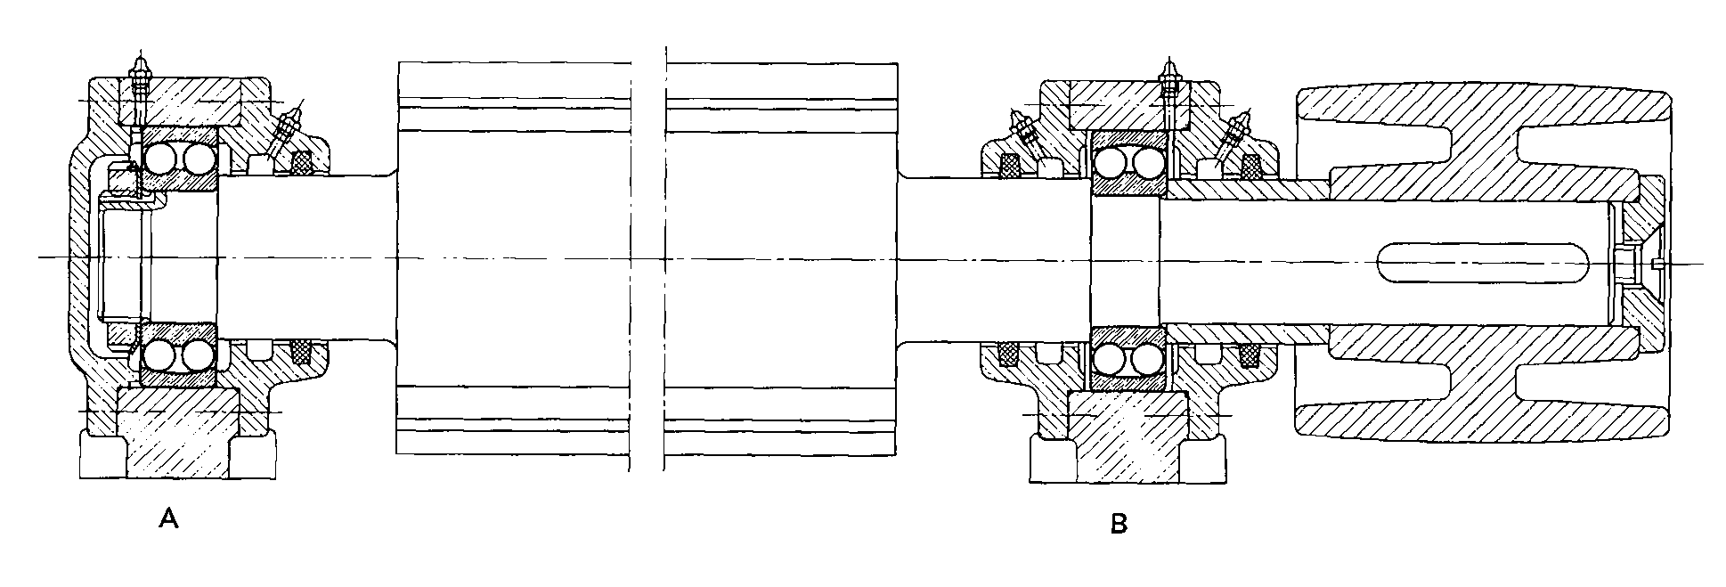
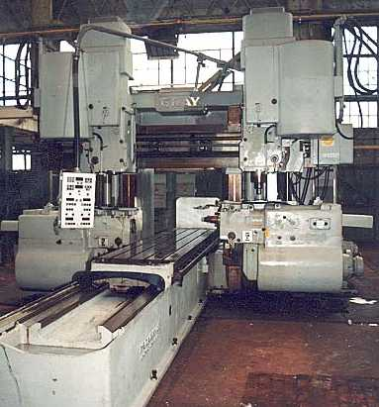
Shaft design
Example of rotating machinery: self-aligning ball bearings
Shaft: used for transmission of power and as a machining tool
Locating bearing (lesser load)
Input pulley
Lubrication system
Sealed bearings
Clamp
Floating bearing (heavier load)
Keyway
Cutting shaft of a planer: shaft diameter (bearings locations) is 40 mm. Input power is 12 HP at maximum speed of 4500 rpm

Slide 16
Shaft Design Guidelines
Some design considerations
Shafts can be designed to minimize both stresses and deflections: use the shortest shaft possible to reduce bending moment
Cantilever configurations typically have larger deflections
Sometimes, hollow shafts are utilized (better stiffness/mass ratio), however, may be more expensive
Minimize stress-concentration features -- particularly in regions subjected to high bending stresses
Use low-carbon steels when designing shafts subjected to minimum deflection considerations
When using gears, shaft deflections at gear locations cannot exceed 0.005 in (127 µm) and slopes cannot exceed 0.03 degrees
If plain bearings are used, slopes at gear locations cannot exceed 0.04 degrees
If plain bearings are used, deflections at gear locations should be less than the oil-film thickness in the bearing
First natural frequency should be at least 3-times larger than the highest frequency expected in service
… Consult standards for additional considerations… (ASME, AGMA… etc…)

Slide 17
Typical Shaft Loadings
Note that constant applied moment = fully reversed stress
Stress range:
Alternating stress component:
Mean stress component:

Slide 18
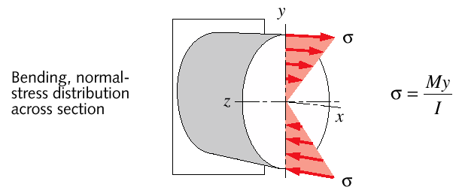
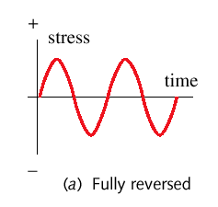
Shaft in Bending
Stress analysis: rotating shaft
Bending (normal) stress may vary over time, however, even if constant, shaft will see reversed stress due to rotation
A
A
As shaft rotates (at a specific speed), sections are subjected to fully reversed bending stress. See point A: stress varies from tension to compression as a function of time (as shaft rotates)
A
Normal stress at point A
Stress variations, at any point A, may induce fatigue failure by bending

Slide 19
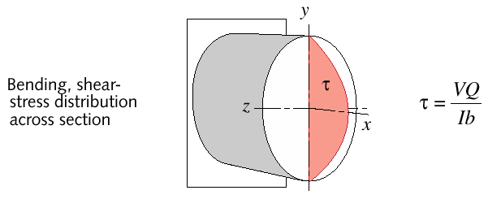
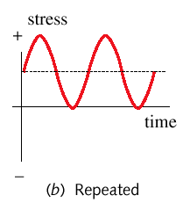
Shaft in Transverse Shear
Stress analysis: rotating shaft
Transverse shear stress may vary over time, however, even if constant, shaft will see reversed stress due to rotation
A
A
As shaft rotates (at a specific speed), sections are subjected to repeated transverse shear stress. See point A: stress varies from zero to maximum as a function of time (as shaft rotates)
A
Transverse shear stress at point A
Stress variations, at any point A, may induce fatigue failure by shear

Slide 20
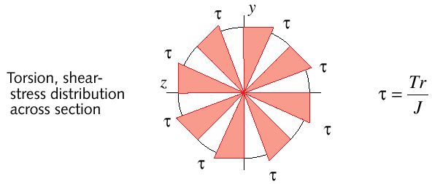
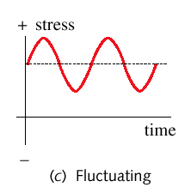
Shaft in Torsion
Stress analysis: rotating shaft
Torsional shear stress may be constant with time, or more likely, fluctuate about a mean value.
A
A
A
Torsional shear stress varies with time only if applied torque fluctuates: alternating stress .
Torsional shear stress at point A. Obtained when only the applied torque (load) changes, Please note pre-load/mean value
Mean torque
Fluctuations in torsional stress may induce fatigue failure by shear.
Fluctuation of torque
(wrt to mean value)

Slide 21
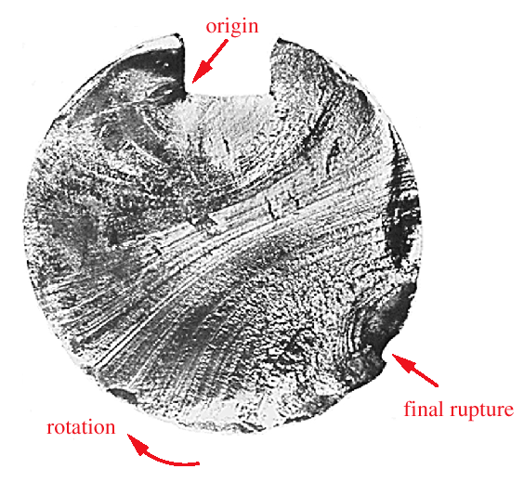
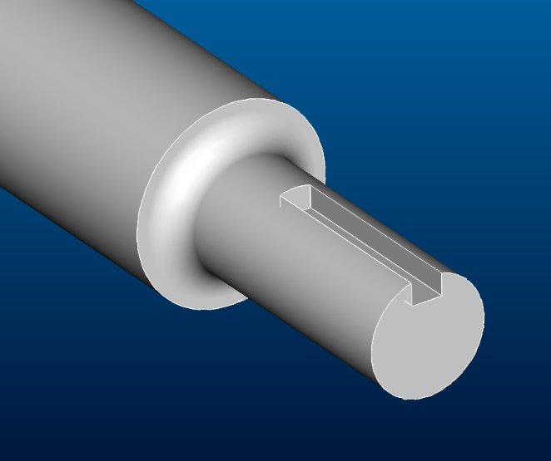
Shafts Fail in Combined-Stress Fatigue
Most shafts have bending and torque loading
Fatigue failures always begin at a crack
Cracks may be present in raw material used for fabrication (crystallographic defects; inclusions; etc.)
Cracks may be introduced during fabrication
Cracks develop over time due to cyclic loading (& corrosion)
Cracks develop around stress concentrations
Shaft failed in fatigue.
Crack initiated at keyway
Shaft with keyway
Failure due to rotating bending

Slide 22
Shaft design
Materials
Ground precision shafts of different materials can be purchased. Make sure to take into account hardness and machinability of material -- geometrical features such as grooves, holes, threads, and keyways may need to be machined
Low- to medium-carbon steels: cold- or hot-rolled
Cold rolled steels used for shaft diameters, φ, lower than 3 inch
Hot-rolled must be machined in order to remove carburized outer layers
Rolled steels may contain residual stresses
Stainless steels – marine and corrosive environments, $$$
Bronze – marine applications (stands up to sea water)
Other: depending on application, stress levels, deflection, etc.
… consult standards (ANSI, ASME, etc…)

Slide 23
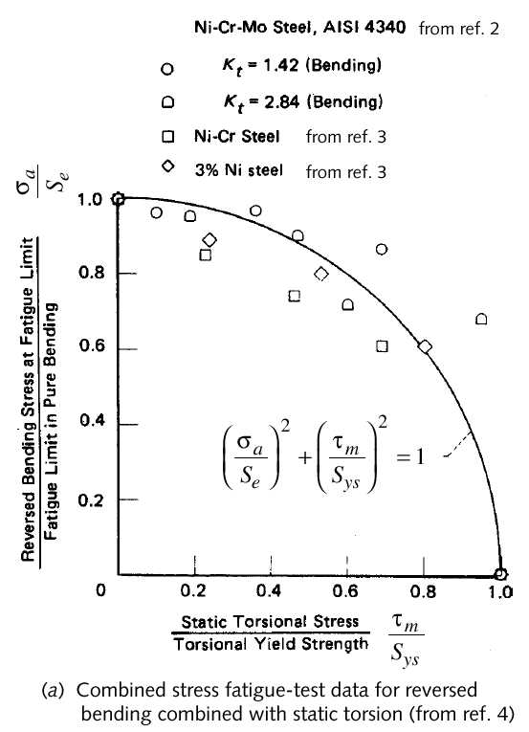
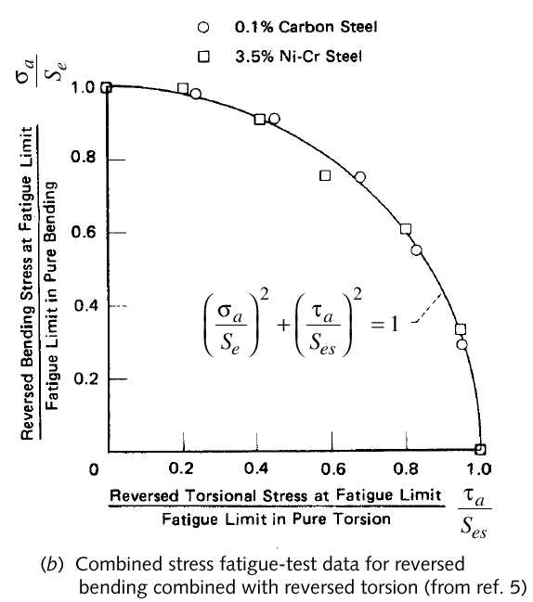
Shaft design
Failure envelope: fatigue failure is taken into account
Experimental data and fatigue failure envelope. See ANSI/ASME standard B106.1M-1985 on “design of transmission shafting.”
Gough Line or ellipse

Slide 24
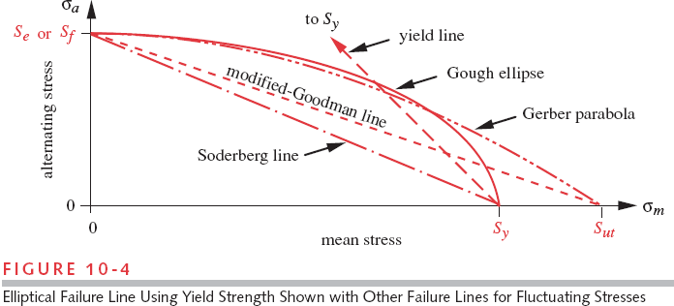
Failure Envelopes

Slide 25
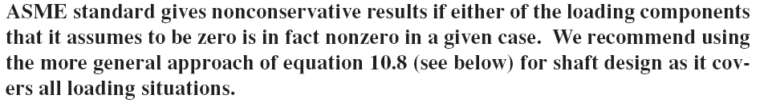
Shaft design
ASME method: fully-reversed bending and constant torsion
I do NOT recommend using this method!
Based on Gough ellipse failure envelope (shown before):
Safety factor: N_{f}
von Mises stress in shear (strain-energy theory):
Amplitude stress in bending and mean torsional stresses: (corrected for fatigue stress-concentration factors)
Shaft dia is calculated as:
withdrawn in 1994

Slide 26
Shaft design
Fluctuating bending and torsion
Use this more conservative, more general method!
Based on von Mises stresses (alternating and mean):
Modified Goodman Line failure envelope is given as:
von Mises stress in shear (strain-energy theory):
Amplitude and mean stress components in bending and shear: (corrected for fatigue stress-concentration factors)
Shaft diameter is calculated as:

Slide 27
Shaft Design Handout
2020DesignOfShafthandout.docx

Slide 28
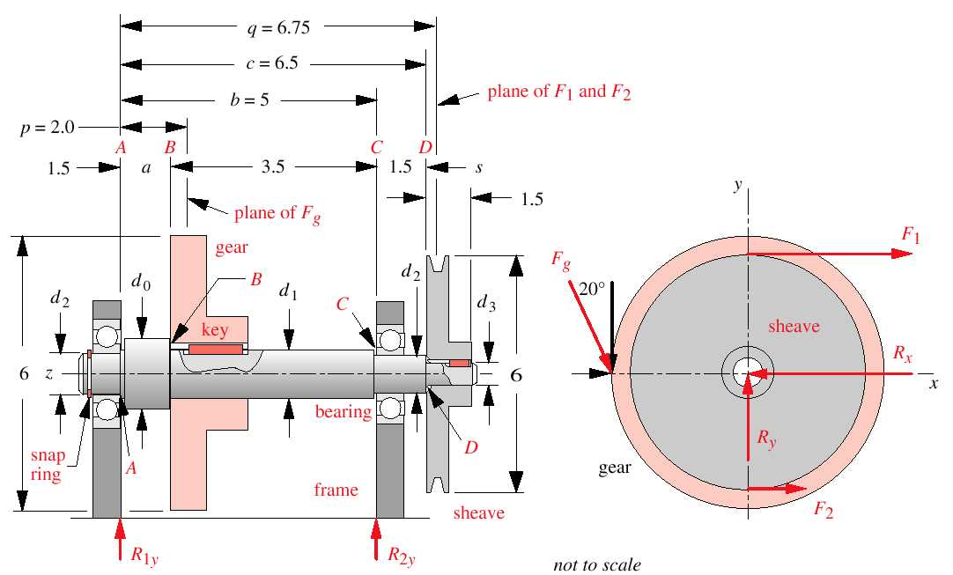
Example of Shaft design
Fluctuating bending and torsion
See: Example 10-1
Mean and alter. torque are both 74 lb-in
Safety factor: 2.5
Infinite life
Material: SAE1030 (good notch sensitivity)
Operating conditions: room temperature
Power: 2HP at 1750 rpm
SCF of 3.5 for radii in bending, 2 in torsion, and 4 at the keyway

Slide 29
ICE 01

Slide 30
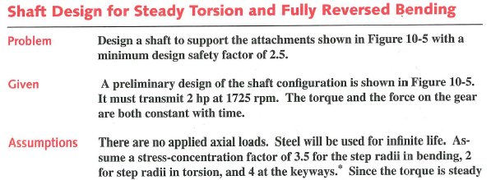
ICE 01

Slide 31
Typical Shaft Loadings
Note that constant applied moment = fully reversed stress
Stress range:
Alternating stress component:
Mean stress component:

Slide 32
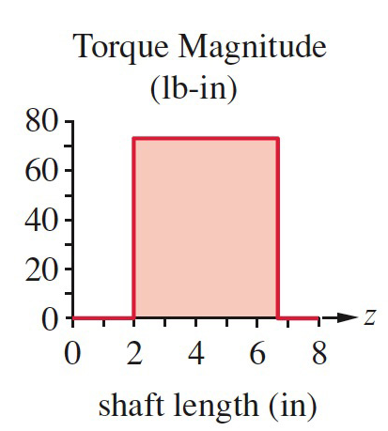
ICE 1
Design of shaft

Slide 33
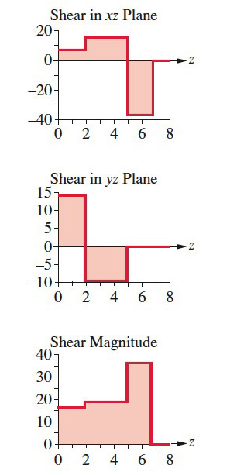
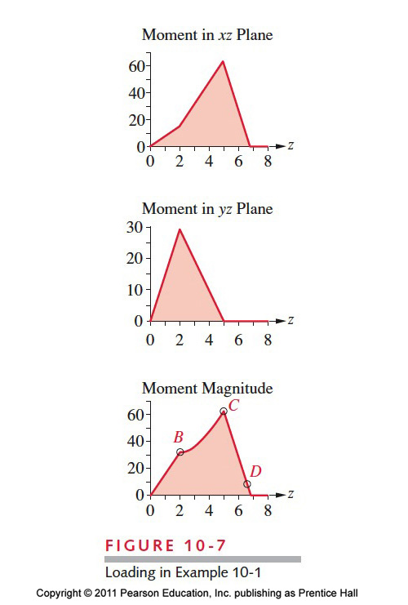
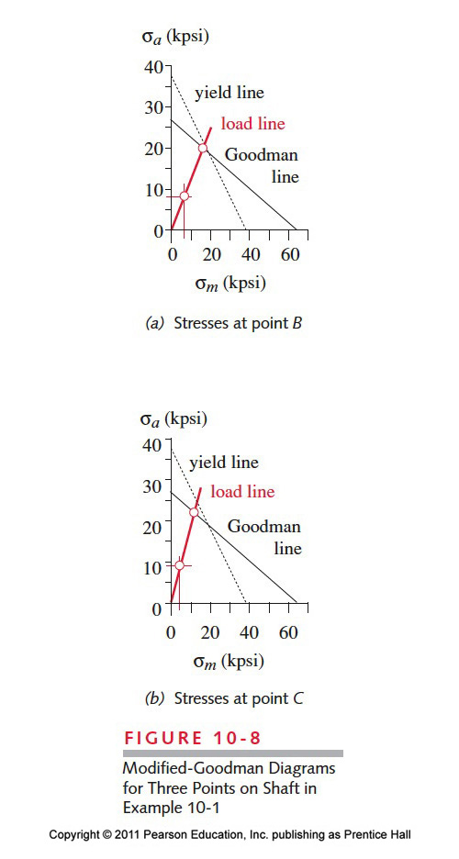
ICE 1

Slide 34
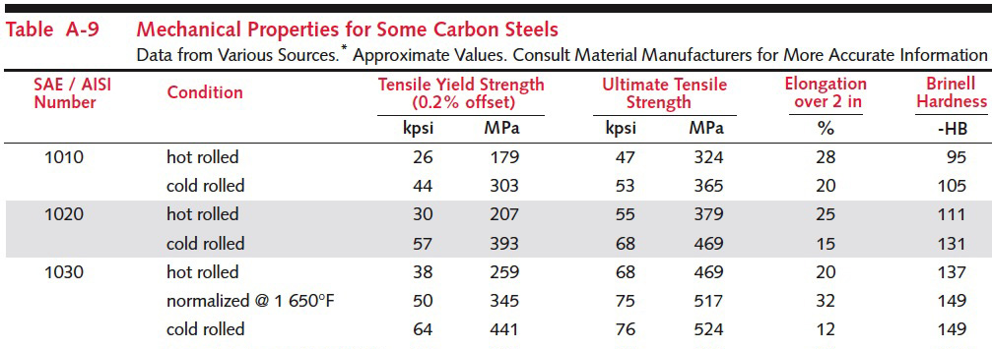
ICE 01
Select Material – SAE 1030 P 1024, table A-9

Slide 35

ICE 01
Uncorrected endurance limit
If published endurance limit is available use it
If not use material property and estimate using eq 6.5a, pp 360
Why these values? (next slide)

Slide 36
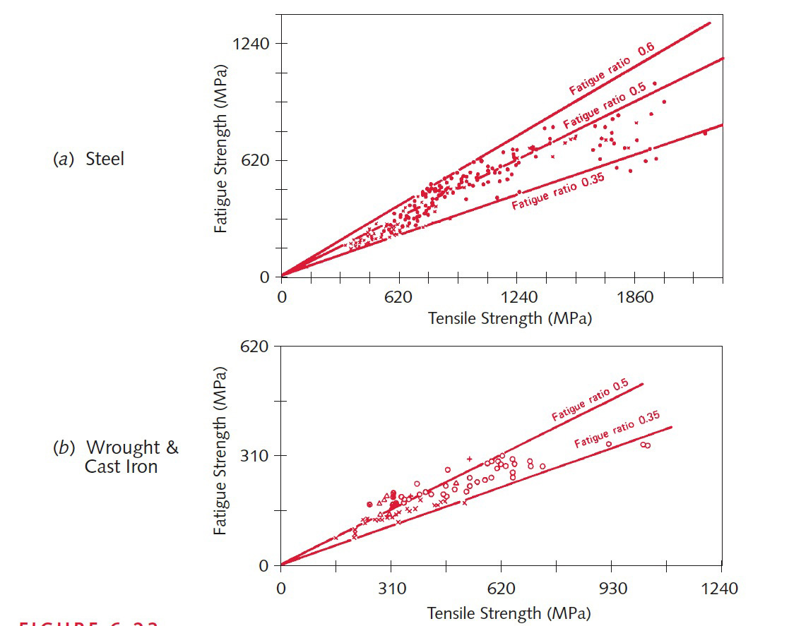
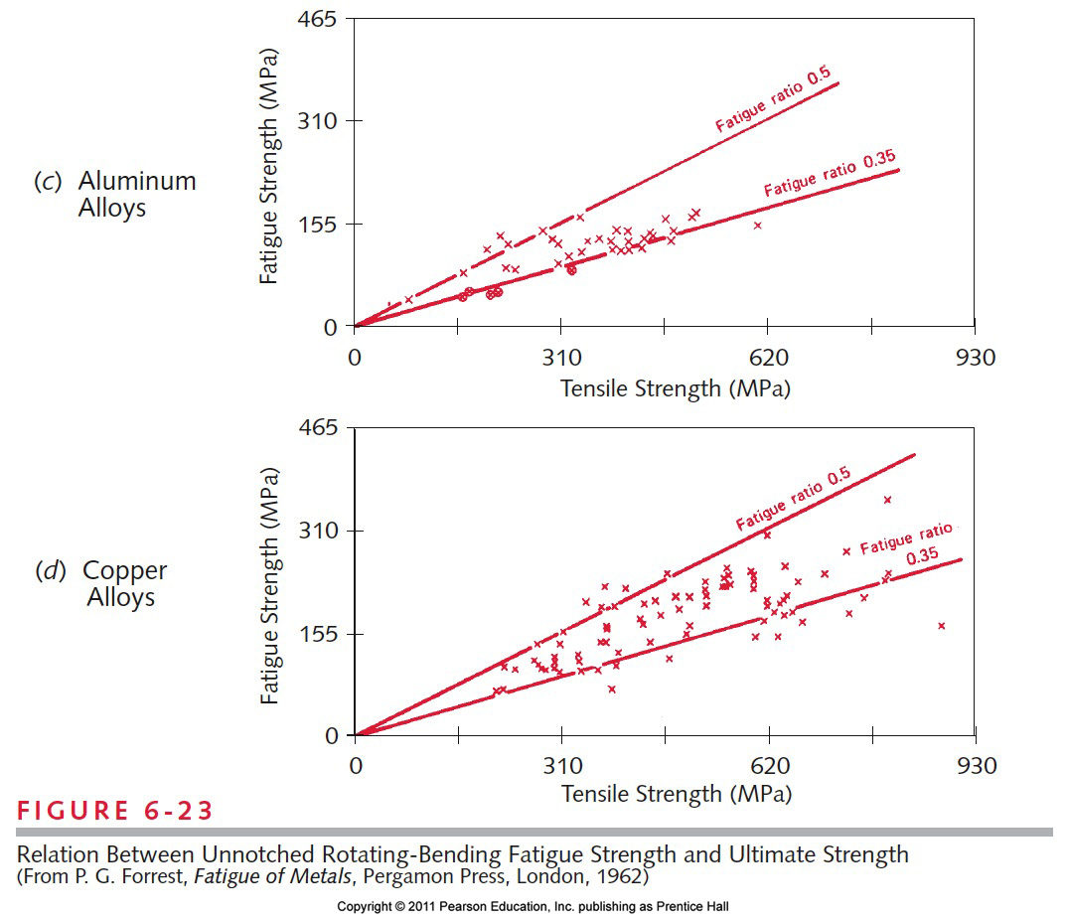
ICE 01
Relation between Unnotched rotating-bending fatigue strength and ultimate strength

Slide 37

ICE 01
Loading Factor (eq. 6.7a, pp. 362)
Why?
Published data is for rotating bending tests

Slide 38

ICE 01
Size factor (eq. 6.7 b pp. 363)
Why?
Published data is for rotating bending tests
Wait we do not know diameter. What to do?

Slide 39
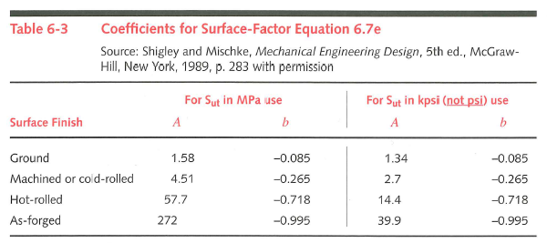
ICE 01
Surface factor (eq 6.7e p. 365 & table 6.3)
Why? I am sure you know this now

Slide 40

ICE 01
Temperature factor (eq. 6.7f pp 367)
Why?
Published data is room temperature

Slide 41
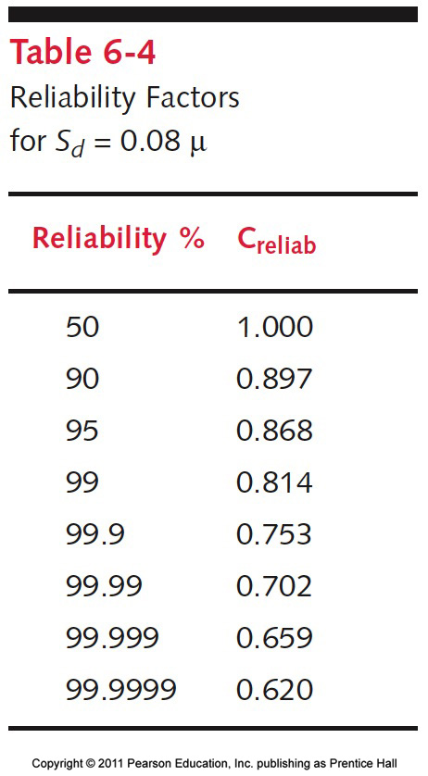
ICE 01
Reliability factor (table 6.4, pp. 367)
Why?
Published data based on experiments and we account for spread of data

Slide 42
ICE 01
plug in and compute

Slide 43

ICE 01
Notch sensitivity (fig 6.35 p 376)

