Slide 1

Anomaly Detection with Robust Deep Autoencoders
Group Member:
Ying Peng
Ye Leng
Junjie Chu
Group 10
The project content can be viewed in Google colab.

Slide 2
Agenda
Introduction of Theory
Background (Autoencoder and RPCA)
Introduction to RDAE
Code Demonstration
Structure of the Program
Deep autoencoder
Variational autoencoder
Robust Deep autoencoder
Other Methods
Experiments
Denoising
Outlier Detection

Slide 3
1. Introduction of Theory
Background (Autoencoder and RPCA)
Introduction to RDAE

Slide 4
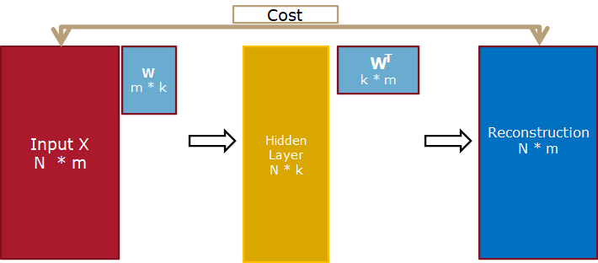



1.1 Background (1/2)
Introduction to theory-Background-Autoencoder
Autoencoders learn the input data themselves.
Autoencoders become non-trivial by having the hidden layers are low-dimensional and non-linear.
Cost function:
Where:
Notes:
logit函数是什么？
NN.linear是线性还是非线性的？

Slide 5
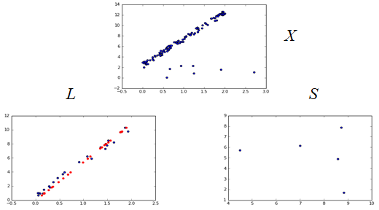
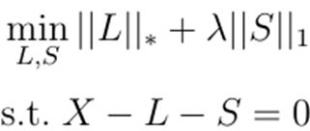
1.1 Background (2/2)
Introduction to theory-Background-RPCA
Robust Principal Component Analysis assumes that an image could be decomposed into two parts.
L contains structured data, thus it is a low-rank matrix. The lower the rank is, the better the components we find (if the number of components is constant).
S contains noise, which is unstructured. RPCA assumes that noise could be represented by a sparse matrix.
Finding low-rank matrix L and sparse matrix S can be transformed into an optimization problem of finding the minimum of the sum of the nuclear norm of L and the first norm of S:
Notes:
sparse matrix 稀疏矩阵。
nuclear norm 是奇异值Singular Value的和，rank是非零奇异值的个数。nuclear norm能近似rank就跟 l1 norm能近似l0 norm一样。

Slide 6
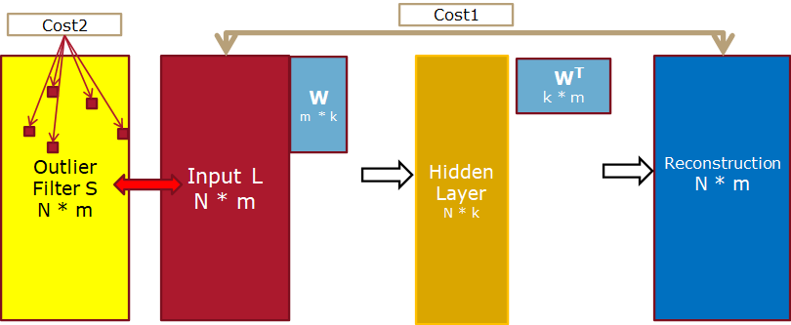

1.2.1 RDAE for denoising (1/1)
Introduction to theory-Introduction to RDAE-RDAE for denoising
RDAE can be viewed as replacing the nuclear norm with a non-linear autoencoder.
The lowest-rank matrix L (i.e. no noise in L) has the minimum of nuclear norm.
The lowest-rank matrix L (i.e. no noise in L) could be reconstructed well via autoencoder.
Replace the nuclear norm with a non-linear autoencoder.
RPCA:
RDAE for denoising:

Slide 7
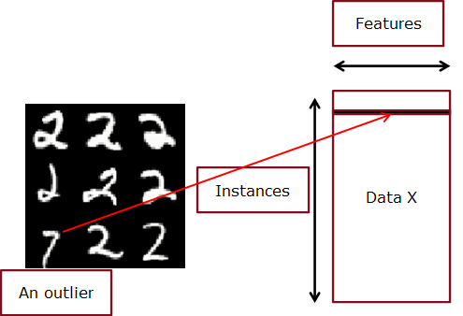
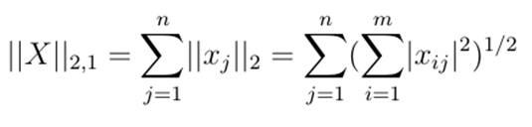
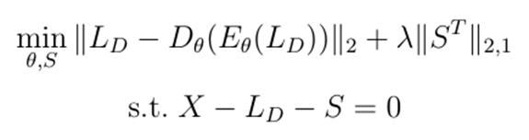
1.2.2 RDAE for outlier detection (1/2)
Introduction to theory-Introduction to RDAE-RDAE for outlier detection
Noise is unstructured and thus we use l1 norm.
Outliers are structured that an outlier is one row in a data matrix and we want to group elements over a row.
Thus l1 norm is replaced by l2,1 norm.
RPCA:
RDAE for denoising:
RDAE for outlier detection:

Slide 8
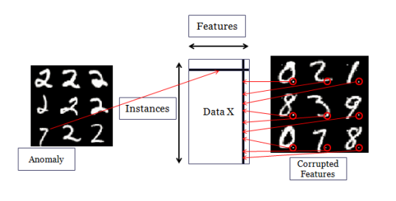
1.2.2 RDAE for outlier detection (2/3)
Introduction to theory-Introduction to RDAE-RDAE for outlier detection
Detail of l2,1 norm
S = X - L
The 2-norm of each column(feature) in S is computed and then compared with Lambda.
If the norm is larger than Lambda, the values of the column will be kept and processed.
If the norm is smaller than Lambda, the values of the column will be set to 0.
The 2-norm of each row(instance) in S is computed and then compared with Lambda.
Equal to each column in S^{T}
Operations are the same of above.
The non-zero columns/rows in S are considered to be the outliers.

Slide 9

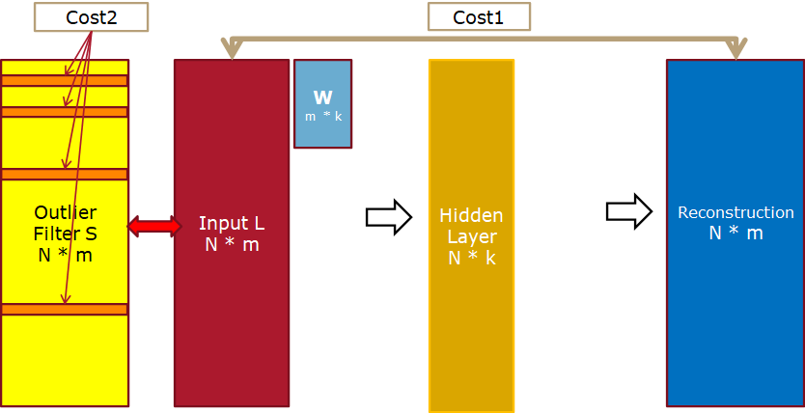
1.2.2 RDAE for outlier detection (3/3)
Introduction to theory-Introduction to RDAE-RDAE for outlier detection

Slide 10
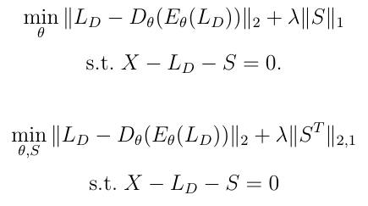
1.2.3 Training and more details (1/2)
Introduction to theory-Introduction to RDAE-Training and more details
Training:
Borrow the idea of ADMM that training each part of an complex object separately with other parts fixed.
Training the autoencoder with S fixed.
Shrink S with the autoencoder fixed.

Slide 11
1.2.3 Training and more details (2/2)
Introduction to theory-Introduction to RDAE-Training and more details
More details:
Minimize L with S fixed
Just a call to a standard autoencoder
Project onto constraint
Minimize S with L fixed
Proximal gradient problem
Project onto constraint
Key points
Theoretical justification (the author still worked in progress)

Slide 12
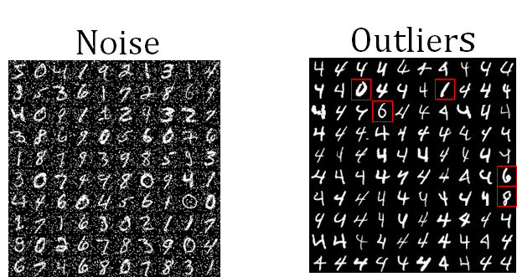
1.2.4 Advantages (1/1)
Introduction to theory-Introduction to RDAE-Advantages
•Important point 1: Both problems can be handled in the same framework
•Important point 2: Do not need any noise/outlier free training samples

Slide 13
2. Code Demostration
Structure of the Program
Deep autoencoder
Variational autoencoder
Robust Deep autoencoder
Other Methods

Slide 14
2.1 Structure of the Program
Language:
Python
Tools:
Google Colab
Models:
Deep autoencoder
Variational autoencoder
Robust Deep autoencoder
Other methods:
shrink
add_noise
compute_f1_score
Imshow(MNIST tutorial)

Slide 15
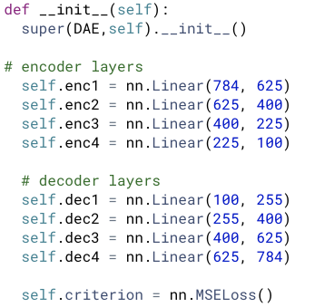
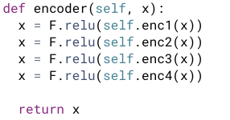
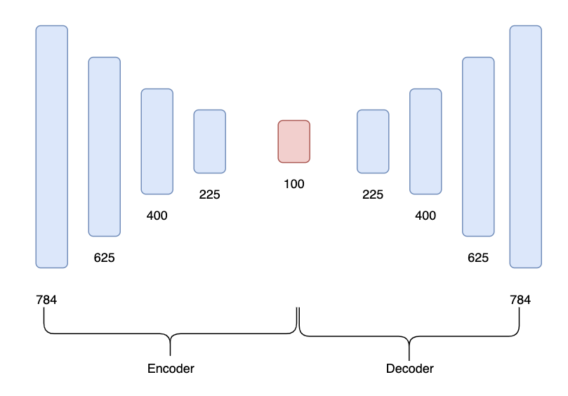
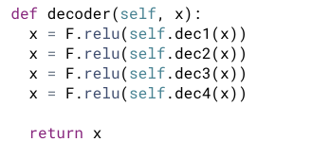
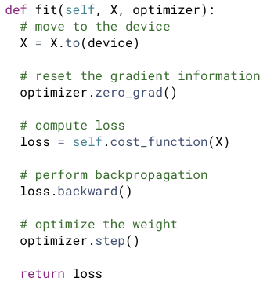
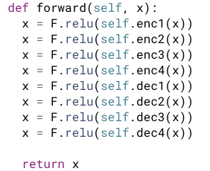
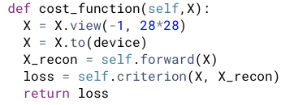
2.2 Deep autoencoder
Class DAE(nn)
__init__()
encoder()
decoder()
forward()
cost_function()
fit()

Slide 16
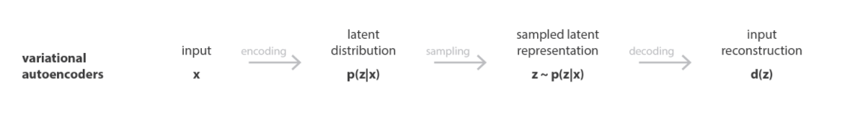

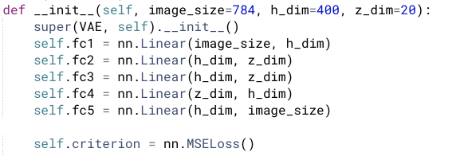
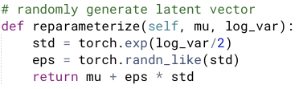

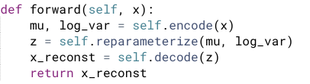
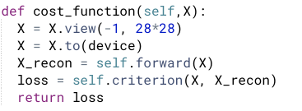
2.3 Variational autoencoder
Class VAE(nn)
__init__()
encoder()
reparameterize()
decoder()
forward()
cost_function()
fit()

Slide 17
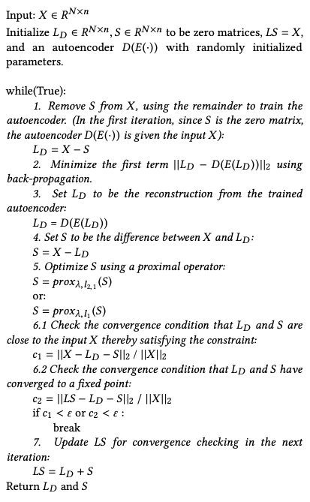
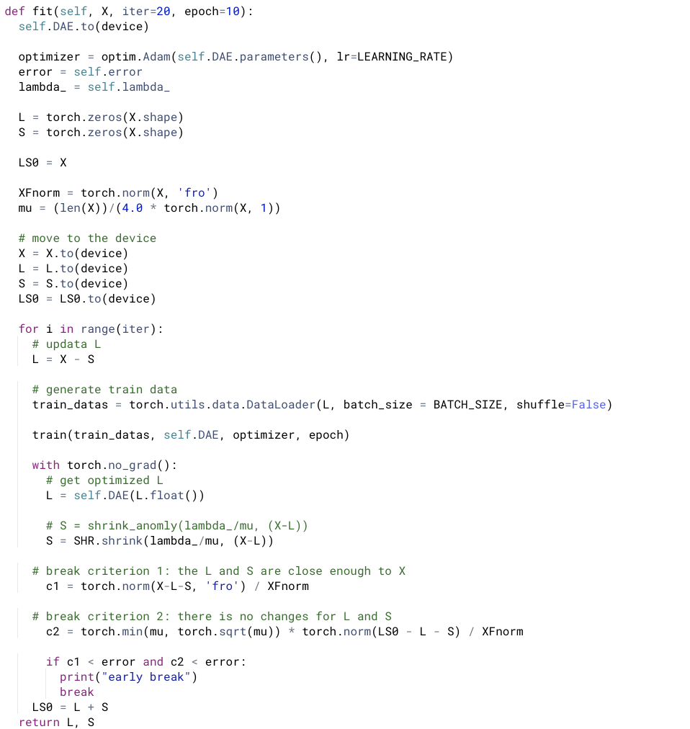
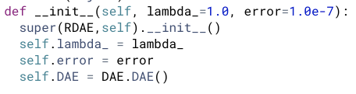
2.4 Robust Deep autoencoder
Class RDAE(object)
__init__()
fit()

Slide 18
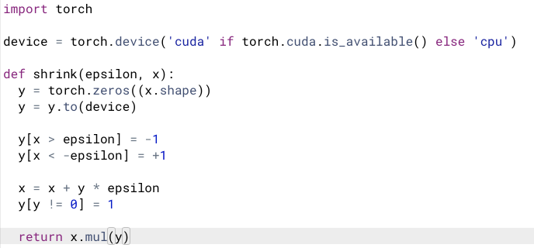
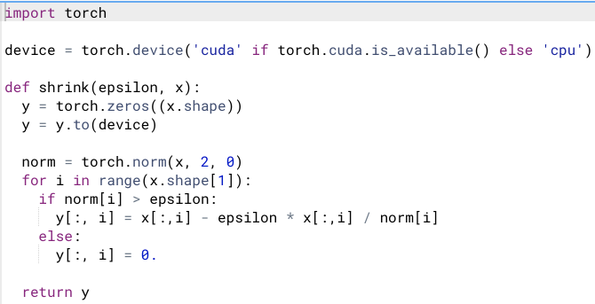
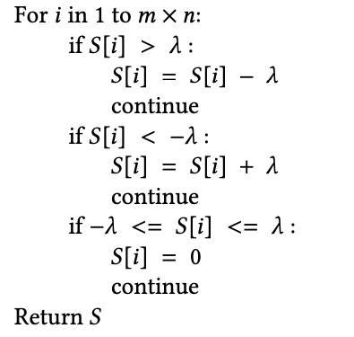
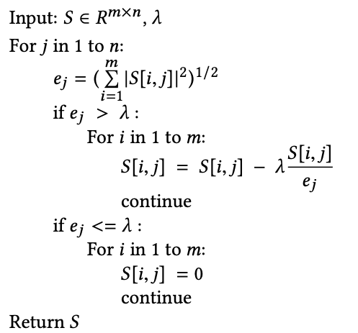
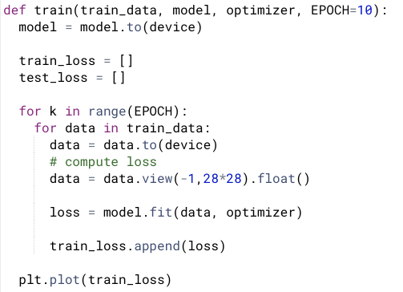
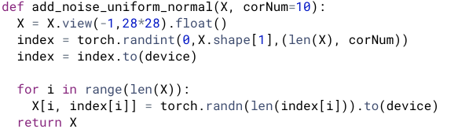
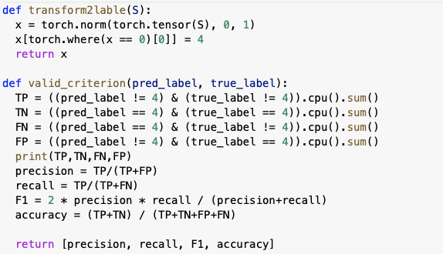
2.5 Other Methods
Methods
shrink1
shrink2,1
add_noise
train
compute_f1_score

Slide 19
3. Experiments
Denoising
Outlier Detection

Slide 20
3.1 Denoising (1/4)
Experiments-Denoising-Experiments Design
The outstanding advantage of RDAE is that it could denoise an image without a noise-free image.
To show that, we use a noisy image to train different models. Then compare the results.
RDAE,DAE and VAE are trained and compared
Also, different numbers of noise points are applied in the experiments.
10,100,250 noise points are added in each image (one image has only one digit).

Slide 21
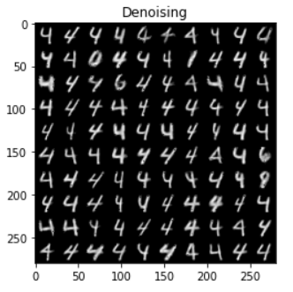
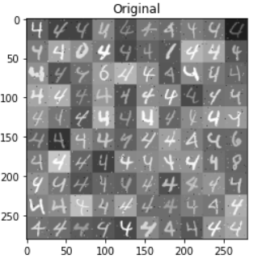
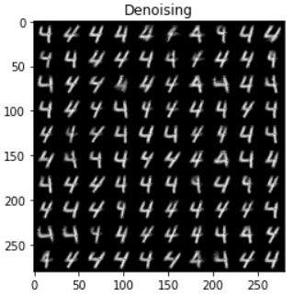
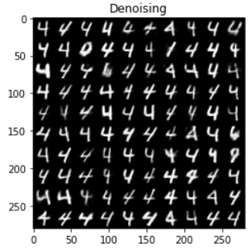
3.1 Denoising (2/4)
RDAE:
DAE:
VAE:
RDAE could reconstruct the digits clearly and denoise the image.
Experiments-Denoising-Results
10 noise points:
DAE could denoise the image, but cannot reconstruct the digits correctly, all digits are transformed to 4, even there are very few noise points.
When the noise is small, VAE and RAE can be used for denoising.
VAE could reconstruct the digits accurately and denoise the image.

Slide 22
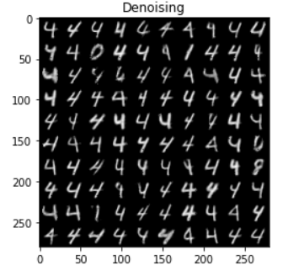
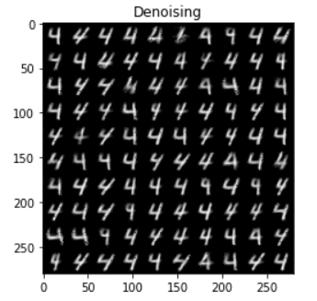
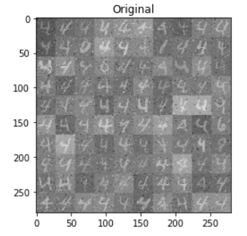
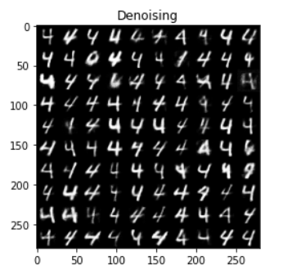
3.1 Denoising (3/4)
RDAE:
DAE:
VAE:
RDAE could reconstruct the digits clearly and denoise the image.
Experiments-Denoising-Results
100 noise points:
DAE could denoise the image, but cannot reconstruct the digits correctly, all digits are transformed to 4.
VAE could reconstruct the digits accurately and denoise the image, but not as clear as those of RAE.

Slide 23
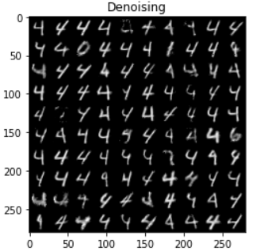
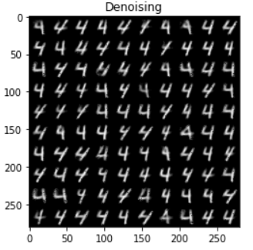
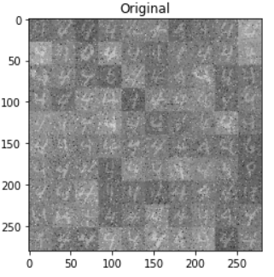
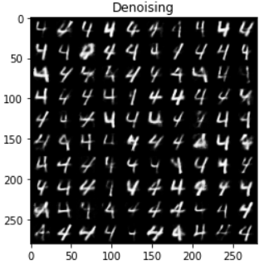
3.1 Denoising (4/4)
RDAE:
DAE:
VAE:
With the number of noise points increasing, the results are nearly the same, but all the reconstructed images become unclear.
When 100 noise points, the VAE could reconstruct 6, but when 250 noise points, it failed to do that. The RAE could still reconstruct 6,8 and other digits.
Experiments-Denoising-Results
250 noise points:

Slide 24
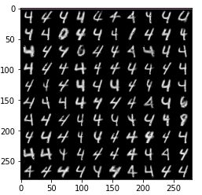
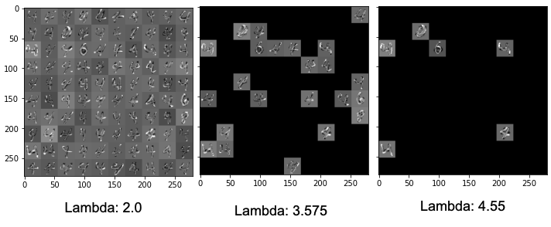
3.2 Outlier Detection - anomalous instance (1/2)
Use S^{T} in 2-Norm
How to choose a optimal λ?
This indicates an example of a false-negative; a “1” digit is supposed to be picked out as an outlier, but is marked as nominal.
Since non-zero rows in S are marked as anomalies, the RDA has a high false-positive rate.
When the λ value is larger, placing a heavier penalty on S, and forcing S to be sparser. Many rows are shrunk to zero which reduces the false-positive rate, but also increases the false-negative rate.
Accordingly, the optimal λ should balance both false-positive and false-negative rates. Thus, we use the F1-score to select the optimal λ

Slide 25
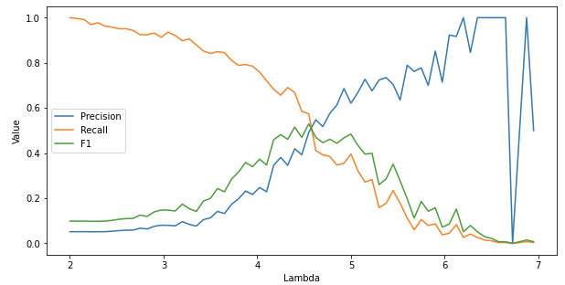
Outlier Detection for l2,1 norm Robust Auto-encoder
First, we try to find the optimal range of lambda. The range is from (2,7, step =0.075)
Here we found the best lambda is around 5, so we pick the values range from (4.5, 5, step = 0.075) and then tune the parameters ‘epoch’ and ‘iteration’.
And finally the parameters are set to be: lambda 4.7250000000000005, epoch 5, iteration 3, with respect to f1 score = 0.6083
3.2 Outlier Detection - anomalous instance (2/2)

Slide 26
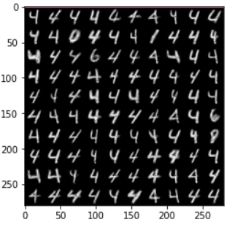
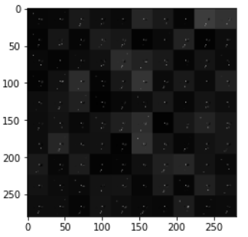

3.2 Outlier Detection - anomalous features (1/1)
Use S in 2-Norm
view: 28*28
view: 1*784

Slide 27
Problems we meet:
The author used a lot of methods for optimization, which we are not familiar with, for example, projected gradient.
The algorithm in the article and demo do not match exactly.
In the demo, the author used a lot of other parameters such as mu, which are not explained at all in the article.
In the article, the author did not give the method to choose the range of lambda.
Possible improvement:
Now all the layers in NN are set to be linear. In the future, convolution layer could be applied to see if any improvement.
Summary

Slide 28
Thank you for your listening!

