Slide 1
Health Monitoring Analytics
Group 1 Demo #2
Zhijie Zhang, Weidi Zhang, Ruotian Zhang,
Tianzhe Wang, Kai Kang, Junjie Feng

Slide 2
What’s in our system ?
Twitter
Store into separate tables
KNN Filter
DB
Display
Data Analyze
Android Device
NLTK Emotional Analyze
NLTK
Categorizing and Tagging Words
SVM – Participation Type Analyze
Web Site
Degree of Fondness for Certain Sports
The Ratio of ‘Self-Involved’ or ‘As a Watcher’
Write back the result

Slide 3
KNN Filter
Refine the training set
Filter out all tweets with URLs
3
Notes:
To become a mature system, more work need to be done in the future.
As so far, in our database, most of the tweets are about sports and only a little of them are talking about food. For future, we need to collect more tweets about food and analyze what kinds of healthy food chosen by people in the different area or different ages. Based on the analysis about what kinds of sports and food are popular in your area or in your age, the system will give more advise about how to live healthier.
In order to further verify the accuracy of our algorithms, we need more test on analyzing tweets and check the result to see if it is desired or not. //And we should use python semantic analysis more flexibly.

Slide 4
Sentiment Analysis
Dive into the source code
NTLK training set
Lazy implementation – avoiding training every time
Little demo here
4
Notes:
To become a mature system, more work need to be done in the future.
As so far, in our database, most of the tweets are about sports and only a little of them are talking about food. For future, we need to collect more tweets about food and analyze what kinds of healthy food chosen by people in the different area or different ages. Based on the analysis about what kinds of sports and food are popular in your area or in your age, the system will give more advise about how to live healthier.
In order to further verify the accuracy of our algorithms, we need more test on analyzing tweets and check the result to see if it is desired or not. //And we should use python semantic analysis more flexibly.

Slide 5
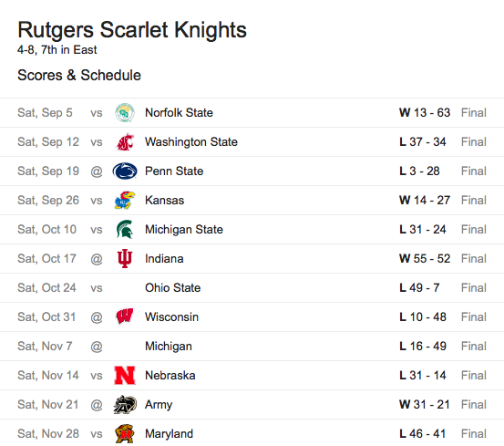
Sentiment Analysis
5
Notes:
To become a mature system, more work need to be done in the future.
As so far, in our database, most of the tweets are about sports and only a little of them are talking about food. For future, we need to collect more tweets about food and analyze what kinds of healthy food chosen by people in the different area or different ages. Based on the analysis about what kinds of sports and food are popular in your area or in your age, the system will give more advise about how to live healthier.
In order to further verify the accuracy of our algorithms, we need more test on analyzing tweets and check the result to see if it is desired or not. //And we should use python semantic analysis more flexibly.

Slide 6
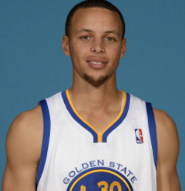
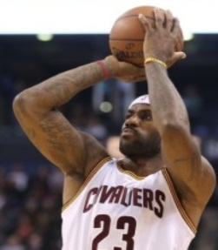


Data Processing flow:
NLTK
Categorizing and Tagging Words
SVM – Participation Type Analyze
DB
DB
Weight Calculation
Feature Selection: more feature, more accurate?
Curry, LeBron …
As a Set !
Curry
LeBron
How is the result?
93.7%
45/300
Surprise
Need more testing: bad tweeter, other parameter
The weight calculation formula is from ‘An Introduction to Support Vector Machine and Other Kernel-based Learning ’ Nello Cristianini and John Shawe-Taylor

Slide 7


Feature Selection
Let our system learn to understand what people expressed !
Build our feature sets for SVM classification.
No more than 140 characters in each tweet.
Unstructured text/Lots of internet slang or Acronyms in Hashtag
15 feature sets in our analysis system.
Components in each feature set.
positive/negative/ambiguous to self-involvement(player)/others(audience)
But, It’s not that simple like above. So we utilize the method of calculating weight of each feature and combine them into final result.
Improve our feature
1.unigram Bigram 2.More internet slangs and acronyms 3. Latent Semantic Analysis of Hashtags.
Ave: 5 characters/word in tweets
Ave: 10~15 “real” words in a tweet
Ave: 25~30 words in a (long) tweet
Category | feature1 | feat 2 | feat 3 | feat 4 | feat 5 | feat 6 | feature7-15
“player” | verb |  |  | weather | mood | terminology | …
“audience” | verb | player name | venue |  | mood | terminology | …

Slide 8
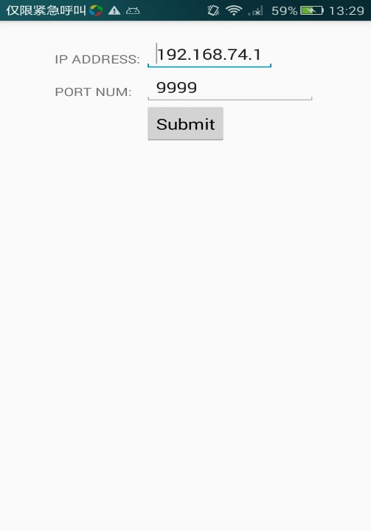
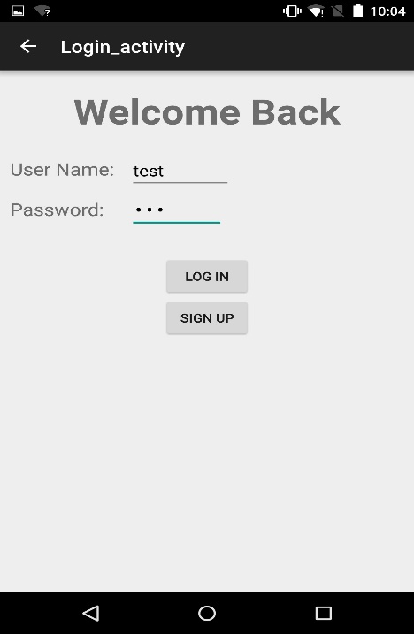
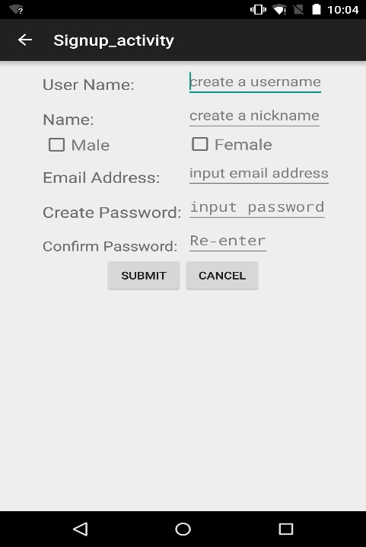
Connected to the database on computer through a server.
All information are stored in the database.

Slide 9
Future Work
Collect more tweets not only about sports but also about food
Add some new features which is related to the health monitoring
Give more advise on healthy life style
Do more test to further verify the accuracy of our algorithms
9
Notes:
To become a mature system, more work need to be done in the future.
As so far, in our database, most of the tweets are about sports and only a little of them are talking about food. For future, we need to collect more tweets about food and analyze what kinds of healthy food chosen by people in the different area or different ages. Based on the analysis about what kinds of sports and food are popular in your area or in your age, the system will give more advise about how to live healthier.
In order to further verify the accuracy of our algorithms, we need more test on analyzing tweets and check the result to see if it is desired or not. //And we should use python semantic analysis more flexibly.

