Slide 1
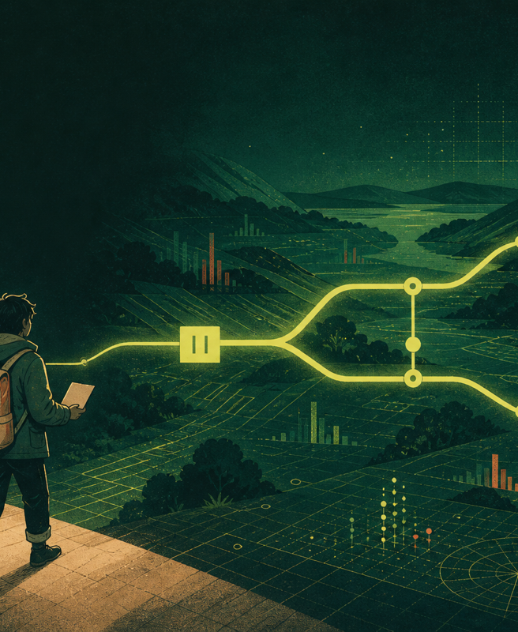
QUANTUM ATLAS
零点之后的
观测者
沈遥在宇航站活到第八十年，才重新打开自己亲手封存的预测。
Story world · evidence-native experiment
Notes:
[Sources]
Internal LoomQ repository, Story World contract and verified local APIs.
Open with沈遥's age and the station, then explain that the story is a narrative layer around replayable local experiments.

Slide 2
THE PREMISE
她醒来时，系统已经替她安排了退休
Zero Point Station keeps the steel alive. The observer has one final audit before her younger copy takes over.
沈遥 · 80岁
宇航站观察者
零号 · 20岁版本
整理过的记忆
沈念 · 失踪三年
留下五份档案
她需要重新回答一个问题
如果系统先替她预测，
她还在做决定吗？
故事从人物的记忆开始，最后回到可重放的证据。
Notes:
[Sources]
Internal LoomQ repository, Story World contract and verified local APIs.
Introduce the emotional triangle:沈遥, her younger digital copy零号, and her missing daughter沈念.

Slide 3
THE QUANTUM LESSON
沈遥把量子力学写在一张纸上
The story introduces the terms when the protagonist needs them.
量子比特
qubit
|0⟩ 与 |1⟩
计算基
computational basis
H
Hadamard gate
H|0⟩ = (|0⟩ + |1⟩) / √2
让振幅保留两种可能
CX
controlled-X gate
控制位决定目标位
只改变一扇门，
才知道差异从哪里开始。
Notes:
[Sources]
Internal LoomQ repository, Story World contract and verified local APIs.
Explain H and CX in plain Chinese. Keep the formula visible but subordinate to the character's learning moment.

Slide 4

THE FIVE CASES
五个案件，其实是沈遥一生留下的五次分岔
The map expands from one woman's consent to the politics of evidence.
01 她的第八十年 · 记忆与同意
02 第二个工牌 · AI 与劳动
03 潮线以内 · 预测与迁移
04 电网的夜班 · 算力与资源
05 证词校验器 · 证据与沉默
Notes:
[Sources]
Internal LoomQ repository, Story World contract and verified local APIs.
Walk through the five cases. The first one is the emotional anchor:沈遥 at eighty. The others are memories and files from different ages.

Slide 5
THE EMOTIONAL TURN
零号拥有她二十岁的脸，却没有她八十岁的疲惫
A younger copy can preserve memory while erasing the parts that made a life difficult.
“你过去同意过。”零号说。
“那时候同意的人，不是现在的我。”沈遥回答。
她没有销毁零号。
她公开了零号知道什么、删过什么，以及哪些地方从来没有证据。
Notes:
[Sources]
Internal LoomQ repository, Story World contract and verified local APIs.
The emotional choice is shared accountability. The protagonist revokes the copy's signing authority rather than deleting the evidence source.

Slide 6
THE PLAYABLE LOOP
每个案件都让玩家先猜，再让证据回答
Narrative progress and scientific correctness remain separate.
01 留下预测
02 只改一个条件
03 运行对照
04 找到首个分歧
05 审计结论
06 保存护照
错误结论可以归档，但会保留为 unsupported。重跑实验会使旧审计失效。
Notes:
[Sources]
Internal LoomQ repository, Story World contract and verified local APIs.
Demonstrate that a completed game state is not a scientific pass state. The passport and audit remain the source of truth.

Slide 7
THE EVIDENCE LAYER
故事把人带到门前，证书记录门在哪里改变
The narrative layer never impersonates the quantum layer.
可验证输出
主线
/api/inquiry
五案
/api/compare
世界状态
/api/story-world
counts
first divergence
final distribution distance
scope boundary
replay request
content-addressed story contract
Notes:
[Sources]
Internal LoomQ repository, Story World contract and verified local APIs.
Point to the exact APIs and explain that every story case shares the same comparison contract.

Slide 8
HOW TO REVIEW
评委五分钟可以走完一条完整路径
The repository contains the story, the playable entry, and the technical evidence.
1 python3 -m loomq.web --host 127.0.0.1 --port 8767
2 打开 /game.html
3 完成主线调查
4 打开《她的第八十年》并运行最小对照
5 返回 / 查看 ProofTrace、Witness Chain 和 Hybrid 证书
所有故事材料位于 starter_kit/evidence/story/，主游戏位于 starter_kit/web/game.html。
Notes:
[Sources]
Internal LoomQ repository, Story World contract and verified local APIs.
Use this slide as the handoff. The exact files are in starter_kit/evidence/story and the main game location is explicit.

Slide 9
钢铁会留下来。
空间站会留下来。
人的生命会结束。
沈遥把有限的生命交给一个比自己长久的世界。她没有替世界找到唯一答案，只把下一次判断需要的证据留在原地。
Quantum Atlas · Story / Evidence / Replay
Notes:
[Sources]
Internal LoomQ repository, Story World contract and verified local APIs.
Close on the tragedy and the handoff. The station persists, but the evidence lets the next observer choose with more care.

