Slide 1
Layered Architecture & Event‑Driven Architecture
CS 5/7319 Final Project – Find Treasure in SMU

Slide 2
GitHub and Presentation
Presentation:https://youtu.be/1bPNWoEjNYg
GitHub:Junliang-Lyu/CS5-7319-Final-Project-Group-8-LYU-WU

Slide 3
Event‑Driven Architecture Project Overview
A text-based adventure game with scenes: Town, Forest, Ruins.
Player interacts via UI buttons to move, pick up items, and use items.
Story progression fully driven by published events.
Chosen architecture 1: Event‑Driven Architecture.

Slide 4
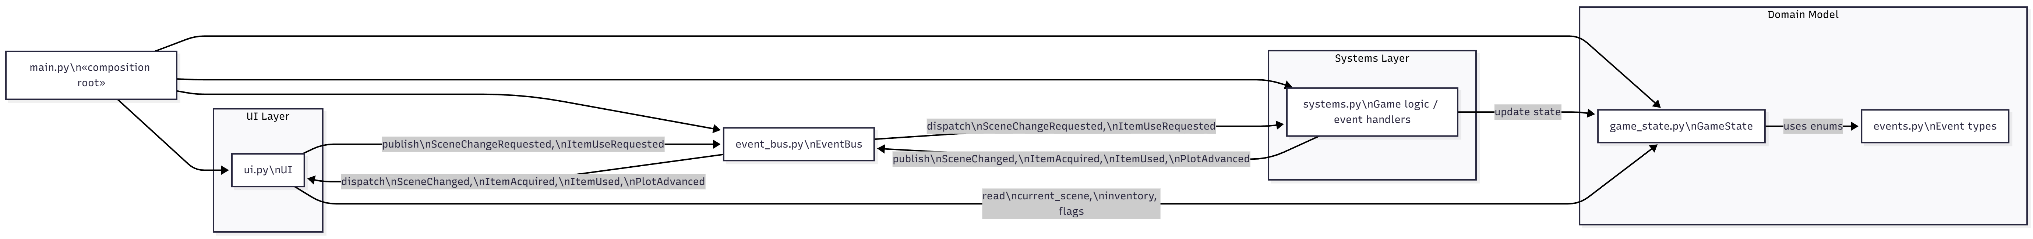
Event‑Driven Architecture
Level‑2 Component Diagram

Slide 5
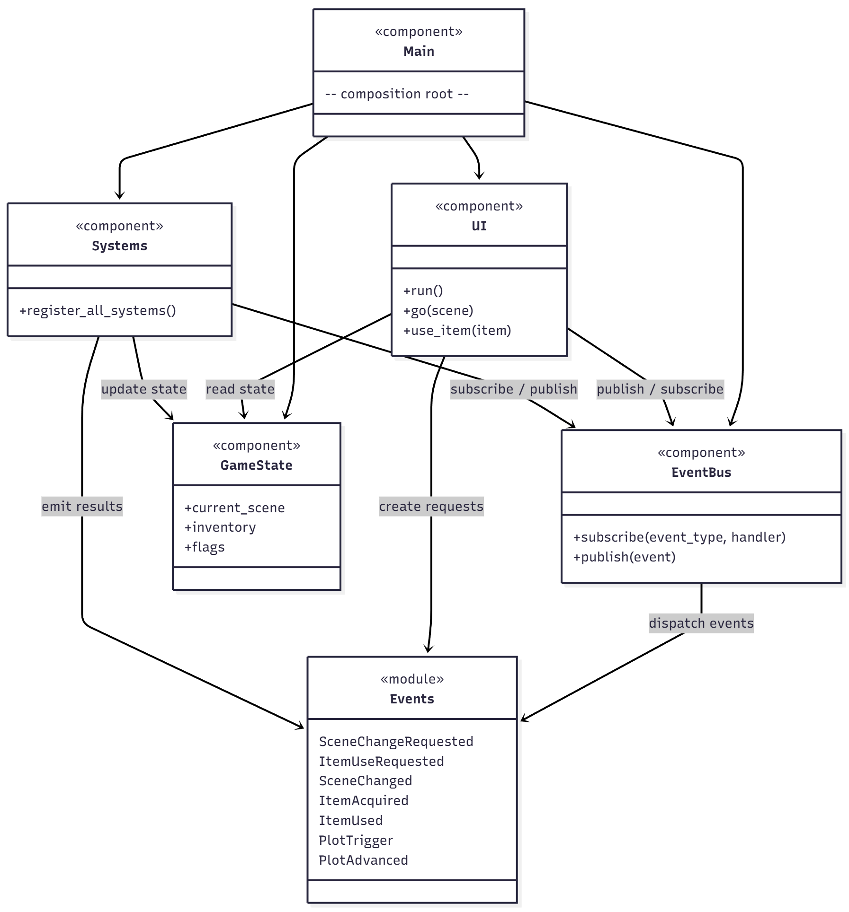
Event‑Driven Architecture
Simplified Class Diagram

Slide 6
Component to Code Mapping
(Event‑Driven Architecture)
UI → ui.py
EventBus → event_bus.py
Systems → systems.py
Game State → game_state.py
Event Types → events.py
Composition Root → main.py

Slide 7
Advantages of Event‑Driven Architecture
Loose coupling between UI, logic, and state.
Easy extension: add new events or systems with minimal changes.
Natural model for scene changes, inventory actions, and story triggers.
GameState acts as the single source of truth.

Slide 8
Disadvantages of Event‑Driven Architecture
Event flows can be difficult to trace across multiple handlers.
EventBus becomes a central dependency.
Event ordering must be carefully designed.
Debugging multi-step chains can be complex.

Slide 9
Rationale – Why It Fits Our Game
Gameplay is inherently event-driven (action → reaction).
UI remains free of logic; systems maintain separation of concerns.
Scene, inventory, and plot logic evolve independently.
Supports adding new scenes, items, and mechanics easily.

Slide 10
Risk Analysis
Risk: event ordering bugs (e.g., incorrect item counts).
Chained events require tracing UI → EventBus → Systems → EventBus → UI.
Many event types can complicate management.
Implementation experience confirmed these risks.

Slide 11
Risk Evidence from Our Implementation
• We encountered a real event-ordering bug during development:
- After using the KEY item, the inventory count did not decrease.
- The ItemUsed event was published before GameState finished updating.
- The UI subscribed to ItemUsed and refreshed immediately, reading stale state.
This demonstrated the architectural risk of incorrect publish.
The issue confirmed that Event-Driven systems require careful event ordering and handler design.

Slide 12
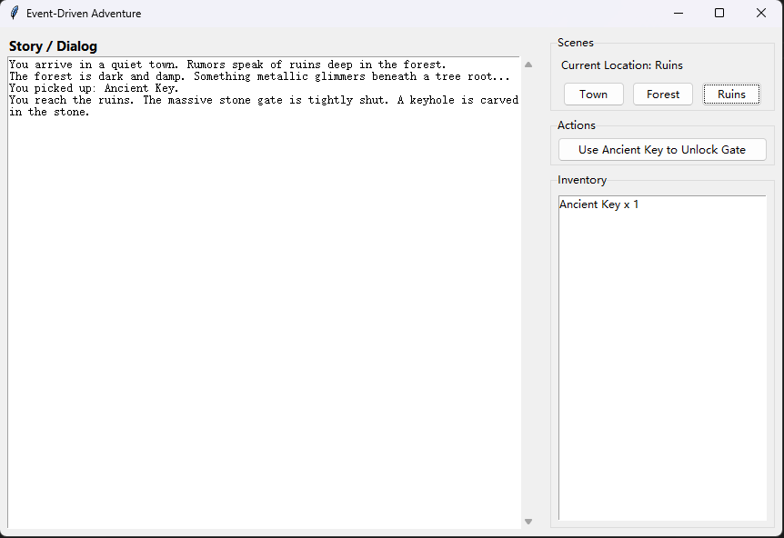
Demo Plan

Slide 13
Layered Architecture Project Overview
A text-based adventure game with scenes:
Caruth Hall, Junkins Building, Library.
Player interacts via UI buttons to move between
scenes, inspect objects, talk to NPCs,
and open the final safe.
Story progression is controlled by scene modules
and a shared PlayerState in a layered structure.
Chosen architecture 2: Layered Architecture.

Slide 14
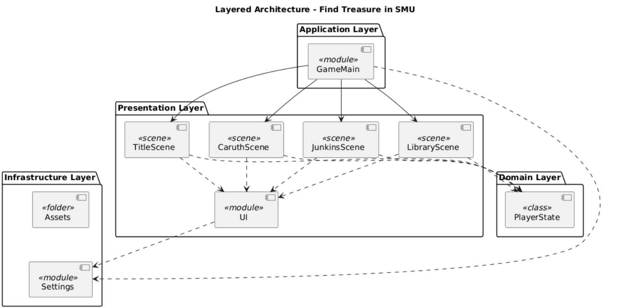
Layered Architecture – Component Diagram

Slide 15
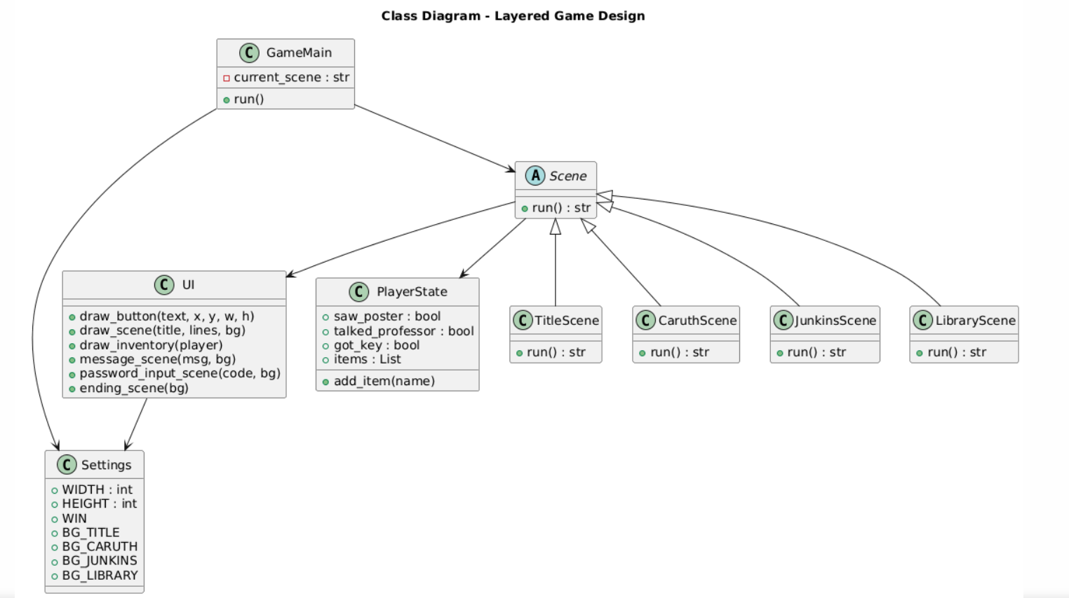
Layered Architecture – Class Diagram

Slide 16
Component to Code Mapping（Layered Architecture）
UI Layer → ui.py
Scene Modules → scenes/
（caruth.py, junkins.py, library.py, title.py）
Application Controller → main.py
Domain Model / Game State → player.py
Infrastructure / Settings → settings.py
Assets (Images / Backgrounds) → assets/

Slide 17
Advantages of Layered Architecture
Clear separation of concerns between UI, scenes, game logic, and assets.
Each layer has a well-defined responsibility, reducing complexity.
Easy to maintain: modifying one layer does not affect others.
High reusability of UI and Scene classes.
Assets and settings are isolated inside the infrastructure layer.
Easier debugging because control flow is explicit, not event-chained.

Slide 18
Disadvantages of Layered Architecture
Stronger coupling between layers than event-driven systems.
UI must directly call scene methods, reducing flexibility.
Less scalable for complex, non-linear game logic.
Adding new mechanics sometimes requires modifying multiple layers.
Interaction logic must be handled manually inside scene classes.
Harder to parallelize logic compared to event-driven handlers.

Slide 19
Rationale – Why Layered Architecture Fits Our Game
Our game is small-scale and scene-based, matching layered structure well.
Scene transitions are straightforward (return next scene name).
Inventory and player state are simple enough to keep in a domain layer.
UI rendering is consistent across scenes and easy to reuse.
Clear code structure makes it easier for students to maintain.
Ideal for beginners learning structured programming before advanced architectures.

Slide 20
Risk Analysis
Risk: Scene logic can become tightly coupled to UI if not controlled.
Risk: Adding too many features in a single layer causes “God Objects.”
Risk: Hard dependencies on ordering (UI → Scene → UI).
Layer boundaries must be carefully respected.

Slide 21
Risk Evidence from Our Implementation
Adding background images required UI and scene modifications simultaneously.
Inventory updates required careful coordination with scene logic.
A scene returned an unexpected string, causing the main loop to break early.
Centralized Scene class inheritance risked over-complexity.
Adding new UI components required modifications in multiple scenes.
These issues confirm the importance of respecting boundaries and keeping layers cleanly separated.

Slide 22
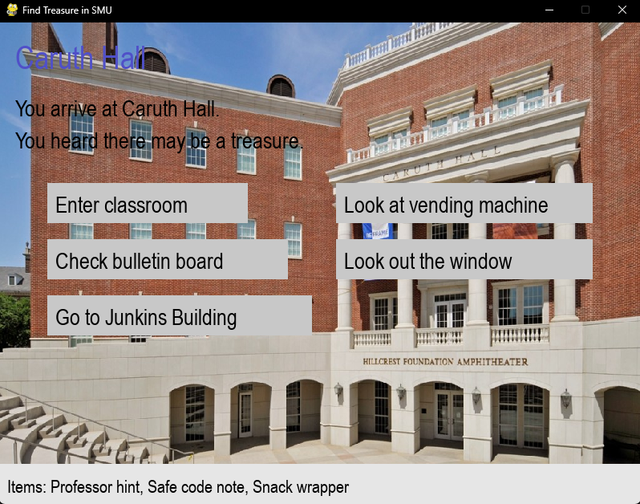
Demo Plan

Slide 23
Architecture Comparison:
Event-Driven vs. Layered
High-level view
Event-Driven Architecture
  Core idea: “action → event → handlers react”
  UI publishes events to an EventBus, and multiple handlers process them.
  Game logic is spread across different systems that subscribe to events.
Layered Architecture
  Core idea: “top-down control”
  Clear layers: Presentation → Application → Domain → Infrastructure.
  A main game loop calls scene functions/classes directly, scenes call UI and domain logic.

Slide 24
Dimension-by-dimension comparison
1) Structure and Organization
Event-Driven
  Decentralized: UI, handlers, and game state are loosely connected via events.
  Good for large or highly interactive systems with many different reactions.
Layered
  Hierarchical: each layer has a clear responsibility.
  Easier to understand at a glance, especially for a small game.

Slide 25
Dimension-by-dimension comparison
2) Control Flow
Event-Driven
  Indirect: user actions become events, events are dispatched, handlers update state, UI reacts.
  Harder to see the full call chain; you must mentally follow the event path.
Layered
  Direct: GameMain decides which scene to run, scenes call UI functions and update PlayerState.
  The execution path for “click → scene → state change → next scene” is explicit and easy to trace.

Slide 26
Dimension-by-dimension comparison
3) Coupling and Dependencies
Event-Driven
  Loose coupling between UI and game logic: UI does not know who will handle an event.
  However, the EventBus becomes a central dependency and must be carefully designed.
Layered
  Stronger coupling: scenes directly depend on UI and PlayerState.
  But these dependencies are simple and predictable, which is acceptable for this project’s scale.

Slide 27
Dimension-by-dimension comparison
4) Extensibility and Scalability
Event-Driven
  Very extensible: adding a new feature is often just “add a new event type + handler”.
  Scales well when many independent systems need to react to the same events.
Layered
  Extensible, but not as flexible: new behaviors may require updates in several layers (scene, UI, maybe domain).
  More suitable for medium-size, not huge, systems.

Slide 28
Dimension-by-dimension comparison
5) Debugging and Testing
Event-Driven
  Harder to debug multi-step chains: event ordering and handler registration can easily cause subtle bugs.
  In our prototype, we even hit a real event-ordering bug (UI reading stale state before GameState was updated).
Layered
  Easier to debug: call stack directly shows which scene and function caused the problem.
  No hidden asynchronous event chains; logic is mostly sequential.

Slide 29
Dimension-by-dimension comparison
6) Fit for “Find Treasure in SMU”
Event-Driven
  Powerful, but overkill for a small, linear, story-driven game.
  The game does not need many independent systems reacting in parallel.
Layered
  Matches the structure of the game naturally:
    A few scenes (Caruth, Junkins, Library)
    A simple PlayerState
    Deterministic puzzle logic and scene transitions
  Easier for classmates and instructors to read and grade.

Slide 30
Why We Ultimately Chose the
Layered Architecture
Although the event-driven architecture is more flexible and theoretically powerful, it introduced practical issues in our small project:
We experienced a real event-ordering bug in the event-driven prototype (UI reacted to an ItemUsed event before the game state had finished updating), which exposed the risk of incorrect event sequencing.
Debugging event chains across multiple handlers and the EventBus was noticeably harder than simply stepping through scene functions in a layered design.
For our game, the flow is essentially:
Title → Caruth Hall → Junkins → Library → Ending,
which is a sequential story, not a highly reactive system.

Slide 31
In contrast, the Layered Architecture provided clear benefits:
1. Simplicity and Clarity
2. Easier Debugging and Maintenance
3. Better Fit for Course Project Scope
4. Lower Architectural Risk
Therefore, after implementing and evaluating both versions, we chose the Layered Architecture as the final architecture for the project, because it offers the best balance between clarity, maintainability, and suitability for a small, scene-based adventure game like “Find Treasure in SMU”.

