Slide 1
House Price Prediction Model Using Machine Learning
Ames Housing Dataset Analysis
CS 7331 • Final Project Presentation
Junliang Lyu • Patricio Martinez • Sean Kane
Project focus
Compare ML models for house-price prediction and identify the housing features that matter most.
Data preparation, model comparison, evaluation, and conclusions.
Built from the original class deck, proposal, and modeling notebook outputs.

Slide 2
Why This Matters
How do you know if a house is overpriced? Can we predict house pricing accurately using data?
Real estate is a major financial decision, so pricing should be based on evidence—not only intuition.
Decision support
Models can give buyers, sellers, and investors a reasonable reference price.
Complex patterns
Area, quality, bathrooms, age, and garage features often interact in nonlinear ways.
Project goal
Use the Ames data to compare a linear baseline with stronger ML models.
A data-driven estimate can improve transparency in property valuation.
Machine learning is useful because house prices depend on many related features.
This project asks whether advanced models give a meaningful improvement over a linear approach.
CS 7331 • House Price Prediction • Ames Housing Dataset

Slide 3
Objective and Hypothesis
Project objectives
Analyze factors affecting housing prices. Build predictive models. Compare model performance. Interpret whether advanced models outperform a linear baseline.
Key factors
Sqft / house size, area or quality, bed & bath, and garage capacity.
Prior work
Studies on the Ames dataset reported that linear regression can still achieve about R² ≈ 0.82. That gives us a useful baseline from the literature and a reason to test whether ensemble models can do better.
Model expectation
Advanced models should outperform the linear baseline in prediction accuracy.
Why this is reasonable
House-price relationships are rarely purely linear, so tree models may capture them better.
CS 7331 • House Price Prediction • Ames Housing Dataset

Slide 4
Ames Housing Dataset Overview
Dataset facts
1460 listed houses 81 variables Located in Ames, Iowa Target variable: SalePrice Key features: OverallQual, GrLivArea, GarageCars, TotalBsmtSF
Why we chose it
Ames Housing is a widely used benchmark and includes structural, quality, and neighborhood information.
2,930
homes in the prepared file
137
encoded features before filtering
80/20
train / test split
Examples of important predictors highlighted in the proposal and notebook:
Overall Qual, Living Area, Garage Capacity, Basement Area, and Age-related variables.
CS 7331 • House Price Prediction • Ames Housing Dataset

Slide 5
Data Preparation
Cleaning
Handled missing values and used the prepared encoded dataset.
Encoding
Categorical variables were already encoded for modeling.
Feature engineering
Used House_Age, Remod_Age, Total_SF, and Total_Bathrooms.
Target transform
Applied log1p to SalePrice before training.
Feature filtering
Reduced 137 → 122 → 107 features.
Split
Used an 80/20 train-test split.
Summary
The main purpose of preprocessing was to make the model inputs cleaner, more stable, and less redundant before training.
CS 7331 • House Price Prediction • Ames Housing Dataset

Slide 6
Models Used and Evaluation Metrics
Lasso (linear baseline)
Regularized linear regression used as the baseline model.
Random Forest
Ensemble of decision trees that captures nonlinear patterns and interactions.
XGBoost
Boosted tree model that often performs strongly on structured tabular data.
Tuning
GridSearchCV with 5-fold CV was used to search key hyperparameters.
Evaluation metrics
RMSE: prediction error size R²: how well the model explains price variation
Note
The slide was updated to match the actual notebook outputs, so the final comparison uses Lasso, Random Forest, and XGBoost.
CS 7331 • House Price Prediction • Ames Housing Dataset

Slide 7
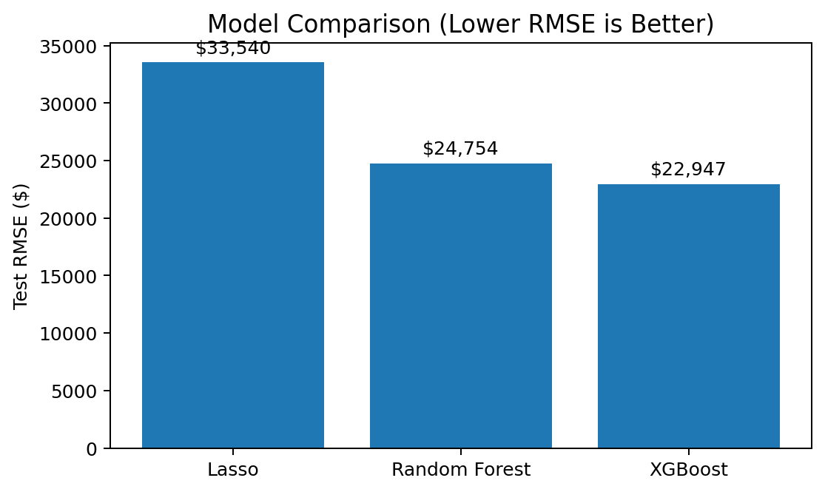
Results
Model
RMSE ($)
R²
Lasso
33,540
0.8597
Random Forest
24,754
0.9236
XGBoost
22,947
0.9343
Main takeaway
XGBoost had the lowest RMSE and the highest R² on the held-out test set.
CS 7331 • House Price Prediction • Ames Housing Dataset

Slide 8
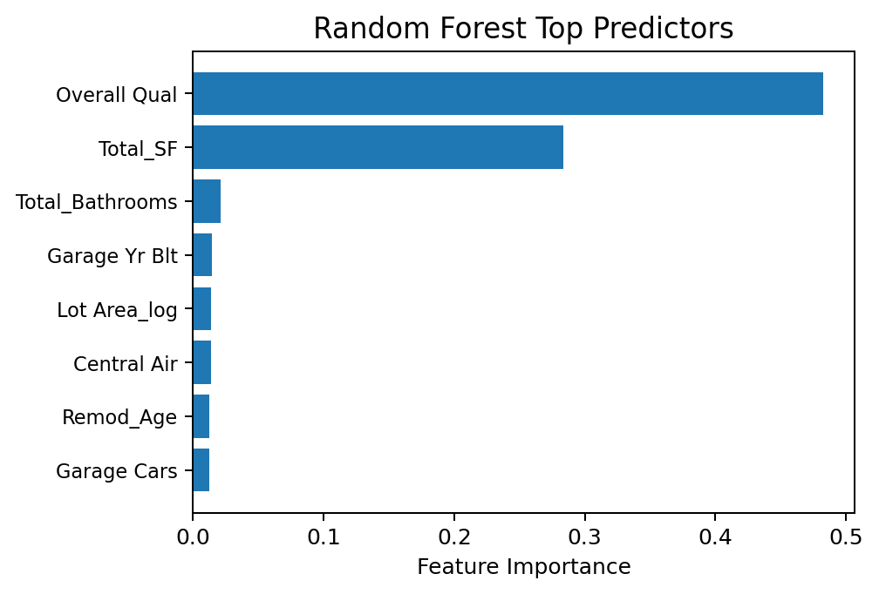
Key Insights
The results support our hypothesis: advanced models outperformed the linear baseline.
XGBoost performed best, with Random Forest second and Lasso last.
This suggests that house prices contain nonlinear relationships that tree-based models capture more effectively.
Our results are also consistent with the proposal literature: stronger ensemble methods improve prediction accuracy on this task.
Top predictors highlighted by the notebook:
Overall Qual, Total_SF, Total_Bathrooms, Garage Yr Blt, Lot Area_log, Central Air, Remod_Age, and Garage Cars.
CS 7331 • House Price Prediction • Ames Housing Dataset

Slide 9
Limitations
Single-market dataset
The model is based on Ames, Iowa housing data, so it may not transfer directly to other locations.
Limited external context
Mortgage rates, economic shifts, and local market shocks were not modeled explicitly.
Interpretability trade-off
The best-performing model is harder to explain than a simple linear baseline.
Preprocessing choices matter
Encoding, filtering, and tuning can change results, so the pipeline should be validated carefully.
CS 7331 • House Price Prediction • Ames Housing Dataset

Slide 10
Conclusion
Three takeaways from the project
1
Machine learning can predict Ames house prices effectively when rich property features are available.
Future work
• Test on other housing markets • Add external economic features • Improve interpretability with SHAP or similar tools
2
Among the models tested, XGBoost performed best with test RMSE ≈ $22.9K and R² ≈ 0.934.
3
Housing quality and total size were the strongest predictors, while ensemble models captured pricing patterns better than the linear baseline.
Thank you
Questions?
Revised deck: original structure kept, content shortened for presentation

