Slide 1
Data-Driven Code Search Engine Based on GraphCodeBERT
Summer Bootcamp Research – SMU, July 2025
Junliang Lyu
Advisor: Prof. Xihao Xie

Slide 2
Project Overview
Reuse of code is important but hard to automate
Keyword-based search ≠ semantic understanding
Goal: Neural-based code search system
Based on GraphCodeBERT + FAISS + reranking

Slide 3
Research Plan
Week 1: Paper review (CodeSearchNet, GraphCodeBERT)
Tools: Hugging Face, GitHub API, FAISS
Week 2: Experiment setup & system design
Week 3: Evaluation & presentation

Slide 4
Model Selection
Compared: CodeBERT vs GraphCodeBERT
Chose GraphCodeBERT: supports structural semantics
Used mean pooling for simplicity
Example code: def greet(): print(hello world)

Slide 5
Dataset
Tried GitHub raw data → messy (mostly URLs)
Switched to Hugging Face CodeSearchNet (Python)
.jsonl format: query + code
Split into train / val / test

Slide 6
Vectorization & Indexing
Used GraphCodeBERT → mean pooling
Saved vectors as .npy + float32 for FAISS
Built two indices:
- L2 (IndexFlatL2)
- Cosine (IndexFlatIP with normalized vectors)

Slide 7
Evaluation
Automatic: MRR（Mean Reciprocal Rank） = 0.396, Recall@5（Recall at top 5） = 0.453
Manual: benchmark queries via UI search
Frontend shows L2 / cosine results
Reranking with cross-encoder boosts performance

Slide 8
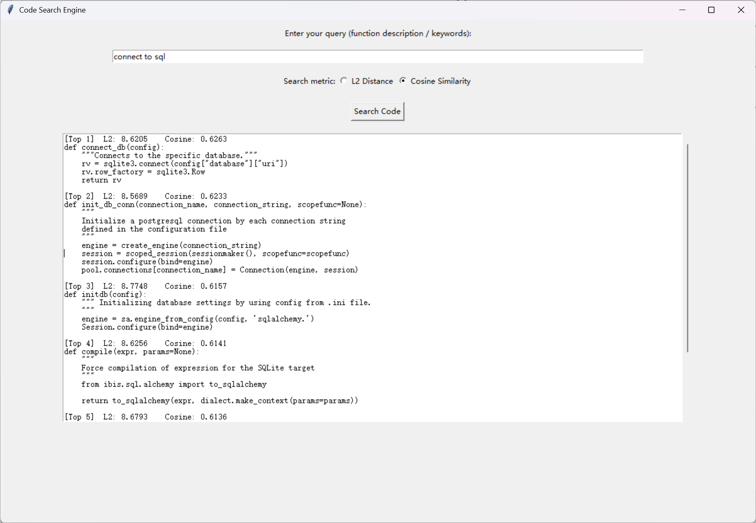

Slide 9
Challenges & Fixes
Structural semantics hard to understand at first
Dataset format issue → switched source
L2 vs Cosine confusion → tested both
UI function errors → fixed & improved

Slide 10
Conclusion & Future Work
Dual-stage search system completed
Future directions:
- Use test set for generalization
- Extend to other languages
- Integrate LLMs for richer query understanding

Slide 11
Thanks

