Slide 1
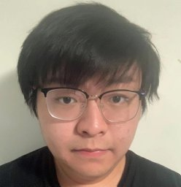

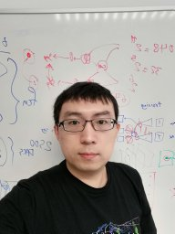



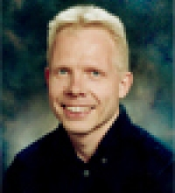



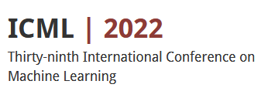

You Only Cut Once: Boosting Data Augmentation with a Single Cut
Junlin Han Pengfei Fang Weihao Li Jie Hong Ali Armin Ian Reid Lars Petersson Hongdong Li
Notes:
Hi I’m Junlin Han. I’m going to talk about our work entitled You Only Cut Once : Boosting data augmentation with a single cut. This work is done by Junlin, Pengfei, Weihao, Jie, Ali, Ian, Lars, and Hongdong.

Slide 2
Highlights
A simple method for performing data augmentations
... benefits a variety of vision tasks, including classification, contrastive learning, and low-level vision, for free
... scales well to almost all augmentation operations
… applies to multiple neural network architectures
Notes:
In this work, we show that the way of performing data augmentations matters in training neural networks. Our simple method benefits a variety of vision tasks, from high-level vision to low-level vision, supervised learning to unsupervised learning. Moreover, our method scales well to almost all augmentation operations and can be applied to multiple network architectures for consistent performance gain.

Slide 3
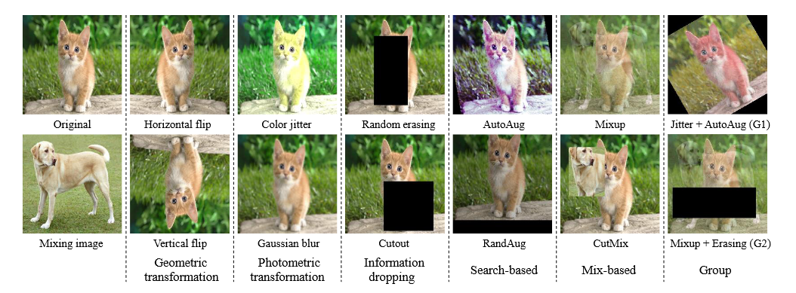
Data augmentation
Notes:
In the past years, data augmentation has been used as a key strategy for training robust neural networks. Different kinds of augmentations are studied, here we briefly summarize some of them. Augmentations are performed at the image-level by default. That is, all pixels inside an image can be potentially affected by augmentation operation.

Slide 4
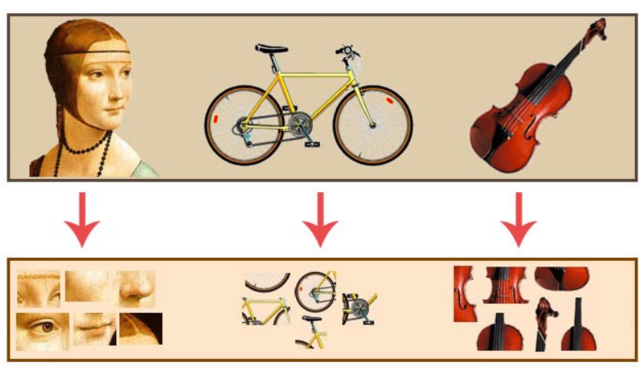
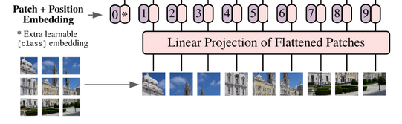
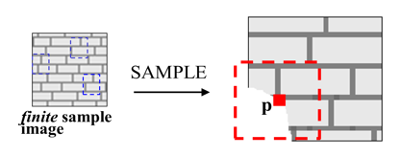

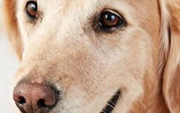
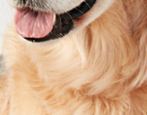
Motivation and Intuition
Bag of features
ViT
Texture synthesis
Human cognition
Notes:
Our motivation and intuition come from the power of internal patches. In fact, patches have been well studied in both high-level vision and low-level vision, as well as in both conventional approaches and learning-based approaches. For example, bag of features extracts patch-level image representation. Recent ViT models split images into patches as the input. Patches are also employed in low-level vision tasks such as texture synthesis. Lastly, human beings can recognize objects from partial patterns. For instance, we can easily figure out these patches come from a dog.

Slide 5
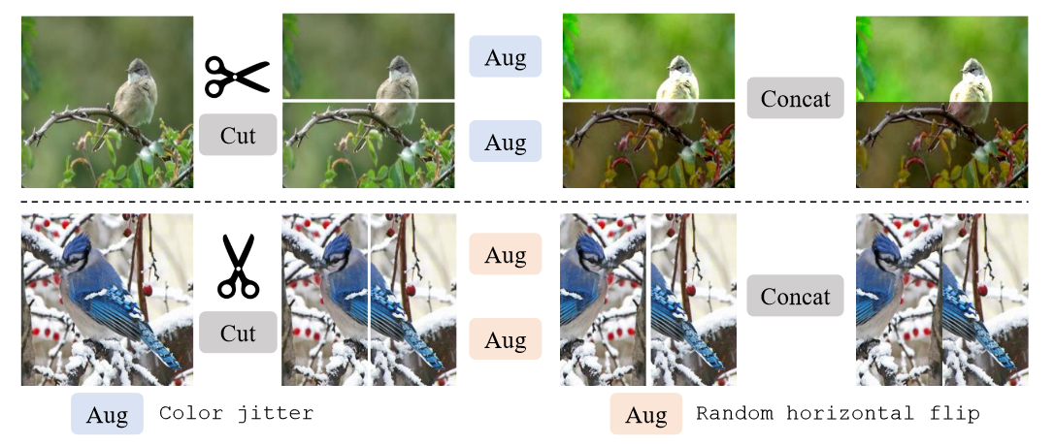
Our method: You Only Cut Once (YOCO)
Notes:
We propose You Only Cut Once, or YOCO. YOCO cuts one image into two pieces, from either horizontal dimension or vertical dimension, then perform the same augmentation operation individually within each piece. As augmentations are determined by randomness, the effects of the same augmentation are usually different for each piece. Thus, concatenating the augmented pieces back yields a more diversified augmented image.

Slide 6
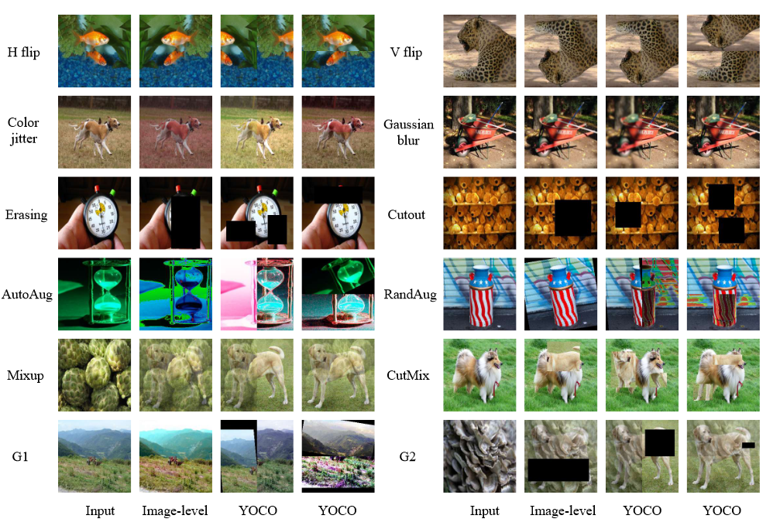
Augmented
images
Notes:
Here are some visual examples of augmented images. Compared to image-level augmentation, images augmented in a YOCO manner are sometimes not globally semantic consistent. Learning with such data hence encourages neural networks to recognize partial patterns.

Slide 7
Experiments
Image Classification
CIFAR-10, CIFAR-100, and ImageNet
Contrastive Learning
Transfer to classification, segmentation, and detection
Low-level vision
Image deraining and image super-resolution.
Notes:
Our main experiments includes image classification, contrastive learning, and low-level vision. For image classification task, we evaluate the performance of YOCO applied to 12 augmentations. YOCO also benefits contrastive learning, where better representation can be learned and transferred to multiple downstream tasks. Lastly, we verify the generality of YOCO by evaluating two low-level vision tasks.

Slide 8
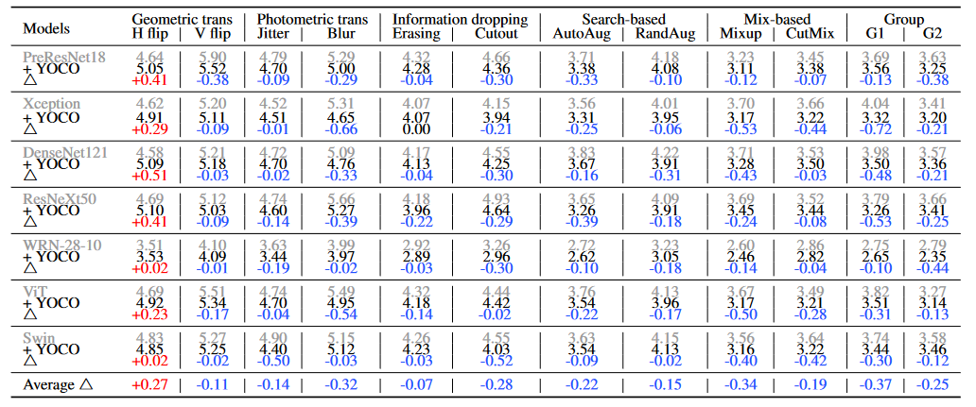
Results: CIFAR-10 Classification
Metric: Top-1 error rate
76/84 results are improved
Notes:
In CIFAR-10 classification task, we report the performance of YOCO on 12 augmentations and 7 neural network architectures, including 5 CNN models and 2 ViT variants. Among 84 results in total, YOCO boosts 76 of them.

Slide 9
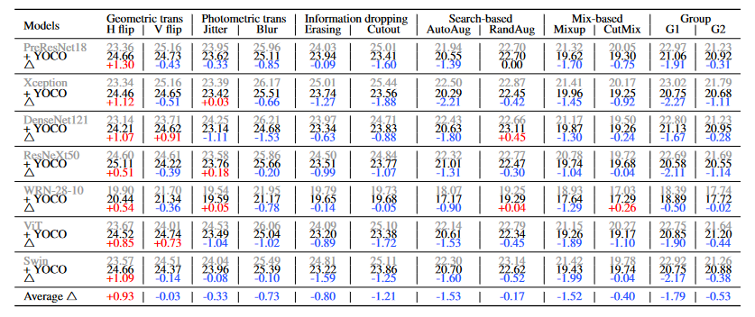
Results: CIFAR-100 Classification
Metric: Top-1 error rate
68/84 results are improved
Notes:
Results on CIFAR-100 are similar to CIFAR-10, where 68 results benefit from activating YOCO.

Slide 10
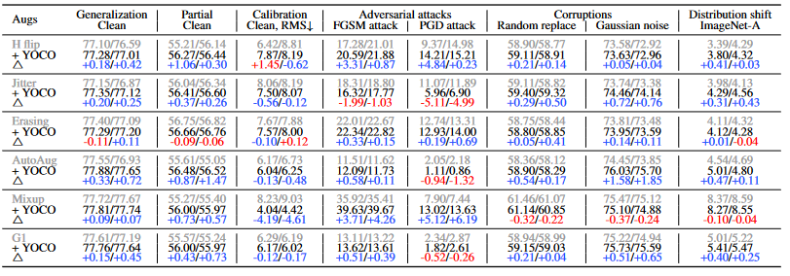
Results: ImageNet Classification
Metric: Top-1 accuracy
best/last results
YOCO outperforms image-level augmentation
Notes:
For ImageNet, we evaluate the test set accuracy, partial image recognition ability, calibration error, robustness against adversarial attacks, corruption robustness, and distribution shift, using a standard ResNet-50 model. Overall, YOCO surpasses image-level augmentation

Slide 11
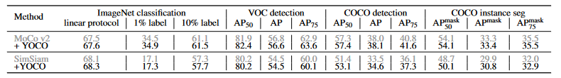
Results: Contrastive Learning
YOCO results in more powerful representation
Notes:
In contrastive learning, we apply YOCO to horizontal flip only. YOCO helps contrastive learning methods to achieve more powerful representations, which can be better transferred to classification, detection, and instance segmentation tasks.

Slide 12

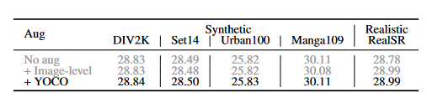
Results: Low-level Vision
Deraining
Super-resolution
Metric: PSNR
YOCO generalizes well to low-level vision tasks
Notes:
Furthermore, we study two representative low-level vision tasks. YOCO consistently outperforms image-level augmentation, showing the generality of YOCO.

Slide 13
Conclusion
YOCO boosts multiple augmentations for free
How to perform data augmentations can be further explored
Code available: https://github.com/JunlinHan/YOCO
Notes:
In conclusion, YOCO can be employed as a default strategy of performing data augmentations. Moreover, how to perform data augmentations are worth further studying. The code of this work is available online. Thank you for your attention.

