Slide 1

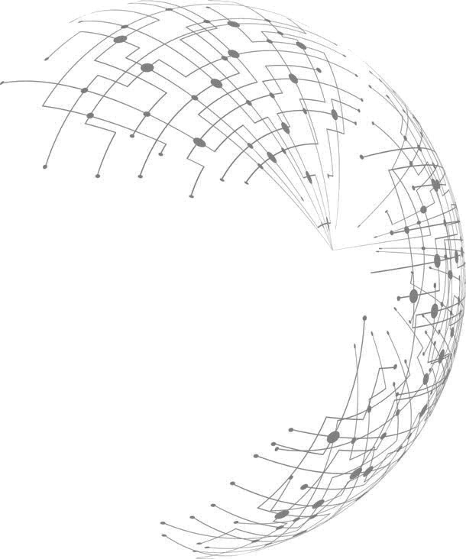
A code construction from finite projective planes
Junming Ke
Institute of Mathematics and Statistics
Page 1 of 16

Slide 2

Background
A
B
Input data
Output data
Clients
A, B
A, B, A, A, …
Data center
Storage
A: | 10
B: | 01
Two main drawbacks:
Nodes that store data A have a high load;
If A is broken, a data center cannot reconstruct A.
Page 2 of 16

Slide 3
Background
Data center
A
B
A+B
Input data
Output data
Clients
A, B
{A}, {B, A+B}
A: | 10
B: | 01
A+B: | 11
A
A
Coded Storage
Nodes that store data A have a high load.
Page 3 of 16

Slide 4

Repair
Data center
A
B
A+B
Input data
Output data
Clients
A, B
A: | 10
B: | 01
A+B: | 11
Coded Storage
A + A + B = B
If A is broken, a data center cannot reconstruct A.
Page 4 of 16

Slide 5

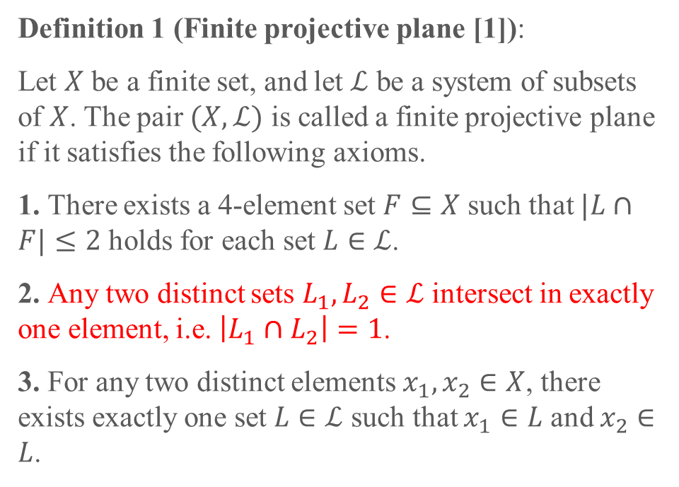
Projective Planes
Definition 1 (Finite projective plane [1]):
Let $X$ be a finite set, and let $ℒ$ be a system of subsets of $X$. The pair $(X, ℒ)$ is called a finite projective plane if it satisfies the following axioms.
1. There exists a 4-element set $F⊆X$ such that $|L∩F|≤2$ holds for each set $L∈ℒ$.
2. Any two distinct sets $L_{1},L_{2}∈ℒ$ intersect in exactly one element, i.e. $\left|L_{1}∩L_{2}\right|=1$.
3. For any two distinct elements $x_{1},x_{2}∈X$, there exists exactly one set $L∈ℒ$ such that $x_{1}∈L$ and $x_{2}∈L$.
Two parallel lines will be intersected.
[1] Nešetřil, Jaroslav, and Jiří Matoušek. Invitation to discrete mathematics. Vol. 21. Oxford University Press, 2009.
Page 5 of 16

Slide 6
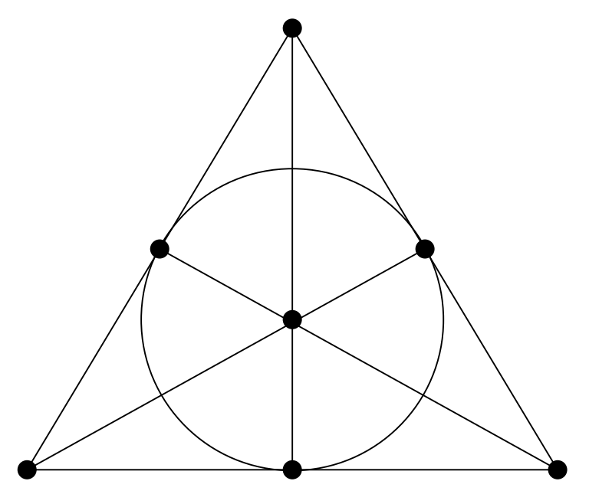
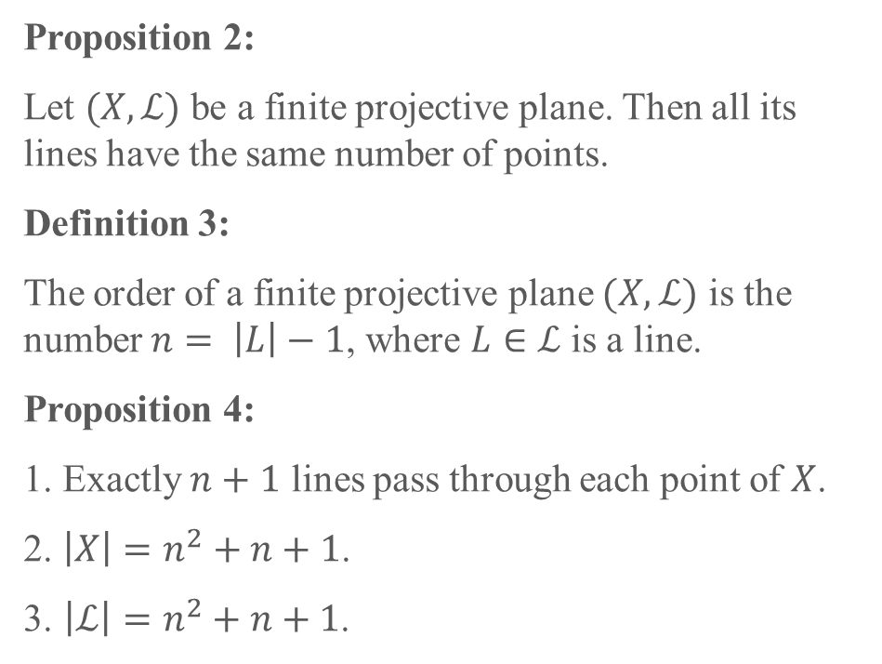

Projective Planes
Proposition 2:
Let $(X, ℒ)$ be a finite projective plane. Then all its lines have the same number of points.
Definition 3:
The order of a finite projective plane $(X, ℒ)$ is the number $n= \left|L\right|−1$, where $L∈ℒ$ is a line.
Proposition 4:
1. Exactly $n+1$ lines pass through each point of $X$.
2. $\left|X\right|=n^{2}+n+1$.
3. $\left|ℒ\right|=n^{2}+n+1$.
The Fano plane, PG$(2,2)$
[1] Nešetřil, Jaroslav, and Jiří Matoušek. Invitation to discrete mathematics. Vol. 21. Oxford University Press, 2009.
Page 6 of 16

Slide 7
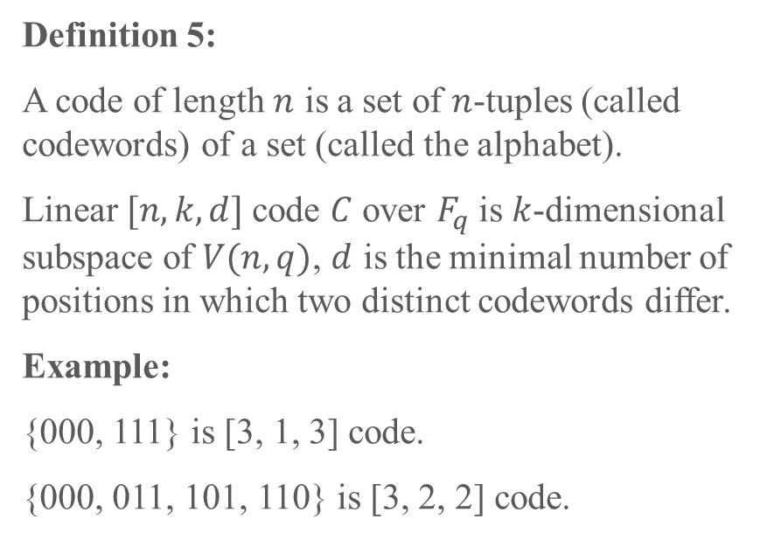
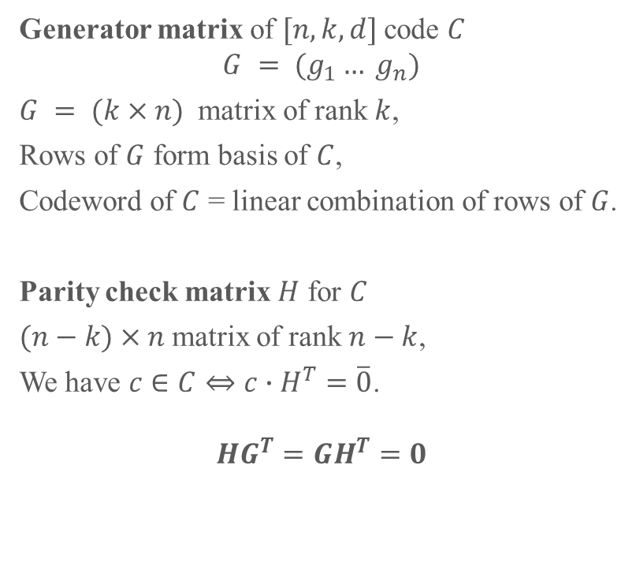
Linear Codes
Generator matrix of $[n, k, d]$code $C$
$$G = (g_{1}… g_{n})$$
$G = (k×n)$ matrix of rank $k$,
Rows of $G$ form basis of $C$,
Codeword of $C$ = linear combination of rows of $G$.
Parity check matrix $H$ for $C$
$(n−k)×n$matrix of rank $n−k$,
We have $c∈C⇔c∙H^{T}=\overline{0}$.
$$HG^{T}=GH^{T}=0$$
Definition 5:
A code of length $n$ is a set of $n$-tuples (called codewords) of a set (called the alphabet).
Linear $[n,k,d]$code $C$ over $F_{q}$ is $k$-dimensional subspace of $V(n,q)$, $d$ is the minimal number of positions in which two distinct codewords differ.
Example:
{000, 111} is [3, 1, 3] code.
{000, 011, 101, 110} is [3, 2, 2] code.
[1] Roth, Ron M. "Introduction to coding theory." IET Communications 47 (2006).
[2] Etzion, Tuvi, and Leo Storme. "Galois geometries and coding theory." Designs, Codes and Cryptography 78.1 (2016): 311-350.
Page 7 of 16

Slide 8



Generator Matrix
Data center
A
B
A+B
Input data
Output data
Clients
A, B
{A}, {B, A+B}
$$\left[A B\right]\left[\begin{matrix}1 & 0 & 1 \\ 0 & 1 & 1\end{matrix}\right]=[A B A+B]$$
Coded Storage
$$G= \left[\begin{matrix}1 & 0 & 1 \\ 0 & 1 & 1\end{matrix}\right], H=[1 1 1]$$
$$HG^{T}=GH^{T}=0$$
Page 8 of 16

Slide 9









Hamming codes
100
$$H= \left[\begin{matrix}\begin{matrix}1 & 0 & 0\end{matrix} & \begin{matrix}1 & 1 & 0\end{matrix} & 1 \\ \begin{matrix}0 & 1 & 0\end{matrix} & \begin{matrix}1 & 0 & 1\end{matrix} & 1 \\ \begin{matrix}0 & 0 & 1\end{matrix} & \begin{matrix}0 & 1 & 1\end{matrix} & 1\end{matrix}\right]$$
The parity check matrix of $[7, 4, 3]$Hamming codes
110
101
111
$$a+b+c$$
$$b$$
$$a+b+d$$
$$a$$
$$c$$
$$d$$
$$a+c+d$$
010
011
001
Venn diagram of $[7, 4, 3]$Hamming codes
Labeling the Fano plane
[1] Nešetřil, Jaroslav, and Jiří Matoušek. Invitation to discrete mathematics. Vol. 21. Oxford University Press, 2009.
[2] Lavrauw, Michel, Leo Storme, and Geertrui Van de Voorde. "Linear codes from projective spaces." Error-Correcting Codes,
Finite Geometries, and Cryptography, AMS Contemporary Mathematics (CONM) book series 523 (2010): 185-202.
Page 9 of 16
Notes:
The points of the projective plane make up the columns of the Hamming Matrix H

Slide 10
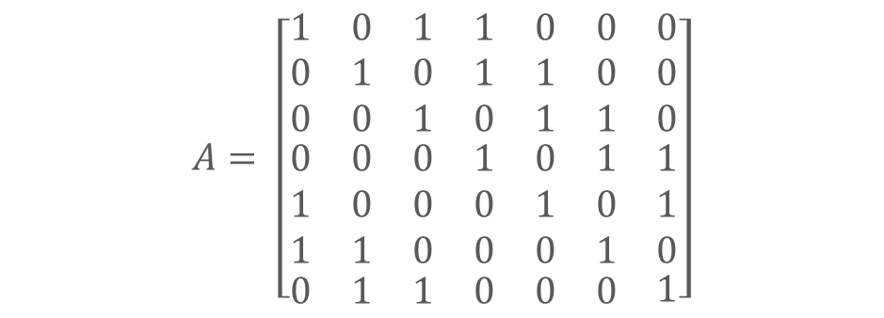





Hamming codes
100
2
$$\begin{matrix}\begin{matrix}1 & 2 & 3\end{matrix} & \begin{matrix}4 & 5 & 6\end{matrix} & 7\end{matrix}$$
$$A= \left[\begin{matrix}\begin{matrix}1 & 0 & 1 \\ 0 & 1 & 0 \\ 0 & 0 & 1\end{matrix} & \begin{matrix}1 & 0 & 0 \\ 1 & 1 & 0 \\ 0 & 1 & 1\end{matrix} & \begin{matrix}0 \\ 0 \\ 0\end{matrix} \\ \begin{matrix}0 & 0 & 0 \\ 1 & 0 & 0 \\ 1 & 1 & 0\end{matrix} & \begin{matrix}1 & 0 & 1 \\ 0 & 1 & 0 \\ 0 & 0 & 1\end{matrix} & \begin{matrix}1 \\ 1 \\ 0\end{matrix} \\ \begin{matrix}0 & 1 & 1\end{matrix} & \begin{matrix}0 & 0 & 0\end{matrix} & 1\end{matrix}\right]$$
$$\begin{matrix}\begin{matrix}\begin{matrix}1, 3, 4 \\ 2, 4, 5\end{matrix} \\ \begin{matrix}3, 5, 6 \\ 4, 6, 7\end{matrix}\end{matrix} \\ \begin{matrix}\begin{matrix}1, 5, 7 \\ 1, 2, 6\end{matrix} \\ 2, 3, 7\end{matrix}\end{matrix}$$
110
101
4
1
7
111
Incidence matrix of $[7, 4, 3]$Hamming codes
010
6
Reorder the columns of $H$ in order to get the cyclic form of $A$.
5
011
3
001
$$H= \left[\begin{matrix}\begin{matrix}1 & 1 & 0\end{matrix} & \begin{matrix}1 & 0 & 0\end{matrix} & 1 \\ \begin{matrix}0 & 0 & 1\end{matrix} & \begin{matrix}1 & 1 & 0\end{matrix} & 1 \\ \begin{matrix}1 & 0 & 1\end{matrix} & \begin{matrix}0 & 0 & 1\end{matrix} & 1\end{matrix}\right]$$
Labeling the Fano plane
$$HA^{T}=AH^{T}=0$$
Page 10 of 16
Notes:
The points of the projective plane make up the columns of the Hamming Matrix H

Slide 11



Hamming codes
100
2
$$A= \left[\begin{matrix}\begin{matrix}1 & 0 & 1 \\ 0 & 1 & 0 \\ 0 & 0 & 1\end{matrix} & \begin{matrix}1 & 0 & 0 \\ 1 & 1 & 0 \\ 0 & 1 & 1\end{matrix} & \begin{matrix}0 \\ 0 \\ 0\end{matrix} \\ \begin{matrix}0 & 0 & 0 \\ 1 & 0 & 0 \\ 1 & 1 & 0\end{matrix} & \begin{matrix}1 & 0 & 1 \\ 0 & 1 & 0 \\ 0 & 0 & 1\end{matrix} & \begin{matrix}1 \\ 1 \\ 0\end{matrix} \\ \begin{matrix}0 & 1 & 1\end{matrix} & \begin{matrix}0 & 0 & 0\end{matrix} & 1\end{matrix}\right]$$
110
101
4
1
7
111
$$G= \left[\begin{matrix}\begin{matrix}\begin{matrix}1 \\ 0\end{matrix} & \begin{matrix}0 \\ 1\end{matrix} & \begin{matrix}1 \\ 0\end{matrix} \\ \begin{matrix}0 \\ 0\end{matrix} & \begin{matrix}0 \\ 0\end{matrix} & \begin{matrix}1 \\ 0\end{matrix}\end{matrix} & \begin{matrix}\begin{matrix}1 \\ 1\end{matrix} & \begin{matrix}0 \\ 1\end{matrix} & \begin{matrix}0 \\ 0\end{matrix} \\ \begin{matrix}0 \\ 1\end{matrix} & \begin{matrix}1 \\ 0\end{matrix} & \begin{matrix}1 \\ 1\end{matrix}\end{matrix} & \begin{matrix}\begin{matrix}0 \\ 0\end{matrix} \\ \begin{matrix}0 \\ 1\end{matrix}\end{matrix}\end{matrix}\right]$$
010
6
5
011
3
001
Labeling the Fano plane
Generator matrix of $[7, 4, 3]$Hamming codes
Moorhouse basis
[1] Moorhouse, G. Eric. "Bruck nets, codes, and characters of loops." Designs, Codes and Cryptography 1.1 (1991): 7-29.
Page 11 of 16
Notes:
The points of the projective plane make up the columns of the Hamming Matrix H

Slide 12




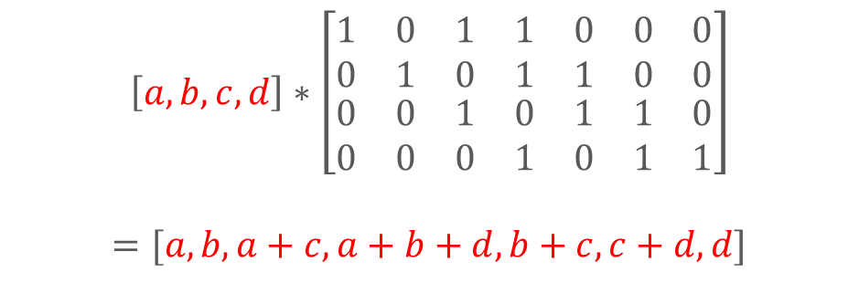

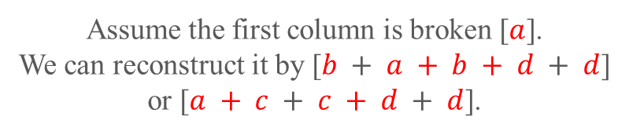
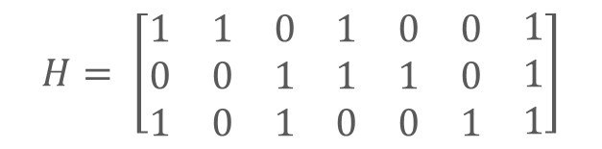



Encoding
$$a$$
$$b$$
$$a+c$$
$$G= \left[\begin{matrix}\begin{matrix}\begin{matrix}1 \\ 0\end{matrix} & \begin{matrix}0 \\ 1\end{matrix} & \begin{matrix}1 \\ 0\end{matrix} \\ \begin{matrix}0 \\ 0\end{matrix} & \begin{matrix}0 \\ 0\end{matrix} & \begin{matrix}1 \\ 0\end{matrix}\end{matrix} & \begin{matrix}\begin{matrix}1 \\ 1\end{matrix} & \begin{matrix}0 \\ 1\end{matrix} & \begin{matrix}0 \\ 0\end{matrix} \\ \begin{matrix}0 \\ 1\end{matrix} & \begin{matrix}1 \\ 0\end{matrix} & \begin{matrix}1 \\ 1\end{matrix}\end{matrix} & \begin{matrix}\begin{matrix}0 \\ 0\end{matrix} \\ \begin{matrix}0 \\ 1\end{matrix}\end{matrix}\end{matrix}\right]$$
$$a+b+d$$
$$b+c$$
$$c+d$$
$$d$$
Data center
Input data
$$\left[a,b,c,d\right]∗\left[\begin{matrix}\begin{matrix}\begin{matrix}1 \\ 0\end{matrix} & \begin{matrix}0 \\ 1\end{matrix} & \begin{matrix}1 \\ 0\end{matrix} \\ \begin{matrix}0 \\ 0\end{matrix} & \begin{matrix}0 \\ 0\end{matrix} & \begin{matrix}1 \\ 0\end{matrix}\end{matrix} & \begin{matrix}\begin{matrix}1 \\ 1\end{matrix} & \begin{matrix}0 \\ 1\end{matrix} & \begin{matrix}0 \\ 0\end{matrix} \\ \begin{matrix}0 \\ 1\end{matrix} & \begin{matrix}1 \\ 0\end{matrix} & \begin{matrix}1 \\ 1\end{matrix}\end{matrix} & \begin{matrix}\begin{matrix}0 \\ 0\end{matrix} \\ \begin{matrix}0 \\ 1\end{matrix}\end{matrix}\end{matrix}\right]$$
$$=[a,b,a+c,a+b+d,b+c,c+d, d]$$
$$H= \left[\begin{matrix}\begin{matrix}1 & 1 & 0\end{matrix} & \begin{matrix}1 & 0 & 0\end{matrix} & 1 \\ \begin{matrix}0 & 0 & 1\end{matrix} & \begin{matrix}1 & 1 & 0\end{matrix} & 1 \\ \begin{matrix}1 & 0 & 1\end{matrix} & \begin{matrix}0 & 0 & 1\end{matrix} & 1\end{matrix}\right]$$
Assume the first column is broken [$a$].
We can reconstruct it by [$b + a + b + d + d$]
or [$a + c + c + d + d$].
[1] Moorhouse, G. Eric. "Bruck nets, codes, and characters of loops." Designs, Codes and Cryptography 1.1 (1991): 7-29.
Page 12 of 16
Notes:
The points of the projective plane make up the columns of the Hamming Matrix H

Slide 13
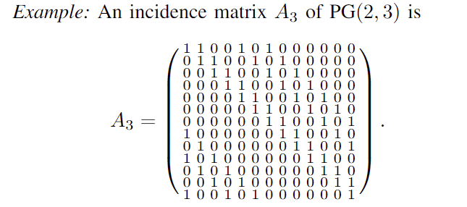
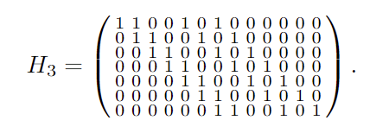
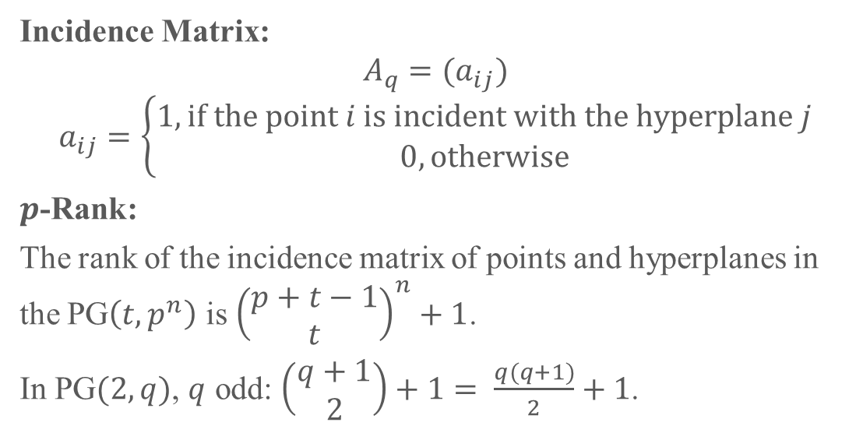

Incidence Matrix
Incidence Matrix:
$$A_{q}=(a_{ij})$$
$$a_{ij}=\left\{\begin{matrix}1, if the point i is incident with the hyperplane j \\ 0, otherwise\end{matrix}\right.$$
$p$-Rank:
The rank of the incidence matrix of points and hyperplanes in the PG$\left(t,p^{n}\right)$ is ${\left(\begin{matrix}p+t−1 \\ t\end{matrix}\right)}^{n}+1$.
In PG$(2,q)$, $q$ odd: $\left(\begin{matrix}q+1 \\ 2\end{matrix}\right)+1= \frac{q(q+1)}{2}+1$.
The rank of $A_{3}$ is $\frac{3(3+1)}{2}+1=7$.
[1] Smith, Kempton JC. "On the p-rank of the incidence matrix of points and hyperplanes in a finite projective geometry."
Journal of Combinatorial Theory 7.2 (1969): 122-129.
[2] Moorhouse, G. Eric. "Bruck nets, codes, and characters of loops." Designs, Codes and Cryptography 1.1 (1991): 7-29.
Page 13 of 16

Slide 14
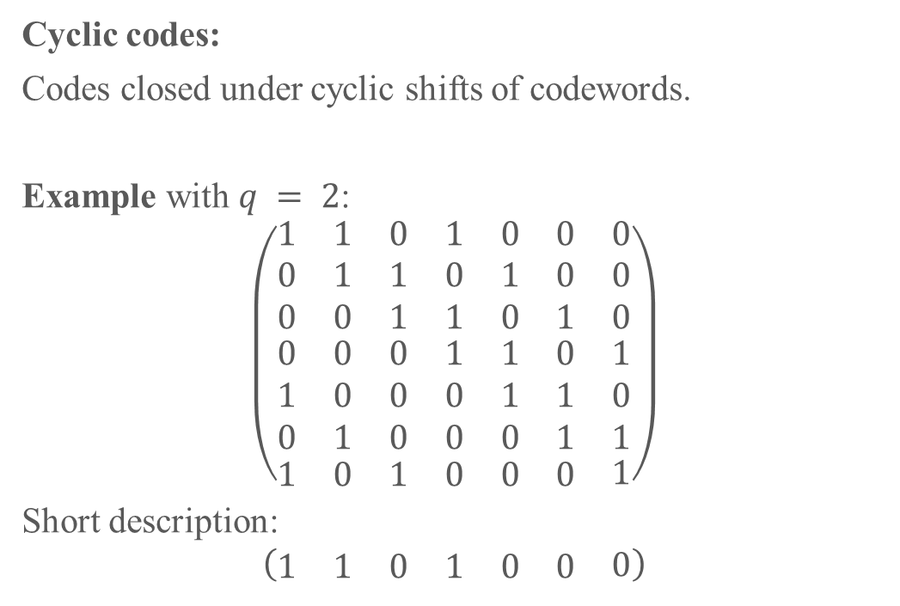
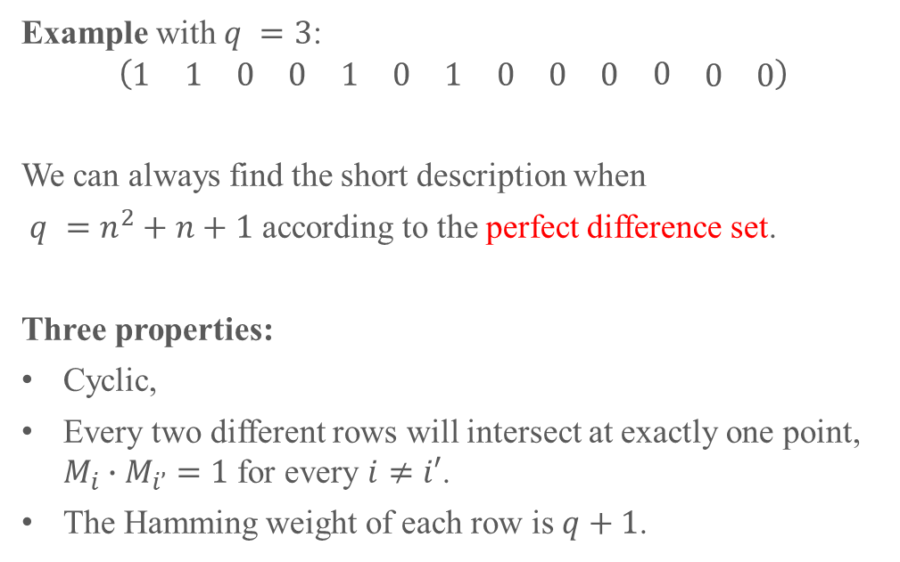
Cyclic
Example with $q =3$:
$$\left(\begin{matrix}\begin{matrix}\begin{matrix}1 & 1\end{matrix} & \begin{matrix}0 & 0\end{matrix}\end{matrix} & \begin{matrix}\begin{matrix}1 & 0\end{matrix} & \begin{matrix}1 & 0\end{matrix}\end{matrix} & \begin{matrix}\begin{matrix}0 & 0\end{matrix} & \begin{matrix}0 & \begin{matrix}0 & 0\end{matrix}\end{matrix}\end{matrix}\end{matrix}\right)$$
We can always find the short description when
$q =n^{2}+n+1$ according to the perfect difference set.
Three properties:
Cyclic,
Every two different rows will intersect at exactly one point, $M_{i}∙M_{i’}=1$ for every $i≠i′$.
The Hamming weight of each row is $q+1$.
Cyclic codes:
Codes closed under cyclic shifts of codewords.
Example with $q = 2$:
$$\left(\begin{matrix}\begin{matrix}1 & 1 & 0 \\ 0 & 1 & 1 \\ 0 & 0 & 1\end{matrix} & \begin{matrix}1 & 0 & 0 \\ 0 & 1 & 0 \\ 1 & 0 & 1\end{matrix} & \begin{matrix}0 \\ 0 \\ 0\end{matrix} \\ \begin{matrix}0 & 0 & 0 \\ 1 & 0 & 0 \\ 0 & 1 & 0\end{matrix} & \begin{matrix}1 & 1 & 0 \\ 0 & 1 & 1 \\ 0 & 0 & 1\end{matrix} & \begin{matrix}1 \\ 0 \\ 1\end{matrix} \\ \begin{matrix}1 & 0 & 1\end{matrix} & \begin{matrix}0 & 0 & 0\end{matrix} & 1\end{matrix}\right)$$
Short description:
$$\left(\begin{matrix}\begin{matrix}1 & 1 & 0\end{matrix} & \begin{matrix}1 & 0 & 0\end{matrix} & 0\end{matrix}\right)$$
[1] Chowla, S. "On difference sets." Proceedings of the National Academy of Sciences of the United States of America 35.2 (1949): 92.
[2] Pless, Vera. "Cyclic projective planes and binary, extended cyclic self-dual codes." Journal of Combinatorial Theory, Series A 43.2 (1986): 331-333.
Page 14 of 16

Slide 15
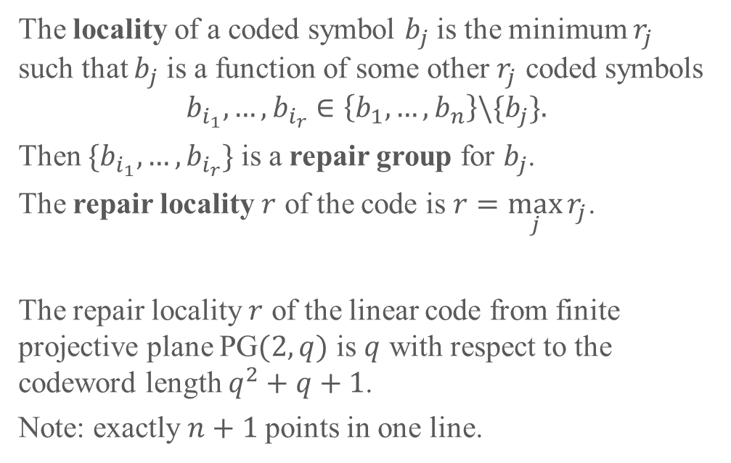
Repair locality
The locality of a coded symbol $b_{j}$ is the minimum $r_{j}$ such that $b_{j}$ is a function of some other $r_{j}$ coded symbols
$$b_{i_{1}},…,b_{i_{r}}∈\left\{b_{1}, …, b_{n}\right\}\backslash \{b_{j}\}.$$
Then $\{b_{i_{1}},…,b_{i_{r}}\}$ is a repair group for $b_{j}$.
The repair locality $r$ of the code is $r=\max_{j}{r_{j}}$.
The repair locality $r$ of the linear code from finite projective plane PG$(2,q)$ is $q$ with respect to the codeword length $q^{2}+q+1$.
Note: exactly $n+1$points in one line.
Page 15 of 16

Slide 16
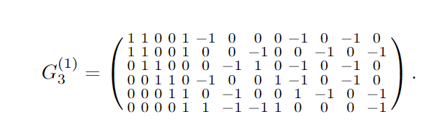
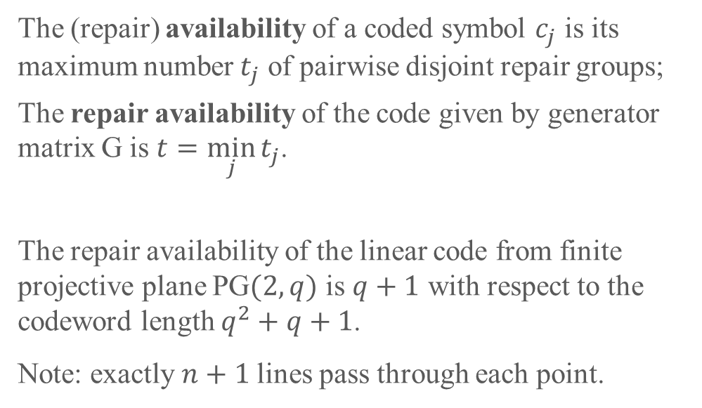
Repair availability
The (repair) availability of a coded symbol $c_{j}$ is its maximum number $t_{j}$ of pairwise disjoint repair groups;
The repair availability of the code given by generator matrix G is $t=\min_{j}{t_{j}}$.
The repair availability of the linear code from finite projective plane PG$(2,q)$ is $q+1$ with respect to the codeword length $q^{2}+q+1$.
Note: exactly $n+1$lines pass through each point.
Page 16 of 16

Slide 17
Thanks for your attention

