Slide 1
Infrastructure

Slide 2
AGENDA
On Demand
Solution – Architecture - Problem Solving
Technologies
Benchmark

Slide 3
On Demand
Real-time
High Performance
Concurrency
Clustering
Load Balancing
Robust
Scalability
Security
Maintenance

Slide 4
Solution – Architecture - Problem Solving
Command and Query Responsibility Segregation (CQRS) Pattern
Advanced Message Queuing Protocol (AMQP) Pattern
Use RabbitMQ

Slide 5
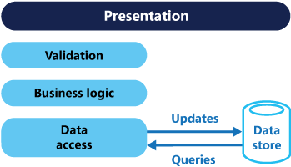
Command and Query Responsibility Segregation(CQRS)
Traditional CRUD architecture
Has some disadvantages
Limited business logic
Mismatch between the read and write representations of data
It risks encountering data contention in a collaborative domain
Both commands and queries are executed in single data repository
Update conflicts caused by concurrent updates when optimistic locking is used
Bad performance with big traffic on request and response

Slide 6
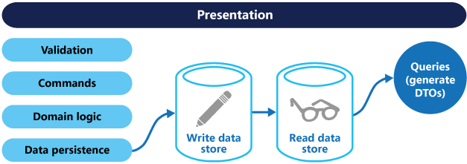
Command and Query Responsibility Segregation(CQRS)
CQRS architecture
Advantages
Split out read and write operations
Maximum performance read-only data storage
Have very fast responses to queries for data
Minimize resource utilization.
Minimize latency
Minimize costs
No more mapping object to tables
Suitable database for query operation and for write data storage
Distributed systems capabilities

Slide 7
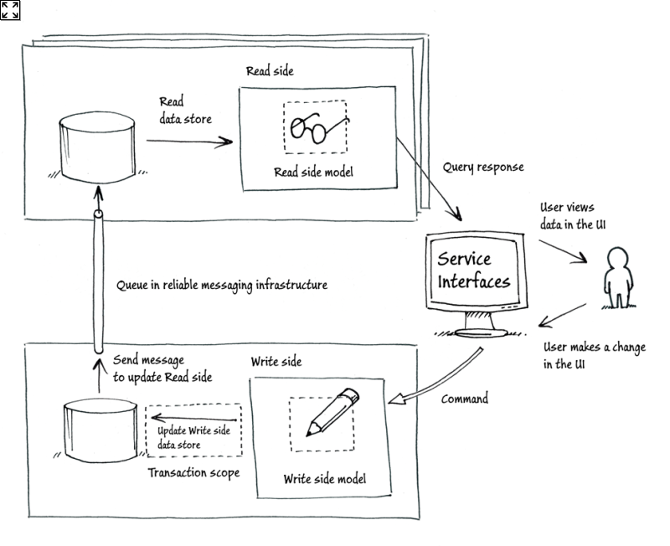
Command and Query Responsibility Segregation(CQRS)
CQRS with Message

Slide 8
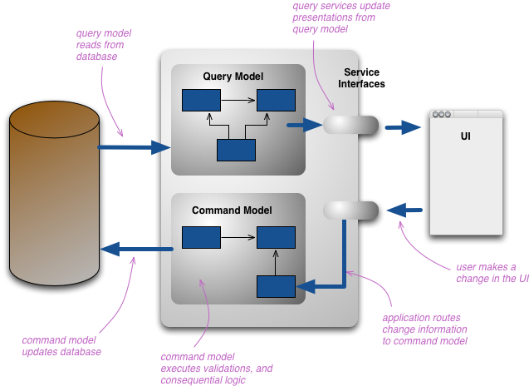
Command and Query Responsibility Segregation(CQRS)

Slide 9
Advanced message Queuing Protocol (AMQP)
Message-based middleware system
Asynchrony
Routing
Scalability
Resiliency
Decoupling

Slide 10
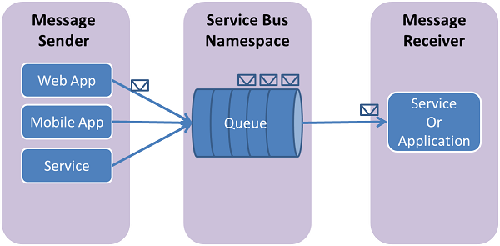
Objectives
Understand the need message queuing?
Basic understanding about Advance Message Queuing Protocol (AMQP)
Explore common message queue patterns
Benchmark

Slide 11
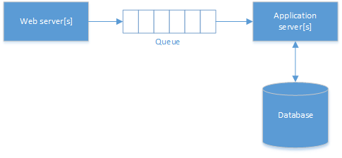
Scenario 1
Decoupling heavy-weight processing from a live user request
Notes:
Scale
Resiliency
Asynchronous

Slide 12
Why not use database?
Efficiency
Polling
Concurrency
Manual clean up
Scaling Won’t Be Easy

Slide 13
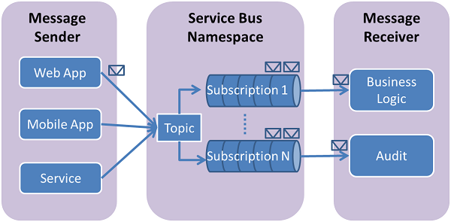
Scenario 2
Decoupling senders and receivers
Notes:
Enterprise Service Bus

Slide 14
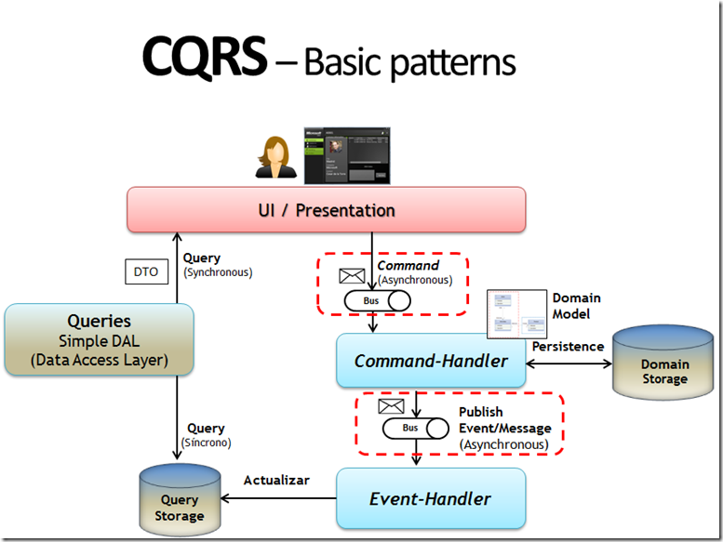
Scenario 2

Slide 15

AMQP Broker implementations

Slide 16
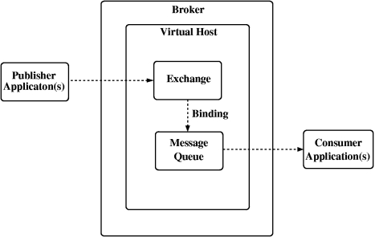
AMQP Model

Slide 17
Exchange
A message routing agent: it will receives messages from publisher and route them to Queue
Default exchange (without a name)
routing messages to a queue (routing key = name queue)
Direct exchange
routing message to a queue based on routing key (not necessary queue name, routing key = bind key)
Fanout exchange
routing message to more queue (pub/sub) and not use a routing key
Topic exchange
routing message to a queue based on routing key like a topic (routing key match pattern)
Header exchange
routing message to queue based on header filters

Slide 18
Exchange
Important attributes
Name
Durability: Durable exchanges last until they are deleted. Temporary exchanges last until the server shuts-down
Auto delete: exchanges last until they are no longer used
Arguments

Slide 19
Binding
An exchange accepts messages from a producer application and routes these to message queues according to pre-arranged criteria.
These criteria are called "bindings“

Slide 20
Queue
Name:
Durable: if set, the message queue remains present and active when the server restarts. It may lose transient messages if the server restarts.
Exclusive: if set, the queue belongs to the current connection only, and is deleted when the connection closes.
Auto delete: Auto-deleted message queues last until they are no longer used
Arguments
Notes:
name - if left unspecified, the server chooses a name and provides this to the client. Generally, when applications share a message queue they agree on a message queue name beforehand, and when an application needs a message queue for its own purposes, it lets the server provide a name.

Slide 21
Message
Message is the atomic unit of processing
A message consists of a content header, holding a set of properties, and a content body, holding an opaque block of binary data.
Broker never modifies content body

Slide 22
Common messages queue patterns

Slide 23
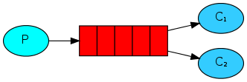
Worker Queue
Worker queues are used to distribute time-consuming task among multiple workers
Especially useful in web application where it’s impossible to handle complex or resource-intensive tasks
Default exchange: direct exchange with no name (empty string) pre-declared by the broker and automatically bound to queue by queue name

Slide 24
Worker Queue
Round-robin dispatching
Message acknowledgement
Message durability
Fair dispatching

Slide 25
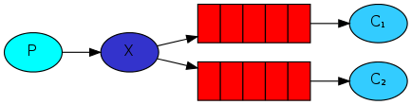
Publish/Subscribe
Delivery messages to multiple consumers
Fanout exchange: broadcasts all the messages it receives to all the queues it knows
Binding: the relationship between exchange and queue

Slide 26
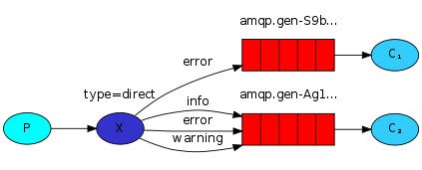
Routing
Subscribe to only a subset of messages
Direct exchange: a message goes to the queues whose binding key exactly matches the routing key of the message

Slide 27
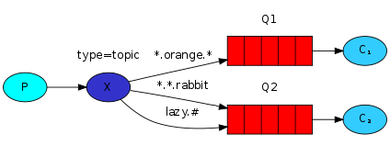
Topic
Routing based on multiple criteria
Topic exchange: matching binding key
* (star) can substitute for exactly one word.
# (hash) can substitute for zero or more words.

Slide 28
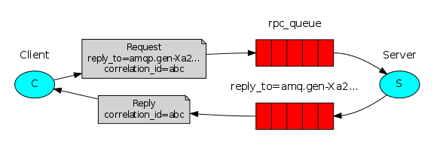
Request/Response or RPC
Run a function on a remote computer and wait for the result

Slide 29
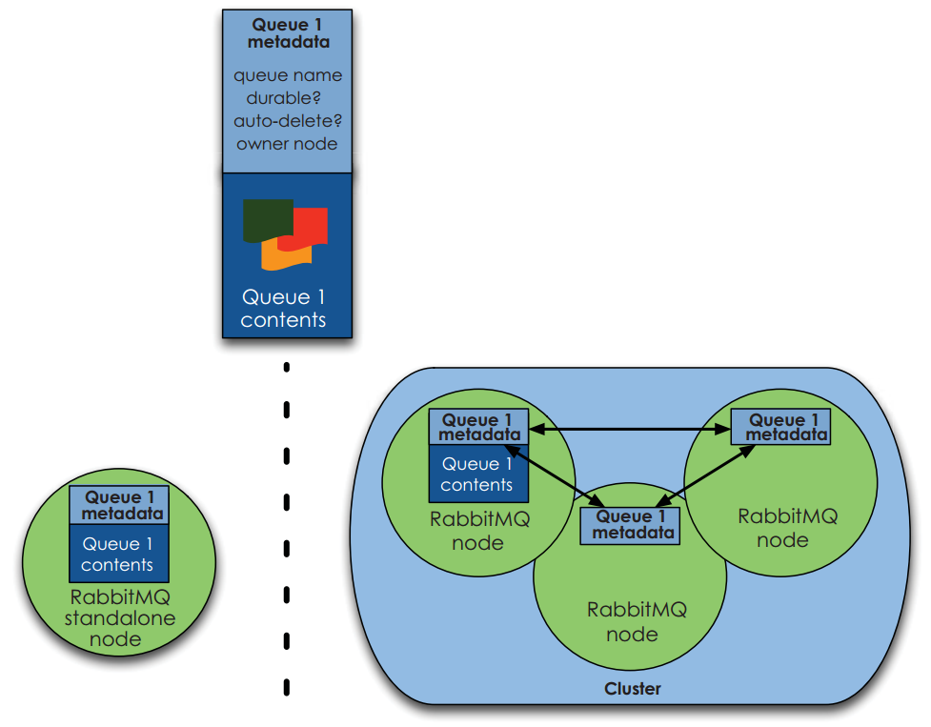
Performance and clustering

Slide 30
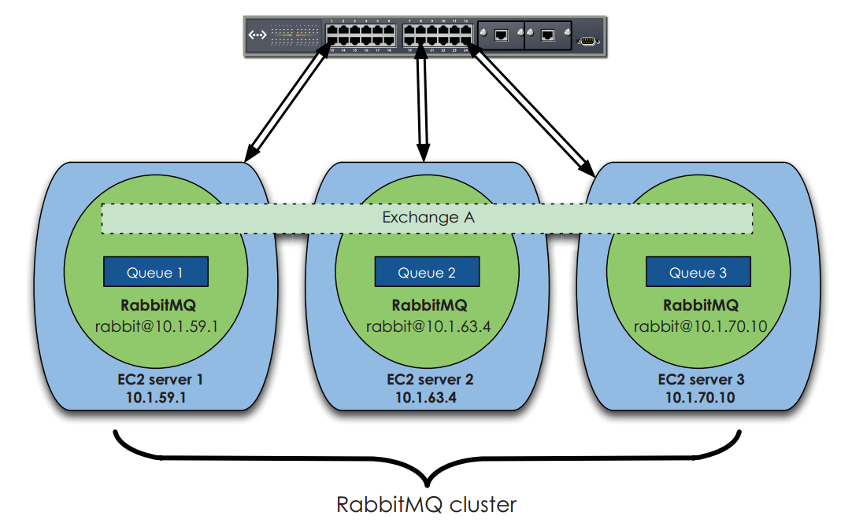

Slide 31
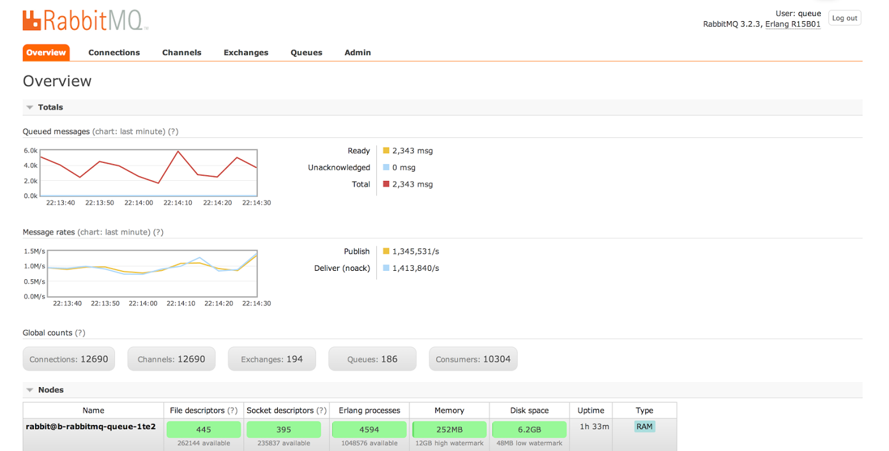

Slide 32
THANK YOU

