Slide 1
RISC-V & NVDLA

Slide 2
什么是RISC-V
A completely open ISA that is freely available to academia and industry.
A real ISA suitable for direct native hardware implementation, not just simulation or binary translation.
An ISA that avoids “over-architecting” for a particular microarchitecture style (e.g., microcoded, in-order, decoupled, out-of-order) or implementation technology (e.g., full-custom, ASIC, FPGA), but which allows efficient implementation in any of these.
An ISA separated into a small base integer ISA, usable by itself as a base for customized accelerators or for educational purposes, and optional standard extensions, to support general-purpose software development.
Support for the revised 2008 IEEE-754 floating-point standard.
An ISA supporting extensive user-level ISA extensions and specialized variants.
32-bit, 64-bit, and 128-bit address space variants for applications, operating system kernels, and hardware implementations.
An ISA with support for highly-parallel multicore or manycore implementations, including heterogeneous multiprocessors.
Optional variable-length instructions to both expand available instruction encoding space and to support an optional dense instruction encoding for improved performance, static code size, and energy efficiency.
A fully virtualizable ISA to ease hypervisor development.
An ISA that simplifies experiments with new supervisor-level and hypervisor-level ISA designs.

Slide 3
开源平台可以提供
Right now, you can download the final user-level ISA specification, a draft compressed ISA specification, a draft privileged ISA specification, and a suite of RISC-V software tools including a GNU/GCC software tool chain, GNU/GDB debugger, an LLVM compiler, a Spike ISA simulator, QEMU, and a verification suite.
You can also visit the UC Berkeley Architecture Research projects page to see a number of RISC-V based projects including a high-performance, energy-efficient Rocket processor (a 64-bit RISC-V single-issue in-order core), suitable for both high-speed simulation and full synthesis, is available for download.

Slide 4
目前已有的一些项目
LowRISC: https://github.com/lowRISC/lowrisc-chip
Rocket Chip: https://github.com/freechipsproject/rocket-chip
Sodor: https://github.com/ucb-bar/riscv-sodor
BOOM: https://github.com/ucb-bar/riscv-boom
Shakti: https://bitbucket.org/casl/shakti_public
YARVI: https://github.com/tommythorn/yarvi
Pulpino: https://github.com/pulp-platform/pulpino
Imperas: Fast Processor Models: http://www.imperas.com/riscv
PicoRV32: https://github.com/cliffordwolf/picorv32
GRVI: Gray Reasearch, LLC: http://fpga.org/grvi-phalanx/
OVPsim: Open Virtual Platforms: http://www.ovpworld.org/riscv
Spike
QEMU
RISCVEMU
Gem5（参考MICRO50的RISC5: Implementing the RISC-V ISA in gem5）
emul8

Slide 5
RISC-V在学术界的影响
First Workshop on Computer Architecture Research with RISC-V (CARRV 2017)
Boston, MA, USA, October 14, 2017, Co-located with MICRO 2017
7th RISC-V Workshop Call for Papers
DATE:JUNE 29, 2017
6th RISC-V Workshop Proceedings
DATE:MAY 28, 2017
5th RISC-V Workshop Proceedings
DATE:DECEMBER 11, 2016
4th RISC-V Workshop Proceedings
DATE:JULY 25, 2016
3rd RISC-V Workshop Proceedings
DATE:JANUARY 23, 2016
2nd RISC-V Workshop Proceedings
DATE:JULY 29, 2015
1st RISC-V Workshop Proceedings
DATE:JANUARY 14, 2015

Slide 6
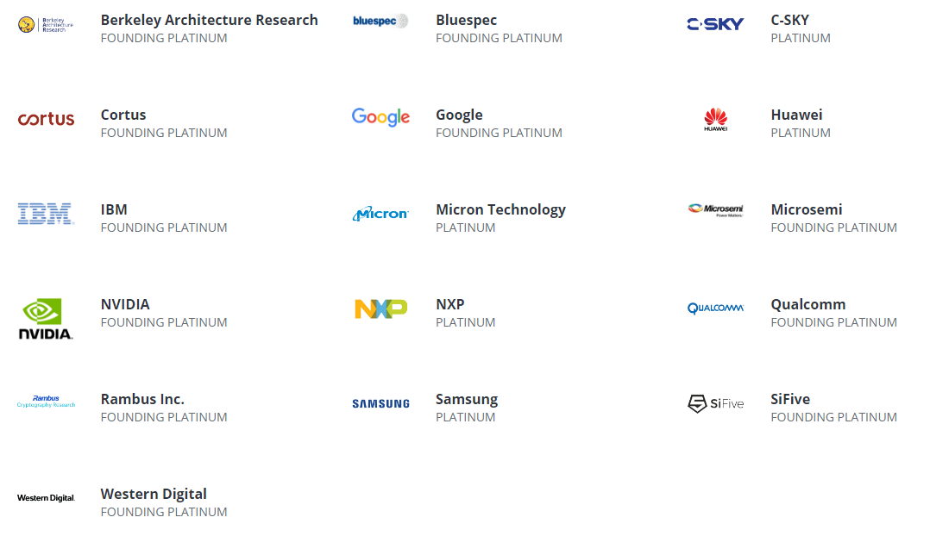
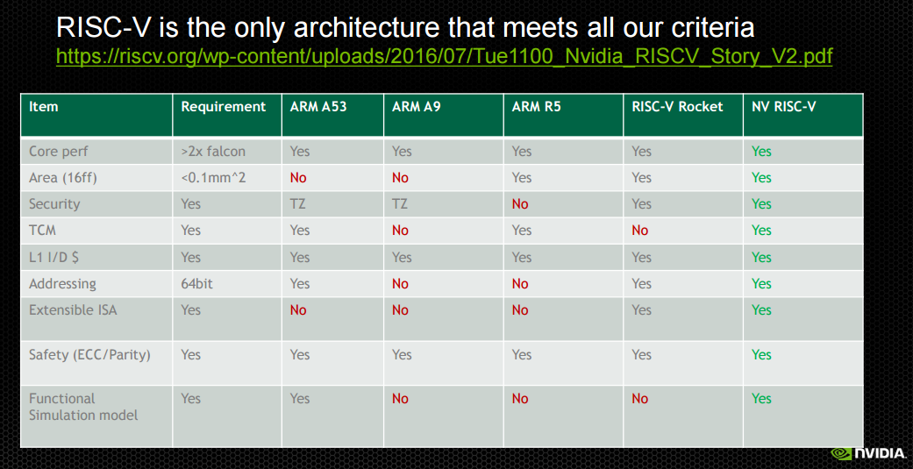
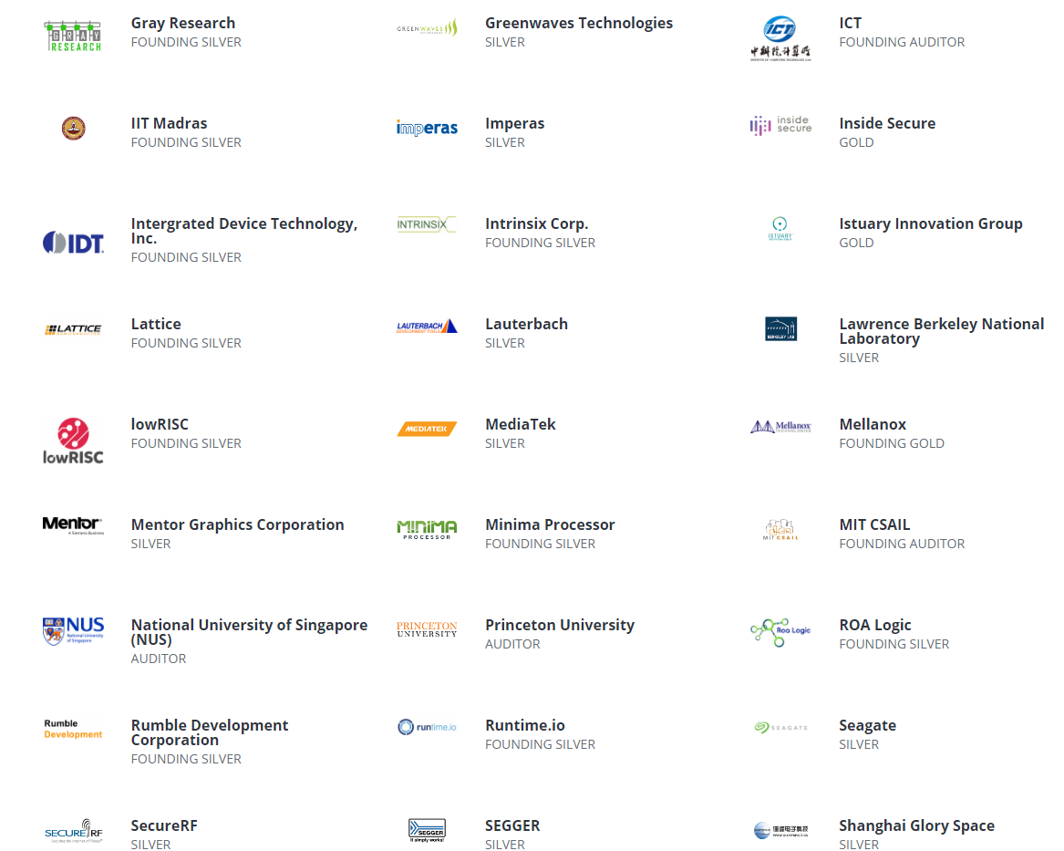
RISC-V在工业界的影响

Slide 7
什么是NVDLA
The NVIDIA Deep Learning Accelerator (NVDLA) is a free and open architecture that promotes a standard way to design deep learning inference accelerators. With its modular architecture, NVDLA is scalable, highly configurable, and designed to simplify integration and portability. The hardware supports a wide range of IoT devices. Delivered as an open source project under the NVIDIA Open NVDLA License, all of the software, hardware, and documentation will be available on GitHub.

Slide 8
NVDLA目前的开源程度
Documentation | Hardware | Software
Conceptual Overview | Large Config Verilog RTL, early access | Performance Estimator Tool
Hardware Architecture | Reference testbench and traces | Linux Kernel Mode Driver source
Software Interface | Reference synthesis scripts | QEMU based C model suitable for software development
Integration Manual | Large config Verilog RTL released | Linux User Mode Driver Runtime source
Roadmap | Small config Verilog RTL, early access | Binary compiler
Software Porting Guide | Small config Verilog RTL released | Application supporting Caffe and TensorFlow models; most CNN related layers
Software architecture document | RTL support for fine grained configuration control | Software sanity tests
 | UVM testbench validation of custom configurations | FPGA support for accelerating software development
 |  | Customizable compiler
 |  | NVDLA compliance test suite
 |  | TensorRT and all supported frameworks
2017-Q3
2017-Q4
2018-H1

Slide 9
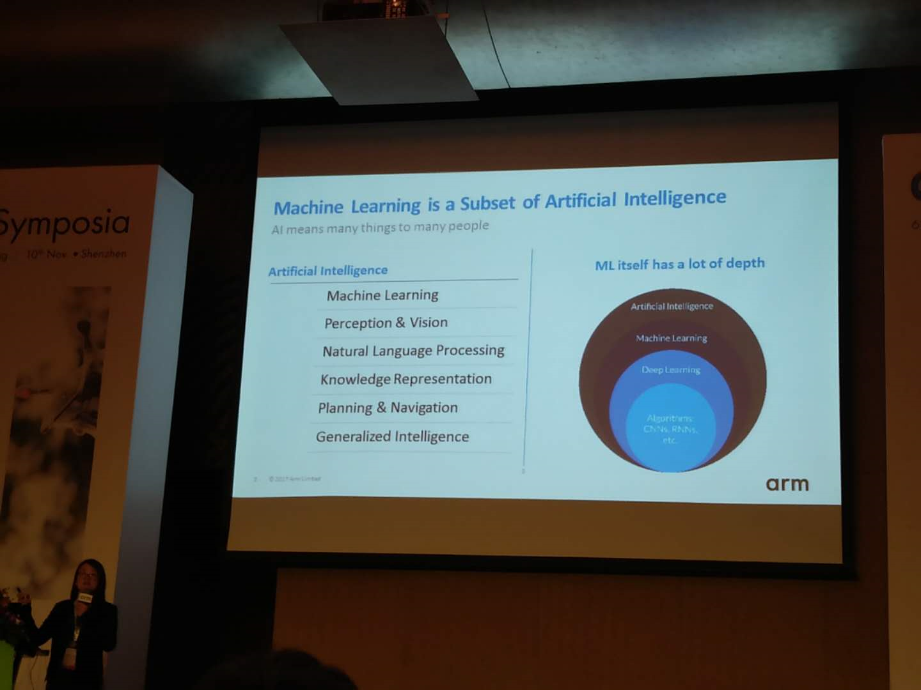
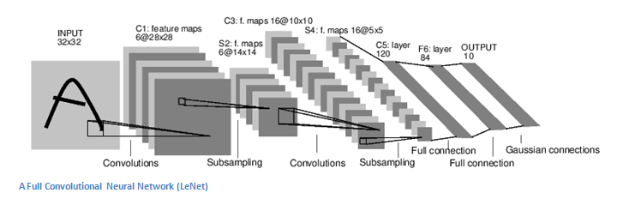
典型CNN网络（LeNET）

Slide 10
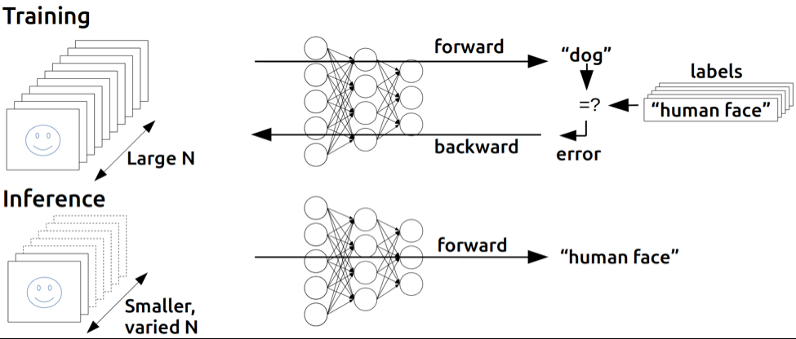
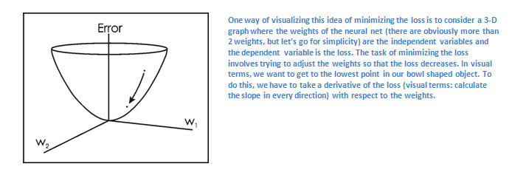
Training & Inference

Slide 11
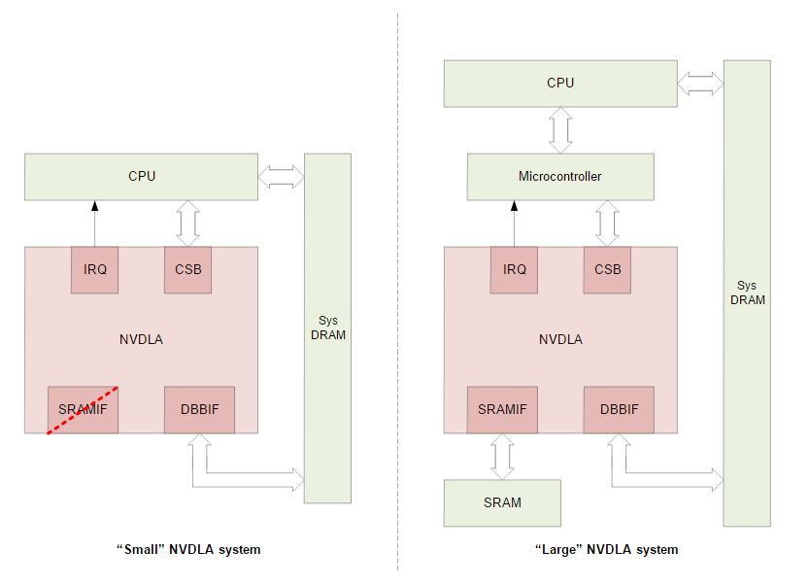
Small & Large

Slide 12
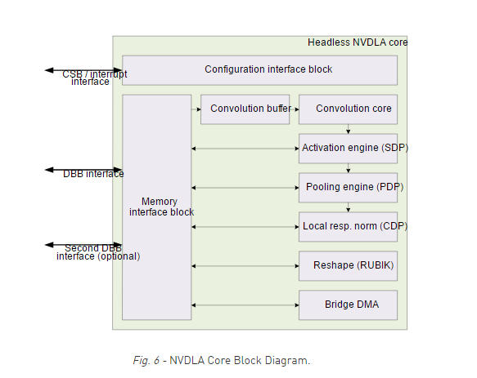
NVDLA架构

Slide 13
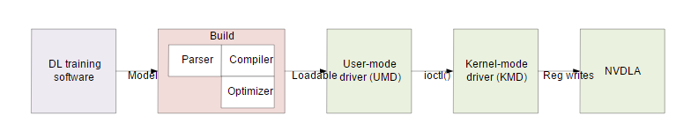
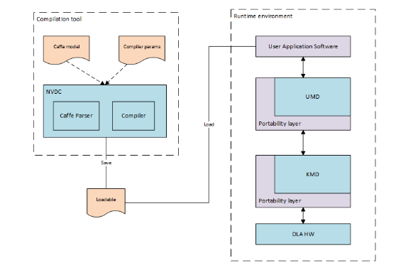

Slide 14
目标
[RISC-V] + [NVDLA]
< 12-month Tape-out
> 1 Framework(TensorFlow or Caffe)
> 1 App(Face detection and recognition)

