Slide 1
NVDLAonFPGA-Interface&DataFlow

Slide 2
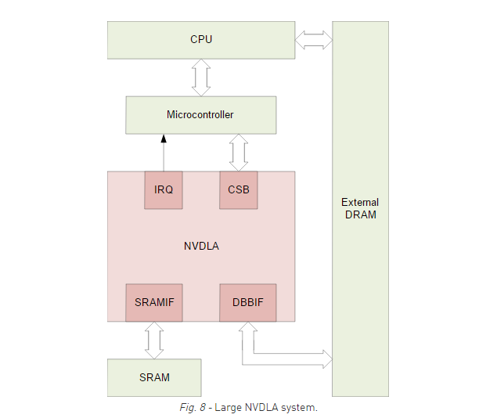
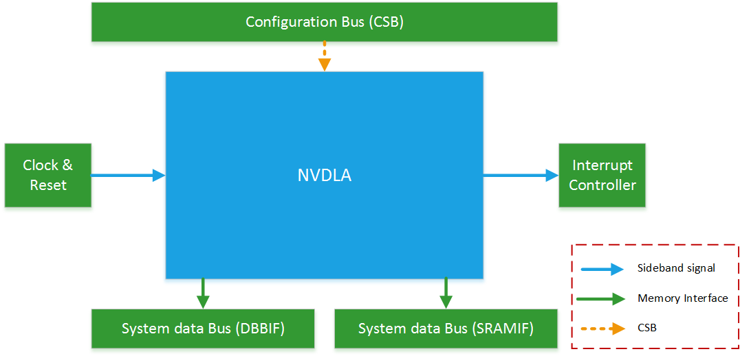
目前开源的Testbench只适用于nv_large模式

Slide 3
CSB-Configuration Space Bus
3个通道
请求通道request channel
读数据通道read data channel
写响应通道write response channel
12-signal
Clock/reset-2
Request channel-6
Read data channel-2
Write response channel-1
Interrupt-1

Slide 4
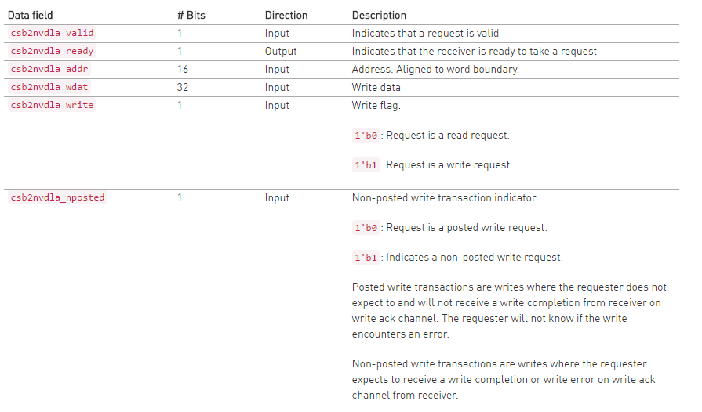
Request channel
valid/ready protocol
32-bit Data/16-bit Addr
不支持burst操作/指令间相互独立

Slide 5
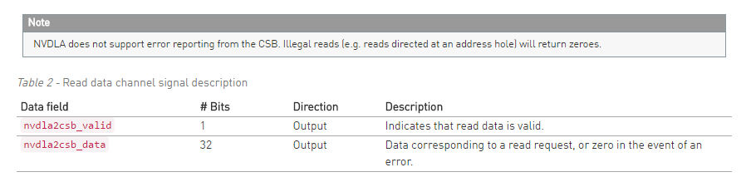
Read data channel
valid-only protocol
strict request order（不支持乱序响应）

Slide 6
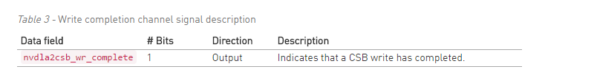
Write response channel
valid-only protocol
in request order（针对no-posted的写响应）

Slide 7
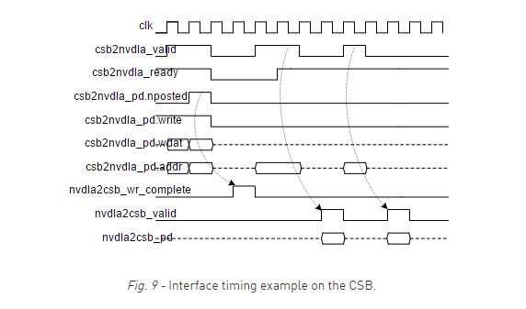
2读2写示例

Slide 8
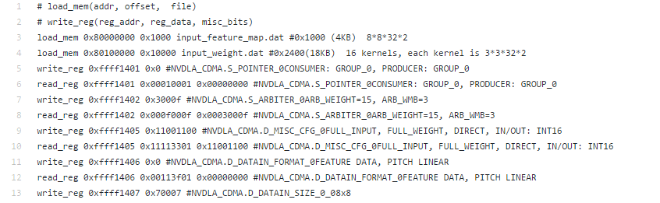
指令格式
7条指令：寄存器/存储器读写，数据搬运，等待中断
write_reg/read_reg
write_reg <misc:16><addr:16> <data:32>
read_reg <misc:16><addr:16> <bitmask:32> <expectedData:32>
write_mem/read_mem
write_mem <addr:64> <bytemask:16> <wdata:128>
read_mem <addr:64> <bitmask:128> <expectedData:128>
load_mem/dump_mem
load_mem <addr:64> <num_bytes:32> <string>
dump_mem <addr:64> <num_bytes:32> <string>
wait
wait <level/edge> <irq#>

Slide 9
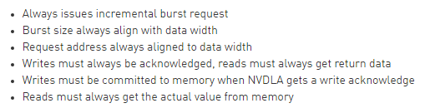
存储器接口DBBIF/SRAMIF
AXI4协议
一些简化
DBB：NVDLA data backbone interface

Slide 10
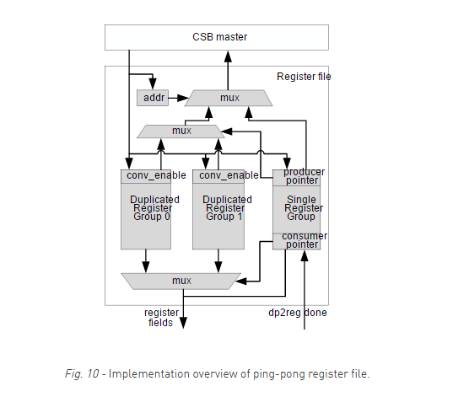
寄存器
每一个子模块都具有独立的ping-pong配置寄存器
Status/Configuration/Command/Profiling
软件使能/硬件清零
子模块间的工作时序以及依赖关系由软件负责维护

Slide 11
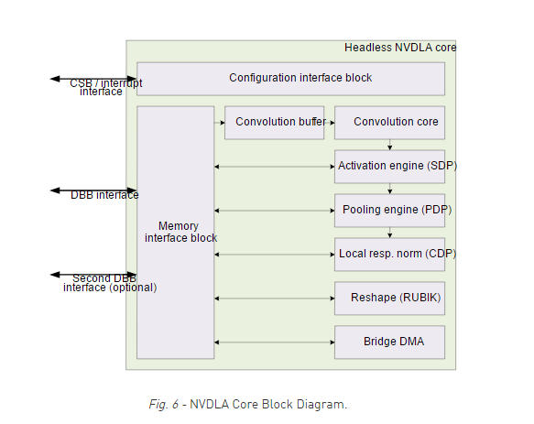
子模块/Pipeline
CDMA (convolution DMA)
CBUF (convolution buffer)
CSC (convolution sequence controller)
CMAC (convolution MAC array)
CACC (convolution accumulator)
SDP (single data processor)
SDP_RDMA (single data processor, read DMA)
PDP (planar data processor)
PDP_RDMA (planar data processor, read DMA)
CDP (channel data processor)
CDP_RDMA (channel data processor, read DMA)
BDMA (bridge DMA)
RUBIK (reshape engine)

Slide 12
CDMA编程示例
After reset, both group 0 and group 1 are in an idle state. The CPU should read the CDMA_POINTER register, and set PRODUCER to the value of CONSUMER. (After reset, CONSUMER is expected to be 0.)
The CPU programs the parameters for the first hardware layer into register group 0. After configuration completes, the CPU sets the enable bit in the D_OP_ENABLE register.
Hardware begins processing the first hardware layer.
The CPU reads the S_STATUS register to ensure that register group 1 is idle.
The CPU sets PRODUCER to 1 and begins programming the parameters for the second hardware layer into group 1. After those registers are programmed, it sets the enable bit in group 1’s D_OP_ENABLE.
The CPU checks the status of the register group 0 by reading S_STATUS; if it is still executing, the CPU waits for an interrupt.
Hardware finishes the processing of the current hardware layer. Upon doing so, it sets the status of the previously active group to idle in the S_STATUS register, and clears the enable bit of the D_OP_ENABLE register.
Hardware advances the CONSUMER field to the next register group (in this case, group 1). After advancing the CONSUMER field, it determines whether the enable bit is set on the new group. If so, it begins processing the next hardware layer immediately; if not, hardware waits until the enable bit is set.
Hardware asserts the “done” interrupt for the previous hardware layer. If the CPU was blocked waiting for a “done” interrupt, it now proceeds programming, as above.
Repeat, as needed.

Slide 13
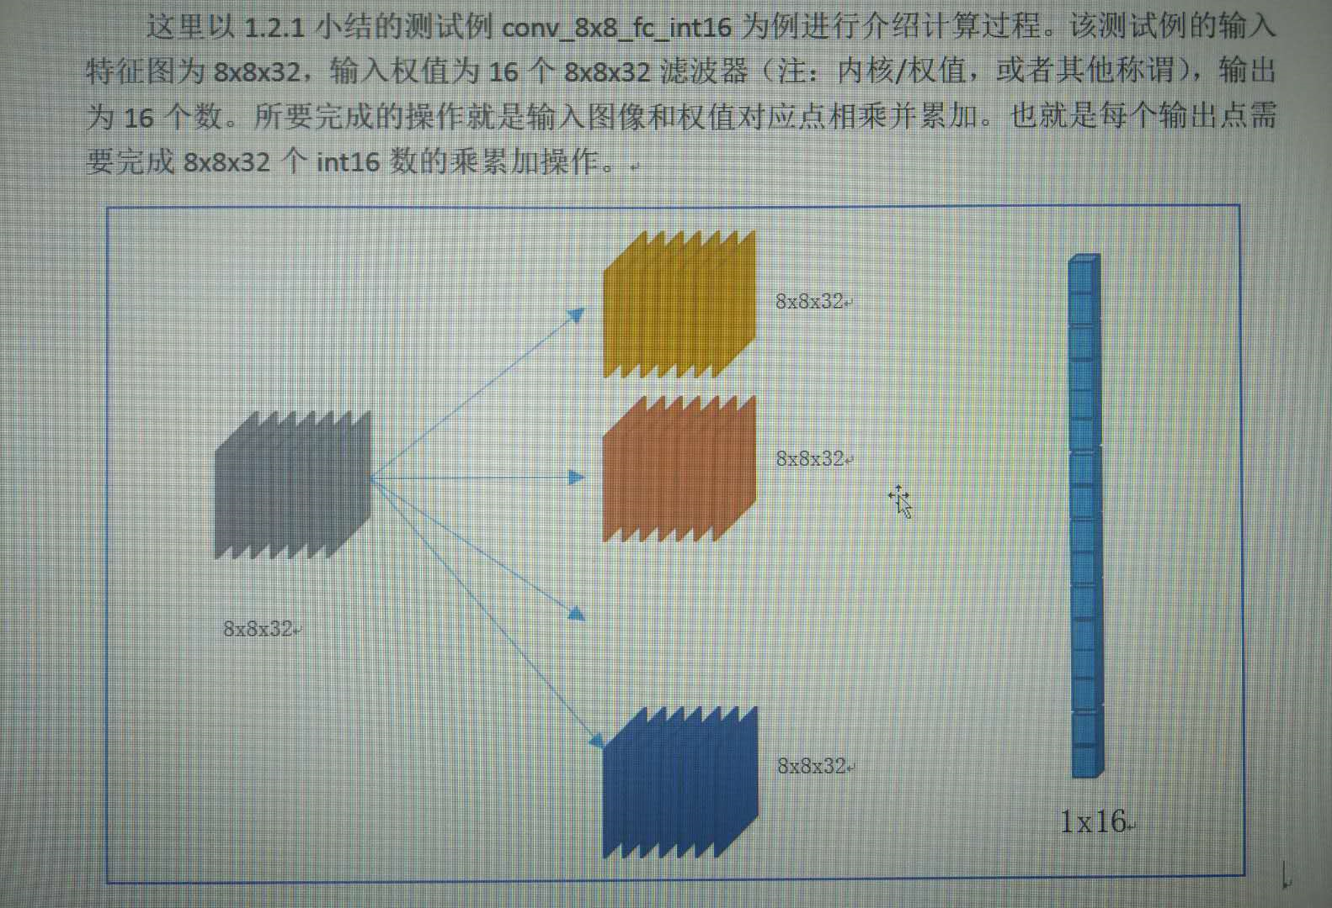
conv_8x8_fc_int16

Slide 14
conv_8x8_fc_int16
测试例文件
input.txn（程序文件）
input_feature_map.dat （输入数据）
input_weight.dat（权值）
output_feature_map.dat（期望结果）
脚本inp_txn_to_hexdump.pl会将input.txn转换成二进制文件，类似于编译器的工作。
将.dat文件转换成32-bit的格式存储，分别为0.raw2/1.raw2。
将期望结果也转换成32-bit的格式，即o.chiplib_replay.raw2，会与实际输出结果0.chiplib_dump.raw2进行对比。
依次完成配置CDMA->CSC->CMACa/b->CACC->SDP，依次使能CACC->CMACa/b->CSC->CDMA，等待中断，清除中断，dump数据。

