Slide 1
Chapter 12
Sorting
Objectives
Upon completion you will be able to:
Understand the basic concepts of internal and external sorts
Discuss the relative efficiency of different sorts
Recognize and discuss selection, insertion and exchange sorts
Discuss the design and operation of external sorts
Recognize natural, balanced, and polyphase merge sorts

Slide 2
12-1 Sort Concepts
Sorts arrange data according to their value. In this chapter, we discuss both internal and external sorts. We divide internal sorts into three categories-insertion, selection, and exchange-and discuss two different sorts in each classification. At the end of the chapter we discuss natural, balanced, and polyphase external sorts.

Slide 3
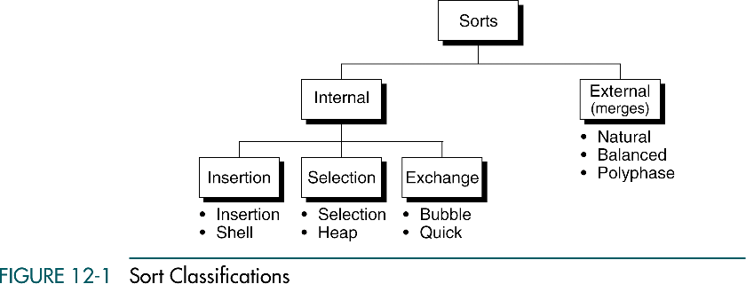
Sort Classifications

Slide 4
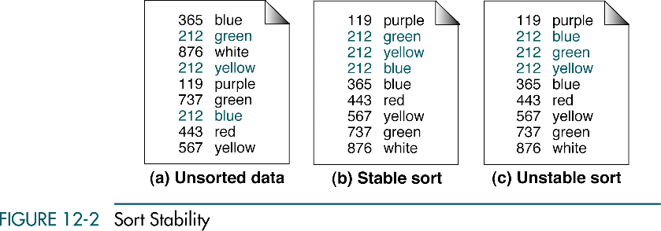
Sort Stability

Slide 5
12-2 Selection Sorts
In each pass of the selection sort, the smallest element is selected from the unsorted sublist and exchanged with the element at the beginning of the unsorted list. We discuss two classic selection sorts, straight selection and heap sort.
Straight Selection Sort
Heap Sort
Selection Sort Efficiency
Selection Sort Implementation

Slide 6
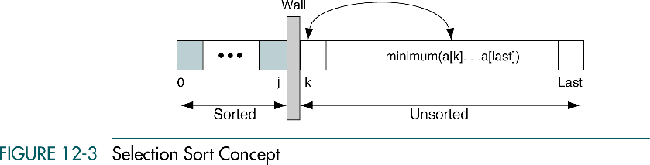
Selection Sort Concept

Slide 7
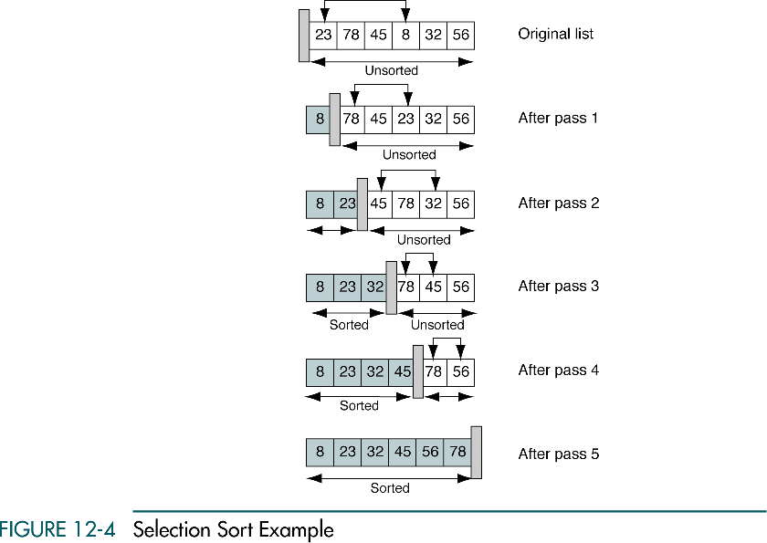
Selection Sort Example

Slide 8
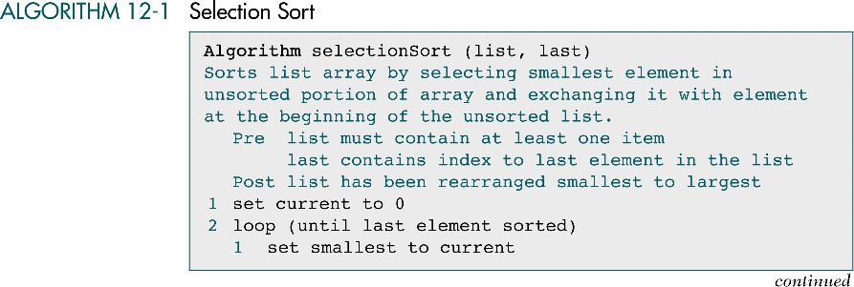
Selection Sort

Slide 9
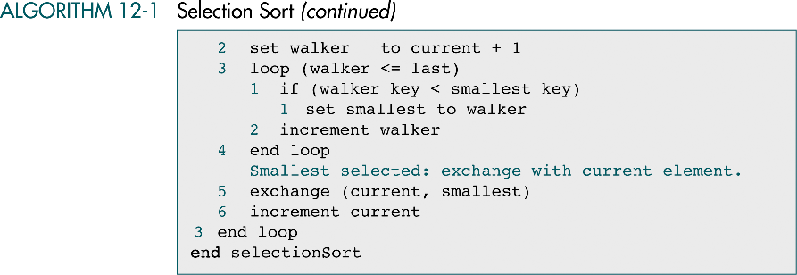
Selection Sort (cont.)

Slide 10
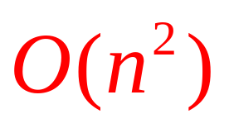
Selection Sort Efficiency
n-1
n-1

Slide 11
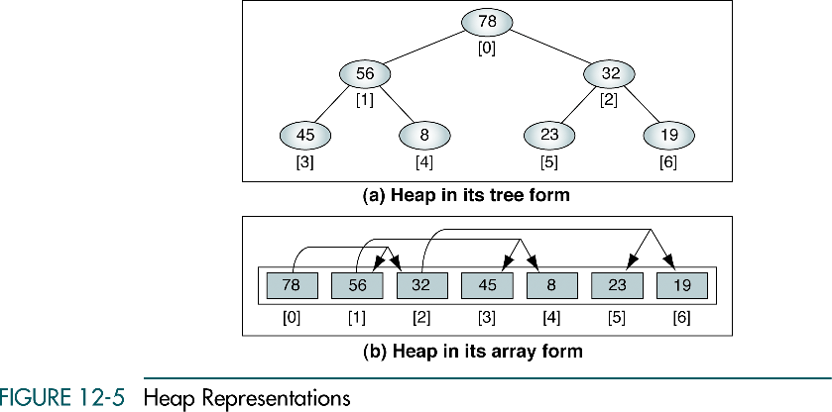
Heap Representations

Slide 12
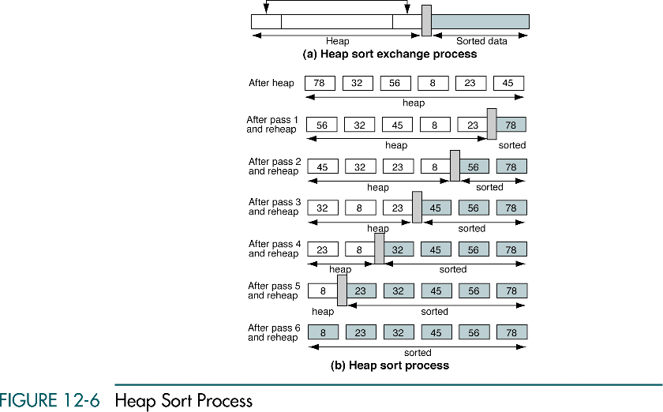
Heap Sort

Slide 13
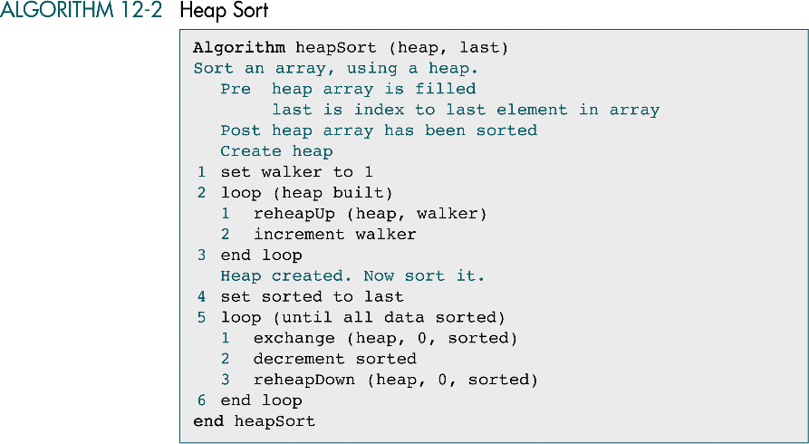
Heap Sort

Slide 14
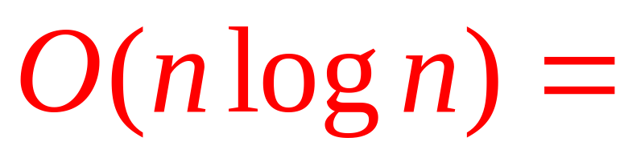
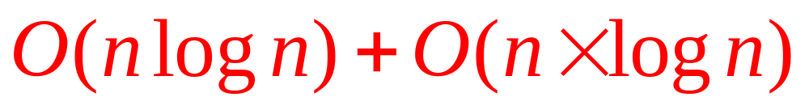
Heap Sort Efficiency
Heap construction
All nodes
Reheap

Slide 15
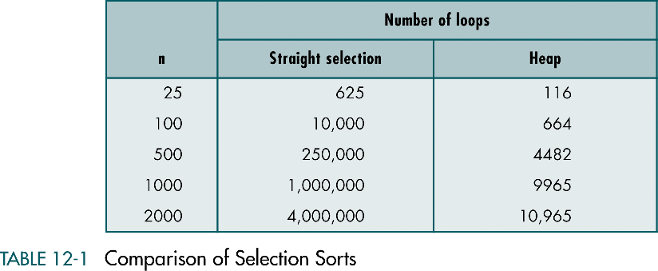
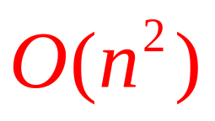

Computation of Selection Sorts

Slide 16
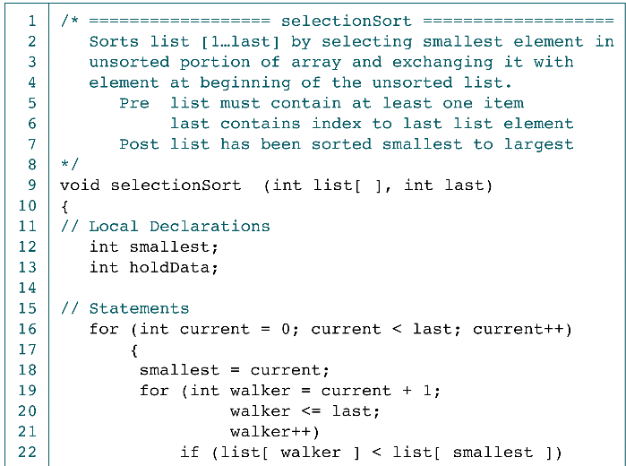
Selection Sort

Slide 17
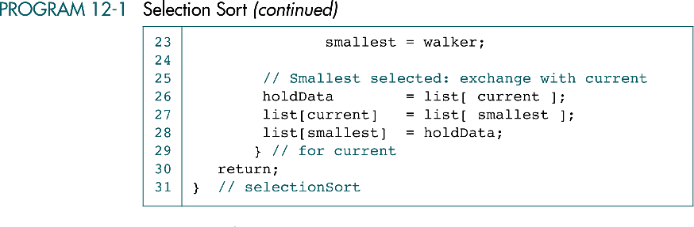
Selection Sort (cont.)

Slide 18
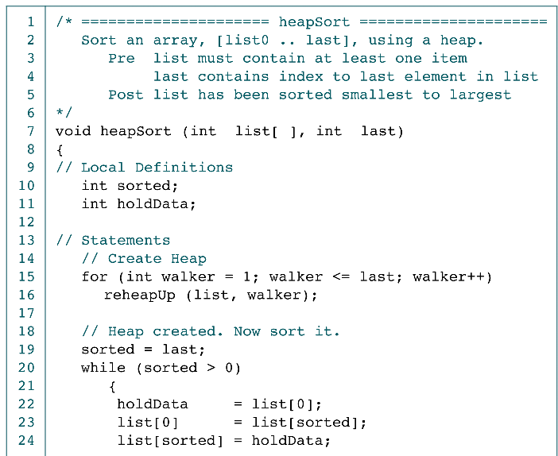
Heap Sort

Slide 19
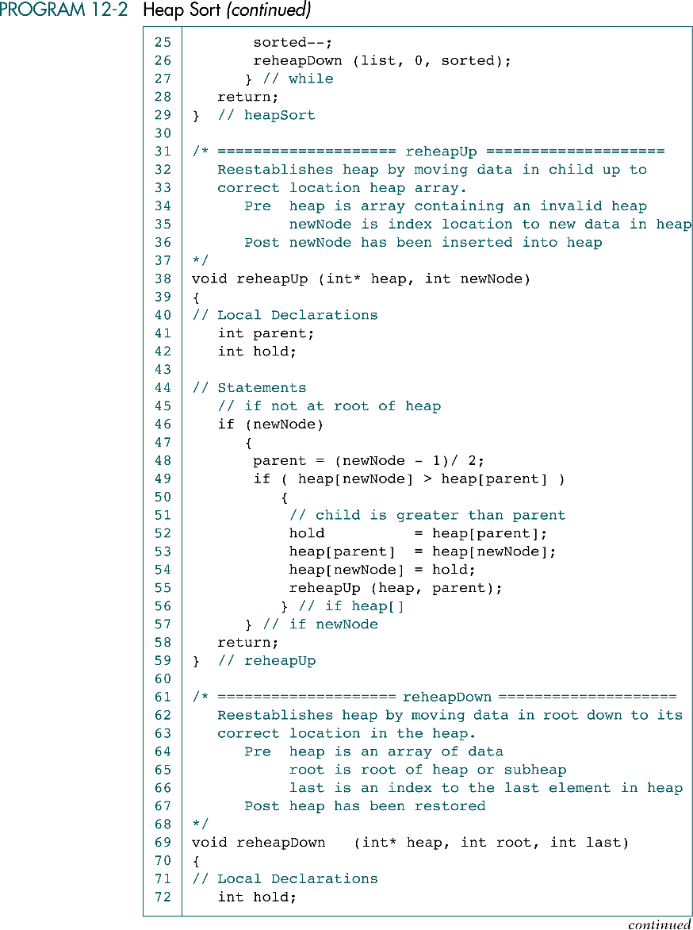
Heap Sort (cont.)

Slide 20
Heap Sort (cont.)

Slide 21
Heap Sort (cont.)

Slide 22
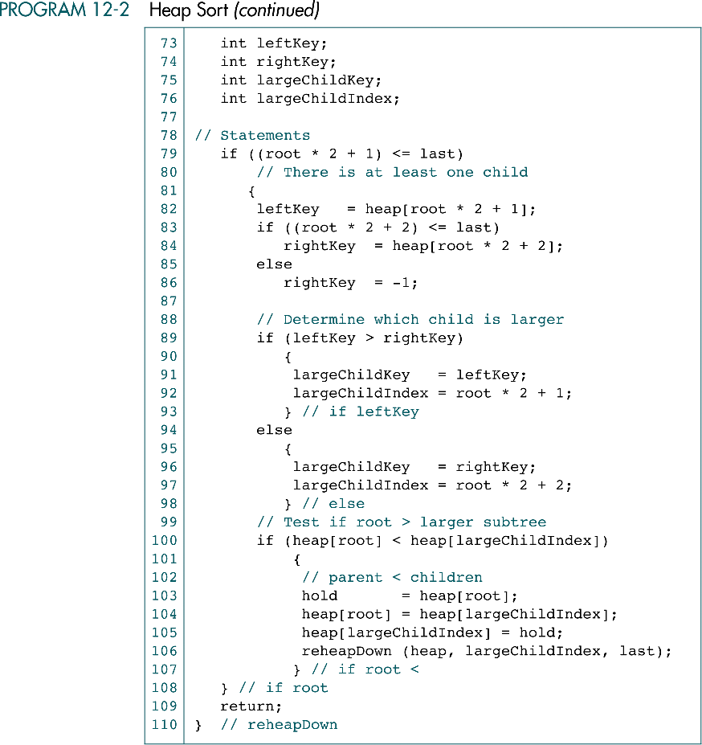
Heap Sort (cont.)

Slide 23
Heap Sort (cont.)

Slide 24
12-3 Insertion Sorts
In each pass of an insertion sort, one or more pieces of data are inserted into their correct location in an ordered list. In this section we study two insertion sorts: the straight insertion sort and the shell sort.
Straight Insertion Sort
Shell Sort
Insertion Sort Efficiency
Insertion Sort Implementation

Slide 25
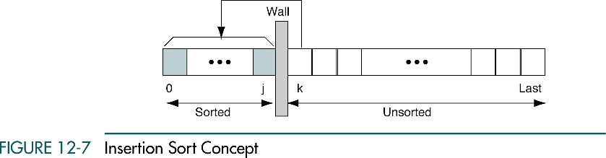
Insertion Sort Concept

Slide 26
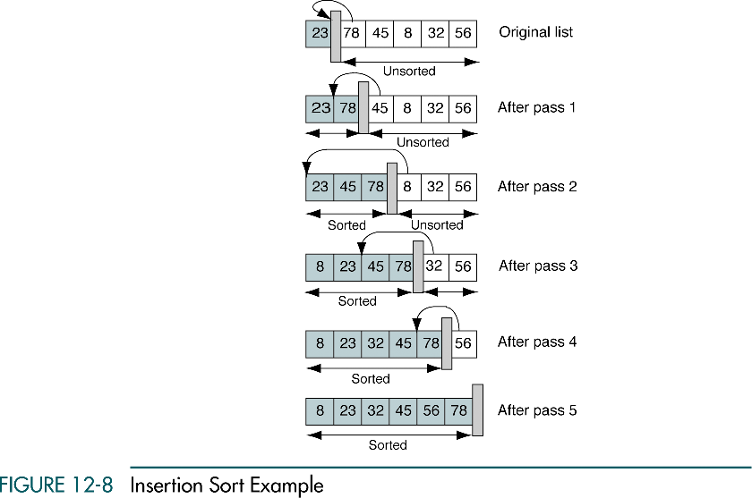
Insertion Sort Example

Slide 27
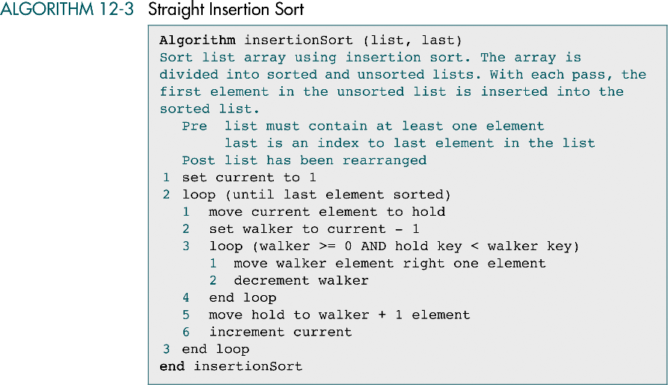
Straight Insertion Sort

Slide 28
Insertion Sort Efficiency
n-1 passes
# of Executions:
Pass 1: 1
Pass 2: 2
Pass 3: 3
.
.
.
Pass n-1: n-1
On average, n/2 executions
are needed for each pass

Slide 29
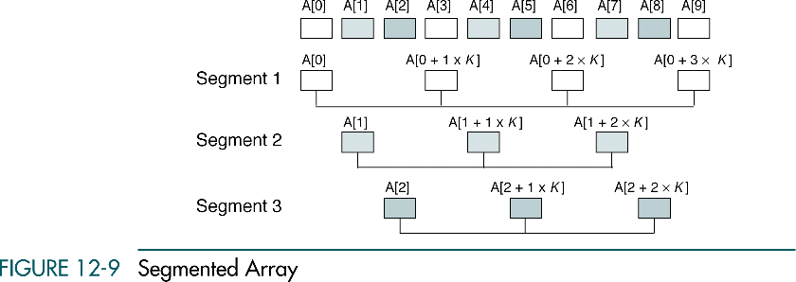
Segmented Array

Slide 30
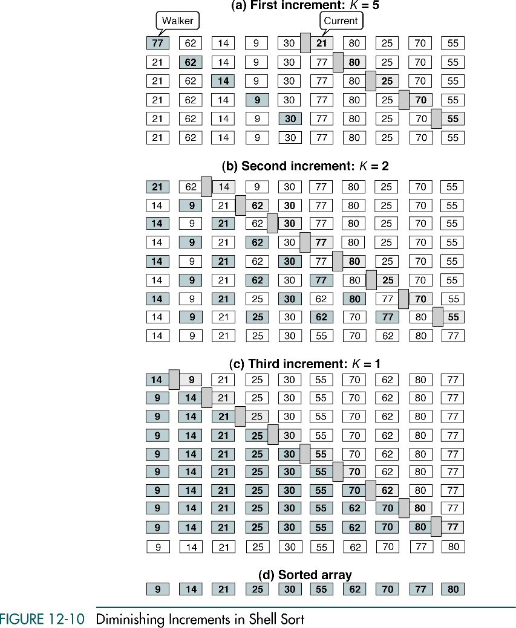
Diminishing Increments in Shell Sort

Slide 31
Diminishing Increments in Shell Sort (cont.)

Slide 32
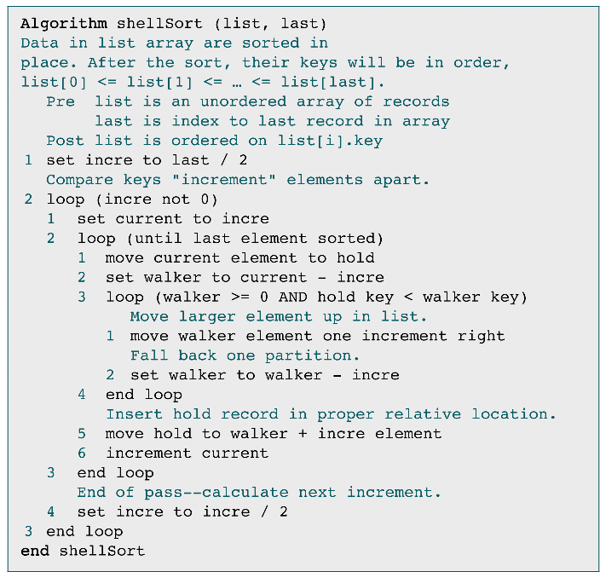
Shell Sort

Slide 33
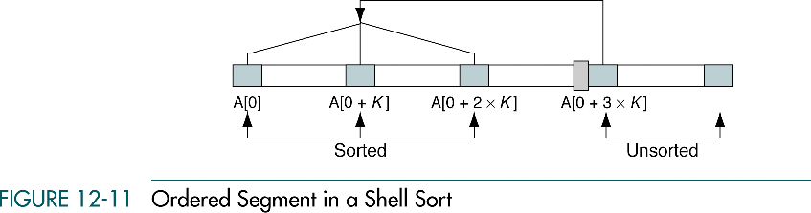
Ordered Segment in a Shell Sort
Insertion
Sort

Slide 34
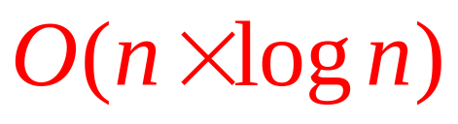
Shell Sort Efficiency
More than
,but less than

Slide 35
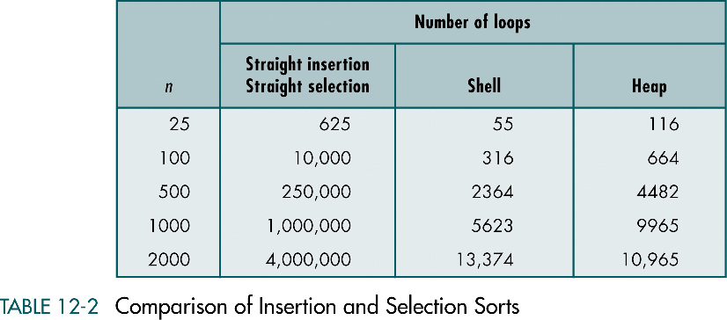
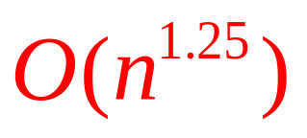
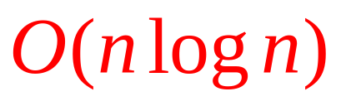
Comparison of Insertion and Selection Sorts

Slide 36
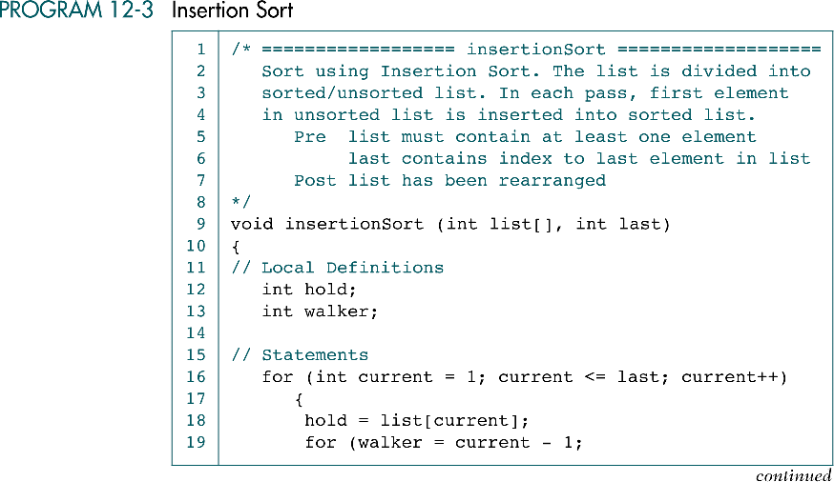
Insertion Sort

Slide 37
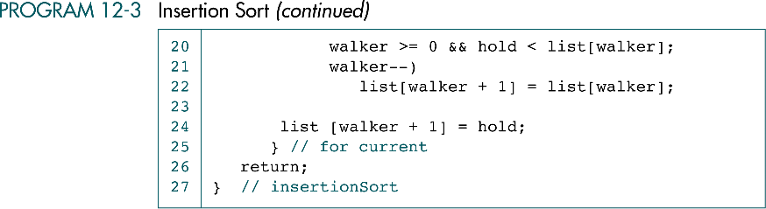
Insertion Sort (cont.)

Slide 38
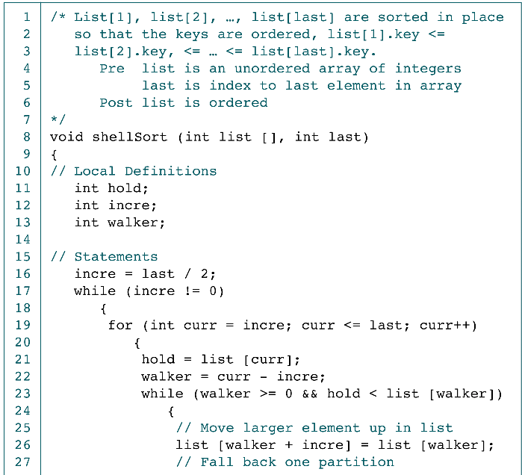
Shell Sort

Slide 39
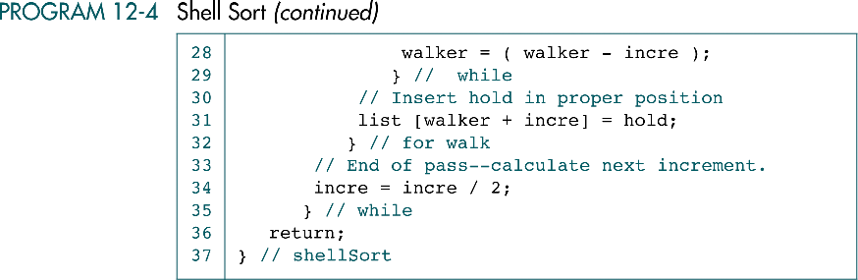
Shell Sort (cont.)

Slide 40
12-4 Exchange Sorts
This section discusses the four basic queue operations. Using diagrammatic figures, it shows how each of them work. It concludes with a comprehensive example that demonstrates each operation.
Bubble Sort
Quick Sort
Exchange Sort Efficiency
Sort Summary
Exchange Sort Implementation

Slide 41
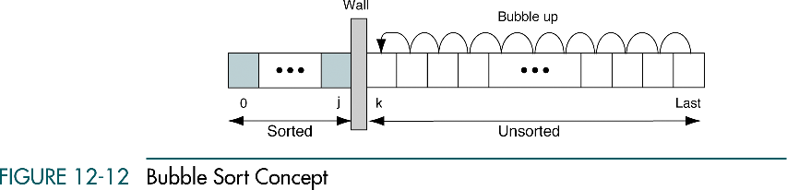
Bubble Sort Concept

Slide 42
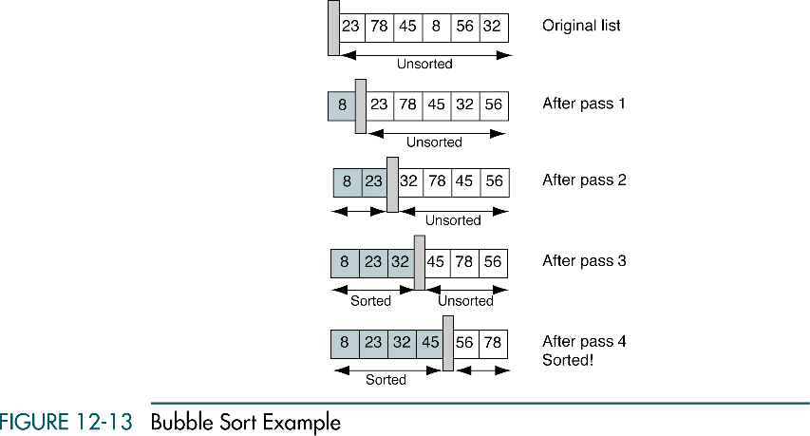
Bubble Sort Example

Slide 43
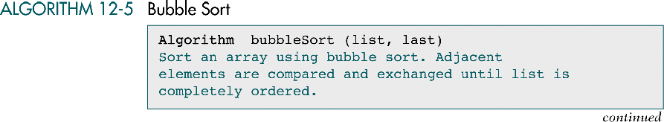
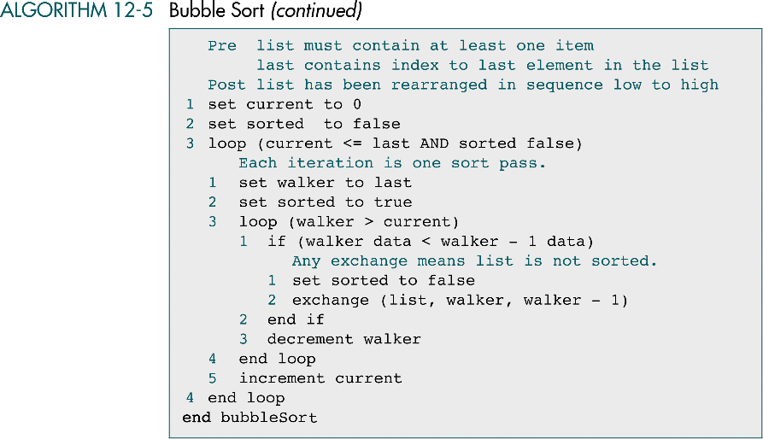
Bubble Sort

Slide 44
Bubble Sort Efficiency
n passes
# of executions:
pass 1: n-1
pass 2: n-2
pass 3: n-3
...
pass n: 0
On average, n/2 executions
are needed for each pass

Slide 45
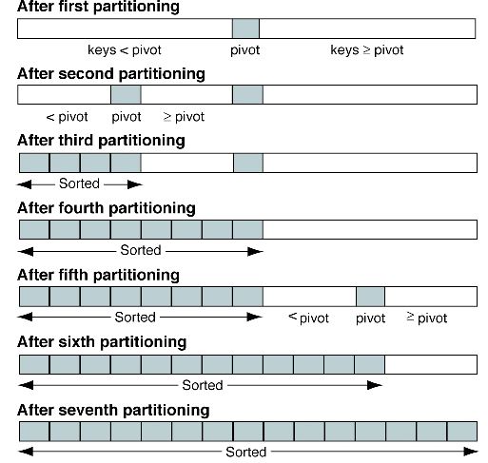
Quick Sort Partitions

Slide 46
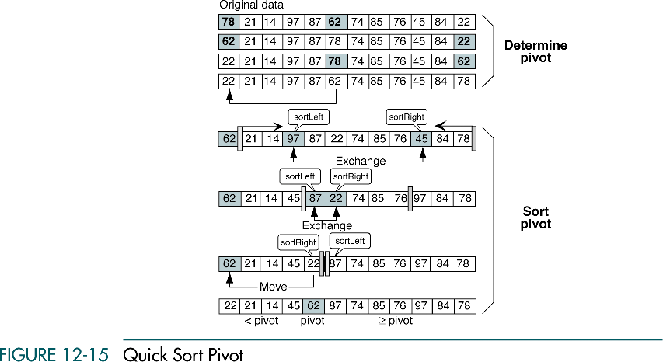
Quick Sort Pivot

Slide 47
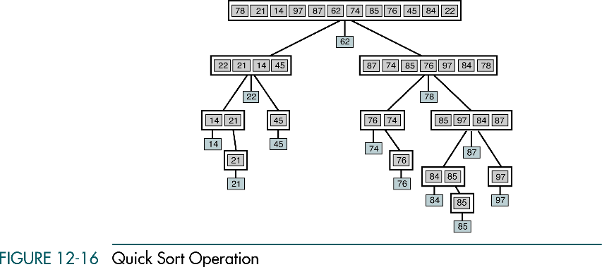
Quick Sort Operation

Slide 48
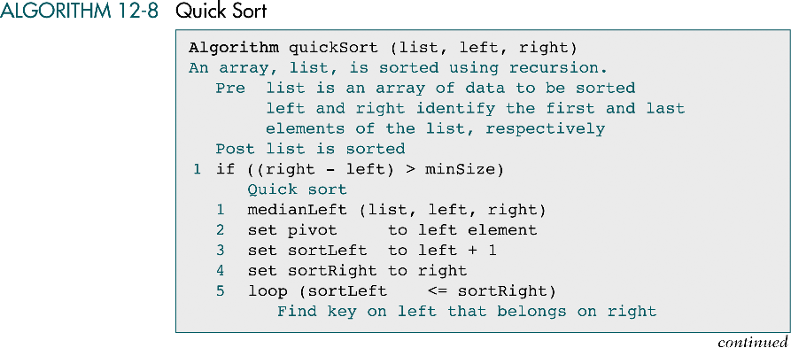
Quick Sort

Slide 49
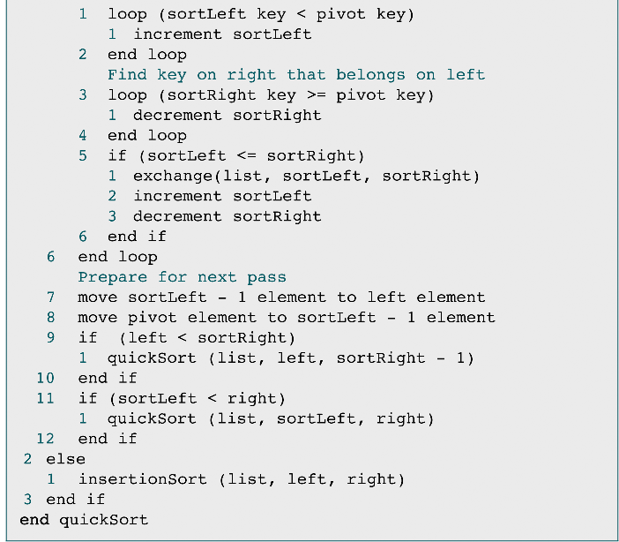
Quick Sort (cont.)
left

Slide 50
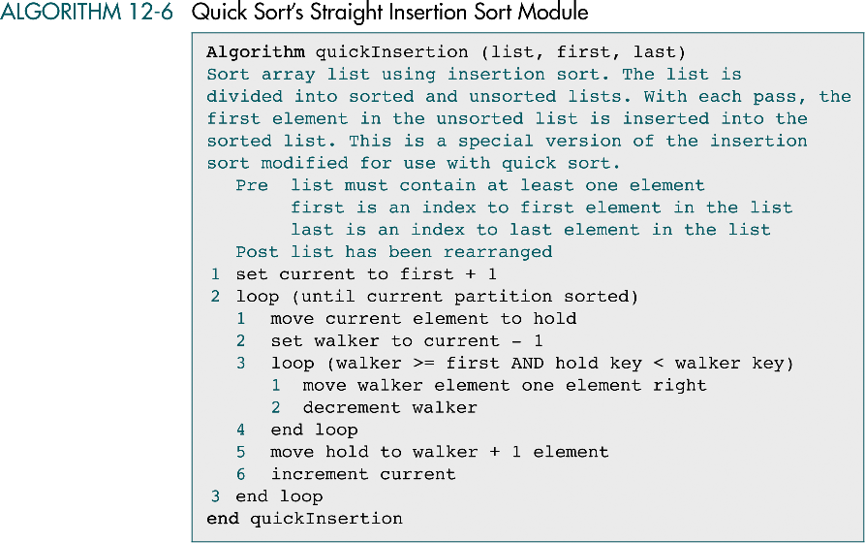
Quick Sort’s Straight Insertion Sort

Slide 51
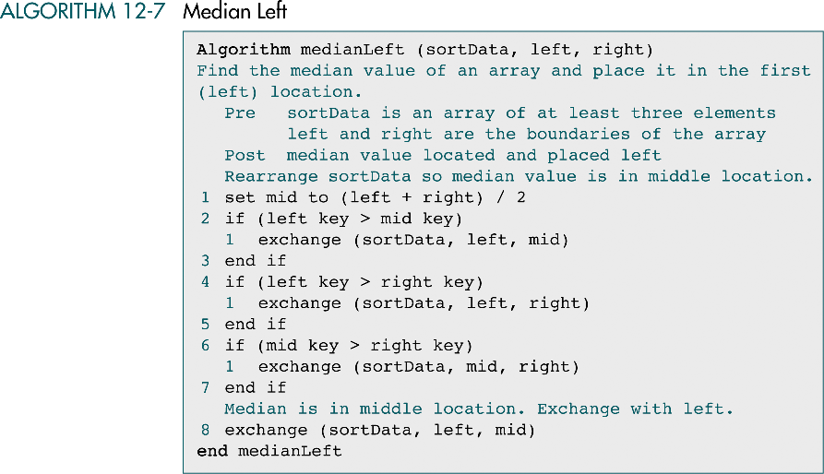
Median Left

Slide 52
Quick Sort Efficiency (Rough)
1. Each pass requires n steps
2. Log(n) passes are required
O(nLog(n))

Slide 53

Quick Sort Efficiency – Worst Case
f(n): number of comparisons to sort an n-element-array
i: the chosen pivot index
f(n) = 0 if n < 2
f(n) = f(i) + f(n-i-1) + n if n ≥ 2
Worst Case
: no Singleton’s mod. and the data were already sorted
f(n) = f(i) + f(n-i-1) + n
f(n) = f(n-1) + n
f(n) = f(n-1) + n
f(n-1) = f(n-2) + n-1
f(n-2) = f(n-3) + n-2
…
f(1) = f(0) + 1
f(0) = 0
f(n) = n+(n-1)+(n-2)+…+1+0
f(n) = n(n+1)/2

Slide 54


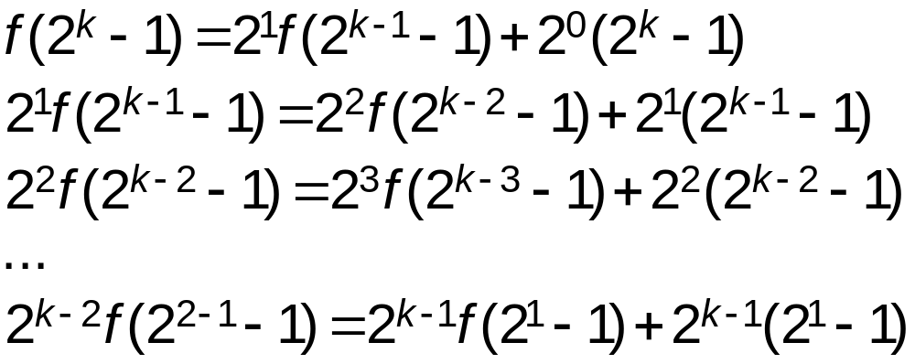
Quick Sort Efficiency – Best Case
Best Case
: the pivot belongs exactly in the middle of the array
f(n) = f(i) + f(n-i-1) + n

Slide 55

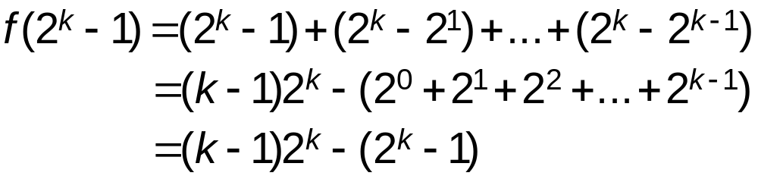

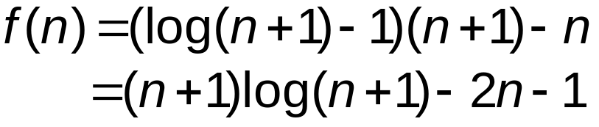
Quick Sort Efficiency – Best Case

Slide 57


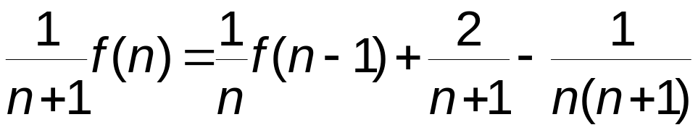
Quick Sort Efficiency – Average Case
Average Case
: the pivot index i can be anywhere
f(n) = f(i) + f(n-i-1) + n
f(n) = (1/n){f(0) + f(1) +…+ f(n-1)}
+ (1/n){f(n-1) + f(n-2)+…+ f(0)} + n
f(n) = (2/n){f(0) + f(1) +…+ f(n-1)} + n
nf(n) = 2{f(0) + f(1) +…+ f(n-1)} +
…………….…(a)
(n-1)f(n-1) = 2{f(0) + f(1) +…+ f(n-2)} +
.…(b)
(a)-(b)
nf(n) - (n-1)f(n-1) = 2f(n-1) + -
nf(n) = (n+1)f(n-1)+2n-1
Divide by n(n+1)

Slide 58
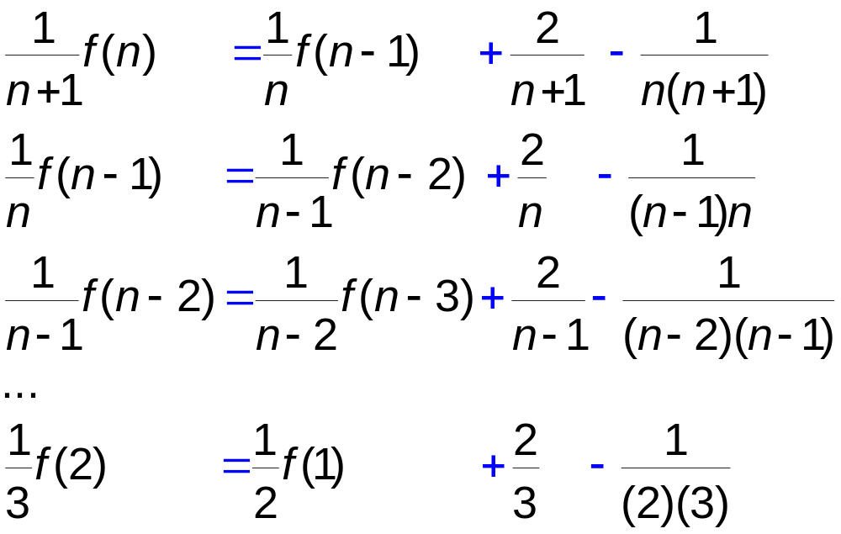
Quick Sort Efficiency – Average Case
(1/(n+1))f(n) = (1/2)f(1)+
(2/(n+1)+2/n-1)+…+2/3-
{(1/n(n+1)+1/(n-2)(n)+1/(n-2)(n-1)+…+1/6)}

Slide 59
Quick Sort Efficiency – Average Case
f(1)=0
(1/(n+1))f(n) = (2/(n+1)+2/n-1)+…+2/3)-
{(1/n(n+1)+1/(n-2)(n)+1/(n-2)(n-1)+…+1/6)}
f(n) = (n+1)(2/(n+1)+2/n-1)+…+2/3)-
{(n+1)(1/n(n+1)+1/(n-2)(n)+1/(n-2)(n-1)+…+1/6)}
f(n) = (n+1)ln n

Slide 60

Sort Comparisons

Slide 61

Bubble Sort

Slide 62

Bubble Sort (cont.)

Slide 63

Quick Sort

Slide 64

Quick Sort (cont.)

Slide 65
Quick Sort (cont.)

Slide 66

Modified Insertion Sort

Slide 67

Medium Left for Quick Sort

Slide 68

Medium Left for Quick Sort (cont.)

Slide 69
12-5 External Sorts
In external sorting portions of the data may be stored in secondary memory during the sorting process. Included in this section is a discussion of file merging and three external sort approaches-natural, balanced, and polyphase.
Merging Ordered Files
Merging Unordered Files
The Sorting Process
Sort Phase Revisited

Slide 70

Simple Merge

Slide 71


Merge Files

Slide 72

Merge Files Example

Slide 73

Sort Phase in an External Sort

Slide 74

Natural Two-way Merge Sort

Slide 75

Balanced Two-way Merge Sort

Slide 76

External Sort Phase Using Heap Sort

