Slide 1
Chapter 7
Binary Search Trees
Objectives
Upon completion you will be able to:
Create and implement binary search trees
Understand the operation of the binary search tree ADT
Write application programs using the binary search tree ADT
Design and implement a list using a BST
Design and implement threaded trees

Slide 3
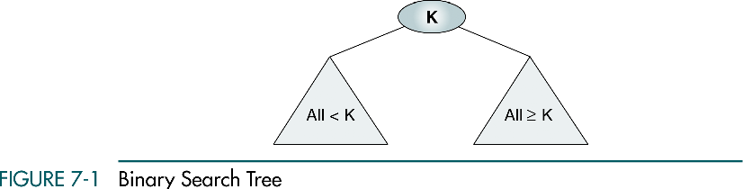
7-1 Basic Concepts
Binary search trees provide an excellent structure for searching a list and at the same time for inserting and deleting data into the list.

Slide 4
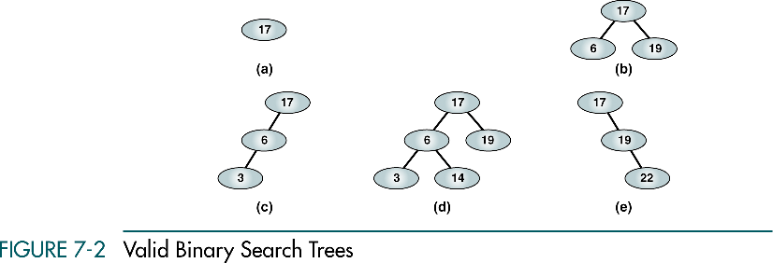
Valid Binary Search Tree

Slide 5
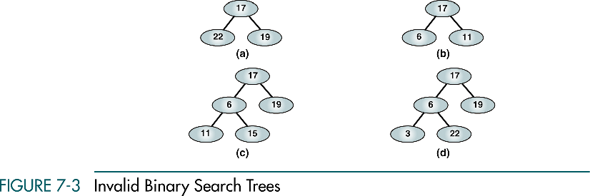
Invalid Binary Search Tree

Slide 6
7-2 BST Operations
We discuss four basic BST operations: traversal, search, insert, and delete; and develop algorithms for searches, insertion, and deletion.
Traversals
Searches
Insertion
Deletion

Slide 7
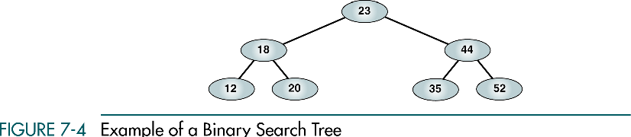
Example of Binary Search Tree
Preorder: 23 18 12 20 44 35 52
Postorder: 12 20 18 35 52 44 23
Inorder: 12 18 20 23 35 44 52

Slide 8
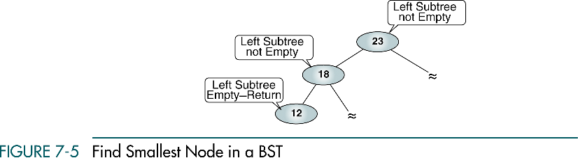
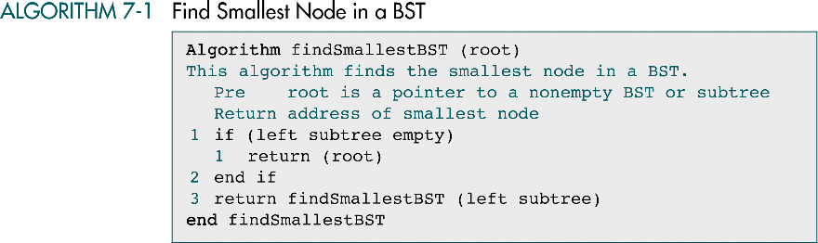
Find Smallest Node in a BST

Slide 9
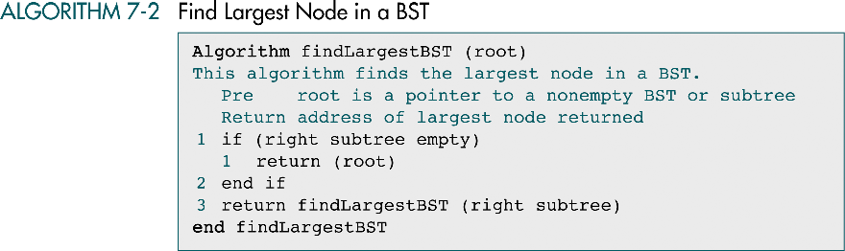
Find Largest Node in a BST

Slide 10
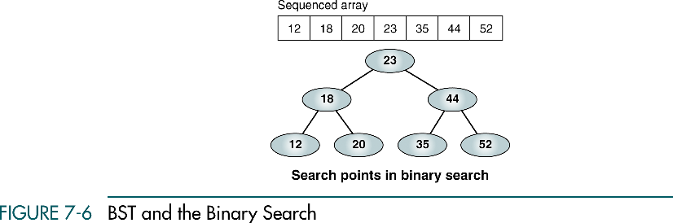
BST and Binary Search

Slide 11
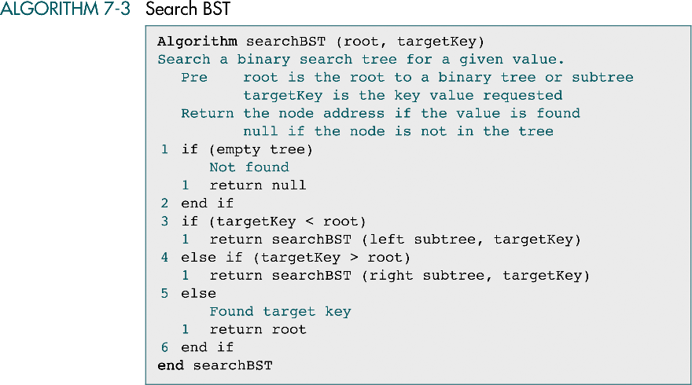
Search BST

Slide 12
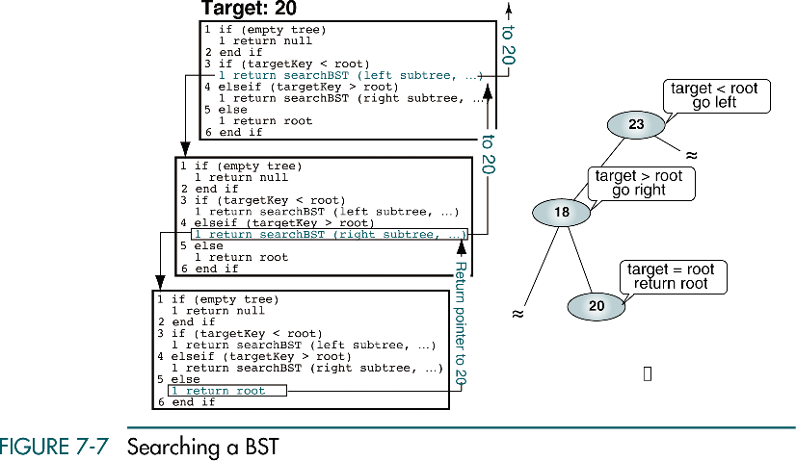
Searching a BST

Slide 13
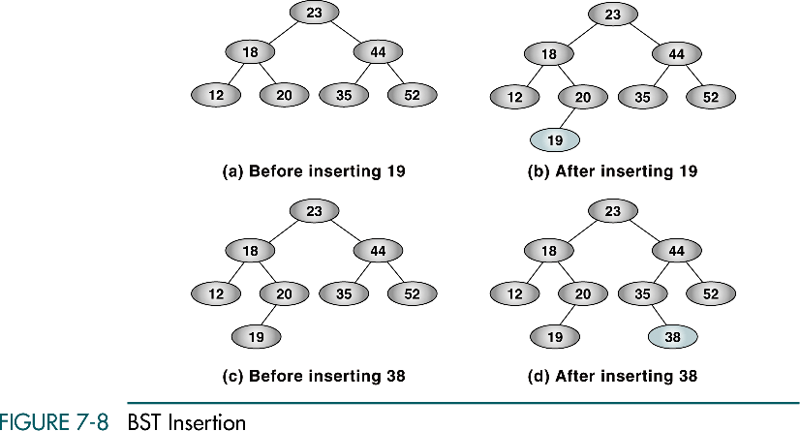
BST Insertion

Slide 14
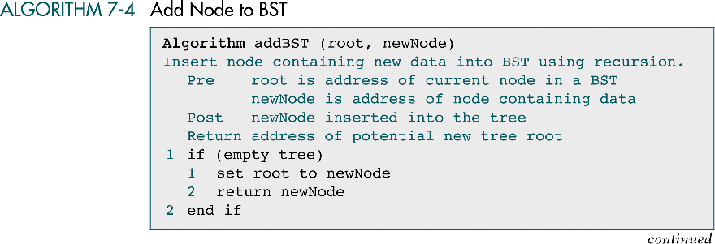
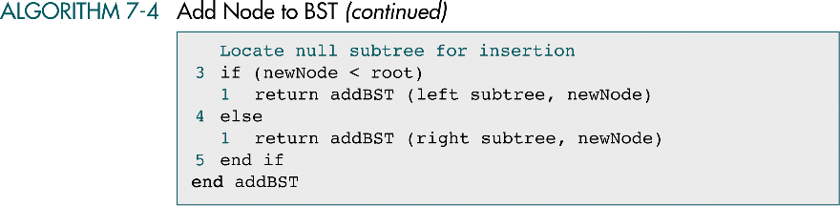
Add Node to BST

Slide 16
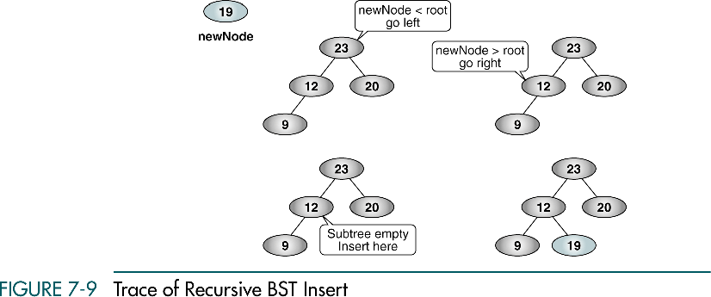
Trace of Recursive BST Insert
25
25
25
25

Slide 17
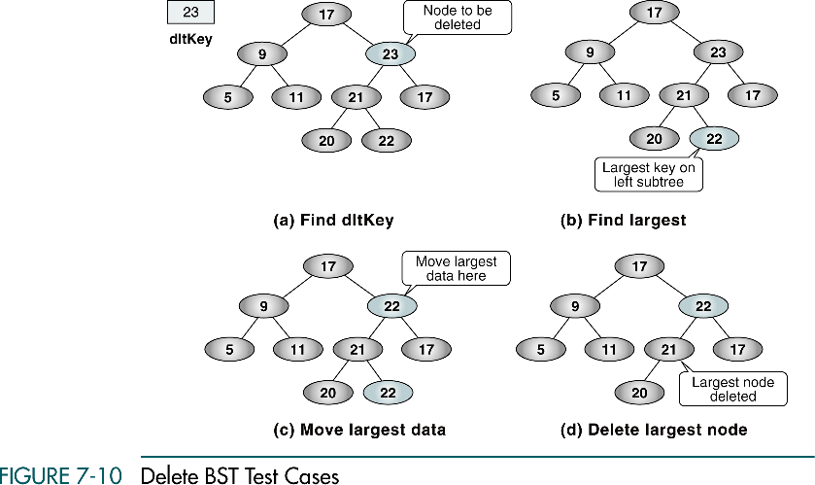
Delete BST Test Cases
26
26
22
22
22
22
26
26
22

Slide 18
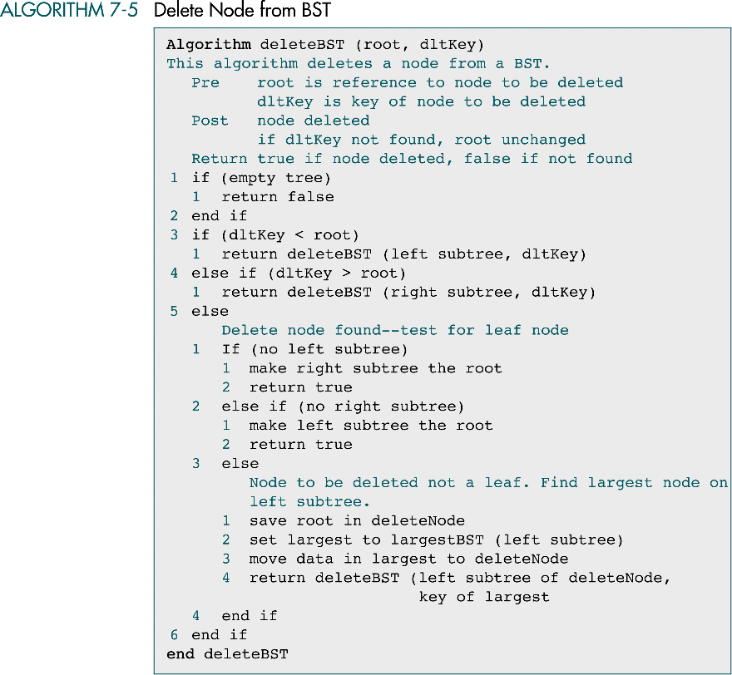
Delete Node From BST

Slide 19
Delete Node From BST (cont.)

Slide 20
7-3 Binary Search Tree ADT
We begin this section with a discussion of the BST data structure and write the header file for the ADT. We then develop 14 programs that we include in the ADT.
Data Structure
Algorithms

Slide 21
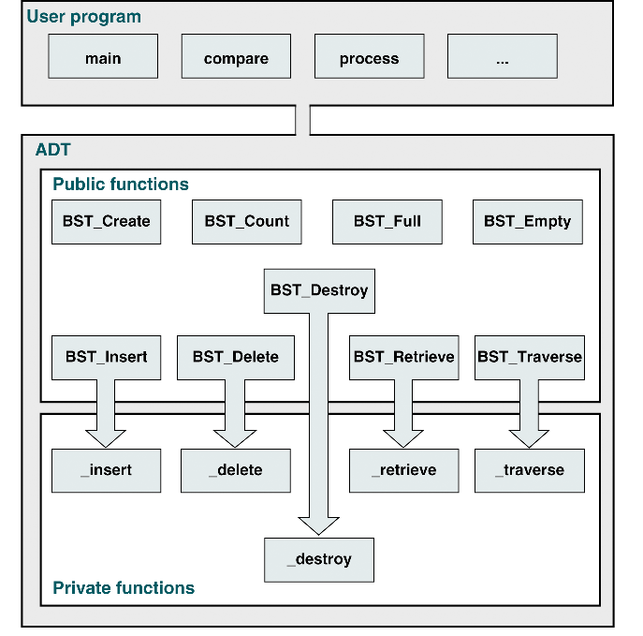
BST ADT Design

Slide 22
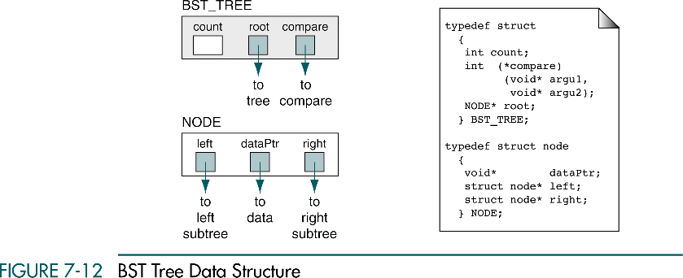
BST Tree Data Structure

Slide 23
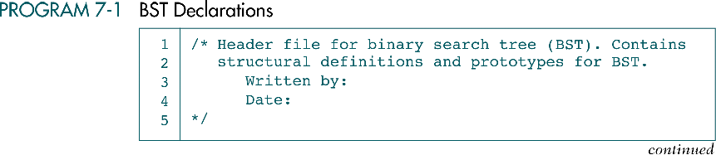
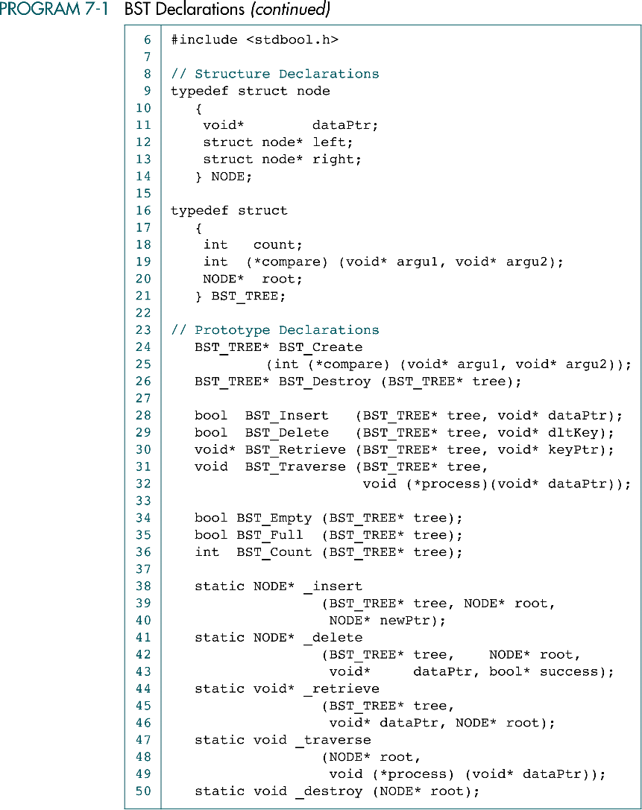
BST Declarations

Slide 24
BST Declarations (cont.)

Slide 25
BST Declarations (cont.)

Slide 26
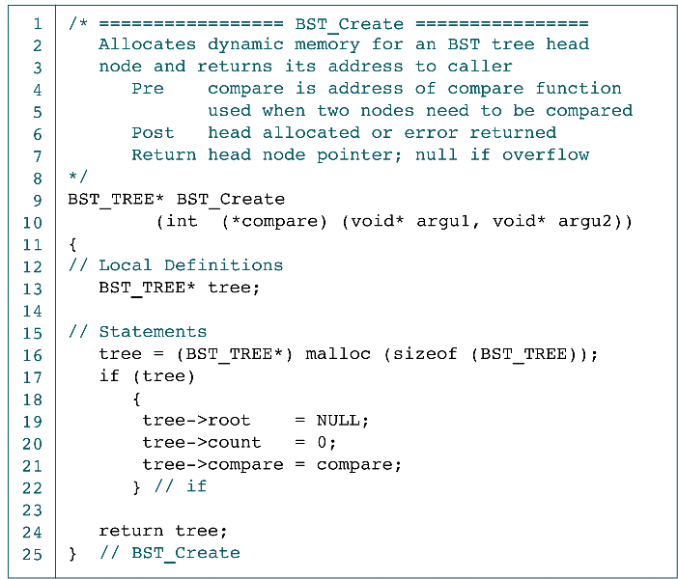
Create BST Application interface

Slide 27
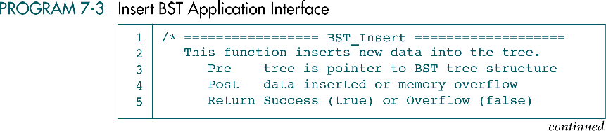
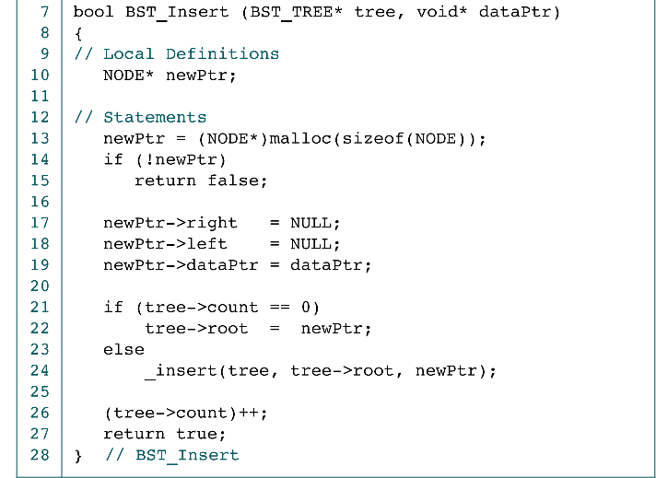
Insert BST Application Interface

Slide 28
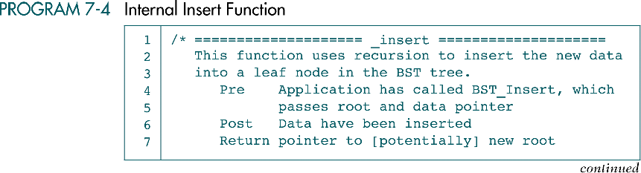
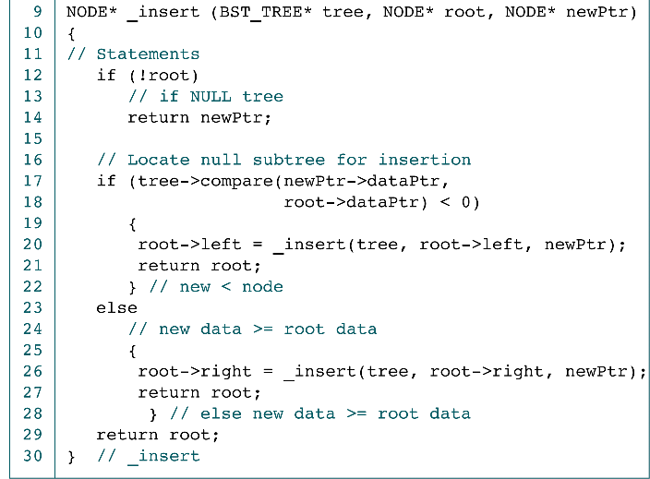
Internal Insert Function
newPtr
tree
root
5
return
root
10
root
8
15
root
4
9
root
newPtr
5

Slide 29
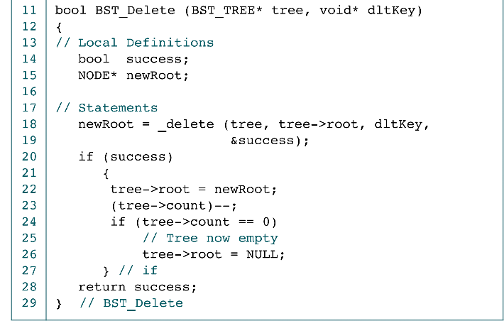
Delete BST Application Interface

Slide 30
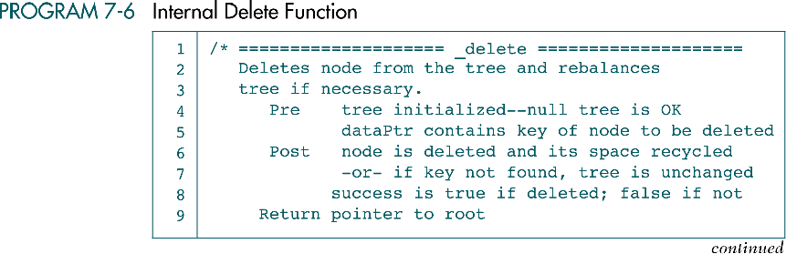
Internal Delete Function

Slide 31
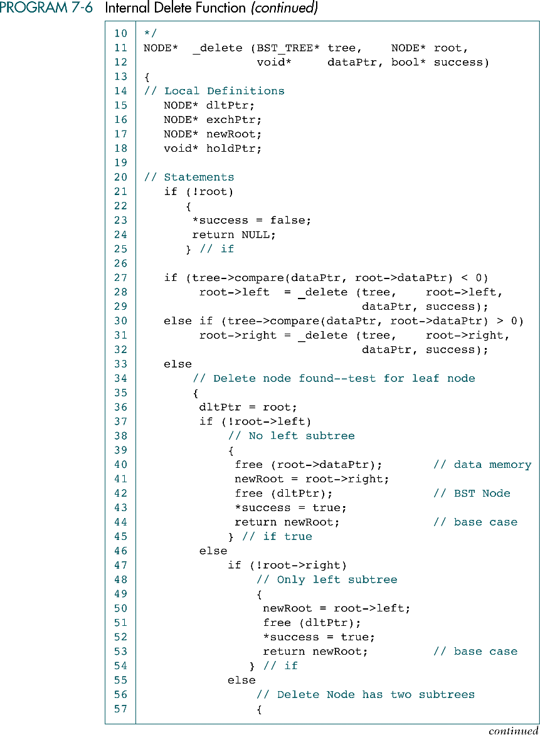
Internal Delete Function (cont.)
dataPtr
tree
root
8
root
10
root
8
15
9

Slide 32
Internal Delete Function (cont.)
dataPtr
tree
root
8
10
root
8
15
Free
dltPtr
newRoot
9

Slide 33
Internal Delete Function (cont.)
dataPtr
tree
root
8
root
10
Free
15
newRoot
9

Slide 34
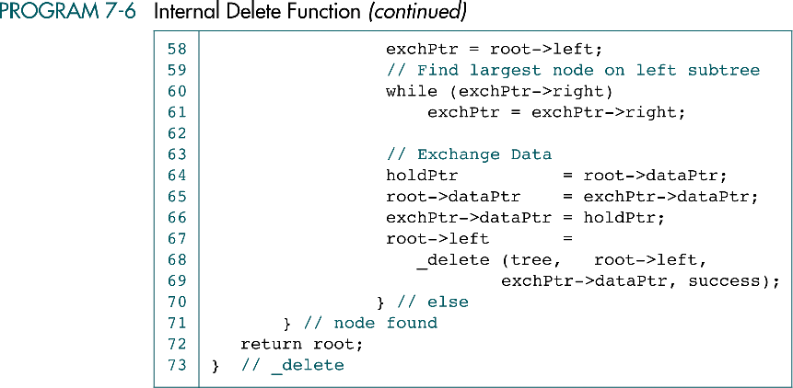
Internal Delete Function (cont.)
Redundant !

Slide 35
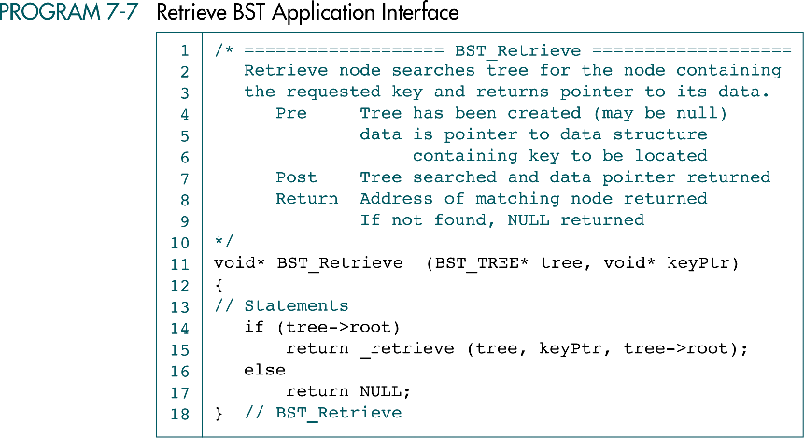
Retrieve BST Application Interface

Slide 36
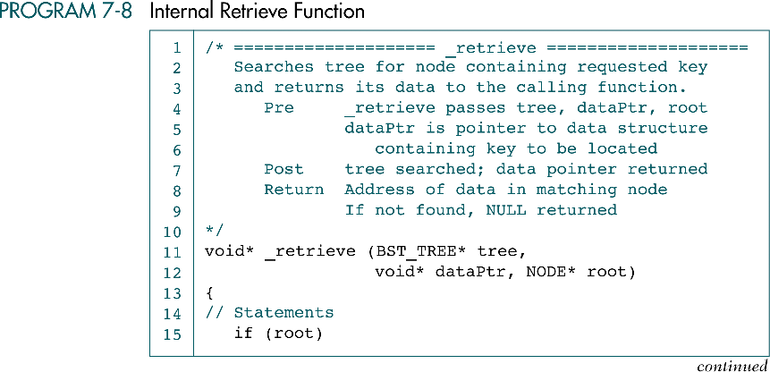
Internal Retrieve Function

Slide 37
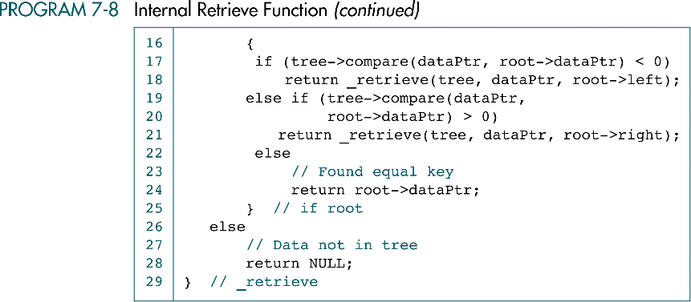
Internal Retrieve Function

Slide 38
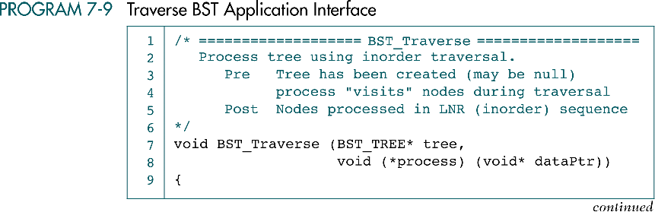

Traverse BST Application Interface

Slide 39
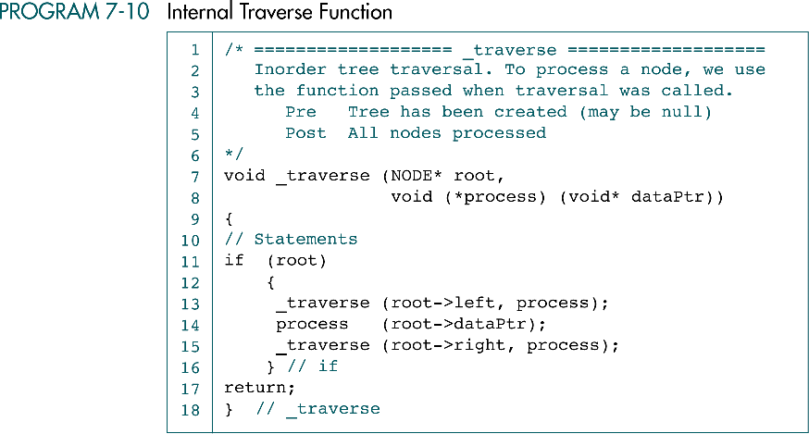
Internal Traverse Function

Slide 40
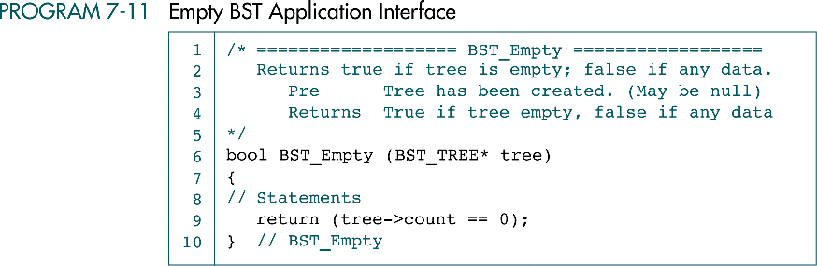
Empty BST Application Interface

Slide 41
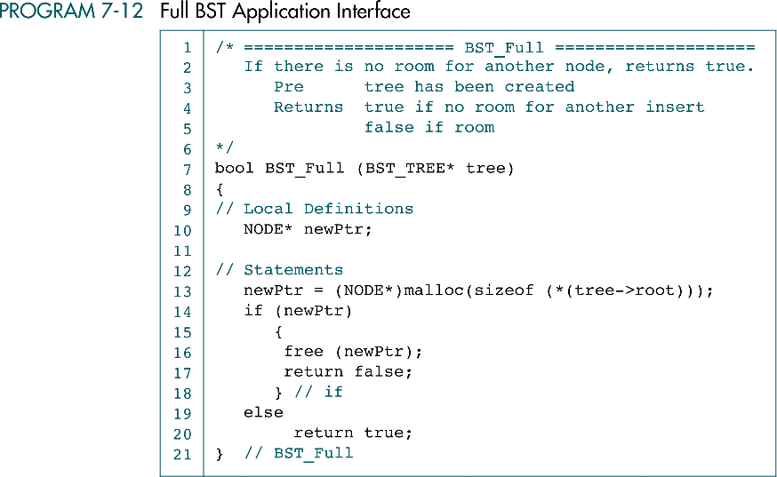
Full BST Application Interface

Slide 42
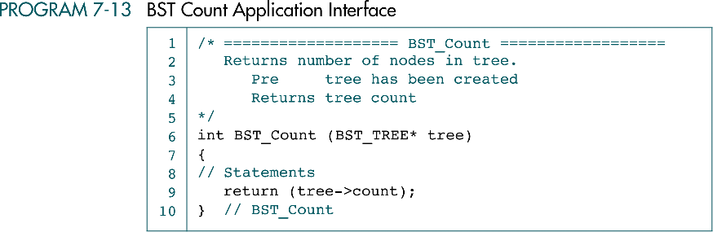
BST Count Application Interface

Slide 43
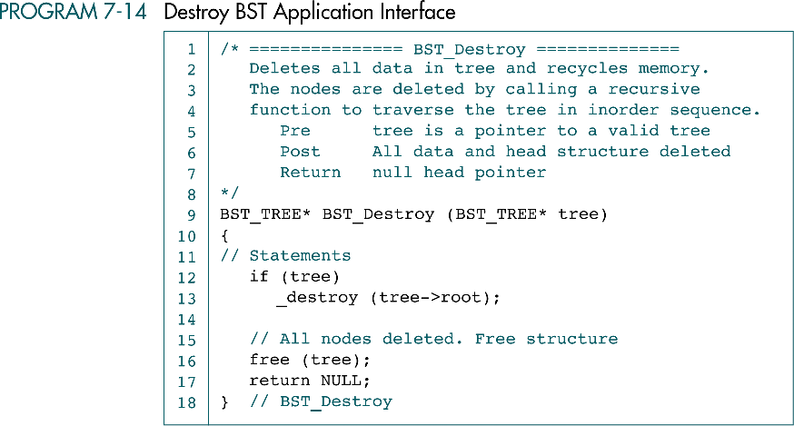
Destroy BST Application Interface

Slide 44
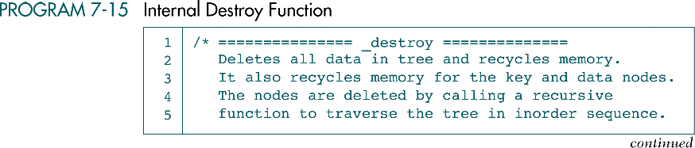
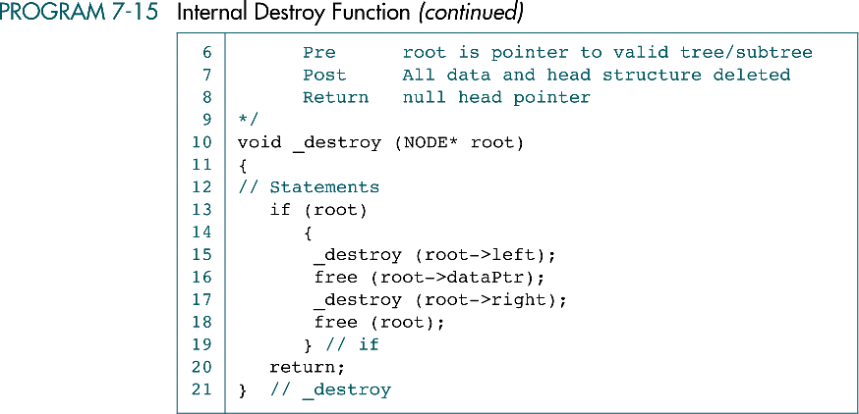
Internal Destroy Function

Slide 45
7-4 BST Applications
This section develops two applications that use the BST ADT. We begin the discussion of BST Applications with a simple application that manipulates integers. The second application, student list, requires a structure to hold the student's data.
Integer Application
Student List Application

Slide 46
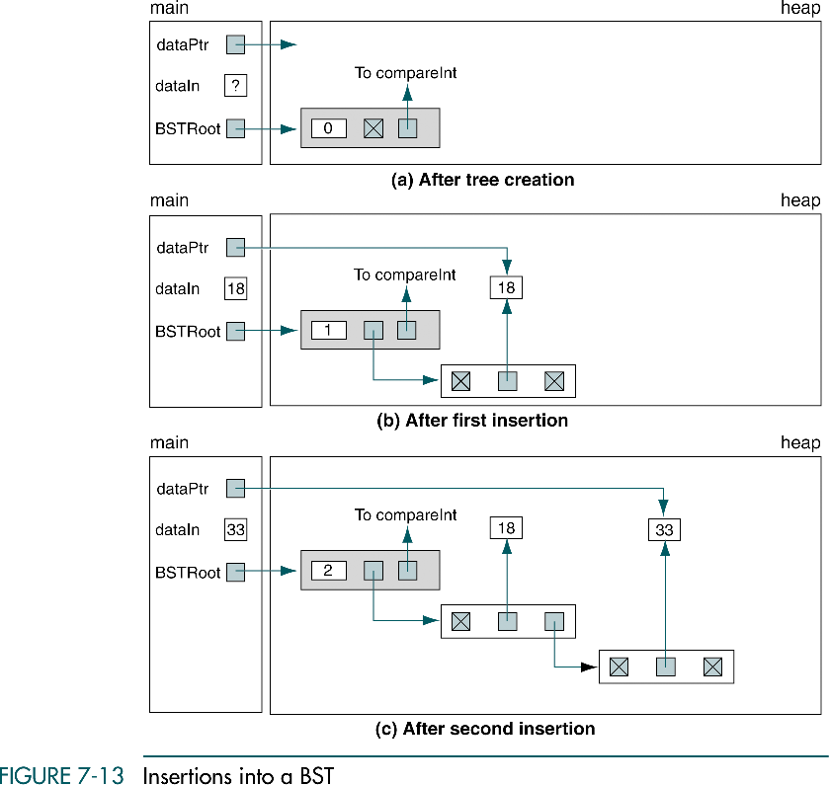
Insertions into a BST

Slide 47
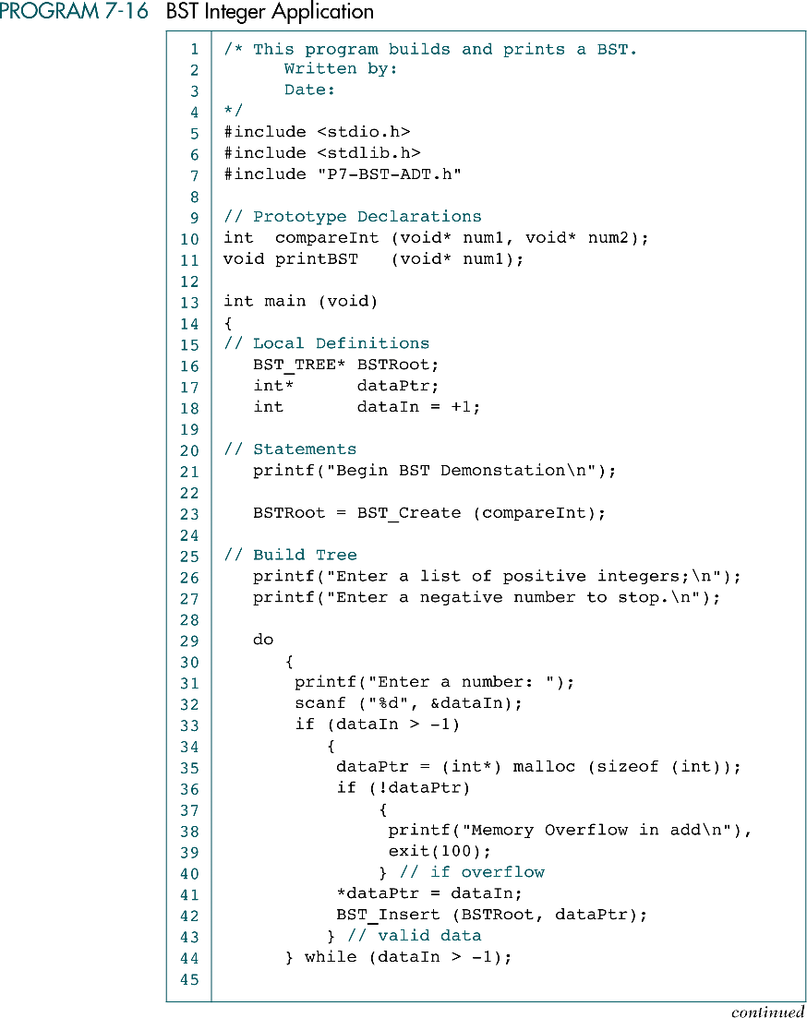
BST Integer Application

Slide 48
BST Integer Application (cont.)

Slide 49
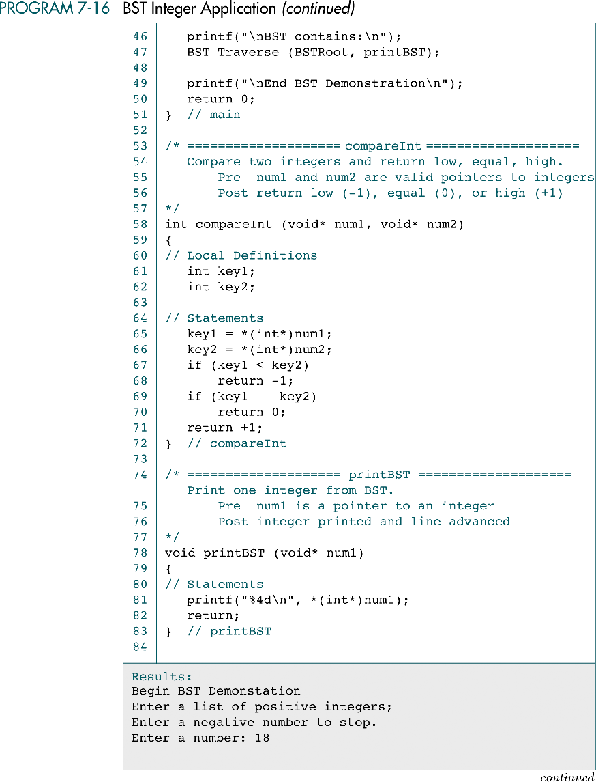
BST Integer Application (cont.)

Slide 50
BST Integer Application (cont.)

Slide 51
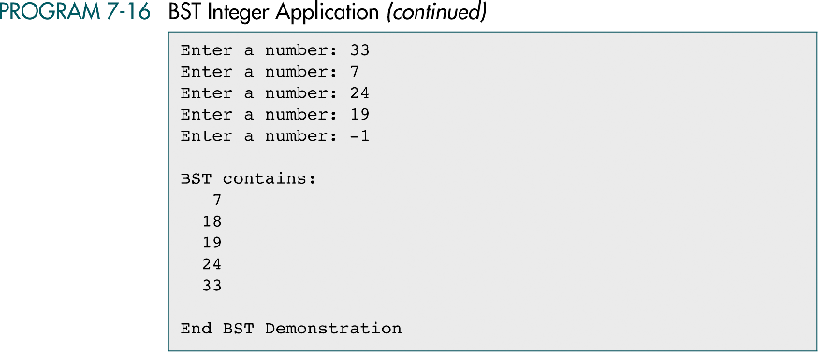
BST Integer Application (cont.)

Slide 52
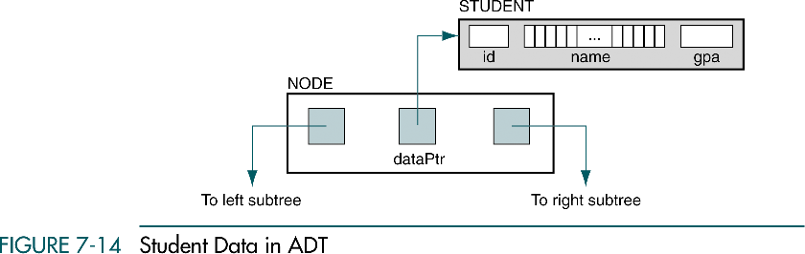
Student Data in ADT

Slide 53
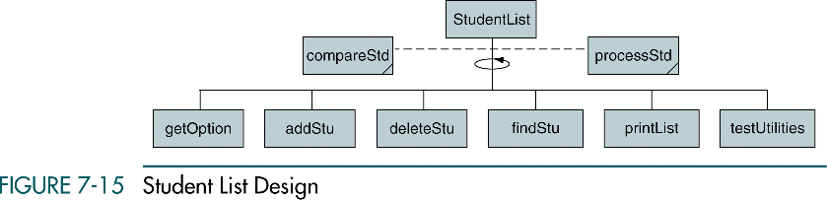
Student List Design

Slide 54
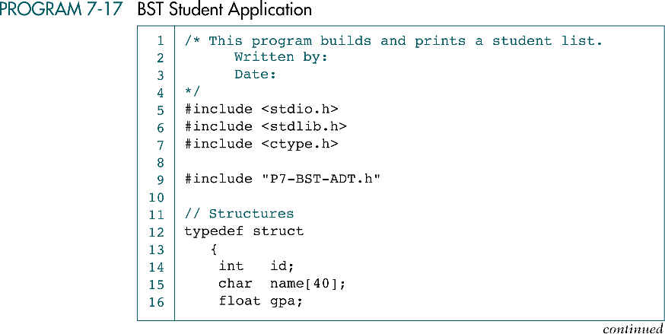
BST Student Application

Slide 55
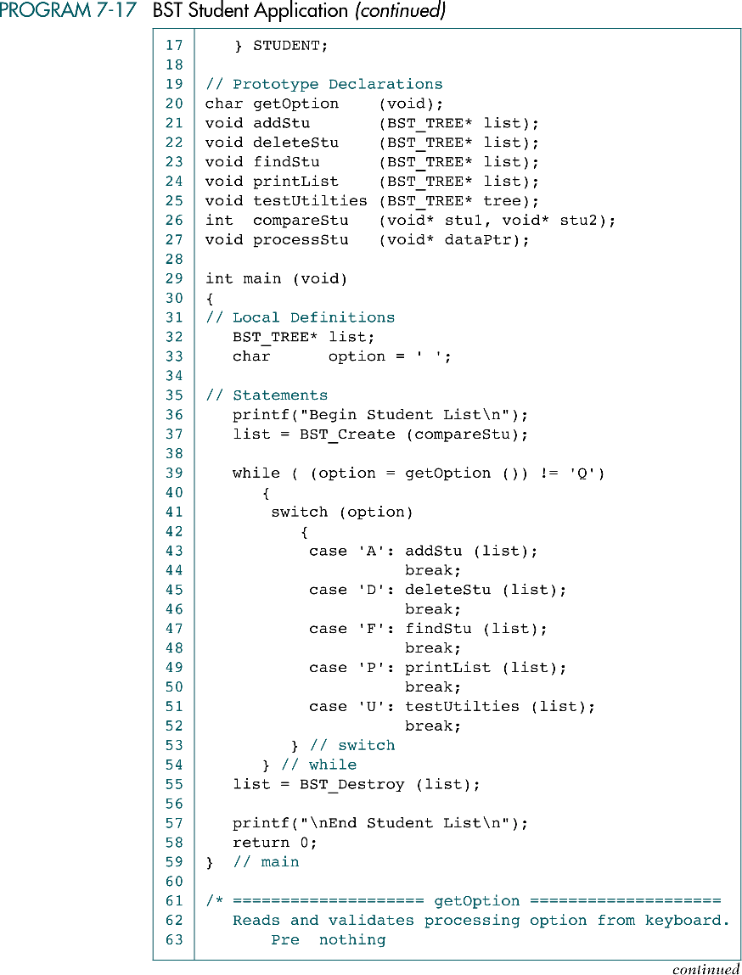
BST Student Application (cont.)

Slide 56
BST Student Application (cont.)

Slide 57
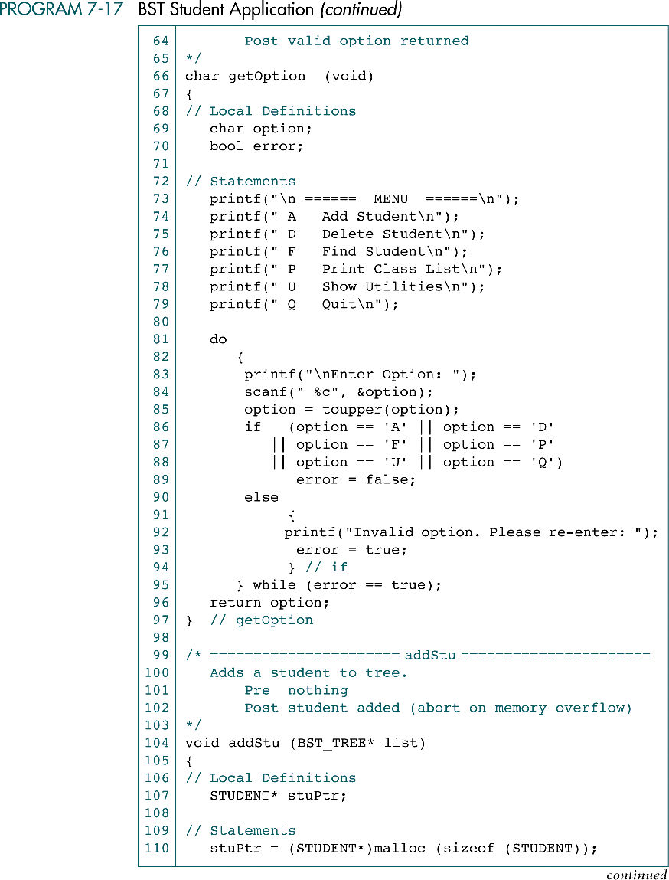
BST Student Application (cont.)

Slide 58
BST Student Application (cont.)

Slide 59
BST Student Application (cont.)

Slide 60
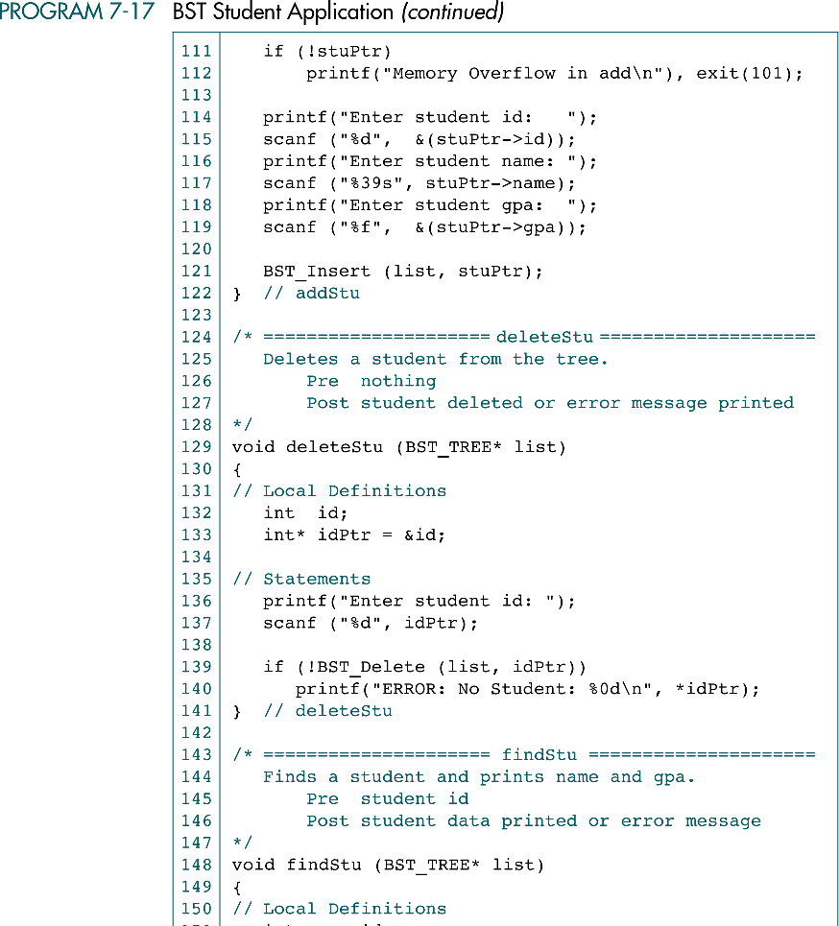
BST Student Application (cont.)

Slide 61
BST Student Application (cont.)
redundant

Slide 62

BST Student Application (cont.)

Slide 63

BST Student Application (cont.)

Slide 64
BST Student Application (cont.)

Slide 65
BST Student Application (cont.)

Slide 66

BST Student Application (cont.)

Slide 67
BST Student Application (cont.)

Slide 68

7-5 Threaded Trees
Recursion or stack are inefficient if the tree must be traversed frequently
In a threaded tree, null pointers are replaced with pointers to their successor nodes
The traversal is more efficient if the tree is a threaded tree
(inorder)

