Slide 1
Chapter 8
AVL Search Trees
Objectives
Upon completion you will be able to:
Explain the differences between a BST and an AVL tree
Insert, delete, and process nodes in an AVL tree
Understand the operation of the AVL tree ADT
Write application programs using an AVL tree

Slide 2
8-1 AVL Tree Basic Concepts
An AVL (Adelson-Velskii and Landis) tree is a BST that is guaranteed to always be balanced. We begin with a discussion of its basic structural differences and then discuss the four different balancing situations that can occur when data are inserted or deleted.
AVL Tree Balance Factor
Balancing Trees

Slide 3
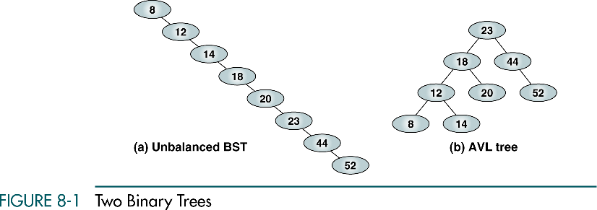
Two Binary Trees

Slide 4
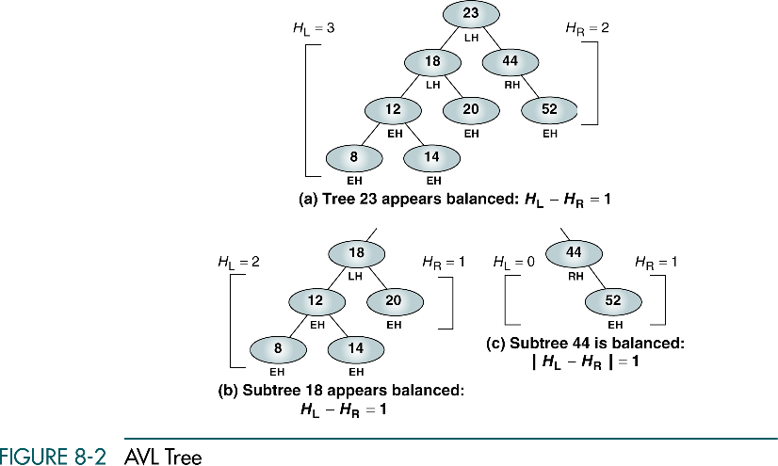
AVL Tree
LH: left high (+1)
EH: even high (0)
RH: right high (-1)

Slide 5
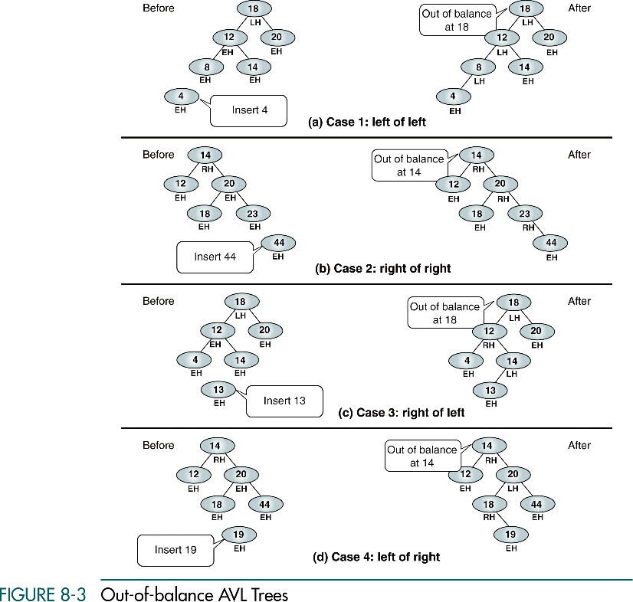
Out-of-balance AVL Tree

Slide 6
Out-of-balance AVL Tree (cont.)

Slide 7
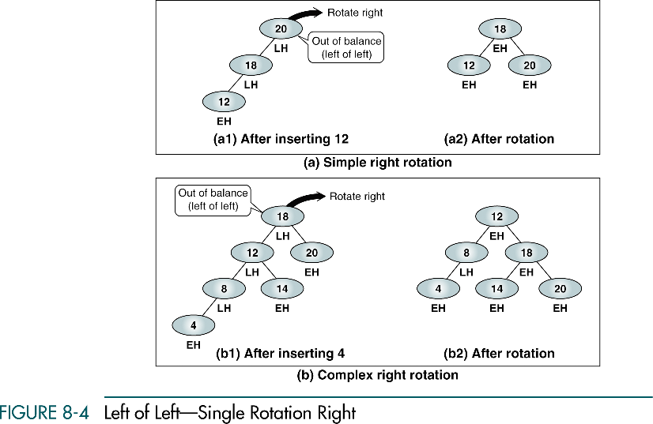
Left of Left – Single Rotation Right

Slide 8
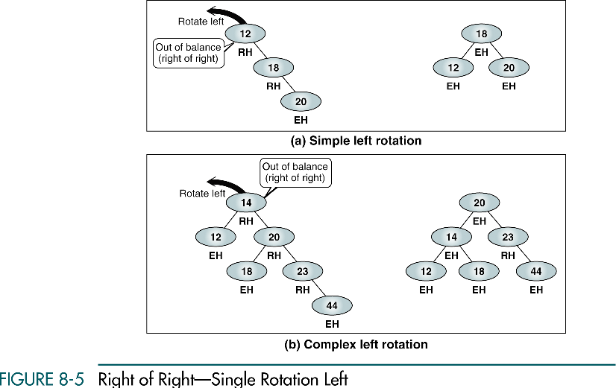
Right of Right – Single Rotation Left

Slide 9
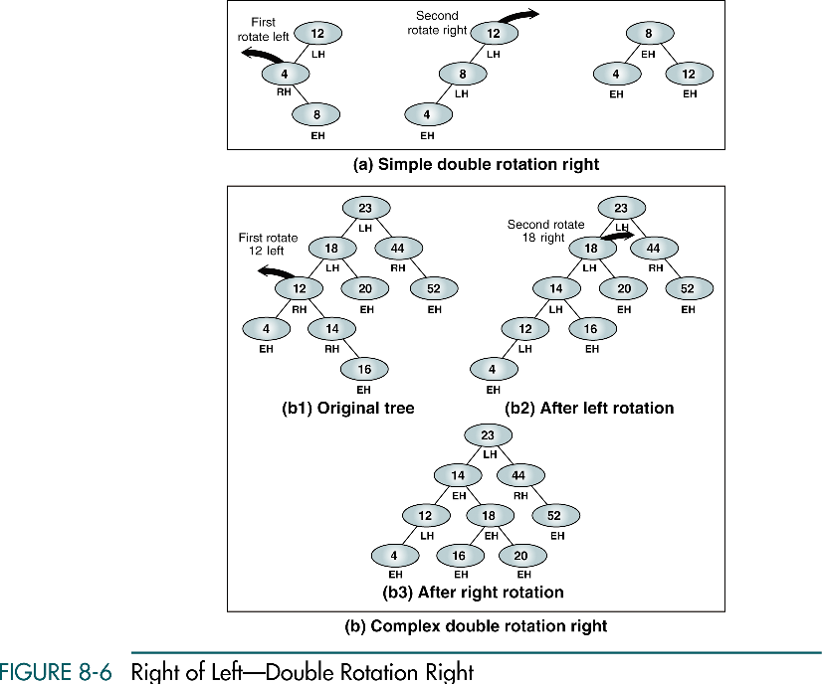
Right of Left – Double Rotation Right

Slide 10
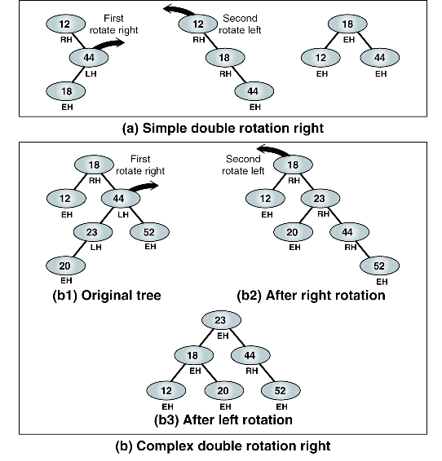
Left of Right – Double Rotation Right

Slide 11
8-2 AVL Tree Implementations
Insertion and deletion in an AVL tree follow the same basic rules for insertion and deletion in a BST. The difference lies in the tree balancing, which occurs as we back out of the tree. In this section we develop the insertion and deletion algorithms for a AVL tree, including algorithms to balance the tree.
Insert into AVL Tree
AVL Tree Delete Algorithm

Slide 12
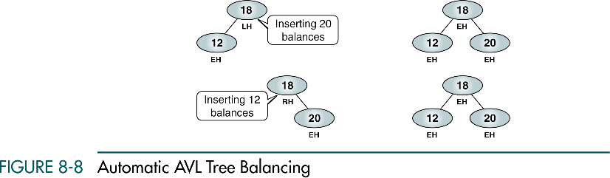
Automatic AVL Tree Balancing

Slide 13
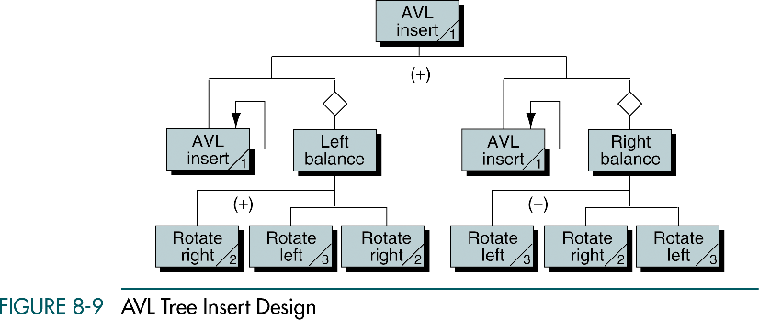
AVL Tree Insert Design

Slide 14
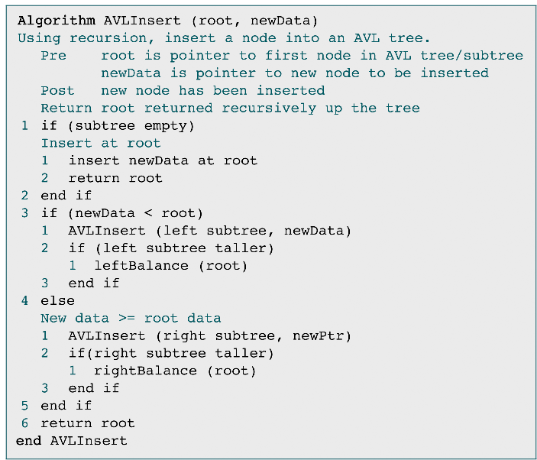
AVL Tree Insert

Slide 15
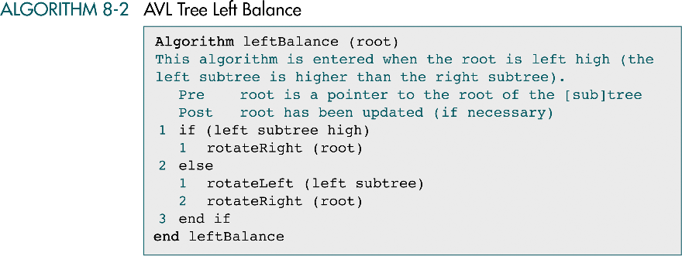
AVL Tree Left Balance

Slide 16
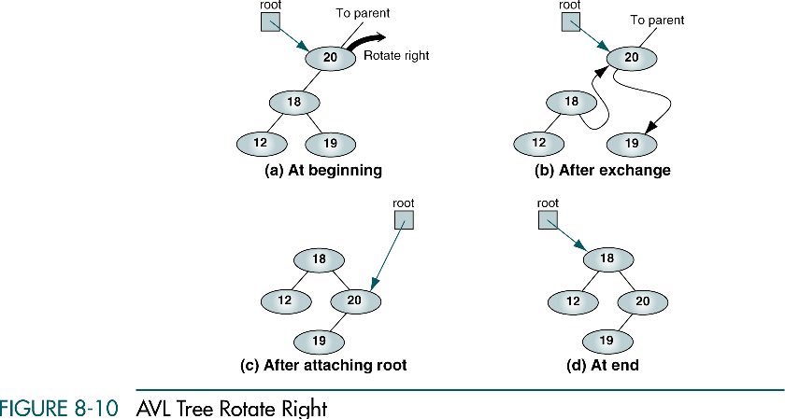
AVL Tree Rotate Right

Slide 17
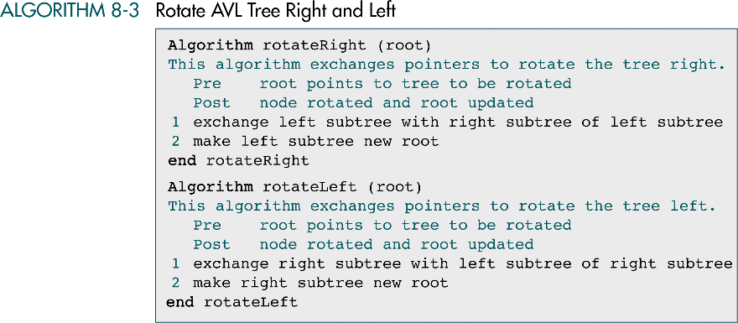
Rotate AVL Tree Right and Left

Slide 18
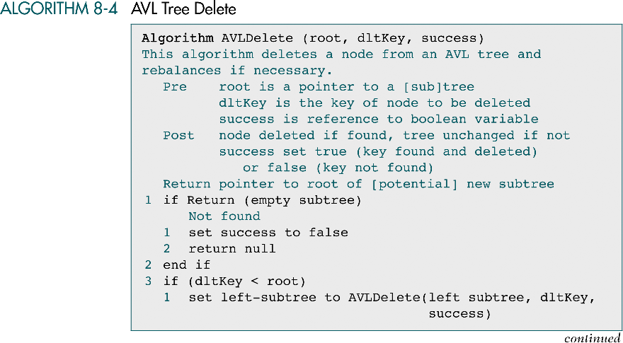
AVL Tree Delete

Slide 19
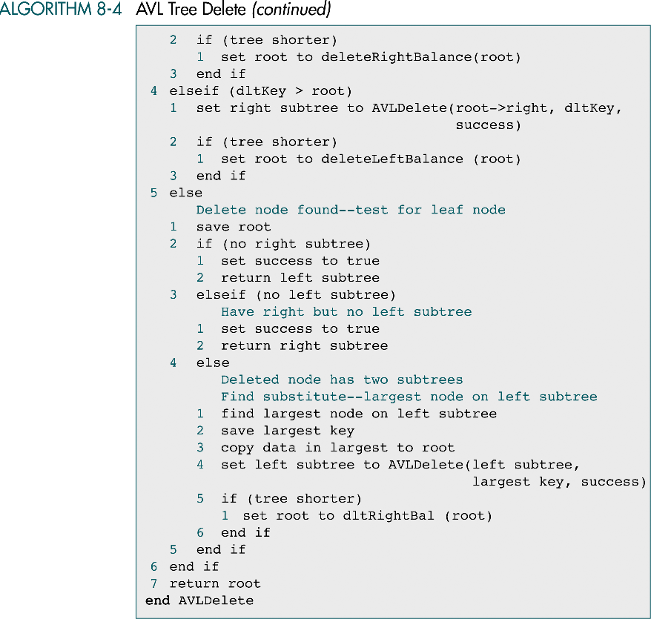
AVL Tree Delete (cont.)

Slide 20
AVL Tree Delete (cont.)

Slide 21
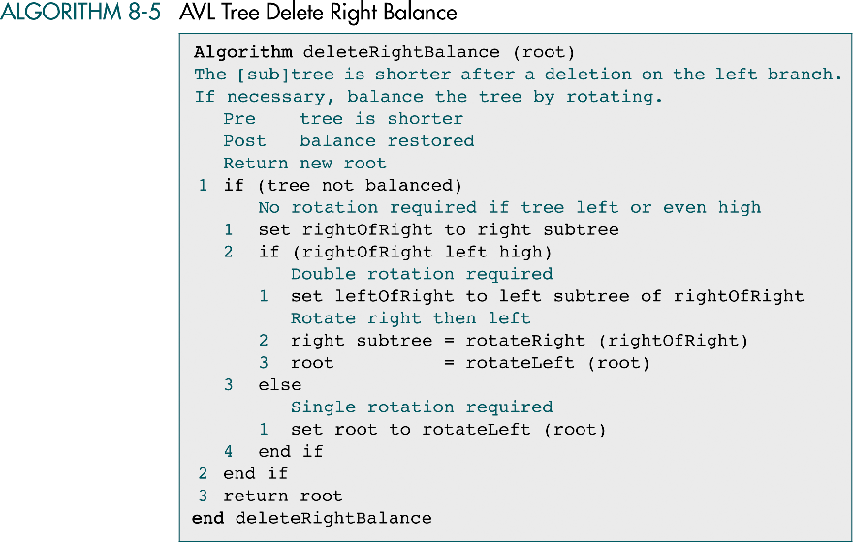
AVL Tree Delete Right Balance

Slide 22
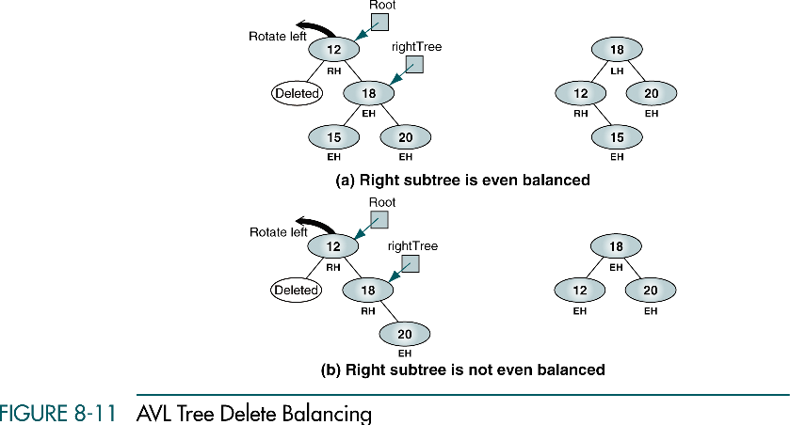
AVL Tree Delete Balance

Slide 23
8-3 AVL Tree Abstract Data Type
In this section we discuss and write the C code for the AVL ADT. We begin with a discussion of the data structure and then develop 17 functions for the ADT. Some functions are left for student development.
Insert into AVL Tree
AVL Tree Delete Algorithm

Slide 24
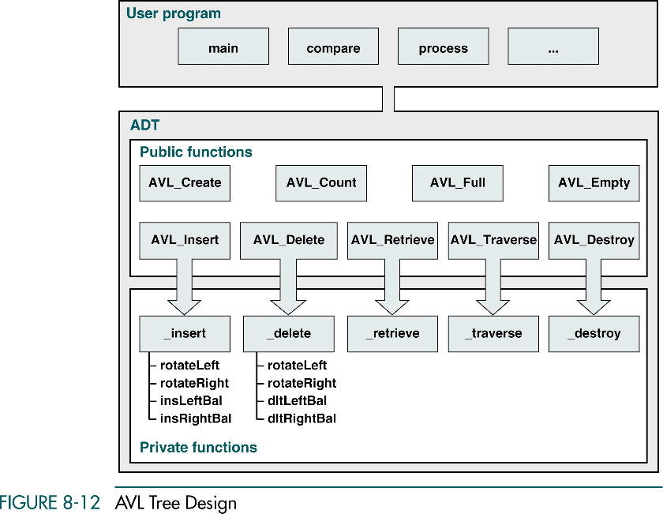
AVL Tree Design

Slide 25
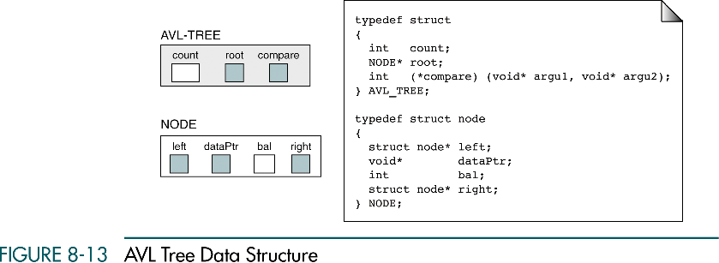
AVL Tree Data Structure

Slide 26
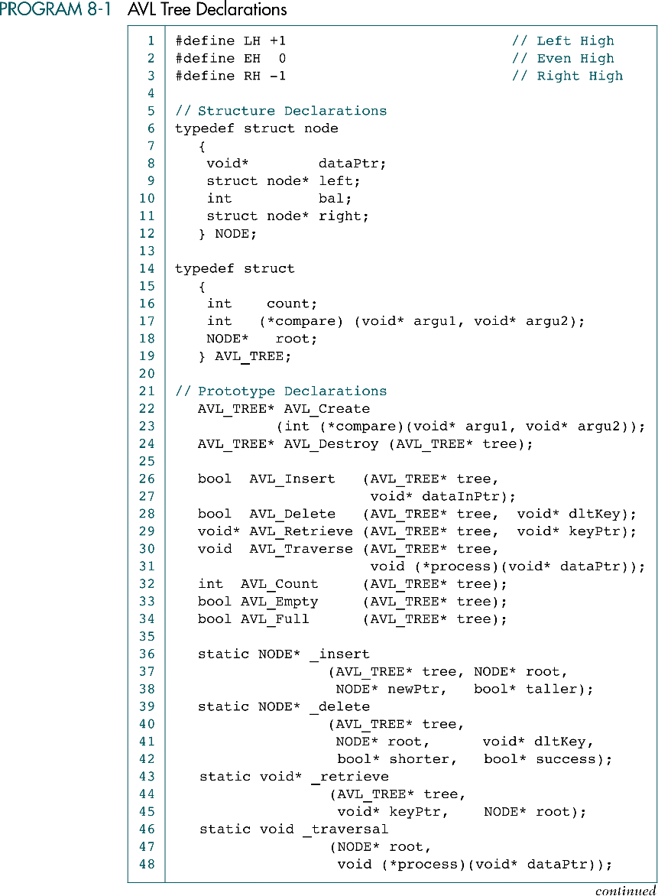
AVL Tree Declarations

Slide 27
AVL Tree Declarations (cont.)

Slide 28
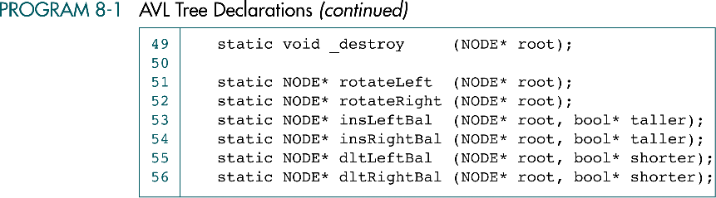
AVL Tree Declarations (cont.)

Slide 29
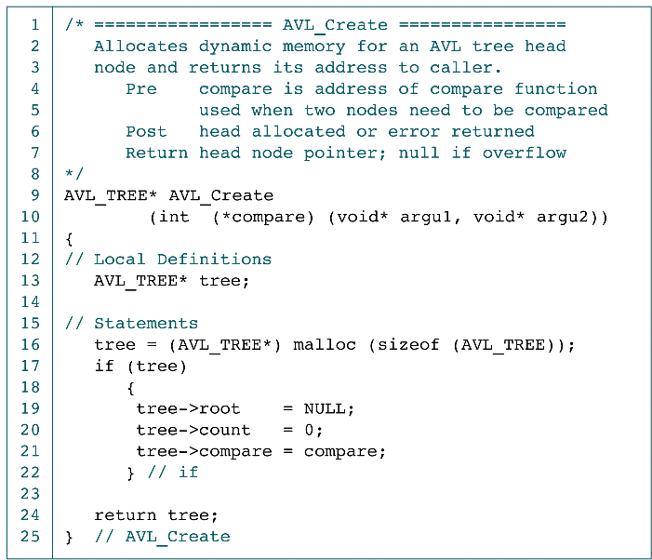
Create AVL Tree Application Interface

Slide 30
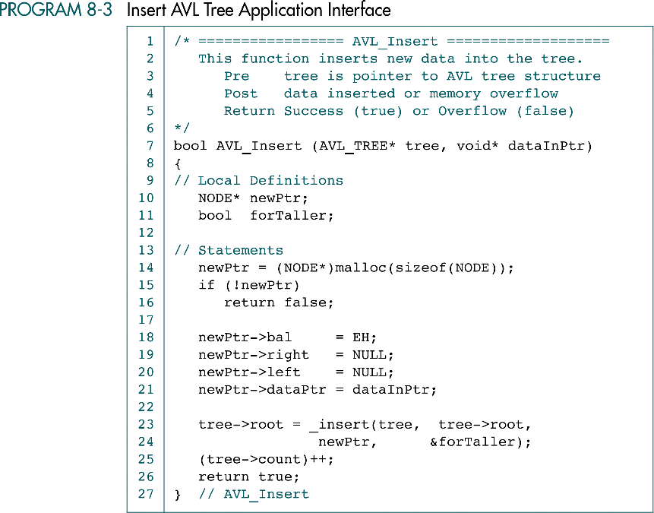
Insert AVL Tree Application Interface

Slide 31
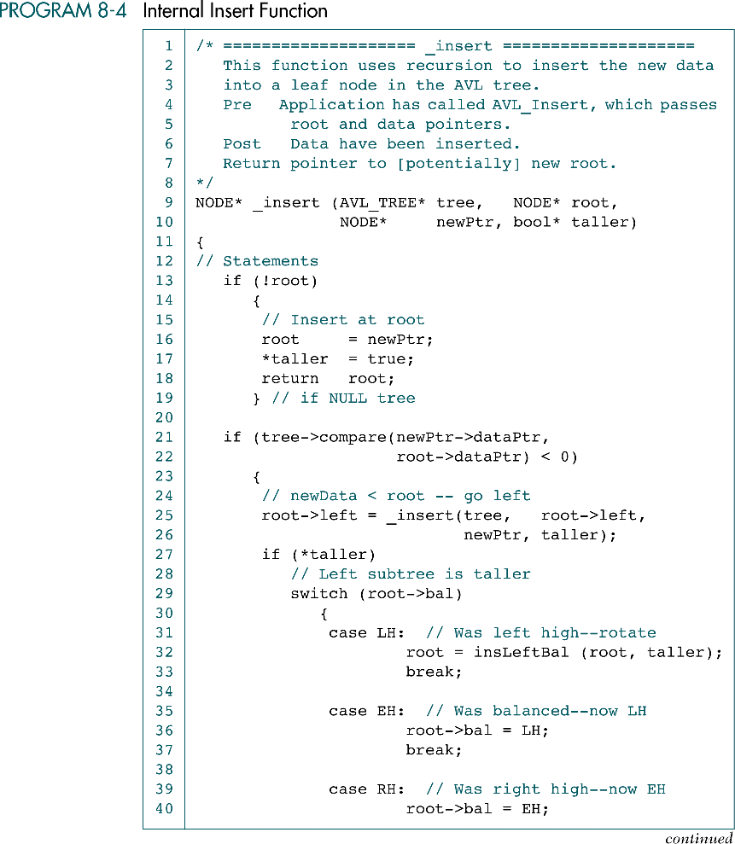
Internal Insert Function

Slide 32
Internal Insert Function (cont.)
root
15
root
10
20
LH
root
8
EH
root
Null
5
newPtr

Slide 33
Internal Insert Function
15
Taller = true
10
20
LH
8
EH
root
Null
5
newPtr

Slide 34
Internal Insert Function (cont.)
15
Taller = true
root
10
20
LH
root
8
EH
LH
root
Null
5
newPtr

Slide 35
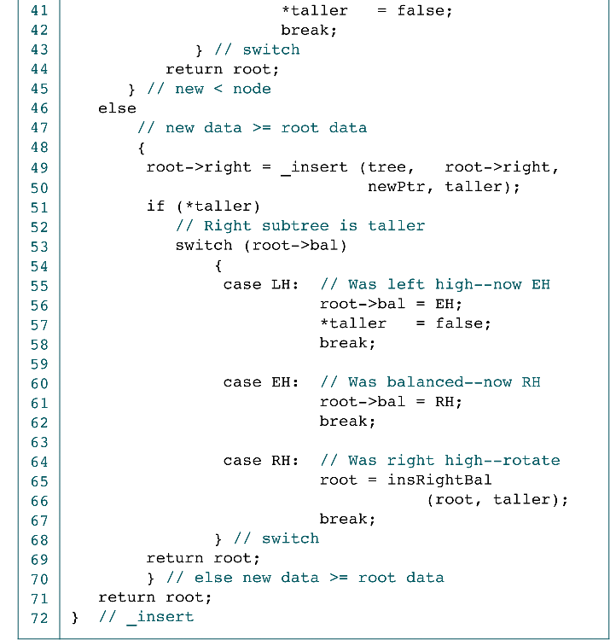
Internal Insert Function (cont.)

Slide 36
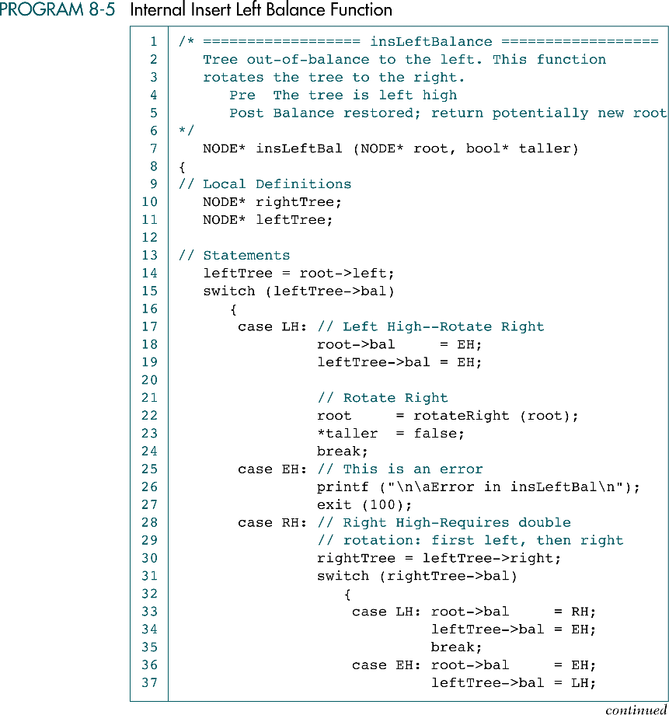
Internal Insert Left Balance Function
taller = false
taller = true
15
root
10
LH
20
EH
leftTree
8
LH
EH
5
taller = true
15
root
10
LH
20
EH
leftTree
8
RH
LH
rightTree
9
EH

Slide 38
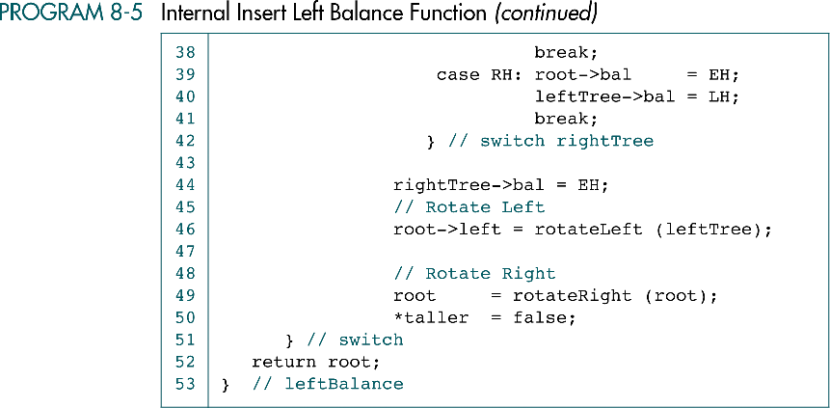
Internal Insert Left Balance Function (cont.)
taller = false
taller = true
15
root
10
20
EH
leftTree
9
8
LH
8
9
rightTree
EH
EH

Slide 39
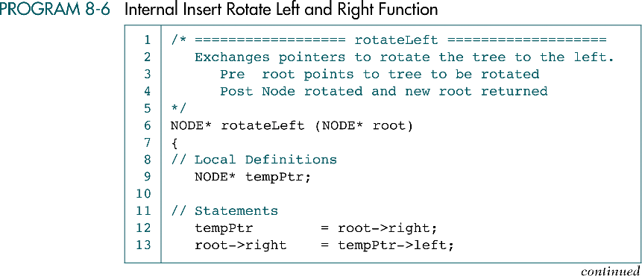
Internal Rotate Left & Right Function

Slide 40
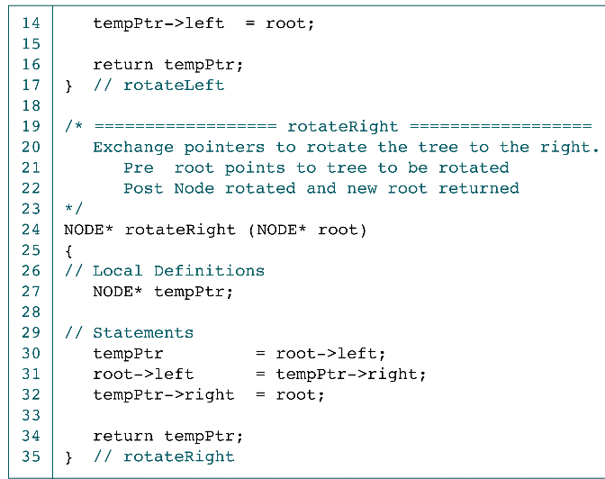
Internal Rotate Left & Right Function (cont.)
root
root
15
15
root
20
10
20
8
8
tempPtr
8
8
10
5
5
9
9

Slide 41
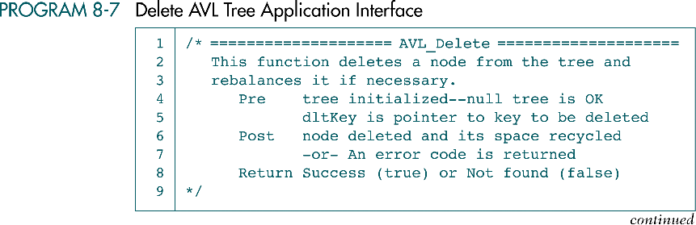
Delete AVL Tree Application Interface

Slide 42
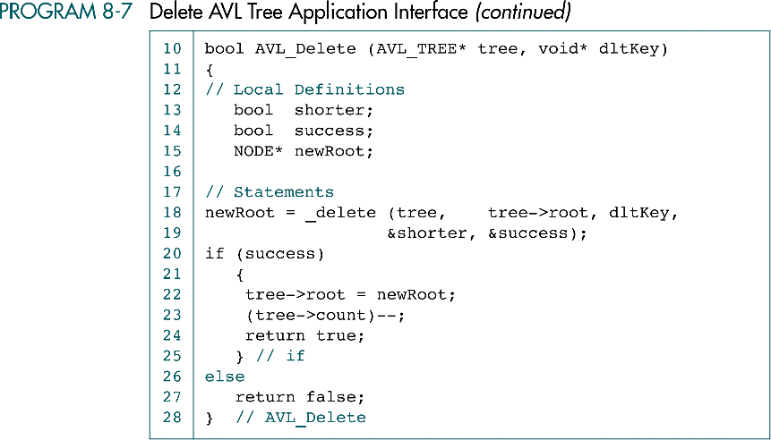
Delete AVL Tree Application Interface (cont.)

Slide 43
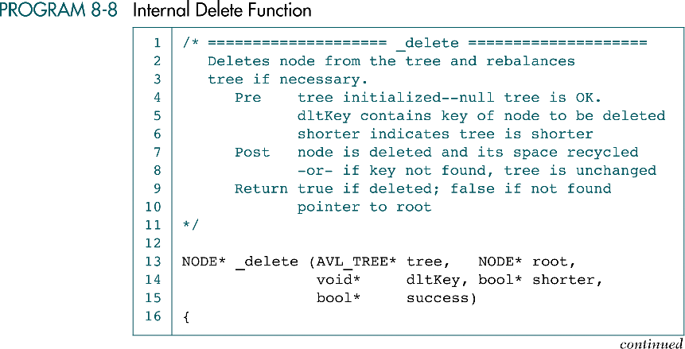
Internal Delete Function

Slide 44
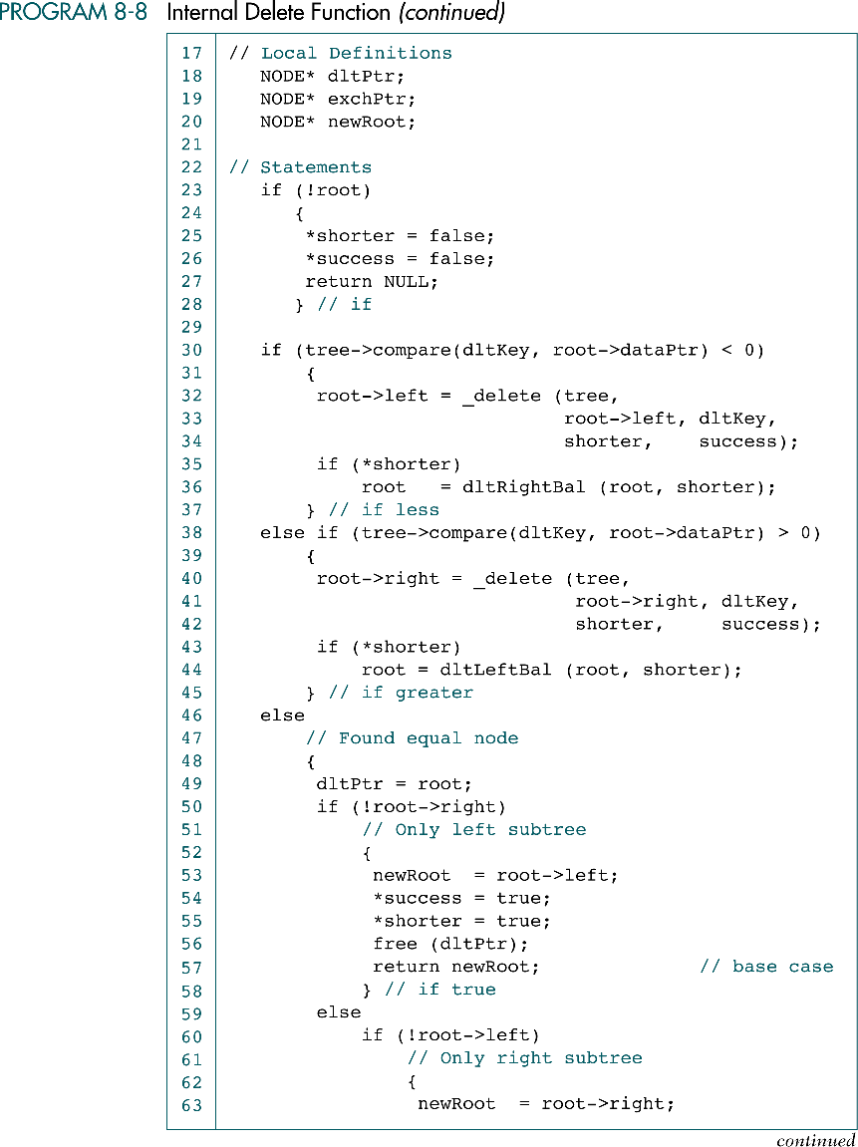
Internal Delete Function (cont.)
dltKey
root
8
8
5
root
5
20
3
15
25
// root = NULL
13

Slide 45
Internal Delete Function (cont.)
dltKey
success = true
shorter = true
5
8
8
root
5
20
free
detPtr
newRoot
3
15
25
13

Slide 46
Internal Delete Function (cont.)
success = true
shorter = true
root
8
8
5
20
newRoot
3
15
25
13

Slide 47
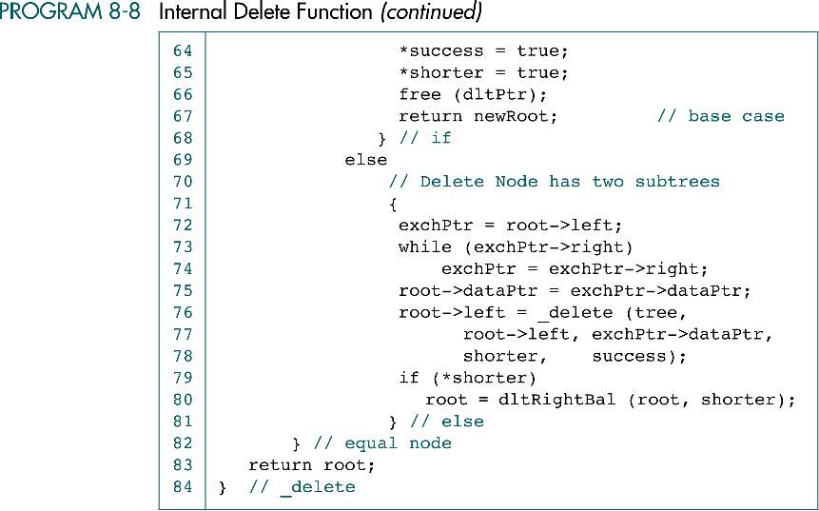
Internal Delete Function (cont.)

Slide 48
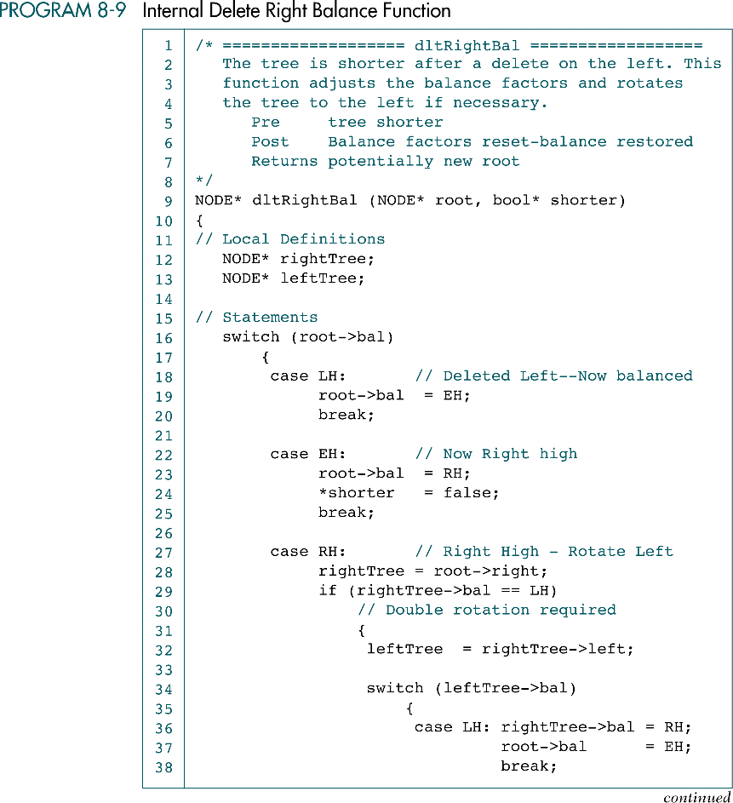
Internal Delete Right Balance Function

Slide 49
Internal Delete Right Balance Function (cont.)
success = true
shorter = true
root
8
8
EH
RH
20
LH
3
RH
rightTree
15
LH
25
leftTree
13

Slide 50
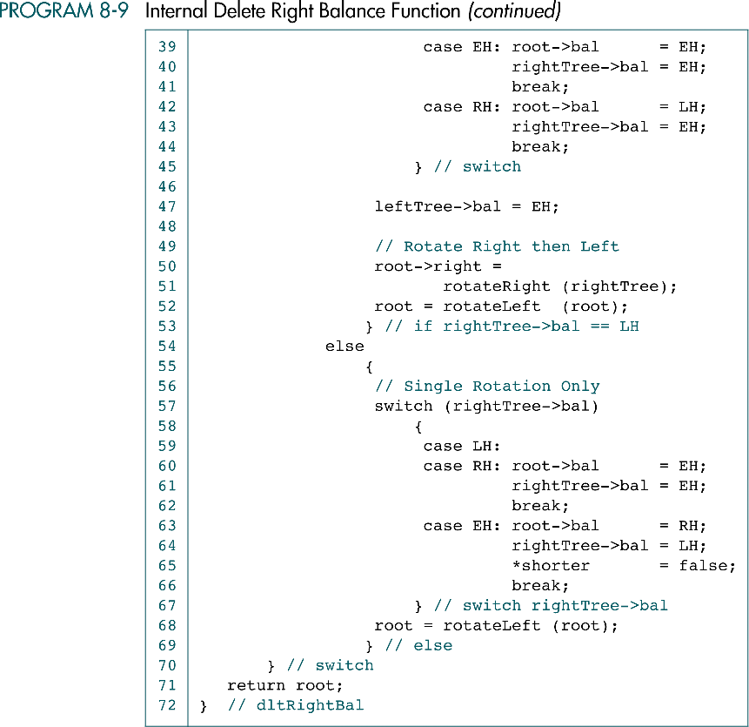
Internal Delete Right Balance Function (cont.)
success = true
shorter = true
root
8
8
EH
3
20
RH
rightTree
15
EH
25
LH
leftTree
13
root
8
root
15
3
13
20
25

Slide 51
Internal Delete Right Balance Function (cont.)

Slide 52
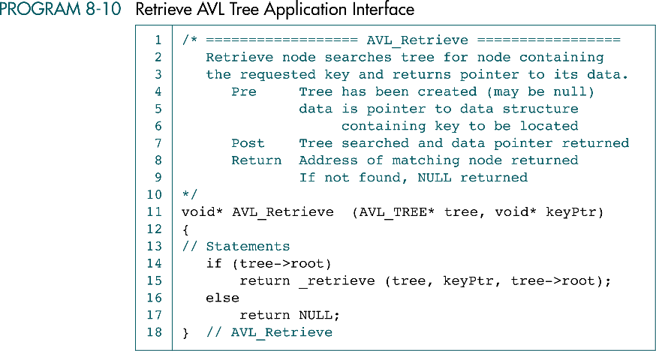
Retrieve AVL Tree Application interface

Slide 53
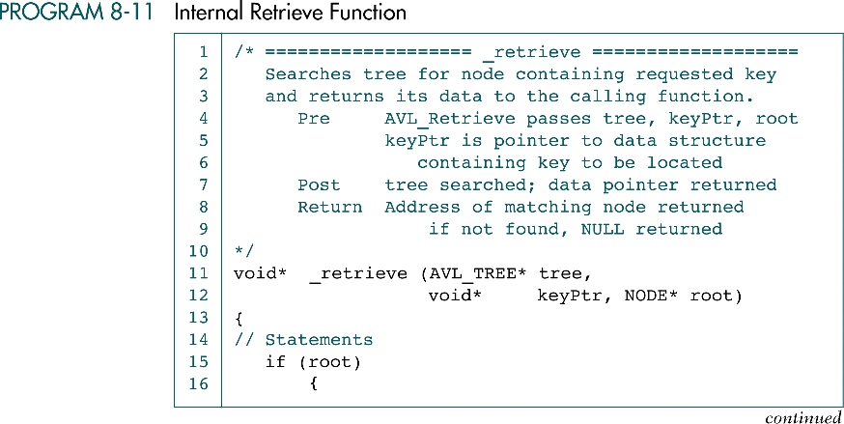
Internal Retrieve Function

Slide 54
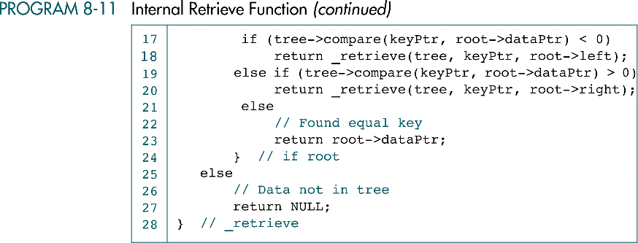
Internal Retrieve Function (cont.)

Slide 55
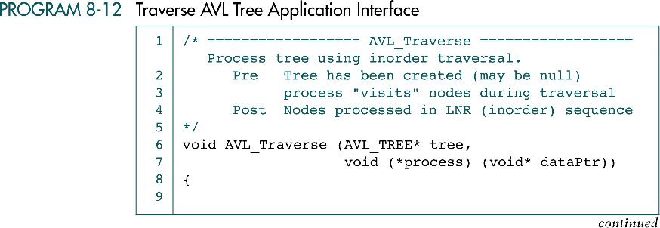

Traverse AVL Tree Application Interface

Slide 56
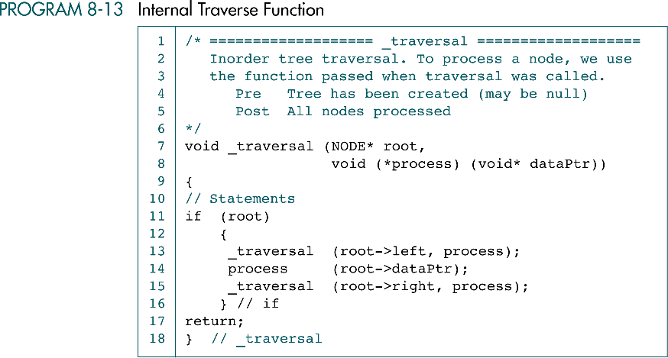
Internal Traverse Function

Slide 57
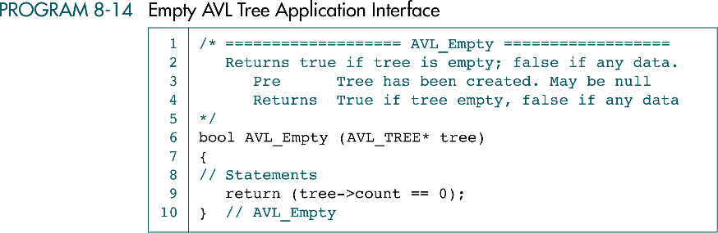
Empty AVL Tree Application Interface

Slide 58
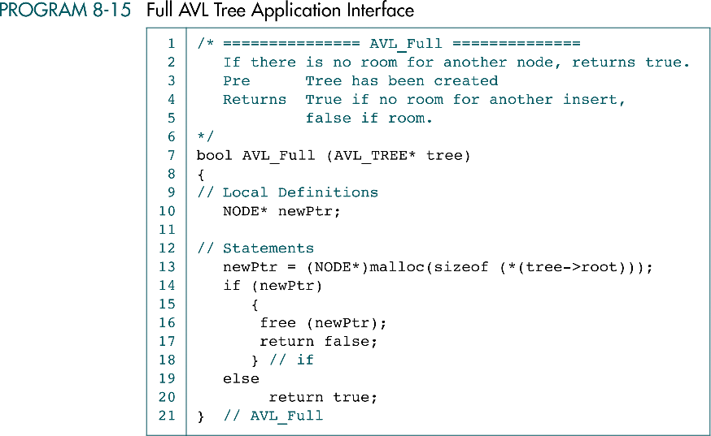
Full AVL Tree Application Interface

Slide 59
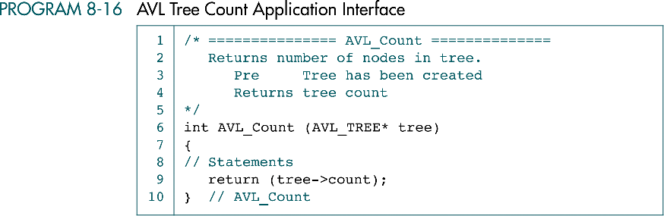
AVL Tree Count Application Interface

Slide 60
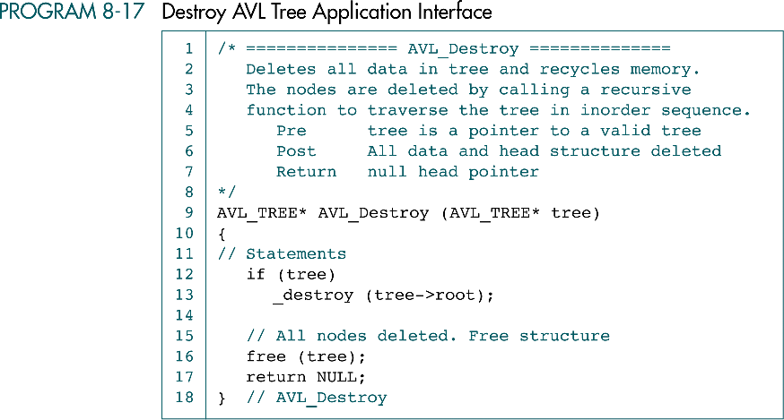
Destroy AVL Tree Application Interface

Slide 61
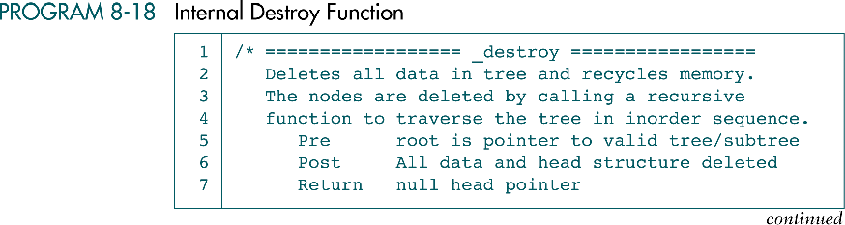
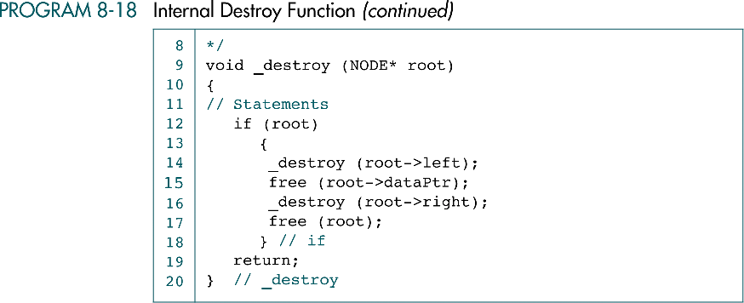
Internal Destroy Function

Slide 62
8-4 Application-Count Words
To demonstrate the use of an AVL tree, we write an application to count the words in a file. After discussing the application data structure, we write five functions, including main, to build and print the word list.
Data Structure
Program Design

Slide 63
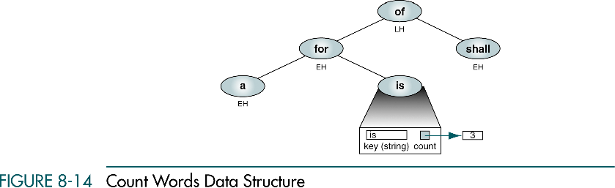
Count Words Data Structure

Slide 64
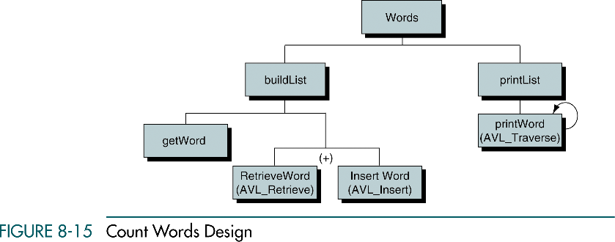
Count Words Design
Given word is
not in the tree

Slide 65
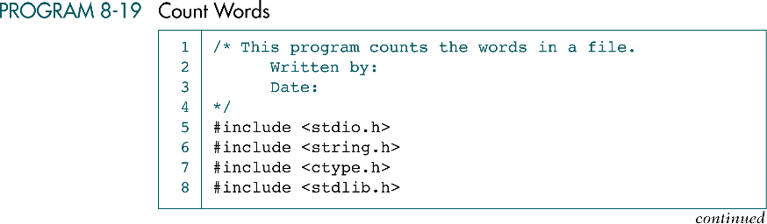
Count Words

Slide 66

Count Words (cont.)

Slide 67
Count Words (cont.)

Slide 68

Build List

Slide 69
Build List (cont.)

Slide 70

Build List (cont.)

Slide 71

Get Word

Slide 72

Get Word (cont.)

Slide 73


Compare Word Function

Slide 74

Print Word List

Slide 75

Print Word List (cont.)

Slide 76

Insertion into AVL Tree

